Slide 1















BLCK Space & Beyond Space Projects
Presented by ThinkHigher

Slide 2
How it began…
Appreciating intersectionality
Conversations with Black pupils
Secondary research within the team
A research project with Professor J Arday

Slide 3
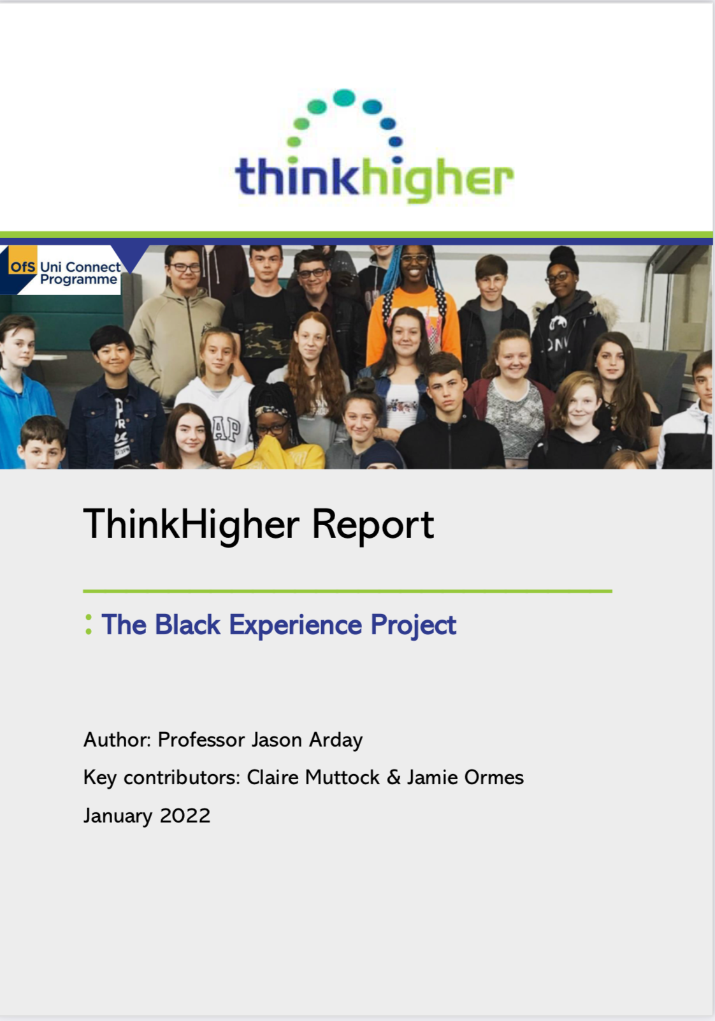

The Black Student Experience Report
11 participant aged 15-18
5 Themes:
Eurocentric Curriculum
Experiences of Racism
Impacts of Racism
Hair
Opportunities for Change

Slide 4
Experiences of Racism
- Unfair treatment from teachers
- Microaggressions
- Negative Stereotyping
Eurocentric Curriculum
- Negative discourse
Impacts of racism
- Feelings of exclusion
- Mental wellbeing struggles
- Gaslighting and confusion
- Internalisation
Opportunities for Change
- Improving staff competence
- Talking more responsibility
- Increasing representation
- Engaging in dialogue about race
- Creating spaces of belonging
Hair
- Negative ascriptions
- Fetishisation
Themes &
Subtypes

Slide 5
The Black Student Experience Report
Some Recommendations
Theme 1: The curriculum should be taught using a range of methods that promote discussion and sharing of experiences rather than exclusively pedagogy
• Decolonising the curriculum should be seen not just in the context of history, but across all subjects.
Theme 2: Teachers should be provided with more training and development opportunities to support identification and challenge of internal biases;
• Data should be collected around consequences (e.g. detention rates, exclusions) and disaggregated ethnicity to monitor and highlight bias in decision-making;
Theme 3: Staff should be provided more training and development to be able to sensitively facilitate classroom discussions around race and racism;
• Educational staff should develop an understanding of how to support their pupils to build navigational and resistance capital
• Clear mechanisms should be in place for addressing and challenging racism;
• Support systems should be put in place for young Black children experiencing racism, which is clearly communicated and implemented by all staff
Theme 5: The need to develop cultural competence, awareness and an ability to challenge racism and engage in dialogue around race should be reflected in relevant policies, strategies and role descriptions;
• Schools and colleges should conduct reviews, in conjunction with Black pupils, parents and staff, to identify ways in which to foster belonging;
• Schools and colleges should consider making use of partnerships with each other to facilitate shared spaces of belonging, particularly where they have lower numbers of Black pupils and staff

Slide 6
BLCK Space Pilots
Year 10 pupils at a school in Rugby
Year 12 pupils at Saints Café, Nuneaton
6 weekly sessions led by Black HE ambassadors to build a sense of belonging and support attainment
Session Schedule
Identity, Culture and Heritage
Careers
Mental Health and wellbeing
Communication
Metacognition and Study Skills
Positive Change
Life Skills

Slide 7
Over to you…
What do you think were the barriers we faced when setting up the pilot projects?

Slide 8
Pilot Barriers…
Schools understanding the project
Inaccurate information shared
Participants misunderstanding the project
Mistrust

Slide 9
BLCK Space & Beyond Space Projects
Lessons learned & feedback from the pilot projects led to the creation of 2 new projects…

Slide 10
BLCK Space & Beyond Space Projects
BLCK Space | Beyond Space
2 schools | 1 school
Black & mixed Black heritage pupils | Pupils eligible for Free School Meals (FSM)
Years 7-11 | Years 7-11
Focus on attainment raising alongside sense of belonging

Slide 11
Project Schedule
 | Year 8 | Year 9 | Year 10 | Year 11
Session 1: before half-term | Identity, Culture & Heritage | Identity, Culture & Heritage |  | Post-16 Pathways workshop
Session 2: After half-term | Metacognition: Individual learning styles and study techniques | Metacognition: study skills and differentiation | October half term: Passtonbury- Revision and study skills event
End of term trip: 21st December 2023 | Silverstone | Silverstone

Slide 12
Project Schedule
 | Year 8 | Year 9 | Year 10 | Year 11
Session 3: before half-term | Effective communication: English study skills Reluctant Readers collaboration | Effective presentations: English study skills | Self-efficacy and motivation workshop
Session 4: After half-term | Networking- ‘Who am I? Who are you?’ | Networking and careers |  | Signposting and networking event
End of term trip: Easter 2024 | Lego Campus Experience | Lego Campus Experience

Slide 13
Project Schedule
 | Year 8 | Year 9 | Year 10 | Year 11
Session 5: before half-term | Managing a budget | Understanding debt in the real world
Session 6: After half-term | Math study skills LUM collaboration | Math study skills LUM collaboration | Work experience opportunities Coventry Careers Hub collaboration
End of term trip: July 2024 | Hamilton | Hamilton
August 2024 |  |  |  | GCSE Results Day support and information. Transition to next step

Slide 14
Session Experiences
*Identity, Culture & Heritage
*Metacognition
*Self- Efficacy & Motivation

Slide 15
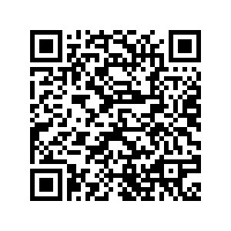
Metacognition: Learning Styles

Slide 16
Focus Group Responses
Tell me what it means to you to belong somewhere
“When you feel comfortable you see maybe some of the people you know are from there, like she is also from (place) so I feel comfortable with her” – Y8 BLCK space
“Where I feel where I belong is um people who know what I am going through… there is a lot of racism there and I feel like I belong where people have experienced that” Y8 BLCK Space
“Definitely not in school” – BLCK Space Y8
“I feel safe, with my brothers and sisters and my parents because it is one of the many places that autistic children are allowed” – Y8 Beyond Space
“With black people, because you can relate” – BLCK space Y9

Slide 17
Focus Group Responses
Do you feel a sense of belonging at school?
“No because people are really racist to be fair” – BLCK space Y8
“With my Head of Year, I don’t belong…. Because I really found out what he said about me” – BLCK Space Y8
“Teachers give me a headache when they say ‘tuck in your T-shirt and neaten up your tie’” – Beyond Space Y8
“I don’t think I belong in school because, school is prison” – Beyond Space Y8
“I don’t think I belong to this school because I don’t like it” – BLCK space Y8
“Err no because like I tried like to tell a problem and they don’t sort it” – Beyond Space Y8
“There is no cultural diversity here” – BLCK Space Y9
“I feel like I belong when I am with my friends, but I didn’t belong when they (school) are talking about slavery coz everyone turns around and looks at you when they say stuff about slavery” – BLCK space Y9

Slide 18
Focus Group Responses
How about university? Do you feel you would belong there?
“I think I would belong in university because there are lots more people and it will be more positive and friendly” - Beyond Space Y8
“I think there will be way more black people so I will fit in as well” – BLCK Space Y9
“ I think it will be a bit scary at first, but once you settle in it will be alright” – Beyond Space Y8
“I think it will be more diverse, like with different cultures” – BLCK space Y9
“My Mum was in university. She told stories about people being racist to her and how she wasn’t fully accepted.” – BLCK Space Y8
“Err, if I go to a posh one, it will definitely be mostly white people there. Because my brother goes to a posh one” – BLCK Space Y8
“I think I would like uni because I get my own room” – Beyond Space Y8

Slide 19
Focus Group Responses
What are the biggest challenges you face in education (now or in the future)
“I am actually a little but scared because GCSE’s are going to be really hard” – BLCK space Y9
“One of the biggest challenges in the future is probably trying to pay bills, and trying to do basic life because schools not very good at teaching you that” – Beyond Space Y9
“The teachers…. Most of them are racist” – BLCK Space Y8
“I don’t know, It’s just that I am in year 9” – BLCK Space Y9
“My Mum was in university. She told stories about people being racist to her and how she wasn’t fully accepted.” – BLCK Space Y8
“ I think it will be a bit scary at first, but once you settle in it will be alright” – Beyond Space Y8
“I find sometimes people don’t understand what I say, so I try to change me voice…….back in Africa I had a different education than here so yes, it’s very hard” – BLCK Space Y9

Slide 20
Feedback from sessions
“You guys are amazing” – Beyond space Y8
“very good session, felt comfortable and enjoyed the ambassadors company – she is a good listener” – BLCK Space Y9
“I felt very comfortable because others had the same mindset as me” – BLCK space Y8
“I enjoyed speaking to someone (ambassador) as they understand what I mean” – Beyond Space Y8
“really good session, very entertaining and a good place to share thoughts” – BLCK Space Y9
“I think it was good because we got to know what metacognition was” – BLCK Space Y9
“I feel at home” – BLCK Space Y8
“Good session helped me out thinking about what I need to achieve” – Beyond Space Y9

Slide 21
What Next
Review the evaluation from these projects and make changes if needed
Introduce small group mentoring with the ambassadors alongside the sessions
Use this framework to work with other underrepresented groups across more schools
Recruit more ‘champions’ from the projects to give back to future students on the programme

Slide 22
Any Questions?

