Slide 1
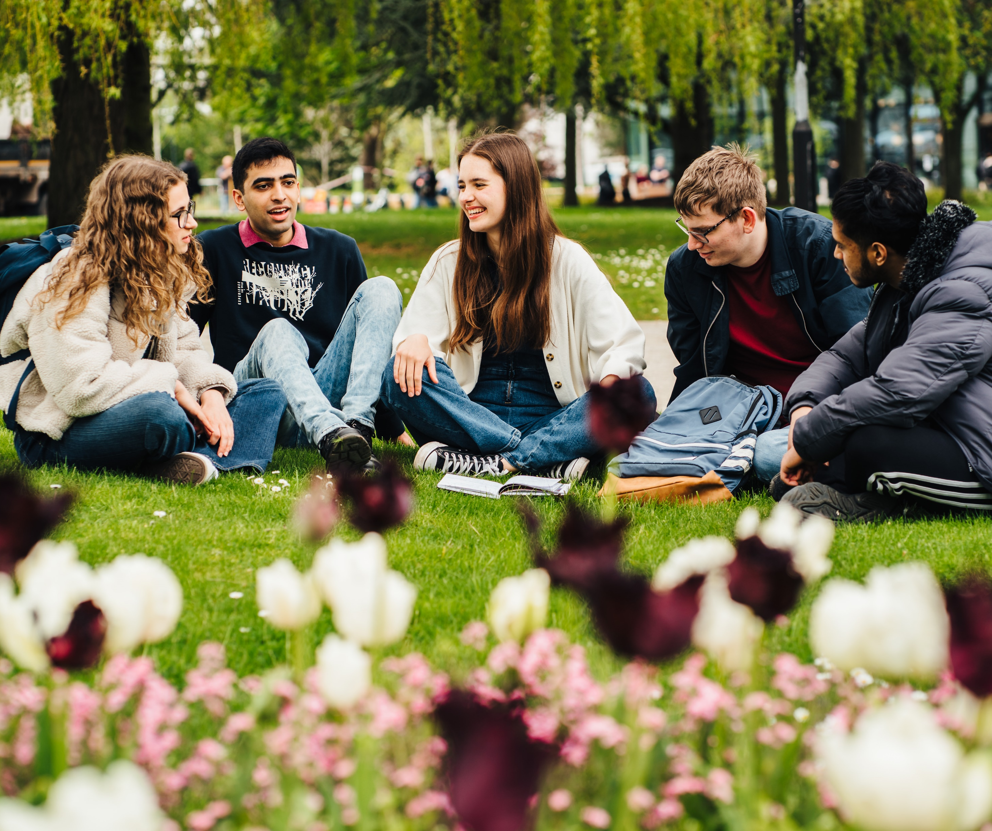
Developing skills, confidence, agency & resilience for student success
Sarah Bennett, Skills Developer for Personal Development Programmes
Parmjit Dhugga, Warwick Award Manager
Student Opportunity

Slide 2
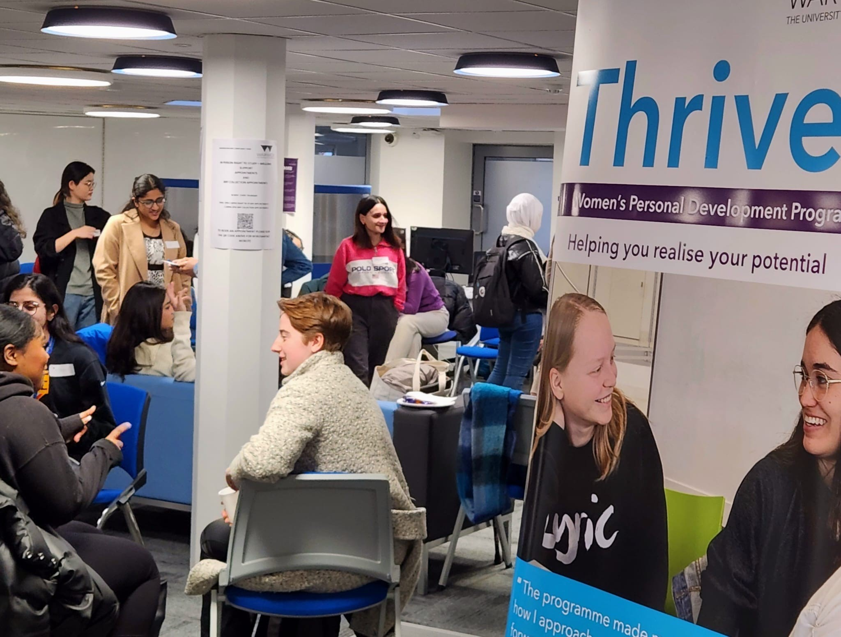
Thrive personal development programme

Slide 3

Thrive – the story so far
A personal development programme to support student success
Thrive is a women’s personal development programme for UG and PG students
Aims to increase students’ confidence, agency and resilience
Co-developed with students, delivered by a team of experts from across the university
Content​ includes: values, strengths, imposter phenomenon, purpose and positivity, personal power, visibility and resilience
Participants can choose to be paired with a mentor after the programme
Current audience - students who identify as women or non-binary people comfortable in a female centred community
The themes of Thrive are applicable to many student groups

Slide 4
Impact of Thrive
Thrive has helped me build myself by setting my values and boundaries... this programme [is] a life-changing course.
Average % increase:
    Confidence : 4.5 increased to 7.6 (67% increase)
    Resilience : 5.5 increased to 7.7 (39% increase)
    Agency : 5.6 increased to 7.7 (38% increase)
4% of those who attended Thrive were Warwick Scholars
Community of support and sense of belonging​
Data from first 3 programmes only
I wish I attended a program like Thrive when I was in my first year – cannot imagine how powerful it will be to assist my whole university journey.
Thank you so much for this beneficial course. It is changing my way of thinking about myself.

Slide 5
Thrive for Widening Participation students
Funding allowing, we plan to develop streams of Thrive for specific WP audiences:
    Warwick Scholars
    Estranged students
    Care leavers
    Sanctuary Scholars
Working with students from these groups to understand the themes most relevant to them and co-create bespoke programmes
Longer term, embedding into degree programmes is the best way to make accessible to all students
Embedding into induction for the new BSc Child and Family Health and
Wellbeing course in CLL

Slide 6
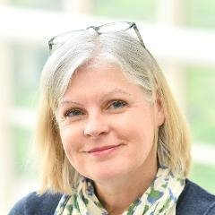
Thrive Contact
To find out more about Thrive, please get in touch
Sarah Bennett
Skills Developer for Personal Development Programmes
Skills team, Student Opportunity
Sarah.j.r.bennett@warwick.ac.uk
warwick.ac.uk/services/skills/personaldevelopment/

Slide 7

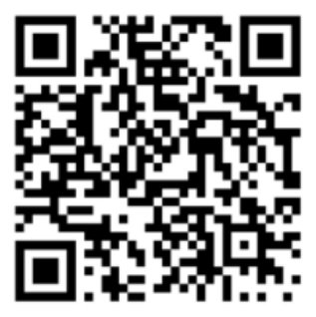
The Warwick award carers’ pathway
Parmjit Dhugga
Warwick Award Manager

Slide 8









The Warwick Award
The Warwick Award is based around 12 Core Skills that employers tell us are crucial for the next step in your journey.
  General overview – how it works and what it is intended to do​
  Background – need for this as students struggle to recognise and articulate their skills​
  Recognise a wide range of activities​
  We know students gain valuable transferable skills through caring ​

Slide 9

The Carers’ Pathway
Students with Caring Responsibilities (Variable CSPs)
Students with caring responsibilities develop a number of the 12 core skills at the heart of the Warwick Award through their day-to-day activities.
Completion of this activity allows you to reflect on the skills you have gained through your caring role and how these may be useful in other settings, e.g. in your studies, work experience, job applications and in the workplace.
You will need to:
Identify an appropriate advocate and ask them to complete the Advocacy Form on your behalf.
Complete the 'Students with Caring Responsibilities' Moodle course.
Submit your reflection and Advocacy Form for review by the Warwick Award team.

Slide 10
Students with Caring Responsibilities
Award Recognition
Students working towards the Gold level of the Warwick Award can claim 20 Core Skills Points (CSP) on completion of this activity. Students working towards the Silver, Postgraduate, Exchange or Apprentice levels can claim 10 CSP.
Who can take part?
Students who:
Provide unpaid care to a family member or friend who couldn't cope without their support.
Are responsible for the care of wellbeing of a child or children under 18.
Your advocate must be someone you know in a professional capacity, who is aware of, and willing to confirm their knowledge of your caring responsibilities. An advocate could be your personal tutor, a module leader, a representative from an external carer’s agency or from the Student’s Union Parents and Carers Network, for example. If you are struggling to identify a suitable advocate, then please contact the Warwick Award team and we’ll do our best to help.

Slide 11
Data and impact
Engagement and breakdown
  8 students have engaged and 4 have completed and have been awarded their CSP.
What other activities do students on the carers’ pathway do?
    Forage Virtual Work Experience, Thrive, Warwick Award: Critical Thinking Moodle course (2 CSP), TeamWork Virtual International Programme (12 CSP), Independently Organised Placements (Variable CSP), Independent Volunteering (Variable CSP), WBS: Consulting Experience Weekend (3 CSPs)
Opportunity to collect data on which students are carers – currently we don’t know

Slide 12
Impact
Feedback from students
Overall, I found the course to be very informative and useful in helping me to better prepare for interviews and enhance my transferable skills. ​ [It] helped me to reflect on my experiences and develop my skills. In particular, I found the journal activity to be very helpful in building a good set of examples.
I hope more students with caring responsibilities take advantage of this course. I found it to be a great resource that has helped me to better understand my strengths and how to articulate them in various contexts.
“Overall, I found the course to be very informative and useful in helping me to better prepare for interviews and enhance my transferable skills. ​
The duration and content of the course were well-structured and comprehensive, and I really appreciated the inclusion of various activities and resources that helped me to reflect on my experiences and develop my skills. In particular, I found the journal activity to be very helpful in building a good set of examples. ​
I hope more students with caring responsibilities take advantage of this course. I found it to be a great resource that has helped me to better understand my strengths and how to articulate them in various contexts. Thank you for providing such a valuable course and for your efforts in supporting students with caring responsibilities.​”

Slide 13
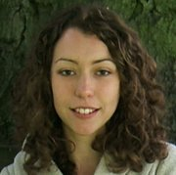

Carers' Pathway Contact
To find out more about the Carers' Pathway, please get in touch
Lisa Faulkner​
Skills Developer​
Skills Team, Student Opportunity​
lisa.faulkner@warwick.ac.uk
https://warwick.ac.uk/services/skills/warwickaward/carers/

