Slide 1

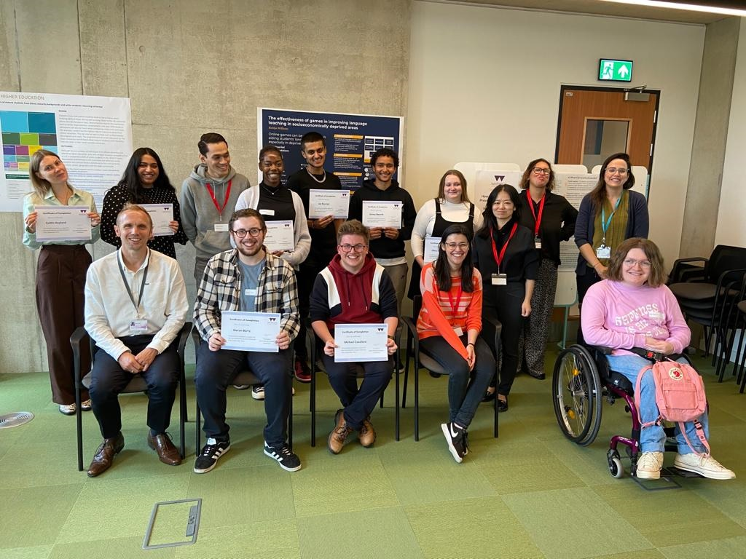
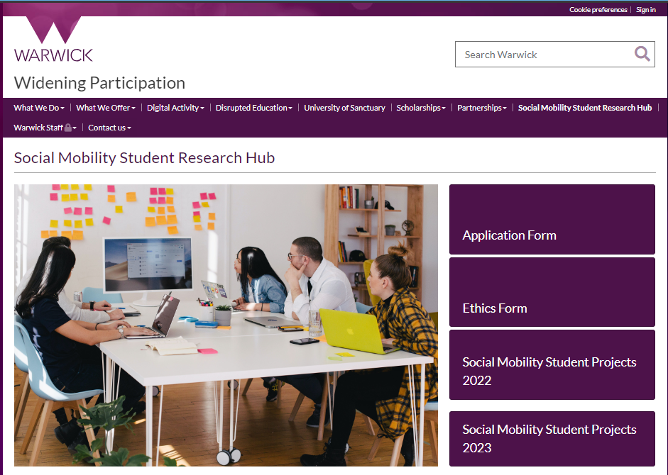
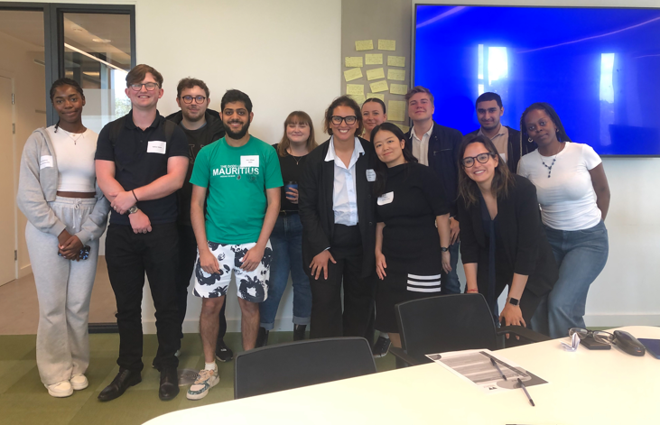
Social Mobility Student Research Hub
Tammy Thiele, Victoria Hill, Judith Ajebon, Daniel Cashmore, Catherine McCarthy, Ellis Ryan (WP Evaluation Team)
Youn Affejee, Aїcha Hadji-Sonni, Bing Lu (SMSRH mentors)

Slide 2

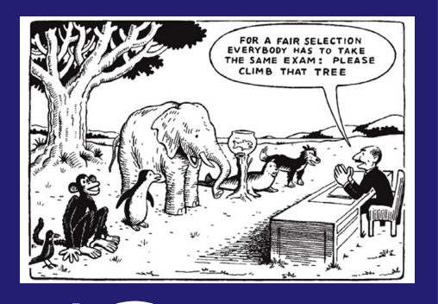
The Social Mobility Student Research Hub (SMSRH)
Aims to improve access to and participation in research for students from underrepresented groups, including those of low socio-economic status backgrounds
Offers funding, research training, support from PGR mentoring and project team + opportunities for collaboration
Uses co-creation approach that emphasises learner empowerment
Expanded WP research base
Notes:
Developing research that highlights barriers and challenges students themselves have faced
Our aim is to enhance opportunities into and whilst at university for all.
We want to ensure that the University of Warwick is representative of our local and wider national communities.
Ensuring the university is accessible to students from all backgrounds, but also that students are given the same chance to succeed when they arrive, and beyond.

Slide 3
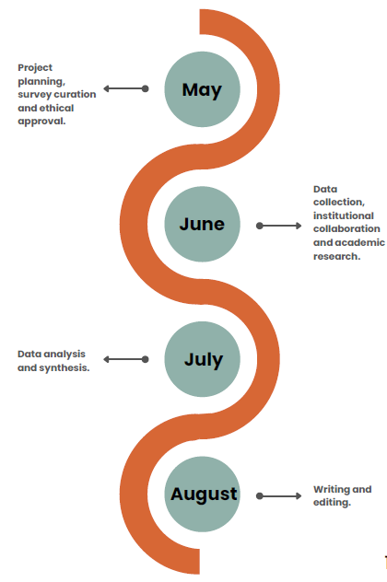
Who and what has the Research Hub involved?
30 UG and PGT students from various WP backgrounds and departments (English, History, Liberal Arts, History, PPE, Sociology, Politics, Economics, and Law)
Collaborators included UpReach, IntoUniversity, The Sutton Trust and other HEIs (BCU, UoL)
4x PGR mentors, staff from the WP team, from Wellbeing and Disability Services (WDS), and academics from Education Studies
Application process and Research Ethical approval
Written reports, Literature reviews, Podcasts, Documentary videos, Posters
All invited to conference where students presented outputs
Project Timeline by Olivia Collins 2024
Notes:
Application process, ethical approval, and mentor recruitment
Say what has happened so far this year… applications, accepted, officially launched last week
Conference had guest speaker etc

Slide 4
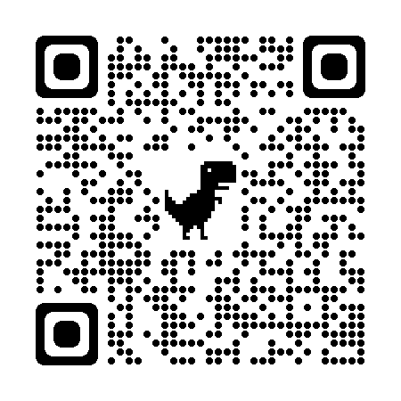
Project outputs

Slide 5
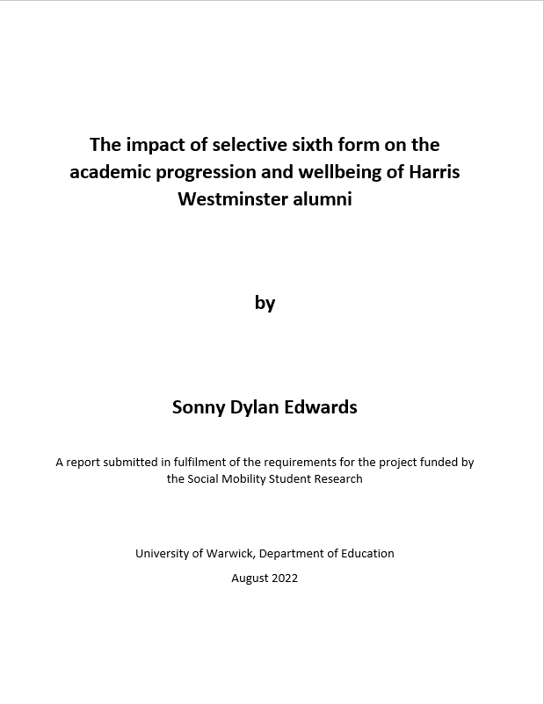
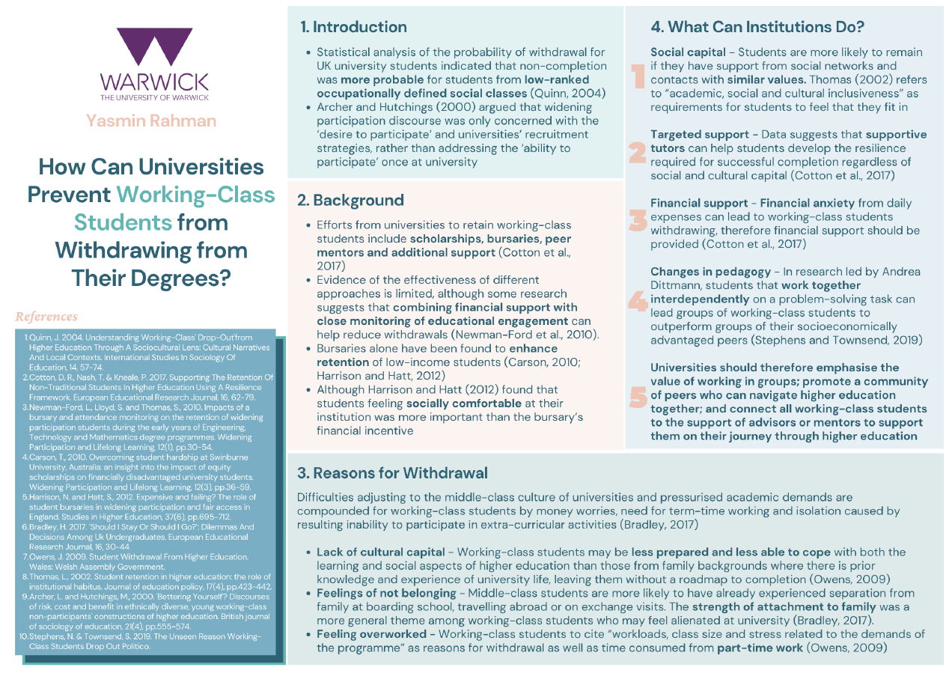
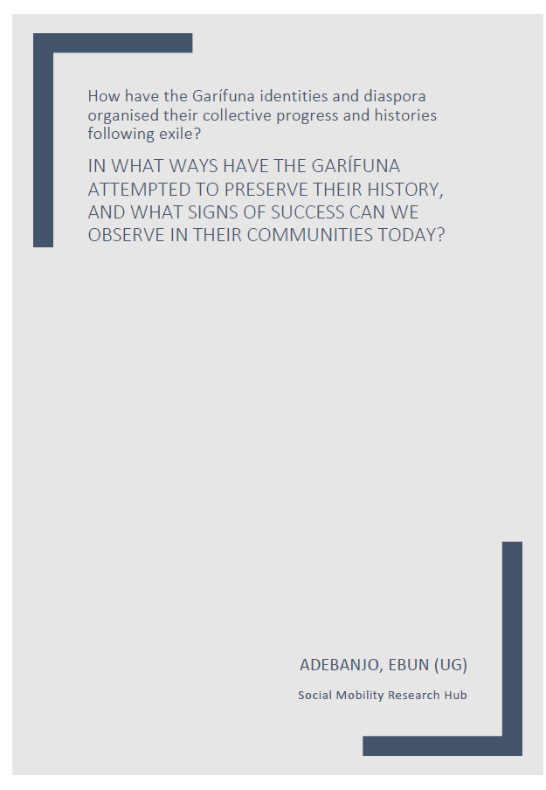
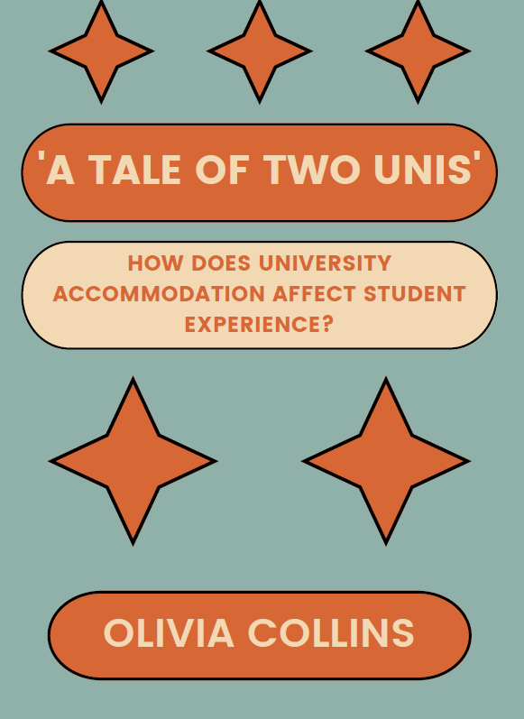
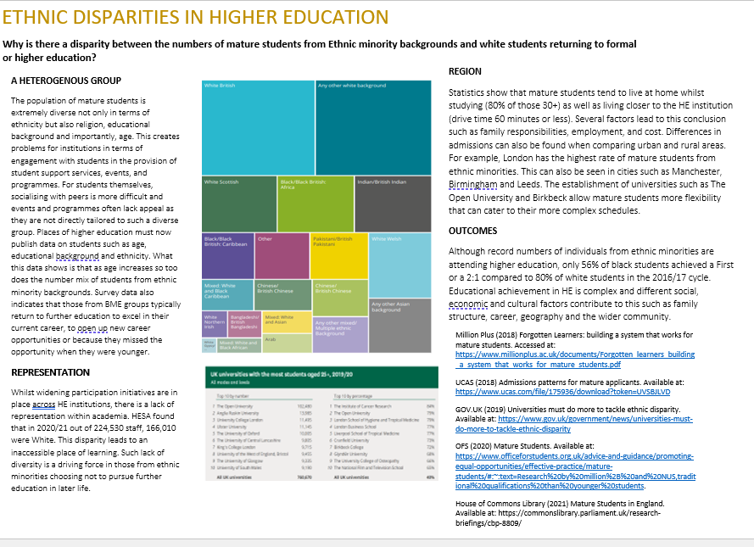
Project outputs
warwick.ac.uk/study/outreach/studentprojects/
Notes:
Students have produced an array of outputs… some of which you can see in front of you.
The projects have researched numerous subjects,
Around inequality of access, student experience and success, and graduate outcomes.
looking into school systems impact on students, imposter syndrome, ethnic disparities, impact of class and socioeconomic status on outcomes, support for SEN student access, impacts of disabilities, impacts of WP programmes, organisation recruitment of WP students
But I will just highlight one student/study from last year…

Slide 6
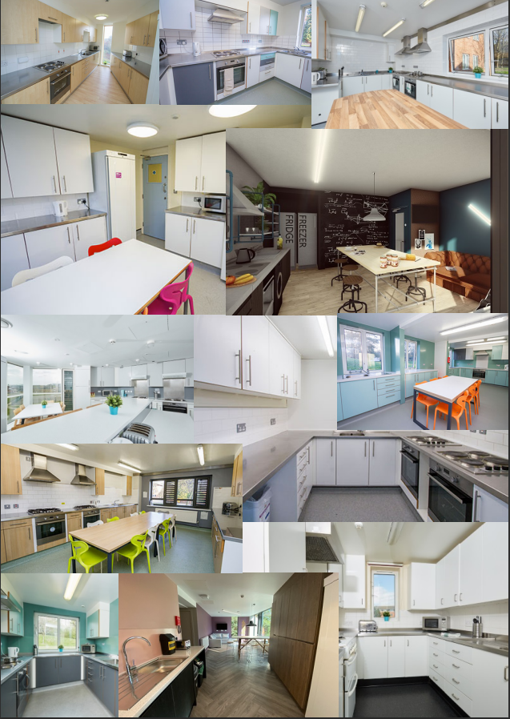
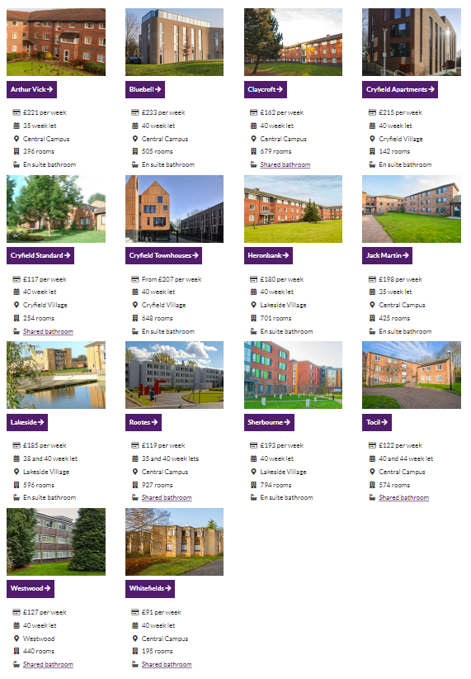
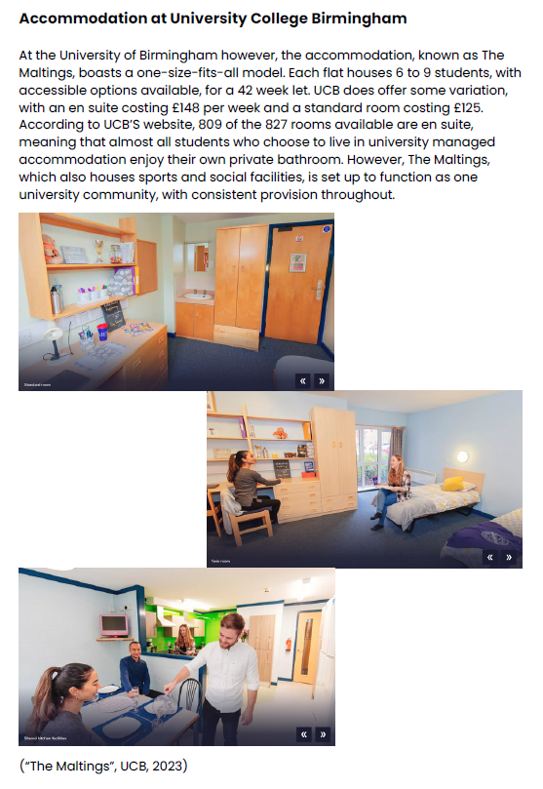


Olivia Collins:
‘How does University accommodation affect student experience?’
Notes:
A student named Olivia Collins looked at how university managed accommodation influences student experience at Warwick and UCB (University College Birmingham) and compared the experiences of WP students with non-WP students.
This was Olivia’s second year participating in the SMSRH. She said really enjoyed her experience so see decided to apply again
Warwick offers various hall accommodations all with different costs. The cheapest is Whitefields at £91 a month, and the most expensive is Bluebell at £233 a month. However, UCB offers on the most part offers a one-size-fits-all model – all students get the same experience.
She conducted an online survey (with 79 responses from both uni’s) AND (4) semi-structured interviews with Warwick students.

Slide 7
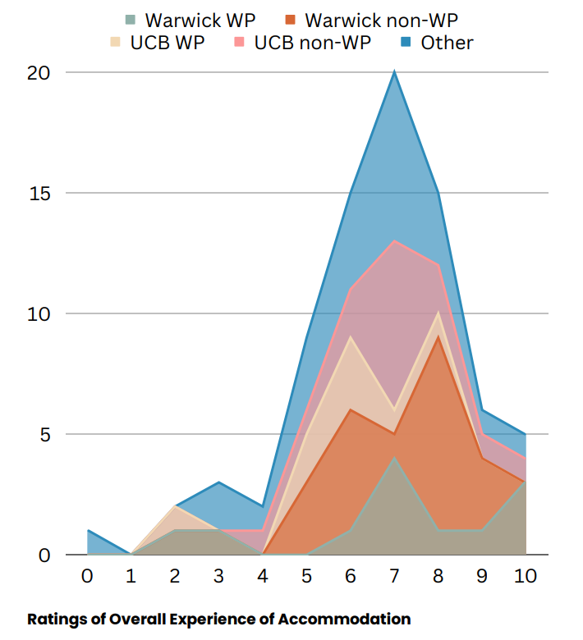
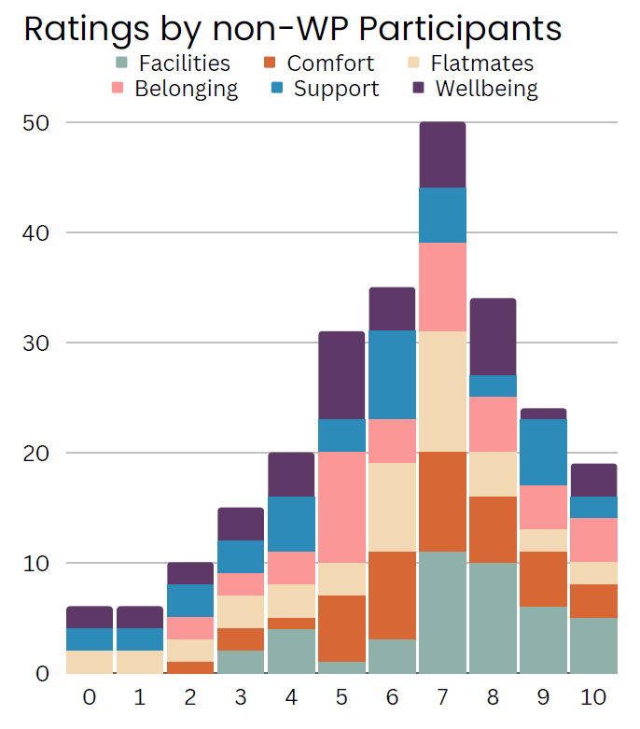
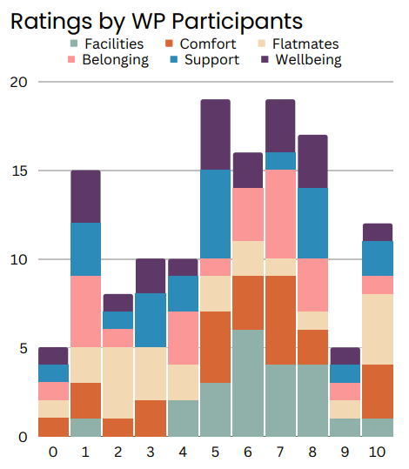
Olivia Collins:
‘How does University accommodation affect student experience?’
Notes:
Surveys revealed that accommodations were mostly rated favourably at both universities (7/10). However, WP students more often gave lower scores than non-WP students.
More Warwick students gave a low rating to the facilities and the experiences of wellbeing, flatmates and support, in comparison to UCB students.
WP students from both uni’s gave much more varied ratings of accommodation facilities than non-WP students, with many more negative ratings.

Slide 8

Olivia Collins:
‘How does University accommodation affect student experience?’
the system that decides which flat you end up in does not work, and that the questions are too absurd and abstract
Party town Rootes”….
everyone calls it [Whitefields] Shitefields
Whitefield's you know being for very poor people is one stereotype, Rootes being full of party animals and lunatics [...] [Bluebell] elite of the elite
Because of like the reputations of different accommodations at Warwick People don't expect WP or low-income students to end up in Bluebell
[the spread of stereotypes and rumours happened] “just like through osmosis
Notes:
The interviews revealed strong negative impacts of tiered accommodation system at Warwick – i.e, cheap Whitefields, Rootes and expensive Bluebell. WP students expressed more emotion about the social stereotypes of accommodation type/community. But all interviewees expressed negative thoughts about the stereotypes of different student communities on campus based on accommodation.
Recommendations:
Spread awareness of WP
Improve flatmate system – matching
Accommodation needs to be more affordable
Accommodation needs to be more equal – unequal investment in accommodations.

Slide 9



SMSRH Evaluation
Motivation
WP topics
Experience
Learning
Facilitation
Funding
Training
Mentoring
Impact
Skills
Confidence
Prospects
Notes:
Over 30 online surveys, and 12 semi-structured interviews with student researchers have been conducted to evaluate the effectiveness of the Research Hub since 2021-22.
We found their main motivations we their interest in the WP topics, experience of research and to learn new things and about their chosen project
Participants felt the funding/stipend was very important, and they wouldn’t be able to do it without it. And the research training/experience and the mentoring was also highlights that enabled them to take part in the programme
Participants said SMSRH had a positive impact on their skillset – learning how to do surveys, interviews, reports etc. They also said it increased their confidence and future prospects

Slide 10


SMSRH - Platform for students’ voices:
I wanted to give a glimpse into the world of a disabled person
It’s giving students that platform to really speak on issues that matter to them if that makes sense
I’ve never seen something like this before that gives students from WP groups a voice and an opportunity, a platform as research is so exclusionary, like they’re all middle class. I think this is a gateway to improving access to postgrad and it should be like wider than the university, involve all the universities
I wanted to make sure that student voices were informing that University process
Notes:
One of the overriding themes from the feedback was that the SMSRH provided a Platform for students’ voices
helping to understand and address WP-related challenges

Slide 11


SMSRH - Gateway to future research
I felt like I learned a lot of practical skills, which I didn't necessarily learn throughout my degree
I feel like it actually unlocked quite a big passion for research that I didn't realise that I had. And I mean it got me very interested in looking at things like, you know, master's degrees somewhere down the line
“I'd never done a full research paper before, and I probably wouldn't have done it without the hub…. I felt like I learned a lot with that because that's how I do research now in my job. So, I feel like that's actually been really, really helpful for what I'm doing now.”
Notes:
And the other main theme was that the hub seemed to be a Gateway to future research:
Students had enhanced research expertise, interest, develop new skills, knowledge and confidence to explore future research possibilities - which several have since gone on to pursue

Slide 12
SMSRH mentors: success stories too
Mentor from ethics to conference:
Mastering the whole research project cycle
•Personal development: more comfortable, confident, balance research, work, and life
•Professional development: oral and written communication, team leading, team playing
•Academic development: co-organisation of the conference, use expertise of research process and education research

Slide 13
Bing - A journey from supervisee to supervisor
Relate to own research
Transferable skills
Oversee the project cycle

Slide 14

Aicha

Slide 15
Youn - 'Outreach' within university
Social mobility aspects add to WP perspective in my own research
Mentees with diverse background brings originality in approaching research
Cycle of sharing information and gaining new perspective through mentees work
Notes:
-SMSRH is an example of outreach within university and a good way of continuing widening participation closer to home (especially on retention which gets less attention than access)
-Mentees from different dept and fields bring originality in approaching research: creative with videos and flexibility to adapt to the project throughout – great to see as a new researcher
Cycle of passing on information through references and getting back a new perspective after mentees write literature review
WP perspective more prominent in my own research since SMSRH

Slide 16
Conclusion and Next Steps
Importance of inclusive research opportunities: amplifying underrepresented voices and highlighting experiences
Future directions: sharing findings and connecting students with decision-making
Research Hub 3.0 has now launched with 12 students
Responding to lessons learned and strengthening our evaluation

Slide 17
Questions?
Feel free to contact us: socialmobilityhub@warwick.ac.uk
Check out our website: warwick.ac.uk/study/outreach/studentprojects/

