Slide 1
The Walk of Shame: Measuring Success from my Council Estate Room
Maria Sheriff

Slide 2
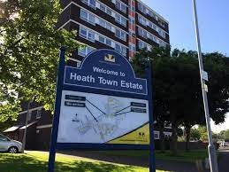
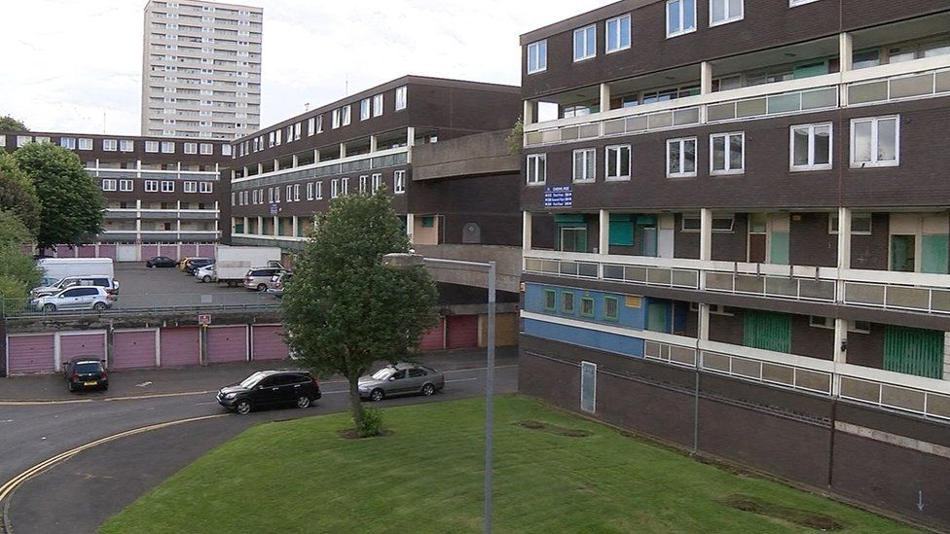
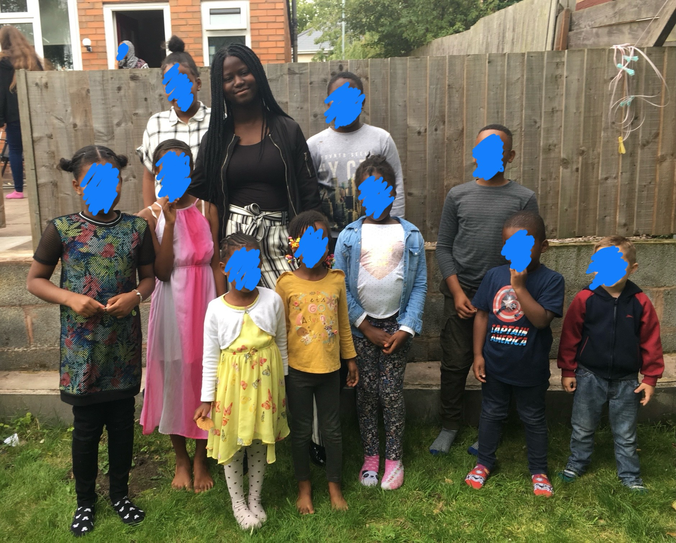
Where it all began…

Slide 3
Why I felt like a student failure
1
Failure of securing something big
2
3
Being diagnosed with learning disabilities
The academic burnout
Fear of judgement
Moving back home
I am excited to announce that I will soon be unemployed!

Slide 4
FIRST GEN STUDENT EXPERIENCE: MINI INTERVIEWS
https://youtu.be/oRjmfFDw720?si=u1l2DACdNXW12IuX

Slide 5
Personal interviews: Hearing from WP students
Doing well academically
Getting a good career/job
Pressure from family/ Wanting to make family proud

Slide 6
How to manage the issues WP students face in higher education
Continued support : Societies such as 93% club
Peer groups/mentors- adjustment
Financial support
Encouragement over expectations

Slide 7

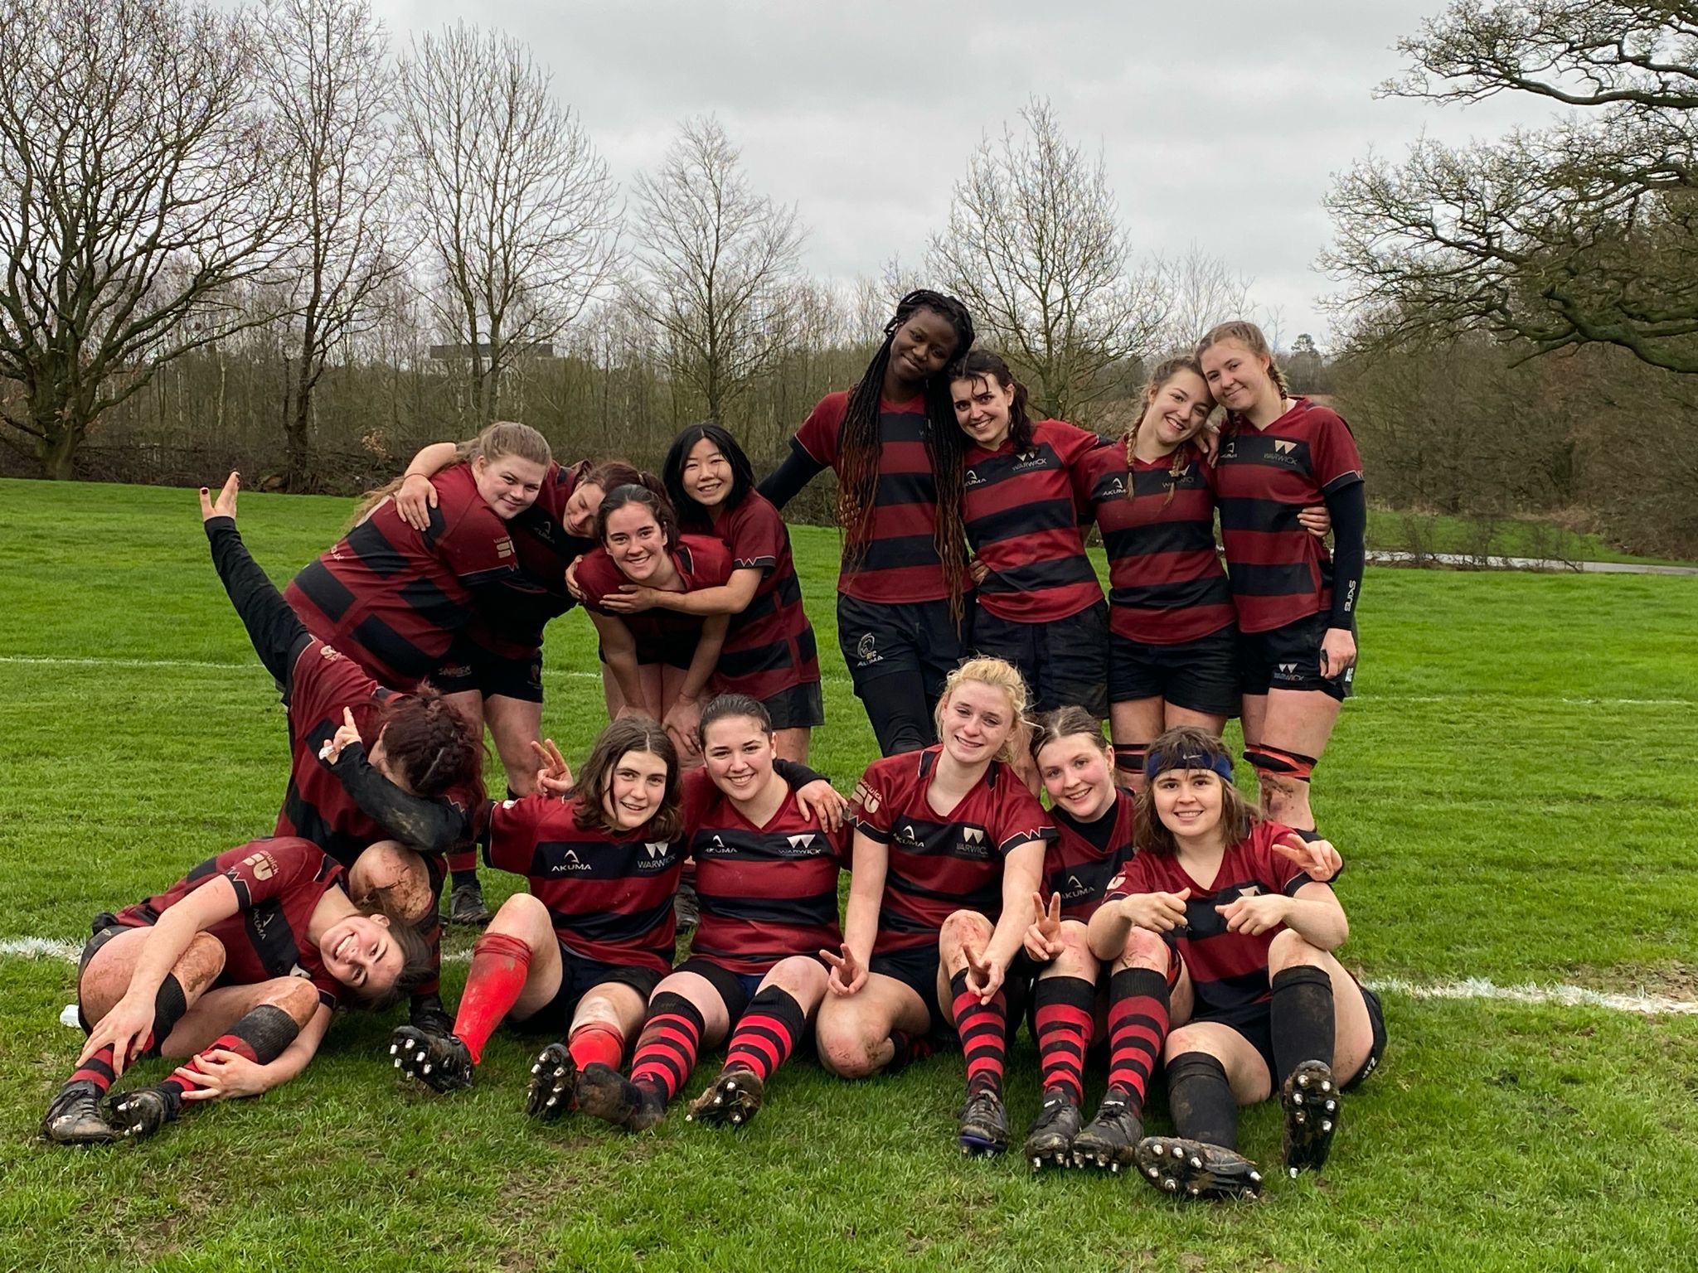

Reconstructing student success

Slide 8
What does student success mean to you?

