Slide 1



You Are What You Think
WP Presentation by Jubilee O

Slide 2




Slide 3



Slide 4
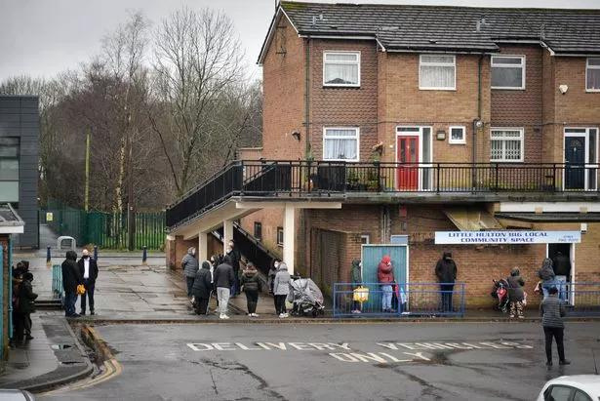

Slide 5



Attend top 10 university
One of 150 Future Leaders
Top 40 Undergraduate of the Year
Multiple internships with top companies

Slide 6



Slide 7


Slide 8
Self Perception

Slide 9

Self Perception
Potential

Slide 10
Self Perception
Potential

Slide 11
Romans 12:2
“But be transformed by the renewing of your mind”
Ephesians 4:23
“Be renewed in the spirit of your mind”

Slide 12

OLD
NEW

