Slide 1


Student Mobility opportunities
Research show those who undertake international study or work experiences are:
9% more likely to gain a 2:1
24% less likely to be unemployed
9% more likely to be in a graduate job six months after graduation
5% higher earnings after six months of graduation
Notes:
THIS SESSION IS BEING RECORDED and will be available to be watched again at your leisure following today’s session.
Hello and welcome to the student mobility overview for 2023-24.
There are opportunities and a list of universities that you can undertake mobility opportunities has been provided to your department. The past couple of years has taught us that we cannot guarantee that selected placements will go ahead in person. Europe has imposed more onerous visa requirements that were not present in the past which has made it more expensive to visit Europe. But, we have to plan ahead and we are moving ahead with mobility plans for autumn 2023.
We have a wide range of study partnerships with universities across the world, although we have seen this year the increasing popularity of students undertaking self-sourced work placements abroad. Please check with your department whether they permit work placements as part of the year abroad and whether there are any particular requirements for a proposed placement.
Of course, you may alternatively decide that a short term mobility opportunity is more attractive to you and I would recommend that you sign up to the short term mobility mailing list to receive details of opportunities mainly aimed at the summer break.
The information in this short presentation will provide some of the practical details you will need to consider if you are interested in year abroad and then we will talk to you again in the spring term with the next update.
Questions will be addressed at the end. Feel free to use the chat if you think of questions as we go through.

Slide 2
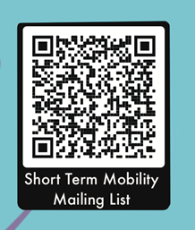

Short Term Mobility – Study
Warwick International Intensive Study Programme
- last opportunity to apply from 7-19 March 2024
warwick.ac.uk/wiispapply
SJTU Global Challenge
Summer Schools
Language Courses
www.warwick.ac.uk/shortmobility
HOW TO FIND OUT ABOUT OPPORTUNITIES:
Sign up for the Short Term Mobility Mailing List to hear about opportunities and funding here
Student stories from students who have undertaken short term mobility experiences here
Notes:
Maria

Slide 3

Short Term Mobility - Volunteering
www.warwick.ac.uk/shortmobility

Slide 4



Year Abroad – Funding and Finance
All students on mobility for a full year
Students pay a reduced tuition fee to Warwick (normally 15% of normal fee)
Students pay no tuition fee to their host university
Students access their student loan as normal
Bursary eligibility often remains too
Students may be eligible to higher maintenance loan if visiting a country with high cost of living
Notes:
Madeeha

Slide 5


Insurance & Support
Business Travel Insurance
The university Business Travel Insurance policy is in place for all students on mobility programmes.
Emergency medical cover in place for all registered students.
Wellbeing Support
Students are still registered at Warwick, unless an opportunity is taking place after they have graduated.
Still able to access all Warwick services whilst away.
Notes:
Madeeha

Slide 6

Funding – Turing Scheme
Funding for international study, work, volunteering opportunities 4 weeks+
SEMESTER/YEAR ABROAD
Non-WP students
£1,200 / £2,800 a year funding support
WP students
Up to £2,900 / £4,900 a year funding support
4 WEEK EXPERIENCE
Non-WP students
£480
WP students
Up to £1,900

Slide 7

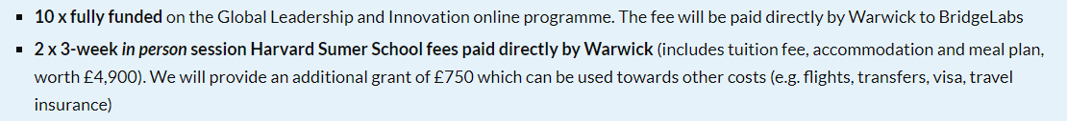
Funding – North America Bursary

Slide 8


What our students say
“For me this entire experience was amazing, and I am so grateful for the opportunity! I was able to widen my international network and develop long lasting connections with friends and aspiring leaders from across the globe from Chile to Russia to Australia.”
“The experience has led me to seek a Year Abroad option if possible during my degree.”

