Slide 1

The WP Staff and Student Network’s Present….
Student Voice: A WP Perspective
Wednesday 8th March 2023
Notes:
CE

Slide 2


Slide 3
Housekeeping
No planned fire alarms
Catering – please check allergen sheet
Facilities
Rooming
Photography
Notes:
CE

Slide 4
Timetable
Time | Activity
9:15am | Refreshments and Registration
9:30am – 10:15am | Having a Voice: A Lived Experience Student and Staff Panel
10:15am – 10:30am | Movement
10:30am – 11:15am | Workshop/Update Session 1
11:15am – 11:45am | Movement and Refreshment Break
11:45am – 12:30pm | Workshop/Update Session 2
12:30pm – 1:15pm | Lunch and Networking
1:15pm – 2:00pm | Workshop/Update Session 3
2:00pm – 2:15pm | Movement
2:15pm – 3:00pm | Closing Plenary
3:00pm | End
Notes:
CE

Slide 5
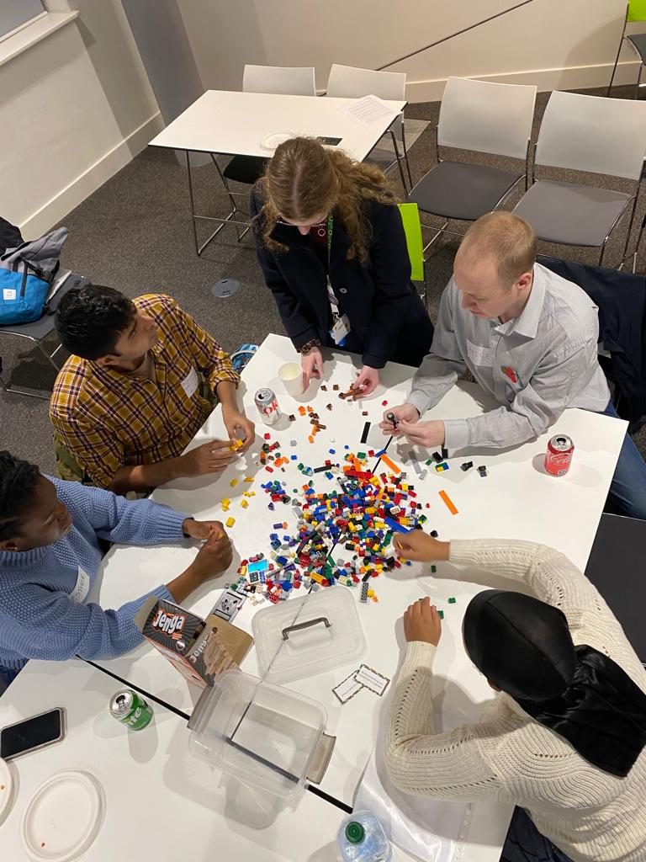
Context: Why this event?
Partnership between the Staff and Student Networks
Important to collaborate and to make our voices heard
Offering a seat at the table to those from WP backgrounds
Opportunity to discuss life experiences and to make change
Chance to have a dialogue on an equal platform
Safe conversations outside of usual environments
Notes:
AB

Slide 6
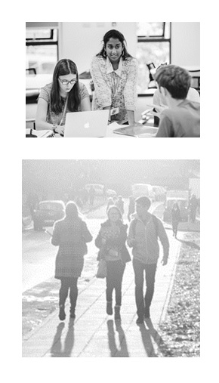
Context: Why WP? What do we mean by Widening Participation?
You were eligible for Free School Meals while at secondary school
You come from a low socio-economic background where your household income is below £35,001
You come from an area with low progression rates to higher education
You are in receipt of a Warwick Bursary or other means tested financial support
You are a student with disabilities - including seen and unseen disabilities, specific learning differences, mental health difficulties, autistic spectrum disorder or any other disabling condition
You are a mature student who entered higher education over the age of 21
You have spent time in local authority care, either in a foster home or a group home
You are an estranged student who is not supported by their parents
You have caring responsibilities - this could include, physical, practical or emotional care
Neither of your parents attended university and gained a degree (e.g. BA/BSc or equivalent) - excluding if they were/are a mature studen
Also a recognition of intersectionality, and also barriers other students face, for example: Ethnicity, Gender, Religion
Notes:
AB

Slide 7
www.slido.com
#1684357
Notes:
AB

Slide 8
Why is it important to me to feel I have a voice?
Notes:
AB

Slide 9
What are the challenges in making my voice heard?
Notes:
AB

Slide 10
Having a Voice: A Lived Experience
Student and Staff Panel
Notes:
AB

Slide 11

Having a Voice: A Lived Experience
James Blake – Research Fellow, Physics
Olivia Worringham – WP Assistant Officer
Sian Bolton – Graduate management Trainee
Michaela Sey – Law UG
Leigh Mencarini – History of Art UG
Notes:
CE

Slide 12
Think About:
Any reflections on student voice within your own communities?
Is a diverse and inclusive student voice utilised effectively in your own work?
Are there any networks or individuals that you can connect with to share good practice?
Are there any actions that can be taken away from sessions attended today?
Notes:
AB

Slide 13
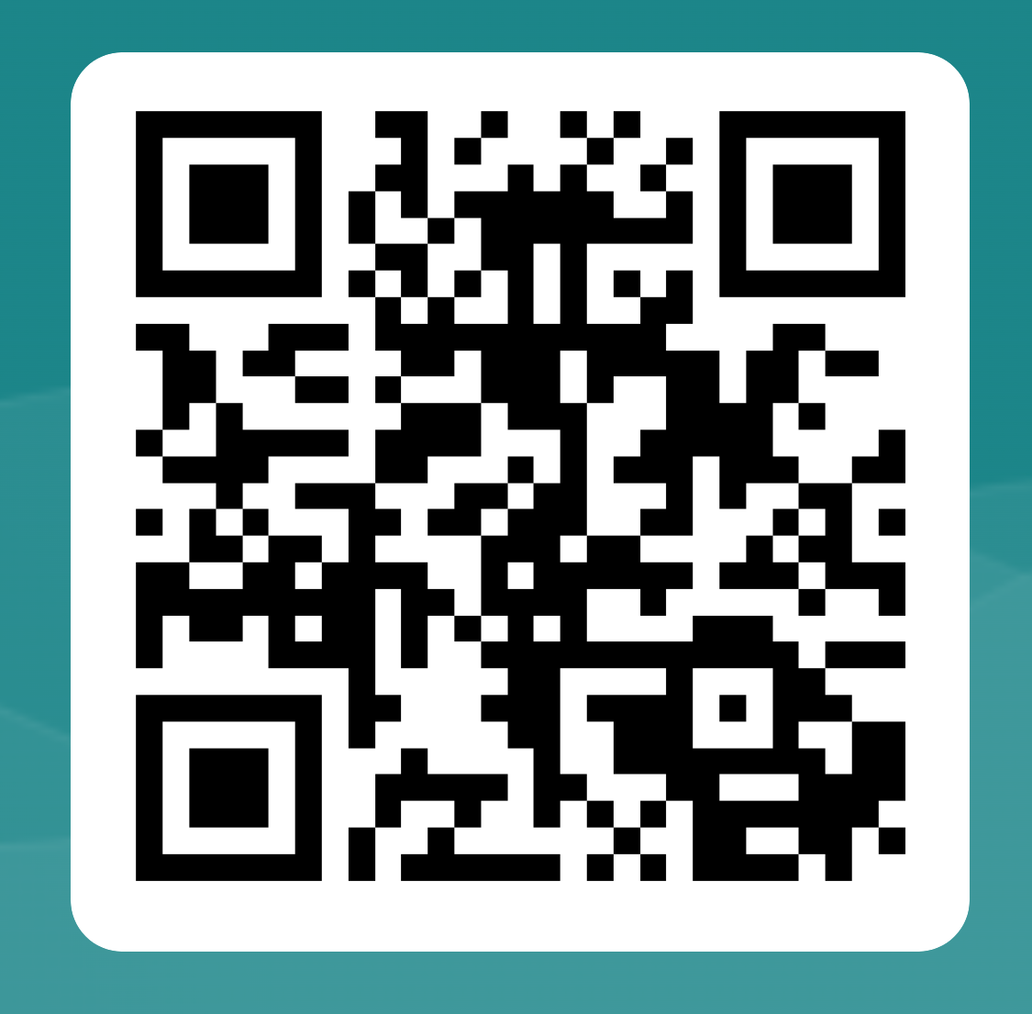
Next Steps
Workshops have been allocated – see your name labels
Catering available outside foyer area
Dietary requirements will be labelled
Note Takers
Each workshop session will have a note taker, these will be shared post event along with presentations
Feedback and Social Media
#warwickstudentvoice
https://forms.office.com/e/26drtcNuN1
Notes:
CE

Slide 14
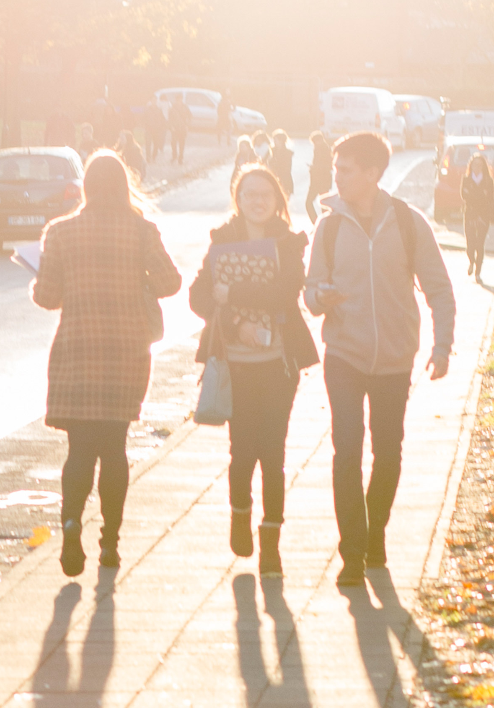
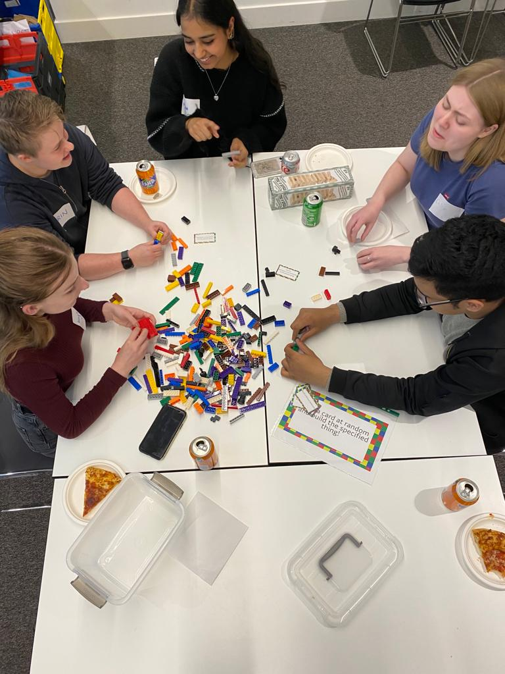
Thank you and enjoy your day!
Notes:
CE

