Slide 1
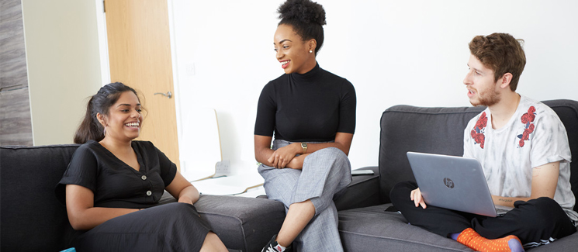
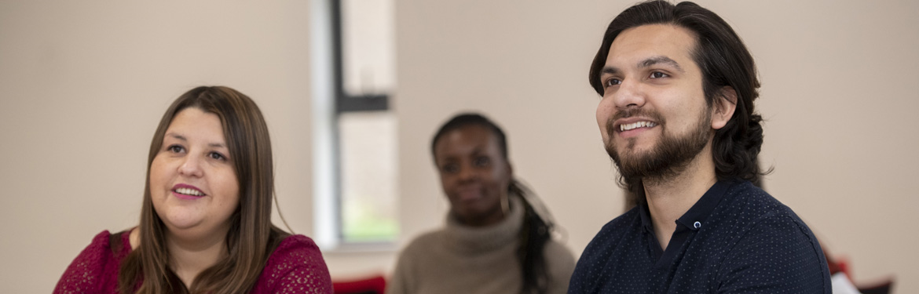
Using student voice in committees

Slide 2
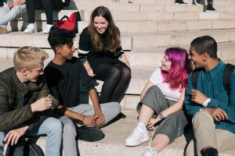
Today’s session:
Find out a little more about what you're doing
Share what we’ve done with the WP Student Advisory Group
Student Rep Training
Please feel free to let us know if you have any questions

Slide 3

How is SV represented in your area of work/study

Slide 4
The Widening Participation Committee recognised the importance of including the student voices within its work as such they decided commission the setting up a Widening Participation Student Advisory Group (WP SAG) as one of their three working groups.
The group acts as a forum where current students from a diverse range of backgrounds can support the University to enhance its WP practice and policy.
This extends across the whole student lifecycle, from pre-entry through to graduation and beyond, incorporating access, transition, student success and progression.
Widening Participation Student Advisory Group – How it started

Slide 5
How we got started
Worked collaboratively
New PT WP SU Officers
Consulted at all stages
Clear expectations and timelines
Membership Recruitment and selection
Meetings
Publicised the opportunity as widely as possible
Made criteria clear
Outline of the role
Offered training and support
Maintained transparency
Co-chaired
Agreed agenda in advance
Support the University to enhance its WP practice and policy
Agenda and minutes distributed
Student led
Have student voices heard and have an opportunity to make a real impact

Slide 6
Briefing
Agenda
Input – pre, post and during
Chairing
Teams channel/email
Building confidence
Wider context – University policies etc.
Informal
Supporting Members to engage positively

Slide 7
Proactive rather than reactive
Limiting ‘guest’
Substantial items – WPC paper
Demonstrating next step/impact
Acknowledging but not focusing on personal experience
Review
Collaboration
Briefing and setting expectations re role
Student voice – not a focus group
What's worked well?

Slide 8
Where can we improve?
Highlight the group and its work more
Maintaining positive level of engagement
Increased transparency
Website
Recruiting new members – how do we engage those who are hard to reach?
Share some of the good practice and learning points

Slide 9
Collaborating with Megan from Inclusive Education on the training
Using some of the lessons learnt from WP SAG briefing
Introducing some of the additional formality around committee meetings – language, who’s who etc
Explaining what the meetings can look and feel like
Looking at what they can get out of their involvement
Student Rep Training

Slide 10
Gave members the opportunity to meet ahead of the first meeting and build rapport
Allowed the members of the group/Reps to engage more confidently
Set expectations – also allowed any questions to be answered
Explained purpose and function of the group/meeting
Increased meeting engagement – supporting them to take up space
A chance to familiarise themselves with meeting structure
What (we hope)! the training did….

Slide 11
Challenges Student Reps
Formal structures of University meetings, chairs, agendas etc
They can feel intimidating
Balancing agendas and priorities
Transparency
Reading – papers
Timings of meetings/prep
Engaging with training/support

Slide 12

Feedback…
Questions? Thoughts? Ideas?

