Slide 1

Co-creation, gamification and student engagement
Amy Stickels, Anna Tranter, Vincent Amaitis and Daria Khorovich
Warwick Foundation Studies,
University of Warwick

Slide 2


Our students
Warwick Foundation Studies – International Foundation Year Programme
Currently circa 200 students across 10 course pathways – from Business to Maths to Arts & Humanities
Students from all over the world - China, Middle East, Japan, Kazakhstan, Russia, Korea, Nigeria
Students are mostly non-native speakers – IELTS ranging from 5.5 to native speakers.

Slide 3
We aim to develop:
Independent and engaged learners
Equality of opportunity
A positive learning experience
Inclusive learning
Sense of belonging
Prepared for study
Building confidence
Sense of achievement

Slide 4
Pedagogical underpinning:
Gamification
The application of a gaming mechanism into other areas with the aim of enhancing the process and experience.
Gamification is already embedded in our everyday life e.g. loyalty points for our coffee, rewards for tracking and achieving fitness goals.
Gamification can be linked to improving motivation and engagement and improved cognitive learning (Caponetto et al, 2014)
  Co-creation
“Doing together as equal partners”
We wanted to empower students to be creative, to develop their own questions, to test their knowledge and understanding and to have fun whilst doing it.
“Student-staff partnerships are an important facilitator to deeper student engagement and participation” (Bovill & Felten, 2016)

Slide 5

What we did?
First seminar each week we gave students a post it note as they entered the classroom.
Instructions to write a question and answer(s) on the post it note – to be submitted on the way out of the classroom.
Students could choose multiple choice, true or false, this week’s topic or a topic covered in the previous weeks.
We then used these questions to create an interactive quiz on Kahoot and ran the quiz the next seminar (later in the week).

Slide 6

What do our students think?

Slide 7

Kahoot...
Reduces stress and anxiety
Demonstrates the strength of alternate learning methods
Makes complicated themes clear
Reduces language barrier

Slide 8

Additionally, Kahoot...
Increases competitiveness in a friendly way
Increases brain reaction speed
Attracts attention due to user interface
Encourages everyone to participate

Slide 9
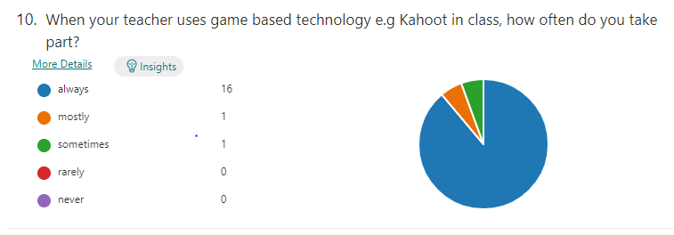
What did we find?
Majority of students do take part:
(89% reported "always") and qualitative responses suggested they find them fun, engaging and see quizzes as a form of a game (61%):
"I love games"
"it's good! it's fun! it's lit!"

Slide 10
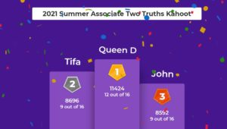
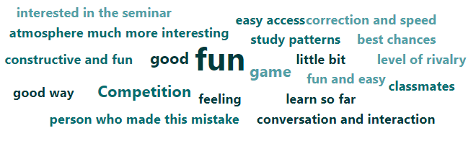
What do students like about it?
It is the game-based elements that students enjoy the most:
The interactivity:
“I’m not a gamer but this motivates me”
“Playing games during class is always the best way to learn new things and/or to memories things"
Competitive element of the quizzes:
“It increases the level of rivalry”
“I remember more”
“I don’t want to lose”
Leader boards
“I want to see my name”
“It motivates me”

Slide 11
Do students prefer to be anonymous?
Mixed opinions about anonymity:
50% of our student said they use their own name:
“that’s my name”
“I take it seriously – that’s why I use my name”
“I want my teachers to see my progress! Leaving my name also gives me certain pressure to answer questions which I think is a good thing because with pressure, I can do better.”
Majority who did not want to use their name said this was for fun rather than being about “face issues”:
“It’s fun to use another name”
“I like to guess who is who”
“If I win, I can reveal myself (like the masked singer)!”
“I like the flexibility of using my name or choosing another – we are all different!”
Some argue "flexibility is important" to choose to be anonymous or not.

Slide 12
“Why do you like it?”
Students are more actively engaged:
“When a game begins, my brain works more active”
“It reminds me what I need to improve”
“It’s like coffee – addictive!”
It changes the study pattern:
“It makes the studying atmosphere more interesting”
“If I know there is a quiz – I concentrate more”
“I’m excited – I like the routine of doing the quiz”

Slide 13
Students as co-creators:
“We are creating not just learning”
“It’s more quiz like if we write our own questions, otherwise it's like a test particularly with my educational background”
“ I also felt valued by my teacher, I was participating and creating content to be imparted to the rest of the class”

Slide 14
Community building
Some students also like that a game-based quiz in class is reassuring:
“you can see that you are not the only person who made this mistake.”
"..makes me feel part of the lesson“
Students’ sense of belonging is known to be strongly associated with academic achievement and a successful life at university (Ahn & Davis, 2020).

Slide 15
Considerations:
Time to read AND understand/ respond is an issue for some. Reading time and question length is important.
Sometimes the timings for each question are too quick:
“it gives me pressure…and makes me nervous”
Some prefer teacher to read question out as it aids understanding BUT others it slows down their processing of the question.
Language – the need to ensure that questions are worded in a way students can access.

Slide 16

And if you needed any more encouragement to have a go:
Interactive games in seminars are beneficial for students and tutors.
Co-creation can add to the student learning gain.
Foster student engagement and collaborative learning.
Builds a sense of belonging.

Slide 17


Any questions ?
Please feel free to contact us:
a.stickels@warwick.ac.uk
anna.tranter@warwick.ac.uk

Slide 18
References:
Ahn, M. Y., & Davis, H. H. (2020). Four domains of students’ sense of belonging to university. Studies in Higher Education, 45(3), 622–20. https://doi.org/10.1080/03075079.2018.1564902
Bovill, C., & Felten, P. (2016). Cultivating student–staff partnerships through research and practice. International Journal for Academic Development, 21(1), 1–3. doi: 10.1080/1360144X.2016.1124965
Caponetto, I., Earp, J., & Ott, M. (2014, October). Gamification and education: A literature review. In European Conference on Games Based Learning (Vol. 1, p. 50). Academic Conferences International Limited.

