Slide 1

Amplifying Student Voices
Widening Participation and Social Mobility
Cherryl Jones, Widening Access and Lifecycle Manager
Jo Bowers, Warwick Scholars Lead
Emily Cannon, Priority Groups Lead
8th March 2023 WP Student and Staff Network Conference
Notes:
CJ

Slide 2
Amplifying Student Voices
What do we mean and why it is important
The WP Approach
Listening
Synthesising
Amplifying
Notes:
CJ

Slide 3

Amplifying Student Voices – what do we mean?
Definitions of amplify:
increase the volume
enlarge upon or add detail to
to make larger, greater, or stronger
What does this mean for how we work with Students?
We want all students to feel heard
We can help uncover the bigger picture
We enable students voices to have an impact and effect change
Notes:
CJ

Slide 4

Amplifying Student Voices – why is it important?
Why is this important for Staff?
Enables reflective practice
Improves provision for students
Informs institutional change
Why is this important for Students?
Students are empowered to contribute to change for the benefit of themselves, their peers and others
Outcomes improve through the building of self-efficacy, resilience, confidence to enable a positive focus on academic achievement and career trajectory
Barriers and obstacles are removed to create truly equal access for all to all aspects of the student experience
Notes:
CJ

Slide 5
The WP approach
Listen
Synthesise
Amplify
Notes:
JB

Slide 6
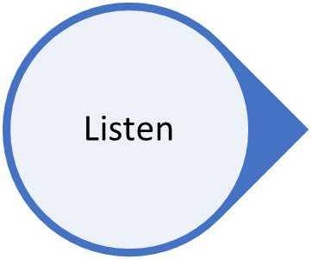
Listen
Surveys
Focus groups
Social media
Indirect
Conversations
Behaviours
Notes:
JB

Slide 7
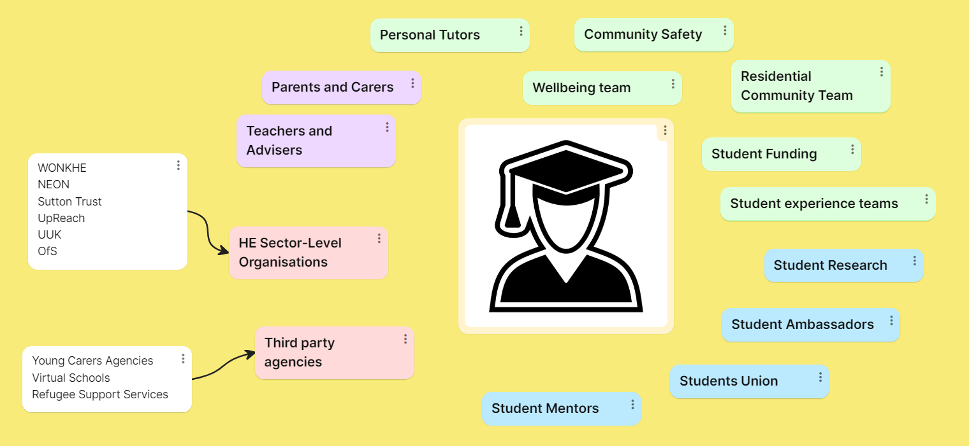
Notes:
JB

Slide 8
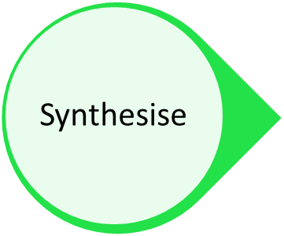
Synthesising into reflective practice: a case study for programme development
Literature review
Researched other universities
Focus groups with students at local schools and colleges
Conversations with teachers/advisers at local schools and colleges with high WP numbers
Looked at data of local students participating on one of our existing access programmes
Conversations with student funding regarding existing financial support
Notes:
JB

Slide 9
Synthesising into reflective practice: a case study for improving the student experience
Current Warwick students who are young adult carers
Young Carers Services – a connection with these services means current students can access bespoke support for their caring responsibilities
Warwick Award recognition of skills – collaboration between teams has ensured that the skills of carers are recognised
Mitigating Circumstances review
Notes:
CJ

Slide 10
Scenarios – what can you ‘hear’ from these situations? What do you do with the information?
You hold regular student voice meetings/opportunities. The same 4-5 people attend and the discussions tend to cover the same issues.
You have developed a programme to support students to access virtual careers skills development but struggle to fill the places.
You’ve had feedback from a few students about the mitigating circumstances process hasn’t worked for their situation and one of those students has subsequently dropped out of their studies.
You send out frequent newsletters with opportunities but don’t hear much back and have no way of checking whether they are being opened or read, or which students are accessing the opportunities.
Notes:
JB

Slide 11

Empathetic Amplification
We have a responsibility for how we use students' voices
Advocacy over 'exploitation'
Using the voices of people experiencing hardship without making them the focal point for change (JRF Talking about poverty project)
Risk benefit analysis
Notes:
CJ

Slide 12
Amplifying Student Voices – what do we mean?
Definitions of amplify:
increase the volume
enlarge upon or add detail to
to make larger, greater, or stronger
What does this mean for how we work with Students?
We want all students to feel heard
We can help uncover the bigger picture
We enable students voices to have an impact and effect change
Notes:
CJ

Slide 13
What they told us | How we responded
Finance continues to be a barrier despite myth-busting and IAG | Tuition fee discount Bursary support
Students not feeling confident of getting an offer/getting the grades – even when they do! | Reduced offer Guaranteed offer
Lack of specialist teachers, high turnover of teachers, specialist subjects (e.g. Further Maths) not available | Subject specific tuition
Feeling that Warwick/RG/High Tariff unis ‘not for them’, worries about not fitting in | Mentoring Visits to campus
Students report wanting to stay close to home. 65% of access programme students went to a university within an hour of home, but only 10% came to Warwick. | Geographical area focus
Some universities’ programmes require additional work from students (e.g. research project) that takes away from their A level studies. | Did not include an additional task, with all focus on achieving the best possible grades through tutoring and revision support
2
3
2
1
2
3
Notes:
JB

Slide 14
When students are heard it can result in Agile Institutional Change
Pandemic response: IT Support Scheme
WP Student Network, Warwick Scholars Team, WP leads in academic departments ALL reported students with no laptops/wifi.
Cost of Living: Uplift Funding for Students facing financial hardship
Make your voices heard!
Notes:
CJ

Slide 15
Takeaway thoughts
For staff:
There is no 'end point' when amplifying students voices – students' voices change
Sometimes the loudest voice isn't reflective of all the other voices in the room – take time to listen to a range of voices
For students:
If you're not heard the first time SHOUT LOUDER
Notes:
CJ

