Slide 1


Connecting WP Students and Staff: A Guide
Kieran Barry
Widening Participation Officer, Warwick Students’ Union
President, The 93% Club Warwick

Slide 2
Contents
Questions to be answered:
What is ‘Widening Participation’?
How can different kinds of WP students be supported?
How can the voice of WP students be identified?
What networks are available?
How can staff amplify and support these voices?
How can WP staff be supported and identified?
How can WP-specific concerns be addressed?
What is meaningful support and representation?

Slide 3
Over to you
What do you understand Widening Participation to be?

Slide 4
The Warwick Students’ Union Definition
From an area where progression to Higher Education is low | From a low socioeconomic background
First generation of your family to go to university | A care leaver/estranged student
A Young Carer | Do these represent everyone? Is a WP label helpful? Can we really define it?

Slide 5
Specific support for different groups
From an area where progression to HE is low Support with effective transition, strong Outreach into communities to encourage applications?
From a low socioeconomic background Removal of financial barriers, social mobility prospects?
First generation of your family to go to university Specific tailored advice during transitional period on university life and academics?
A Care Leaver or Estranged Student Enhanced financial support, understanding of individual experiences?
A Young Carer Flexibility around availabilities, financial support for caring?

Slide 6
The question to address
How can you identify (other) WP people and support their voices effectively?

Slide 7
Available networks
Student Societies | WP Student and Staff Networks (all of us!)
Individual departmental networks | The Widening Participation Team
If in doubt, email the SU’s Widening Participation Officer (currently me, next year is Mya Kaur) on wpo@warwicksu.com

Slide 8
Which of these is not a student society?
93% Club Warwick | Warwick Inspire
Warwick Inclusion in Finance | BASE (Black and/or State Educated) Law

Slide 9
Which of these is not a student society?
93% Club Warwick | Warwick Inspire
Warwick Inclusion in Finance | BASE (Black and/or State Educated) Law

Slide 10
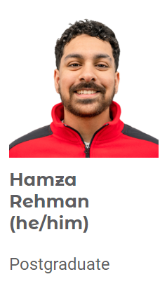
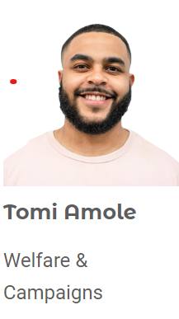
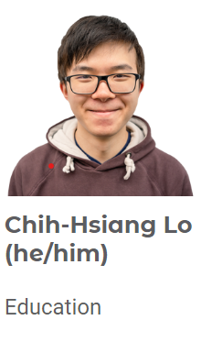
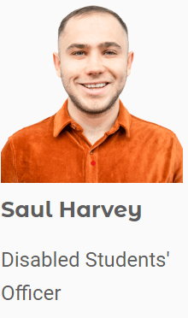
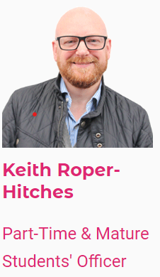
Some other relevant SU contacts

Slide 11
Over to you
How can staff support and amplify WP student voices?

Slide 12
Some of my suggestions
Effective representation
Utilising knowledge
Being active
As a WP staff member, being an effective representative of student concerns in the university.
Being approachable and knowledgeable about WP concerns.
Connecting your knowledge with students, especially on WP issues and experiences.
Using knowledge in WP-specific spaces, such as speaker panels for societies.
For non-WP students and staff, being an effective ally and raising concerns.
Hosting events for WP students to seek out their voices; looking at student research in the area.

Slide 13
A question…
How can students and bodies like the SU effectively support WP members of staff in return?
It’s an area we’d like to know more about!

Slide 14
A final question to address
How can WP-specific concerns be addressed where they are raised?
Note: The following section will include some scenarios and quotations which are emotionally sensitive or triggering, based on financial difficulties and fitting into university.

Slide 15
The problem: Some (anonymous) quotes
“A private school student told me that I would probably be unemployed after university because of my background”
“Some student in my seminar said to everyone that he thought that accent discrimination was perfectly ok in job applications. As someone with a strong accent, I felt uncomfortable”
“Nothing is affordable. I was rejected from hardship funding because I had some savings for after university, so I can’t survive now without working more hours a week”
“Honestly, I feel like this university doesn’t care about me at all beyond my money”

Slide 16
Some common scenarios
Financial difficulties, cannot afford rent and food on campus
Difficulties with finding people from similar backgrounds they feel comfortable with
Life outside of university is difficult and affecting studies
Are receiving discrimination from other students based on socioeconomic background, accent, personal circumstances, disability, etc.
Don’t feel comfortable talking about these issues; they do not feel understood or represented

Slide 17
Case Study 1
Student A is having a hard time adjusting to university.
They are the first in their family to go to university, so had no idea what to expect beforehand and are struggling.
They are finding it difficult to find a community of people like them, as a student from a working-class background. They cannot afford to attend events which societies are hosting.
They also have mentioned that they are receiving indirect discrimination because of their accent, and “unfairness” around them receiving the Warwick Bursary.
They are struggling with their essays, because they have had no guidance on essay writing and do not know where to go for help.
They have came to you because they are thinking of dropping out of university.

Slide 18
Case Study 2
Student B is having financial difficulties.
They are financially estranged from their parents, so do not receive any funding from their parents to help with university costs.
Their household income in the past year was £35,500, so they do not receive any of the bursaries. Their usual household income is £33,000, but their parents worked overtime to pay off debts that they had.
They were rejected from hardship funding because they have not completely used their overdraft, but have an overdue rent payment and their laptop has broken.
They are working an average of 20-30 hours a week now to get money that they need for maintenance, and have came to you because they are struggling to balance everything.

Slide 19
Case Study 3
Student C is having caring difficulties.
They are a mature student, and have two children to take care of while studying full-time.
They have to drop and pick up their children from school at designated times, so do not have total flexibility to attend lectures and seminars. They also find it difficult to complete assignments when there are multiple due at the same time, so rely on self-certifications.
They have come to you as their Personal Tutor as their mandatory workshop has been scheduled at the same time as when they would pick up their child from school.
They also have expressed a concern about three essays which are due on the same day, and are worried about completing all of these on time.

Slide 20
Reflection: Taking it forward
What will you take forward from this?

Slide 21
Any questions?
Thanks for listening!

