Slide 1


Drafting a Conference Proposal
Tips for crafting a successful conference presentation
28 November 2024

Slide 2
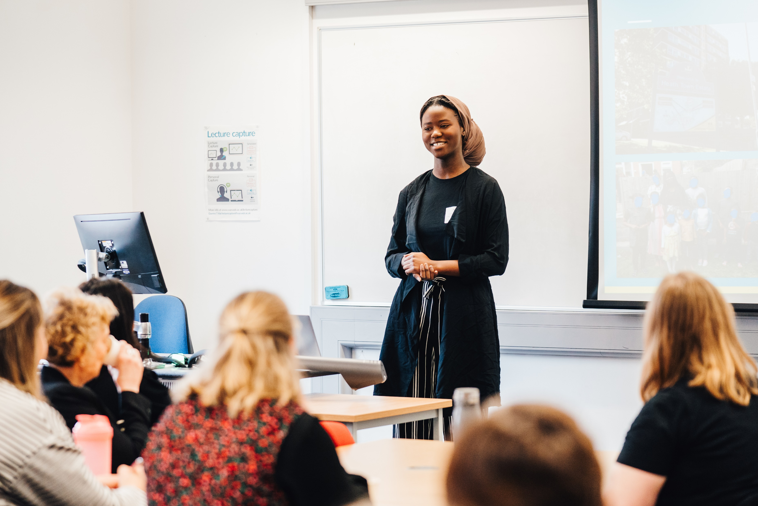
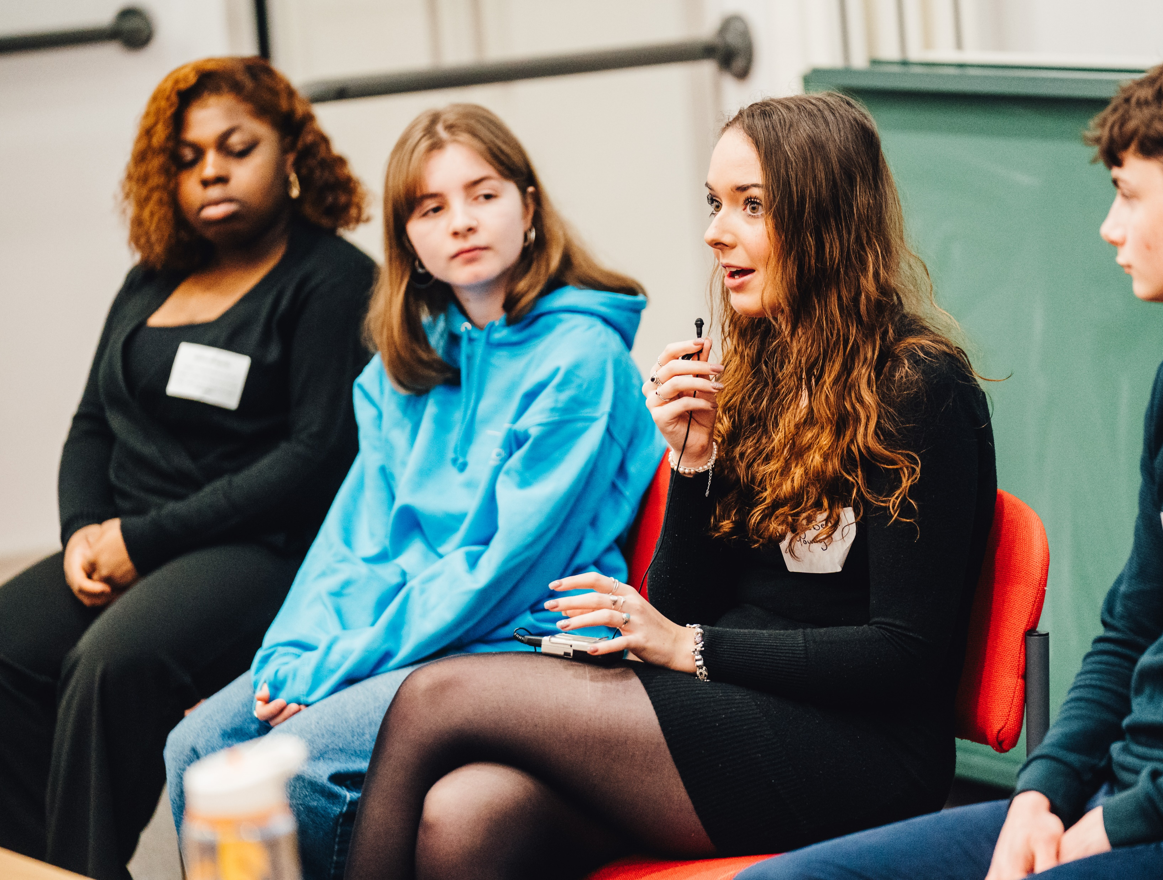
What’s the Widening Participation Conference?
Every year, the Widening Participation team hosts a student and staff-facing conference to share successes and challenges of Widening Participation work and student experiences at the University.
Students and staff provide session content for conference attendees, based on projects, interventions, and lived experiences.
This year, the theme of the conference is Widening Participation at Warwick: Past, Present, and Future, to help us reflect on WP work and look forward at new developments.

Slide 3

Types of proposals
Insight Talks (20 minutes)
Interactive Workshops (45 minutes)
Short talks that highlight a specific element of WP work or student journeys.
Can include slide presentations.
Should leave time for questions and answers.
Will be part of a set of talks (usually 2-3 are presented together).
An opportunity to deliver a longer session, covering a topic in more depth.
These should be interactive and include activities, reflection/ discussion time, or other means to engage attendees.
We can provide materials including things like flipchart paper and markers.

Slide 4
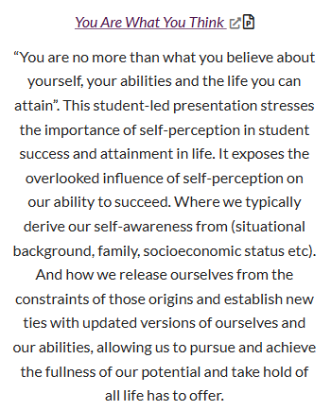
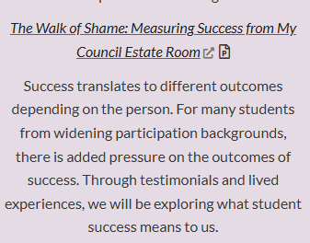

Examples of Insight Talks

Slide 5
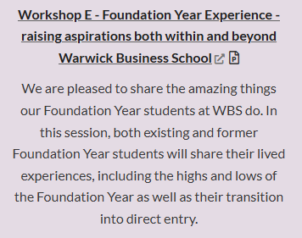
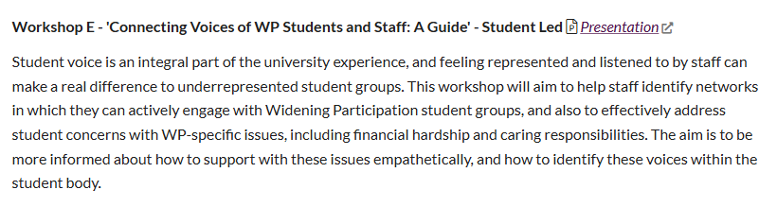
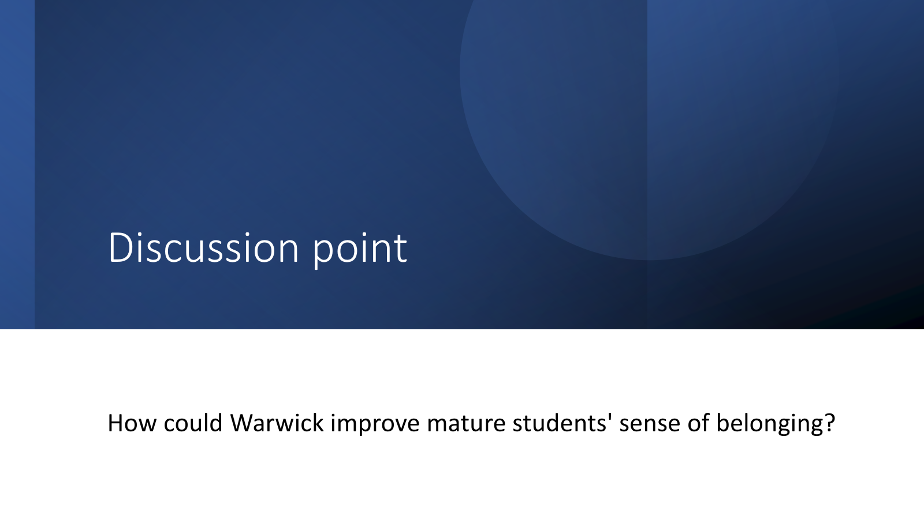
Examples of Interactive Workshops

Slide 6

What’s involved in writing a proposal?
You’ll need to fill in the session proposal form, which will ask you to include:
Which session type you want to run
Any additional speakers (students or staff) you will have
Title of your session
Short blurb (max 100 words) to feature in the programme
How the session will explore the conference theme
Resources you might need to run the session
If you’re successful, you will need to:
Put together slides to present on the day
Develop your interactive element
Attend the conference and present!

Slide 7

What should your proposal include?
Be sure your proposal addresses the conference theme and explores at least one element of WP work or experiences.
Consider sharing your own lived experience, if you feel comfortable doing so.
Use your own research, classwork, society/social experiences, or reflections you have as a student as a starting point for a session.
If you’re proposing an interactive workshop, be sure there are interactive elements.
100 words is short – use them wisely!
If you’re collaborating on a project or nervous to present on your own, submit a joint proposal with friends, classmates, other students, or staff members!

Slide 8
Tips for writing a proposal
Make your session title catchy and interesting
Ensure your proposal is clear and includes what you want attendees to get out of it
Propose a session on a topic you’re passionate about
Use data and evidence to back up your topic and consider multiple student experiences
Consider your audience: who is your session for
When in doubt, address the five W’s: who, what, where, when, why (and how)

Slide 9

Submission Logistics
You can submit your proposal on our website.
The deadline to apply is Friday 10 January 2025!
Look at previous year’s programmes to get a feel for sessions (including titles, short blurbs, and presentation slides).
If you need any support or have any questions, contact us at wpcommunity@warwick.ac.uk.

