Slide 1

Amanda Bishop
WP Faculty Coordinator

Slide 2
How do you get in to university?
Yr. 12 & 13
A-Levels or equivalent
Finding out about different subjects
Visiting different universities and looking at prospectuses
Yr. 10 & 11
GCSE – Maths & English (9-4)
Work experience
Hobbies & interests
Applying to up to 5 universities
Researching post-16 education/training
Subject choice
Looking further ahead
What subjects do you enjoy?
Yr. 7 -9
GCSE options choice

Slide 3




Who might go to university?
Only the most intelligent?
Only those whose families have lots of money?
Only the most boring, nerdy person?
Only those whose parents have been?
Anybody who wants to go can
That includes everybody in this room

Slide 4

Where can you go to university?
Almost anywhere - in the world…
Over 150 different universities in the UK
c. 50,000 different courses
Over 150 Higher Education colleges
New universities
Old universities
In the city
On a campus
By the sea
There’s a place out there that’s suitable for everybody
Notes:
Read off slide really...

Slide 5
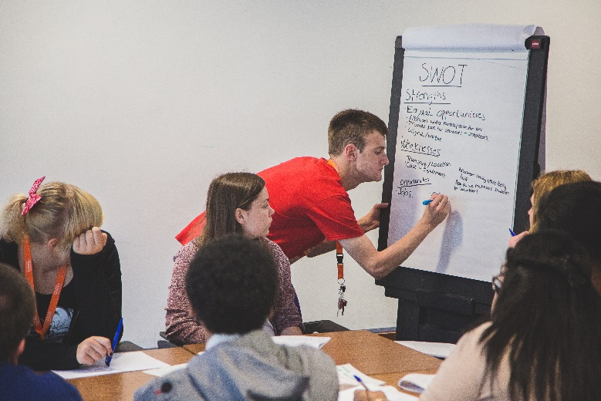

Why go to university?
To learn more about a subject you enjoy
To gain highly valued qualifications
To prepare for your career
To earn more money
To make new friends and do new things
To gain independence
Notes:
You can choose one or two subjects that you really enjoy – not just subjects you’re studying at school.
As you go into Year 10 you’ll start to have more choice over what you study. You’ll have to keep some subjects, like Maths, English and Science but others, like History, Geography and Drama are often optional so it’s worth starting to have a think about what you really enjoy and are good at.
Qualifications, career and money
Are there any jobs you’d like to do? Maybe you’d like to become a teacher, or an engineer, a lawyer or a journalist. or even run your own company!
You make lots of new friends, in your first few days at uni, it can seem a bit daunting but you quickly realise that nobody has any friends here and everyone is trying to make them!
Some people choose to move away from home to university – this means you have to learn to look after yourself and become a lot more independent

Slide 6
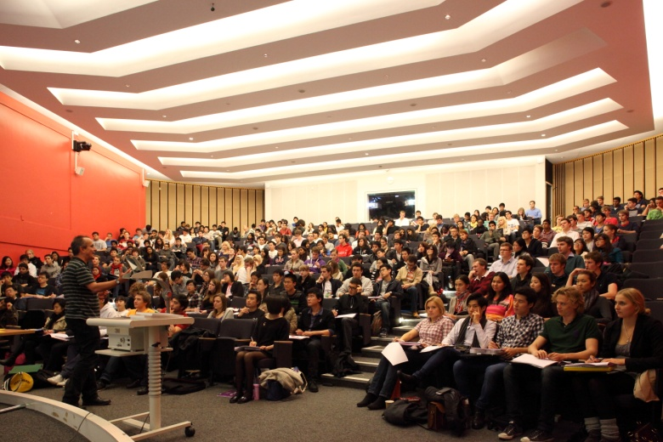
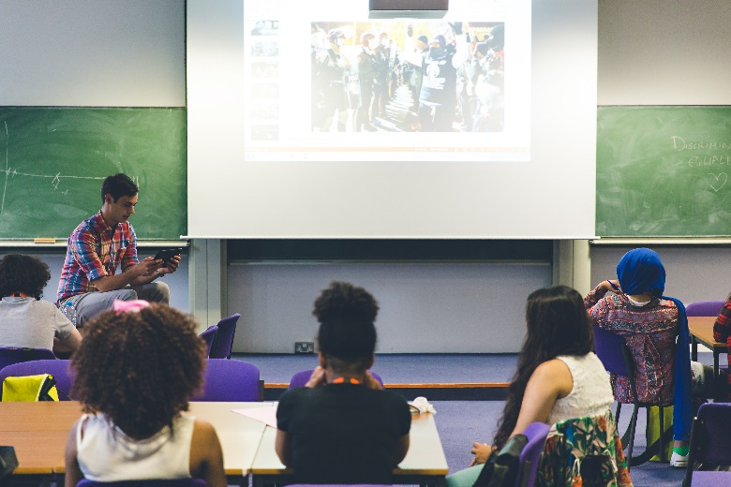
Academic work Typical Timetable
Q. How many hours do you think the average university student spends in class each week?
A. 10-15
Students have lots of ‘spare’ time
independent study
laundry, cooking, shopping, sleeping
social activities
sports
employment
Notes:
Students are often seen as being lazy! This is because they only have about 10 hours a day when they are actually in classes. However, the rest of the time they are actually very busy people.
A lot of university work is done outside of classes, in their own time, like reading in the library or writing essays and reports. As well as things like working to earn money, looking after themselves by cooking and doing laundry and taking part in social activities.

Slide 7
What’s life like as a student?
Social
Clubs and Societies
Sports
Chaplaincy
Study
Lectures
Tutorials
Making new friends
Independence
Independent Study
Planning your time
Experiencing new things
Working
Support and advice is available 24/7
Notes:
You can do almost anything you can think of through the university. University will help you develop in a lot of ways, it’s not just about learning your subject, it’s also about learning how to look after yourself and how to live independently.

Slide 8

Post It Notes
One question about University you would like to know…
Courses
Type of uni
Student life style
Location
Campus

Slide 9

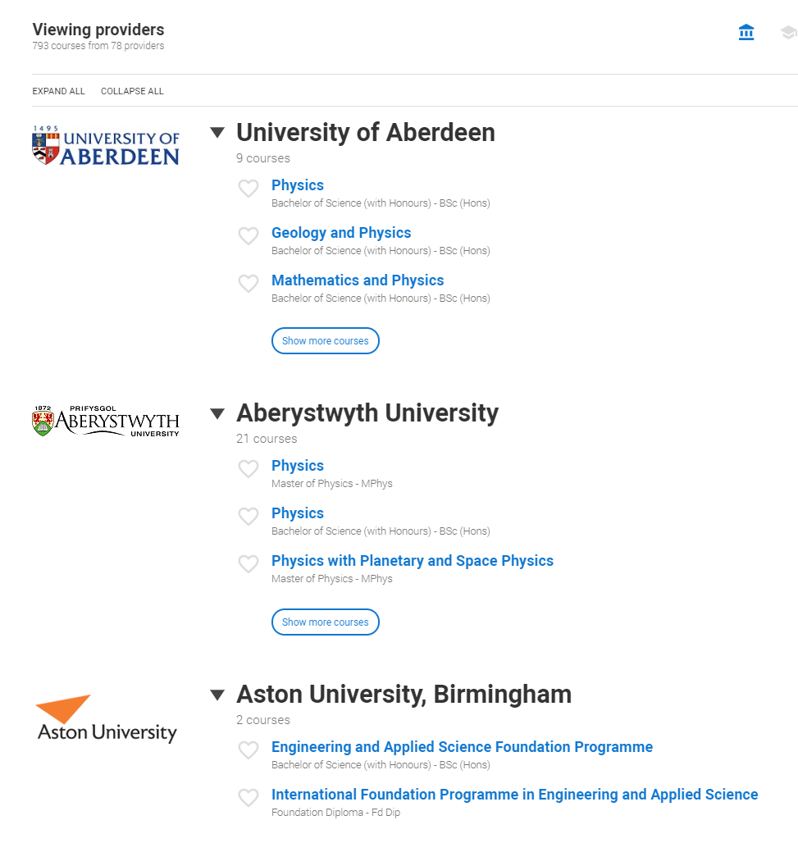
Courses
Over 50,000
A-Z Game……
Over to you.
You have 3 mins to list a course from A-Z

Slide 10

Ready, steady, go…….

Slide 11


Slide 12
What is a University? What is a campus? What do you find on a campus?

Slide 13
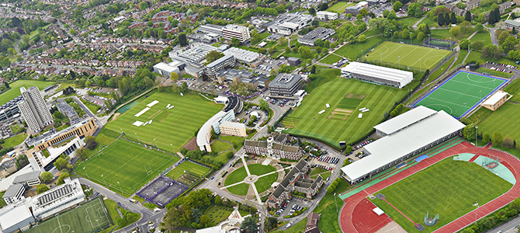
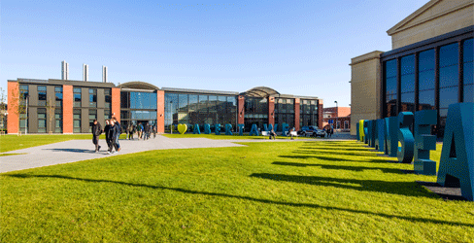
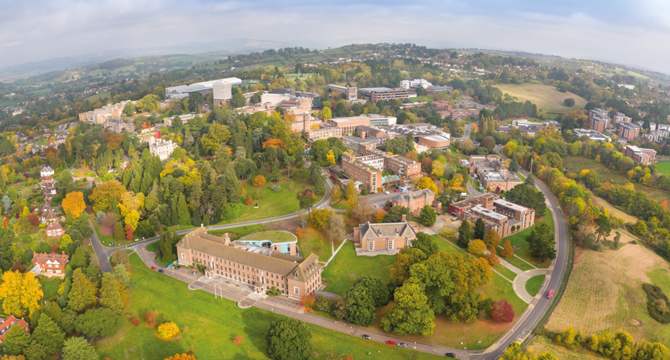
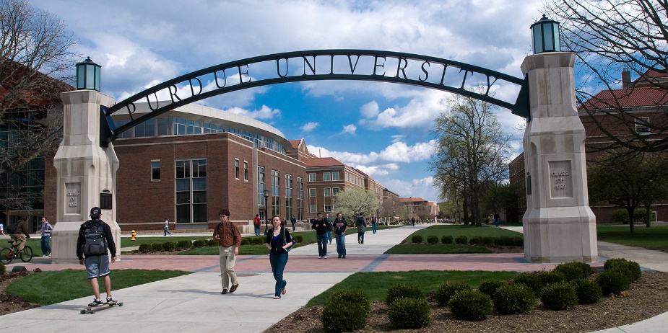
2050 – University of the Future
Notes:
Give them up to 10 mins on this, then ask them to feed back.

Slide 14
2050 – University of the Future
You are going to come up with what your University would look like…
It must include:
Name
Location
Building – which ones why?
What kind of study spaces?
Facilities
i.e. sport centre, social hub, games rooms, green space, Halls etc
Notes:
Give them up to 10 mins on this, then ask them to feed back.

Slide 15


Slide 16
2050 – University of the Future
Feedback
Notes:
Give them up to 10 mins on this, then ask them to feed back.

Slide 17

Our Ambassadors

Slide 18
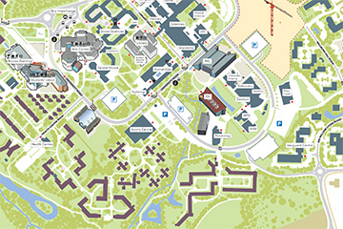
Campus Tour
You can join us for our Virtual Open Days here:
https://warwick.ac.uk/study/undergraduate/visits/opendays/

Slide 19
Questions
If you have any questions, please email the relevant University of your choice or if you have a general question, please ask your teacher.
If you want to speak to someone at Warwick, please feel free to email schools@warwick.ac.uk or look at our website.

