Slide 1

*SCHOOL NAME HERE*
Moving from Primary to Secondary School is an exciting, but sometimes scary time! A new building, new rules, new teachers, new routines and new friends are just some of the changes you will experience but this booklet will help you get used to some of the routines and features of your new school!
School image
School image
School logo

Slide 2

Draw a self portrait here.
Name:
Birthday:
My Primary School:
Eye Colour:
Hair Colour:
Height:
Favourite Colour
Favourite Animal
If I could have a superpower, I’d….
Favourite School Subject
Best place I’ve ever been to…
Dream country to visit…
If I could travel back in time, I’d go to…
My dream job is…

Slide 3



Life is a journey! Think back through primary school and write down your favourite memories or events that have shaped you to become the amazing person you are!

Slide 4
Full Name of the School
School Address
School Telephone Number
Name of the Head Teacher
School Starts at
School Finishes at
I will get to school by
How long will it take you to get to school?
What time will you have to leave home?
Add 10 words around the image below to describe your new school .
School image

Slide 5
List 4 things you are most excited about moving to *SCHOOL NAME*
List 4 things you are a little worried/nervous about
List 4 things you would like to know about *SCHOOL NAME*
List 4 things that will help you when moving to *SCHOOL NAME*
List 4 differences between your primary school and *SCHOOL NAME*

Slide 6
Find the subjects below in the Word search – they are vertical, horizontal and diagonal!
M | A | F | S | E | H | M | G | E | O | H | I | M | J | E | E | A
F | M | A | M | W | S | L | U | S | M | I | S | E | T | T | I | S
R | U | D | A | N | C | E | Z | S | A | C | P | N | U | H | A | I
A | F | G | T | R | D | P | W | R | I | I | A | G | T | I | N | U
H | S | R | H | P | G | R | T | E | N | C | I | T | O | C | A | O
J | T | A | S | L | U | B | N | Y | R | A | N | E | R | S | S | L
T | U | B | J | E | I | C | Q | L | E | R | M | X | T | A | S | S
E | E | A | U | H | E | M | U | A | H | S | U | D | I | N | E | P
N | F | X | L | G | E | O | G | R | A | P | H | Y | M | D | M | A
G | I | M | T | V | M | A | I | T | Y | E | O | A | E | M | B | N
L | O | A | I | I | O | T | O | H | R | T | T | S | C | O | L | I
I | P | T | E | E | L | G | R | D | U | O | E | R | A | R | Y | S
S | P | U | F | O | S | E | E | K | R | M | P | T | T | A | E | H
H | I | S | T | O | R | Y | S | C | S | A | S | M | E | L | R | A
E | N | J | V | E | P | I | F | J | N | O | M | U | R | S | B | K
J | K | C | A | T | E | R | I | N | G | C | N | A | R | P | U | M
Y | Z | X | T | L | S | V | Z | C | O | M | P | U | T | I | N | G
Maths
English
Science
Geography
History
Art
Music
PE
Drama
Dance
Textiles
Catering
Computing
Ethics and Morals
Spanish
Assembly
Tutor Time

Slide 7
















Match up the subject to the correct icon
Maths
English
Science
Geography
History
Art
Music
PE
Drama
Dance
Textiles
Catering
Computing
Ethics and Morals
Spanish
Tutor Time

Slide 8

 | Monday | Tuesday | Wednesday | Thursday | Friday
Tutor 08:30-08:50 |  | ASSEMBLY
Period 1 08:50-09:40 | MATHS TAS B4 | SCIENCE ECU D11 | ENGLISH JTR B10 | CATERING DMI D2 | PE LSA Hall
Period 2 09:40-10:30 | ENGLISH JTR B10 | MATHS TAS B4 | HISTORY ZCB D3 | CATERING DMI D2 | PE LSA Hall
BREAK 10:30-10:50
Period 3 10:50-11:40 | GEOGRAPHY SKO D9 | ENGLISH JTR B10 | ETHICS VDI A5 | ETHICS VDI A5 | MATHS TAS B4
Period 4 11:40-12:30 | SCIENCE ECU D11 | ENGLISH TOB LRC | MATHS TAS B4 | SCIENCE ECU D11 | GEOGRAPHY SKO D9
LUNCH 12:30-13:00
Period 5 13:00-13:50 | COMPUTING THU A3 | ART TMI B8 | DRAMA ARO Studio | ETHICS VDI A5 | ENGLISH JTR B10
Period 6 13:50-14:40 | SPANISH EFB B11 | TEXTILES DMI E3 | DANCE KWA Studio | MUSIC TMO E2 | HISTORY ZCB D3
Extra-Curricular 14:40-15:40 |  | DRAMA CLUB |  |  | FITNESS CLUB
What lesson do you have at 14:00 on Thursday?.......................................
What are the initials of your Geography teacher? ………………………..
How many minutes does each lesson last? …………………………………
How long is tutor time? …………………………………………………………..
How long is lunch and break combined? …………………………………...
Which room is PE in? ……………………………………………………………..
How many times a week do you have the following:
  Maths: ………………………………..
  English: ……………………………….
  History: ……………………………….
Which days will you need your PE kit (you will need it for dance as well) ………………………………………………………………………………
Who are your two English teachers? …………………………………………
Name all subjects in A block: …………………………………………………

Slide 9















At secondary school, you will be moving around to different classrooms for different lessons. You could be in 7 classrooms in one day. This means that you need to bring all the equipment you will require with you for the day. You can keep larger items such as your PE kit in your locker, however you can only go to your locker before school, at break and lunchtime and at the end of the day. Below are some items you will need to bring – can you identify them and add anything else?

Slide 10
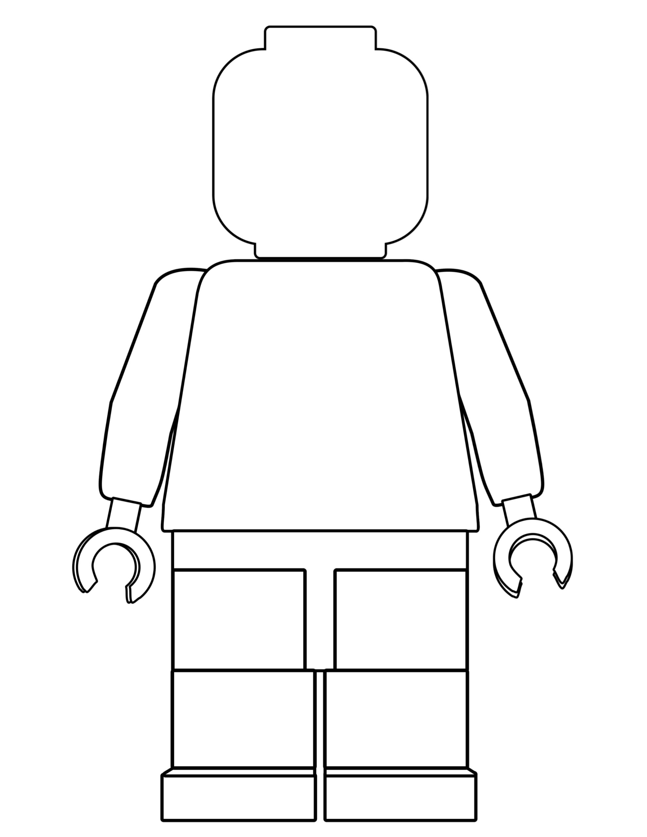
One of the different things about moving to secondary school is the change in what you will wear. At *SCHOOL NAME*, we pride ourselves in looking smart and professional at all times. Use the school website or the information booklet to draw and label the school uniform you will wear onto the Lego figure
Why is wearing the correct school uniform important?
…………………………………………………………………………………………………………………………………………………………………………………………………………………………………………………………………………………………………………………………………………………………………………………………………………………………………………

Slide 11
Getting to *SCHOOL NAME* safely is just as important as being there. In the box below, draw the route you are going to take to school (whether that’s walking, cycling, driving or by bus). Identify spots where there could be hazards (e.g. busy roads) and explain how you will manage this safely!

Slide 12

Our CPR Expectations Policy applies to the way we choose to conduct ourselves, the way that we behave towards other people, and the way that we behave in our lessons.
They are expectations, because we are expected to behave in this way; it is not a choice.
The expectation that we have is that we all behave in a way that means that we are calm, collected and respectful towards one another, and that we arrive for our lessons punctual and prepared.
Calm & Collected
Punctual & Prepared
Respectful & Responsible
CPR
Match the correct description to each letter of the CPR policy
Turning up on time to lessons
Working successfully as part of a team
Being respectful of other peoples beliefs
Having your shirt tucked in neatly
Contributing to lessons
High level of respect shown to all
Saying good morning to people as you pass
Supporting others
Holding the door open for a teacher
Having a pen, pencil and ruler in lesson
Consistent punctuality over the whole year
Helping with Breakfast Club
Turning up on time to lessons
Acting as an ambassador role
Going above and beyond with your work
Staying calm if something goes wrong
Being respectful to other staff and students
Sitting with someone who is alone at lunch
Apologising if you have done something hurtful
Turning up on time to lessons
Discussing issues with a teacher rather
Remembering your homework
Giving someone a compliment
Asking for help when needed

Slide 13

When you go to Secondary School, you will learn a huge number of new skills, and improve skills you have practiced in Primary School. In the goal below, use the list to write in 10 new skills or things you’d like to build on in your years at Secondary School.
Be in a school play or production | Speak another language | Represent your school in a national competition
Learn to play a musical instrument | Volunteer in the local community | Travel to another country
Play for a school team | Learn how to survive in the wild | Take care of the school garden
Learn how to manage money | Taste food from another country | Walk the school dog
Cook a new meal from scratch | Read new books | Take part in a fancy dress day
Create a piece of art | Raise money for charity | Become Head Boy or Girl
Learn how to read a map | Join an after school club | Learn to dance
Use computers to create your own website | Learn First Aid | Improve your singing
Make new friends from other schools | Work as part of a team | Try camping

Slide 14



After secondary school, you can move onto college or an apprenticeship and then to University or into a job! It’s normal not to know what you want to do yet but this is a chance for you to have a think about your dream jobs!
Icons to represent that job:
Icons to represent that job:
Icons to represent that job:

