Slide 1

WARWICK ACCESS PROGRAMMES
YOUR CHOICE, YOUR JOURNEY
Notes:
We are here to speak to you about Access programmes on offer at Warwick which are designed specifically to support you on your journey to university.

Slide 2
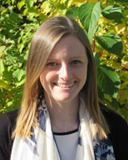
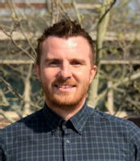
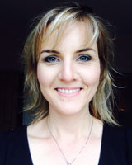






We are here to help – Our team
Laura
Paul
Marie
Jo
And our programmes

Slide 3
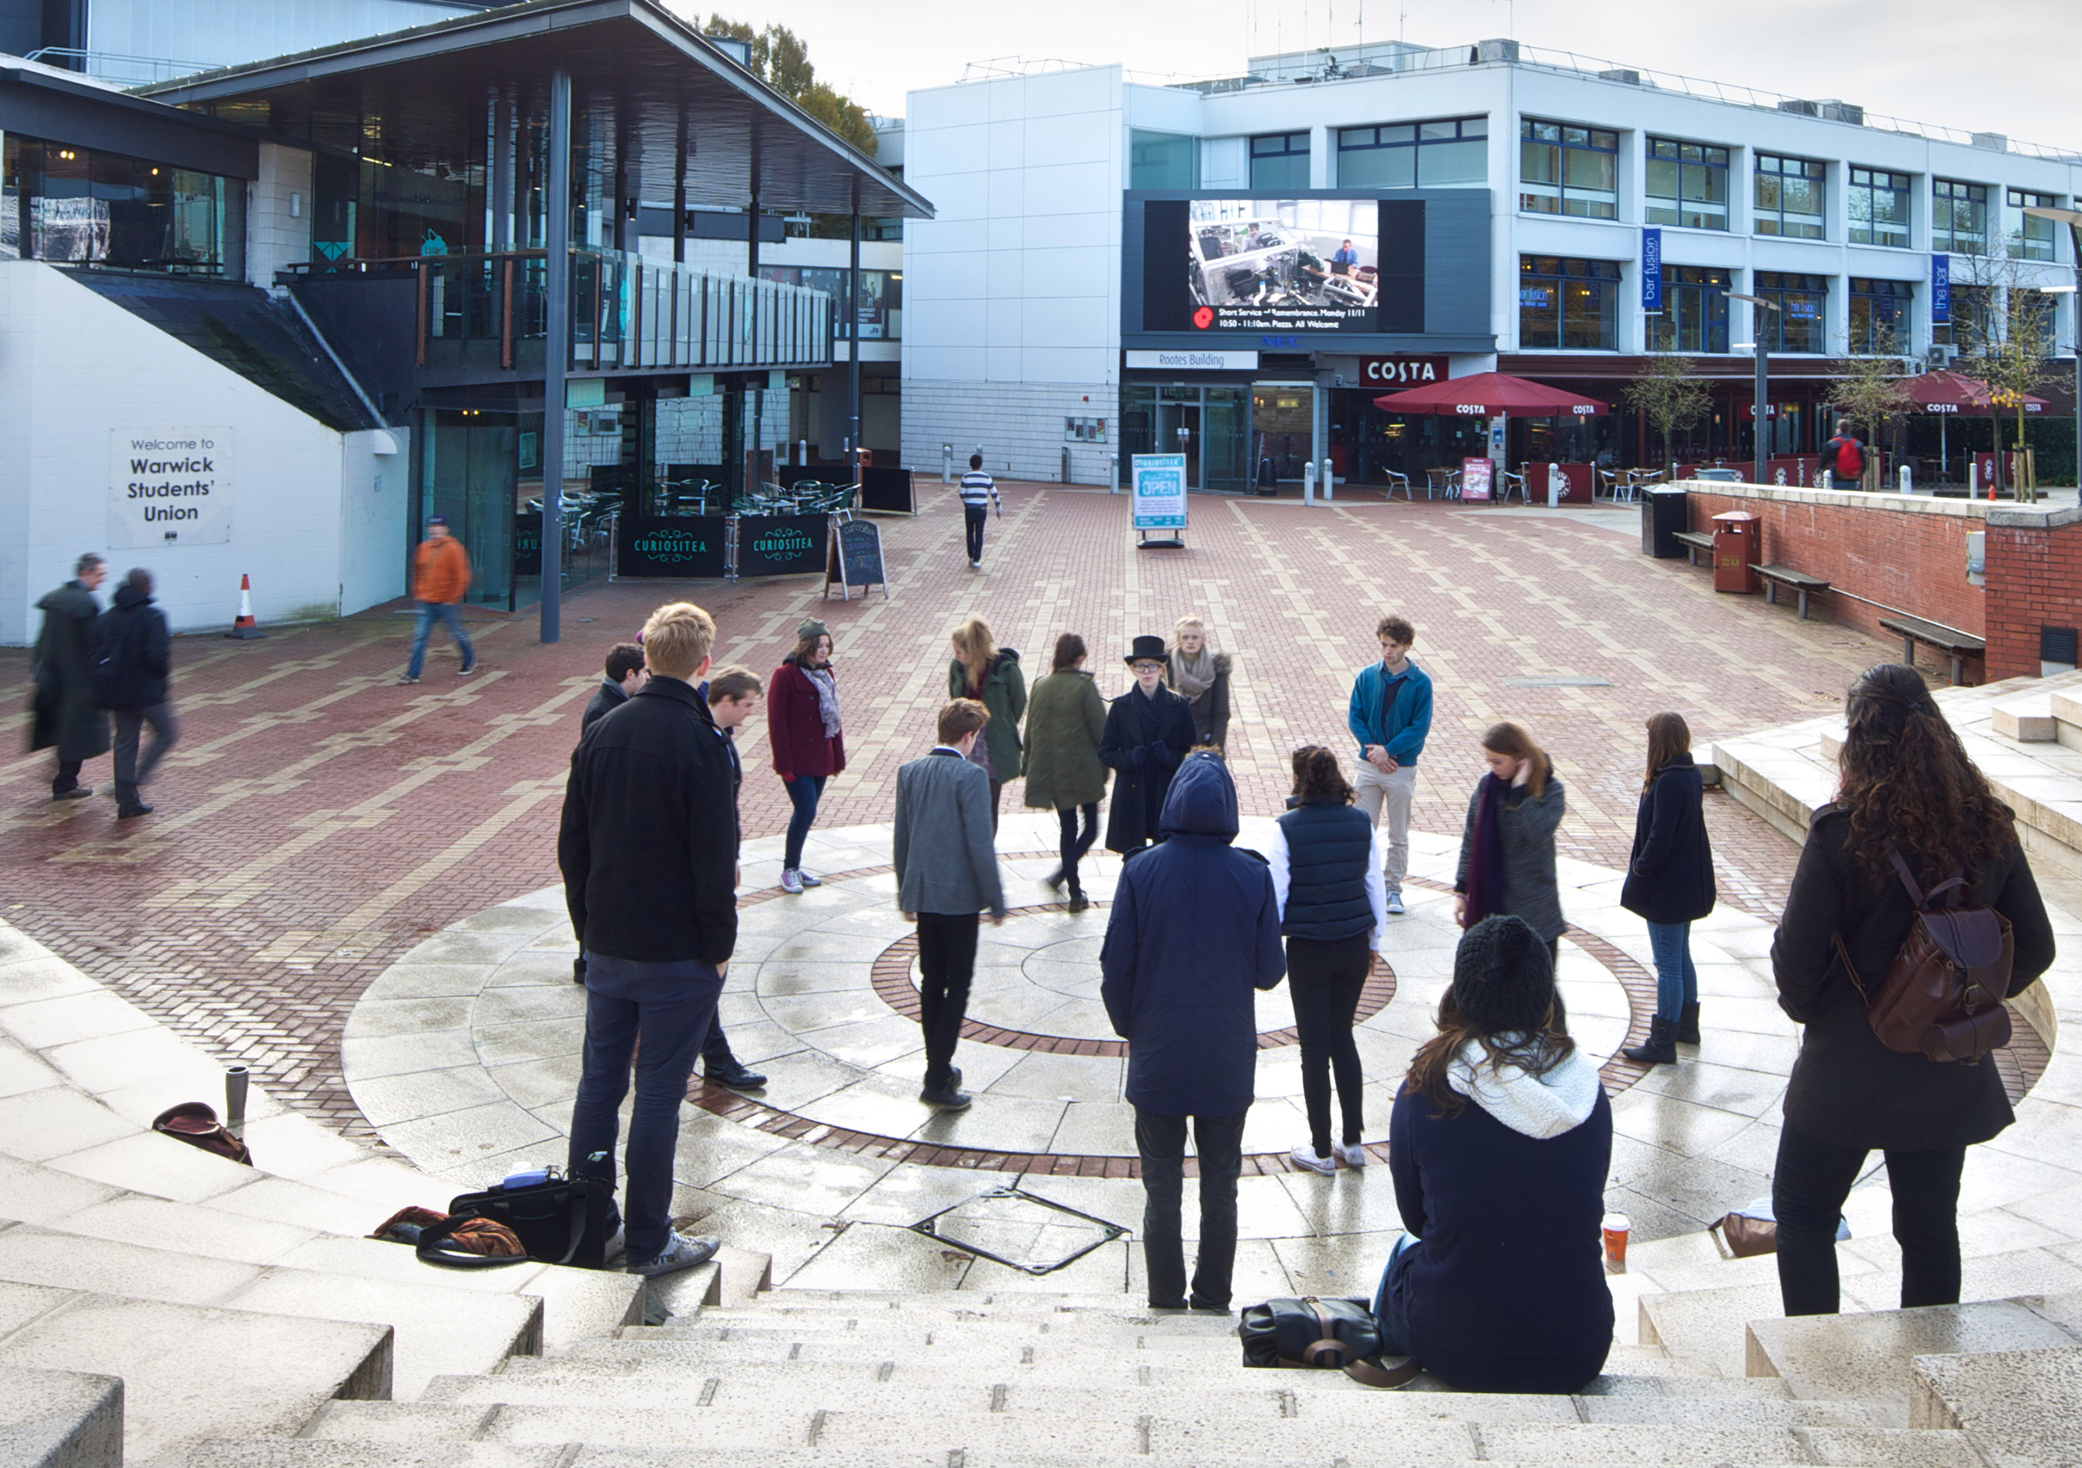
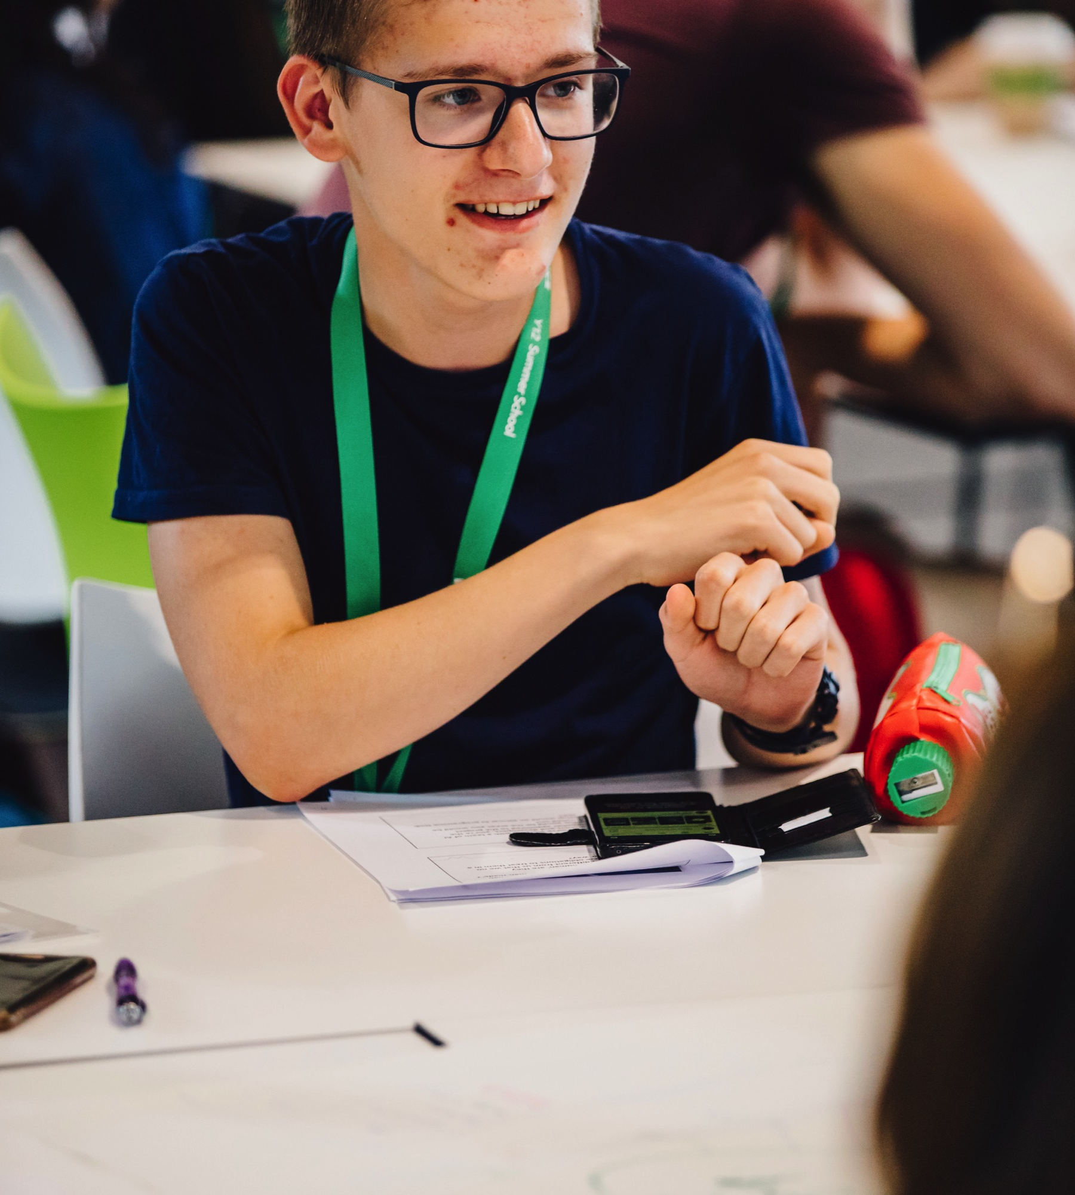


All of our programmes will give you…
Support with UCAS
Taster lectures
A feel for what it is like to be a student at university
New friends
Academic Skills

Slide 4
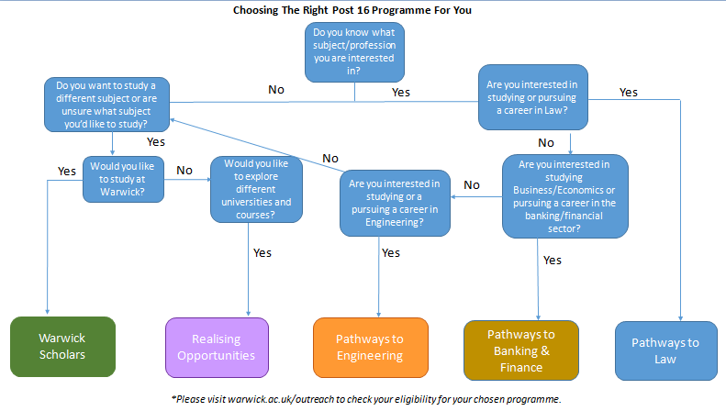

Slide 5



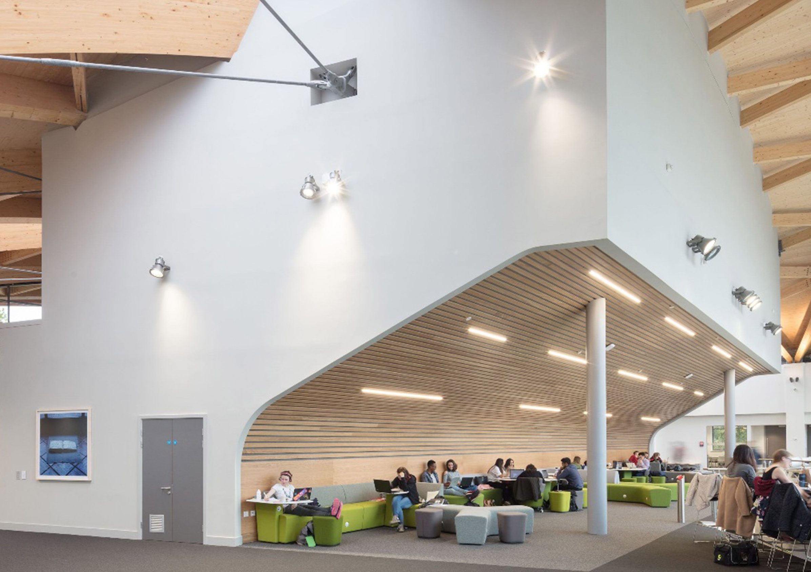
And on successful completion even more…
Special consideration
Enabling you to make informed choices
A reduced offer
The ability to apply for a £2000 bursary

Slide 6


Realising Opportunities

Slide 7


Should I apply?
http://www.realisingopportunities.ac.uk/prospective
Notes:
Explain that the aim is to encourage them to go study at the best university suited to them.
Explain the benefits of studying at a research intensive university: Experts with cutting edge facilities in a learning environment where teaching is research led with research carried out to solve problems in the wider world, or improve things! Students graduating from these universities are highly employable and sought by big companies like Microsoft, Google, Amazon, MI5…

Slide 8
How to apply?
www.realisingopportunities.co.uk/apply
Applications will open on 5th January 2021.
Let your head of sixth form know that you would like to apply and send us an email at ROWarwick@Warwick.ac.uk
We will send your school an application pack for you in early December

Slide 9
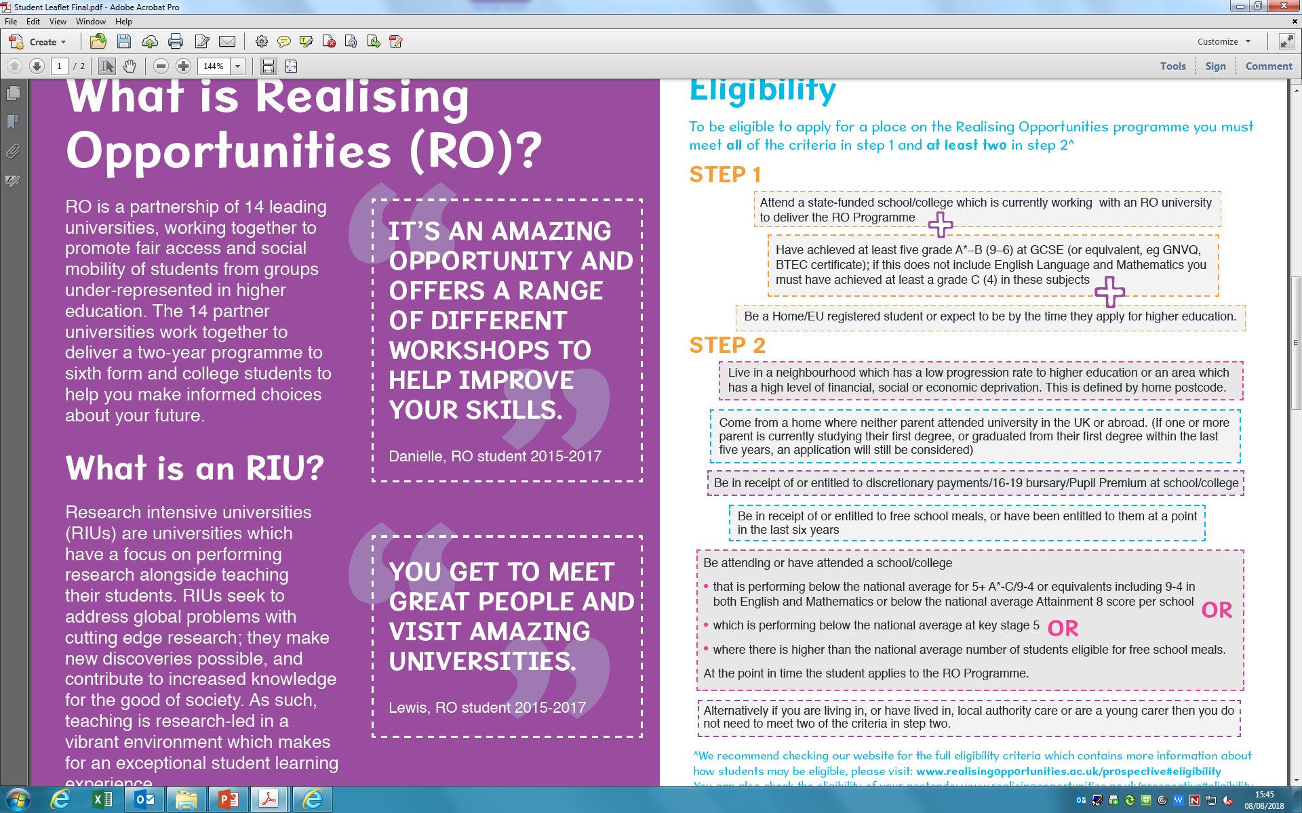

What RO students have to say…

Slide 10

Warwick Scholars
Be part of something

Slide 11
Should I apply?
Want to study at Warwick?
Would like to explore if Warwick is the place for you?
Notes:
At Warwick, we believe that access to a world-leading university should be open to people from all backgrounds. We are committed to supporting you, our local students, to reach your academic potential and join us at a university that offers a strong academic challenge through teaching and research excellence. A place that encourages you to search out what inspires and excites you.
Warwick Scholars is designed to help you to gain a place at Warwick by maximising your academic potential, developing skills that will help you to succeed here and providing insight and experience of what it will be like to study here.
Support doesn't stop once you enrol at Warwick - you will continue to be a Warwick Scholar throughout your studies and even after you graduate, giving you enhanced access to a wide range of additional opportunities.
Aims of the programme: Widening Access to Warwick
Supporting students to reach their full academic potential
Providing insight and experience of studying at Warwick
Developing skills that will help students to succeed at Warwick
Continued support throughout the degree programme
Membership of a community of Warwick Scholars
Investment in our local community

Slide 12


What does Warwick Scholars offer
Ongoing support from sixth form all the way to graduation
Specific subject support
Join the Warwick community from year 12
A typical Year 12 Programme | A typical Year 13 programme
Spring Term Subject taster day Applications open Summer Term UCAS workshop | Autumn Term Year 13 Residential Launch UCAS applications support Online mentoring Open Day support Spring Term Academic enrichment in your department 1:1 online A level tutoring A level revision bootcamp
Notes:
New friends: Becoming part of the University of Warwick community in year 12
4 years programme: Ongoing support – from arrival to graduation
Support to complement your post 16 studies
Year 12
Advice and guidance
UCAS support
Academic insight
Study skills
Year 13
1:1 online tuition
Revision support

Slide 13
Specific benefits to Warwick Scholars:
A real flavour of what it is like to be a student at Warwick
Meeting with Warwick students
If you fully engage with the programme, you will be guaranteed an offer from Warwick which will include a grade reduction of between 2 to 4 A-level grades, alongside a 50% tuition fee discount.
Notes:
Successful applicants who complete all elements of Warwick Scholars will receive
A guaranteed offer of 2-4 grades below the standard admissions offer
50% tuition fee discount per year
Access to a means-tested bursary of £2,000 per year

Slide 14
How to apply
Applications will open in April.
You will need to nominate a teacher to support your application
You will also need to write a short personal statement.
It will be an online form and you will need to provide us with your GCSE results and A-level predictions

Slide 15
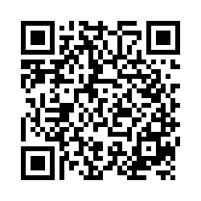
How can I find out more?
Compare our programmes:
https://warwick.co1.qualtrics.com/jfe/form/SV_57qxPCV1JOx1F7n
Visit our website
Visit the RO website
https://warwick.ac.uk/study/outreach/whatweoffer/warwickscholars/
http://www.realisingopportunities.ac.uk/
Notes:
Find out more on our website, in our brochures or in the online tool that your teacher will send you following this talk.

Slide 16
Applications will open:
Realising Opportunities January 5th 2021
Warwick Scholars in April 2021
Any questions email us at
post16@warwick.ac.uk

