Slide 1
When is an aircraft safe and defect free?
Researchers: ADI, KOMALPREET, FORTINA

Slide 2
Introduction
The definition of defect according to Non-Destructive Testing, written by R. Halmshaw is “the term ‘defect’ signifies that the material… is defective or unserviceable”
Aircrafts are safety critical and this testing can determine whether they are allowed to fly.

Slide 3

Proof Testing
The first type of testing is proof testing (destructive).
The material can be tested to its limits, allowing for the introduction of defects, this can give the manufactures an insight of the amount of load/stress a particular material can handle.
Often the worst case scenario is considered
Examples: Bending wings, Ingestion tests: birds and water etc, (K Moskvitch, 2014)
However this is not the only the only type of testing.

Slide 4
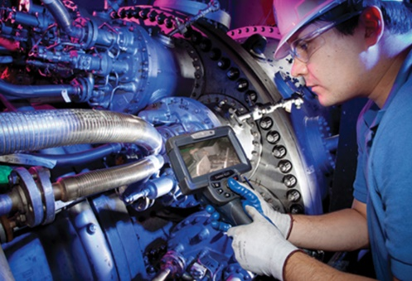
Non-Destructive Testing
Non destructive testing is a method of testing used pre and post flights to check the upkeep of the structural integrity of the aircraft
This testing, as is said in its name, is not destructive, the components tested are available for continued use after: the test itself does not affect the component as a proof test would
Examples of NDT are, radiography, ultrasonics, eddy current, and visual tests.
These tests, unlike proof testing, no longer check the tolerances of stress in components, but now check for defects within components.
However, NDT is not fool proof, it can have errors and therefore the reliability of the tests must also be checked.
(ASNT News)
An example of a visual test from ‘Aviation Week’

Slide 5
Reliability
Reliability → describes the overall level of achievement of a particular inspection measured against the aims of the inspection. (R.W.Nichols,1992)
Even though non destructive testing techniques can be used to detect a majority of the flaws in certain materials , there is also the possibility that a given flaw will not always be detected
Therefore it is equally as important that there are studies on probabilities and reliabilities of certain testing methods (R.Halmshaw,1987)
For example there could be wrongly detected flaws for materials that aren’t really flawed at all or flaws that are not detected at all.

Slide 6
Conclusion: When is ‘good’ good enough?
We have discussed multiple methods of testing in this presentation, but when is it safe to use?
This is a broad and subjective topic but a general answer can be given. Within our research we have learned of the extensive testing methods that aircraft manufacturers employ to test the materials and components within their aircraft.
However we have also discussed the fact that no test is 100% reliable and so the tests can lead to false positives and danger, but only rarely.
A bigger issue is the fact that aircraft manufacturers do not use a concept of no expense spared and they look to make a profit.
The larger companies have their reputation on the line and must employ the cheapest but most effective method of testing for flaws. They will not spend as much money as possible using every test available, and as the most marketable test is radiography, (Non-Destructive Testing-current capabilities and future directions by P Cawley) and most aircrafts do not regularly fall out the sky, we believe it may be said that modern safety standards are enough to determine when an aircraft is safe.
In the future efforts could be made to find more efficient, reliable, and cheap methods of testing than those which are employed today, such as recent developments that ultrasonic are actually safer, and possibly cheaper. (Non-Destructive Testing-current capabilities and future directions by P Cawley)

Slide 7
References:
Non-Destructive Testing, written by R. Halmshaw
(K Moskvitch, 2014)
(ASNT News)
(R.W.Nichols,1992)
(R.Halmshaw,1987)
(Non-Destructive Testing-current capabilities and future directions by P Cawley)

