Slide 1

Warwick Access Programmes

Slide 2
Our access programmes
Benefits of working with us
Eligibility criteria
Pathways to the Professions
Realising Opportunities (RO)
Warwick Scholars

Slide 3

Our Programmes
01

Slide 4








Access Programmes
Pathways to the Professions
Realising Opportunities
Warwick Scholars
Notes:
All programmes begin in Year 12 and finish in year 13
RO and Pathways recruit begin early in year 12
Warwick Scholars begins summer of Year 12

Slide 5
Which programme is for me?
No
Do you know which subject or profession you are interested in?
Yes
Are you interested in perusing a career in law?
Do you want to study a different subject, or are you unsure what to study?
No
Yes
Are you interested in studying business or economics, or perusing a career in the banking or finance sector?
No
Do you want to study at the University of Warwick?
Would you like to explore courses and universities?
No
No
Are you interested in perusing a career in engineering?
Yes
Yes
Yes
Yes
Warwick Scholars
Realising Opportunities
Pathways to Engineering
Pathways to Banking & Finance
Pathways to Law

Slide 6
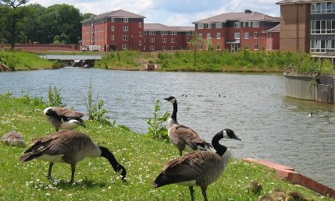

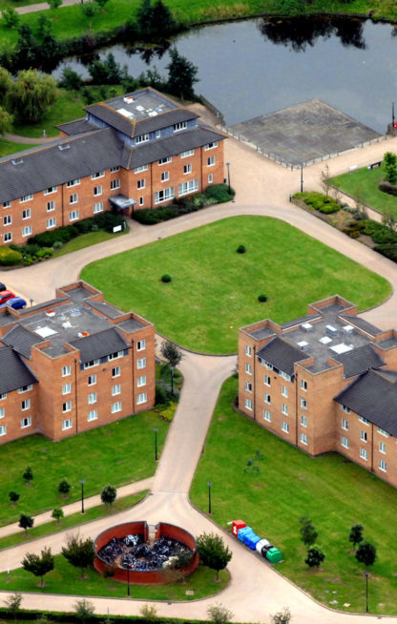
All our programmes provide…
Taster lectures
Support with UCAS
The opportunity to make new friends
Academic skills
Transferable life skills
A feel for what university life is like
The opportunity to talk to current students
A chance to explore the University of Warwick
Online content, support and guidance

Slide 7

On completion
Having successfully completed the programme you are
You are eligible to receive an alternative offer at Warwick
You’re able to apply for a £2,000 bursary
You’re able to make informed choices regarding what’s next for you
You have met new friends and engaged with the academics, students and Warwick community
You have new skills and experiences for your CV and personal statement
You’re more confident in yourself and your next steps

Slide 8
Eligibility Criteria
02

Slide 9
Eligibility Criteria
All programmes have similar eligibility criteria, some may very slightly if they are in partnership with an external charity.
Essential Criteria
Additional Criteria
You do not need to meet all the below, however the more criteria you meet the more likely you are to gain a pace.
Attend a state funded school / college
Studying in Year 12
Be eligible for Home UK fee status
Academic Criteria:
Achieved at least five GCSEs at grades 9-6
If this doesn’t include Maths / English Language, at least a 4 in those subjects
Live in a neighbourhood with a low rate of progression to higher education and/or a high level of socio-economic deprivation.
Would be in the first generation of your family to attend university.
Be in receipt of, or entitled to, discretionary payments/16-19 bursary at school/college
Have been in receipt of Free School Meals whilst at secondary school.
Be living in/have lived in local authority care, be a young carer, or are estranged/living independently from your family.

Slide 10
Pathways to the Professions Pathways to Banking & Finance Pathways to Engineering Pathways to Law
03

Slide 11
Are you interested in studying Business, Economics, Law or Engineering? Are you interested in a career in the financial, legal or engineering sectors? If so, Pathways to the Professions is the programme for you.

Slide 12
What are the Pathways programmes?
A 2-year programme working in partnership with the Sutton Trust, other universities and employers to offer you…
On and off-campus events
Work experience placements
Insight days and trips to employers
CV and personal statement support
Networking with employers
Mentoring
A 2-night residential event with students on Pathways programmes nationally
Access to Sutton Trust Online
On successful completion of the programme you may be eligible for a reduced offer of up to 2 A-level grades lower when applying to Warwick, along with other alternative offers at other Pathways universities.

Slide 13
The Pathways Programme
Year 12
Year 13
Autumn Term
Launch event
Spring Term
CV support mentoring
Sector Day
Work experience placements
Academic Taster Day
Summer Term
Mentoring
Work experience placements
Personal statement and LNAT events
National Conference (Residential)
Insight Days and trips
Webinars
Autumn Term
Relaunch event – Mock assessment centre
Spring Term
External events
A-level Bootcamp
Programme graduation

Slide 14
Pathways to the Professions
Pathways to Banking & Finance
Pathways to Engineering
Pathways to Law
University Partners: University of Warwick, University of Leicester, London School of Economics, University of Liverpool
2024/25 Work experience placement examples: Metro Bank, Bank of New York, Bank of England
Examples of trips to employers: Deutsche Bank, Coventry Building Society, JLR
University Partners: University of Warwick, University of Liverpool,
Cardiff University
2024/25 Work experience placement examples: Mercedes AMG F1, Ramboll, Tilbury Douglass
Examples of trips to employers: Mercedes AMG F1, British Airways, Tilbury Douglass
University Partners: University of Warwick, University of Leeds,
London School of Economics
Queen Mary University
University of Exeter
Cardiff University
2024/25 Work experience placement examples: Crown Prosecution Service, Ministry of Justice, Environmental Agency, Boult,
Examples of trips to employers: The Inner Temple
Note: Work experience placement partners are subject to change and placements or trips with specific employers cannot be guaranteed.

Slide 15

Pathways to the Professions
How do I apply?
Visit our website to find out more:
https://warwick.ac.uk/study/outreach/whatweoffer/post-16-programmes/wap/
Apply via the Sutton Trust website:
https://pathways.suttontrust.com/
Applications are open now
Applications close Monday 27th October 2025

Slide 16
Realising Opportunities
04

Slide 17
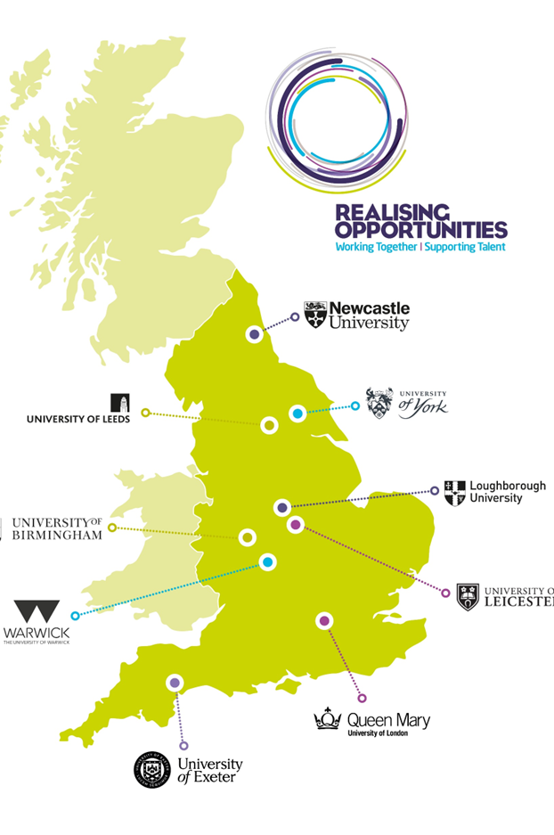
Realising Opportunities
Overview
1 Programme
9 Research Intensive universities
Over 6,000 courses
There are three compulsory elements of the programme to successfully complete RO:
Attend at least two RO events/activities
Pass the skills4uni online multiple choice quiz
Complete the RO Academic Skills Module (ASM)

Slide 18
Realising Opportunities
What are Research Intensive Universities?
The RO Partner universities are all RIUs which means they have:
Leading academics and tutors who are experts in their field
Vibrant learning environments where new discoveries are being made
Cutting edge facilities thanks to investment associated with research
Top careers guidance and strong links with business
World-renowned reputations which are highly valued by employers

Slide 19








Realising Opportunities Programme Benefits
Alternative offers from the RO Partners universities, which are typically two grades lower than the standard offer
Additional consideration when you make applications to RO Partner universities through UCAS
Develop your skills in analysis, critical thinking, evaluation and research through taking the RO Academic Skills Module (ASM)
Online support through a variety of resources, including online sessions, speaking to the RO Ambassador, and speaking to current students at our Partner universities at events.
Experiences and support to help you make an informed choice about higher education and research-intensive universities
A virtual National Student Conference where you will get a chance to meet others from across the country taking part in RO and representatives from all the RO Partner universities
A Launch event with your host university to celebrate your place on the RO programme, get you started, and meet university representatives
skills4uni – An online study skills challenge and multiple choice quiz which will help you develop your planning and independent research skills

Slide 20

Realising Opportunities Support

Slide 21

Realising Opportunities
How do I apply?
Check the eligibility criteria on our website, you can check your post code eligibility by visiting the RO website.
Ask the RO contact at your school or college for the Student Application Key for your school.
Go to realisingopportunities.co.uk/apply to enter the Student Application Key and complete your application form.
Ask your parent/carer to complete the online parent/carer permissions form which will be sent to their email address once you have submitted your application.

Slide 22
Realising Opportunities
Key dates and events
October
Student application deadline
November
Parent/carer permission forms and teacher references deadline
January
RO launch at the University of Warwick
TBC
National Student Conference
Academic Skills Module
To find out more visit www.realisingopportunities.ac.uk

Slide 23
Warwick Scholars
05

Slide 24
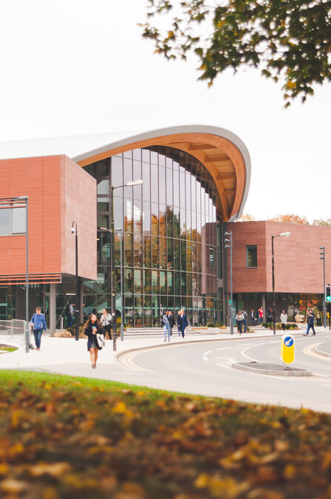
Warwick Scholars
What is Warwick Scholars?
Widening access to University of Warwick
Supporting students to reach their full academic potential
Providing insight and experience of studying at Warwick
Developing skills that will help students succeed
Continued support throughout the degree programme
Membership of the Warwick Scholars community

Slide 25
Warwick Scholars
What is involved?
Residential launch event
Support to attend our open days
UCAS application support
Mentoring from a UG Warwick Scholar
1-1 online tuition
Opportunities with departments and revision
Student Finance information and guidance
Revision support*

Slide 26

Warwick Scholars
What support do you receive?
Support from enrolment to graduation and beyond
Dedicated Warwick Scholars Team contact
Exclusive opportunities
Additional consideration for existing opportunities
Removing barriers
Making the most of university

Slide 27

Warwick Scholars
Current Benefits
Receive support from a dedicated contact and team at the University
Mentoring from a current undergraduate student
Tutoring in one A Level subject
On successful completion of all elements of the Warwick Scholars programme, applicants will receive:
A guaranteed offer of 2-4 grades below the standard admissions offer
50% tuition fee discount per year of study
Access to a bursary of up to £2000 per year of study
Receive support from a dedicated contact and team at the University
Mentoring from a current undergraduate student
Tutoring in one A Level subject
On successful completion of all elements of the Warwick Scholars programme, applicants will receive:
A guaranteed offer of 2-4 grades below the standard admissions offer
50% tuition fee discount per year of study
Access to a bursary of up to £2000 per year of study

Slide 28
Warwick Scholars
How to apply
Applications will open Spring 2026
You can be on Pathways or Realising Opportunities as well as Warwick Scholars
Complete the online application form – including all relevant information
You will need to provide some personal details, your GCSE results and information about your parent/carers’ education
You will need to nominate a teacher to support your application and provide your A Level predicted grades (make sure you check with them first as we can’t process your application without this!)
Finally, on the application form you will need to write a short personal statement (approx. 250 words)

Slide 29
Warwick Access Programmes
FAQ’s
Can I apply for any course at Warwick? YES, any UG course. We are particularly interested in applications for Arts/Humanities courses
If accepted onto Warwick Scholars do I still apply on UCAS? YES – you apply as normal via UCAS.
Is the offer unconditional? No – it is conditional on you completing the programme and getting the required grades
What if I get accepted onto Warwick Scholars, then decide I don’t want to come to Warwick? You will remain on the programme until you stop engaging or no longer have an active application with Warwick e.g. don’t apply, don’t accept the offer, are unsuccessful or apply for a non-guaranteed course
What is the time commitment? Attendance at a Warwick Scholars residential launch, 1 hour a week for 10 weeks of tutoring, 1 evening mentor launch, 30 minutes…ish a month mentoring and an optional revision bootcamp
Can I apply for deferred entry? Yes – You can apply for deferred entry by 1 year at the discretion of the department
Can I reapply as a Warwick Scholar in a future UCAS cycle? NO – Your Warwick Scholars offer is only for one UCAS cycle.

Slide 30
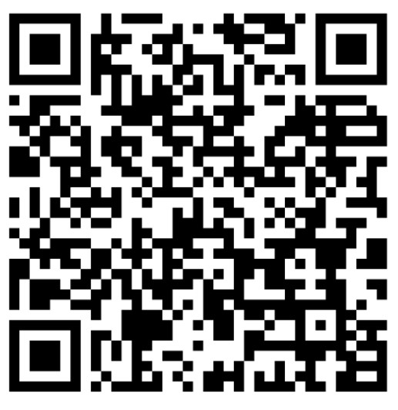
Where can I find information on programmes, eligibility criteria and application forms?
Scan the QR code or visit the website below:
warwick.ac.uk/study/outreach/whatweoffer/post-16-programmes/wap/
Have further questions? Email us!
post16@warwick.ac.uk

Slide 31
Thank you. Any questions?

