Slide 1

Analytics in support of management decision-making:
data and people
Dr Eleanor Reynolds
July 2026

Slide 2


Dr Eleanor Reynolds
Assistant Professor (Teaching Focused)
BSc, MSc, PhD, AFHEA, WIHEA fellow
WBS BSc Management Science (1999-2002)
WBS MSc Business Analytics and Consulting (2011-2014)
WBS PhD “Discovering Everyday Problem Structuring” (2015-2023)
Severn Trent Water (2003-2015)
“like the head of a hydra” (crayon on sugar paper, 2023)

Slide 3

Typical module delivery approach
Complete weekly tasks before the lecture
Attend lecture
Attend seminar
Review weekly summary

Slide 4

Structure of today’s session
Lecture content:
What might an analytics intervention look like?
How do we determine what questions our analysis should answer?
What can we deliver with different analytic approaches?
Seminar content:
Evaluating real case examples

Slide 5

What might an analytics intervention look like?

Slide 6

Analytics
Methods and models to support decision-makers
Reasoned statement of options and consequences
Multimethodological approach – i.e. combining methods and models
Rational, systematic approach to decision-making

Slide 7

Multimethodology in OR interventions
Multimethodology is concerned with intervention design
People (agents)
Situation
(problem context)
Methodologies
(tools)
Three key aspects to consider
(adapted from Mingers, 2001)

Slide 8
CRISP-DM

Slide 9
Data (1 of 2)
Surveys
Interviews
Focus groups
Primary
  Data / information you’ve collected yourself
  Internally produced data
Secondary
  Data / information from someone else
  Published material
Sales or production data
Internal performance measures
Social media
News articles
Annual reports
Analyst reports
Customer groups

Slide 10
Data (2 of 2)
Objective
Subjective
Report on annual changes in staff satisfaction survey results
Survey on use of next day delivery services
Primary
Interviews with general public on pain relief preferences
Time series data showing sales volumes to UK retailers
Social media-based focus group on knife crime
Social media references to musical genre
Corpus analysis of journalistic attitudes toward the UK monarchy
Secondary
Collation of historical data on regional temperatures
Industry-wide collation of financial performance metrics
Expert-led report on the future of social media

Slide 11
Analytics is more than code and hard sums
If I had an hour to solve a problem, I’d spend 55 minutes thinking about the problem, and 5 minutes thinking about the solution.
Albert Einstein (allegedly)

Slide 12
CRISP-DM

Slide 13
CRISP-DM
Intervention design
People (agents)
Situation
(problem context)
Methodologies
(tools)

Slide 14
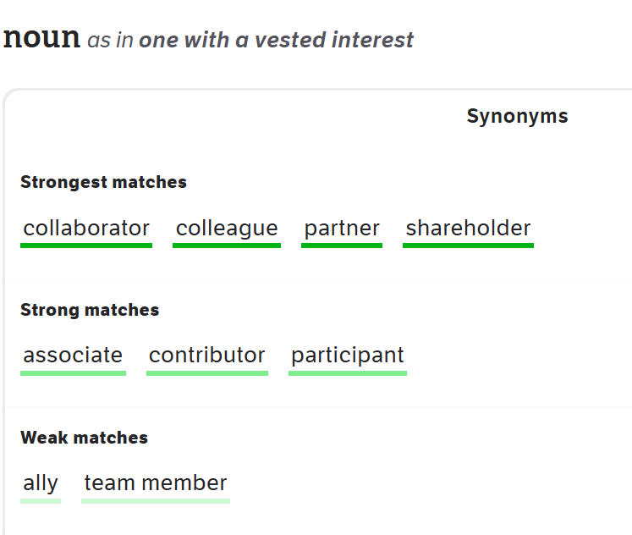
People… or stakeholders…
9 Synonyms & Antonyms for STAKEHOLDERS | Thesaurus.com
[accessed 17 July 2025]

Slide 15
What might an analytics intervention look like?
Engaging with stakeholders and data to understand the business problem…
… using a carefully planned sequence of methods and models…
… to establish a reasoned statement of options and consequences…
… that provide a rational, systematic approach to supporting decision-makers

Slide 16
How do we determine what questions our analysis should answer?

Slide 17
Understanding the business
Business problem
Analytics problem
( )
Analytics toolkit

Slide 18
Understanding the business
CRISP-DM excerpt
evaluation
onward activity flow
Business problem
Analytics problem
( )
Analytics toolkit

Slide 19
Business vs Analytics problems: what’s the difference?
Business Problems
Expressed in the language of the business
May initially be vague and poorly specified
Typically require context to fully define and understand
Analytics Problems
(Ideally) expressed in the language of the modelling approach
Need to be precise and well specified
Typically Must incorporate the required context
Analytics projects are negotiated with stakeholders

Slide 20
From business problem to analytics problem
divergent
convergent
divergent
convergent
business problem framing
analytic solution space
discovery
definition
delivery
development

Slide 21
Problem framing (or problem-setting) is…
“a deliberate and conscious process in which we choose what to study but which is guided by frames that may be unconsciously or subconsciously applied.”
“a frame or framework enables us to see some things and to miss or ignore others.”
(Pidd, 2009, p52)

Slide 22
Play video
https://www.youtube.com/watch?v=F-TyPfYMDK8

Slide 23
From business problem to analytics problem
divergent
convergent
divergent
convergent
business problem framing
analytic
solution space
discovery
definition
delivery
development

Slide 24
Selection of tools driven by the type of questions we’re asking
 | Past | Present | Future
Information | What happened? | What is happening now? | What will happen?
Insight | How and why did it happen? | What is the next best action? | What is the best/worst that can happen?
Alerts
Simulation
(Davenport et al, 2010)
Recommendation
Extrapolation
Reporting
Modelling

Slide 25
Selection of tools driven by the type of questions we’re asking
 | Past | Present | Future
Information | What happened? | What is happening now? | What will happen?
Insight | How and why did it happen? | What is the next best action? | What is the best/worst that can happen?
Reporting
Alerts
Extrapolation
Modelling
Recommendation
Simulation
(Davenport et al, 2010)

Slide 26
How do we determine what questions our analysis should answer?
Engaging with people (stakeholders) and data to understand the business problem
Translating the business problem into an analytics problem
Using that translation to identify appropriate tools

Slide 27
What can we deliver with different analytic approaches?

Slide 28
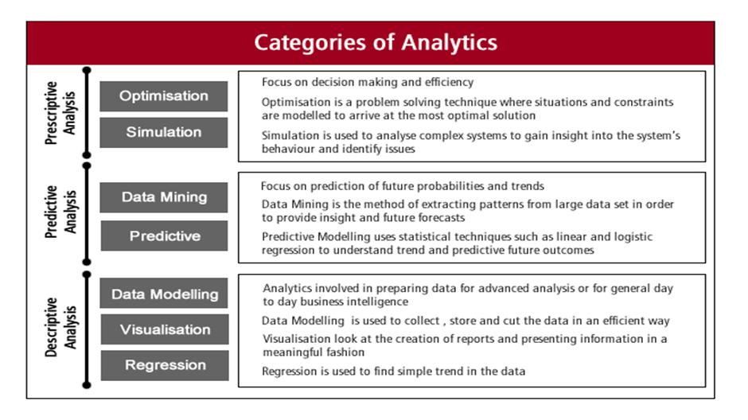
Solution types (1 of 2)

Slide 29
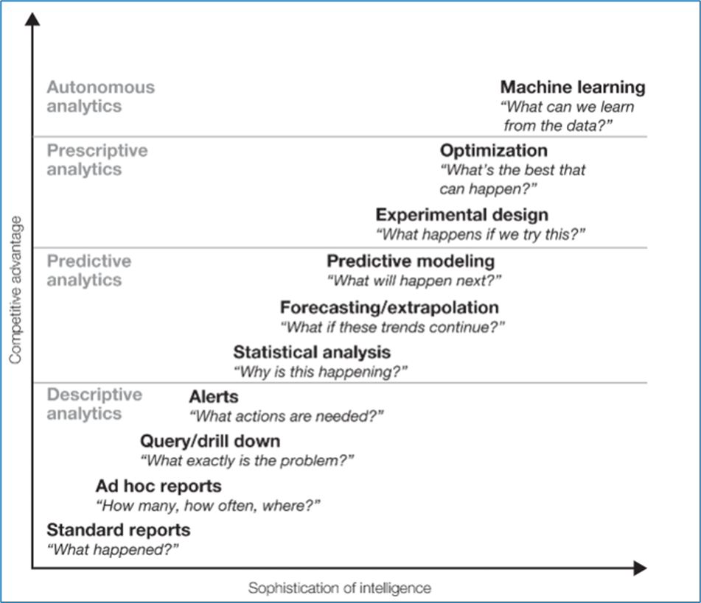
Solution types (2 of 2)

Slide 30
What can we deliver with different analytic approaches?
A clear process (sequence of activities) and audit trail (record of sources and of analytic processes)
Targeted statements about the options and consequences – for example, answering the question “what happens if we try this?”
Recommendations upon which decision-makers can rely when taking decisions, in the knowledge that the clarity and audit trail support a defensible rationale

Slide 31
What did we cover?
Lecture content:
What an analytics intervention might look like
Determining what questions our analysis should answer
What we can deliver with different analytic approaches
Seminar content:
Evaluating real case examples

Slide 32


?
?
?
?
?
?
?

