Slide 1

Analytics in support of management decision-making:
data and people
Seminar
July 2026

Slide 2

Structure of today’s session
Individual prep
Access and read articles
Group activity
Article review and template completion
Debrief
Peer-to-peer sharing
Reflection
What role does collaboration play in the overall success of analytic interventions?

Slide 3
Case allocation
Case 1: Assessing UK space capabilities
Case 2: Gender equality in education
Case 3: Mental health service capacity

Slide 4
Case evaluation template
Intervention context
Translation from business problem to analytics problem
Delivery and evaluation

Slide 5

Intervention context
What is the situation or problem context?
What people are involved and who do the analysts engage with during the intervention?
What sort of data is available?

Slide 6
Translation from business problem to analytics problem
What is the problem that is being addressed?
What sequence of methods or tools is used?
What is the main analytic technique?

Slide 7
Delivery and evaluation
Can you describe the rational, systematic approach taken?
What type of output is produced and what does it enable the users to do?
How well is the output received?
How successful do you think the project was?
If you were the analyst, what might you do next or how might you improve your output?

Slide 8
Peer review: two stars and a wish
To give and receive feedback is an important accomplishment.
Share your output with another group, taking time discuss what you have each produced.
Identify two positive comments (stars) and a constructive comment (a wish) about your peer’s output.

Slide 9
Plenary review: question types
 | Past | Present | Future
Information | What happened? | What is happening now? | What will happen?
Insight | How and why did it happen? | What is the next best action? | What is the best/worst that can happen?
Reporting
Alerts
Extrapolation
Modelling
Recommendation
Simulation
(Davenport et al, 2010)

Slide 10
Plenary review: question types
 | Past | Present | Future
Information | What happened? | What is happening now? | What will happen?
Insight | How and why did it happen? | What is the next best action? | What is the best/worst that can happen?
Case 3: Mental health Showing gaps and…
Case 2: Education Consolidating data to identify which students to call
Case 1: UK space capability
Gauging confidence in estimating deliverability and benefits
Case 3: Mental health … rehearsing potential operational changes
(Davenport et al, 2010)

Slide 11
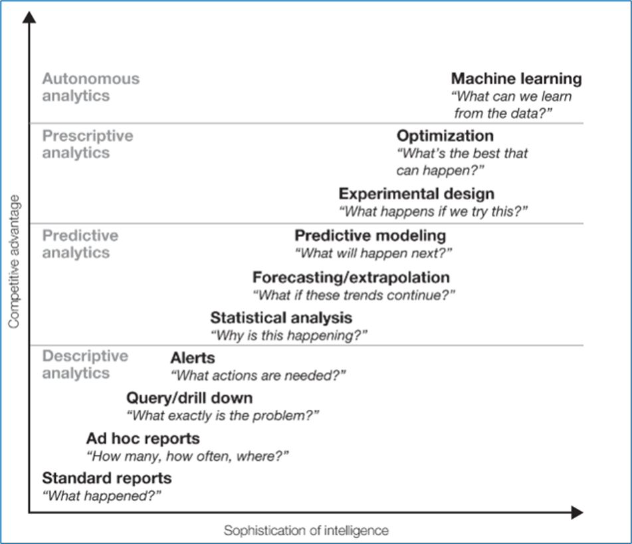
Plenary review: solution types

Slide 12
Plenary review: solution types
Case 3: Mental health
Case 1: UK space capability
Case 2: Education

Slide 13

Your thoughts and reflections
Plenary reflection:
What role did collaboration play in the overall success of these analytic interventions?

Slide 14



