Slide 1
An introduction to Business
Design a Technology Solution for a Business
Dr. Ephie Wang
17th July 2026
Notes:
Students become consultants.
They choose technologies to solve a business problem and pitch their solution.

Slide 2
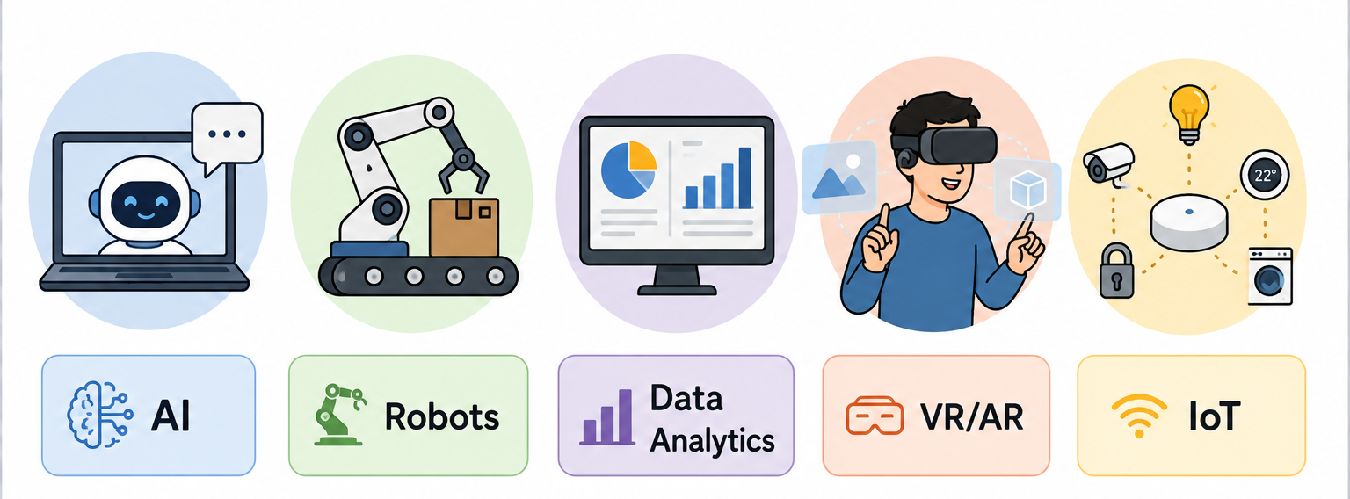
Which technology do you think will change business the most?

Slide 3
Which technology do you know the least about?

Slide 4
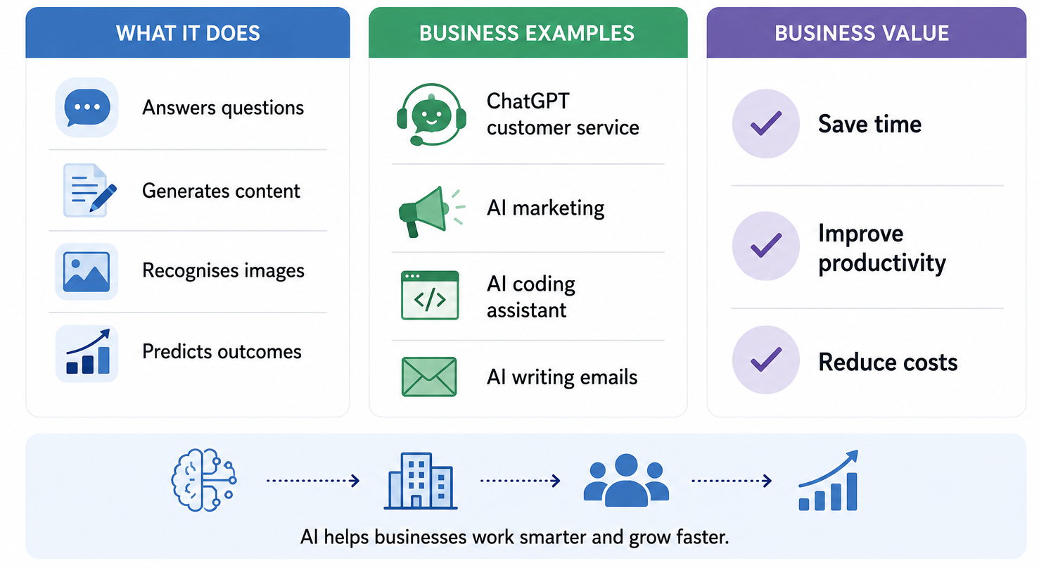
Artificial Intelligence
Notes:
Machine that think, learn and help humans

Slide 5
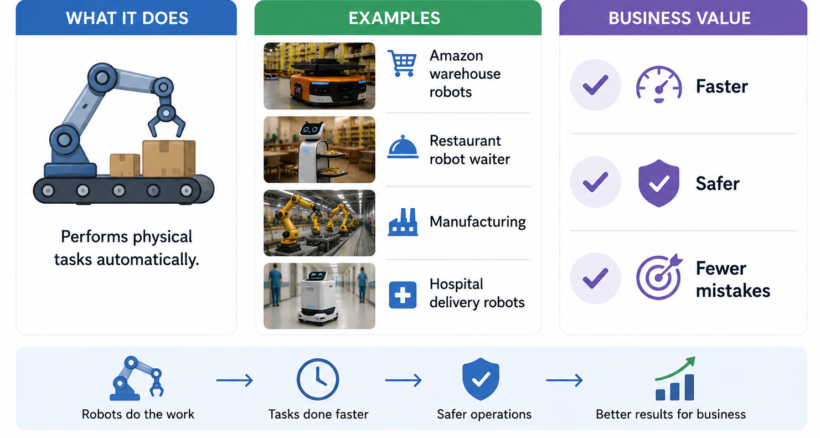
Robots
Notes:
Machines that do physical work automatically

Slide 6
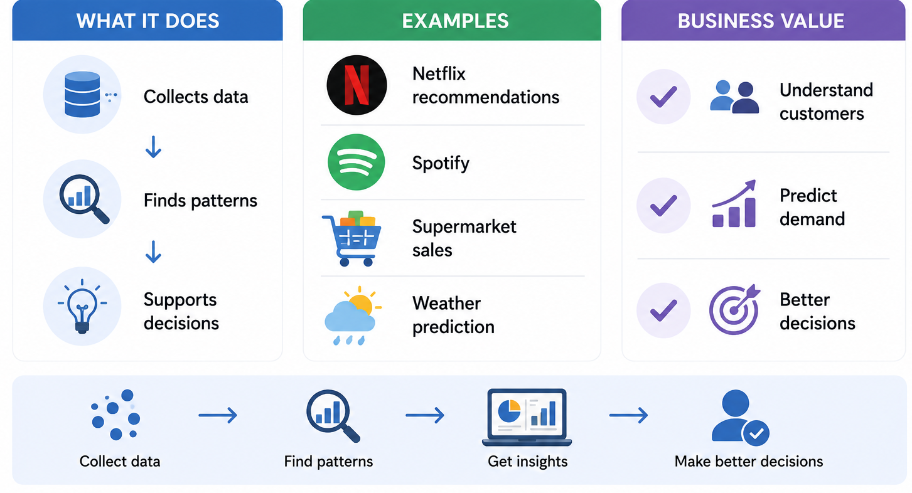
Data Analytics
Notes:
Turning data into useful insights

Slide 7
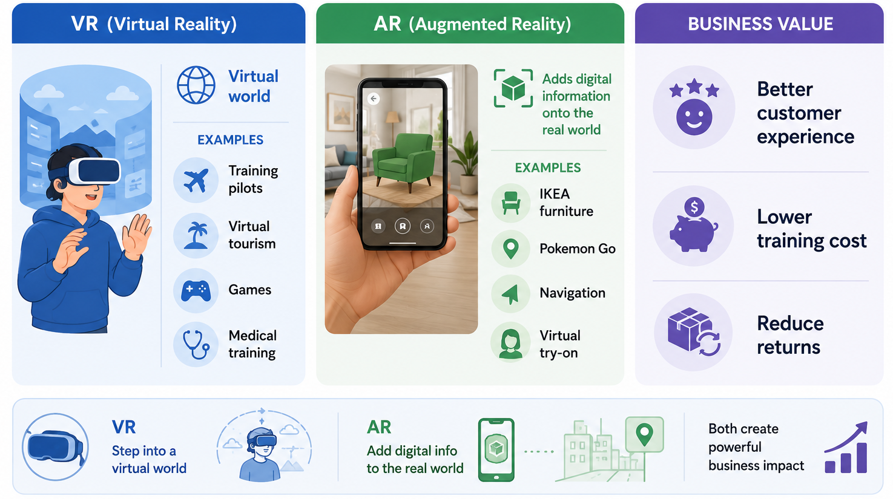
VR/AR
Notes:
Immersive technologies that enhance experience

Slide 8
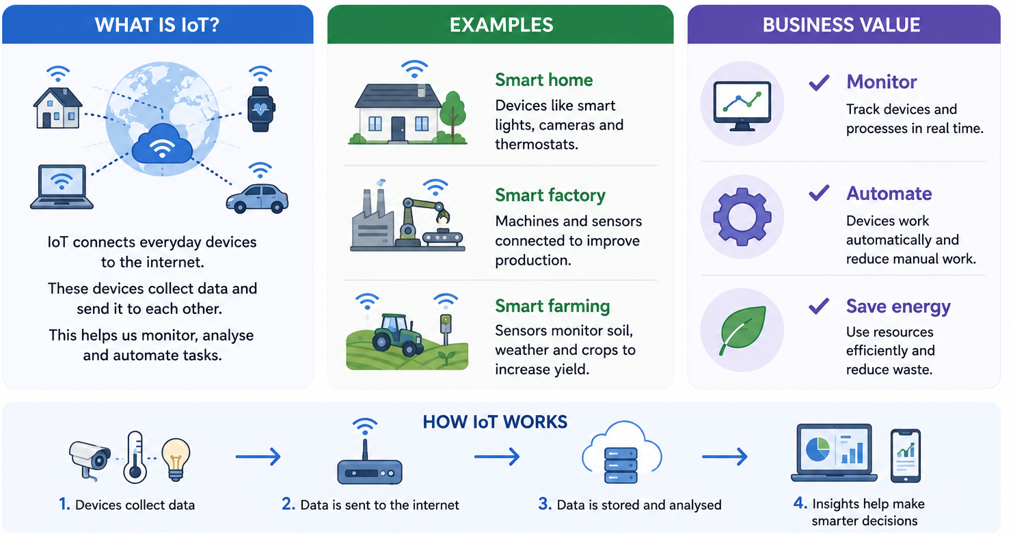
Internet of Things (IoT)
Notes:
Smart devices connected to the internet
They collect and share data

Slide 9
As-Is To-Be module
Business → Problems → Technology → Better Business
Technology
As-Is
Identify problems
Design To-Be
Symptoms
Root Cause
Prescription

Slide 10


Your challenge
Imagine you are consultants.
Choose ONE business.
Identify ONE business problem.
Use ONE or TWO technologies.
Design a better future business.
Pitch your idea.

Slide 11
Your challenge
The business areas can be:
Restaurant
Supermarket
Gym
Hospital
Airport
Hotel
Cinema
Fashion Store
Library
Theme Park
University
Bakery
Coffee Shop
Zoo
Or your choice

Slide 12
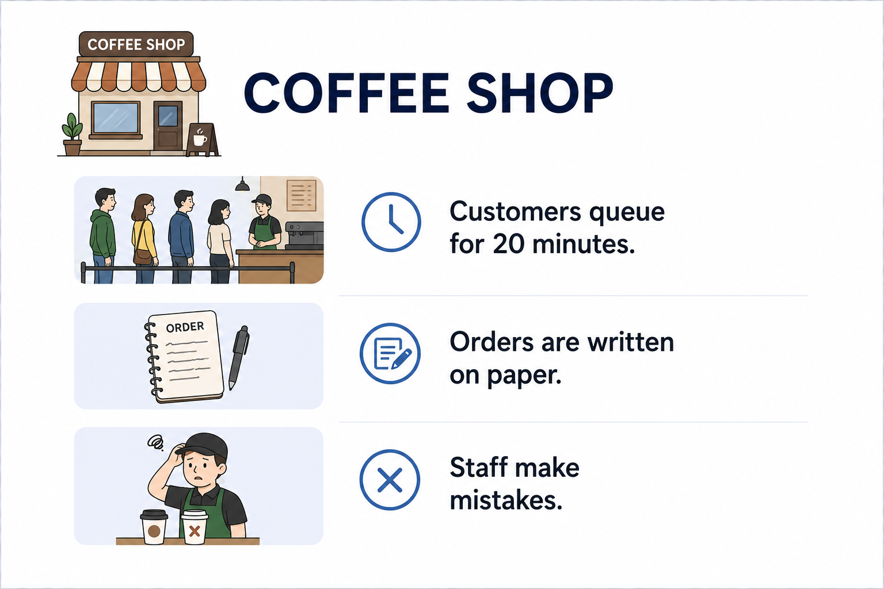
Deliverable: 3 Columns
Column 1 - Current Business
Business name
Pain point
Current process
As-Is

Slide 13
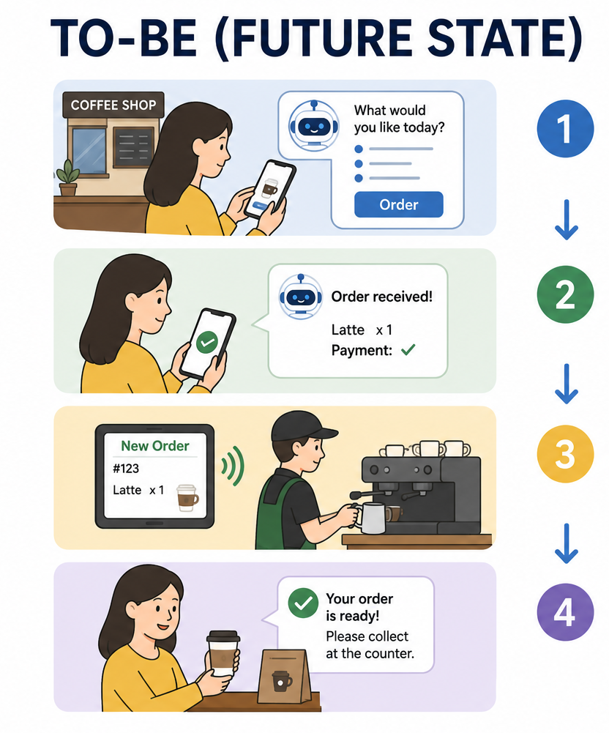
Deliverable: 3 Columns
Column 2 - Technology Solution
Which technology?
How does it work?
To-Be

Slide 14
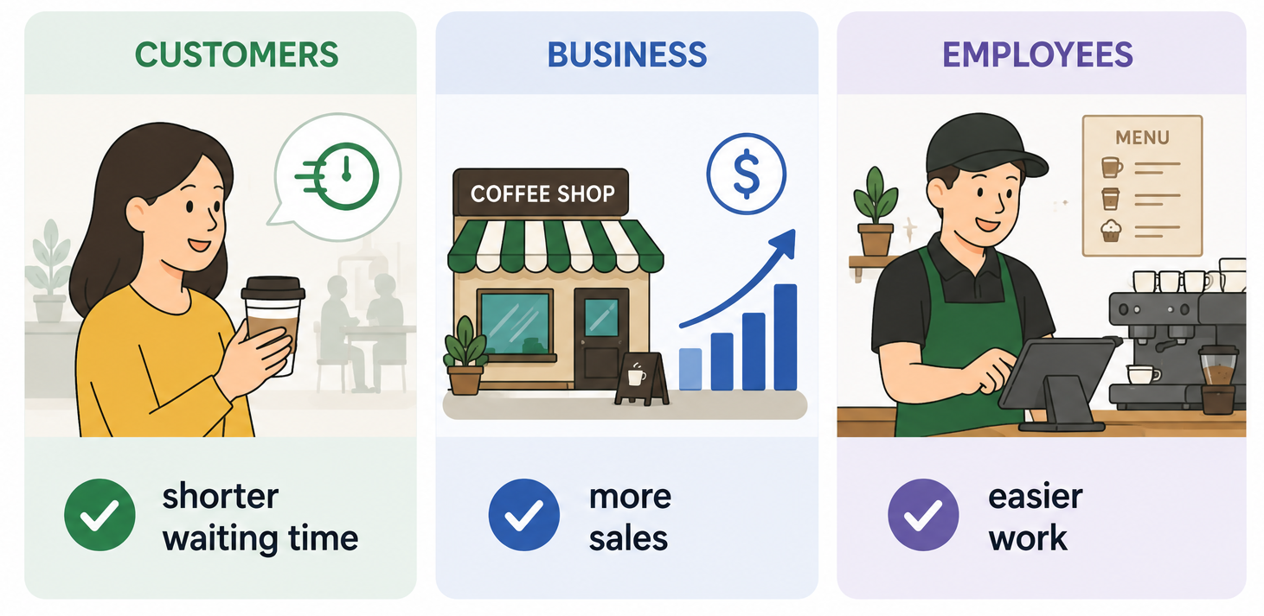
Deliverable: 3 Columns
Column 3 - Business Value
Benefits
Customers
Business
Employees

Slide 15

40 mins
Presentation 5 mins
Q&A

Slide 16

Thank you!

