Slide 1

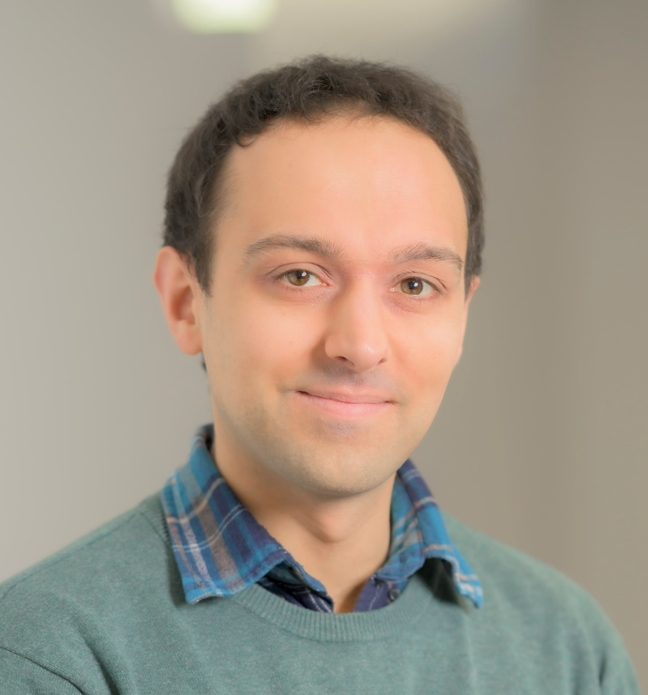
Pre-University Summer School
An Introduction to…
Mathematics and Statistics
Chris Jones
C.Jones.26@warwick.ac.uk
Friday 21st July 2023

Slide 2
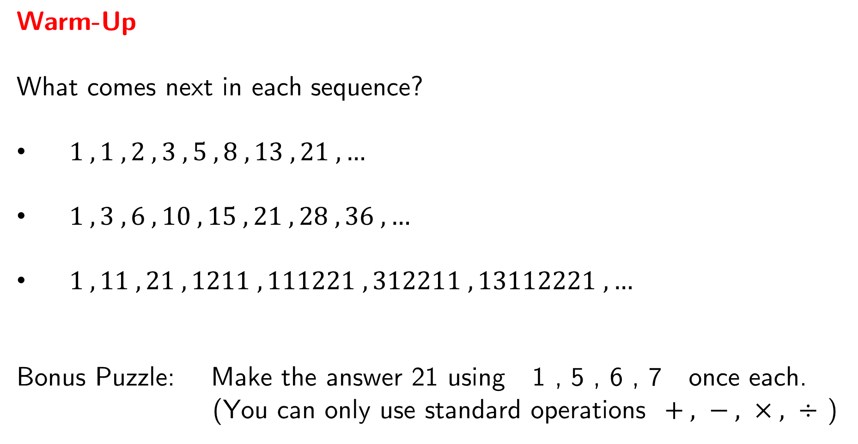
Warm-Up
What comes next in each sequence?
$1 , 1 , 2 , 3 , 5 , 8 , 13 , 21 , …$
$1 , 3 , 6 , 10 , 15 , 21 , 28 , 36 , …$
$1 , 11 , 21 , 1211 , 111221 , 312211 , 13112221 , …$
Bonus Puzzle: Make the answer 21 using 1 , 5 , 6 , 7 once each.
(You can only use standard operations $+ , − , × , ÷$ )

Slide 3
Session Aims:
To provide a brief taster of what it can be like to study
Mathematics and Statistics at university.
To demonstrate the beauty and relevance of these disciplines by exploring a selection of topic areas.
To highlight some of the individuals involved in the discovery and development of the concepts shown.
To enjoy investigating some mathematical problems together.

Slide 4
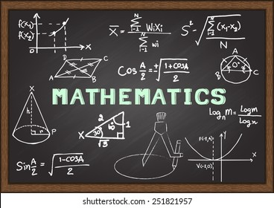

Science
Art
Language
Discovery
People
Rigour
Nature
Pure
General
Communication
Models
Uncertainty
Prediction
Powerful
Data
Understanding
Information

Slide 5
Analysis
Fractal Geometry
Session
Overview
Probability
Combinatorics

Slide 6
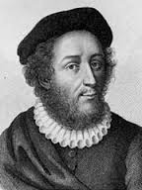
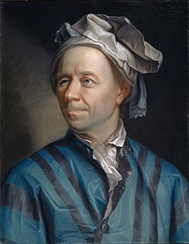
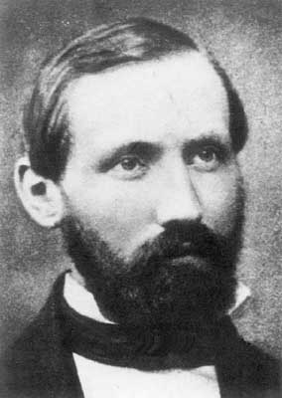
Analysis
When does changing the order of a sum change the answer?
How far off the edge of a table can a stack of blocks reach?
What does all of this have to do with guitar strings?
Madhava of Sangamagrama
1300’s / 1400’s
Nicole Oresme
1300’s
Leonard Euler
1700’s
Bernhard Riemann
1800’s

Slide 7
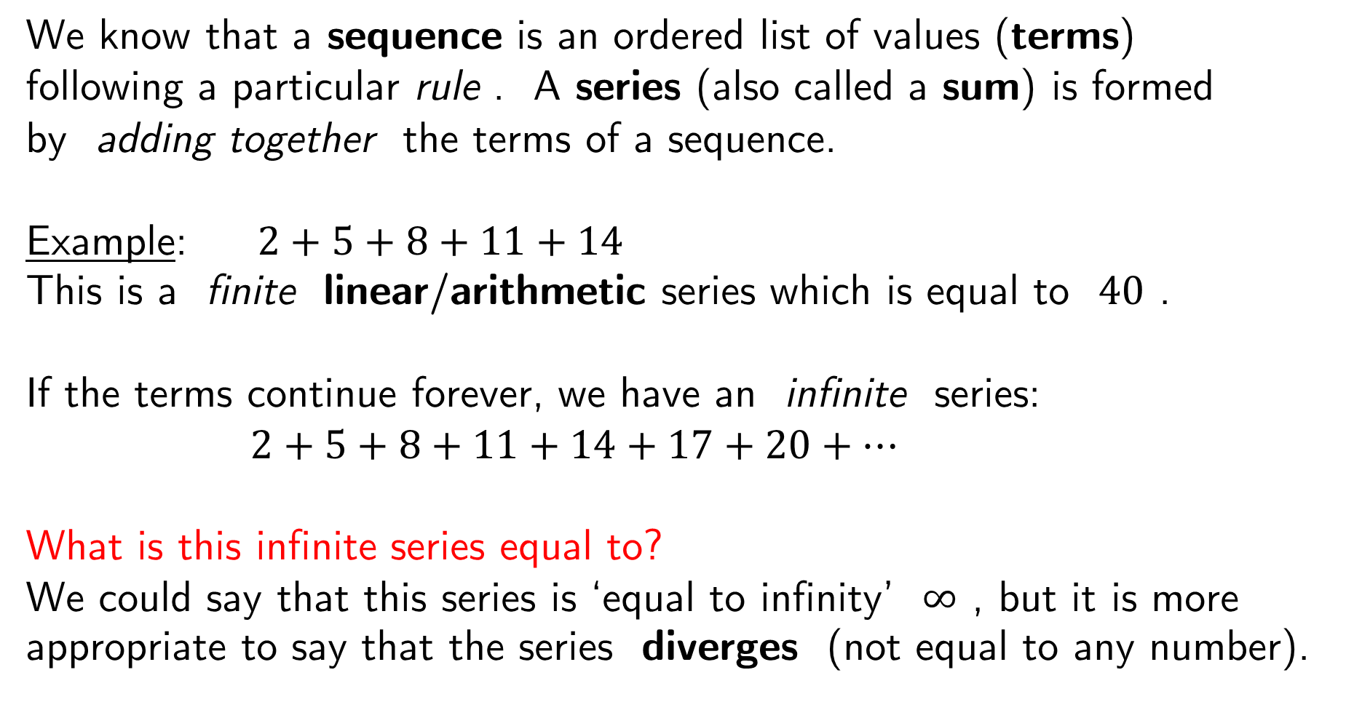
We know that a sequence is an ordered list of values (terms)
following a particular rule . A series (also called a sum) is formed
by adding together the terms of a sequence.
Example: $2+5+8+11+14$
This is a finite linear/arithmetic series which is equal to $40$ .
If the terms continue forever, we have an infinite series:
$2+5+8+11+14+17+20+…$
What is this infinite series equal to?
We could say that this series is ‘equal to infinity’ $∞$ , but it is more appropriate to say that the series diverges (not equal to any number).

Slide 8
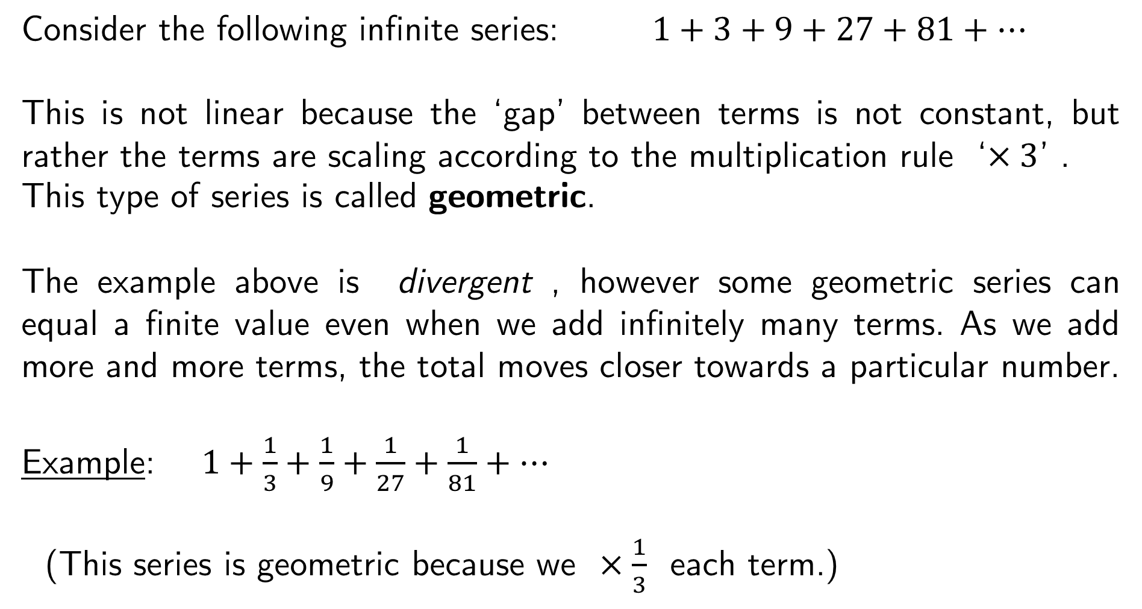
Consider the following infinite series: $1+3+9+27+81+…$
This is not linear because the ‘gap’ between terms is not constant, but rather the terms are scaling according to the multiplication rule ‘$×3$’ .
This type of series is called geometric.
The example above is divergent , however some geometric series can equal a finite value even when we add infinitely many terms. As we add more and more terms, the total moves closer towards a particular number.
Example: $1+\frac{1}{3}+\frac{1}{9}+\frac{1}{27}+\frac{1}{81}+…$
(This series is geometric because we $×\frac{1}{3}$ each term.)

Slide 9
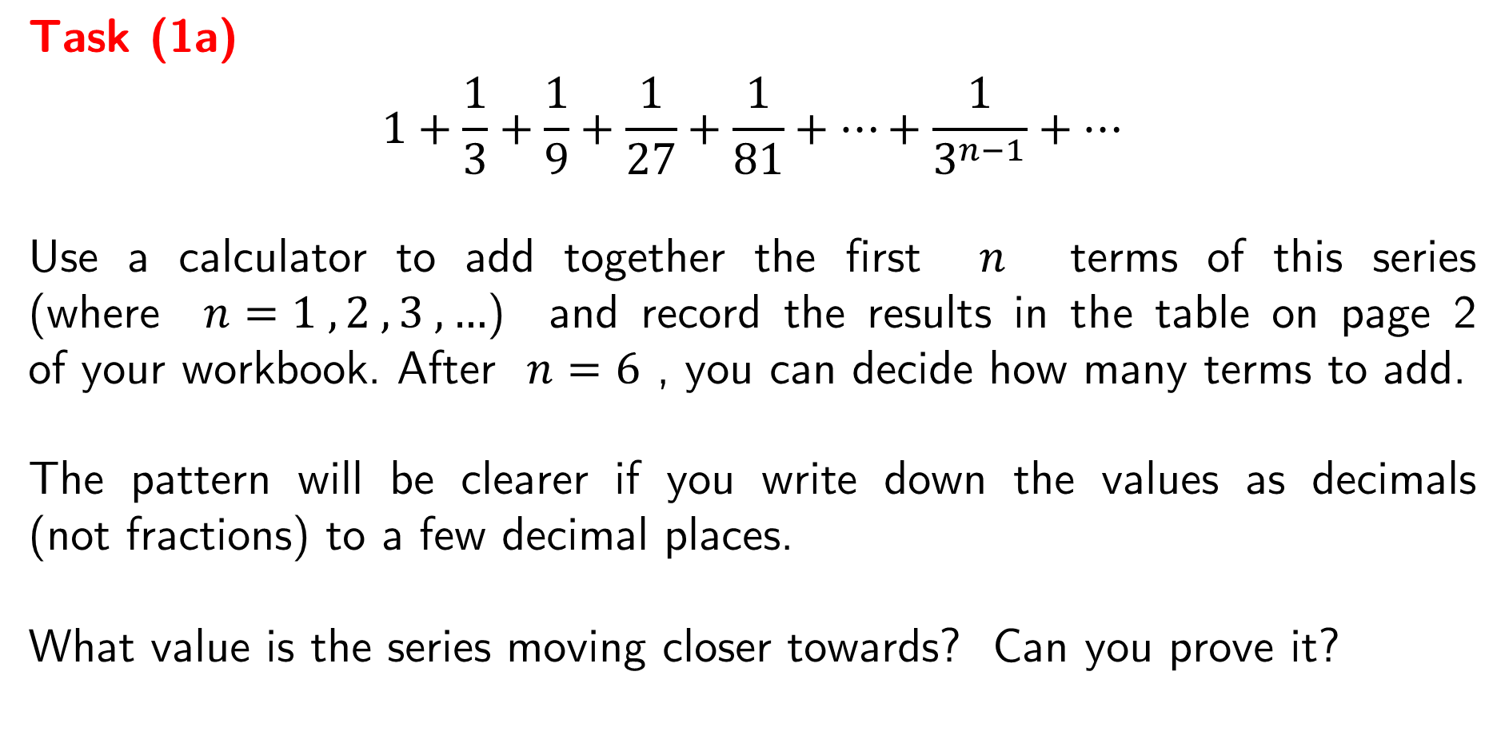
Task (1a)
$$1+\frac{1}{3}+\frac{1}{9}+\frac{1}{27}+\frac{1}{81}+…+\frac{1}{3^{n−1}}+…$$
Use a calculator to add together the first $n$ terms of this series
(where $n=1 , 2 , 3 , …$) and record the results in the table on page 2
of your workbook. After $n=6$ , you can decide how many terms to add.
The pattern will be clearer if you write down the values as decimals
(not fractions) to a few decimal places.
What value is the series moving closer towards? Can you prove it?

Slide 10
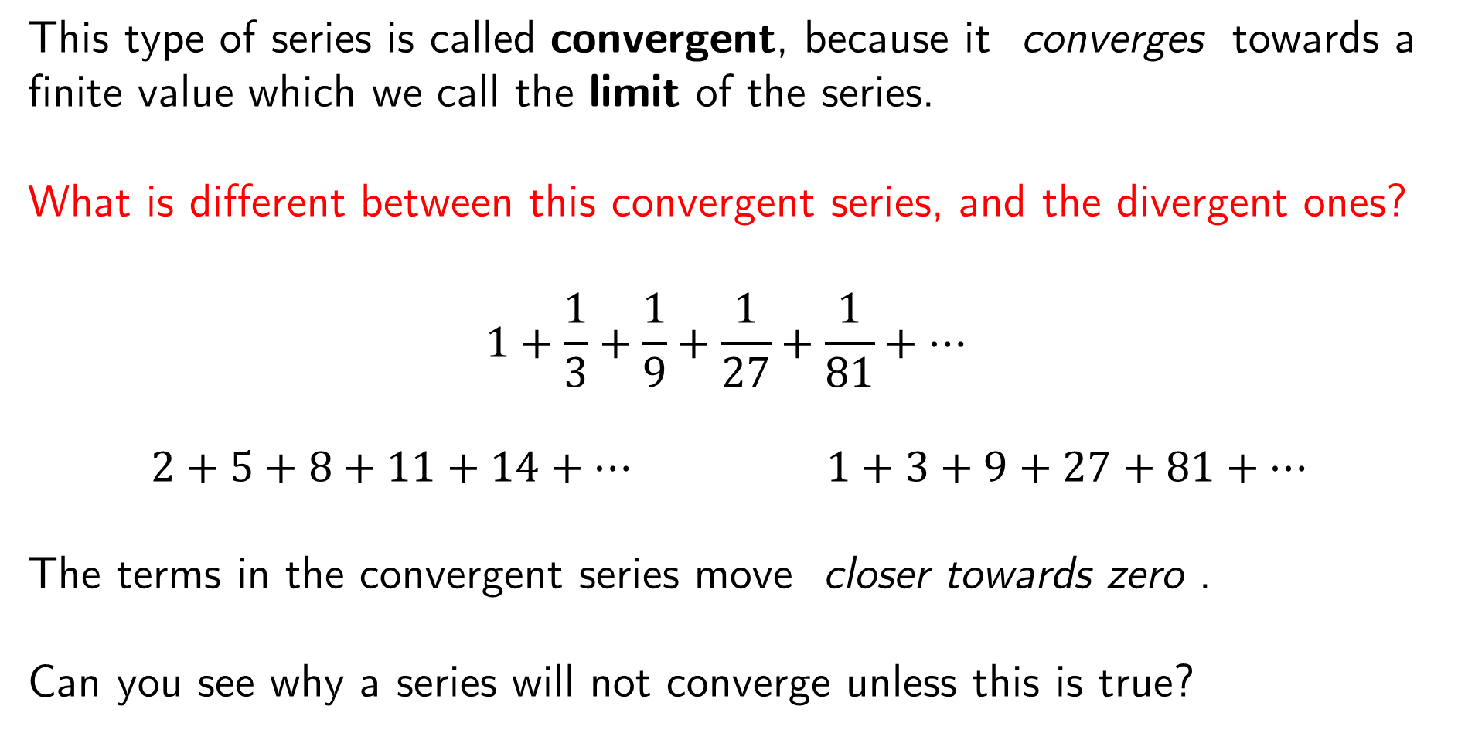
This type of series is called convergent, because it converges towards a finite value which we call the limit of the series.
What is different between this convergent series, and the divergent ones?
$$1+\frac{1}{3}+\frac{1}{9}+\frac{1}{27}+\frac{1}{81}+…$$
$2+5+8+11+14+…$ $1+3+9+27+81+…$
The terms in the convergent series move closer towards zero .
Can you see why a series will not converge unless this is true?

Slide 11
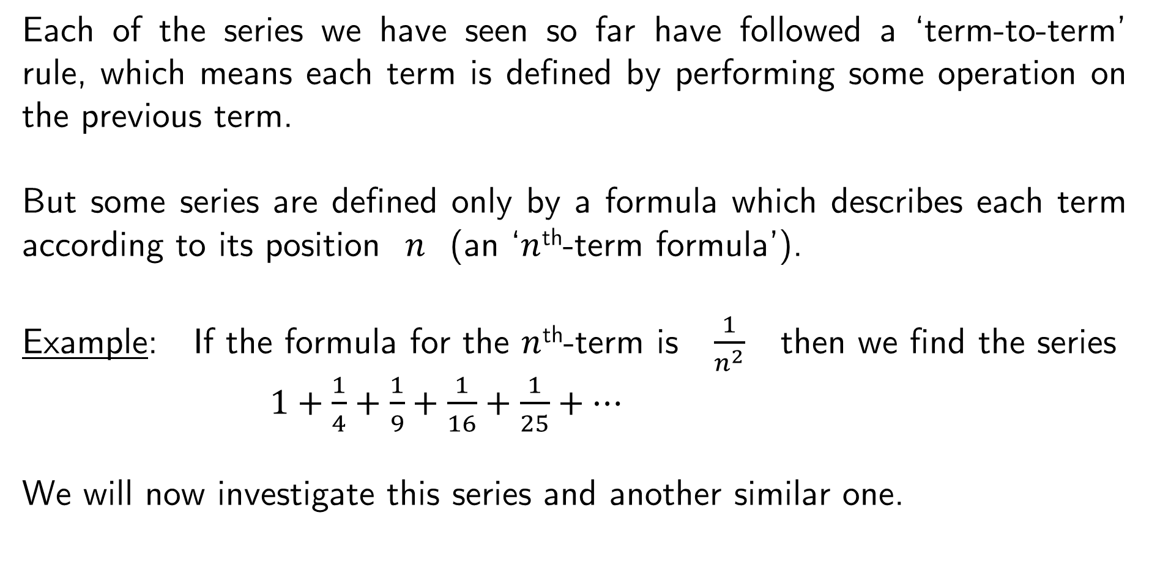
Each of the series we have seen so far have followed a ‘term-to-term’ rule, which means each term is defined by performing some operation on the previous term.
But some series are defined only by a formula which describes each term according to its position $n$ (an ‘$n$^{th}-term formula’).
Example: If the formula for the $n$^{th}-term is $\frac{1}{n^{2}}$ then we find the series
$1+\frac{1}{4}+\frac{1}{9}+\frac{1}{16}+\frac{1}{25}+…$
We will now investigate this series and another similar one.

Slide 12
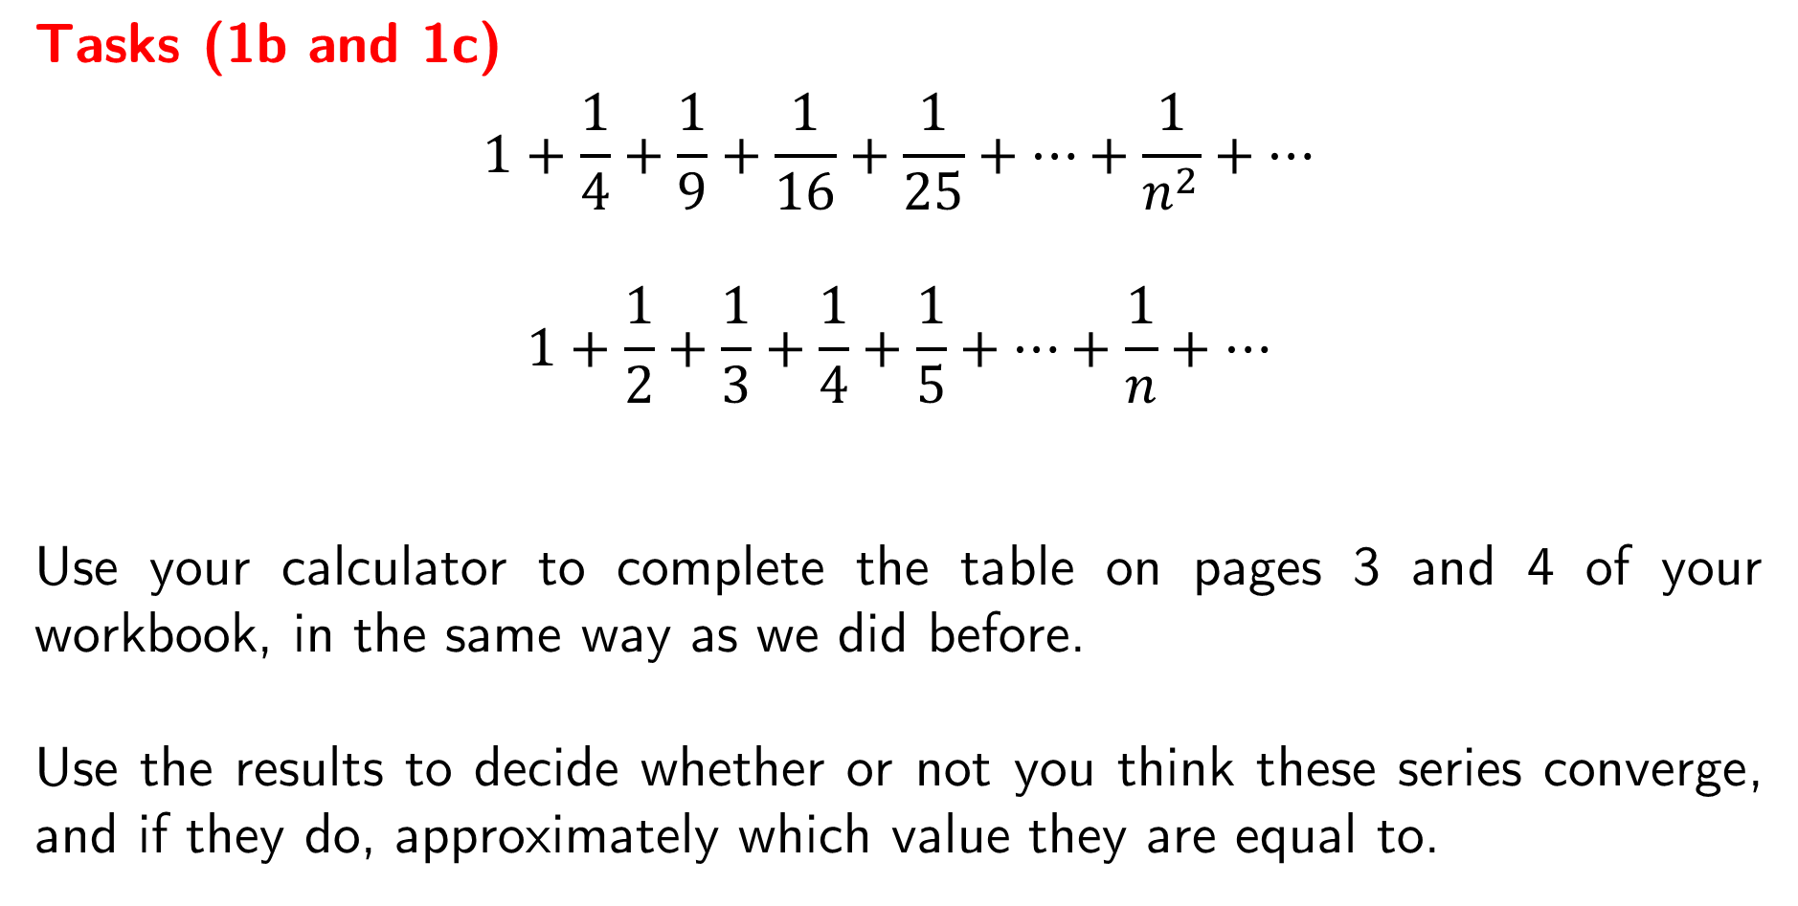
Tasks (1b and 1c)
$$1+\frac{1}{4}+\frac{1}{9}+\frac{1}{16}+\frac{1}{25}+…+\frac{1}{n^{2}}+…$$
$$1+\frac{1}{2}+\frac{1}{3}+\frac{1}{4}+\frac{1}{5}+…+\frac{1}{n}+…$$
Use your calculator to complete the table on pages 3 and 4 of your workbook, in the same way as we did before.
Use the results to decide whether or not you think these series converge, and if they do, approximately which value they are equal to.

Slide 13
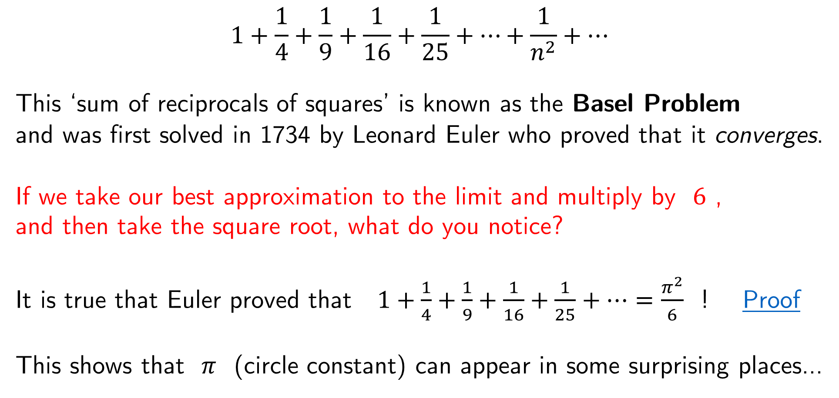
$$1+\frac{1}{4}+\frac{1}{9}+\frac{1}{16}+\frac{1}{25}+…+\frac{1}{n^{2}}+…$$
This ‘sum of reciprocals of squares’ is known as the Basel Problem
and was first solved in 1734 by Leonard Euler who proved that it converges.
If we take our best approximation to the limit and multiply by $6$ ,
and then take the square root, what do you notice?
It is true that Euler proved that $1+\frac{1}{4}+\frac{1}{9}+\frac{1}{16}+\frac{1}{25}+…=\frac{π^{2}}{6}$ ! Proof
This shows that $π$ (circle constant) can appear in some surprising places…

Slide 14
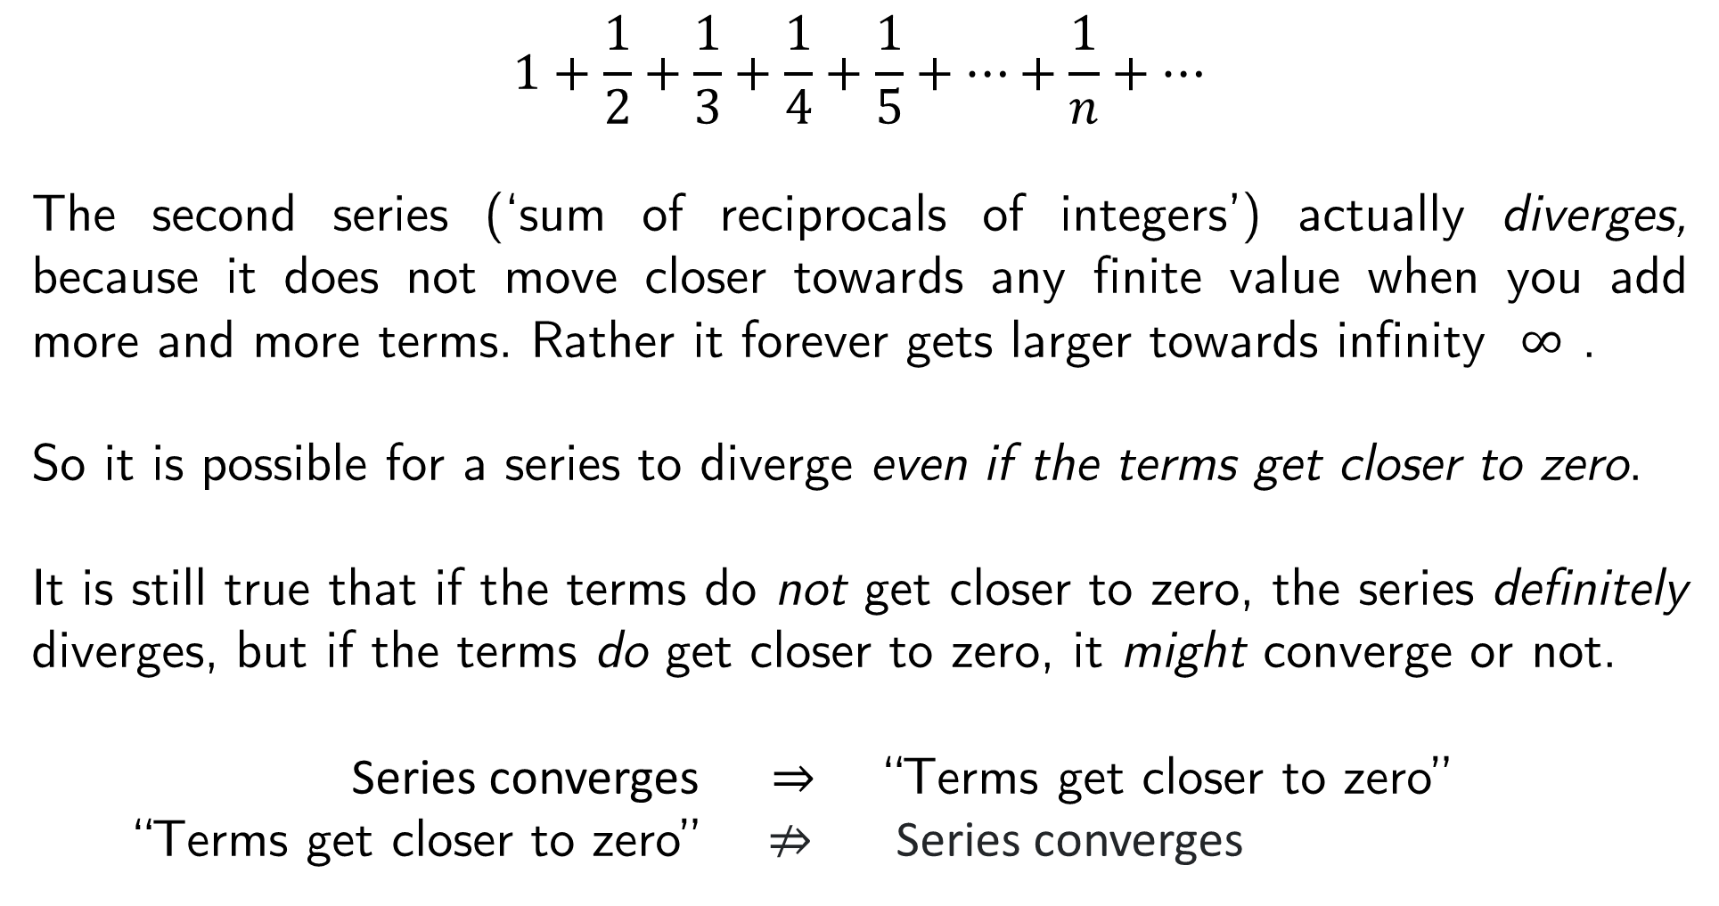
$$1+\frac{1}{2}+\frac{1}{3}+\frac{1}{4}+\frac{1}{5}+…+\frac{1}{n}+…$$
The second series (‘sum of reciprocals of integers’) actually diverges, because it does not move closer towards any finite value when you add more and more terms. Rather it forever gets larger towards infinity $∞$ .
So it is possible for a series to diverge even if the terms get closer to zero.
It is still true that if the terms do not get closer to zero, the series definitely diverges, but if the terms do get closer to zero, it might converge or not.
Series converges $⇒$ “Terms get closer to zero”
“Terms get closer to zero” ⇏ Series converges

Slide 15
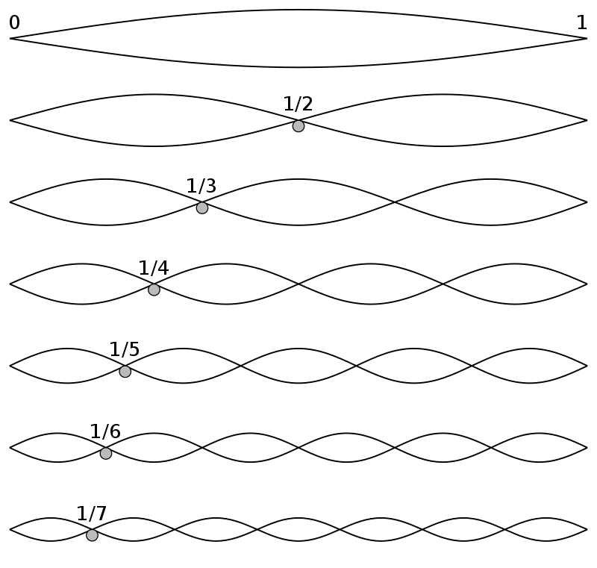
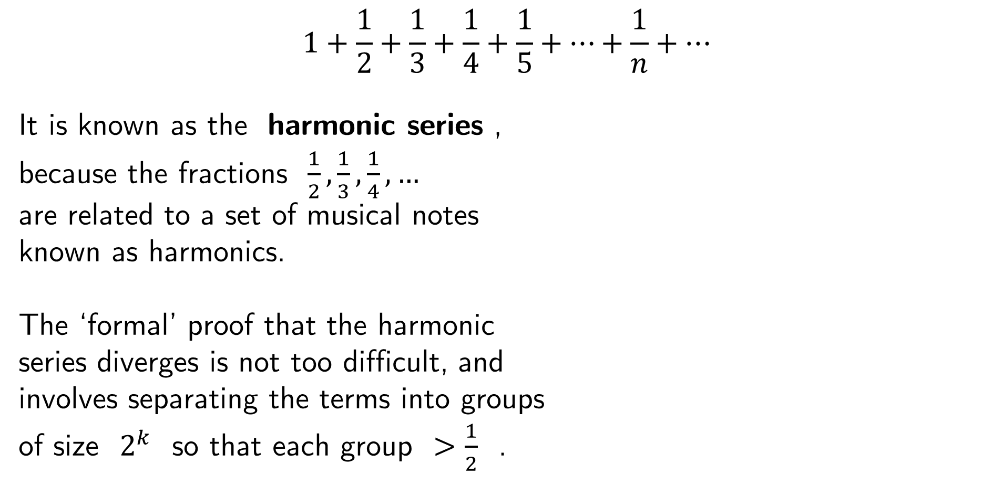
$$1+\frac{1}{2}+\frac{1}{3}+\frac{1}{4}+\frac{1}{5}+…+\frac{1}{n}+…$$
It is known as the harmonic series ,
because the fractions $\frac{1}{2},\frac{1}{3},\frac{1}{4}, …$
are related to a set of musical notes
known as harmonics.
The ‘formal’ proof that the harmonic
series diverges is not too difficult, and
involves separating the terms into groups
of size $2^{k}$ so that each group $>\frac{1}{2}$ .

Slide 16
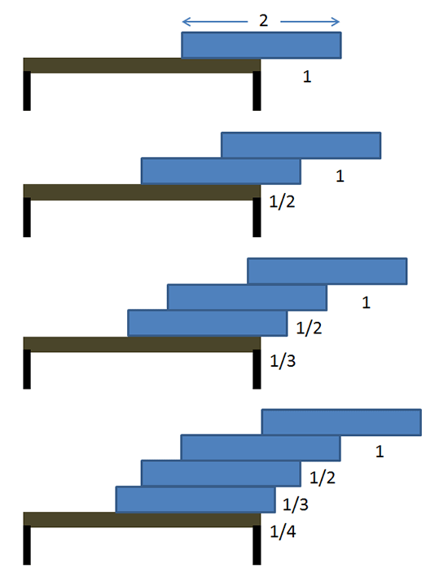
One particular application of the harmonic series is known as the
block-stacking problem , which asks:
“ How far over the edge of a table can be reached by simply stacking blocks on top of each other without them falling off ? ”
Since the harmonic series diverges, it turns out that it is possible to reach
infinitely far off the edge of the table!
But because the series only increases very slowly, you would need a very large number of blocks to reach particularly far.

Slide 17
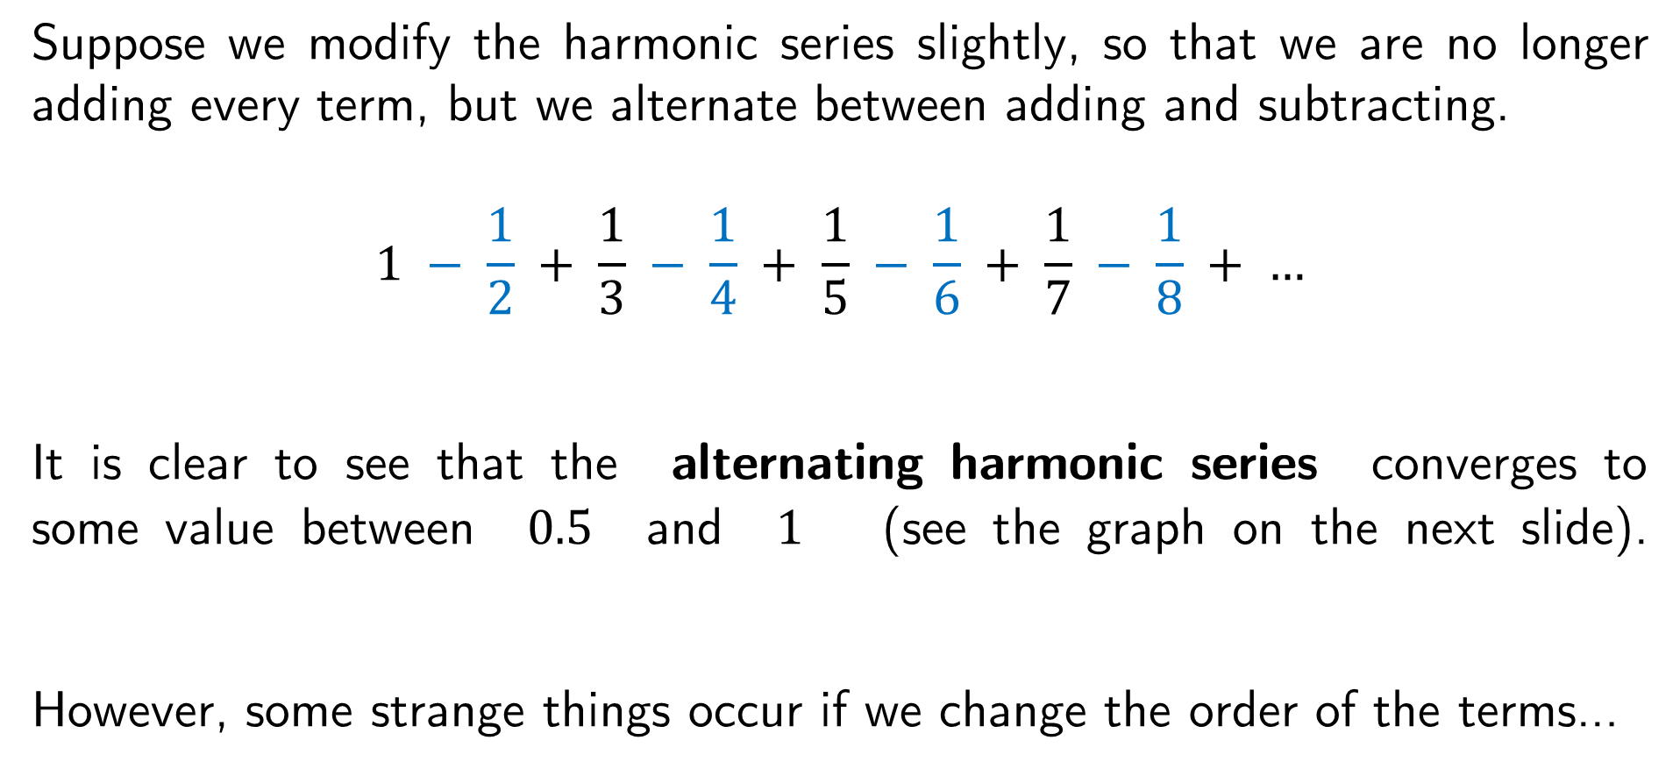
Suppose we modify the harmonic series slightly, so that we are no longer adding every term, but we alternate between adding and subtracting.
$$1 − \frac{1}{2} + \frac{1}{3} − \frac{1}{4} + \frac{1}{5} − \frac{1}{6} + \frac{1}{7} − \frac{1}{8} + …$$
It is clear to see that the alternating harmonic series converges to some value between $0.5$ and $1$ (see the graph on the next slide).
However, some strange things occur if we change the order of the terms…

Slide 18
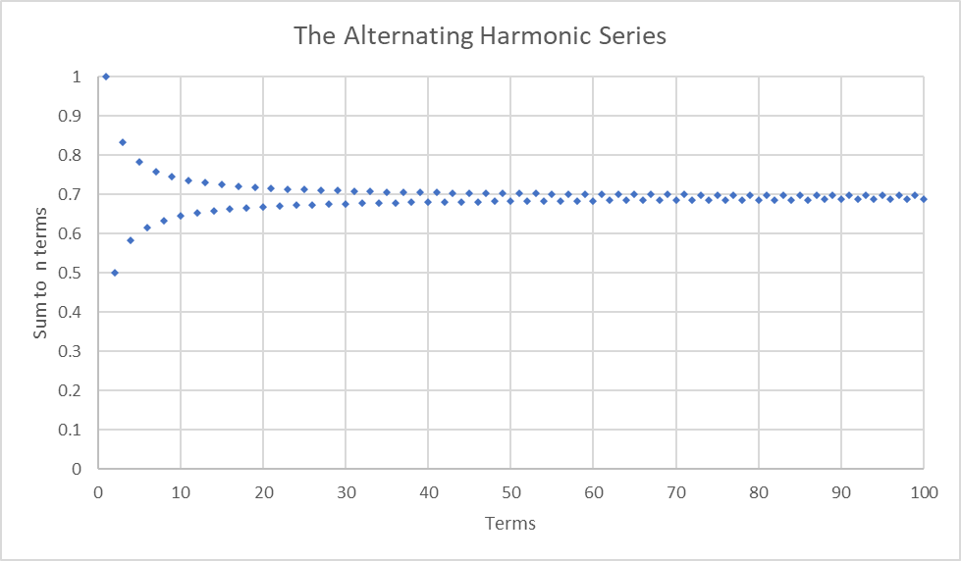

Slide 19
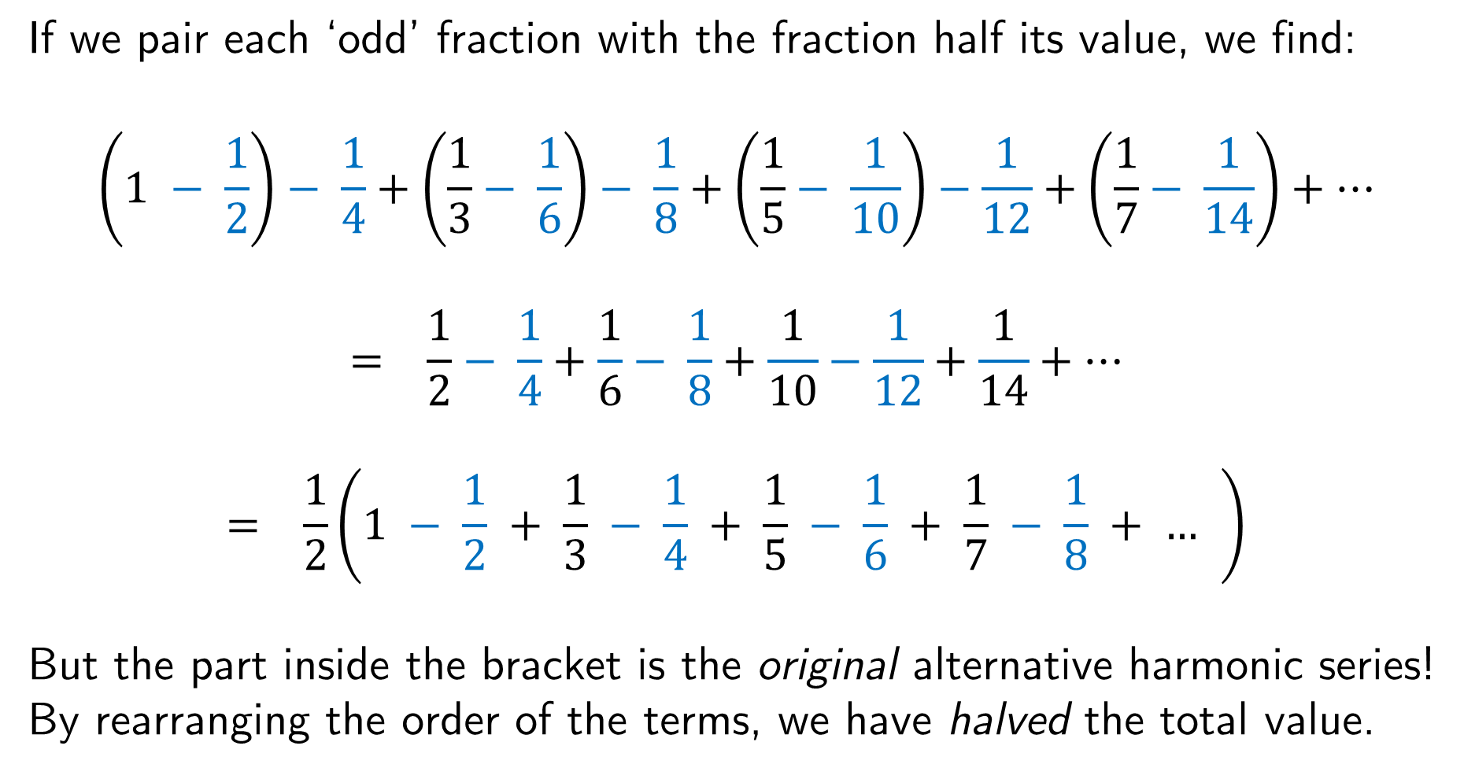
If we pair each ‘odd’ fraction with the fraction half its value, we find:
$$\left(1 − \frac{1}{2}\right)− \frac{1}{4}+\left(\frac{1}{3}− \frac{1}{6}\right)− \frac{1}{8}+\left(\frac{1}{5}− \frac{1}{10}\right)−\frac{1}{12}+\left(\frac{1}{7}− \frac{1}{14}\right)+…$$
$$= \frac{1}{2}− \frac{1}{4}+\frac{1}{6}− \frac{1}{8}+\frac{1}{10}−\frac{1}{12}+\frac{1}{14}+…$$
$$= \frac{1}{2}\left(1 − \frac{1}{2} + \frac{1}{3} − \frac{1}{4} + \frac{1}{5} − \frac{1}{6} + \frac{1}{7} − \frac{1}{8} + … \right)$$
But the part inside the bracket is the original alternative harmonic series!
By rearranging the order of the terms, we have halved the total value.

Slide 20
Therefore, we must be very careful when dealing with infinite series which involve some added terms and some subtracted terms, because changing the order can change the result.
This was shown by Augustin-Louis Cauchy in 1833, and then in 1868 Bernhard Riemann proved that for some particular series it is possible to rearrange the terms in such a way as to provide any value you want !
This has become known as Riemann’s Rearrangement Theorem , which also says that we can make a series fail to converge at all just by changing the order of the terms.

Slide 21
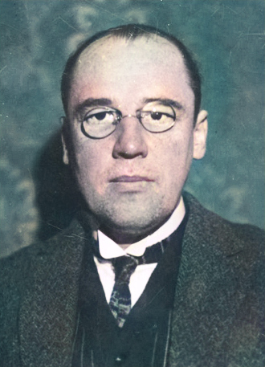
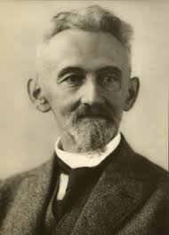
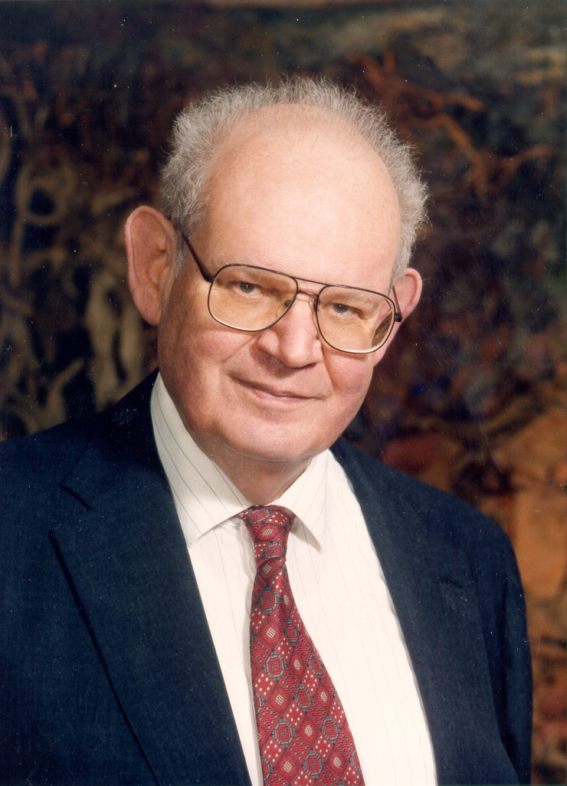
Fractal Geometry
What does it mean for an object to have non-integer dimension?
What is the total length of the coastline of Great Britain?
What is my favourite vegetable?
Wacław Sierpiński
Early 1900’s
Felix Hausdorff
Late 1800’s / Early 1900’s
Benoit B Mandelbrot
1950’s to 2000’s

Slide 22


A fractal is a geometric object with an infinite amount of detail , and also a property known as self-similarity .
Essentially what this means is that you can ‘zoom-in’ on a fractal however far
you want , and you will continue to see shapes that look identical to the original object.

Slide 23
Task (2a)
We are going to see how a fractal can be generated algorithmically
(i.e. by a repeating process).
On page 6 of your workbook is an equilateral triangle.
You are going to roll a dice to decide which vertex (corner) to start at.
Then you are going to roll again and move half-way towards that number.
Each time you move, draw a dot, and that is your new starting point.

Slide 24
One thing you should notice is that there is a central triangle which will
always remain blank. (Can we think why this must be true?)
There will also be many other triangular spaces which are always blank.
If we repeated this process forever, the set of points we would find is a fractal called the Sierpinski Triangle . This object can also be formed by repeatedly ‘cutting out’ triangles until only the fractal remains.
Here is a fantastic online tool for visualising: Mathigon Link

Slide 25
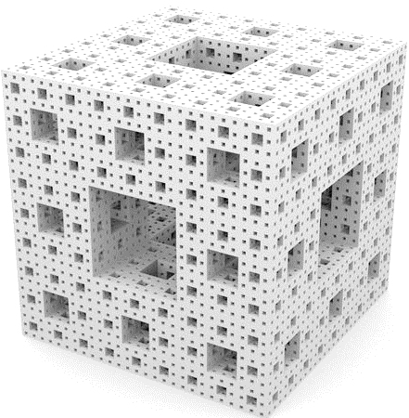
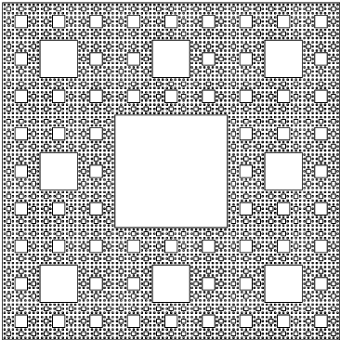
Some other fractals…
Sierpinski Carpet
Menger Sponge

Slide 26
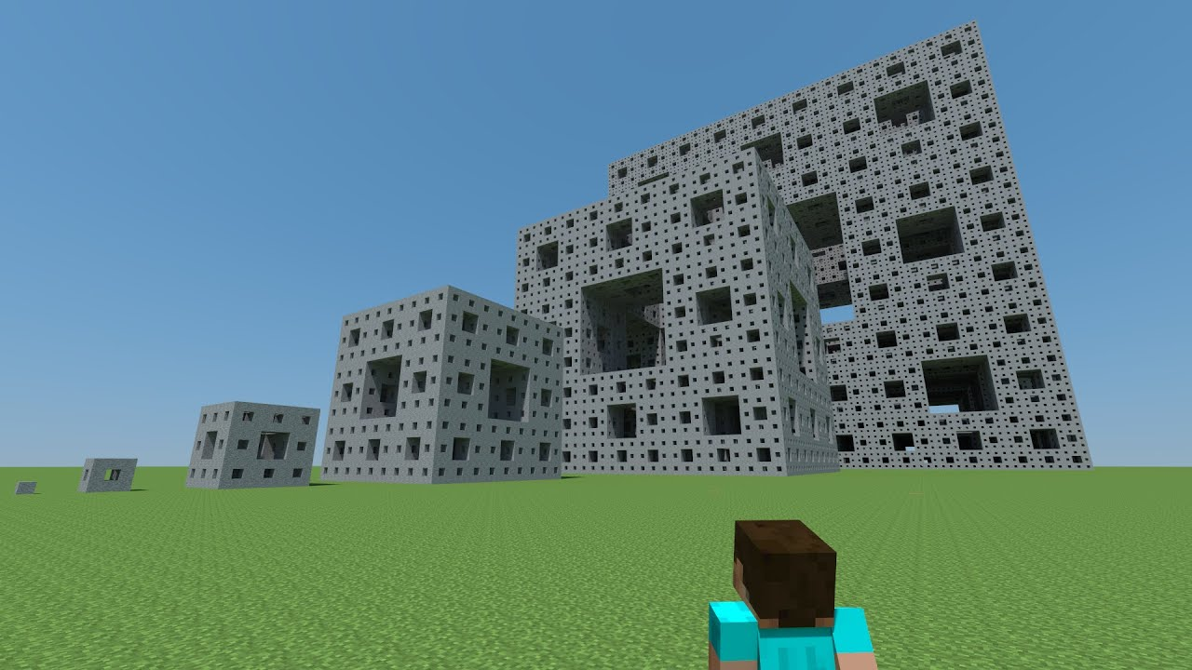
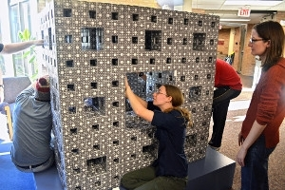
A sequence of shapes approaching the Menger Sponge, created in Minecraft
And something similar made in real life

Slide 27
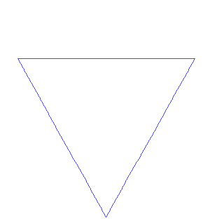
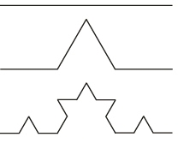
The Koch Snowflake is generated by repeatedly converting the middle-third of an equilateral triangle into two sides of a smaller equilateral triangle.
Each iteration, the sides are 3 times smaller, but there are 4 times as many sides in total… therefore the total perimeter grows to infinity !
This kind of fractal can be used to model the shape of coastlines.

Slide 28
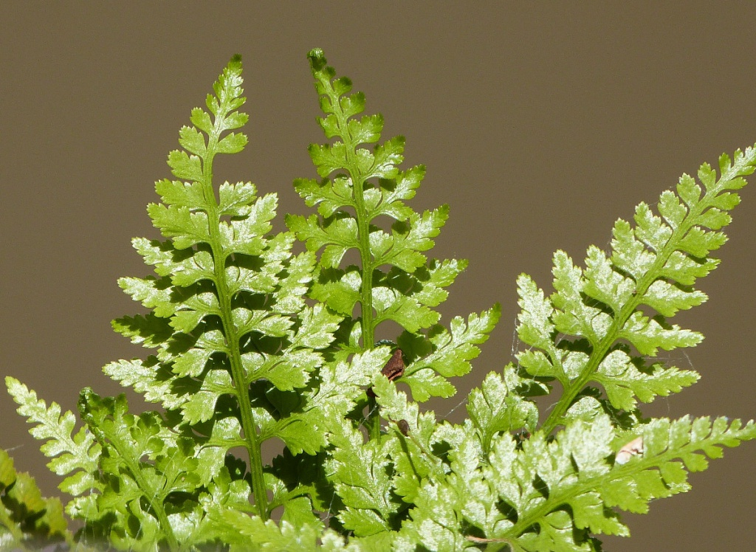
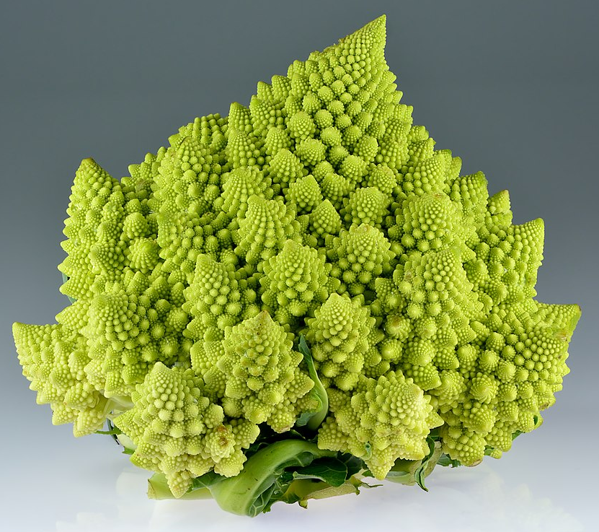

Fractals in nature…
Black Spleenwort
Romanesco Broccoli
Barnsley Fern

Slide 29
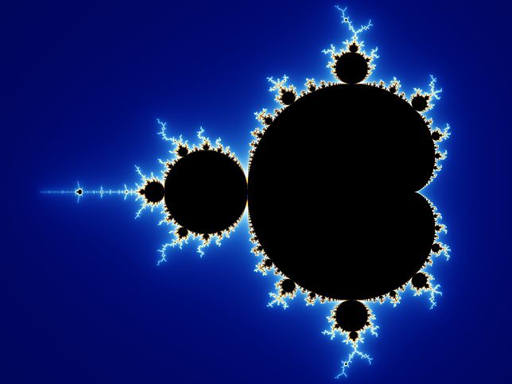
One of the most well-known fractals is called the Mandelbrot Set , which was popularised by Benoit B. Mandelbrot in 1980.
Zoom

Slide 30
How do we define the ‘dimension’ of an object?
e.g. a square is a 2-dimensional shape, and a cube is 3-dimensional.
The regular way of thinking about it, is to count how many axes (directions) of movement there are within the object. But there is another way to define it, which is known as the Hausdorff Dimension .
To calculate the Hausdorff Dimension of an object, we ask the question:
How many copies of the object do we need to form a larger version of it?

Slide 31
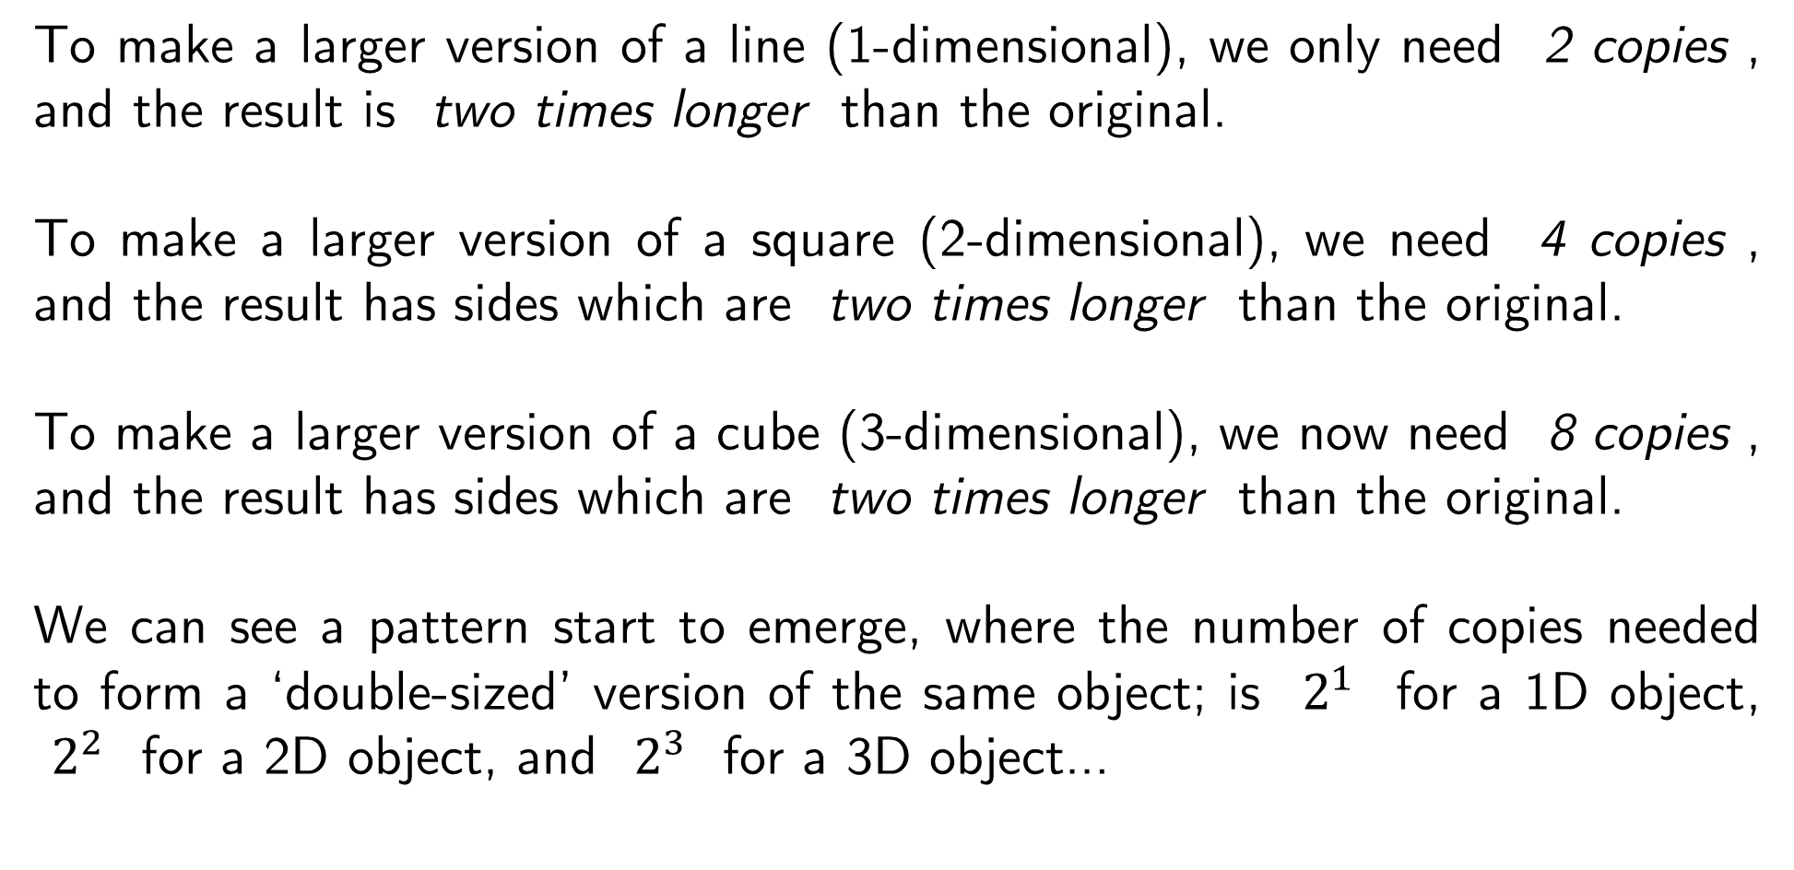
To make a larger version of a line (1-dimensional), we only need 2 copies , and the result is two times longer than the original.
To make a larger version of a square (2-dimensional), we need 4 copies , and the result has sides which are two times longer than the original.
To make a larger version of a cube (3-dimensional), we now need 8 copies , and the result has sides which are two times longer than the original.
We can see a pattern start to emerge, where the number of copies needed to form a ‘double-sized’ version of the same object; is $2^{1}$ for a 1D object,
$2^{2}$ for a 2D object, and $2^{3}$ for a 3D object…

Slide 32
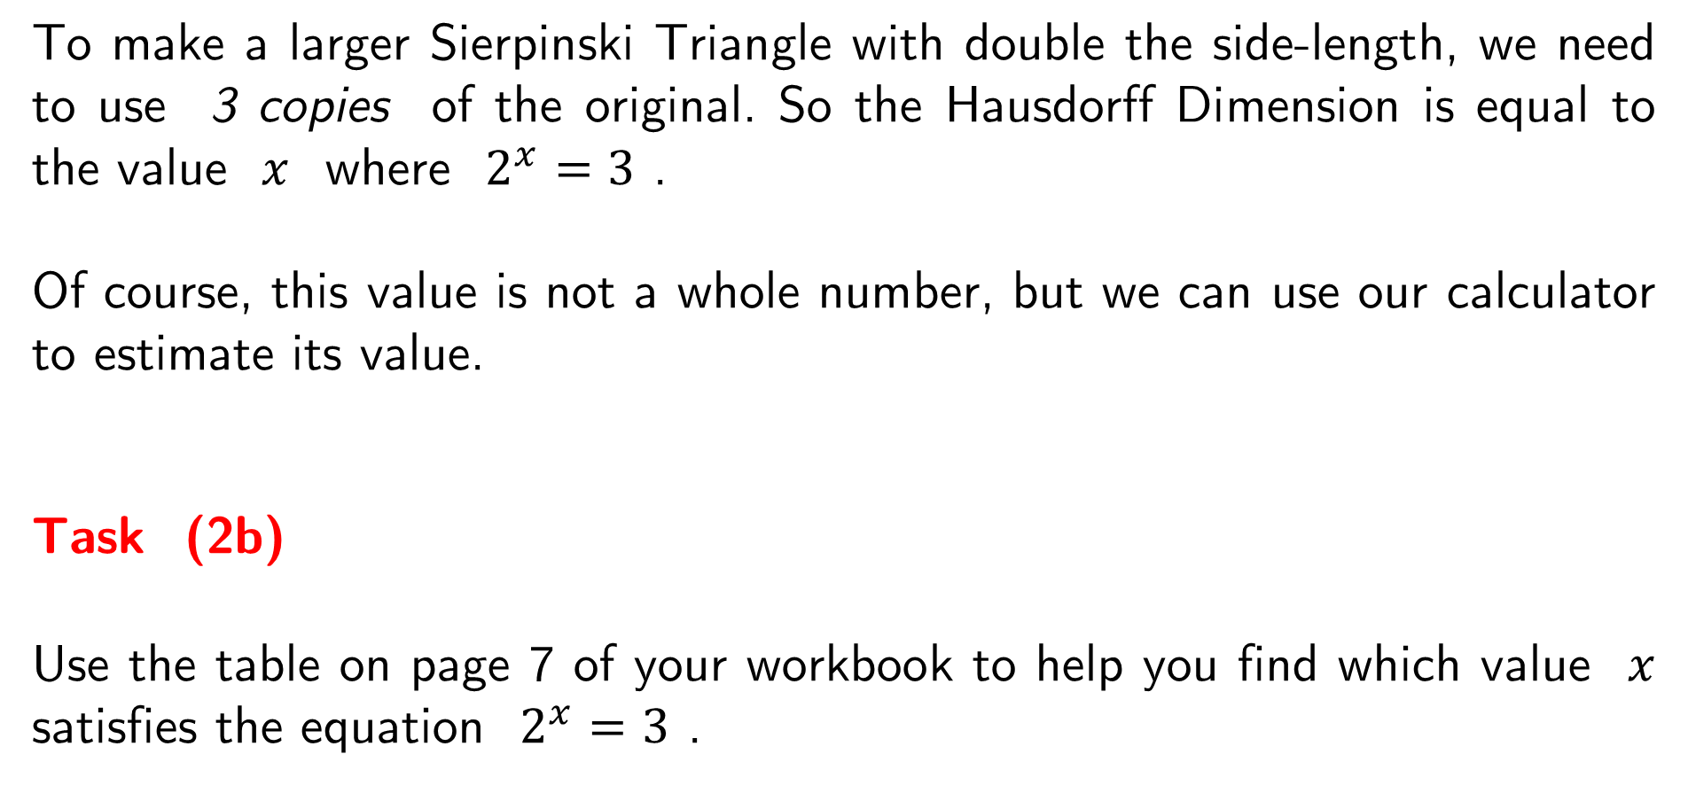
To make a larger Sierpinski Triangle with double the side-length, we need to use 3 copies of the original. So the Hausdorff Dimension is equal to the value $x$ where $2^{x}=3$ .
Of course, this value is not a whole number, but we can use our calculator to estimate its value.
Task (2b)
Use the table on page 7 of your workbook to help you find which value $x$ satisfies the equation $2^{x}=3$ .

Slide 33
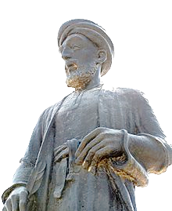
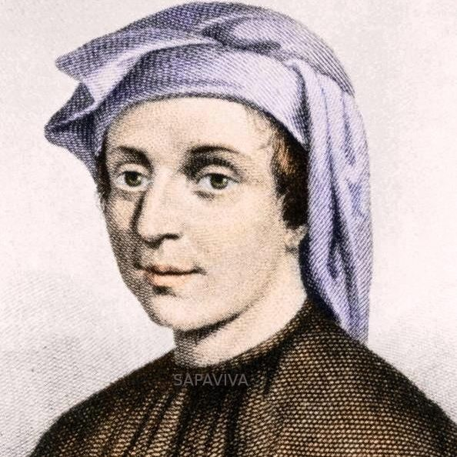
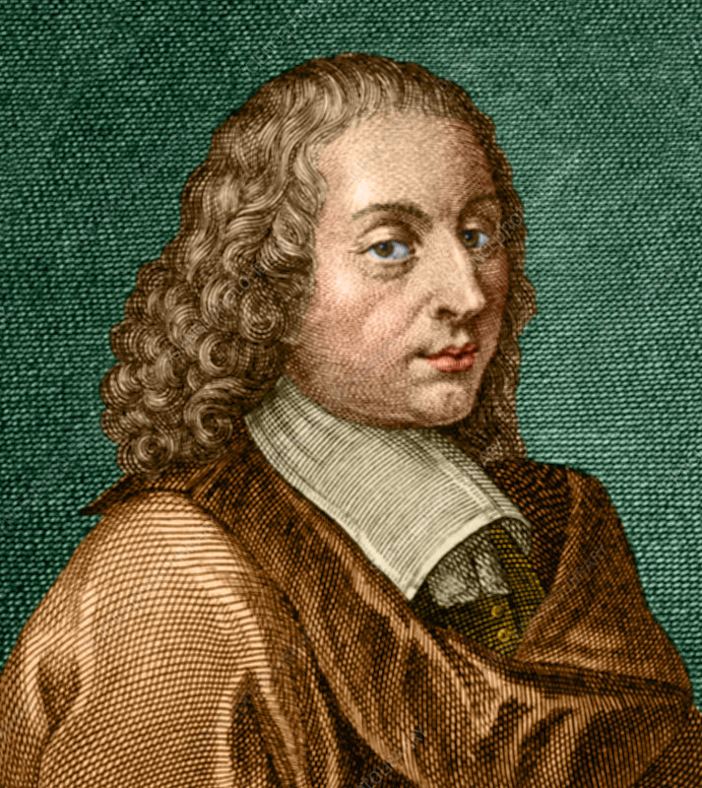
Pingala
2nd or 3rd Centuries BC
al-Khalil ibn Ahmad al-Farahidi
700’s
Leonardo Fibonacci
Early 1200’s
Blaise Pascal
1600’s
Combinatorics
How is mathematics related to language and poetry?
Why do I have an issue with combination padlocks?
If ‘43 quintillion’ is the answer, what is the question?

Slide 34
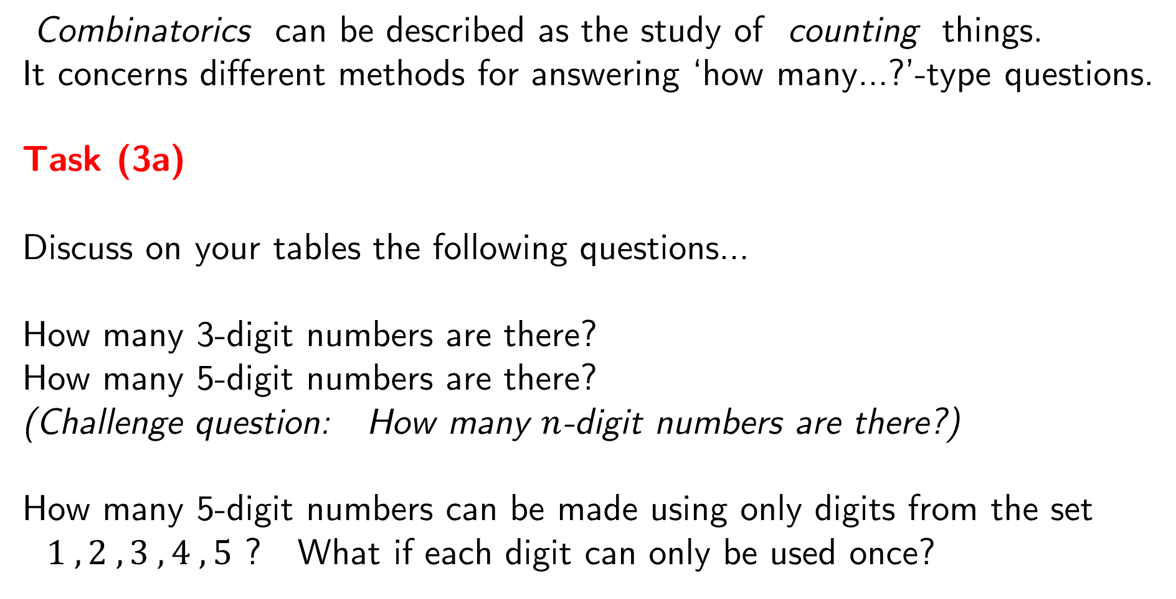
Combinatorics can be described as the study of counting things.
It concerns different methods for answering ‘how many…?’-type questions.
Task (3a)
Discuss on your tables the following questions…
How many 3-digit numbers are there?
How many 5-digit numbers are there?
(Challenge question: How many $n$-digit numbers are there?)
How many 5-digit numbers can be made using only digits from the set
$1 , 2 , 3 , 4 , 5$ ? What if each digit can only be used once?

Slide 35
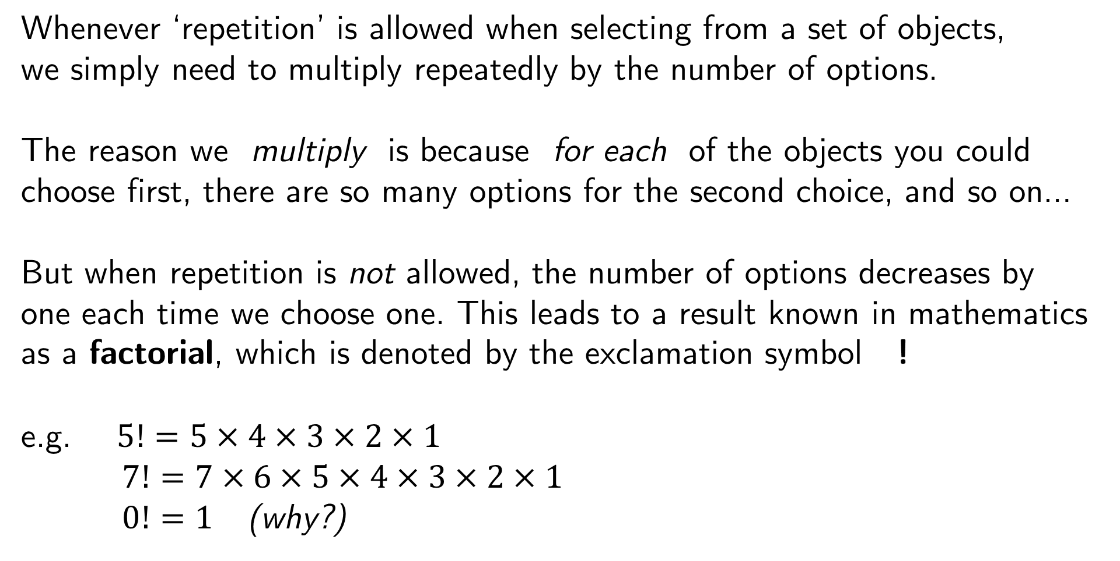
Whenever ‘repetition’ is allowed when selecting from a set of objects,
we simply need to multiply repeatedly by the number of options.
The reason we multiply is because for each of the objects you could choose first, there are so many options for the second choice, and so on…
But when repetition is not allowed, the number of options decreases by one each time we choose one. This leads to a result known in mathematics as a factorial, which is denoted by the exclamation symbol !
e.g. $5!=5×4×3×2×1$
$7!=7×6×5×4×3×2×1$
$0!=1$ (why?)
Essentially, the factorial provides the number of ways that a chain of characters can be rearranged (e.g. anagrams).

Slide 36
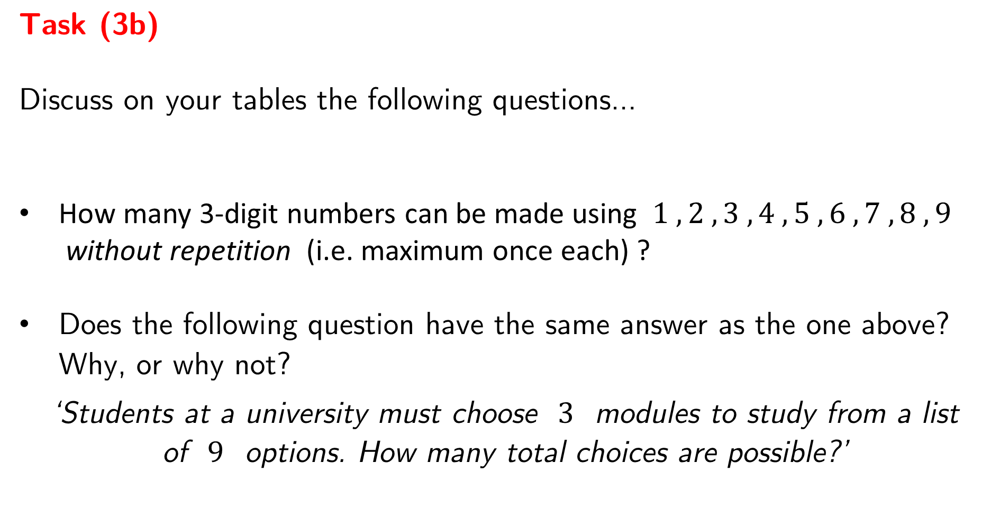
Task (3b)
Discuss on your tables the following questions…
How many 3-digit numbers can be made using $1 , 2 , 3 , 4 , 5 , 6 , 7 , 8 , 9$
without repetition (i.e. maximum once each) ?
Does the following question have the same answer as the one above?
Why, or why not?
‘Students at a university must choose $3$ modules to study from a list
of $9$ options. How many total choices are possible?’

Slide 37
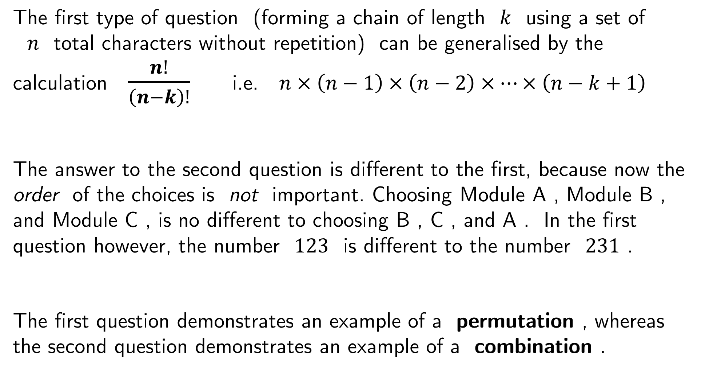
The first type of question (forming a chain of length $k$ using a set of
$n$ total characters without repetition) can be generalised by the calculation $\frac{n!}{\left(n−k\right)!}$ i.e. $n×\left(n−1\right)×\left(n−2\right)×…×\left(n−k+1\right)$
The answer to the second question is different to the first, because now the order of the choices is not important. Choosing Module A , Module B , and Module C , is no different to choosing B , C , and A . In the first question however, the number $123$ is different to the number $231$ .
The first question demonstrates an example of a permutation , whereas the second question demonstrates an example of a combination .

Slide 38
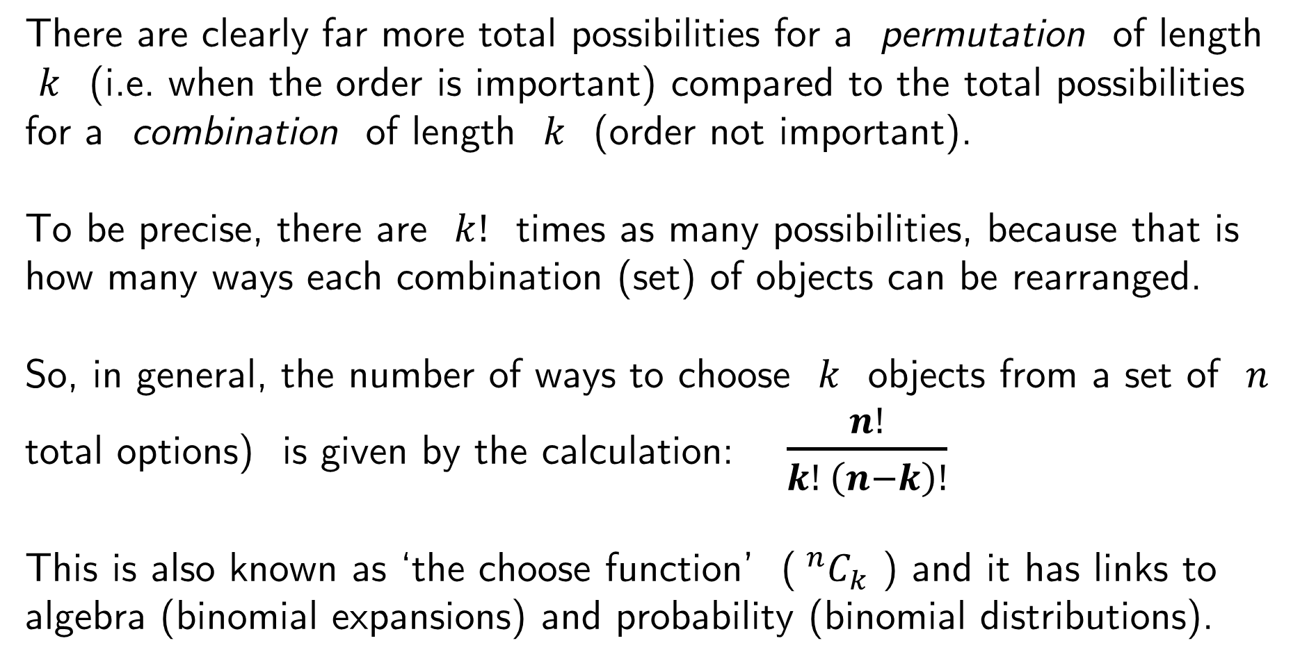
There are clearly far more total possibilities for a permutation of length
$k$ (i.e. when the order is important) compared to the total possibilities for a combination of length $k$ (order not important).
To be precise, there are $k!$ times as many possibilities, because that is how many ways each combination (set) of objects can be rearranged.
So, in general, the number of ways to choose $k$ objects from a set of $n$ total options) is given by the calculation: $\frac{n!}{k! \left(n−k\right)!}$
This is also known as ‘the choose function’ ($^{n}C_{k}$ ) and it has links to algebra (binomial expansions) and probability (binomial distributions).

Slide 39
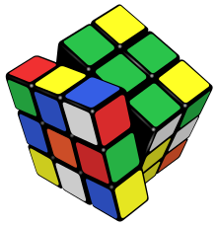
Combinatorics can be applied to almost any field of study.
Pingala was an Indian poet who wrote over 2100 years
ago about the number of possible ways to form the
lines of a poem using particular rhythms and syllables.
Al-Khalil ibn Ahmad al-Farahidi (8th Century)
used permutations and combinations to calculate
the total number of words that could possibly by
formed using the Arabic language.
In modern times, combinatorial ideas helped mathematicians determine that the Rubik’s Cube has
43 252 003 274 489 856 000 permutations.

Slide 40
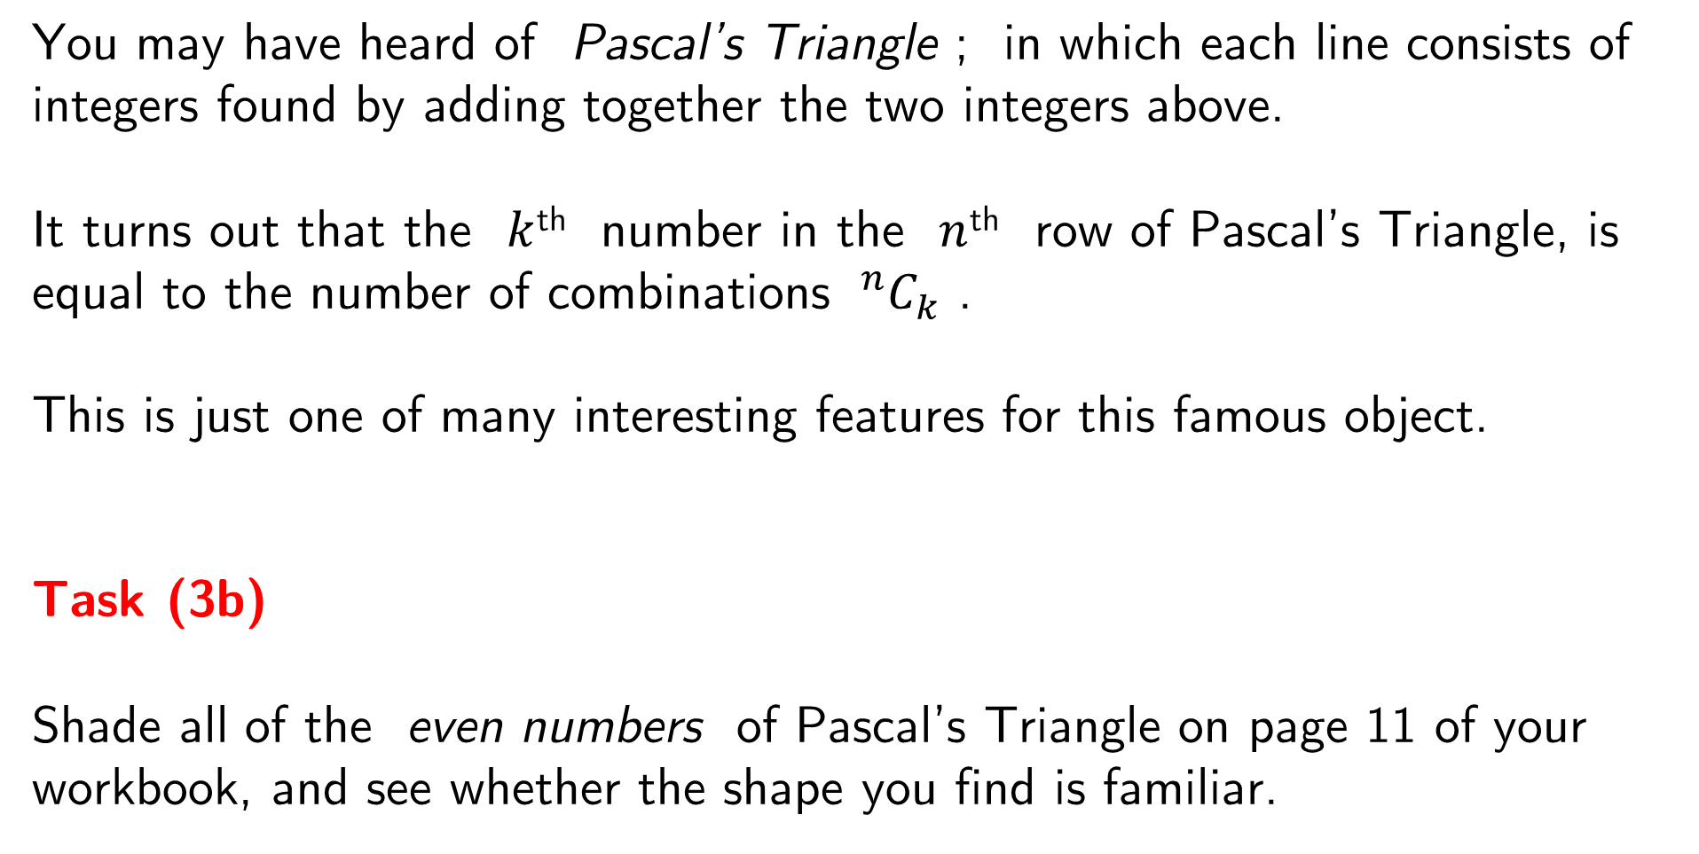
You may have heard of Pascal’s Triangle ; in which each line consists of integers found by adding together the two integers above.
It turns out that the $k$^{th} number in the $n$^{th} row of Pascal’s Triangle, is equal to the number of combinations $^{n}C_{k}$ .
This is just one of many interesting features for this famous object.
Task (3b)
Shade all of the even numbers of Pascal’s Triangle on page 11 of your workbook, and see whether the shape you find is familiar.

Slide 41
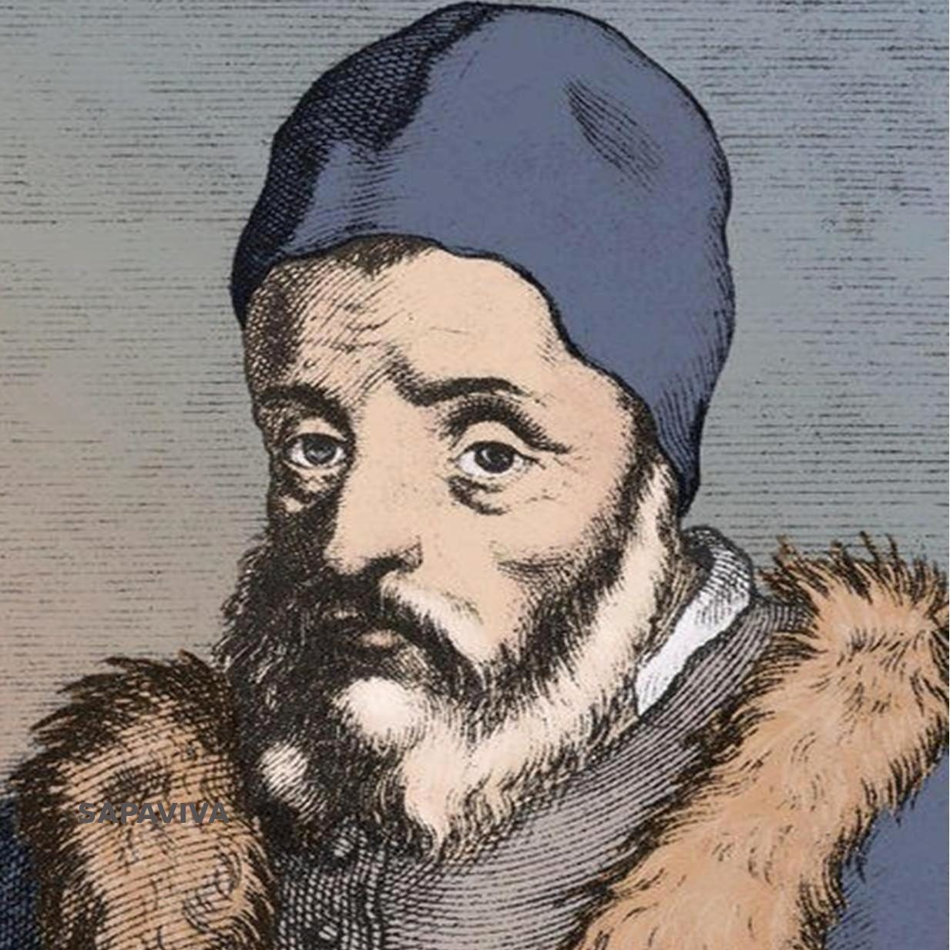
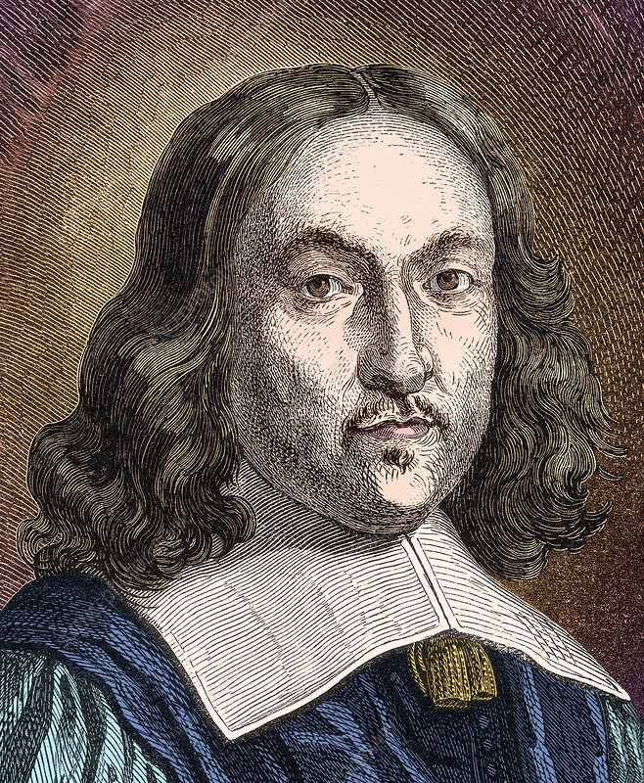
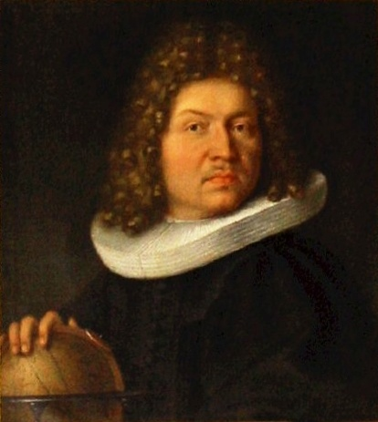
Gerolamo Cardano
1500’s
Pierre de Fermat
1600’s
Jacob Bernoulli
Later 1600’s
Probability
Is it possible for mathematical results to be surprising?
What links randomness, prime numbers, and circles?
Why is it always better to have more data?

Slide 42

How likely is it that two people in this room share the same birthday?
Make a guess for the probability, and then let’s find out!

Slide 43
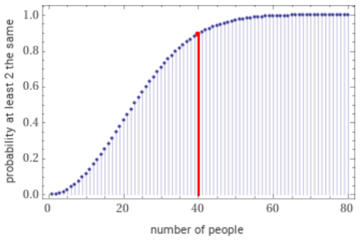
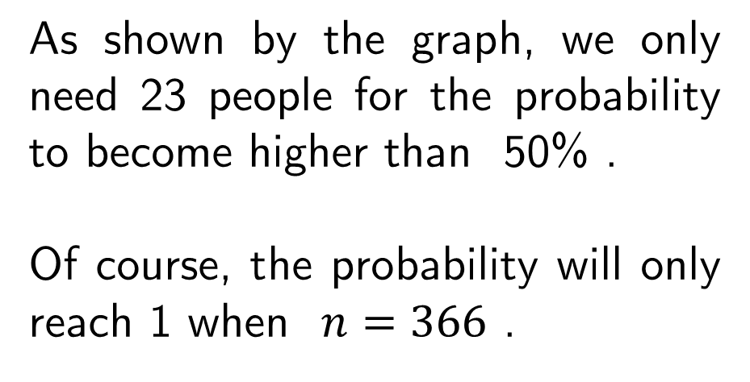
Amazingly, in a group of 40 people, the probability that two people share a birthday is over 89% , even though there are 365 possible birthdays.
Probability is one of the few areas of mathematics and statistics which has the ability to be consistently surprising.
As shown by the graph, we only need 23 people for the probability to become higher than 50% .
Of course, the probability will only reach 1 when $n=366$ .

Slide 44
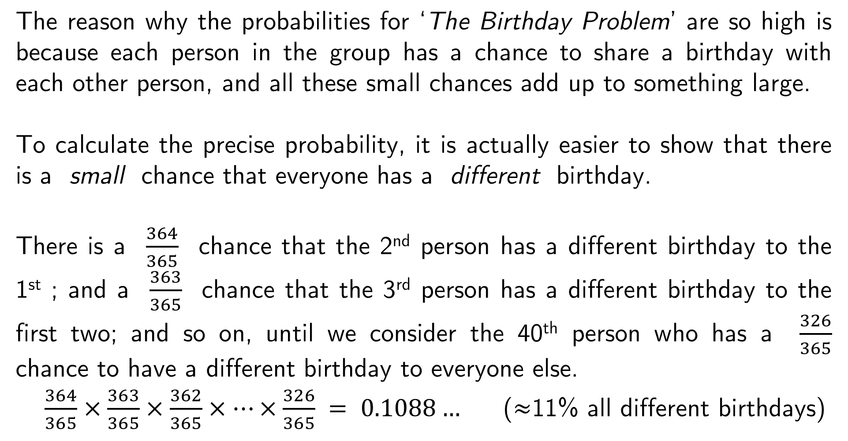
The reason why the probabilities for ‘The Birthday Problem’ are so high is because each person in the group has a chance to share a birthday with each other person, and all these small chances add up to something large.
To calculate the precise probability, it is actually easier to show that there is a small chance that everyone has a different birthday.
There is a $\frac{364}{365}$ chance that the 2nd person has a different birthday to the 1st ; and a $\frac{363}{365}$ chance that the 3rd person has a different birthday to the first two; and so on, until we consider the 40th person who has a $\frac{326}{365}$ chance to have a different birthday to everyone else.
$\frac{364}{365}×\frac{363}{365}×\frac{362}{365}×…×\frac{326}{365} = 0.1088…$ ($≈$11% all different birthdays)

Slide 45
The reason why Probability is considered a topic in Statistics , is because there are many things for which it is difficult (or even impossible) to calculate the exact chance, and therefore we collect data to inform us about how likely certain things are to occur.
e.g. The probability that a randomly selected person is called Steve.
Or the probability that the next car you see is green.
Statistics is (partly) about using known data to measure uncertain events.
We are going to perform a data collection experiment to help us estimate the probability for a particular event involving divisibility of integers…

Slide 46
What is the probability that two randomly selected integers are co-prime ?
‘Co-prime’ means they have no common factors (apart from 1)
In other words, the highest common factor (hcf/gcd) is equal to 1 .
e.g. 8 and 9 are co-prime , 6 and 9 are not , 5 and 15 are not .
Task (4)
In pairs, each generate a random number from 1 to 100 , and then record whether or not your numbers are co-prime using the table on page 13 of the workbook. Repeat this process as many times as you can.

Slide 47

Quick checks:
They are not co-prime if both
numbers are even.
You can check divisibility by 3 or 9
by adding the digits.
If one number divides the other
then they are not co-prime.
If one number is prime, then they
must be co-prime unless it is a factor of the other number.
Prime Numbers

Slide 48
How can you use your data to estimate the probability?
If we count the frequency of co-primes out of the total frequency, this provides us with something called the experimental probability .
As we collect more and more data, the experimental probability will move closer towards the true, theoretical probability . This convergence is known as the law of large numbers , which was first mathematically proven by Jakob Bernoulli in the 1680’s.
In this case it is possible to prove the theoretical probability, which is closely related to something we have seen previously…

Slide 49
Interested in more? You may enjoy these!
Matt Parker on YouTube: Stand-up Maths
Grant Sanderson on YouTube: 3Blue1Brown
Mathigon.org: Topics Mathematician Timeline
Or take a look at any of the following books…

Slide 50


Slide 51


Slide 52


