Slide 1
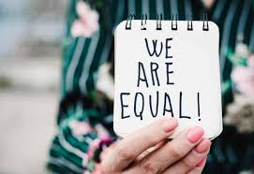
Discrimination
Politics Taster Session

Slide 2
What is politics?

Slide 3

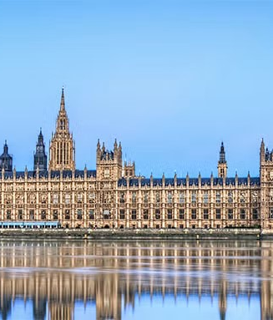
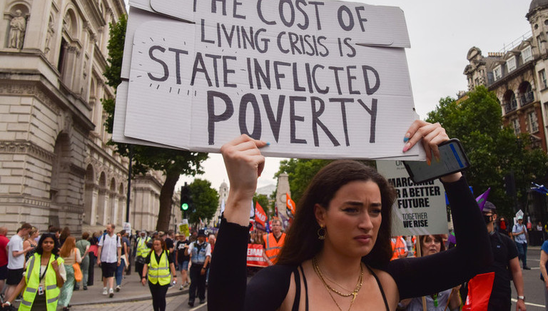
What is politics?
The politicians’ view of ‘politics’: the ‘game’
Politics as formal and informal institutions
Politics as something we all do

Slide 4
Discrimination is a political issue because:
It violates the principles of human rights and equality, which are fundamental political values in democratic societies
It results in marginalization and exclusion of certain groups from the benefits and opportunities available in society
It can be perpetuated or challenged through power structures in politics and society.
It can serve as a critical issue for voters and electoral platforms
It can drive social movements, protests and lobbying

Slide 5
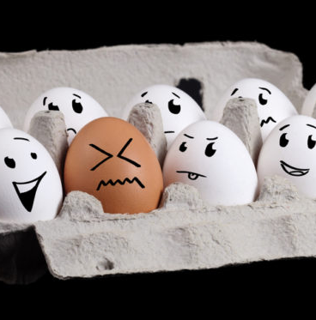
Overview
What is discrimination?
Direct and indirect discrimination
Why is discrimination wrong?
Some puzzles
Statistical discrimination: the case of racial profiling

Slide 6
1. The concept of discrimination

Slide 7
The legal definition of discrimination
The Equality Act 2010 legally protects people from discrimination in the workplace and in wider society, based on: Age, Race, Sex, Gender reassignment, Disability, Religion or belief, Sexual orientation, Marriage or civil partnership, Pregnancy and maternity
The European Convention for the Protection of Human Rights declares, “The enjoyment of the rights and freedoms set forth in this Convention shall be secured without discrimination on any ground such as sex, race, color, language, religion, political or other opinion, national or social origin, association with a national minority, property, birth or other status” (Article 14).
However, Wouter Vandenhole finds that “[t]here is no universally accepted definition of discrimination” (2005: 33).

Slide 8
The philosophical concept of discrimination
An agent, X, discriminates against someone, Y, in relation to another, Z, by Φ-ing (e.g., hiring Z rather than Y) if, and only if:
There is a property, P, such that Y has P or X believes that Y has P, and Z does not have P or X believes that Z does not have P
X treats Y worse than he treats or would treat Z by Φ-ing, and
It is because (X believes that) Y has P and (X believes that) Z does not have P that X treats Y worse than Z by Φ-ing.
Notes:
Moralized – age discrimination

Slide 9
Protected characteristics
Age
Race
Sex
Gender reassignment
Disability
Should we expand the list of protected characteristics ?
Religion or belief
Sexual orientation
Marriage or civil partnership
Pregnancy and maternity

Slide 10
Casamitjana v League Against Cruel Sports
Jordi Casamitjana was employed by an animal welfare charity (LACS) where he was dismissed.
LACS stated that he was terminated from his employment due to gross misconduct.
However, Mr Jordi Casamitjana maintained that it was due to his belief in ethical veganism.
It was argued that his choice to be a vegan was more than a lifestyle, it was to do with ethics that impacts all aspects of his life. He has regularly participated in animal protection campaigns both independently and through organisations.
On 3 January 2020 an Employment Judge ruled that “ethical veganism” qualifies as a “philosophical belief” which is one of the nine protected characteristics under the Equality Act 2010.

Slide 11
Group discussion: Should we expand the list of protected characteristics?
Veganism
Facial tattoos
Weight

Slide 12
2. Direct and Indirect Discrimination

Slide 13
Direct Discrimination
A discriminates directly against P on the basis of a characteristic C if and only if A treats P unfavourably because P has C or because A believes that P has C.
It is often intentional but can be unintentional (e.g., implicit bias)
It may involve mistakes (e.g., a person might experience discrimination because he is mistakenly thought to be a Muslim)
It isn’t always morally wrong (e.g., a man might justifiably be rejected for a job in a women’s refuge because of his gender)
But does C have to involve being a member of a ‘socially salient group’?
  ‘A group is socially salient if perceived membership of it is important to the structure of social interactions across a wide range of social contexts’ (Lippert-Rasmussen, Born Free and Equal?, p. 30)

Slide 14
Example: Roma case
In 2002, several men of Roma descent entered a bar in a Romanian town and were refused service. The bar employee explained his conduct by pointing out to them a sign saying, “We do not serve Roma.”
The Romanian tribunal deciding the case ruled that the Roma men had been the victims of unlawful direct discrimination.
The bar’s policy, as formulated in its sign, explicitly and intentionally picked out the Roma qua Roma for disadvantageous treatment.
It was those two features—explicitness and intention—that made the Roma case a paradigmatic example of direct discrimination.

Slide 15
Indirect Discrimination
A rule (or policy) indirectly discriminates against people who possess some characteristic C when the adoption of that rule is not the result of any bias against people who possess C, but acting on it nevertheless on average disadvantages people who possess C compared to people who don’t.
The disadvantage caused is unintentional (although it may be foreseeable)
Indirect discrimination is not always morally wrong
It can be hard to know whether discrimination is direct or indirect

Slide 16
Example: Griggs v. Duke Power (1971)
A company in North Carolina used a written test to determine promotions. The use of the test had the result that almost all black employees failed to qualify for the promotions.
The company was not accused of direct discrimination, i.e., there was no claim that a racially discriminatory attitude was behind the decision of the company to use the written test.
But the court found that the test did not measure skills essential for the jobs in question and that the state of North Carolina had a long history of deliberately discriminating against blacks by, among other things, providing grossly inferior education to them.
In ruling for the black plaintiffs, the court reasoned that the policy of using the test was racially discriminatory, because of the test’s disproportionate racial impact combined with the fact that it was not necessary to use the test to determine who was best qualified for promotion.

Slide 17
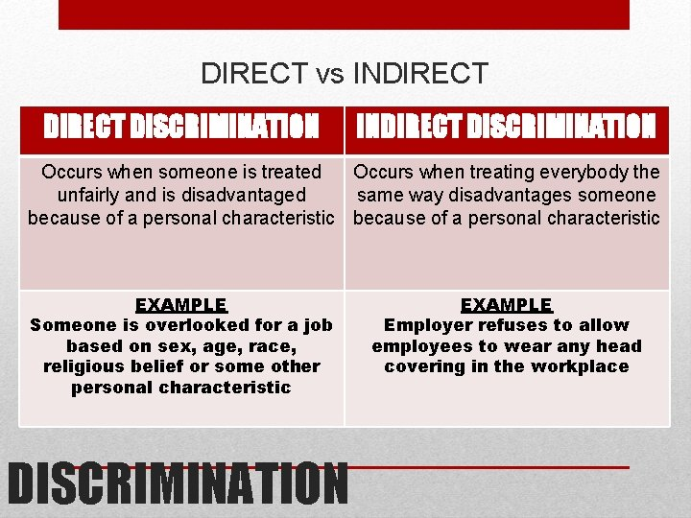
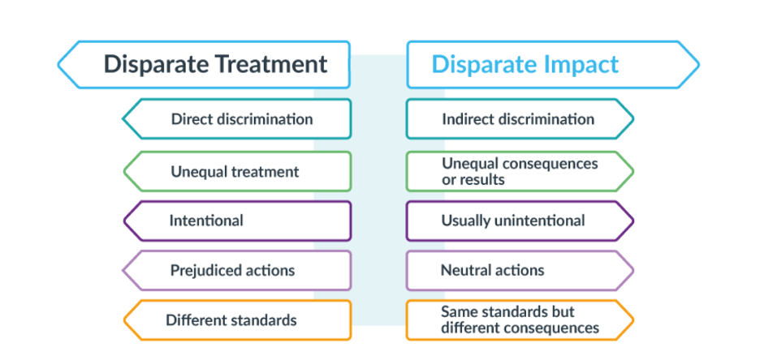
Direct vs Indirect Discrimination

Slide 18
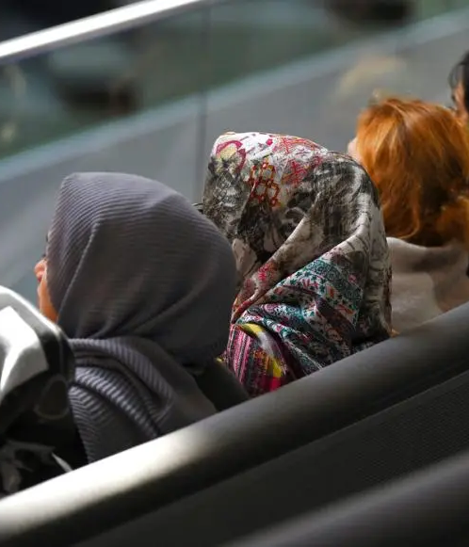
Group discussion: Are employers justified in imposing religious dress bans?

Slide 19
3. The wrongness of discrimination

Slide 20
Theories of what makes discrimination wrong
Theories that focus on the act of discrimination and what it expresses
Discrimination is wrong when and because it is demeaning or disrespectful
Discrimination is wrong when and because it is intrinsically unfair
Theories that focus on the consequences of discrimination
Discrimination is wrong when and because it doesn’t lead to the greatest happiness
Discrimination is wrong when and because it leads to an unjust distribution of benefits and burdens

Slide 21
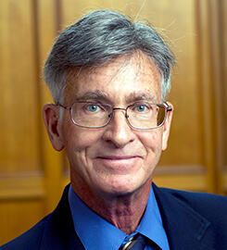
Larry Alexander
‘[w]hen a person is incorrectly judged to be of lesser moral worth and is treated accordingly that treatment is morally wrong regardless of the gravity of its effects’
[Alexander, ‘What Makes Wrongful Discrimination Wrong?’]
Discrimination is wrong, when it is wrong, because of the beliefs of the person doing the discriminating (i.e., the discriminator)
In particular, it is wrong when the discriminator believes that the victim is morally inferior

Slide 22
Lippert-Rasmussen’s counter example
Imagine a racist society in which there’s an unregulated drug testing program
One scientist, A, tests drugs on a racial minority because he believes they are inferior.
Another scientist, B, believes that members of this racial minority are of equal moral worth, but nevertheless tests drugs on them because he is happy to act in accordance with the racist norms of his society.
If what matters for the wrongness of discrimination is whether the discriminator believes that his/her victims are inferior, then
it’s not clear that B discriminates wrongfully
it would seem that A’s actions must be worse than B’s
Did B wrongfully discriminate? Is this view adequate in explaining the wrongness of discrimination?

Slide 23
Deborah Hellman (1)
Hellman’s account has some similarities with Alexander’s account: both are concerned with how discrimination may involve the denial of moral equality
But Hellman argues that discrimination is wrong (when it is wrong) because of its meaning, i.e., what it expresses
So, for example, in a society in which black people are a disadvantaged group, toilets or water fountains that are segregated by race send out the message that black people are morally inferior

Slide 24
Deborah Hellman (2)
Discrimination can express the idea that the victims have lesser moral worth
It may express this idea even if the discriminator doesn’t think they have lesser moral worth
It may express this idea even if the person discriminating doesn’t intend to treat them as having lesser moral worth.
Consider Lippert-Rasmussen’s two scientists: the behaviour of each sends out the message that members of the racial minority are inferior

Slide 25
Deborah Hellman (3)
Hellman’s account is grounded in the fundamental equal moral worth of all persons:
People have moral worth, i.e., their lives matter morally
People have equal moral worth, i.e., their lives matter equally, from a moral point of view.

Slide 26
Deborah Hellman (4)
People are demeaned when they are treated as if they have lesser moral worth, that is, as if their lives matter less than the lives of others
  ‘To demean is to treat another as not fully human or not of equal moral worth. To demean therefore is partly an expressive act. One’s action expresses that the other is less worthy of concern or respect’ (p. 35)
There is a difference between merely insulting a person and demeaning them

Slide 27
Deborah Hellman (5)
When is an act of discrimination demeaning?
Hellman thinks two factors are crucial:
Whether those who experience the discrimination have a history of mistreatment, or possess a lower social status, or are part of a group that is socially disadvantaged (i.e., whether they possess what Hellman calls an ‘HSD’ trait)
  Without there being an inequality of some sort, an act of discrimination will not in general have the power to demean others or put them down (pp. 35ff).
What the conventional meaning is of the act in the context where it is performed.

Slide 28
Deborah Hellman (6)
Understanding the social meaning of an action may involve complex interpretive judgements (p. 41).
There may be disagreement over social meanings, e.g., people may disagree about the meaning of requiring workers, some of whom may be transgender, to use single sex toilets (pp. 60ff)
But social meanings are often “objective”
  ‘Sometimes it is wrong to classify because of what it expresses – regardless of whether the person or people affected feel demeaned, stigmatised or degraded’ (p. 27)

Slide 29
Deborah Hellman (9)
Case 1:
Suppose a lecturer assigns grades to his students depending on the total number of letters in their full names. The person with the most letters in their full name gets the highest mark.
Hellman would say that this involves discrimination – discrimination on the basis of the number of letters in your name.
But it is not wrongful discrimination – there’s nothing demeaning about it.
Nevertheless it may be wrongful, even if it’s not wrongful discrimination.
Students have a legitimate expectation that their exam scripts will be graded on their merits, according to the criteria set out in handbooks etc.

Slide 30
Deborah Hellman (10)
Case 2:
A university selects students and staff on the basis of political affiliation rather than merit.
Hellman would say that they have violated the purpose of a university, which is to further the values of higher education rather than benefit political cronies (p. 17)
But they haven’t discriminated wrongfully even if they’ve acted wrongfully.
But is this coherent?
Why not say in both Case 1 and Case 2 that the discrimination is wrongful, but that it is wrongful for a different reason?

Slide 31
Group Discussion
Are single-sex toilets demeaning to non-binary people?

Slide 32

Harm-based theories: Kasper Lippert-Rasmussen (1)
“Discrimination is wrong only when it causes harm.”
What does ‘harm’ mean here?
A person is harmed by an action if and only if they are made worse off by it.
Kasper Lippert-Rasmussen:
“An instance of discrimination is wrong, when it is, because it makes people worse off, i.e., they are worse off given the presence of discrimination than they would have been in some suitable alternative situation in which the relevant instance of discrimination had not taken place” (Born Free and Equal?, pp. 154-155)

Slide 33
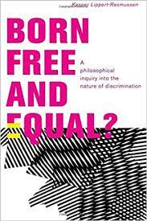
Harm-based theories: Kasper Lippert-Rasmussen (2)
Lippert-Rasmussen accepts that his harm-based theory of what makes discrimination wrong is incomplete in various ways.
Almost any act of discrimination will harm some and benefit others.
Harm is a necessary but not sufficient condition of an act of discrimination being wrong
So a harm-based theory of what makes discrimination wrong will have to provide an account of how we weigh harms to some against benefits to others.

Slide 34
Consequentialist theories
Harm-based theories of what makes discrimination wrong are consequentialist
What is consequentialism?
Consequentialism holds that actions/policies (such as an act of discrimination) are to be judged in terms of whether they maximise moral value
But forms of consequentialism may differ in terms of how they conceive of moral value

Slide 35
4. Some puzzles

Slide 36
Religious liberty vs anti-discrimination law
Claims of religious liberty are frequently made by persons who wish to engage in activities that appear to amount to discrimination.
Religious institutions and religiously-motivated individuals claim to be exempt from the requirements of antidiscrimination laws.

Slide 37

Masterpiece Cakeshop
When religious beliefs conflict with the rights and protections of the LGBT community, how do we navigate the balance between respecting religious freedom and combating discrimination?

Slide 38
Hiring quotas
Should companies be required to implement hiring quotas for underrepresented groups (e.g., women, minorities) to address historical discrimination and promote diversity, even if it means potentially hiring less qualified candidates over more qualified ones from the majority group?

Slide 39

Cultural appropriation
When does the adoption or use of elements from another culture become inappropriate, offensive, or discriminatory, and how can we respect and appreciate cultural diversity without crossing those boundaries?

Slide 40
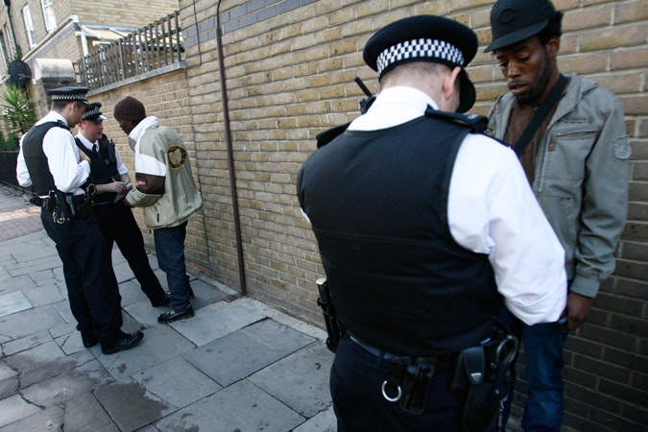
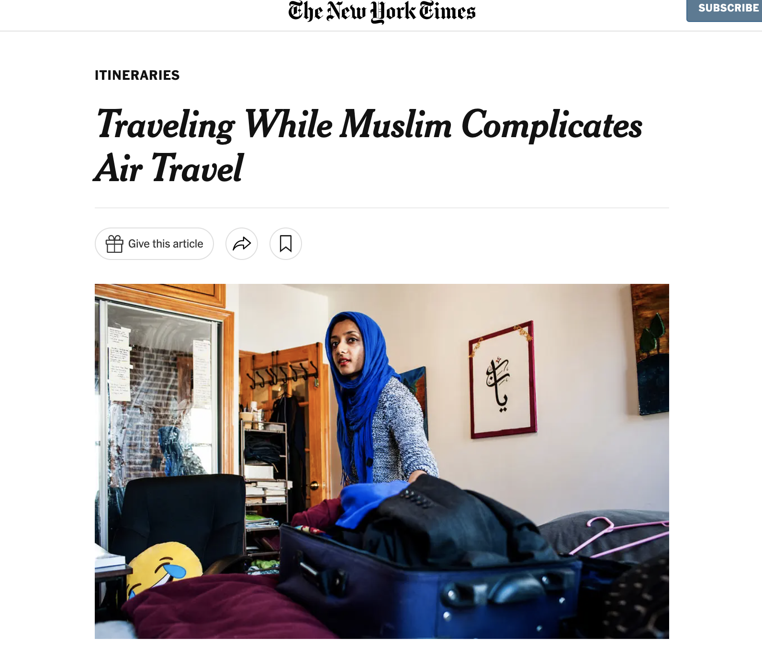
Statistical discrimination
The case of racial profiling

Slide 41
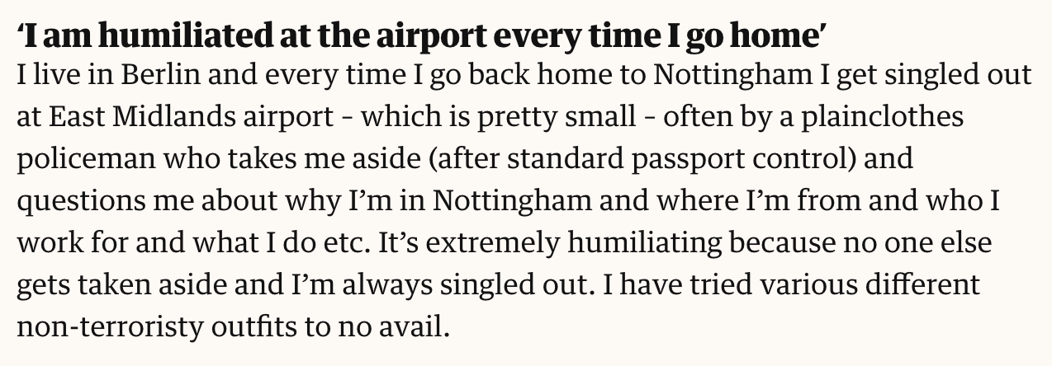
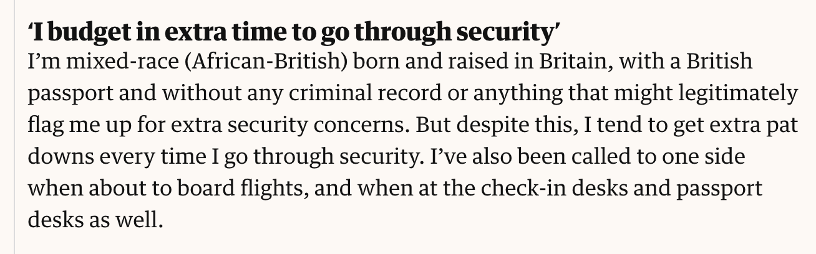

Slide 42
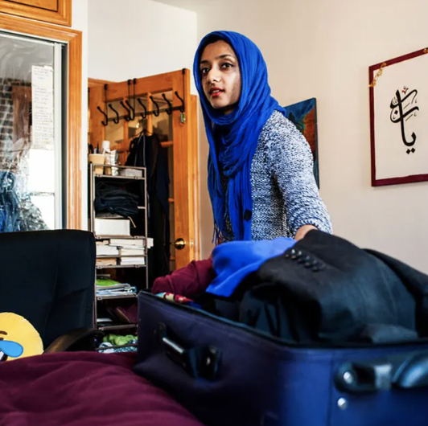
WHAT IS RACIAL PROFILING?
“any police-initiated action that relies on the race, ethnicity, or national origin and not merely on the behavior of an individual” (Risse & Zeckhauser)
E.g. screening at airports, searches of cars and people based on racial criteria.

Slide 43
RISSE AND ZECKHAUSER’s justification of racial profiling
- based on economic theory of crime
UTILITARIAN ARGUMENT: the benefits outweigh the costs.
THE BENEFITS: public good of security.
THE HARMS: resentment, hurt, loss of trust.

Slide 44
Benefits vs harms
THE BENEFITS:
public good of security.
Better at finding those who have committed crimes.
Deterrent effects.
THE HARMS:
R&Z’s claim: negative effects are not that great.
Profiling involves resentment, hurt, loss of trust.
But most of this is about underlying racism, not RP itself.

Slide 45
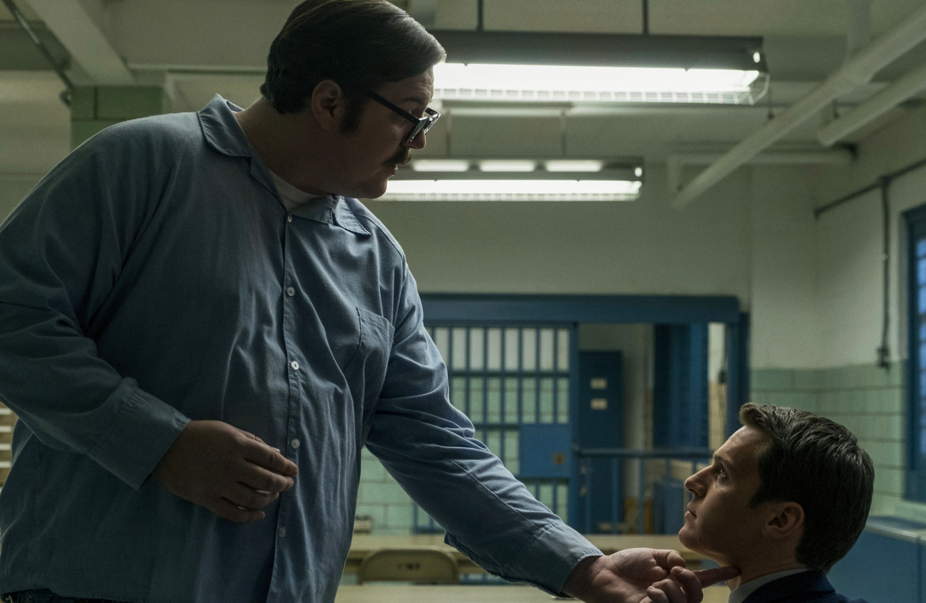
RISSE AND ZECKHAUSER
Profiling itself not troubling, e.g. serial killers.
Harm of profiling an “epiphenomenon”, “parasitic” on existing racism.

Slide 46
LEVER AGAINST R & Z (1)
Racial profiling CONTRIBUTES TO and does not just REFLECT racial injustice.
RP “publicly links black people with a tendency to crime”.
Racial profiling does not just involve resentment, hurt, loss of trust, but also FEAR.
Feelings of “embarrassment, humiliation, inconvenience and distrust” should not be dismissed.

Slide 47

HOSEIN against racial profiling
States must:
Give equal weight to the interests and rights of all members of the political community
Seek to ensure that all members of the political community have CONFIDENCE that this is the case

Slide 48
HOSEIN – Racial profiling creates a reasonable sense of inferior political status
Reasonable sense of inferior political status:
There is a “belief that the state substantially discounts the rights and interests of members of one’s group relative to the rights and interests of members of other groups”.
There is grounds to JUSTIFY this belief.

Slide 49
HOSEIN
Black and AMEMSA people have good reasons to distrust the US state, and especially the parts of the state dealing with crime
Against this background, why might profiling lead to a reasonable sense of inferior political status?
Profiling and stereotyping
Profiling and the use of race as a negative proxy
➔Randomized screening and curbs on police abuse.

Slide 50

WHAT CAUSES CRIME?
Kasper Lippert-Rasmussen:
Higher crime rates in certain groups might be linked to social and economic deprivation.
If this deprivation is UNJUST, then racial profiling cannot be justified.

Slide 51
Debate: Is racial profiling justified?

