Slide 1
THANK YOU FOR JOINING THE PRE-UNIVERSITY SUMMER SCHOOL PRE-DEPARTURE BRIEFING FOR PARENTS/GUARDIANS
WE WILL START THIS SESSION SHORTLY
PLEASE NOTE WE WILL BE RECORDING THIS PRESENTATION

Slide 2

Warwick Pre-University Summer School: Parent Pre-Departure Briefing
14 – 24 July 2026
Notes:
Hello everyone, and thank you very much for joining us today.
We really appreciate you taking the time to join this session, and we hope it will give you a clear and reassuring overview of the Pre-university Summer School programme.
We will be recording this session so we can upload this on our offer holder webpages, so please feel free to keep your cameras off if you prefer nd please ake sure your microphones are muted throuhhgout the presentation to avoid any background noise

Slide 3





Welcome and Introduction
Pre‑University Summer School Team
Rachael Brogan
Suzi Barrett
Katie Barlow
Pre-University Summer School Lead
Fiona Wallace
Director of Summer Schools
Chris Jones
Assistant Academic Director of
Summer Schools
Departmental Safeguarding Officers
Notes:
I’ll start with a quick introduction to who we are.
There are a number of staff on the call today, and we are part of the university team responsible for delivering the Pre-University Summer School.
Our collective goal is to make sure that students not only have a really engaging academic experience, but that they are also safe, supported, and well looked after throughout their time with us. Suzi and I are responsible for the Safeguarding aspects of the programme, and my colleague Katie oversees the academic, social and logisitcal delivery of the programme. Chris is with us today, he is the Assistant Academic Director Director of Summer Schools and he has designed the skills sessions you children will be undertaking as part of the programme.
You’ll see throughout this session that we have a number of different staff roles and we all working together to support students from arrival through to departure.

Slide 4
Purpose of today's session
Give you a clear understanding of how we keep students safe, supported, and well supervised throughout the programme
Explain the key safeguarding measures and wellbeing support in place
Help you understand what to expect and how the programme runs in practice
Provide the information you need to prepare your child for the programme
Clarify what we need from you as parents/guardians to support a safe and positive experience
Give an opportunity to ask questions
Notes:
Before we get into the detail, I just want to quickly explain what we’re hoping you’ll take away from this session.
Really, this is about giving you reassurance — helping you understand how we keep students safe, supported, and well supervised throughout the programme.
We’ll talk through how things work in practice, what your child’s experience will look like, and what you need to do to help them prepare.
We’ll also highlight what we need from you as parents, so everything runs as smoothly as possible.
There will be time at the end for any questions you might have.
Please do use the chat function to note any questions you think of along the way so we can address them at the end of the session.

Slide 5
Student Safety and Support

Slide 6

Student Safety
Carefully selected, vetted and trained staff
  Enhanced DBS checks (including children's barred list) and comprehensive training for all core Summer School staff
  Dedicated Student Support
  Student to ambassador ratio is typically 1:12,
  ensuring accessible pastoral support throughout the
  programme.
  Secure Accommodation
  Controlled access to residences, with staff presence and overnight support.
  Monitoring and Welfare
  Curfews, attendance monitoring and round-the-clock access to staff and on-campus Community Safety teams.
Notes:
Just to give you a bit more reassurance around how we keep students safe throughout the programme — everything we do is built around having the right people, structures, and systems in place. We have delivered the programme for a number of years now and are constantly reviewing and refining our processes so we know they work as we want them to.
All of our staff are carefully selected, fully vetted, and trained, including enhanced DBS checks and safeguarding training. In the UK, a DBS check (Disclosure and Barring Service) is used by employers to make sure people are safe to work with children or vulnerable adults. An enhanced DBS check is the highest level.
Students are supported day-to-day by our Ambassador team, with a strong staff-to-student ratio, so there’s always someone accessible if they need help or support.
In terms of accommodation, your child will be staying in University managed accommodation. It is very secure and has controlled access. There is a staff presence on site at all times — including overnight support.
Throughout the programme, we have clear systems in place for monitoring attendance and wellbeing, including curfews and 24/7 access to staff and our on-campus Community Safety team.
So overall, students are supported and accounted for at every stage, and there is always someone available if they need assistance.

Slide 7
Student Support
Programme Team oversee academic, social, and logistical delivery, manage all staff, lead safeguarding and wellbeing processes, and provide 24/7 support throughout the programme.
Summer School Ambassadors are current Warwick students who provide a friendly introduction to university life.
  Students live in flat groups supported by two dedicated Ambassadors and can contact them throughout the programme.
  Ambassadors provide pastoral support, lead social activities, and help students settle in and make friends.
Lead Ambassadors and Residential Welfare Leads provide additional wellbeing and pastoral support.
Overnight support is available every night through our Residential Night Support team
Students and Ambassadors communicate through WhatsApp groups.
Residential Welfare Leads
Summer School Lead Ambassadors
Summer School Ambassadors
Residential Night Support
Programme Team
Notes:
We’ve talked about the different layers of support, and this slide just brings that together in a bit more detail so you can see how it works in practice.
At the top level, the Programme Team oversees everything — from the academic and social aspects through to logistics, safeguarding, and wellbeing. We’re responsible for making sure the programme runs smoothly and that students are supported at all times, including providing 24/7 support.
Day-to-day, students will mainly interact with our Summer School Ambassadors. These are current Warwick students who help create a friendly and welcoming environment and give students a really good insight into university life.
Students live in flat groups with two dedicated Ambassadors, so there’s always someone nearby that they know and feel comfortable going to if they need anything. Ambassadors support students day-to-day, lead social activities, and help them settle in and build friendships.
Alongside this, we also have Lead Ambassadors and Residential Welfare Leads who provide an extra level of pastoral and wellbeing support, particularly if anything needs to be escalated or there are any issues that need to be dealt with.
Overnight, we have two Residential Night Supports working throughout the night and they are able to escalate issues to senior members of our department who are on call overnight should there be any issues. They also have the support of the 24/7 Community Safety team.
And in terms of communication, students will be in WhatsApp groups with their Ambassadors who each have a university managed phone, so they can stay in touch easily. We have access to these WhatsApp messages during the programme if needed and keep records of these chats for 6 months post programme.
So overall, there are multiple layers of support in place, and students will always have someone they can go to, no matter the time of day.

Slide 8
Roles and Expectations

Slide 9
Key roles and responsibilities
Students
Read, understand and sign student code of conduct.
Engage actively with the programme
Follow student code of conduct and Warwick Principles
Communicate with staff in a timely manner
Adhere to curfews and supervision
Parents
Read, understand and sign parental consent form
Provide essential information as requested
Read through student code of conduct and ensure student understands rules and conduct for a safe experience
Ensure safe travel arrangements for the student
Ambassador team
Provide appropriate supervision for students as per guidelines in parent consent form
Provide support to students
Monitor attendance
Escalate any concerns promptly
Programme team
Ensure appropriate safeguarding policies are in place and apply policies
Escalate any concerns appropriately
Communicate any issues to parents within an appropriate timeframe
Not in loco parentis
Notes:
This slide sets out the responsibilities for everyone involved — students, parents, and staff.
Students are expected to follow the code of conduct, engage with the programme, and communicate with staff.
As parents, your role is to make sure students understand these expectations and to provide accurate information in advance.
And for staff, their responsibility is to provide a safe, supportive, and well-managed environment

Slide 10
Living on Campus

Slide 11
Accommodation and Living Arrangements
Bedrooms and Flats
Single en-suite study bedrooms in Sherbourne Halls
Up to 10 students per flat
Shared kitchen and communal space
Support
Two trained ambassadors live within each flat
Rules and Safety
Students must follow University accommodation rules and flat code of conduct
No access to other flats or bedrooms
Meals and Spending
Breakfast and dinner provided daily
Students purchase lunch (cashless campus – UK-compatible card required)
Flat Allocation
Standard: single-sex flats
Mixed-sex flats available (reflecting typical university living)
Parents/guardians select preference in advance
Notes:
Students will be living in university accommodation in small flat groups. Each student will have their own en-suite study bedroom, along with access to a shared kitchen and communal living space with the other students in their flat. Bedrooms and communal areas are cleaned weekly throughout the programme.
Each flat is supported by dedicated Summer School Ambassadors, who provide day-to-day support and supervision. This helps create a safe and structured environment while still giving students the opportunity to experience a sense of independence and responsibility.
We also have clear accommodation rules in place to help keep everyone safe and happy. Students are not permitted to access other flats or bedrooms and we are very strict about this rule.
In terms of day-to-day living, breakfast and dinner are provided each day, while students purchase lunch on campus and on trips. The University operates a cashless campus, so students will need an appropriate payment card. Although the flats include kitchen facilities, they are not equipped with pots, pans, or cooking utensils. Please let us know about any allergies/dietary requirements in advance using the enrolment form so we can make appropriate arrangements.
By default, students are allocated to single-sex flats. However, parents/guardian can choose mixed-sex accommodation if they would prefer an experience that more closely reflects typical university living. This preference is selected on the enrolment form, and if you indicate that you do not consent to mixed-sex accommodation, your child will be allocated to a single-sex flat.
Living in student accommodation is a really important part of the Summer School experience. It gives students the opportunity to experience university life in a safe and supported environment, build friendships with students from around the world, and develop confidence and independence. For many students, it's one of the highlights of the programme.

Slide 12

Supervision and Independence
Registers are taken at all scheduled activities and a roll call is completed each night before bed
At 10pm, all students must be back in their flats
At 11pm, all students must be in their bedrooms
Residential Night Support staff will be patrolling halls in the night to check that the curfew is adhered to
For the first two days, students are supervised by Ambassadors to support orientation
Following this initial orientation period, students are able to have free time on campus in pairs, with defined boundaries:
  Ambassadors will be around to provide support and will be contactable via phone
  Students must stay on campus
  Students must check in with ambassadors when requested
Notes:
Throughout the programme, we have a number of measures in place to ensure students are safe, supported, and where they are expected to be. Registers are taken at all scheduled activities, and a roll call is completed each evening before students go to bed.
Students are required to be back in their flats by 10pm and in their own bedrooms by 11pm. Residential Night Support staff are on duty throughout the night and regularly patrol the accommodation to ensure these expectations are being followed and to provide support if needed.
During the first two days of the programme, students are supervised by Ambassadors as they familiarise themselves with the campus, programme schedule, and facilities. This orientation period helps students settle in and build confidence navigating the University environment. It is quite a big campus.
Once students are comfortable with their surroundings, they are able to enjoy some free time on campus in pairs. During these periods, students must remain on campus, be contactable by phone, and check in with Ambassadors when requested. Ambassadors are available throughout the day to provide support and guidance, giving students the opportunity to enjoy some independence while ensuring appropriate oversight remains in place.
We know that some students would like a little more freedom, particularly as they settle into university life. However, we've found that striking the right balance between independence and supervision is key. It gives students the opportunity to build confidence, make their own decisions, and enjoy the university experience, while ensuring they remain safe and well supported throughout their time with us.

Slide 13
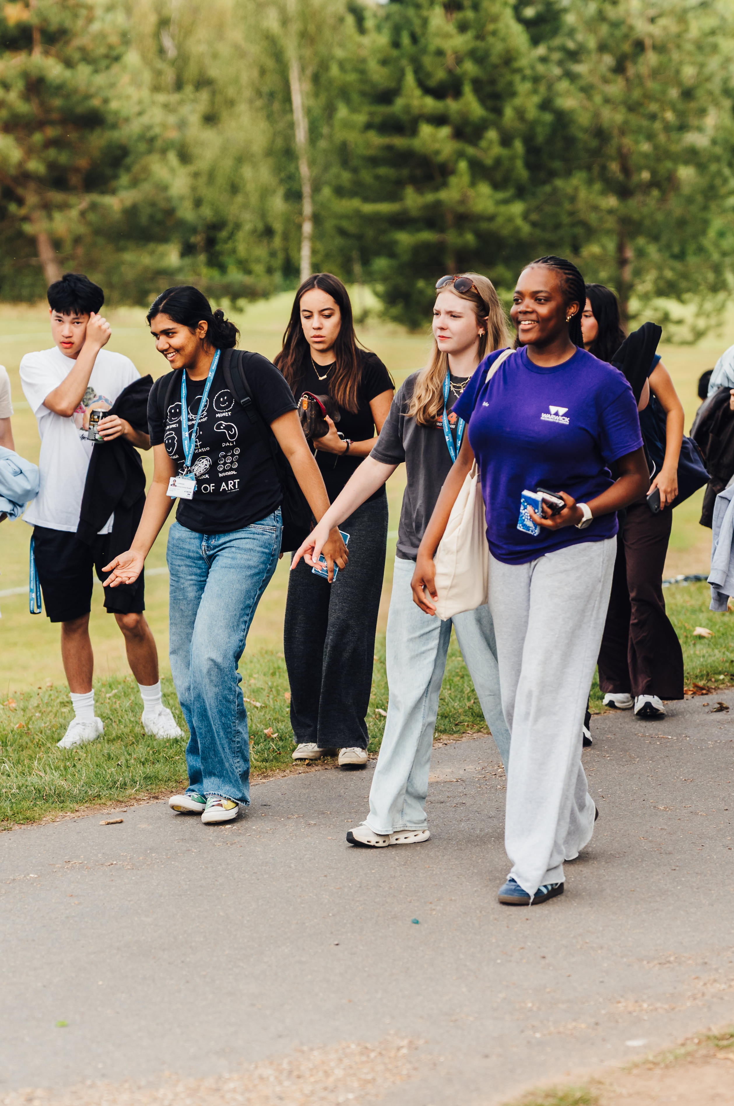
Behaviour Expectations
Students must adhere to the code of conduct during the programme to ensure a respectful and engaging environment
Students are expected to fully participate in all activities during the programme
Students must follow UK laws and the use or purchase of alcohol, vaping, tobacco and illegal substances is strictly forbidden
The use of bicycles, e-scooters and electric bicycles is strictly forbidden
When students arrive, they will co-create a flat code of conduct with their flat group, and a classroom code of conduct to abide by during the programme
Notes:
The Code of Conduct sets out the standards of behaviour we expect and helps ensure that all students can learn, socialise, and live together respectfully.
As this is an immersive Summer School experience, students are expected to engage fully with the academic, social, and cultural activities that form part of the programme. We encourage students to make the most of every opportunity available to them.
Students must also follow UK law at all times. The purchase, possession, or use of alcohol, tobacco products, vapes, or illegal substances is strictly prohibited during the programme. For safety reasons, students are also not permitted to use bicycles, e-scooters, or electric bicycles while participating in the Summer School.
When students arrive, we don't simply present them with a list of rules. Instead, they work with their flat group to create a shared flat agreement and with their classmates to develop a classroom code of conduct. This helps students take ownership of the community they are part of and encourages mutual respect, responsibility, and accountability throughout the programme.
As parents and guardians, we ask for your support in preparing your child for the programme by discussing these expectations with them before they arrive. Being clear about the standards of behaviour expected, and the importance of respecting both staff and fellow students, helps ensure that everyone can have a safe, enjoyable, and rewarding Summer School experience.

Slide 14
Health and Wellbeing

Slide 15
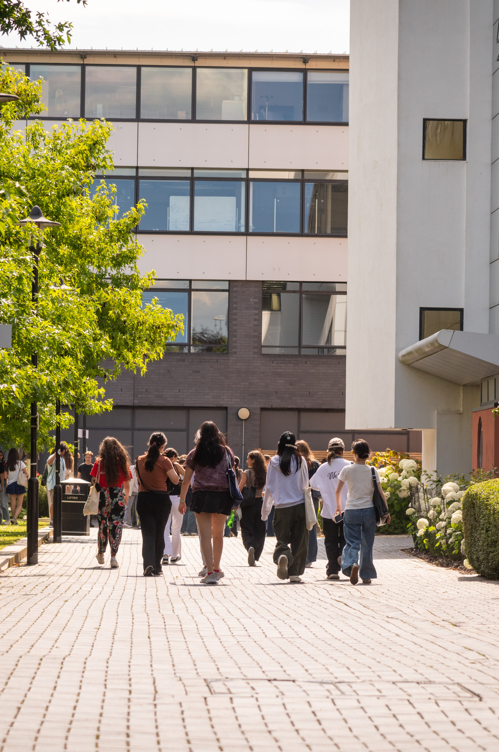
Health, Medical Support and Wellbeing
You must provide details of any medical conditions in advance of the programme so that we can put support in place if required
If students require medication, they must be able to self administer this and must bring enough for the duration of the programme
Our Community Safety team are all trained first aiders and are available 24/7
Staff will help students to access NHS medical services if required
Students are expected to take responsibility for managing themselves and their wellbeing during the programme
If staff have any concerns about a student’s health or wellbeing during the programme, we are available ahead of the programme to discuss concerns and arrange additional support if required
Notes:
Supporting student health and wellbeing is a key priority throughout the Summer School, and there are a few things we ask families to do before the programme begins to help us provide the right support.
Firstly, it is important that you provide details of any medical conditions, health concerns, or support needs in advance through the enrolment process. This allows us to understand any individual requirements and put appropriate support in place before students arrive.
If your child takes medication, they must be able to self-administer it independently and should bring a sufficient supply to last for the entire duration of the programme. Our staff are not able to administer medication, so it is important that students are confident in managing any medication they require.
Throughout the programme, students have access to support whenever they need it. The University's Community Safety team are trained first aiders and are available 24 hours a day, 7 days a week. If a student requires medical attention, our staff will support them in accessing appropriate NHS services and will keep parents informed where necessary.
As part of the Summer School experience, students are encouraged to take responsibility for managing themselves and their wellbeing. This includes looking after their health, attending meals, staying hydrated, getting enough rest, and seeking support when they need it.
Finally, if we have any concerns about a student's health or wellbeing during the programme, we will take appropriate action and contact parents where necessary. Equally, if you have any concerns before the programme begins, we encourage you to get in touch with us in advance so that we can discuss any support your child may need and ensure they are set up for a successful experience.

Slide 16
Safeguarding in Practice

Slide 17
What happens if something goes wrong
Our Approach
How we respond
Student wellbeing and safety is our highest priority
The programme is fully risk assessed, with clear policies and procedures in place
Staff are trained to respond quickly, appropriately, and consistently to any issue
We will always take the necessary action and keep parents informed where appropriate
Sickness or minor injury
  Managed locally through Ambassador team and Community Safety team or access NHS support if appropriate
  Welfare Issue
  Managed by Residential Welfare Lead and escalated internally to Safeguarding Team in appropriate
  Behaviour Issue
  Managed by the Programme Team
  Emergency
  Immediate action taken by staff and emergency services if required
  Parents notified as a priority
Notes:
Student wellbeing and safety are our highest priority throughout the duration of the programme.
The programme has been fully risk assessed in advance, with comprehensive policies and procedures in place to ensure that all activities are delivered safely and responsibly. These measures are designed to identify and minimise any potential risks, while ensuring that appropriate safeguards are consistently maintained across all aspects of the experience.
All staff involved in the delivery of the programme are trained to respond quickly, appropriately, and consistently to any situation that may arise. This includes both routine support and any unforeseen issues, ensuring that student welfare is always managed with care, professionalism, and urgency where required.
In any situation where action is needed, we will always take the necessary steps to safeguard students and ensure their wellbeing. Where appropriate, we will also keep parents and guardians informed, ensuring clear communication and transparency at all times.
Student wellbeing is supported through clear procedures that ensure any issue is managed promptly, appropriately, and by the right team.
In the case of sickness or minor injury, these situations are typically managed locally by the Ambassador team in coordination with the Community Safety team. Staff will provide initial support and care, and where appropriate, guidance will be given on accessing NHS services for further assessment or treatment. The aim is always to ensure students receive timely and appropriate care while remaining supported throughout.
Welfare issues are overseen by the Residential Welfare Lead, who is responsible for monitoring and supporting student wellbeing within accommodation and programme settings. Where concerns require further attention, these issues will be escalated internally to the Safeguarding Team, who are trained to assess and respond to more complex welfare matters in line with established safeguarding procedures.
Behaviour issues are managed by the Programme Team, who will address concerns in a fair, consistent, and proportionate manner. This ensures that expectations are maintained and that all students can participate in a safe and respectful environment.
In the event of an emergency, immediate action will be taken by staff on site, with emergency services contacted without delay if required. In such situations, student safety is the highest priority, and parents or guardians will be notified as a matter of urgency and kept informed as appropriate throughout the situation.

Slide 18
Preparing for Arrival

Slide 19
Parents Actions Prior to Departure
Complete Required Forms
Parental consent form
Team Building consent form
Sports consent form
Enrolment form including medical, access and dietary requirements and emergency contact details
Travel information form
Student Code of Conduct
Image Consent
Upload student photo for ID card
Travel and Entry Requirements (if travelling internationally and/or independently)
Made appropriate travel arrangements for arrival into the UK
Check UK visa requirements and secure appropriate visa
Book airport transfers (if required)
Arrange travel and medical insurance
Preparing your Child for the Programme
Read the parent consent form and student code of conduct, and ensure your child understands the expected standards of behaviour and what will happen if these expectations are not met
Notes:
Before the programme begins, there are a few important actions we ask parents and guardians to complete to help ensure everything runs smoothly and that we have the information we need to support your child effectively.
The first step is to make sure all required forms have been completed. These include the Parental Consent Form, Team Building Consent Form, Sports Consent Form- these are specifcally for parents to fill out. Then there are the Enrolment Form, Travel Information Form, Student Code of Conduct, and Image Consent Form which we ask you to complete alongside your child. As part of the enrolment process, please ensure that any medical conditions, dietary requirements, access needs, and emergency contact details are provided. Students will also need to upload a photograph for their University ID card before arrival.
If your child is travelling internationally or independently, it is important to ensure that all travel and entry requirements have been arranged in advance. This includes checking visa requirements and securing the appropriate visa where necessary, making suitable travel arrangements for arrival into the UK, booking airport transfers if required, and arranging appropriate travel and medical insurance. Please note under 18s need to be met at the airport and cannot stay overnight in hotels in the UK unaccompanied. We will cover more about this shortly.
Finally, one of the most valuable things you can do before your child arrives is help them prepare for the experience ahead. We encourage you to read through the Parent Consent Form and Student Code of Conduct together and discuss the standards of behaviour we expect during the programme. Having clear conversations about independence, responsibility, and respectful behaviour helps students arrive feeling confident and ready to make the most of the opportunities available to them.
Completing these steps before departure will help ensure your child has a smooth arrival and is well prepared for a safe, enjoyable, and rewarding Summer School experience.

Slide 20
Airport Pick-Ups/ Drop-offs
Day and Date | Timings | Airport
Tuesday 14th July | 13:30pm BST | London Heathrow
Tuesday 14th July | 13:30pm BST | Birmingham International Airport
Friday 24th July | 10:00am BST | London Heathrow
Friday 24th July | 09:00am BST | Birmingham International Airport
Must be booked in advance. Can only be picked up if student is going to be able to be at the meet point for the time required including time to get to the correct terminal.​
Ambassadors will meet and greet.​
We will send further details in advance to students who have booked, including exactly where to meet, what the ambassador will look like and the mobile number for the ambassador.​
To ensure a smooth arrival process, flight bookings should be coordinated to align with the published airport pick‑up times where an airport transfer has been booked. Arrivals significantly earlier than the scheduled pick‑up window may result in delays at border control. Likewise, departure flights on the final day of the programme must be scheduled to coincide with the designated airport drop‑off times where an airport transfer has been booked.
Notes:
For students travelling independently, we offer an airport transfer service to help ensure a smooth and supported arrival. Airport transfers must be booked in advance and are only available for students whose flights arrive within the published transfer window and who can reasonably reach the designated meeting point within the required timeframe, including time needed to clear border control, collect luggage, and travel to the correct terminal if necessary.
On arrival day, Summer School staff and Ambassadors will be at the airport from 9:00am to meet students as they arrive. Ambassadors will provide a friendly welcome, help students navigate the airport, and accompany them as they begin their journey to campus. They are also there to liaise with Border Force in case they have any questions about the minor travelling or the programme.
For students who have booked an airport transfer, we will send detailed arrival information in advance. This will include the exact meeting location, details of what the Ambassador will be wearing or carrying for identification, and a mobile contact number that students can use if they need assistance on arrival.
To help the arrival process run smoothly, we strongly recommend booking flights that align with the published airport transfer times. Flights arriving significantly earlier than the transfer window may result in students experiencing a longer wait at the airport before departing for campus. Similarly, on the final day of the programme, departure flights should be booked to coincide with the designated airport drop-off times if an airport transfer has been arranged.
Our aim is to make the arrival and departure process as straightforward and reassuring as possible, ensuring students are supported from the moment they arrive in the UK.

Slide 21
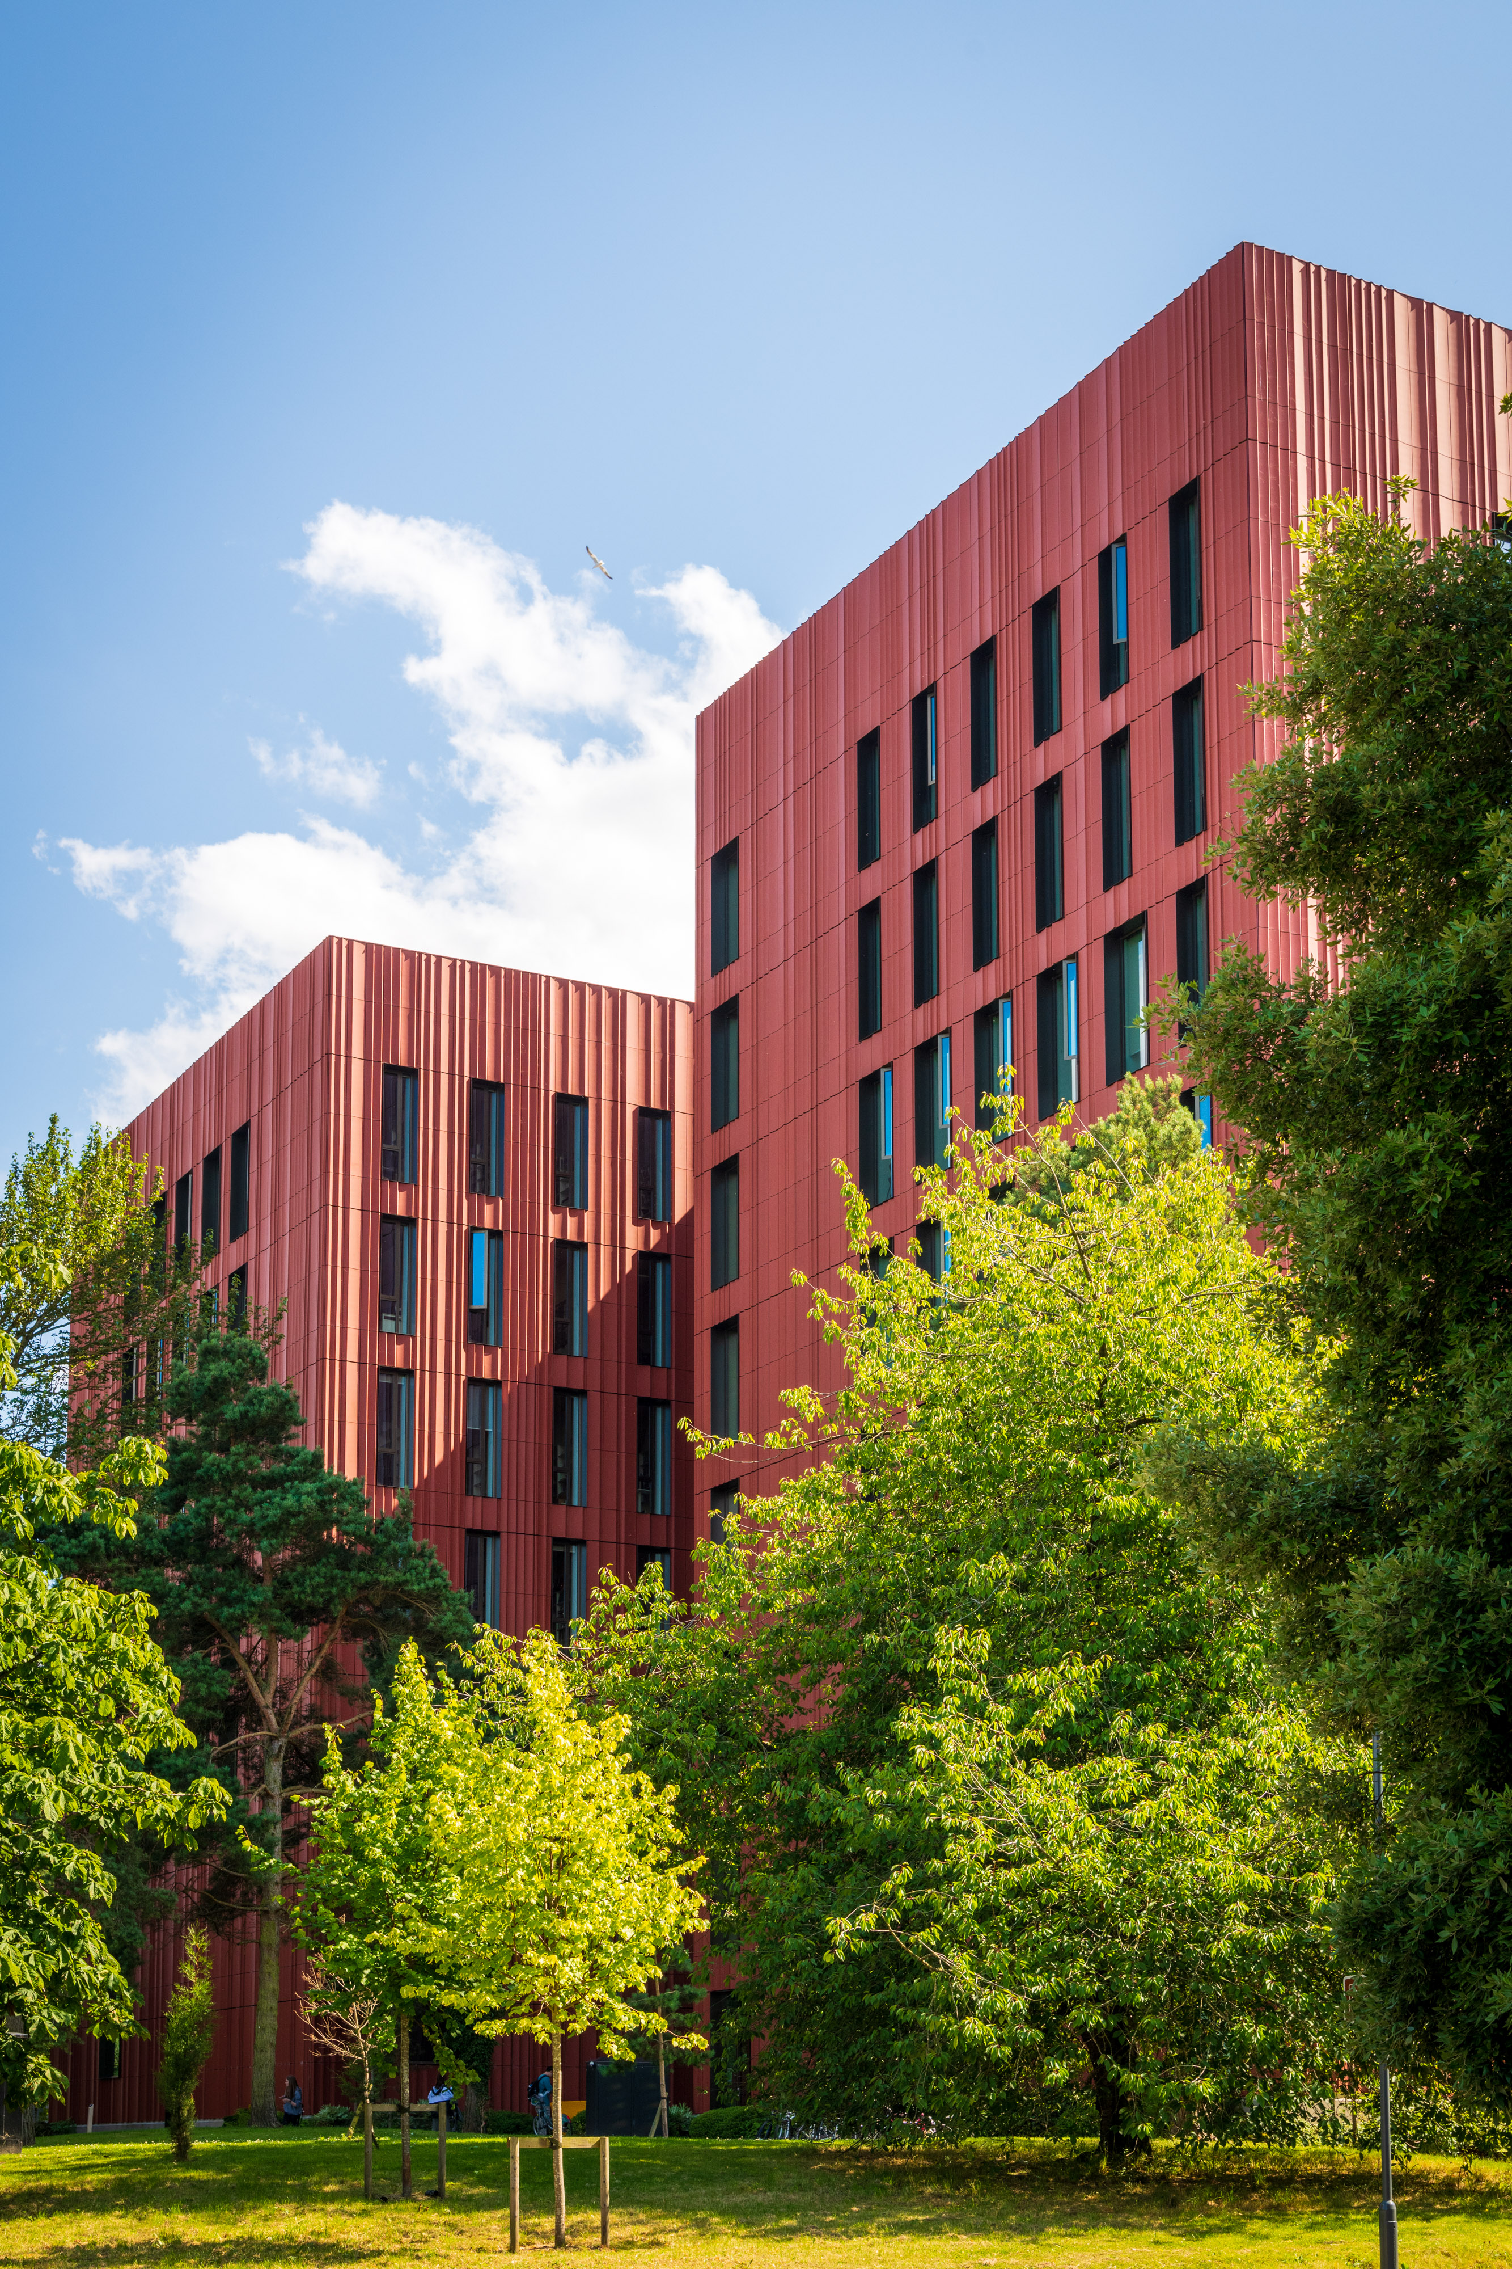
Registration
Registration 12:30pm – 3:30pm in the
Radcliffe Conference Centre (Central Campus)
We will need to check the VISA permission – all students should bring their passport even if a British Passport Holder
Students will receive their ID card, emergency contact cards and their accommodation keys
Students will be allocated into Summer School Ambassador group and meet the ambassadors
No parents or guardians are allowed in the Halls so must drop off at Radcliffe
There is a Parent Welcome Event hosted in Radcliffe during registration to meet our staff and other parents, find out more about the programme, and ask any questions
Notes:
On arrival day, registration will take place between 12:30pm and 3:30pm at the Radcliffe Conference Centre on central campus.
As part of the check-in process, we are required to verify visa permissions where applicable, so all students should bring their passport with them, including British passport holders.
During registration, students will receive their University ID card, emergency contact card, and accommodation keys. They will then be allocated to their Summer School Ambassador group and introduced to the Ambassadors who will be supporting them throughout the programme.
For safeguarding and operational reasons, parents and guardians are not permitted to enter the halls of residence, so drop-off will take place at the Radcliffe Conference Centre.
While students are completing registration, we will also be hosting a Parent Welcome Event at Radcliffe. This provides an opportunity to meet members of the team, connect with other parents, learn more about the programme, and ask any questions you may have.
Our aim is to make arrival day as smooth, welcoming, and well-supported as possible for both students and parents.

Slide 22
The Programme

Slide 23
Outline of Programme – Week 1
Tuesday
- Arrival and Registration
- Icebreakers & settling in
- Flat time & co-create code of conduct
- Welcome event & quiz (Dirty Duck)
Wednesday
- Induction talk & campus tour
- Buffet lunch
- Team building & street food
- Social time
Thursday
- Teaching
- Skills sessions
- Guest lecture
- Social time
Friday
- Teaching
- Skills sessions
- Social time
Saturday
- Trip to Oxford
- Walking tour
- Chauffeured punting experience
- Social time
Sunday
- Trip to Warwick Castle
- Social time

Slide 24
Outline of Programme – Week 2
Monday
- Teaching
- Skills sessions
- Personal Statement session
- Boom Battle Bar
Tuesday
- Teaching
- Skills sessions
- Applying to Warwick session
- Social time
Wednesday
- Teaching
- Skills session presentations
- Social time
Thursday
- Teaching
- Finale activities
- Farewell event (disco & karaoke)
Friday
- Departures

Slide 25
Departure Arrangements

Slide 26

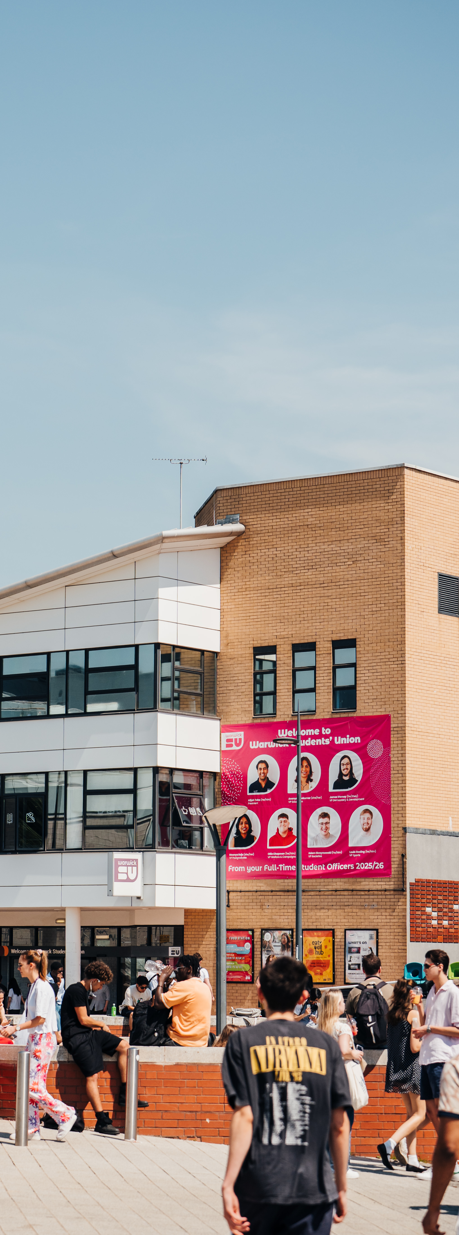
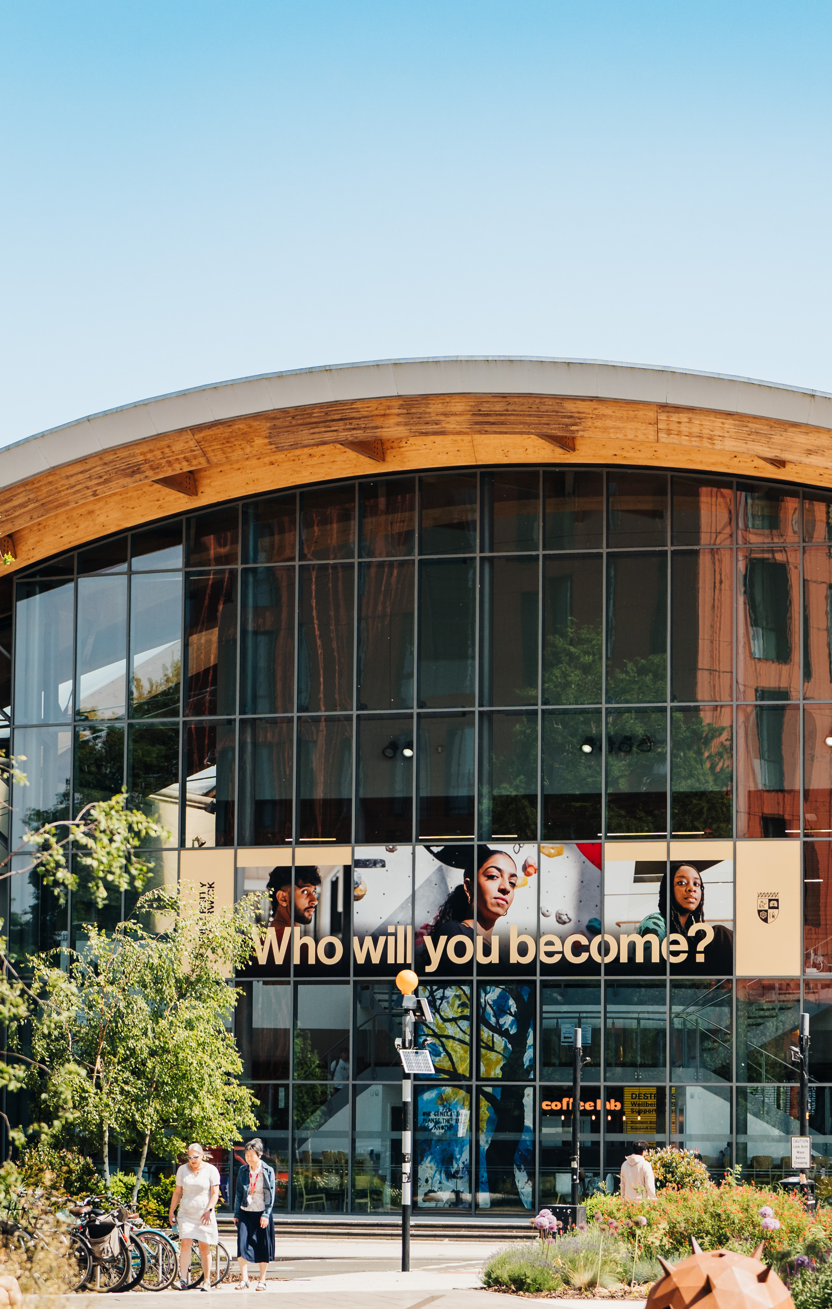
Departure Arrangements
All students must depart the programme by 9:30am on Friday 24th July
Airport drop off for Heathrow will leave campus at 7am
Airport drop off for Birmingham Airport will leave campus at 8am
Parents and guardians are also asked to consider and plan for contingencies in the event of unforeseen circumstances
Please note that hotels in the UK do not typically permit guests under the age of 18 to check in without an accompanying adult
Notes:
All students will be required to depart the programme by 9:30am on Friday 24th July.
For those travelling to Heathrow Airport, transport will leave campus at 7:00am. For Birmingham Airport, departure from campus will be at 8:00am.
Parents and guardians are kindly asked to make appropriate arrangements and consider contingency plans in case of any unforeseen delays or changes to travel plans.
Please also be aware that, in the UK, hotels do not typically allow guests under the age of 18 to check in without being accompanied by an adult.

Slide 27
Communication and Contact Points

Slide 28

Parent Communication & Contact During the Programme
How we will contact you:
Via collective email within the first few days of the programme to let you know about arrival and initial activities and at the end of the programme after the students have departed. (Parents/guardians email address)
We will make individual contact if any issues arise (Either emergency contacts and parents/guardians, or parents/guardians)
How you can contact us:
Email: preunisummerschool@warwick.ac.uk
Via duty phone for urgent issues
Please do not contact Ambassadors directly
Key information
Emergency contacts must be UK-based and available to travel to campus if required
Students receive an emergency contact card on arrival with all key phone numbers
No visitors permitted during the programme
Notes:
At the start of the programme, we will send a collective email within the first few days of arrival. This will provide key updates regarding student arrival, settling in, and initial programme activities. A further collective email will be sent at the end of the programme, once students have departed, to confirm completion and share final information. All communication will be sent to the email address provided by parents and guardians.
In addition to these scheduled updates, we will make direct individual contact should any issues arise during the programme. This may include contacting either the designated emergency contacts or parents and guardians directly, depending on the nature and urgency of the situation.
If you need to contact us, please do so via the official programme email address: preunisummerschool@warwick.ac.uk. For urgent matters only, a duty phone will also be available to ensure timely support and response.
Please note that parents/guardians are advised not to contact Ambassadors directly regarding programme queries or concerns. All communication should go through the official channels outlined above.
A few important points to be aware of: all emergency contacts provided must be UK-based and able to travel to campus if required. On arrival, each student will receive an emergency contact card containing all essential phone numbers for quick reference.
Finally, please be aware that visitors are not permitted during the programme.

Slide 29
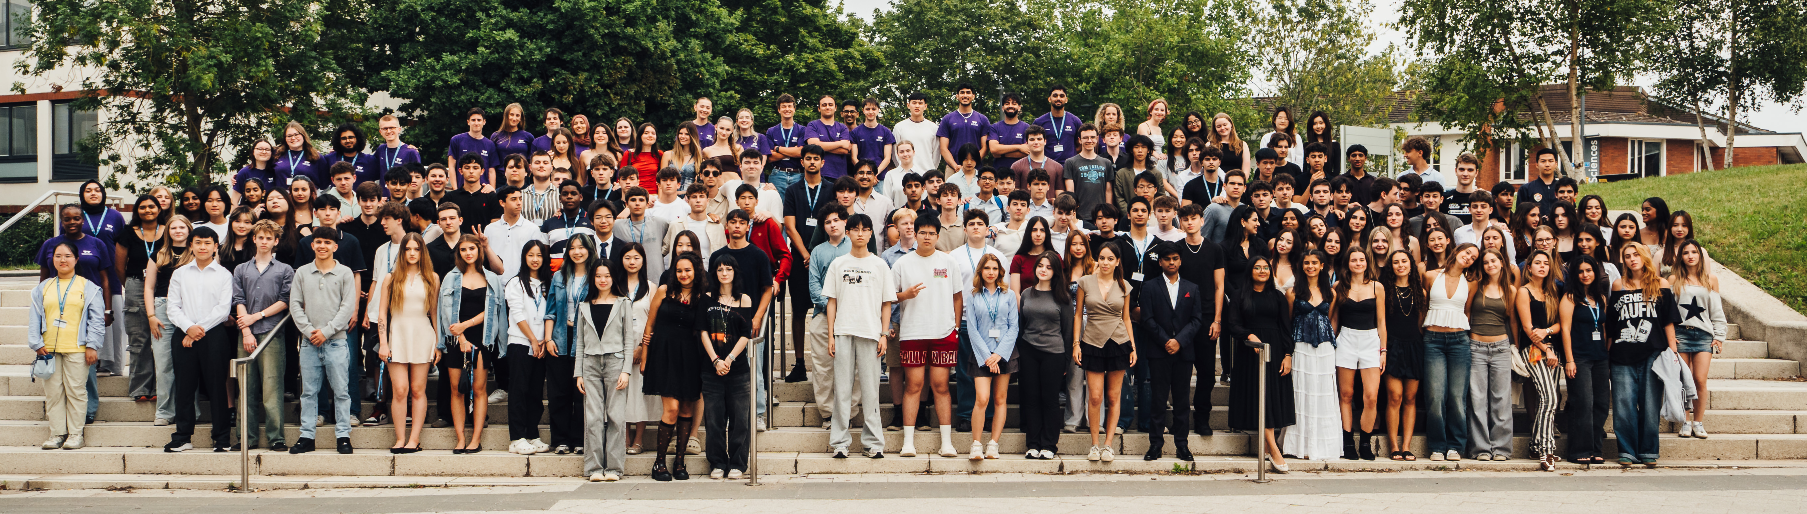
Any Questions?
Contact: preunisummerschool@warwick.ac.uk
and see handbook for emergency contact details

