Slide 1
THANK YOU FOR JOINING THE PRE-UNIVERSITY SUMMER SCHOOL PRE-DEPARTURE BRIEFING.
WE WILL START THIS SESSION SHORTLY
PLEASE NOTE WE WILL BE RECORDING THIS PRESENTATION

Slide 2
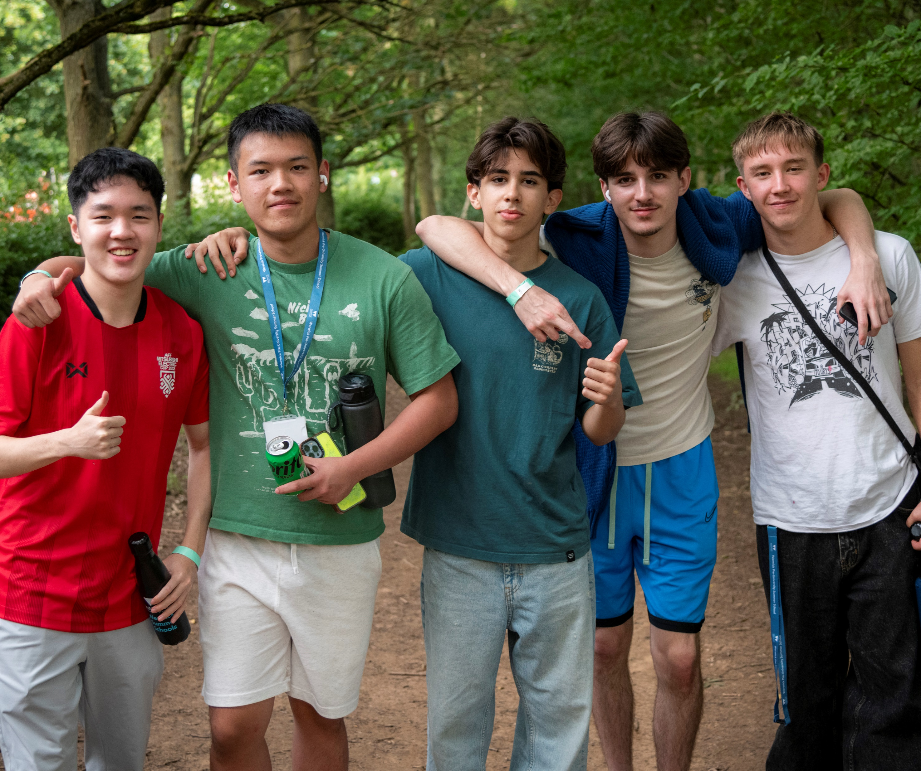
Warwick Pre-University Summer School
Your university adventure starts here
14 – 24 July 2026

Slide 3
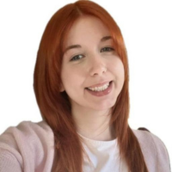
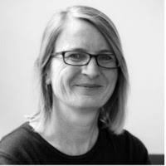
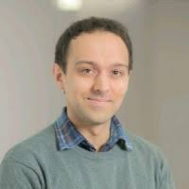
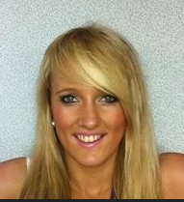
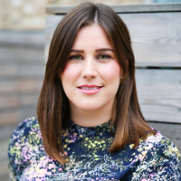
Welcome and Introduction
Pre‑University Summer School Team
Katie Barlow
Pre-University Summer School Lead
Rachael Brogan
Suzi Barrett
Fiona Wallace
Director of Summer Schools
Chris Jones
Assistant Academic Director of
Summer Schools
Departmental Safeguarding Officers
Notes:
I’ll start with a quick introduction to who we are.
There are a number of staff on the call today, and we are part of the university team responsible for delivering the Pre-University Summer School.
Our collective goal is to make sure that students not only have a really engaging academic experience, but that they are also safe, supported, and well looked after throughout their time with us. Suzi and I are responsible for the Safeguarding aspects of the programme, and my colleague Katie oversees the academic, social and logisitcal delivery of the programme. Chris is with us today, he is the Assistant Academic Director Director of Summer Schools and he has designed the skills sessions you children will be undertaking as part of the programme.
You’ll see throughout this session that we have a number of different staff roles and we all working together to support students from arrival through to departure.

Slide 4
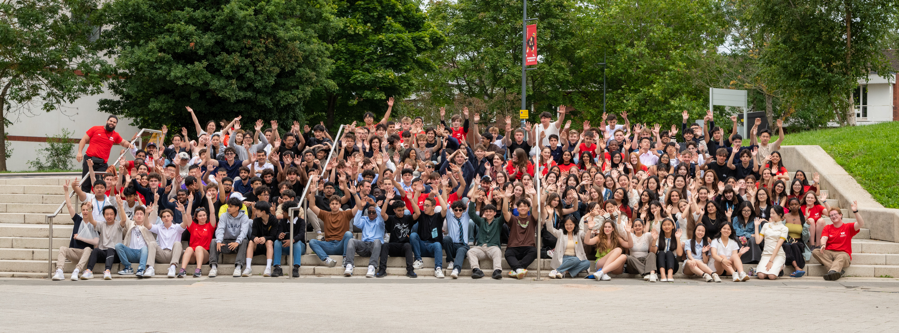
Who is attending the Pre-University Summer School?
126 students currently booked to attend.
66 taking A Taste of Business, Economics and Finance
25 taking A Taste of Science and Engineering
21 taking A Taste of Social Sciences
14 Taking A Taste of Health, Medical and Life Sciences
Students attending from around 40 different countries
26 Summer School Ambassadors
4 Lead Ambassadors – Jimmy, James, Gracie, Sana
2 Night Duty Managers – Aishah, Kai
2 Residential Welfare Leads – Madhu, Lottie
3 key members of staff – Katie, Suzi, Rachael
Support from our wider team

Slide 5
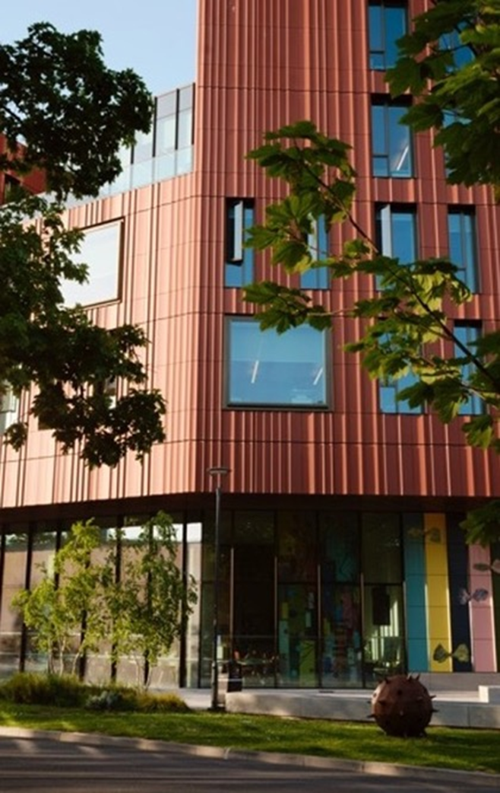
What's covered in this session?
Arrivals, first two days and support
Academic programme and skills
Social and cultural programme
And a chance to ask questions!

Slide 6
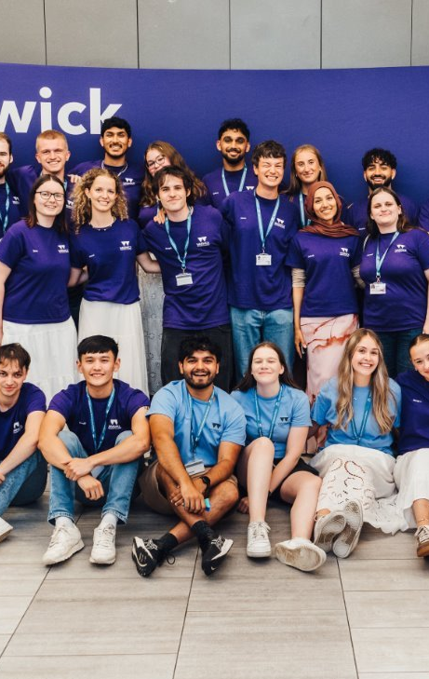
Arrival, first days and support

Slide 7
Before you arrive...be prepared
Have you completed?
Have you?
Parental consent form
Student code of conduct
Image consent form
Enrolment form including medical, access and dietary requirements, emergency contact details
Travel information form with arrival details and contact details including phone number that works as soon as you arrive
Team building consent form
Physical activity readiness form
Uploaded your photo for your ID card?
Read the Handbook and all information in advance- to be sent shortly
Checked your timetable? – to be sent shortly
Paid for travel/medical insurance?
Paid the balance for the programme?
Booked airport transfers (if required)?
Have you checked?
Any visa requirements for entering the UK and secured the appropriate visa?

Slide 8
What to pack for the Pre-University Summer School
Clothes for all weathers! Including suncream, umbrellas and warmer clothes
Sportswear/trainers
Swimwear/towel for the pool if needed
Smarter clothes for the evening events
Laptop/tablet
UK plug adaptor
Bilingual dictionary (if needed)
Bank card that works in the UK
Money (don’t bring too much, we can’t keep it for you and the campus is cashless) or a bank card that works in the UK
Mobile phone and a SIM card/package that will work in the UK as soon as you arrive
Medication – prescribed and basics e.g. paracetamol – check rules for buying in the UK

Slide 9


Travelling to the UK
Summer School dates: Tuesday 14th July – Friday 24th July 2026
The closest airport to the University is Birmingham International (BHX) – lots of airlines fly to Birmingham (you may have to take a non-direct flight via Europe)
There are rail and coach links from all major airports to Coventry (taxis from Birmingham airport to the University are also reasonably priced)
If arriving by car to campus – follow our instructions in the handbook for parking
EDI
GLA
NCL
MAN
BHX
LTN
STN
LHR
LCY
LGW

Slide 10
Passport Control
Students who applied for a VISA in advance(usually visa nationals):
Students applying for leave on arrival to the UK (non-visa nationals only):
Have your visa activated by UK Border Force, if you applied in advance OR
To have your passport endorsed with an Ink Stamp if you are a Non-Visa National, applying on arrival OR
Use your biometric passport to enter via an e-Gate if you are an eligible Non-Visa National.
If visiting the Immigration Desk, please check the entry stamp to make sure they have endorsed the right vignette and that they have stamped the right date of entry.
Must carry application evidence in their carryon luggage
Must visit the Immigration Desk, on arrival at the UK Border
Must state the purpose of the visit, e.g. Short period of study under 6 months, attending a viva, etc.
Must provide any documentary evidence requested by the Border Force official
Make sure you have printed and signed the unaccompanied minor letter- available on Offer Holder webpage next week
Students with an ETA
Your ETA will be linked to the passport you applied with. You only need to show your passport when you travel to the UK.​
Make sure you also have access to the email decision from UVKI with your 16-digit ETA reference number just in case.​

Slide 11
Airport Pick-Ups/ Drop-offs
Day and Date | Timings | Airport
Tuesday 14th July | 13:30pm BST | London Heathrow
Tuesday 14th July | 13:30pm BST | Birmingham International Airport
Friday 24th July | 10:00am BST (leaving campus 7:00am BST) | London Heathrow
Friday 24th July | 09:00am BST (leaving campus 8:00am BST) | Birmingham International Airport
Must be booked in advance. Can only be picked up if student is going to be able to be at the meet point for the time required including time to get to the right terminal.​
Ambassadors will meet and greet.​
We will send further details in advance to students who have booked, including exactly where to meet, what the ambassador will look like and the mobile number for the ambassador.​

Slide 12
Safety and support
Food and drink
Summer School Ambassadors and Lead Ambassadors (DBS/Safeguarding trained)
Community Safety team (security and first aid, 24/7)
Summer School team (DBS/safeguarding trained)
Curfews and rules – ensure familiar with parent/guardian information in advance
Member of staff on duty 24hrs – Residential Night Support team on duty overnight
WhatsApp groups with ambassadors
Emergency Contact Cards
Lanyards/ID cards
Wellbeing support, Disability support, Chaplaincy
Risk Assessment and Escalation Policies in place
All breakfasts and dinners included in Rootes Restaurant, some lunches included
Refreshments on teaching days
Lunches - mostly not included
Also places to buy extras on campus -Rootes Grocery Store, Cafes etc

Slide 13
Registration and first days
Registration
First days
Registration 12:30pm – 3:30pm in the
Radcliffe Conference Centre (Central Campus)
We will need to check the VISA permission – everyone should bring their passport even if a British Passport Holder
ID card and instructions to access the WiFi
Accommodation check in
Allocated into Summer School Ambassador group and meet ambassadors
No parents or guardians are allowed in the Halls so must drop off at Radcliffe
Parent Welcome Event in Radcliffe to meet members of our team, find out more about the programme and ask any questions
Tuesday evening- welcome event with quiz and games
Wednesday - welcome talk, campus tour with Summer School Ambassadors, buffet lunch, teambuilding event on campus with street food and ice cream van
Make sure parents have signed the team building consent form

Slide 14
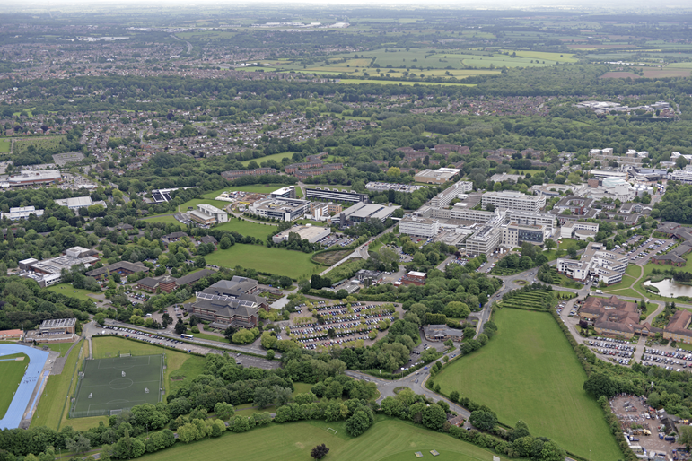
Campus
Warwick is a ‘Campus-University’
Sports Facilities, Library, Grocery store, Pharmacy, Post Office, ATM machine, Restaurants, all available on campus
Library access included – ID card
Gym and swim included (make sure you complete the gym form if you wish to use the gym/swim facilities)

Slide 15
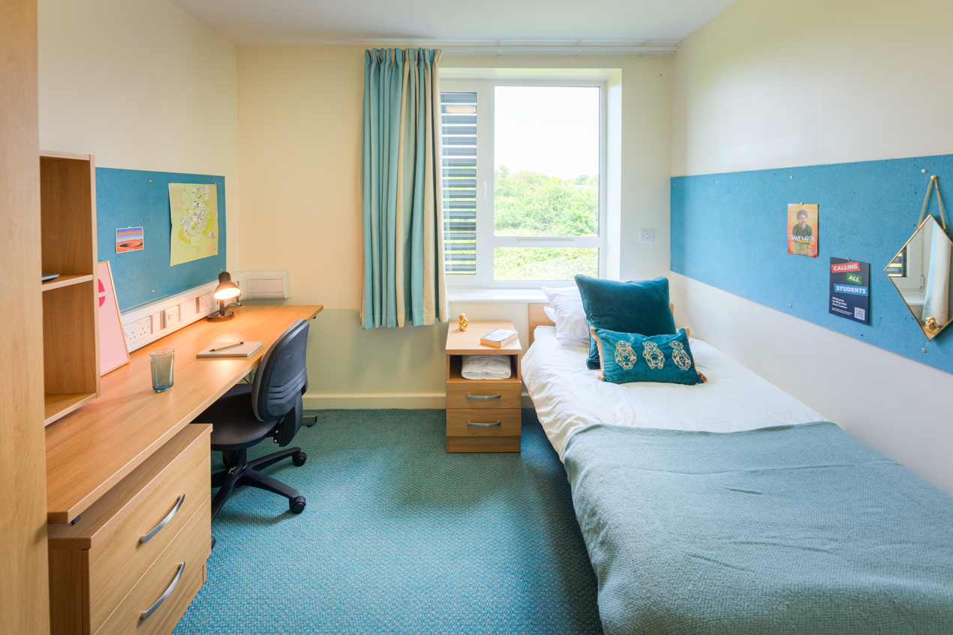
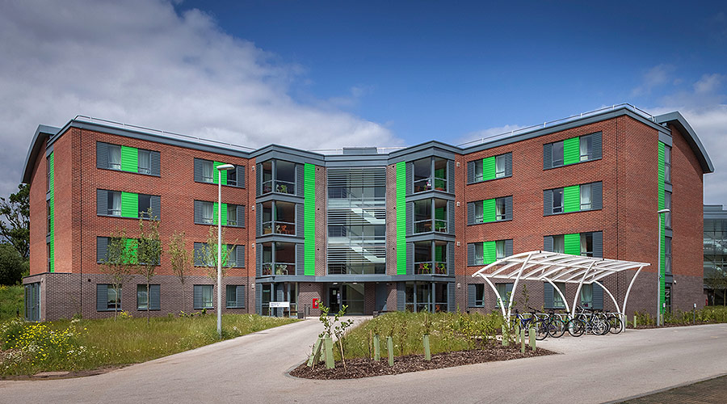
Accommodation
Students are staying in en-suite halls in Sherbourne (single or mixed sex flats, preference indicated on enrolment form) with ambassadors
Up to 10 students per flat
Bedding and towels included​
Half board - make sure you budget for lunches/drinks/snacks​
Kitchens with cooking facilities but no pots, pans, cutlery included
Rooms and kitchens cleaned weekly
Laundry services available- details in handbook​
Notes:
Your accommodation includes bedding and towels, and rooms and kitchens are cleaned weekly. Shared kitchens have cooking facilities, but you’ll need to bring or buy your own pots, pans, and cutlery if you plan to cook- you shouldn’t need to cook as breakfast and dinner is provided.
Laundry facilities are available on campus, and details are in the handbook which will be shared with you ahead of the programme.
You’ll also have access to Warwick Sport facilities, including the gym and swimming pool.

Slide 16
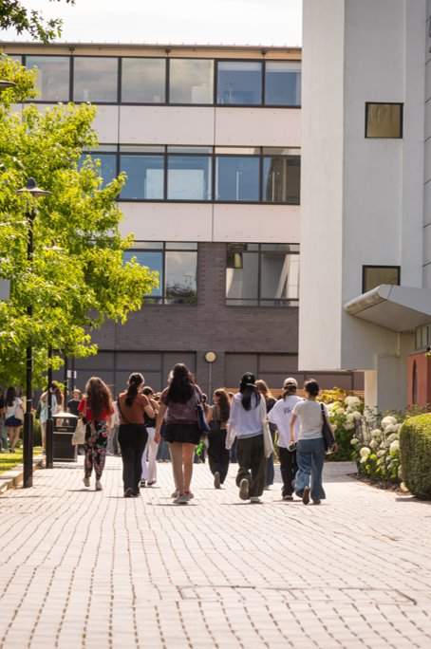
Academic Programme

Slide 17
Academic Programme
Academic Discipline
Skills
Preparing for Study
Guest Lectures
6 days of teaching
Online resources during the programme
8 hours of skills sessions – team building project activity leading to a presentation
Preparing for study – Applying to Warwick and Personal Statement Workshops
Guest lecture from Inca Hide-Wright (Warwick Alumni)

Slide 18
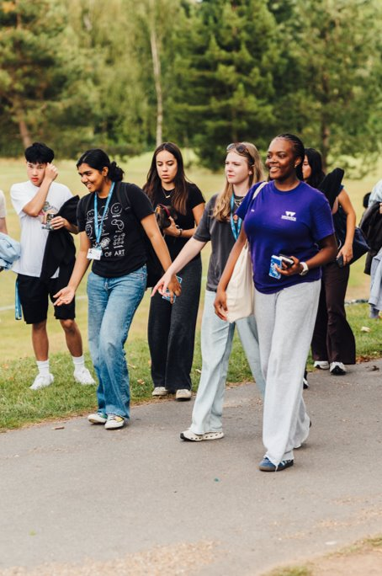
Social and Cultural Programme​

Slide 19
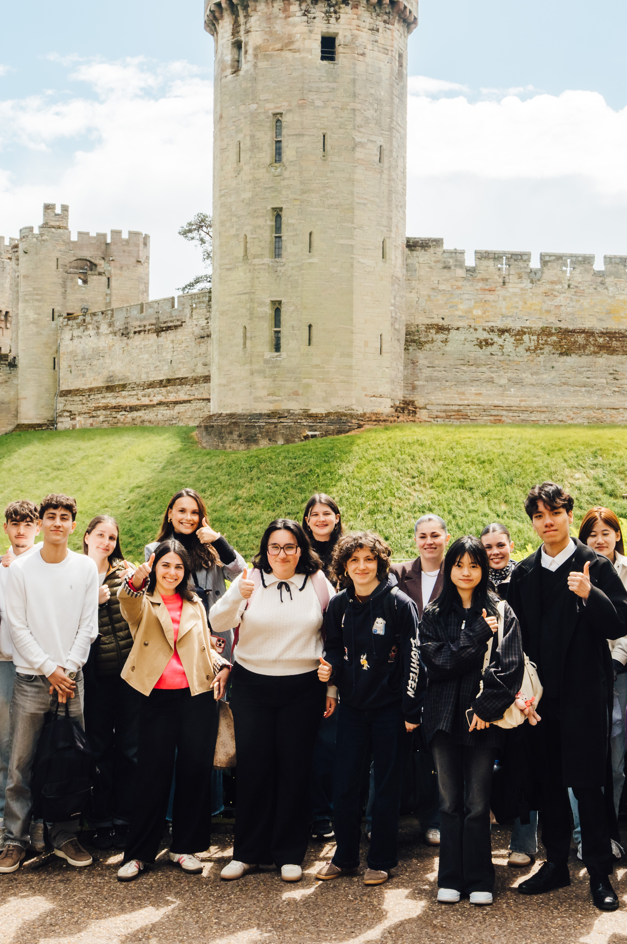
Social and Cultural Programme
Welcome event and quiz on first evening
Team building and street food event
Visit to an entertainment and games venue
Warwick Castle day trip
Oxford day trip including walking tour and punting on the river
Farewell evening event – international buffet, karaoke and disco
Wide variety of activities for free time including group sports and games, showcasing activities at Warwick

Slide 20
Any Questions?
Contact: preunisummerschool@warwick.ac.uk
and see handbook for emergency contact details

