Slide 1
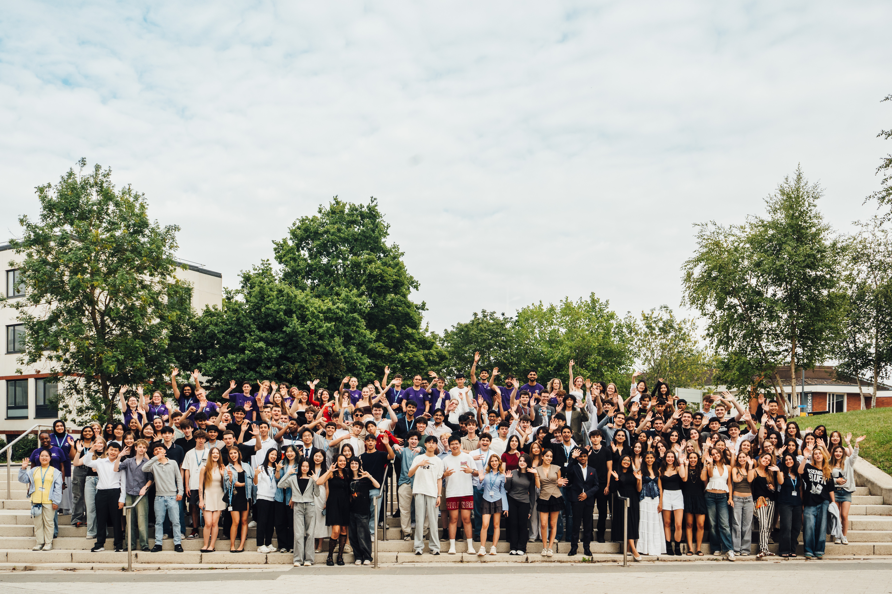
Pre-University Summer School
14-24 July 2026

Slide 2
Pre-University Summer School
14-24 July 2026

Slide 3
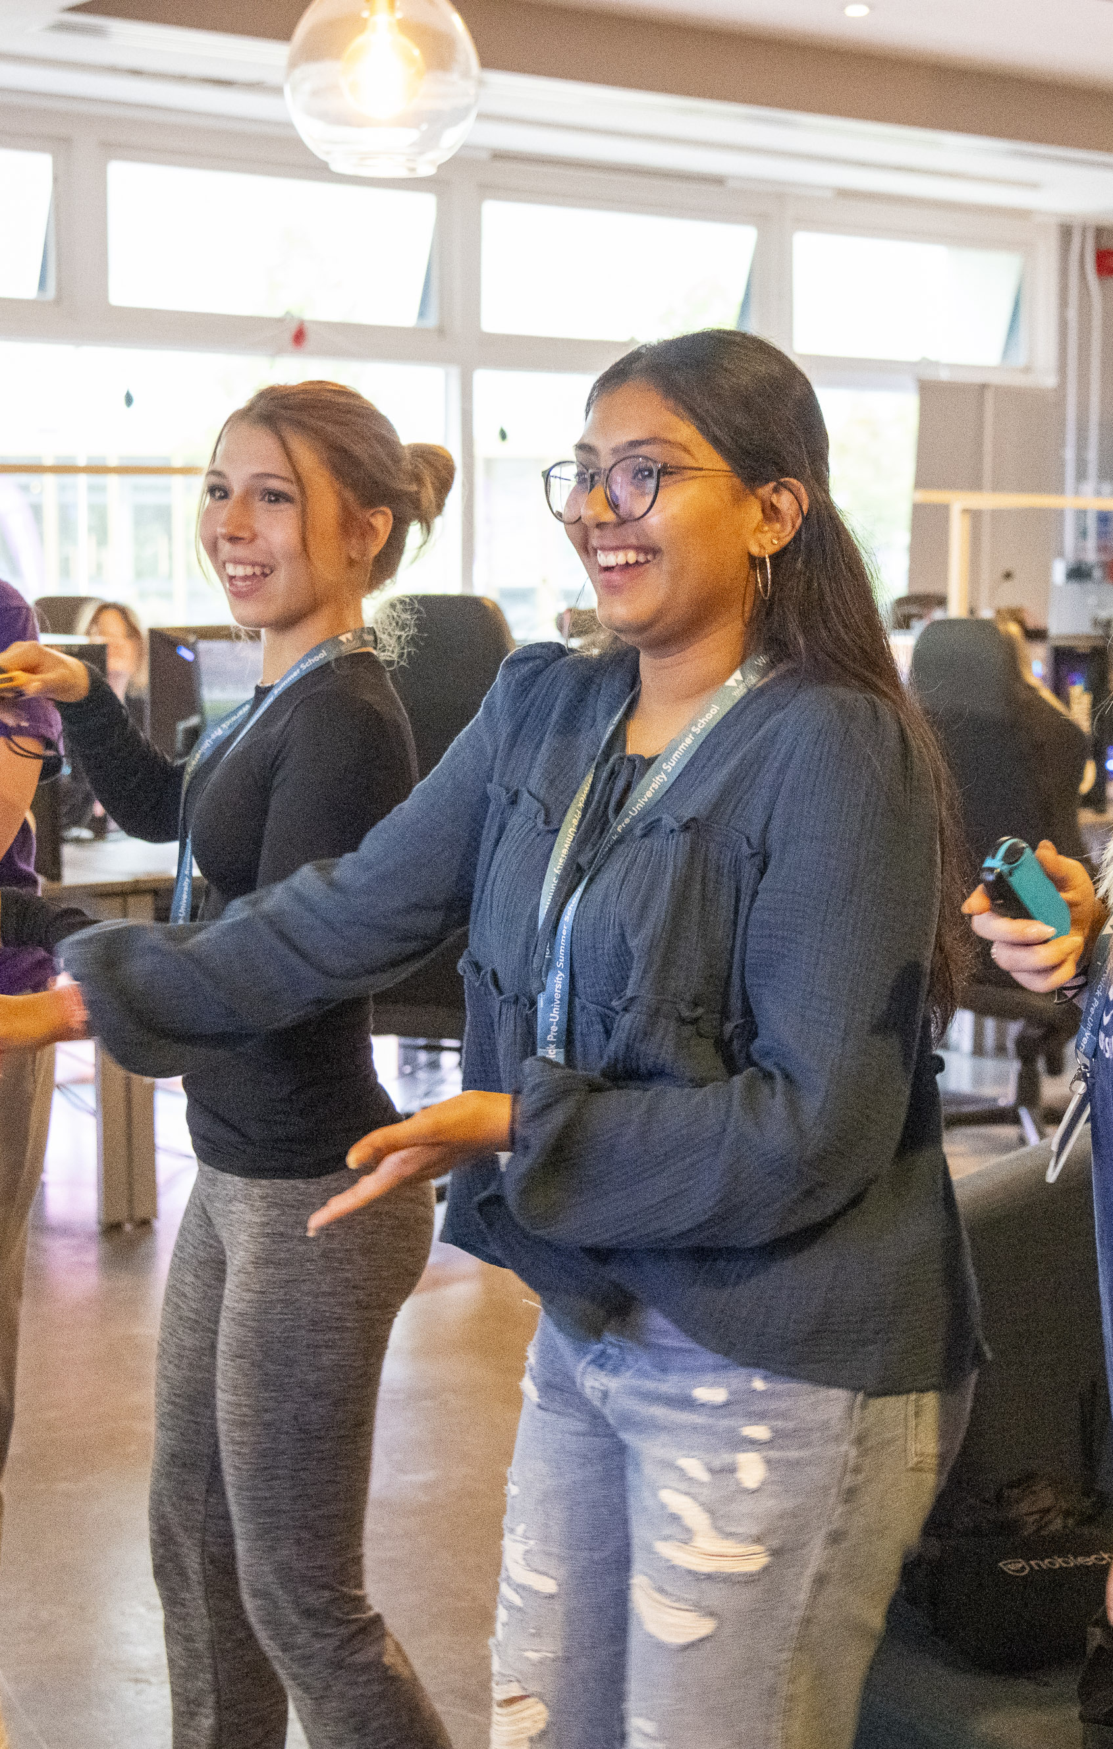
Why spend your summer with us?
Exciting, 10-night residential programme for 16-17-year-olds​ (14-24 July 2026)
Hosted at the University of Warwick Campus, with access to all Warwick facilities​
Included in the course:​
All teaching, personal development and guest lectures​
Preparation for applying to UK universities​
Social events and cultural visits​
Accommodation, breakfast and evening meals​
Day trips to Oxford and Warwick Castle
Ambassador support​ from current Warwick students

Slide 4
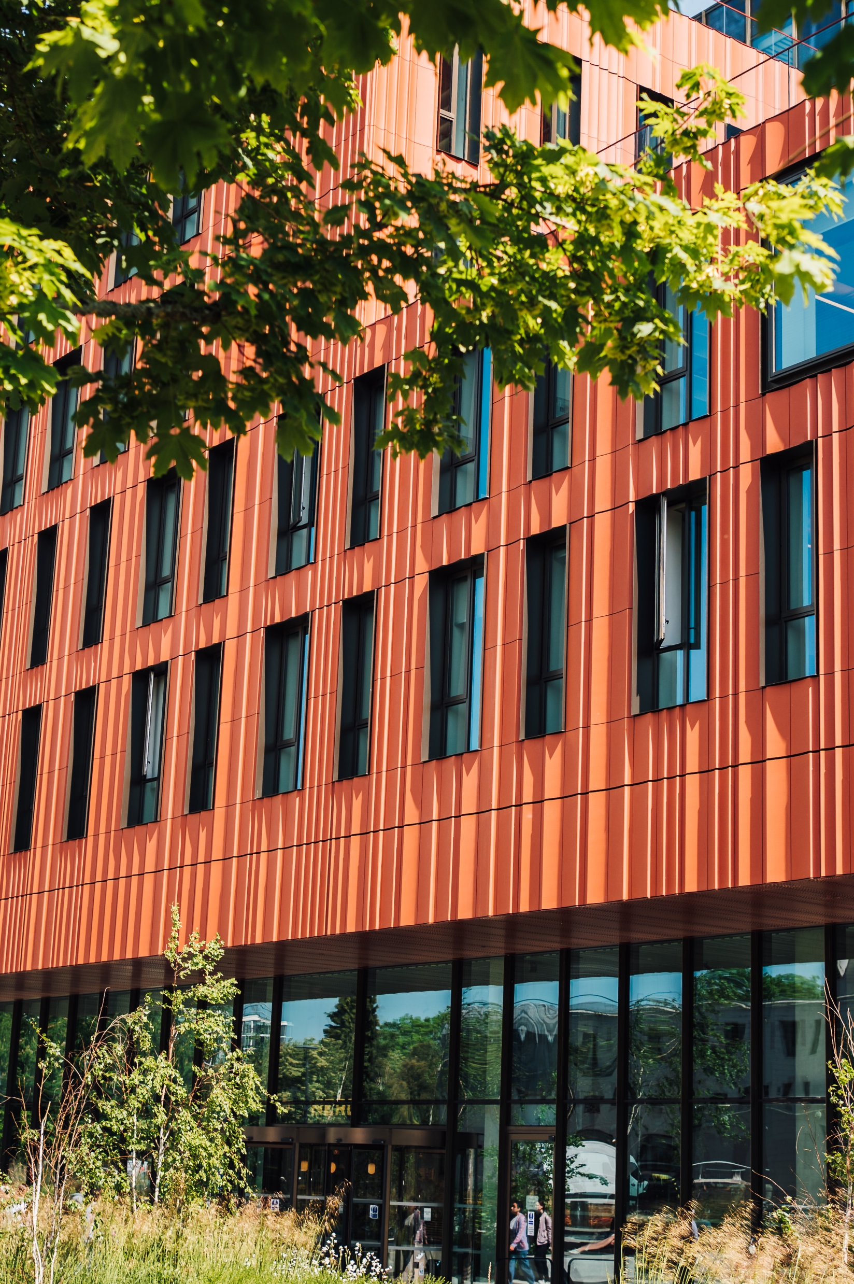

Why Warwick?
The University of Warwick is a leading, Russell Group university in the UK
8th in the UK
Guardian UNIVERSITY RANKINGS 2025
22th in EUROPE
QS World Rankings 2026
74th in the world
QS World Rankings 2026

Slide 5
Course Options 2026
A Taste of Economics and Finance
Introduction to Finance
Game Theory
Behavioural Economics
Cryptocurrency
Macro and microeconomics
A Taste of Social Sciences
Law
Philosophy
Education Studies
Sociology
Politics
A Taste of Science and Engineering
Life Sciences
Psychology
Mathematics and Statistics
Computer Science
Engineering
A Taste of Arts and Humanities
Film and Television studies
English
Theatre and Performance
History
Liberal Arts

Slide 6
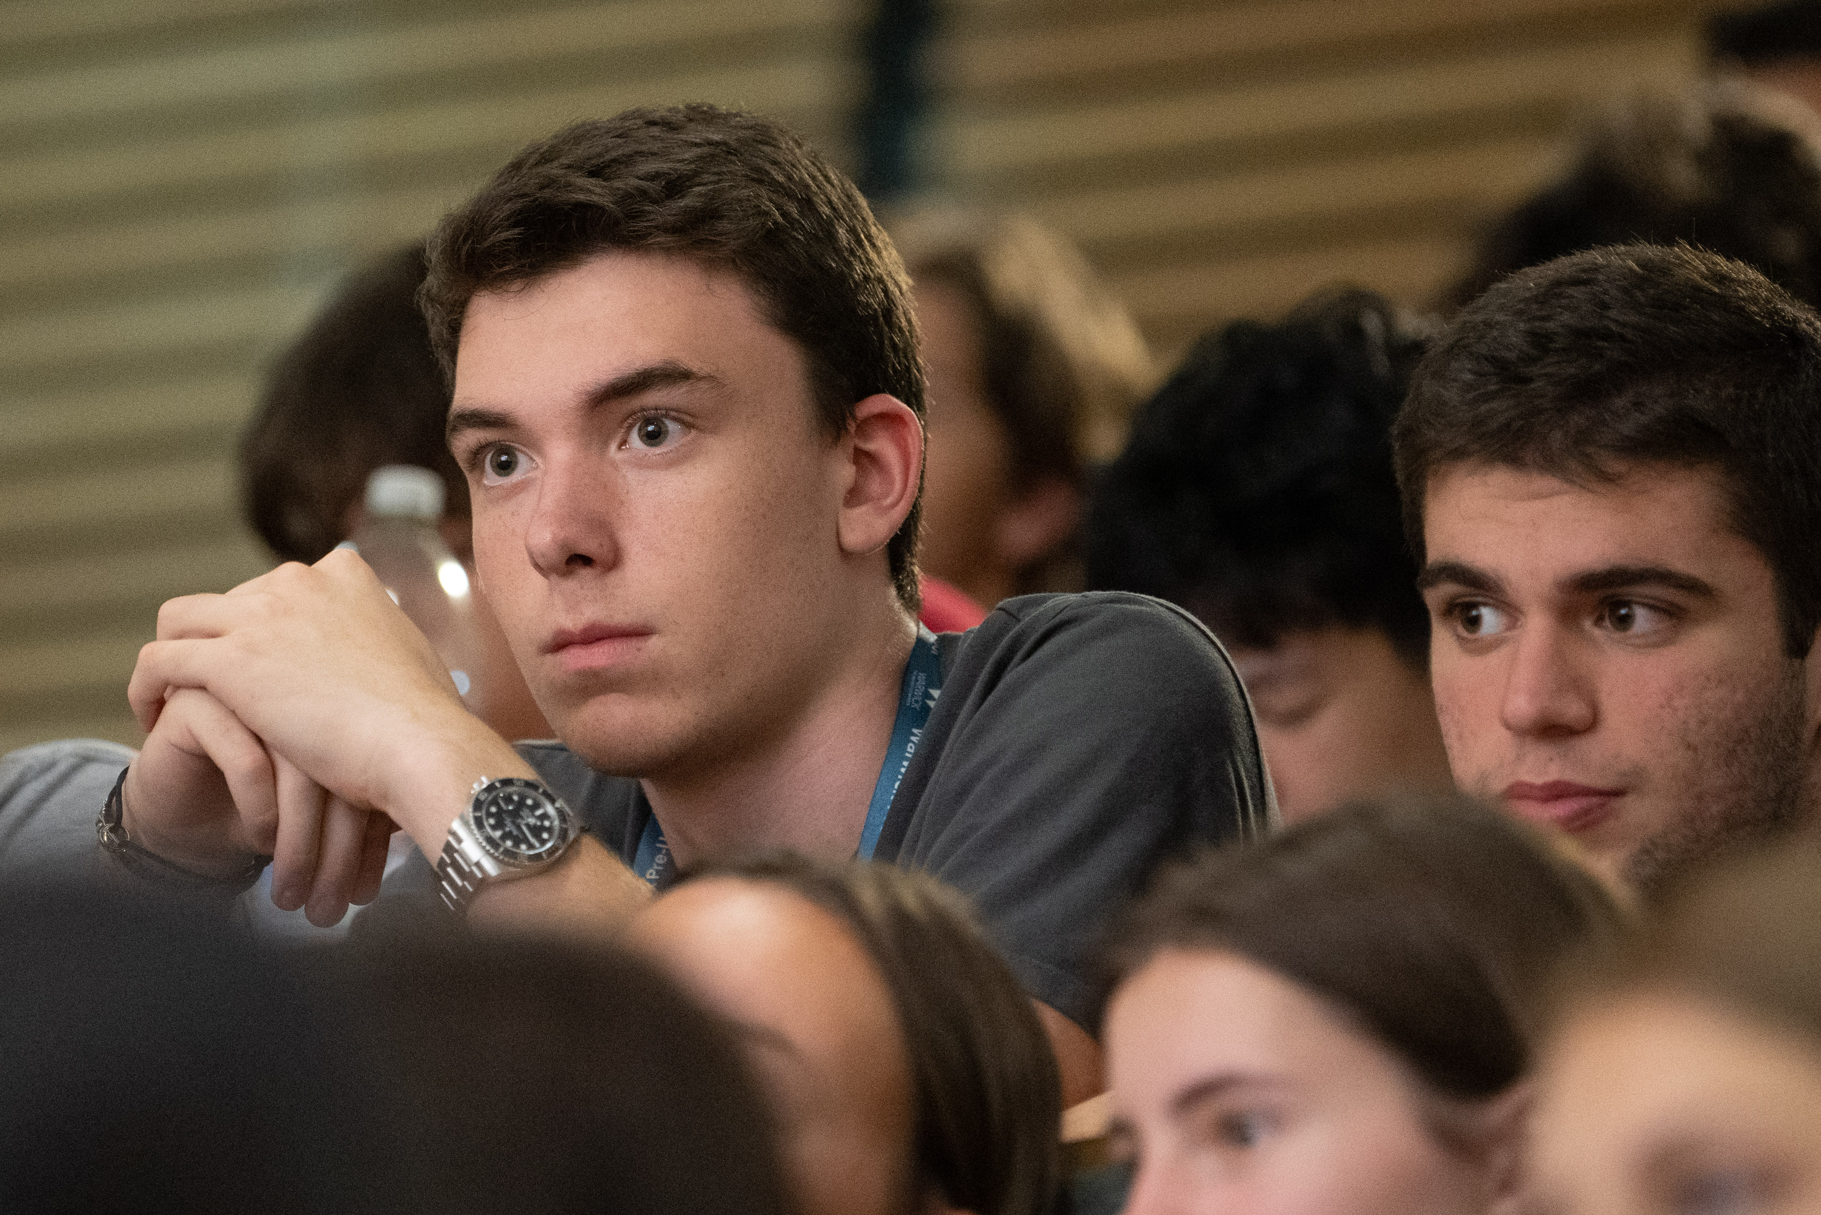


Course Content
All courses are taught by Warwick staff, with delivery via lectures and seminars
29 hours of contact time overall
Guest speaker session
Preparing for Study in the UK (2 x practical sessions)
Personal Development sessions

Slide 7
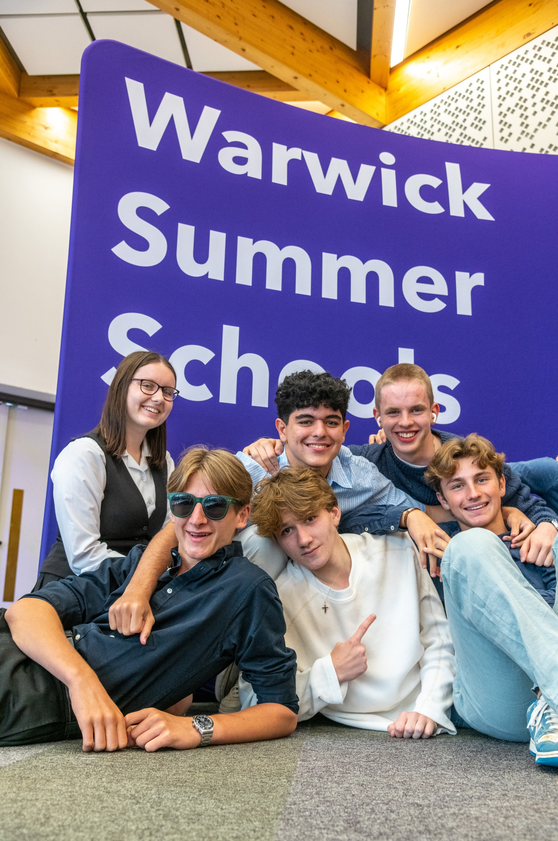
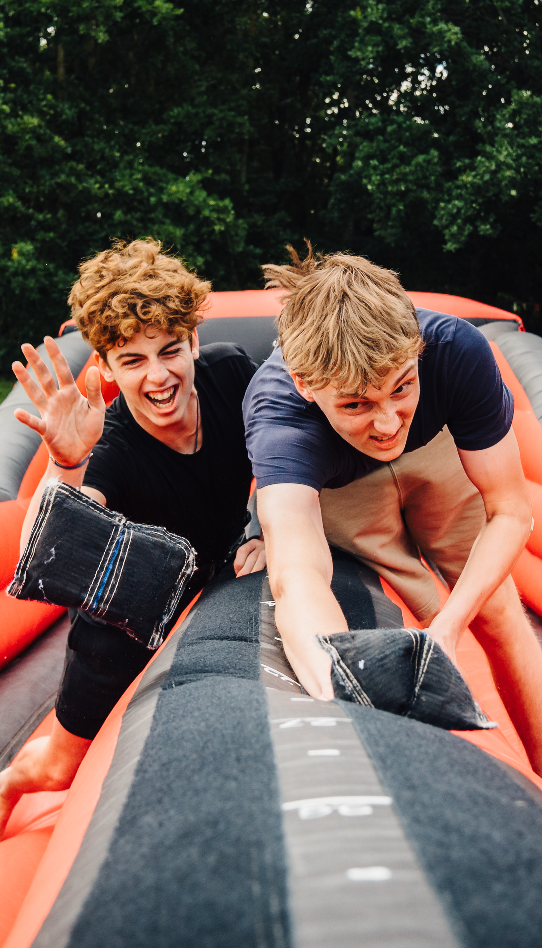
Social and Cultural Programme
A range of activities included to suit all students
Some events will be held on campus to showcase all that Warwick has to offer:
    Welcome BBQ
    Teambuilding event and street food
    E-sports centre
    Sports, games, films
    Curry, karaoke and disco farewell
Events off campus will include:
    Day trip to Oxford – punting on the River Cherwell, walking tour, and time for lunch and shopping
    Morning exploring Warwick Castle

Slide 8
Safety and Welfare
Airport pickups and drop-offs available
-14 July and 24 July from London Heathrow and Birmingham International
Dedicated team of staff with DBS checks and trained in safeguarding
Campus environment with 24-hour security provided via our Community Safety team
Fully trained Summer School Ambassadors (current Warwick students) live alongside the students and accompany them on all trips – also DBS checked
Individual study bedrooms with en-suite bathrooms – choice of mixed or single-sex flats
Code of conduct and parental consent forms required by all

Slide 9
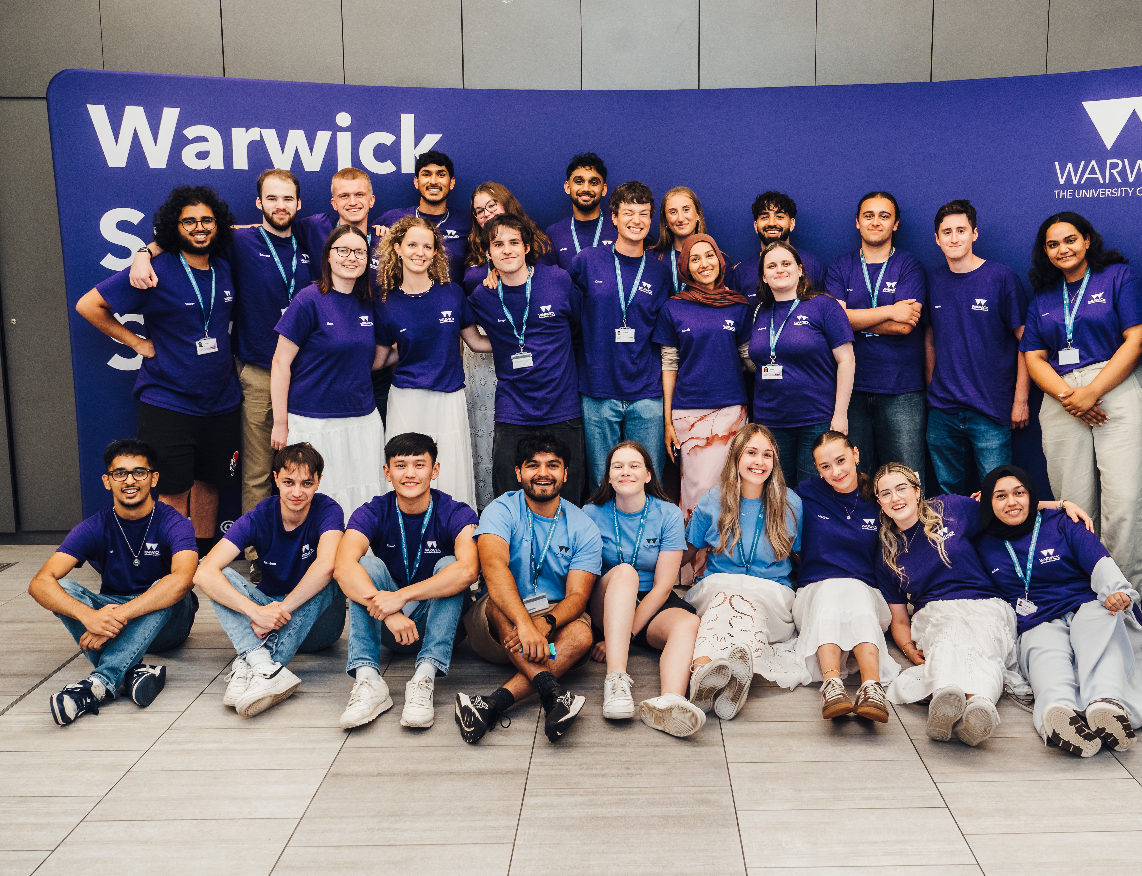
Summer School Ambassadors
Our friendly Summer School Ambassadors will welcome you from day one and live alongside you in your flat throughout the programme
Each flat has its own ambassador who will be your main point of contact for any questions or support.
Ambassadors take part in all planned social and cultural activities, offer pastoral and wellbeing support, and organise extra evening events and ice-breakers to help you make friends
All Summer School ambassadors are existing Warwick students, currently studying a range of degree courses
They offer a fantastic insight into life as a student at Warwick - ask them any questions that you have about life at Warwick
We have Lead Ambassadors to provide an extra level of support and Night Managers to provide any help and assistance during the night

Slide 10
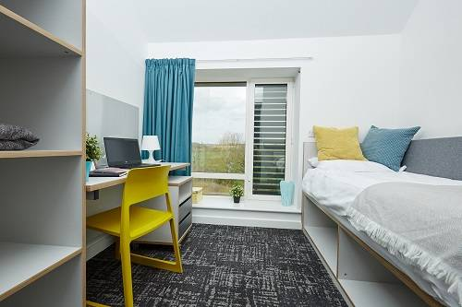
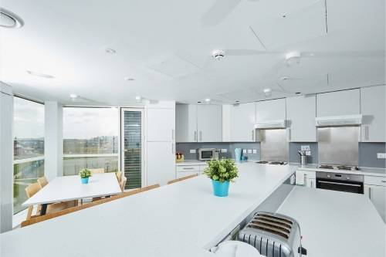
Catering and Accommodation
  10 nights of accommodation in Sherbourne Halls of Residence
  Single study bedrooms with a desk, and an en-suite bathroom – bedding and towels provided
  Sports Centre Membership – access to the gym and swimming pool
  Catered for breakfasts and dinners, some lunches also included, but there will be some occasions where you'll need to buy lunch when on campus or on some trips - there will be lots of options available

Slide 11
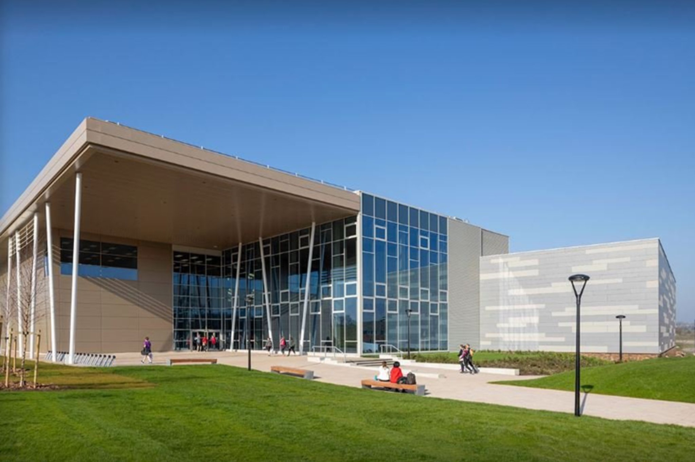
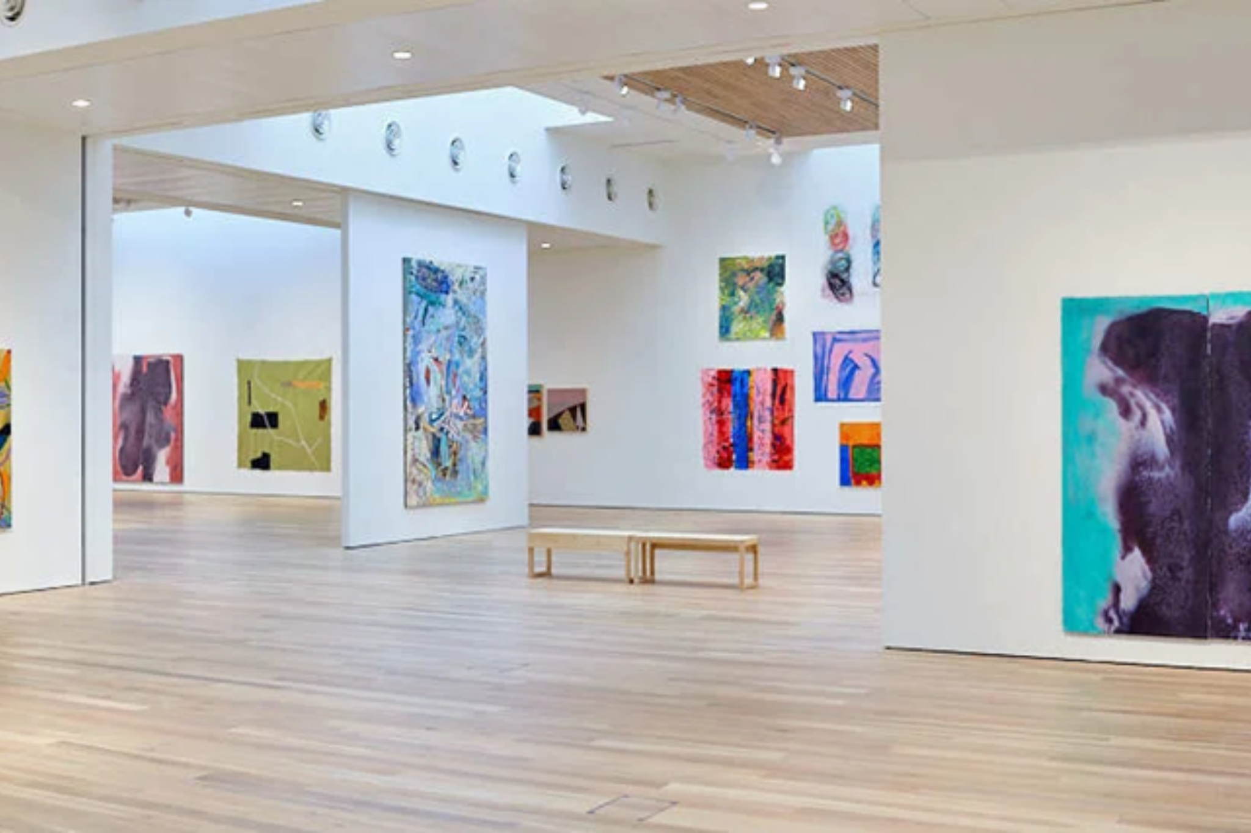
PRESS Students can also access
Sport and Wellness Hub
Warwick Art Centre
Gym, swimming pool, football pitch, tennis courts, indoor climbing wall and basketball court and more
The largest venue of its kind in the UK outside the Barbican Centre in London.
Cinema, theatre space, gallery, and concerts

Slide 12
Fees and Admissions 2026
Applications made online, via our website- deadline 31st May 2026
  Short application form to gather personal details and education history
No subject-specific requirements; students should be enthusiastic to study and motivated by their chosen subject
No English tests required – we assess your English based on your correspondence with us
We aim to review the application and respond within 3-5 working days
If a visa is required, we will issue a visa invitation letter after the deposit payment
Programme fee
  £5250 (£1000 deposit required to secure place, payment deadline in your offer email)
  £50 non-refundable application fee
Fees include: all tuition, accommodation, breakfast and evening meals, social programmes, activities, travel to Oxford and all activities on trips
Fees do not include: Visa fees, money for lunches or personal spending
Airport pick-ups and drop-offs available for additional costs

Slide 13
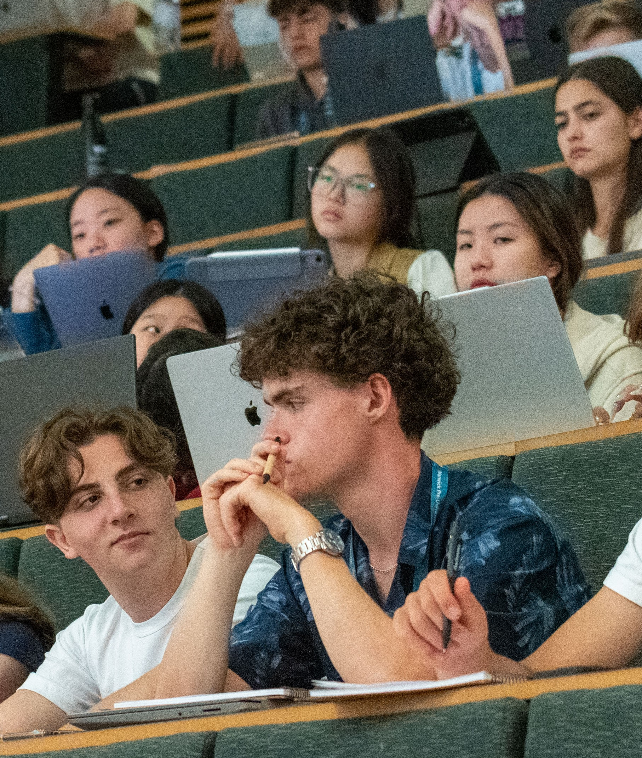
What our students say
Maxime
Country: Belgium
PRESS course: A taste of Economics and Finance
“The main skill that I developed during the 10 days was, without a doubt, the ability to present a project with confidence in front of a larger group of people. I had the chance to do this during our group project. This will definitely be useful in my future professional career. I also developed my social skills to approach different people and become friends with them.”

Slide 14
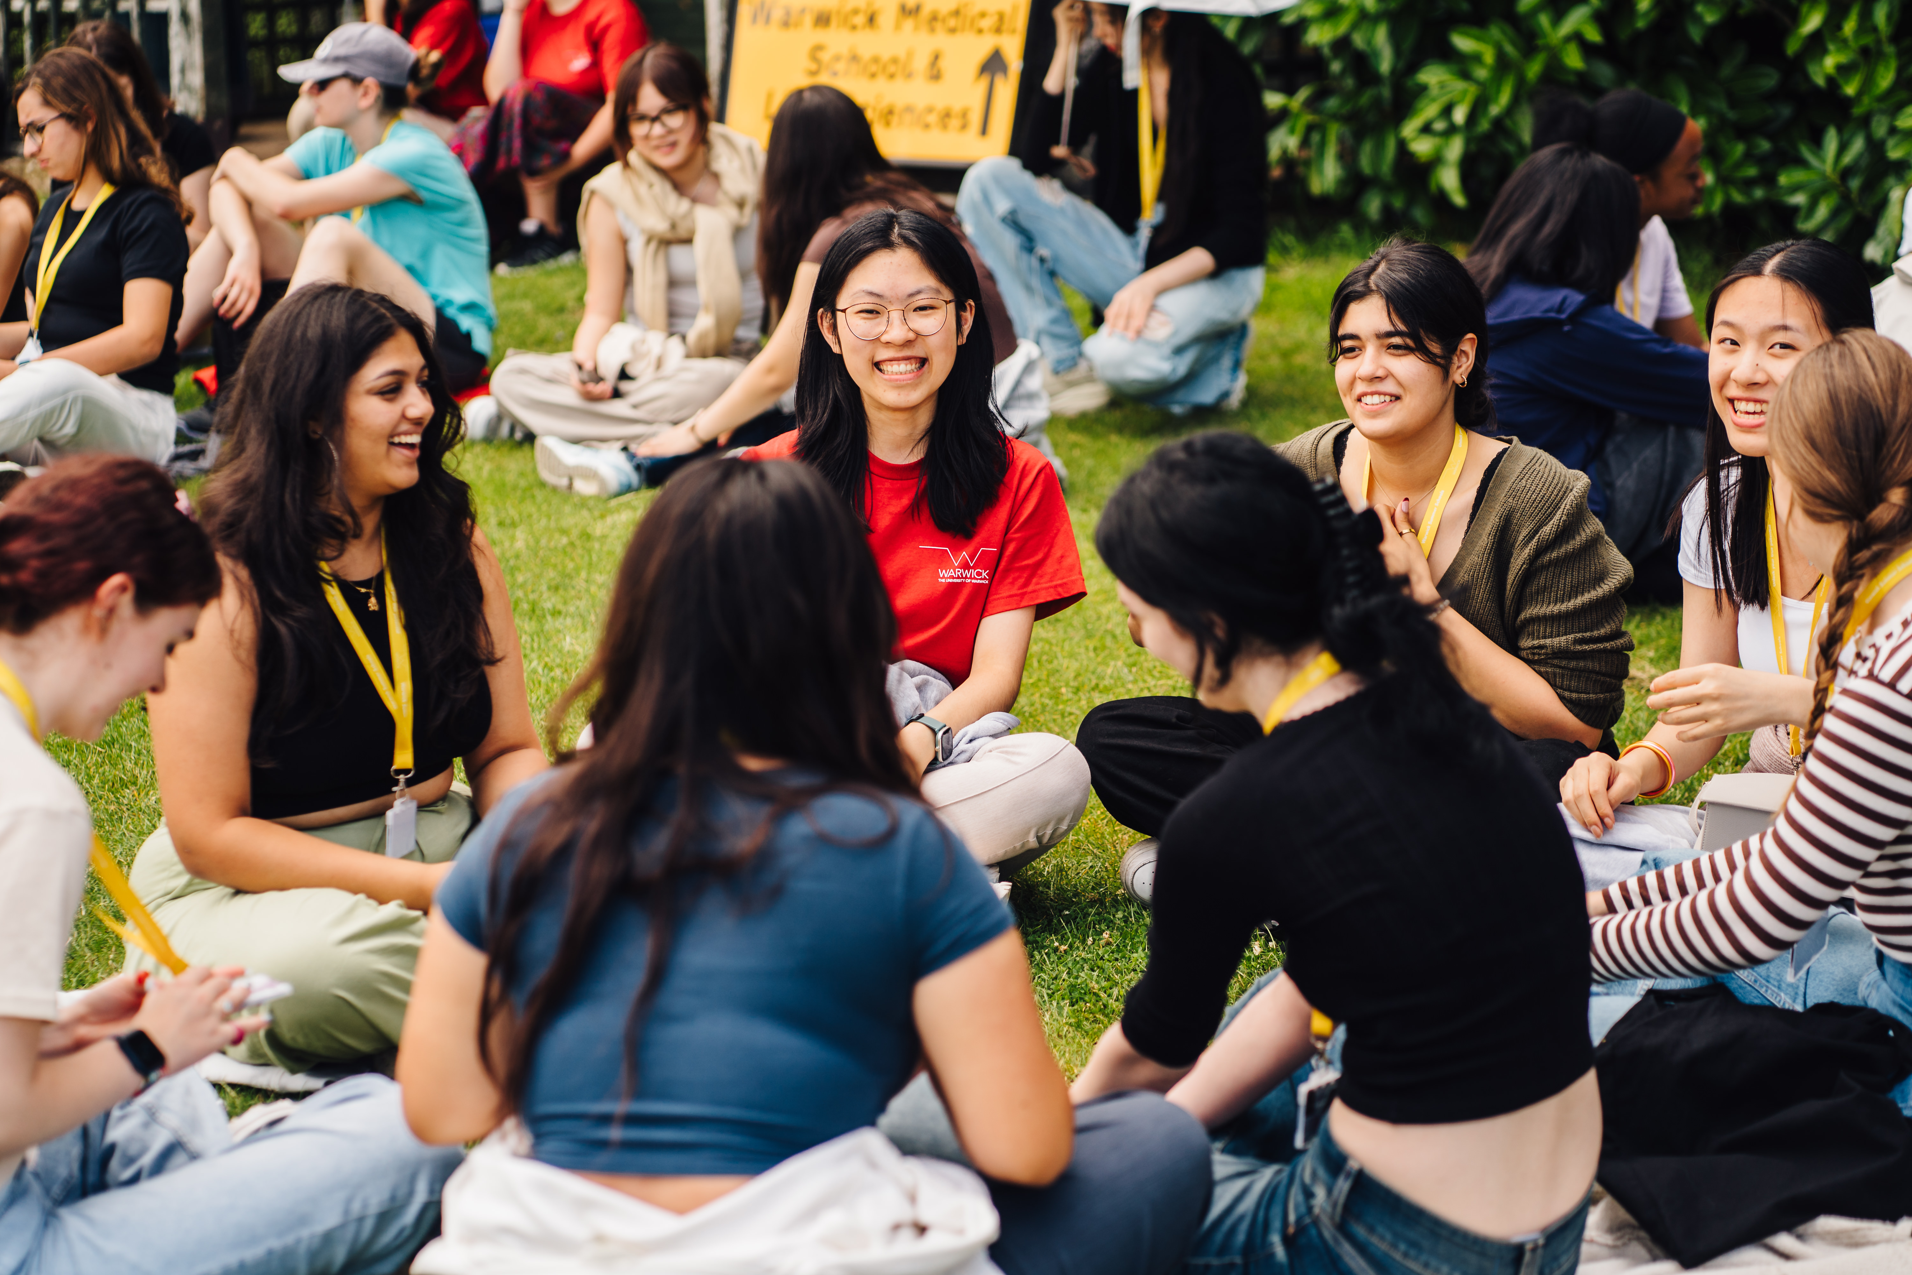
Thank you for listening
Questions?

