Slide 1
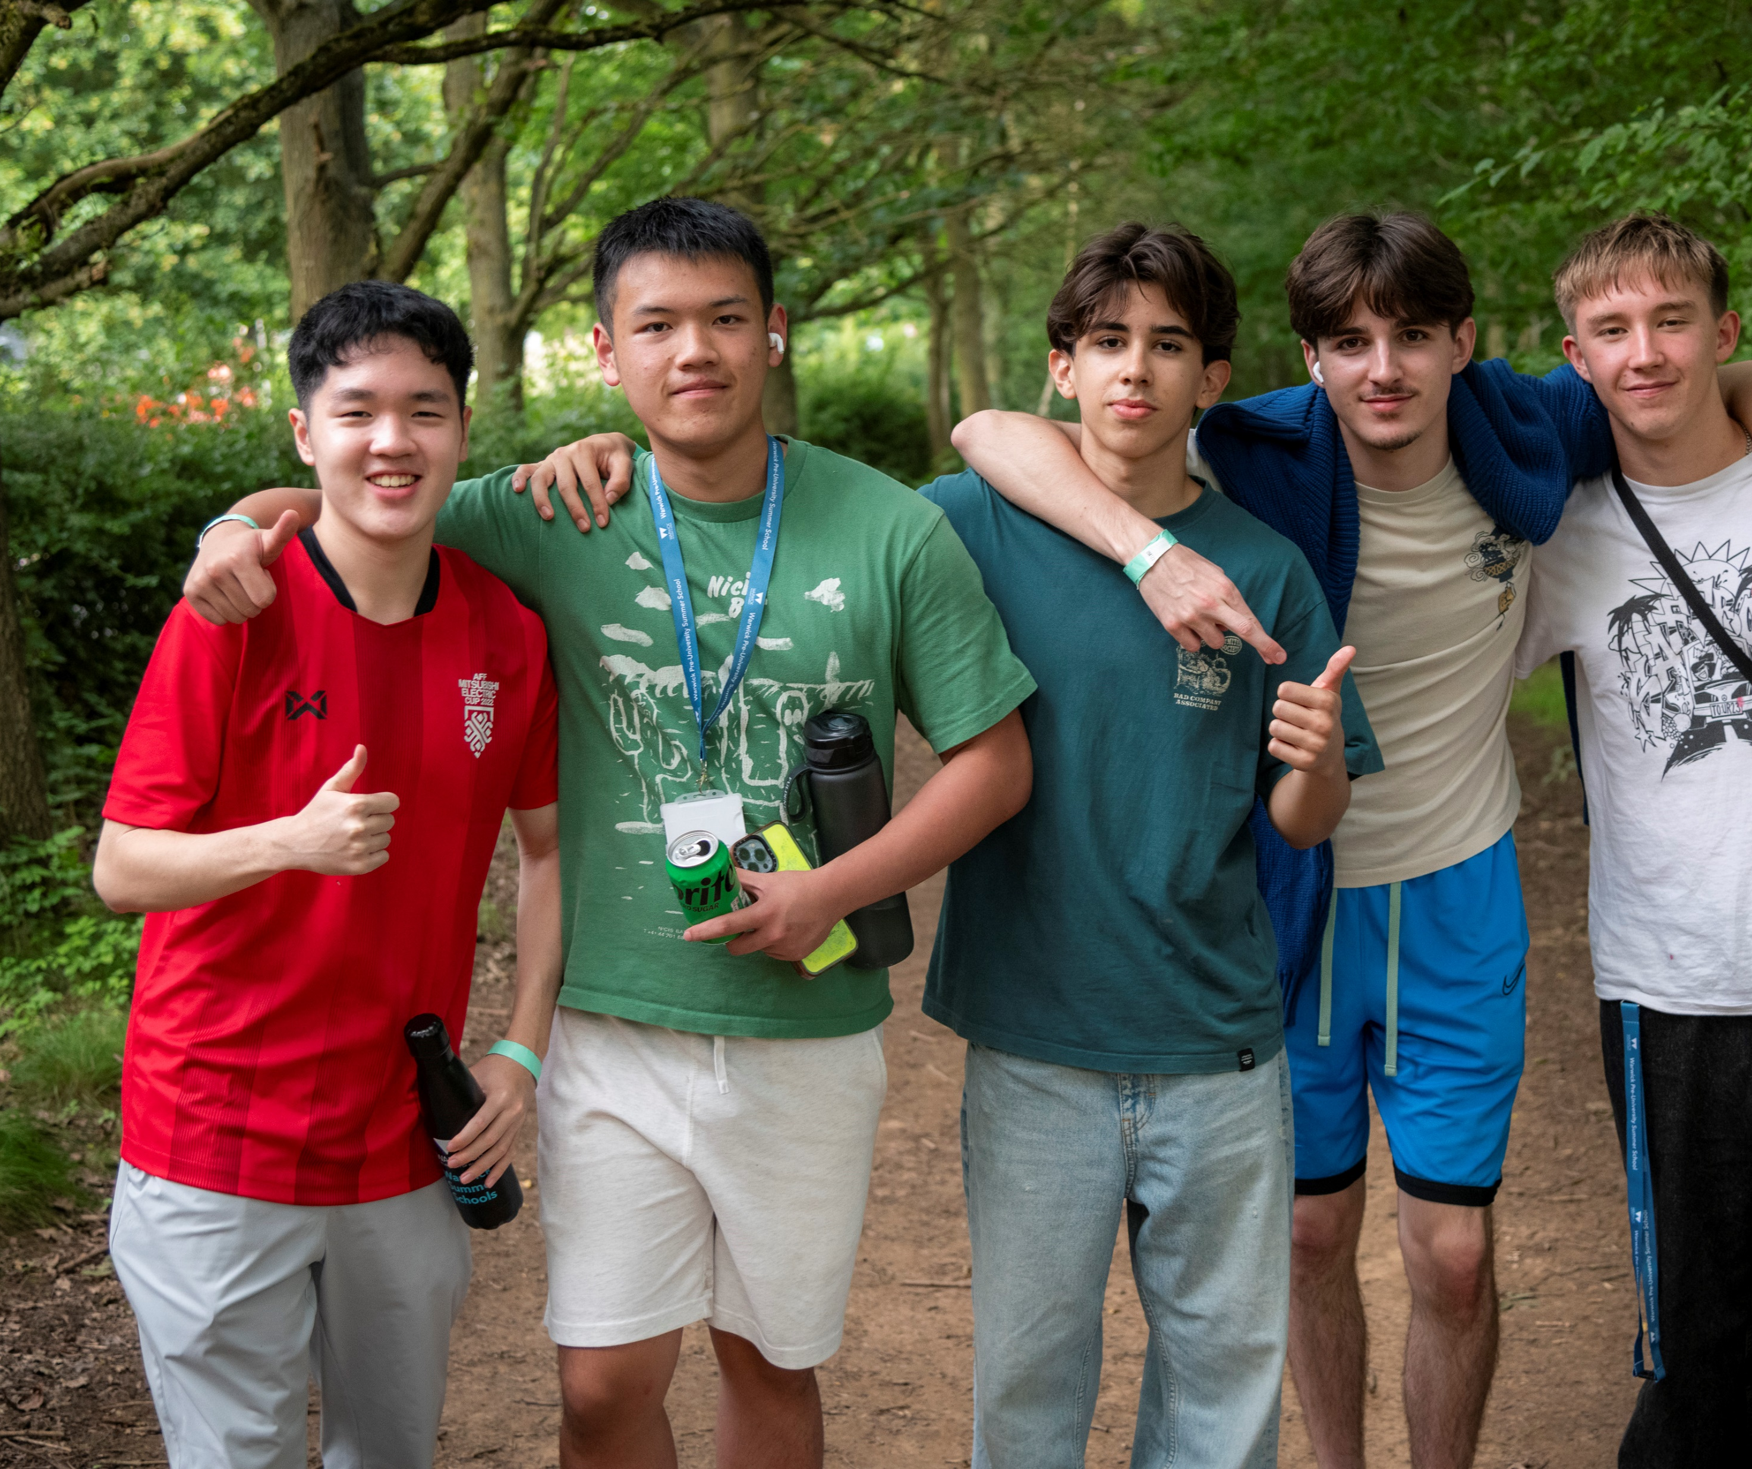
Warwick pre-university summer school
Your university adventure starts here
15-25 July 2025
October 2024

Slide 2

Why spend your Summer with us?
Exciting, 10-night residential programme for 16-17 year-olds
Hosted at the University of Warwick Campus, with access to all Warwick facilities
Included in the course:
All teaching, personal development and guest lectures
Preparation for applying to UK universities
Social events and cultural visits
Accommodation, breakfast and evening meals
Full sightseeing programme in London
Full Warwick ambassador support

Slide 3
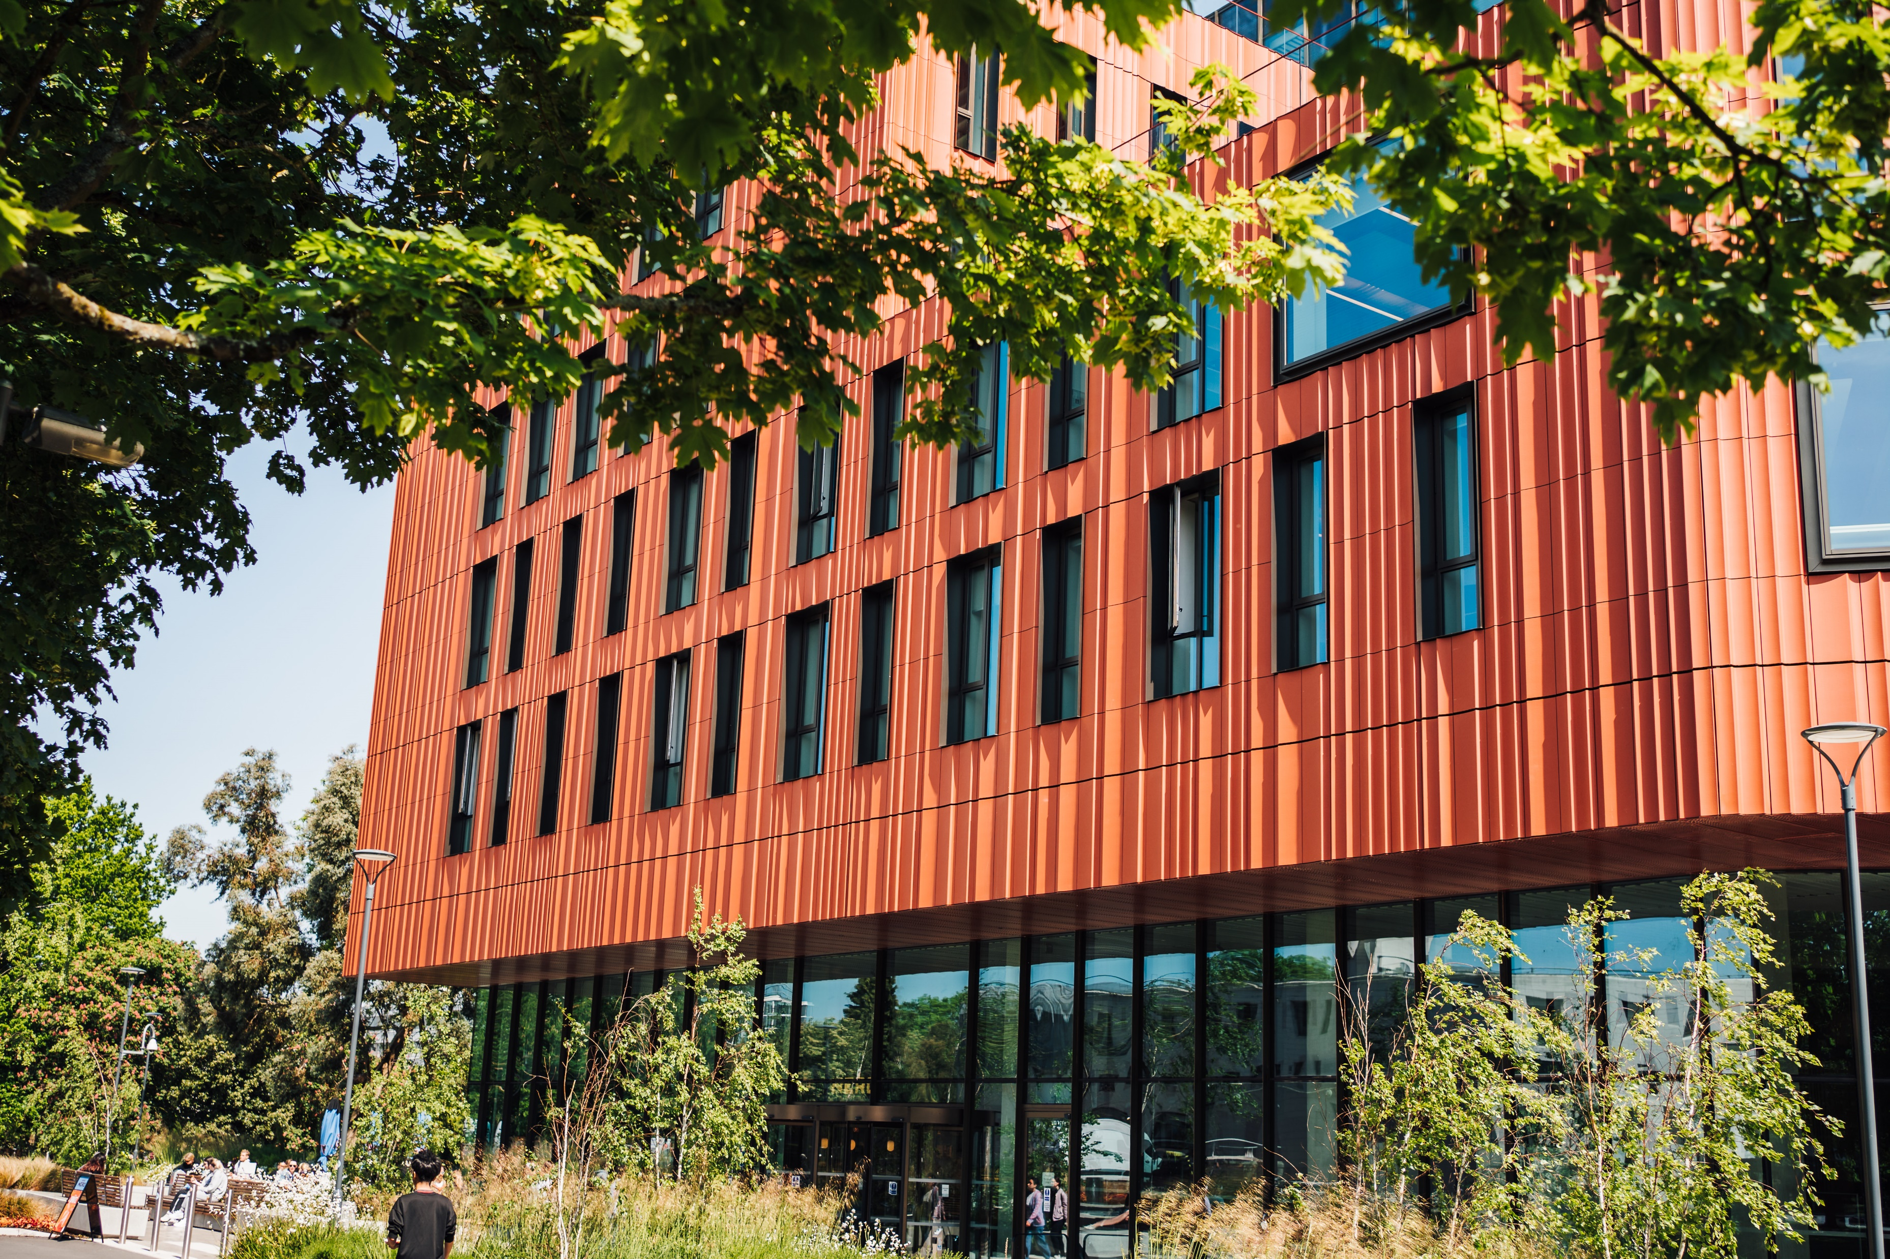

Why Warwick?
The University of Warwick is a leading, Russell Group university in the UK.
8th in the UK GUARDIAN University RANKINGS 2025
22nd in EUROPE QS WORLD RANKINGS 2025
69th in the world QS World Rankings 2025
95% of our students would recommend the Pre-University Summer School!

Slide 4




Course Options 2024
A Taste of Economics and Finance
Introduction to Finance
Game Theory
Behavioural Economics
Cryptocurrency
Macro and microeconomics
A Taste of Social Sciences
Law
Philosophy
Education Studies
Sociology
Politics
A Taste of Science and Engineering
Life Sciences
Psychology
Mathematics and Statistics
Computer Science
Engineering
A Taste of Arts and Humanities
Film and Television Studies
English
Theatre and Performance Studies
History
Liberal Arts

Slide 5
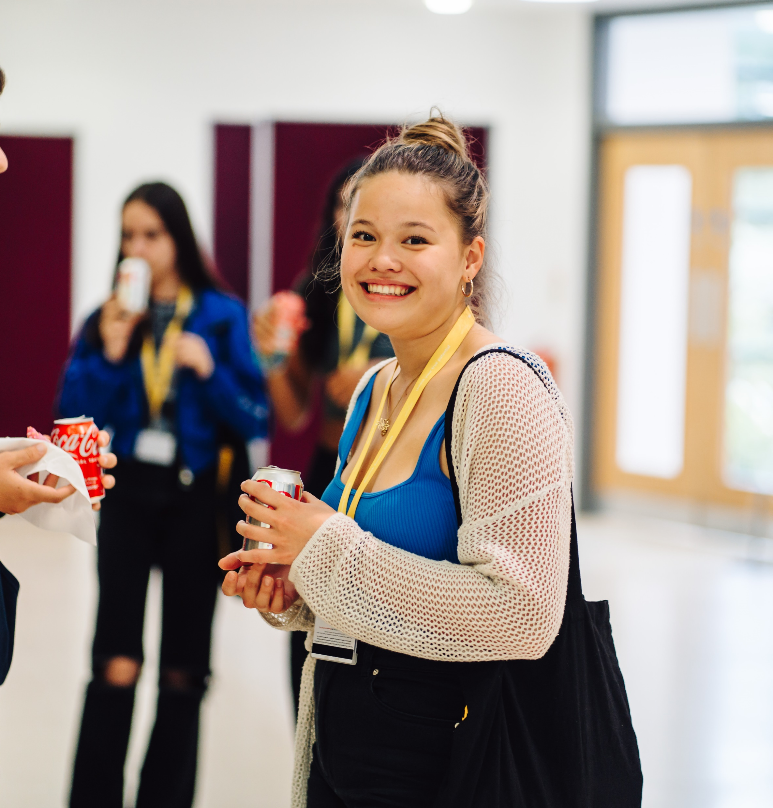


Course Content
All courses are taught by Warwick staff, with delivery via lectures and seminars
24 hours of contact time overall
Alongside academic content, courses include:
Guest speaker session
Preparing for Study in the UK (2 x practical sessions)
Personal Development sessions

Slide 6
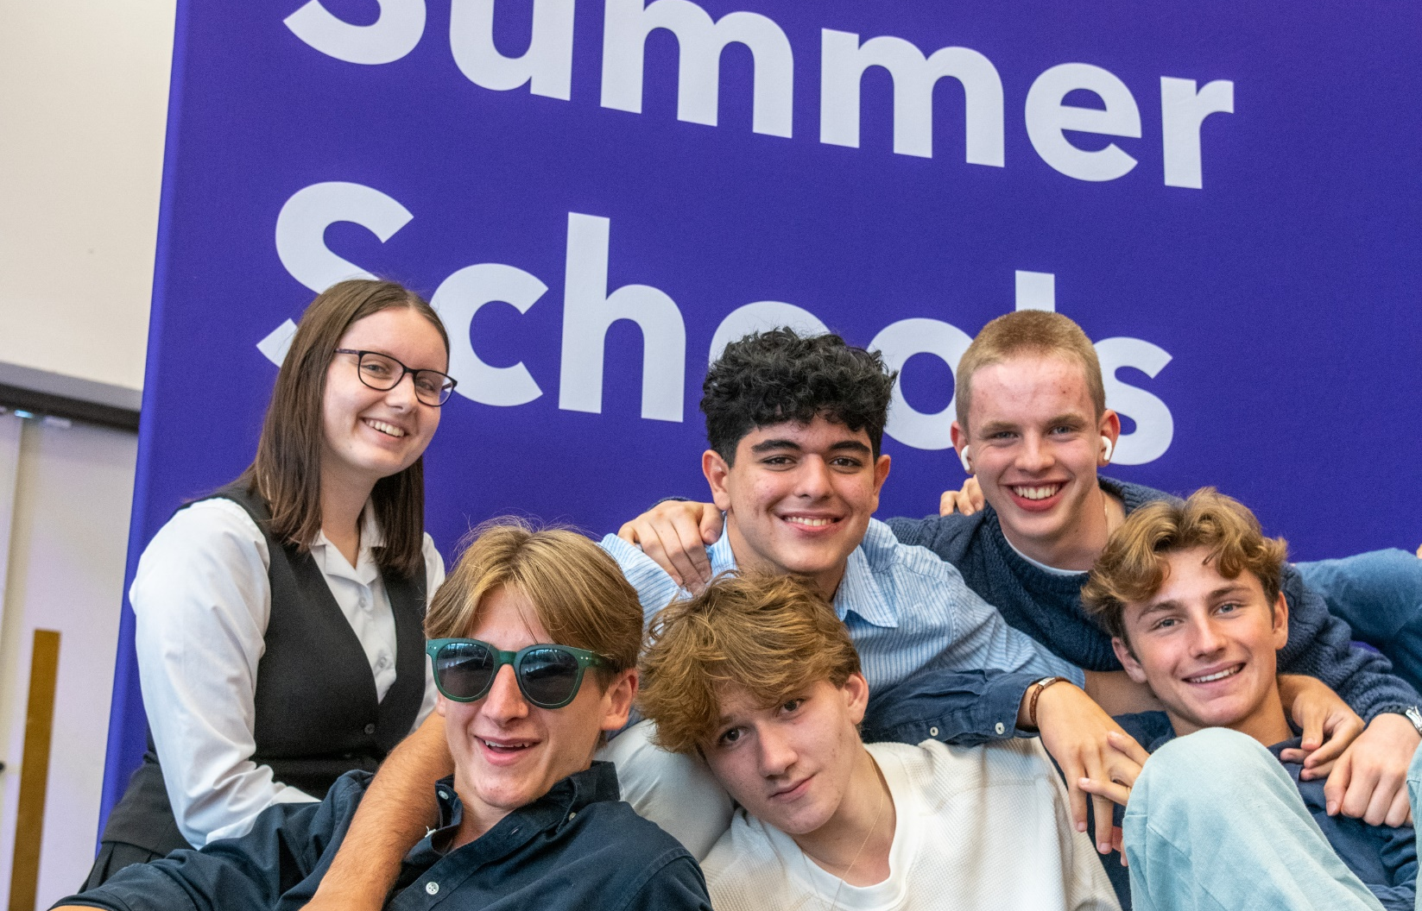
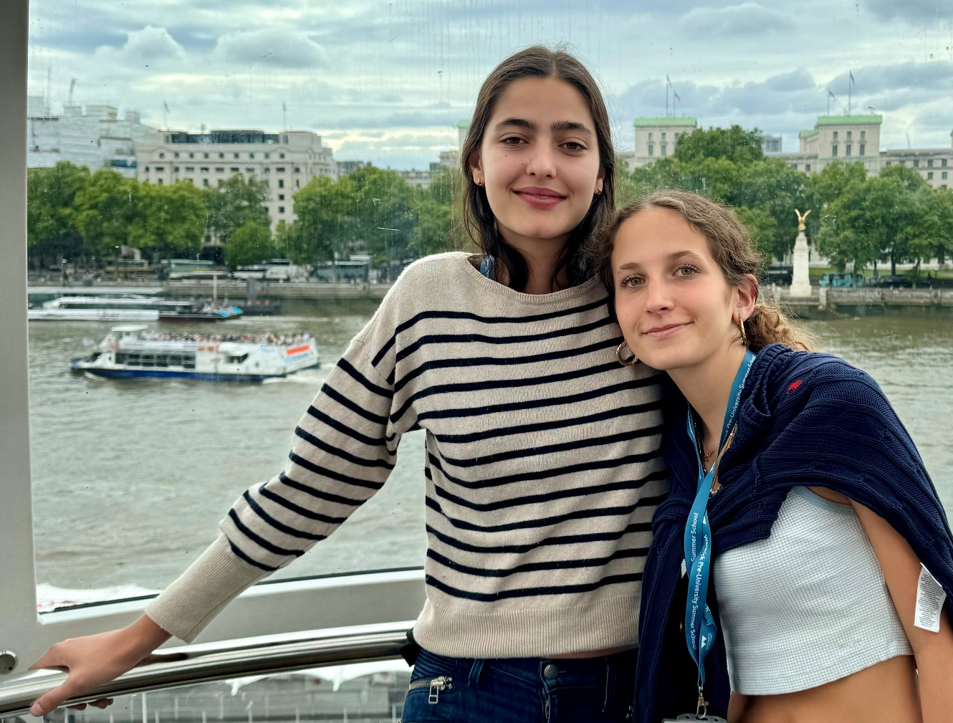
Social and Cultural Programme
A range of activities included to suit all students
Some events will take place on campus, showcasing Warwick and everything it has to offer:
Welcome BBQ
Teambuilding event and street food
E-sports centre
Sports, games, films
Curry, karaoke and disco farewell
Events off campus will include:
Day trip to Oxford – punting on the River Cherwell, walking tour, and time for lunch and shopping
Day trip to London – a tour of the Houses of Parliament, a West End Show or River Cruise and London Eye

Slide 7
Safety and Welfare
Airport pickups available (details published in early 2025)
Dedicated team of staff with DBS checks and trained in safeguarding
Campus environment with 24-hour security provided via our Community Safety team
Fully trained Summer School Ambassadors (current Warwick students) live alongside the students and accompany them on all trips – also DBS checked
Individual study bedrooms with en-suite bathrooms – choice of mixed or single-sex flats
Code of conduct and parental consent forms required by all

Slide 8
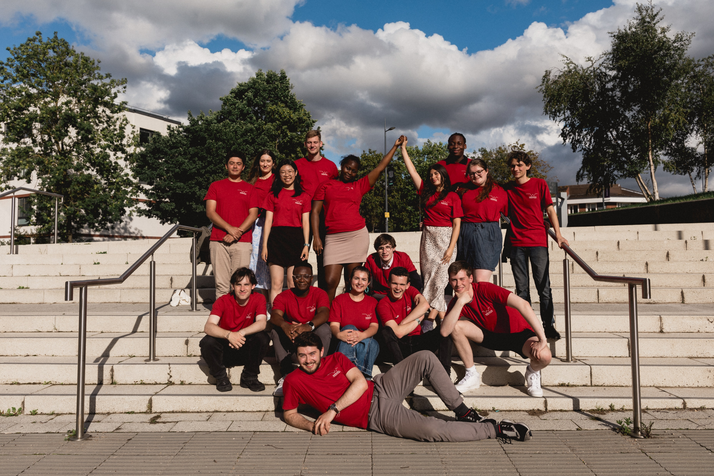
Summer School Ambassadors
There to meet and greet you from the start and live alongside you in your flat for the duration of the Summer School
Each flat is allocated a Summer School ambassador who will be the main points of contact
Ambassadors join all the planned social and cultural activities, as well as offering pastoral and wellbeing support - also arrange informal entertainment, activities and ice-breakers in the evenings
All Summer School ambassadors are existing Warwick students, currently studying a range of degree courses
They offer a fantastic insight into life as a student at Warwick - ask them any questions that you have about life at Warwick
We have Lead Ambassadors to provide an extra level of support and Night Managers to provide any help and assistance during the night.
Each year, our students feedback that the Summer School Ambassadors are a highlight of the programme!

Slide 9
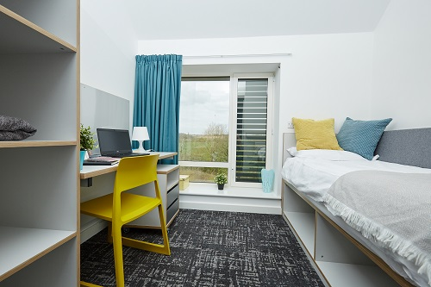
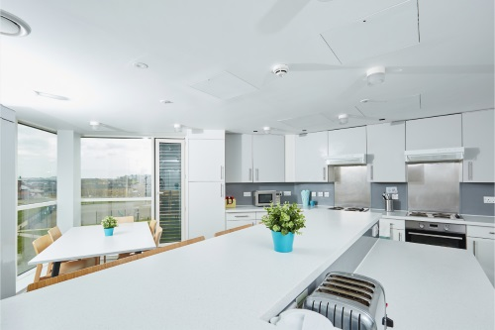
Catering and Accommodation
10-nights of accommodation in Sherbourne Halls of Residence
Single study bedrooms with desk, and an en-suite bathroom – bedding and towels provided
Sports Centre Membership – access to the gym and swimming pool
Catered for breakfasts and dinners, some lunches also included, but there will be some occasions where you'll need to buy lunch when on-campus or on some trips - there will be lots of options available

Slide 10
Fees and Admissions
Applications made online, via our website
Short application form to gather personal details and education history
£50 non-refundable application fee
No subject specific requirements, students should be enthusiastic to study and motivated by their chosen subject
No English tests required – we assess your English based on your correspondence with us
We aim to review application and respond within 3-5 working days
Programme fee - £4950 (inclusive of all tuition, accommodation and most catering)
£1000 deposit required to secure place, remaining fee due by 6 June
If a visa is required, we will issue a visa invitation letter after deposit payment
Applications will close 31 May 2025

Slide 11
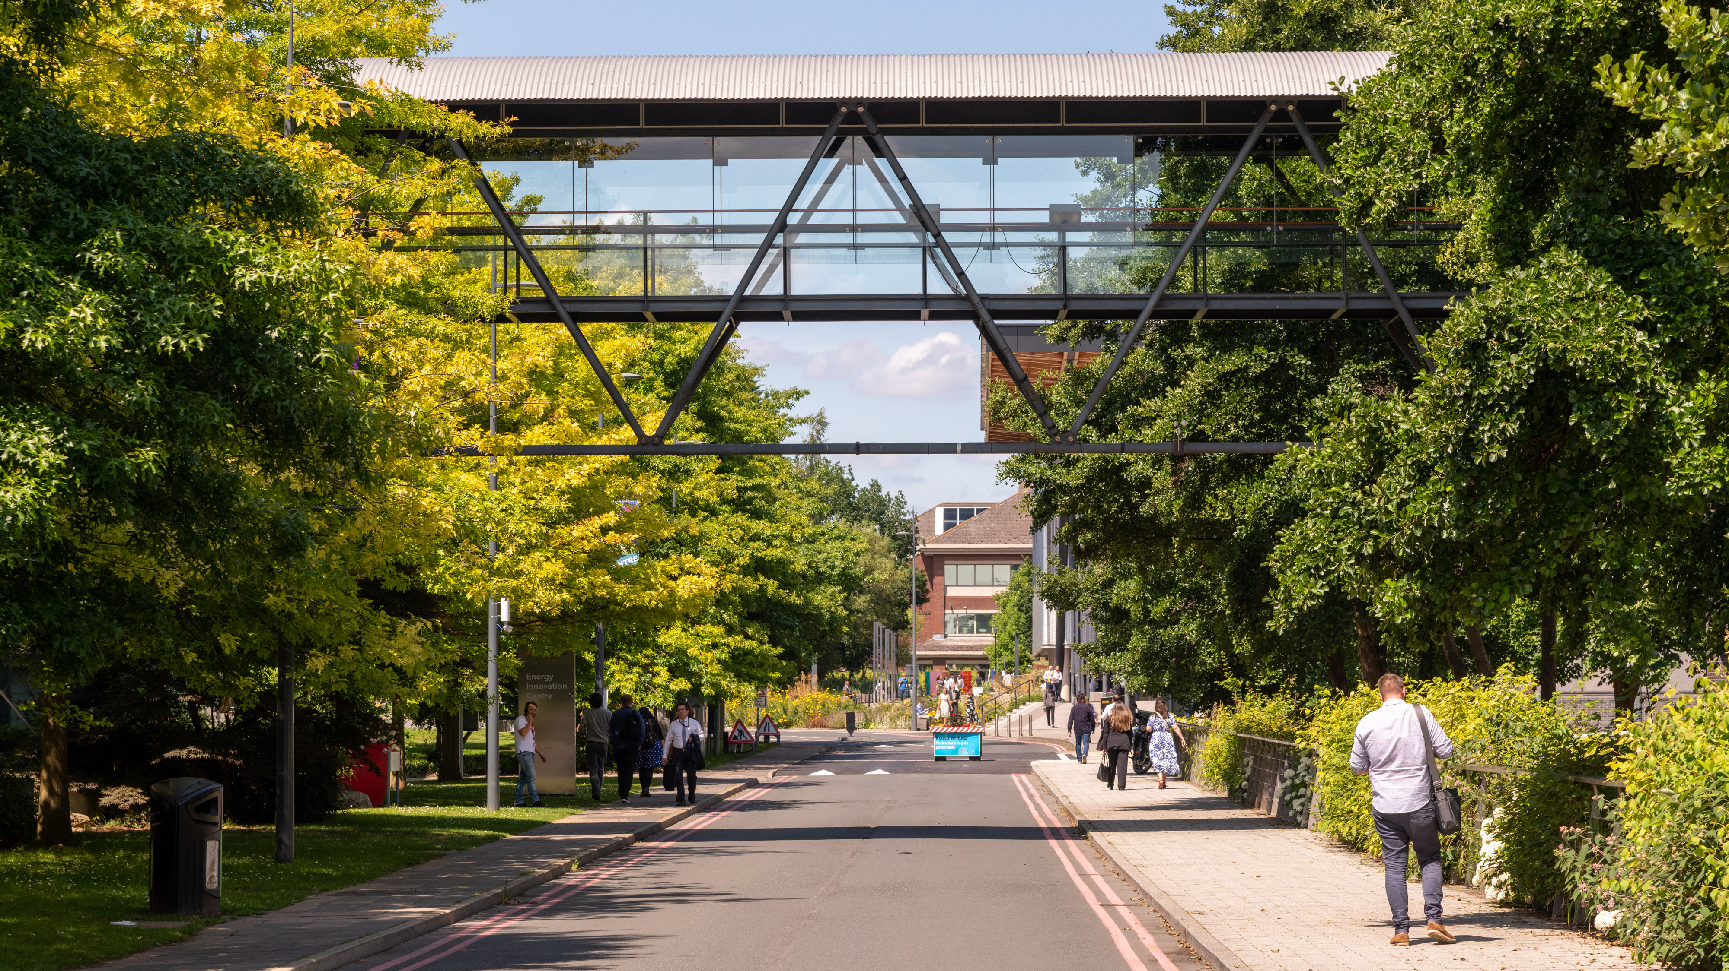
Questions?

