Slide 1

Warwick Summer School
Student Survey 2025

Slide 2
Please tell us what you think
We value your feedback and want to hear what you think about the Warwick Summer Programme to help us make it event better in future years.

Slide 3

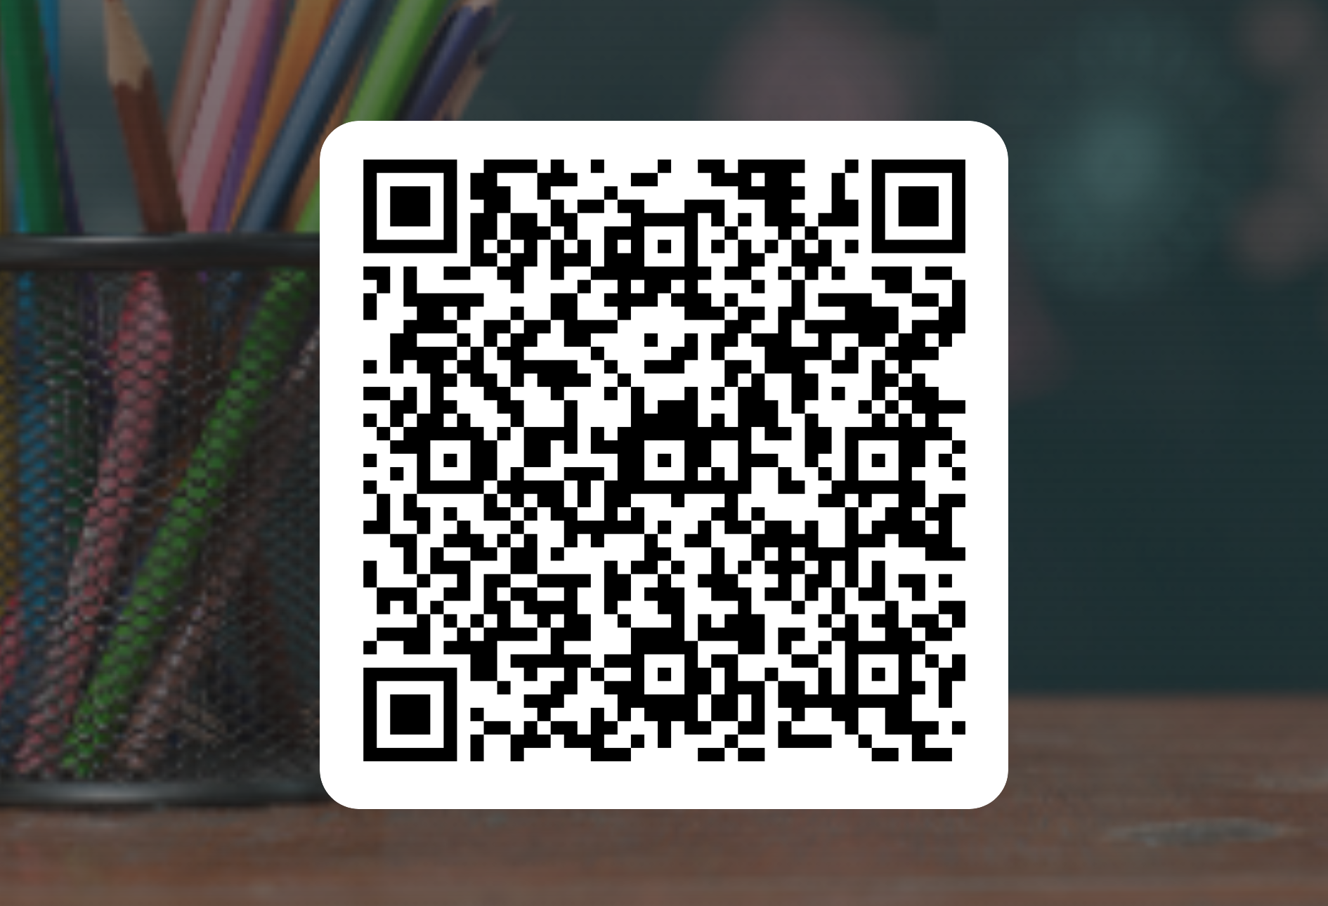
To access the survey use the QR code provided
Please complete this during your final lecture taster session

Slide 4
