Slide 1


Topics in International Business & Finance
(Warwick Summer School 2023)
Week 1
Banking, Money Markets,
Bond Markets, Equity Markets,
Securitisation, Derivatives
Lecturer:
Farzad Javidanrad

Slide 2
Some Preliminaries
Lecturers
Dr. Farzad Javidanrad, email: F.Javidanrad@warwick.ac.uk
Dr. Ernil Sabaj, email: Ernil.Sabaj@warwick.ac.uk
Teaching Assistant
Dr. Cholwoo Kim email: Cholwoo.Kim@warwick.ac.uk

Slide 3
Course Aims
This course aims to:
Explore some of the key theoretical concepts/issues in the world of business, and finance,
Find how multinational corporations leverage financial markets when seeking to exploit international business opportunities,
Explore the challenges brought by globalisation in the international economic environment and the relevance of these to financial and capital markets and business strategies.
Using different frameworks and methodologies, students will investigate the interaction between firm strategies, and economic policies under the changing international environment.

Slide 4
Learning Outcomes
To gain an understanding of the key concepts in the financial and international business environment and its competitive and investment climate
To provide students with an in-depth understanding of the correlations between the areas of finance and the global economy
To examine issues from both a business and economic perspective
To enhance your understanding of the strategic context in which international business operates
To help prepare you for a career in the finance operations of large multinational corporations.

Slide 5
Course Structure
For this course, there will be 4 hours of teaching on most weekdays, comprised of lectures and small group teaching. The structure will be:
3 hours of lectures.
A 1-hour seminar in small groups.
Students will also be given time each day for independent study.
Towards the end of the third week, students will be given the chance to work as a group and present one of the papers on the approved list of papers and the lecturer gives feedback on the presentation.

Slide 6
Papers (1 of 6)
Luc Laeven and Fabian Valencia, Resolution of Banking Crises: The Good, the Bad, and the Ugly, IMF Working Paper, WP/10/146
Margaux MacDonald and TengTeng Xu , Financial Sector and Economic Growth in India, IMF Working Paper , WP/22/137
Boileau Loko and Yuanchen Yang , Fintech, Female Employment, and Gender Inequality, IMF Working Paper , WP/22/108
Ruchir Agarwal and Gita Gopinath , Seven Finance and Trade Lessons from COVID-19 for Future Pandemics, IMF Working Paper, WP/22/97
Charles Kahn, Manmohan Singh, and Jihad Alwazir , Digital Money and Central Bank Operations, IMF Working Paper, WP/22/85
Yoke Wang Tok and Dyna Heng , Fintech: Financial Inclusion or Exclusion?, IMF Working Paper, WP/22/80
Alnasaa et al 2022, Crypto, Corruption, and Capital Controls: Cross Country Correlations, IMF Working Paper, WP/22/60
Dimitri G. Demekas and Pierpaolo Grippa , Financial Regulation, Climate Change, and the Transition to a Low-Carbon Economy: A Survey of the Issues, IMF Working Paper, WP/21/296

Slide 7
Papers (2 of 6)
Pizzinelli et al 2021, Assessing Banking and Currency Crisis Risk in Small States, An applicationto the EasternCaribbean Currency Union, IMF Working Paper, WP/21/276
Hüser et al 2021, How Does the Repo Market Behave Under Stress? Evidence From the COVID-19 Crisis, IMF Working Paper, WP/21/267
Marlon Rawlins and Luisa Zanforlin 2021 , Resolving Bank Failures and Institutions: Is There a Link? Some Empirical Evidence, IMF Working Paper, WP/21/211
Serhan Cevik and João Tovar Jalles 2020, Feeling the Heat: Climate Shocks and Credit Ratings, IMF Working Paper, WP/20/286
Baba et al 2020, Fintech in Europe: Promises and Threats, IMF Working Paper, WP/20/241
Cerutti et al 2020, Banking Across Borders: Are Chinese Banks Different?, IMF Working Paper, WP/20/249
Marco Gross and Christoph Siebenbrunner 2019, Money Creation in Fiat and Digital Currency Systems, IMF Working Paper, WP/19/285
Belkhir et al 2019, Bank Capital and the Cost of Equity, , IMF Working Paper, WP/19/265
Narayhan, P. and Phan, D. (2018) ‘A survey of Islamic banking and finance literature: Issues, challenges and future directions’, Pacific Basin Finance Journal, in press.

Slide 8
Papers (3 of 6)
King, R.G. and Levine, R. (1993) ‘Finance and growth: Schumpeter might be right’, Quarterly Journal of Economics, 108(3), 717–737.
Goetz, M. (2012) ‘Bank diversification, market structure and bank risk taking: Theory and evidence from U.S. commercial banks’, www.bostonfed.org/bankinfo/qau/wp/2012/qau1202.pdf
Claessens, S., Ratnovski, L. and Singh, M.M. (2012) ‘Shadow banking: Economics and policy’, IMF Staff Discussion Note, www.imf.org/external/pubs/ft/sdn/2012/sdn1212.pdf
Claessens, S. and van Horen, N. (2012) ‘Foreign banks: Trends, impact and financial stability’, IMF Working Paper, WP/12/10.
Claessens, S. and van Horen, N. (2014a) ‘Foreign banks: Trends and impact’, Journal of Money, Credit and Banking, 46(1), 295–326.
Bertay, A.C., Demirgüç-Kunt, A. and Huizinga, H. (2013) ‘Do we need big banks? Evidence on performance, strategy and market discipline’, Journal of Financial Intermediation, 22(4), 532–558.
Beltratti, A. and Stulz, R.M. (2012) ‘The credit crisis around the globe: Why did some banks perform better during the credit crisis?’, Journal of Financial Economics, 105(1), 1–17.
Beck, T., Demirguc-Kunt, A. and Merrouche, O. (2013) ‘Islamic vs. conventional banking: Business model, efficiency and stability’, Journal of Banking & Finance, 37(2), 433–447

Slide 9
Papers (4 of 6)
Bank for International Settlements (2018) Implications of fintech developments for banks and bank supervisors. https://www.bis.org/bcbs/publ/d431.pdf
Bank for International Settlements (2018) ‘International banking and financial market developments’, BIS Quarterly Review. http://www.bis.org/publ/qtrpdf/r_qt1803.htm
Arcand, J.L., Berkes, E. and Panizza, U. (2012) ‘Too much finance?’, IMF Working Paper, WP/12/161.
Acharya, V.V., Schnabl, P. and Suarez, G. (2013) ‘Securitization without risk transfer’, Journal of Financial Economics, 107(3), 515–536.
Abedifar, P., Ebrahim, S., Molyneux, P. and Tarazi, A. (2013) ‘Risk in Islamic banking’, Review of Finance, 17, 2035–2096.
Cavusgil, S. Tamer and Knight, Gary. ‘The born global firm: an entrepreneurial and capabilities perspective on early and rapid internationalization’, Journal of International Business Studies, vol. 46, no. 1 (2015).
Driffield, Nigel, Jones, Chris and Crotty, Jo. ‘International business research and risky investments, an analysis of FDI in conflict zones’, International Business Review, vol. 22, no. 1 (2013).
Gao, Gerald Yong, Danny Tan Wang and Yi Che. ‘Impact of historical conflict on FDI location and performance: Japanese investment in China’, Journal of International Business Studies, vol. 49, no. 8 (2018).
Hillemann, Jenny and Gestrin, Michael. ‘The limits of firm-level globalization: Revisiting the FSA/CSA matrix’, International Business Review, vol. 25 (2016).

Slide 10
Papers (5 of 6)
Makino, Shige and Tsang, Eric W. K. ‘Historical ties and foreign direct investment’, Journal of International Business Studies, vol. 42 (2010).
Lee, Seung-Hyun, Oh, Kyeungrae and Eden, Lorraine. ‘Why do firms bribe?’ Management International Review, vol. 50, no. 6 (1 December 2010).
Beleska-Spasova, Elena and Glaister, Keith W. ‘The geography of British exports: country-level versus firm-level evidence’, European Management Journal, vol. 27 (2009).
Davis, Lucy. ‘Ten years of anti-dumping in the EU: economic and political targeting’, Global Trade and Customs Journal, vol. 4, no. 7 (2009).
Meschi, Pierre-Xavier and Riccio, Edson Luiz. ‘Country risk, national cultural differences between partners and survival of international joint ventures in Brazil’, International Business Review, vol. 17, no. 3 (June 2008).
Piscitello, Lucia. ‘Multinationals and economic geography: location, technology and innovation’, Journal of International Business Studies, vol. 44, no. 8 (2013).
Levy, Orly, Beechler, Schon, Taylor, Sully and Boyacigiller, Nakiye A. ‘What we talk about when we talk about “global mindset”: managerial cognition in multinational corporations’, Journal of International Business Studies, vol. 38, no. 2 (March 2007).
Asmussen, Christian Geisler, Pedersen, Torben and Dhanaraj, Charles. ‘Host-country environment and subsidiary competence: extending the diamond network model’, Journal of International Business Studies, vol. 40, no. 1 (2009).

Slide 11
Papers (6 of 6)
Gao, Gerald Yong, Tan Wang, Danny and Che, Yi. ‘Impact of historical conflict on FDI location and performance: Japanese investment in China’, Journal of International Business Studies vol. 49, no .8 (2018).
Meyer, Klaus E., Mudambi, Ram and Narula, Rajneesh. ‘Multinational enterprises and local contexts: the opportunities and challenges of multiple embeddedness’, Journal of Management Studies, vol. 48, no. 2 (March 2011).
Piscitello, Lucia. ‘Multinationals and economic geography: location, technology and innovation’, Journal of International Business Studies, vol. 44, no. 8 (2013).
Vahlne, Jan-Erik, Ivarsson Inge and Johanson, Jan. ‘The tortuous road to globalization for Volvo’s heavy truck business: extending the scope of the Uppsala model’, International Business Review, vol. 20, no. 1 (February 2011).
Yip, George S., Rugman, Alan M. and Kudina, Alina. ‘International success of British companies’, Long Range Planning, vol. 39, no. 2 (June 2006).

Slide 12
Course Assessment
The module will be assessed via a 2-hour examination. It should be noted that the exam is not compulsory for everyone, apart from some. Everyone who completes the course, whether or not they sit the exam, will receive a certificate of attendance.
However, by taking the exam, you will also receive a grade/mark for the course, which can be helpful to you.

Slide 13
Topics for Week 1 (with Farzad)
Banking
Money markets
Bond markets
Securitisation; credit rating
Equity (stock) markets
Derivatives I: futures and options
Derivatives II: credit derivatives
Financial regulation (time allowing)

Slide 14
Topics for Week 2 (with Ernil)
The International Economic Environment
Multinational Corporations: internal organization and strategies
Market Structure and Firms’ Strategies
Foreign Domestic investment
Business Strategy - Use of Game Theory

Slide 15
Topics for Week 3 (with Farzad)
Globalisation: What is it and what are its drivers
Principles of International Trade
International Competition and Cooperation
Economic and Political Country Risks
Risk of Expropriation

Slide 16
Suggested Reading :
Textbooks for this course
Simon Collinson, Rajneesh Narula, Alan M. Rugman and Amir Qamar, International Business, 8th Edition, Pearson Education, 2020
Frederic S. Mishkin and Stanley Eakins, Financial Markets and Institutions, Global Edition, 9th Edition, Pearson Education, 2020
Jonathan Berk and Peter DeMarzo, Corporate Finance, Global Edition, 3rd edition, Pearson Education, 2014
John D. Daniels, Lee H. Radebaugh and Daniel Sullivan, International Business, Global Edition, 17th Edition, Pearson Education, 2021
John J. Wild and Kenneth L. Wild, International Business: The Challenges of Globalization, Global Edition, 9th Edition, Pearson Education, 2019
John Lipczynski, John Goddard and John O.S. Wilson, Industrial Organization: Competition, Strategy and Policy, 5th Edition, Pearson Education, 2017
Sloman, John, et al. Economics for Business Enhanced. Available from: VitalSource Bookshelf, (8th Edition). Pearson International Content, 2019.
Michael Parkin, Microeconomics, Global Edition, 14th Edition, Pearson Education, 2022
Barbara Casu, Claudia Girardone and Philip Molyneux, Introduction to banking, 3rd edition. Pearson Education, 2021.
Glen Arnold, Modern Financial Markets and Institutions, Pearson Education, 2012
Marc Levinson, Guide to Financial Markets, 6th edition, The Economist, 2014
• Textbooks for today
Chapter 1 in Simon Collinson, Rajneesh Narula, Alan M. Rugman and Amir Qamar, International Business, 8th Edition, Pearson Education, 2020
Chapters 1 and 2 in Frederic S. Mishkin and Stanley Eakins, Financial Markets and Institutions, Global Edition, 9th Edition, Pearson Education, 2020

Slide 17
The Banking & Money Market
Banking

Slide 18
Outline and Learning Outcomes
Banking
Bank activities and services: Bank’s balance sheet
Bank Profits, Theory of Loanable Funds (Fractional Reserve Banking)
International and Multinational Banks

Slide 19
Suggested Reading:
Core Textbooks
Chapters 17 and 19 in Frederic S. Mishkin and Stanley Eakins, Financial Markets and Institutions, Global Edition, 9th Edition
Optional
Chapters 1, 2, 3, 4, 5, 7, 8, 9, 10, 11, 12, 18, 20 in Barbara Casu, Claudia Girardone and Philip Molyneux, Introduction to banking, 3rd edition. Pearson Education, 2021.
Chapter 2, Glen Arnold, Modern Financial Markets and Institutions, Pearson Education, 2012
Marc Levinson, Guide to Financial Markets, 6th edition, The Economist, 2014

Slide 20
Useful Websites
Newspapers/news websites:
Financial Times, The Economist, Reuters
Central banks and regulators:
Bank of England –http://www.bankofengland.co.uk
Financial Conduct Authority – http://www.fca.org.uk/
European Central Bank –http://www.ecb.europa.eu
US Federal Reserve – http://www.federalreserve.gov/
Bank for International Settlements – http://www.bis.org/
Industry associations:
British Bankers’ Association – http://www.bba.org.uk/
American Bankers’ Association –http://www.aba.com

Slide 21
Some Preliminary concepts
Some preliminary concepts we need:
1- Hedge Fund: It is a company of private investors. Their money is managed by professional fund managers who use a wide range of strategies, usually investing in risky securities to gain a return above the average investment return in the market.
2- Security: A security is a tradable financial asset with a monetary value such as equities, bonds, commercial papers, etc.
3- Merger & Acquisition: When two companies come together to combine their businesses, it's called a merger. Both companies agree to join forces in a merger and become one entity. They pool their resources, employees, and expertise to create a stronger, more competitive company. It's a way for companies to grow and expand their operations. (e.g. Facebook & WhatsApp, Google & YouTube)
On the other hand, an acquisition happens when one company buys another company. In this case, one company, the acquiring company, takes over the other, called the target company. The acquiring company pays money or offers its stock to the shareholders of the target company to gain control over it. The target company becomes a part of the acquiring company. (e.g. Vodafone & Mannesmann)

Slide 22
Banks
Definition of Bank:
A bank is a financial institution that is licensed by monetary authorities either to accept deposits and lend/invest money to make a profit or to provide some services such as money and debt transactions, underwriting securities, etc., and get fees for their services.
Financial Institution vs Financial System: Banks are the backbone of the financial system, but the financial system is a complex structure including many different financial institutions such as banks, insurance companies, pension funds, mutual funds, security markets, etc. They are all regulated by governments to a certain degree.
The financial system includes not only financial institutions but also financial markets, regulatory bodies, payment systems, and infrastructure that support financial transactions (e.g. the Society for Worldwide Interbank Financial Telecommunication, SWIFT). It provides a framework for mobilising savings, channelling investments, managing risks, and facilitating economic activities.

Slide 23
Banks
A growing economy requires a healthy financial system that transfers funds from savers/lenders to borrowers and protects the rights of the lenders and borrowers. But there are two issues:
1- How do we know the funds are transferred to and used by borrowers with the best productive investment opportunities?
2- Do banks (as the major financial institutions) have just an intermediary role in the economy? Do they have other roles that might be unhealthy for the economy?
Keep these questions in your mind as we come back to these questions later.

Slide 24
Banks
Types of Banks:
There are a variety of banks in terms of their functionalities, but the most important of them are:
Retail Banks: They deal with the general public through different branches and/or through online banking. They offer different loans and facilities such as credit cards, and overdraft facilities. etc. Examples of retail banks include HSBC, Barclays, Royal Bank of Scotland, and Lloyds Banking Group.
Commercial or Corporate Banks: These banks provide services to small and large businesses. Their services include providing credit, cash management, paying wages, etc. Examples: Lloyds Banking Group, Barclays, HSBC, Royal Bank of Scotland (RBS), Santander, and JPMorgan (USA).
Investment Banks: These banks provide a variety of services and financial transactions such as underwriting and assisting with merger and acquisition (M&A) activities. “Their clients include large corporations, other financial institutions, pension funds, governments, and hedge funds”. Examples: same banks + Goldman Sachs, UBS, Credit Suisse, etc.

Slide 25
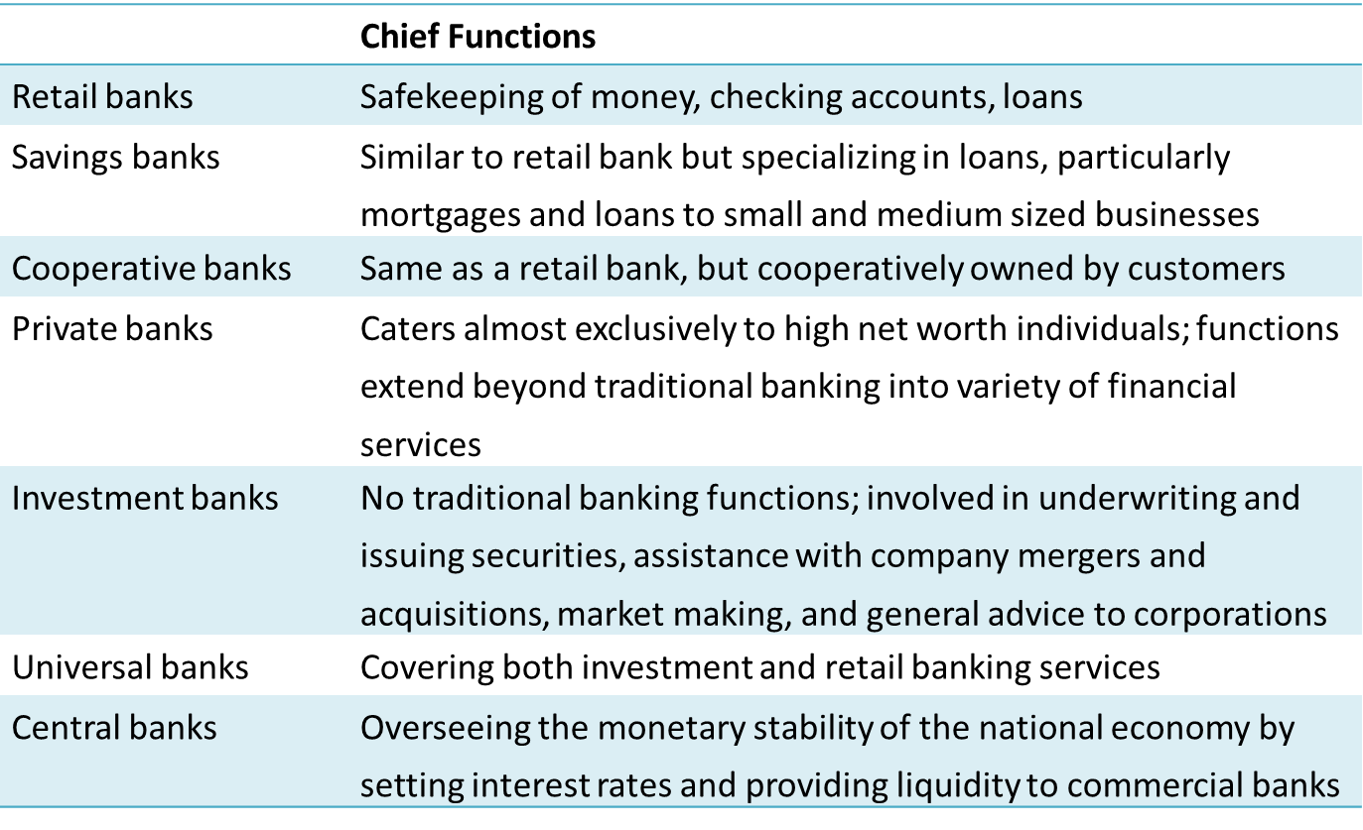
Banks
Central Banks: It is the regulatory body of the financial system and work as an independent entity (in a spectrum) that do not deal with the public directly but are responsible for the health and stability of the whole economic system, generally, and the determination of the base interest rate, supply of money, and keeping inflation near its target, particularly.
Other Forms of Banks:
Including Saving banks, private banks,
universal banks (see the table)
Adopted from Macroeconomic in Context, by Dünhaupt, Dullien, Goodwin, Harris, Nelson, Roach, Torras

Slide 26
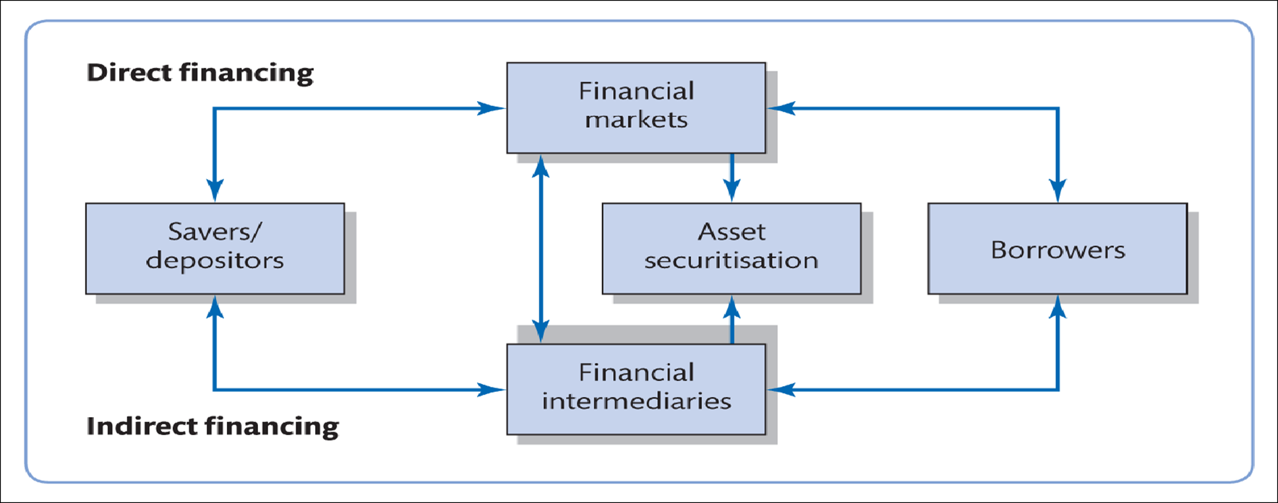
Banks
Banks play an important role in channelling funds to finance (indirectly) productive and unproductive investment opportunities.
They provide loans to businesses, finance college educations, and allow us to purchase homes with mortgages.
Direct participation in the financial market, e.g., borrowing directly from lenders by selling bonds to them.

Slide 27
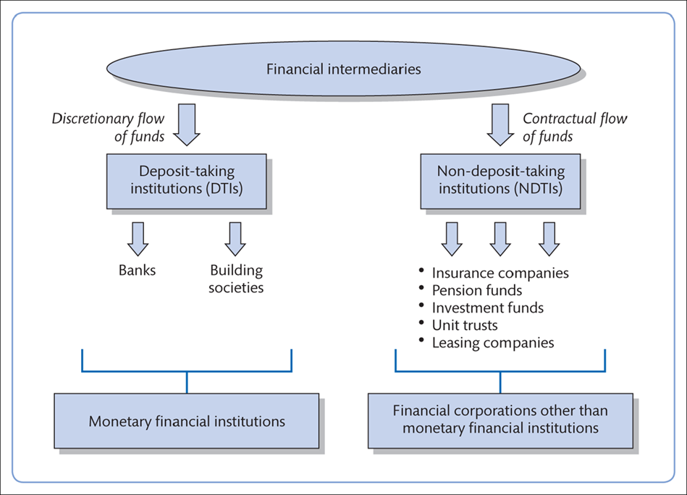
Non-bank Financial Institutions
The term financial intermediary is used for banks as deposit-takers and non-banks as non-deposit-takers.
The second financial institutions (including insurance companies, hedge funds, pension funds, private equity funds, etc.) are not much regulated by financial authorities and they constitute shadow banking systems.
“The shadow banking system played a major role in the expansion of housing credit in the run-up to the 2008 financial crisis”. (Investopedia)

Slide 28
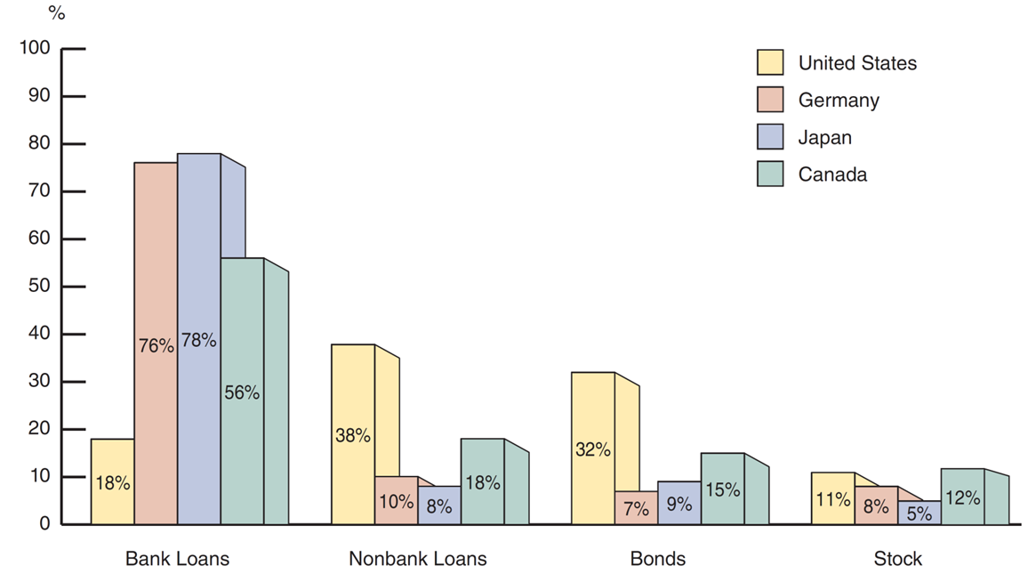
Basic Facts About Financial Structure Through Some Countries
“The chart shows how nonfinancial businesses get external funding in the U.S., Germany, Japan, and Canada”.
“Notice that, although many aspects of these countries are quite different, the sources of financing are somewhat consistent, with the U.S. being different in its focus on debt”.
Sources of External Funds for Nonfinancial Businesses:
A Comparison of the United States with Germany, Japan, and Canada
Indirect finance
Direct finance
Sources: Andreas Hackethal and Reinhard H. Schmidt, “Financing Patterns: Measurement Concepts and Empirical Results,” Johann Wolfgang Goethe-Universitat Working Paper No. 125, January 2004. The data are from 1970–2000 and are gross flows as percentages of the total, not including trade and other credit data, which are not available.
(The slide is adopted from Financial Markets and Institutions, Mishkin & Eakins, Nine Edition, Pearson Education)

Slide 29
Facts of Financial Structure
Stocks are not the most important source of external financing for businesses. (Direct Finance)
Issuing marketable debt and equity securities is not the primary way businesses finance their operations. (Direct Finance)
Indirect finance, which involves the activities of financial intermediaries, is many times more important than direct finance, in which businesses raise funds directly from lenders in financial markets.
Financial intermediaries, particularly banks in Germany, Japan and Canada, are the most important source of external funds to finance businesses. (Indirect Finance)
(The slide is adopted from Financial Markets and Institutions, Mishkin & Eakins, Nine Edition, Pearson Education)

Slide 30
Facts of Financial Structure (More General)
The financial system is among the most heavily regulated sectors of the economy.
Only large, well-established corporations have easy access to security markets to finance their activities.
Collateral is a prevalent feature of debt contracts for both households and businesses.
Debt contracts are typically extremely complicated legal documents that place substantial restrictions on the behaviour of the borrowers.
(The slide is adopted from Financial Markets and Institutions, Mishkin & Eakins, Nine Edition, Pearson Education)

Slide 31
The Bank Balance Sheet
Let’s Focus more on Banks and specifically on their balance sheet
To understand the activities of the banks, the bank balance sheet is a good start.
A balance sheet for any entity is a list of assets and liabilities of that entity.
A bank’s balance sheet lists sources of bank funds (liabilities) and uses of those sources (assets).
Banks invest these liabilities (sources) into assets (uses) in order to create value for their capital providers, so:
Value of Capital= Total Assets –Total Liabilities

Slide 32
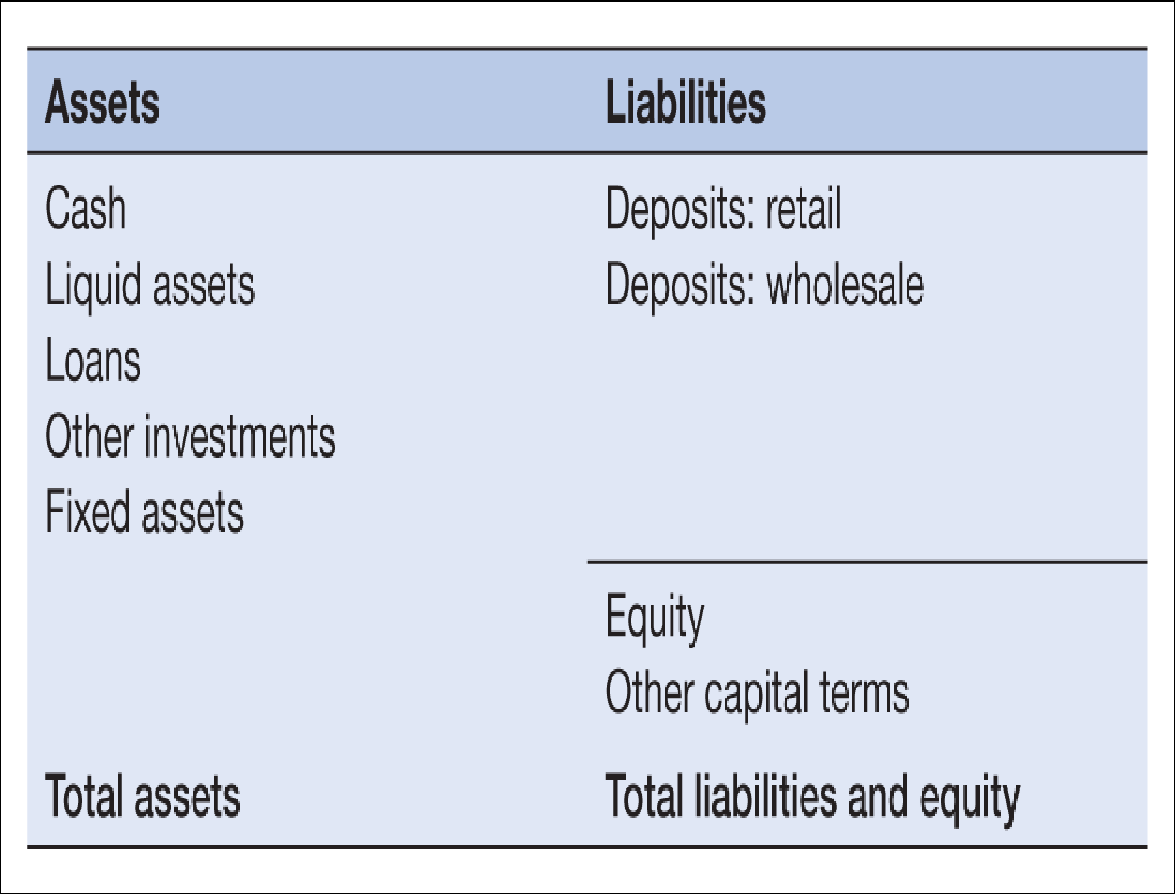
The Bank Balance Sheet
A Very Simplified Version of A Balance Sheet
Assets:
(a)cash;
(b)liquid assets
(securities);
(c)short-term money
market instruments such
as Treasury bills, which
banks can sell (liquidate)
quickly if they have a cash
shortage;
(d)loans;
(e)other investments; and
(f)fixed assets (branch
network, computers,
premises).
Banks’ funds come from:
the general public (retail
deposits);
companies (small,
medium and large
corporate deposits);
other banks (interbank
deposits);
equity issues (share
issues, conferring
ownership rights on
holders);
debt issues (bond issues
and loans); and
saving past profits
(retained earnings).

Slide 33
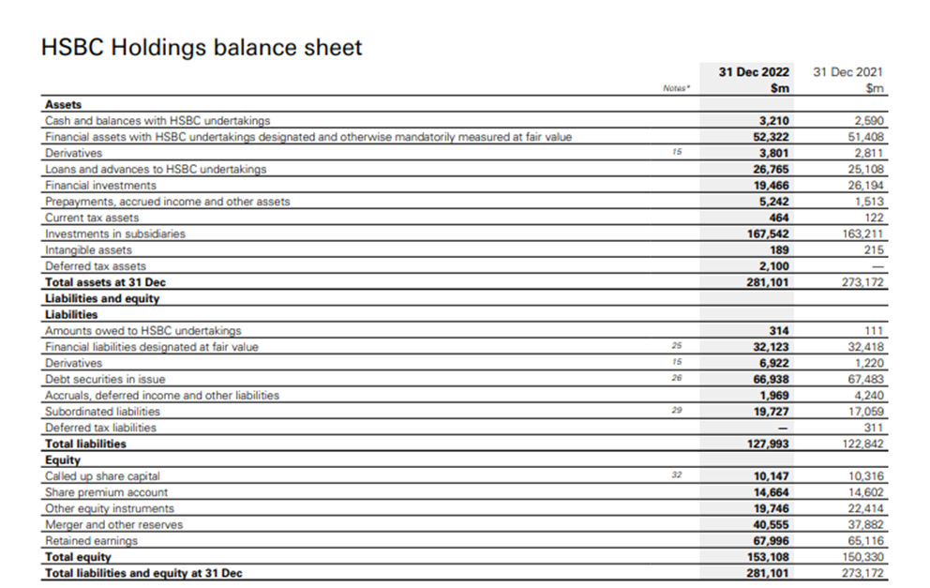
The Bank Balance Sheet (Real But Very Concise Sample)
A Summary Balance Sheet of HSBC (2022)
Adopted from https://www.bing.com/search?q=Summary+balance+sheet+of+HSBC&form=ANNTH1&refig=5033035f971642c2bc43f37ed2b25ae2
We don’t need to focus on this complicated version of the balance sheet

Slide 34
How Banks Make A Profit
Two main sources of the bank’s profit are:
Lending
Investing in financial assets (e.g. stock market, bond market that we talk about them later)
If a bank receives €100 million in deposits (from households or businesses) they are not allowed to lend out all of them. A certain percentage of the deposits (usually 10-20%) must be kept by the central bank as a reserve, the rest is loanable.
The idea of reserve banking: Based on long-term experience, bankers have realised that a fraction of these deposits should be enough to be reserved for any possible withdrawals, but the rest can be lent out and make a profit. So, total loanable funds are a fraction of total deposits, and it is the main source of credit expansion and of the money supply. So, the role of reserves is to provide banks with the liquidity they need to pay depositors who want to withdraw deposits or to settle financial transactions with other banks.

Slide 35
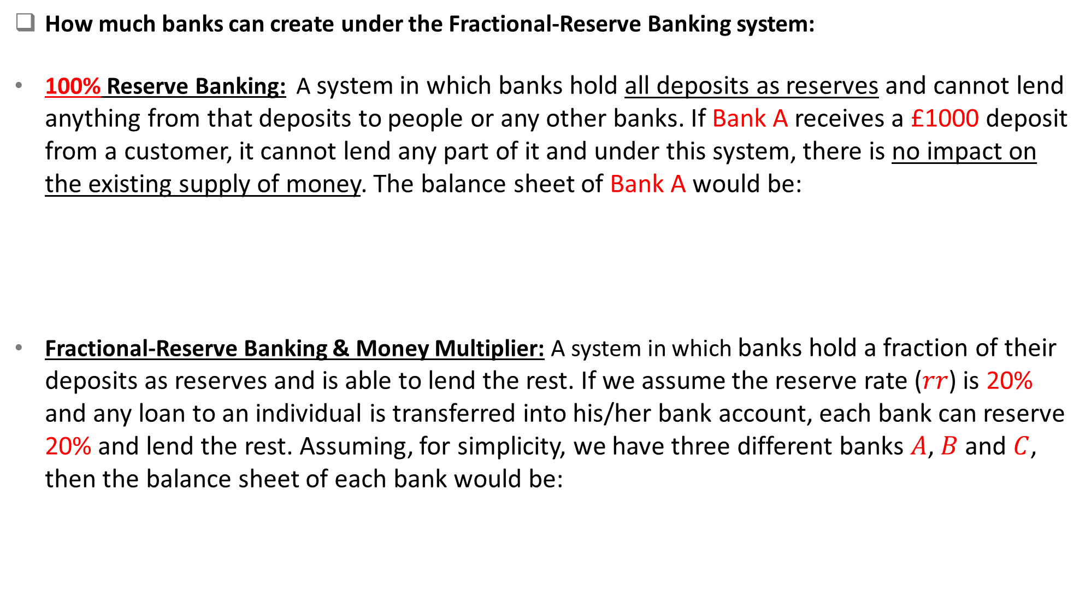
Theory of Loanable Funds (Fractional–Reserve Banking)
How much banks can create under the Fractional-Reserve Banking system:
100% Reserve Banking: A system in which banks hold all deposits as reserves and cannot lend anything from that deposits to people or any other banks. If Bank A receives a £1000 deposit from a customer, it cannot lend any part of it and under this system, there is no impact on the existing supply of money. The balance sheet of Bank A would be:
Fractional-Reserve Banking & Money Multiplier: A system in which banks hold a fraction of their deposits as reserves and is able to lend the rest. If we assume the reserve rate ($rr$) is 20% and any loan to an individual is transferred into his/her bank account, each bank can reserve 20% and lend the rest. Assuming, for simplicity, we have three different banks $A$, $B$ and $C$, then the balance sheet of each bank would be:
Bank A’s Balance Sheet
Assets | Liabilities
£1000 (reserve) | £1000 (deposit)

Slide 36
Theory of Loanable Funds (Fractional–Reserve Banking)
Bank A’s Balance Sheet
Assets | Liabilities
£200 (reserve) | £1000 (deposit)
£800 (loan)
Bank A creates £800 credit which is received by Bank B and this bank, in turn, reserves 20% of that and creates £640 credit, which is received by Bank C and this bank, again, reserves £128 and creates £512 credit.
Bank B’s Balance Sheet
Assets | Liabilities
£160 (reserve) | £800 (deposit)
£640 (loan)
Bank C’s Balance Sheet
Assets | Liabilities
£128 (reserve) | £640 (deposit)
£512 (loan)

Slide 37
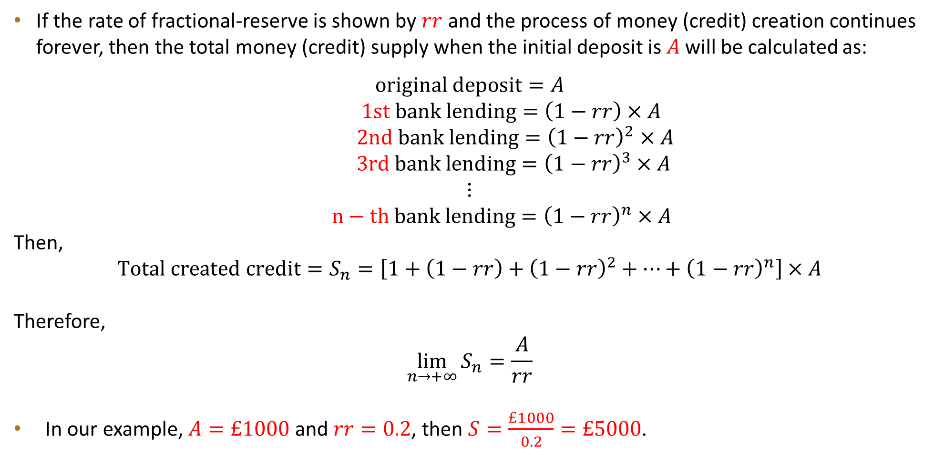
Theory of Loanable Funds (Fractional–Reserve Banking)
If the rate of fractional-reserve is shown by $rr$ and the process of money (credit) creation continues forever, then the total money (credit) supply when the initial deposit is $A$ will be calculated as:
$$original deposit=A$$
$1st bank lending=\left(1−rr\right)×A$
$2nd bank lending={\left(1−rr\right)}^{2}×A$
$3rd bank lending={\left(1−rr\right)}^{3}×A$
$$⋮$$
$n−th bank lending={\left(1−rr\right)}^{n}×A$
Then,
$$Total created credit=S_{n}=\left[1+\left(1−rr\right)+{\left(1−rr\right)}^{2}+…+{\left(1−rr\right)}^{n}\right]×A$$
Therefore,
$$\lim_{n→+∞}{S_{n}}=\frac{A}{rr}$$
In our example, $A=£1000$ and $rr=0.2$, then $S=\frac{£1000}{0.2}=£5000$.

Slide 38
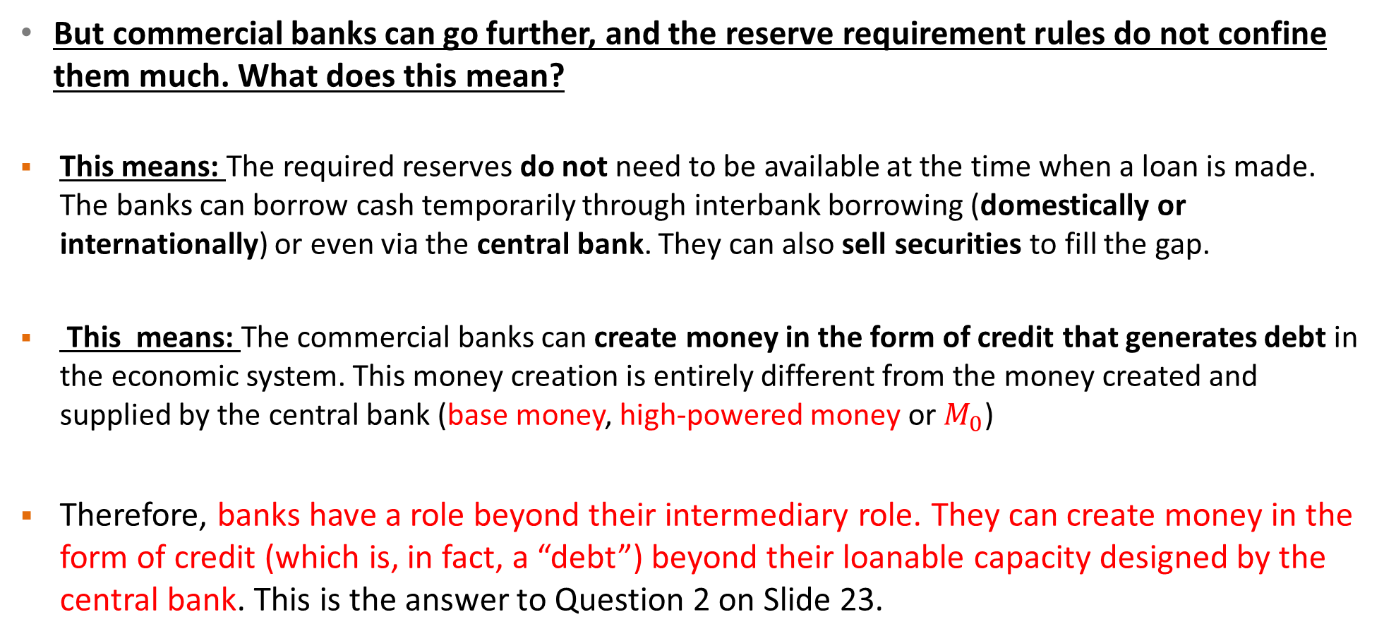
Theory of Loanable Funds (Fractional–Reserve Banking)
But commercial banks can go further, and the reserve requirement rules do not confine them much. What does this mean?
This means: The required reserves do not need to be available at the time when a loan is made. The banks can borrow cash temporarily through interbank borrowing (domestically or internationally) or even via the central bank. They can also sell securities to fill the gap.
This means: The commercial banks can create money in the form of credit that generates debt in the economic system. This money creation is entirely different from the money created and supplied by the central bank (base money, high-powered money or $M_{0}$)
Therefore, banks have a role beyond their intermediary role. They can create money in the form of credit (which is, in fact, a “debt”) beyond their loanable capacity designed by the central bank. This is the answer to Question 2 on Slide 23.

Slide 39
International & Multinational Bank
Now, let’s find out the extent to which banks operate:
Local/Domestic Banks: Provide services only in the country where they have headquarters.
International Banks: Financial institutions that primarily focus on conducting banking activities across national borders and their services include trade finance, foreign exchange and cross-border payment services. International banks may have branches, subsidiaries, or representative offices in different countries to facilitate their global operations. They typically serve clients from various countries and engage in cross-border transactions.
Multinational Banks (MNBs): Also known as global or universal banks, are financial institutions that operate in multiple countries and offer a wide range of financial services beyond traditional banking. In addition to basic banking services, multinational banks may provide investment banking, asset management, insurance, wealth management, and other financial products and services. These banks have a significant presence in various countries and often have extensive branch networks or subsidiaries around the world.

Slide 40
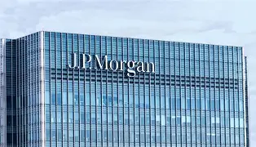
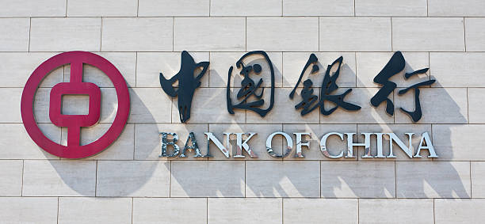
International & Multinational Bank
While "international banks" and "multinational banks" are often used interchangeably, they can have slightly different meanings depending on the context. They share the common characteristic of operating in multiple countries, but multinational banks tend to have a broader scope and a more diverse range of financial services compared to international banks. However, it's worth noting that there can be some overlap between the two categories, and the specific usage of these terms can vary in different contexts.
The terms "international banks" and "multinational banks" are not mutually exclusive. The distinction lies in the fact that multinational banks typically offer a broader range of financial services beyond traditional banking, while international banks often have a narrower focus on cross-border banking activities.
Multinational
Not only provides cross-border banking services like international transfers and trade finance, but it also offers investment banking, asset management, insurance, and consumer credit services in multiple countries with a strong local presence
International
It focuses primarily on cross-border trade finance and foreign currency accounts, without necessarily offering the full suite of financial products that a multinational bank would provide.

Slide 41
International & Multinational Bank
Examples of International Banks:
1- Citibank: Citibank is an international bank headquartered in the United States, New York. It operates in more than 100 countries and provides a wide range of banking services, including retail banking, corporate banking, and investment banking.
2. HSBC (Hongkong and Shanghai Banking Corporation): HSBC is a British international and multinational bank, headquartered in London, with a significant international presence. It operates in over 60 countries and offers services such as retail banking, commercial banking, and global banking.
3. Deutsche Bank: Deutsche Bank is a German bank, headquartered in Frankfurt, that operates globally in over 60 countries. It has a strong presence in Europe, the Americas, and Asia, providing services in areas like corporate banking, investment banking, asset management, and wealth management.

Slide 42
International & Multinational Bank
Examples of Multinational Banks:
JPMorgan: JPMorgan is an American multinational bank and one of the largest banks in the United States, Headquartered in New York. It offers a wide range of financial services, including consumer banking, investment banking, asset management, and treasury services. It has a global presence with operations in over 100 countries.
Barclays: Barclays is a British multinational bank, headquartered in London, with operations in retail banking, corporate banking, and investment banking. It has a strong presence in over 40 countries in Europe, the United States, and Africa, and offers services such as wealth management and credit cards.
Bank of America: Bank of America is an American multinational bank, headquartered in Charlotte, North Carolina that operates globally. It provides a range of financial services, including consumer banking, commercial banking, investment banking, and wealth management. Bank of America has a vast network of branches and ATMs across the United States and serves customers in more than 35 countries.

Slide 43
The Banking & Money Markets
The Money Markets
Many materials about “the Money Markets are adapted from Chapter 11 of Financial Markets and Institutions, Mishkin & Eakins, 2018 Pearson Education Ltd.

Slide 44
The Money Markets
On 2 Oct. 2015, 11 years after its creation, Google officially became a subsidiary of a new holding company called Alphabet Inc. Google is now an Alphabet company but remains dedicated to internet-related products and services, while other projects have been separated into their own companies under the Alphabet umbrella.
Alphabet Inc. is an American multinational technology parent company headquartered in California. In its 2016 annual report, Alphabet Inc. listed $58 billion in short-term securities on its balance sheet, plus $14 billion in actual cash equivalents.
The company does not keep these amounts in its local bank. But where?
This is, of course, a topic of the Money market.

Slide 45
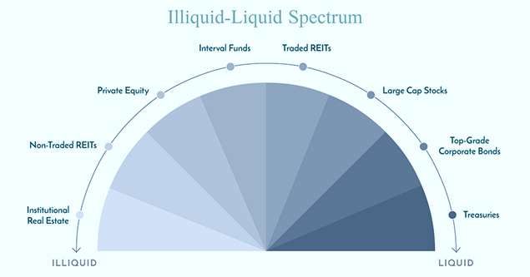
The Money Markets Defined
The term “money market” is misleading. It is not the money (currency) that is traded in the money markets, but securities.
The securities in the money market are short-term with high liquidity; therefore, they are close to being money.
Definition: The money market is a segment of the financial market where short-term borrowing, lending, and trading of highly liquid and low-risk financial instruments take place, typically with maturities of one year or less.
What is the meaning of liquidity? Liquidity refers to the comfort with which a real or financial asset can be transformed into cash without any loss of its market price. Cash is the most liquid asset.
REIT = Real Estate Investment Trust

Slide 46
The Money Markets Defined
Why Do We Need Money Markets?
The banking industry exists primarily & theoretically to mediate the asymmetric information problem between savers-lenders and borrowers-spenders. But this industry is heavily regulated compared to money markets, and for that reason, the money markets have a distinct cost advantage over banks in providing short-term funds.
In an unregulated world (without monitoring the creditworthiness of customers, regulation, reserve ratio obligation, etc.) banking industry would be enough and there would be no need for the money market.
Three characteristics of the money markets:
  Large denominations are usually traded in this market. ($1,000,000 or more)
  Low default risk (risk of not repaying debt by the borrower is low)
  Mature in one year or less from their issue date, although most mature in less than 120 days (The maturity of a security refers to the lifespan of the security. It is the date by which the total amount of the security must be paid by.)

Slide 47
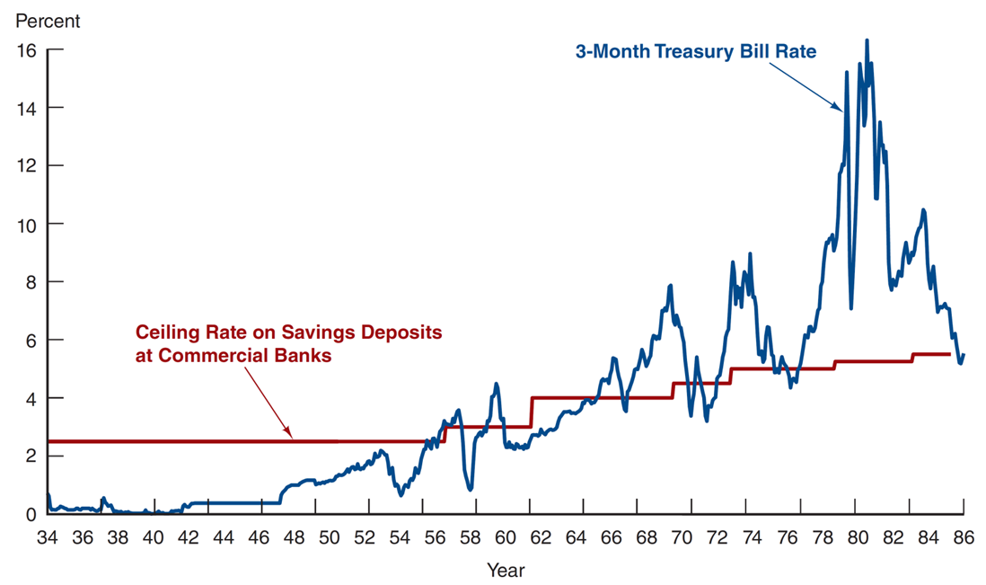
The Money Markets : Cost Advantages
Reserve requirements create additional expenses for banks that money markets do not have.
Regulations on the level of interest that banks could offer depositors led to a significant growth in money markets, especially in the 1970s and 1980s.
When interest rates rose, depositors moved their money from banks to money markets.
Three-Month Treasury Bill Rate and Ceiling Rate on Savings Deposits at Commercial Banks, 1933 to 1986
Source: http://www.stlouisfed.org/default.cfm.

Slide 48
The Purpose of Money Markets
The Purpose Of Money Markets:
For Lenders: It provides a profitable place for short-term surplus funds.
For borrowers: It provides a low-cost source of temporary funds.
Corporations and governments use these markets because the timing of cash inflows and outflows is not well synchronised.
Money markets provide a way to solve these cash-timing problems.

Slide 49
The Participants of the Money Markets
Who Are The Major Lenders And Borrowers In The Money Market (US-Focused)?
Participants | Role
U.S. Treasury Department | Sells U.S. Treasury securities to fund the national debt
Federal Reserve System | Buys and sells U.S. Treasury securities as its primary method of controlling interest rates
Commercial banks | Buy U.S. Treasury securities; sell certificates of deposit and make short-term loans; offer individual investors accounts that invest in money market securities
Businesses | Buy and sell various short-term securities as a regular part of their cash management
Investment companies (brokerage firms) | Trade on behalf of commercial accounts
Finance companies (commercial leasing companies) | Lend funds to individuals
Insurance companies (property and casualty insurance companies) | Through buying and selling securities they maintain the liquidity needed to meet unexpected demands
Pension funds | Sells U.S. Treasury securities to fund the national debt (governments sell T. Securities/gov. bonds to Pension funds and borrow from them)
Individuals | Buys and sells U.S. Treasury securities as its primary method of controlling interest rates
Money market mutual funds | Allow small investors to participate in the money market by aggregating their funds to invest in large-denomination money market securities

Slide 50
The Money Markets Instruments
The Instruments of the Money markets:
We will now examine each of these instruments in the following slides:
  Treasury Bills
  Federal Reserve
  Repurchase Agreements
  Negotiable Certificates of Deposit
  Commercial Paper

Slide 51
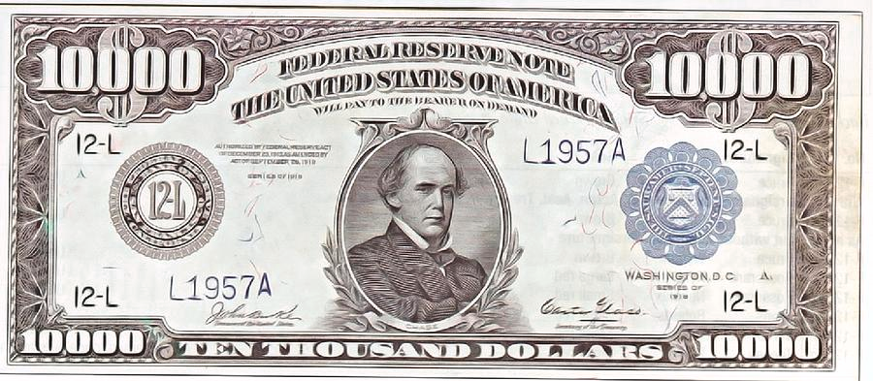
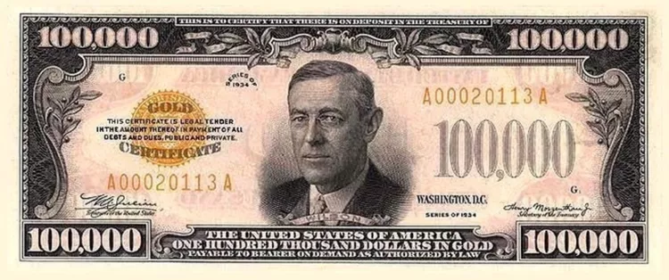
The Money Markets Instruments
  Treasury Bills (also called T-bills): The US Treasury (a US government department) is unique, because:
  It is the largest borrower of dollars not only in the US but in the whole world.
  Its securities (or T-bills) are short-term (1 year or less) US government debt obligations, which are popular worldwide and have many international buyers.
  It issues short-term bills to enable the US government to raise funds until tax revenues are received.
United States Treasury $10,000 Bill. First issued in 1918.
Adopted from: https://pixels.com/featured/united-states-treasury-10000-bill-bootster-and-lord.html
Adopted from: https://www.thoughtco.com/faces-on-us-currency-4153995

Slide 52
The Money Markets Instruments
  Federal Reserve Funds: The Federal Reserve is the Central Bank of the US and holds vast quantities of Treasury securities. Buying and selling T-Bills allow the Fed to control the money supply in the system.
  These are short-term funds transferred (loaned or borrowed) between financial institutions, usually for one day.
  Used by banks to meet short-term needs to meet reserve requirements.
  Repurchase Agreements (repos): These work similarly to the market for fed funds, but nonbanks can participate. A firm sells Treasury securities but agrees to buy them back at a certain date (usually 3–14 days later) for a certain price.
  The Fed usually buy and sells Treasury securities in the repo market to conduct the monetary policy.

Slide 53
The Money Markets Instruments
  Negotiable Certificates of Deposit: A bank-issued security that documents a deposit and specifies the interest rate and the maturity date.
  Denominations range from $100,000 to $10 million
  CDs are term securities and have a specific maturity date as opposed to demand deposits that can be withdrawn at any time.
  Commercial Paper: These are unsecured promissory notes, issued by corporations, that mature in no more than 270 days.
  The use of commercial paper increased significantly in the early 1980s because of the rising cost of bank loans.
  About 60% of commercial papers are sold by the issuer to the buyers. The rest goes to the money market by dealers.

Slide 54
The Money Markets Instruments
The use of commercial paper increased significantly in the early 1980s because of the rising cost of bank loans.
Commercial paper volume:
fell significantly during the recent economic recession
annual market is still large, at well over $0.85 trillion outstanding
A special type of commercial paper, known as asset-backed commercial paper (ABCP)
played a key role in the financial crisis in 2008 backed by securitised mortgages
often difficult to understand
accounted for about $1 trillion
When the poor quality of the underlying assets was exposed, a run on ABCP began. Because ABCP was held by many money market mutual funds (MMMFs), these funds also experienced a run. The government eventually had to step in to prevent the collapse of the MMMF market.

Slide 55
Test Yourself
1) Which of the following are reported as assets on a bank's balance sheet?
Borrowings
Reserves
Savings deposits
Bank capital
Only A and B of the above
2) In general, banks make profits by selling-----liabilities and buying -------- assets.
long-term; shorter-term
short-term; longer-term
illiquid; liquid
risky; risk-free
3) Which of the following statements is true?
A) A bank's assets are its sources of funds.
B) A bank's liabilities are its use of funds.
C) A bank's balance sheet shows that total assets equal total liabilities plus equity capital.
D) All of the above are true.
4) Which of the following statements is true?
A) A bank's assets are its uses of funds.
B) A bank's assets are its sources of funds.
C) A bank's liabilities are its use of funds.
D) Only B and C of the above are true.
5) Which of the following statements is false?
A) A bank's assets are its uses of funds.
B) A bank issues liabilities to acquire funds.
C) A bank's assets provide the bank with income.
D) Bank capital is an asset on the bank balance sheet.
6) A bank's balance sheet
A) shows that total assets equal total liabilities plus equity capital.
B) lists sources and uses of bank funds.
C) indicates whether or not the bank is profitable.
D) does all of the above.
does only A and B of the above.
7) Which of the following are reported as liabilities on a bank's balance sheet?
A) Reserves
B) Checkable deposits
C) Loans
D) Deposits with other banks
8) Which of the following are reported as liabilities on a bank's balance sheet?
A) Discount loans
B) Cash items in the process of collection
C) State government securities
D) All of the above
E) Only B and C of the above

Slide 56
Other Markets- Finance
Bond, Security, Equity, Derivatives
(What is finance and how it works)
B
B
C
A
D
E
B
A

Slide 57
What Is Finance?
What is Finance?
Definition 1 (Drake and Fabozzi):
"Finance is the application of economic principles to decision-making that involves the allocation of money under conditions of uncertainty”.
Definition 2 (John J. Hampton):
"The term finance can be defined as the management of the flows of money through an organisation, whether it will be a corporation, school, or bank or government agency".
Broad Categories of Finance
Personal Finance
Corporate Finance The main topic of financial Economics
Public Finance

Slide 58
Two Main Areas of Financial Economics
Financial economics is the branch of economics that concentrates on firms' financial decisions and investment decisions under uncertainty.
Two main areas of financial economics are asset pricing and corporate finance.
Asset Pricing:
How to value different assets/securities based on their future returns?
What discount rate should be used?
How to involve risk and uncertainty in the calculation?
Corporate Finance:
What should be a capital structure of a corporation/firm?
What source of funds are available for a corporation and what is the optimal combination between shares and bonds which maximises the value of a corporation/firm?

Slide 59
Corporation
Corporations: Large company (or a group of companies) authorised by law to act as a single legal entity run by a set of directors elected by shareholders (owners) with limited liability which means they are not totally responsible for the total debt of company when it fails. (e.g. BP, Tesco, British Airways and etc.)
Corporation is legally defined, so it is a legal entity with the legal power to enter into contracts, acquire assets, etc.
Its rights are protected by law and there is no limit to the number of owners.
The entire ownership stake of a corporation is divided into shares known as stock.
The collection of all shares of a corporation is called the equity of the corporation.
An owner of a share of stock in the corporation is called a shareholder, stockholder or equity holder and they are entitled to dividend payments. (e.g. 10% ownership is entitled to 10% dividend payments)

Slide 60
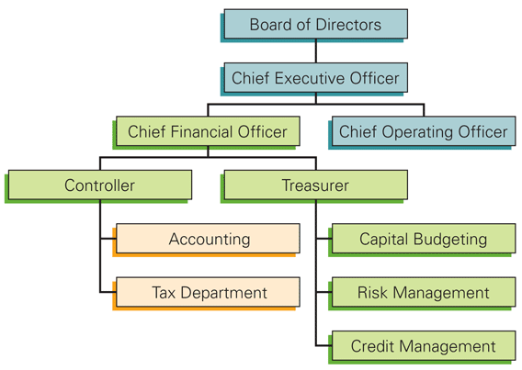
Separation of Ownership & Management in Corporations
The ownership belongs to the shareholders but the management of the corporation is with the Chief Executive Officer (CEO), which is the most senior manager of the corporation and has maximum responsibility in the company.
The CEO manages several subordinate executives, including the Chief Financial Officer (CFO), also known as Finance Director in the UK, who is responsible for financial planning (investment decisions and financial decisions) and risk assessment.
Organizational Chart of a Typical Corporation
Shareholders= Principals=owners
Agent
Adopted from Corporate Finance, Berk & DeMarzo, 2017

Slide 61
Separation of Ownership & Management
Permanent Life: The separation of ownership and management gives a chance for a permanent life to a corporation. Shareholders can transfer their shares to others and CEOs can be replaced by the owners but the corporation can continue as long as it is profitable for the owners.
Limited Liability and Ownership: Shareholders have limited liabilities based on their participation in investment in the company (number of shares). Their shares represent partial or fractional ownership of the company.
Lenders & Investors: By issuing bonds and shares corporations are able to finance their investment projects. Bondholders are lenders (creditors) and shareholders (or stockholders) are investors. In the case of bankruptcy, lenders have a higher priority in claiming the assets, compare to the investors, i.e., they will be paid first from selling the assets. If the liabilities are more than the assets, shareholders’ equity (residual value) will be negative.
Life After Bankruptcy: Bankruptcy of a corporation does not lead necessarily to the liquidation of the firm, which involves shutting down the business and selling off the assets. The debt holders as the new owners may decide to keep the business operating.

Slide 62
Assets
Corporations invest in a variety of assets to increase their flow of returns and consequently to maximise the market value of their shares in order to finance these investments they either use their own resources (re-investment) or outside resources (borrowing/selling shares).
Asset: An economic (tangible or intangible) resource with a price (subject to fluctuations) which is owned /controlled by individual(s) or companies with a capability of producing future returns. E.g. machines, inventories, buildings, lands, cash, vehicles, patents and etc.

Slide 63
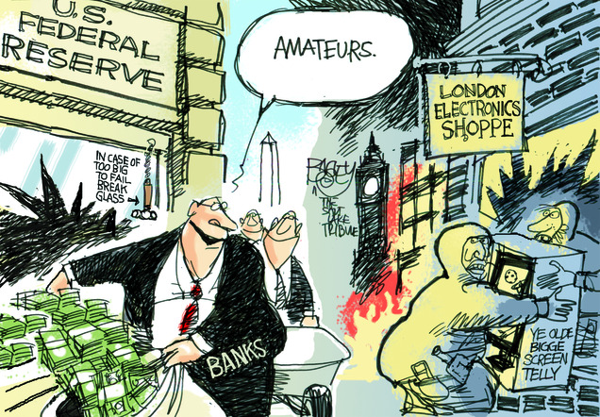
Real & Financial Assets
Assets can be divided into real or financial:
Real assets are physical or tangible assets such as commodities, machinery, buildings, precious metals/stones, arts, equipment and etc.
Financial assets are non-physical or intangible assets such as bank accounts, bonds, shares and etc.
Financial assets are more liquid than real assets, which means they can be converted to money quickly. Money is the most liquid asset as it can be used for purchasing goods and services or for meeting obligations and offsetting claims.
Adopted from http://www.batr.org/totalitariancollectivism/100911.html

Slide 64
Financial Assets & Securities
If corporations borrow from individuals or financial institutions, in fact, they sell claims (promises) on their existing assets or their future cash flow to the lenders. It means lenders can claim them based on their contracts.
Securities: If the claims are not transferable or tradable, they are just financial assets (such as bank deposits, and bank loans) but if they are tradable in the financial markets, they are special financial assets which are called securities (such as bonds, shares). Therefore, securities are those financial assets that can be traded in the financial markets.
So,
Corporate Borrowing = Selling Claims on their Assets
An Asset-Backed Security (ABS) is a security whose income payments and its value are derived from and collateralized (or "backed") by a specified pool of underlying assets, but, contrary to bonds and shares, there is no guarantee or certainty in its payments or its value.
Not tradable Financial Assets (Deposits, Loans)
Tradable Securities (Shares, Bonds, ABS)

Slide 65
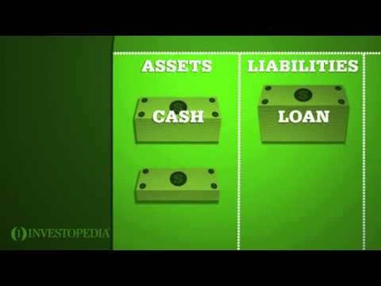
Balance Sheet
Balance Sheet: A financial statement that reviews a company's assets, liabilities and shareholders' equity at a specific time such as the end of the financial year.
This statement shows how a company deals with its assets and debts. It is a measure for investors (shareholders) and creditors (bondholders) to assess the value of the company.
In any balance sheet there should be a balance between the asset side and the liability side at the end of the financial year, i.e.:
Assets= Liabilities + Shareholder’s Equity
The logic behind the formula is clear:
A company should purchase its assets either through investors (shareholders) or creditors.

Slide 66
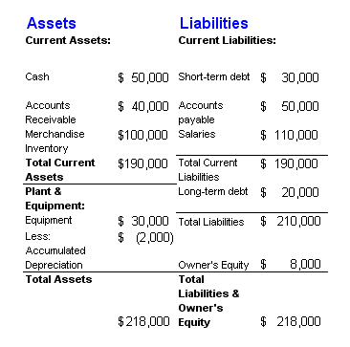
Balance Sheet
Here is an example of a simple balance sheet.
The difference between current assets (short-term assets) and current liabilities (short-term liabilities) is called Net Working Capital. (see the next slide)
Non-current items refer to the long-term elements in the balance sheet.
Adopted from http://www.accounting-tutorial.com/definition-balance-sheet-components

Slide 67
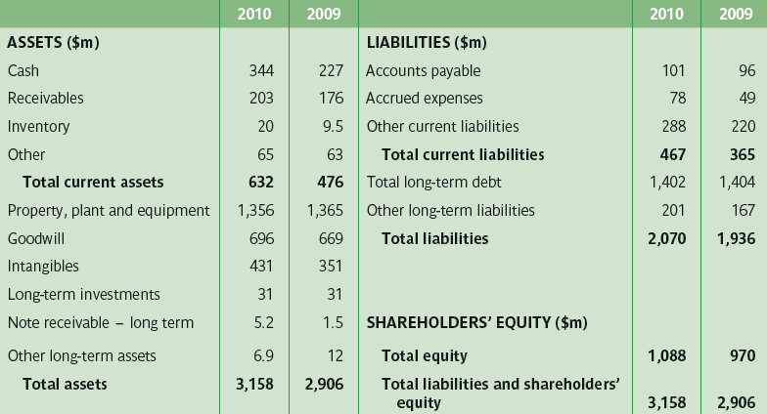
Balance Sheet of Inmarsat plc in 2009 & 2010
Adopted from Hillier’s PPT , The McGraw-Hill Companies, 2012

Slide 68
Investment & Financing Decisions
Two important and broad questions that a financial manager (CFO) in any corporation should face:
What investments should be made? and how to manage the new & existing assets? What is the risk of acquiring the new assets and what is the risk or/and opportunity of keeping existing assets?
How should the new investments be financed? and how the obligations to investors or lenders should be met? Is the re-investment option is doable? What is the payout policy?
Investment Decision
Financing Decision

Slide 69
Investment & Financing Decisions
Investment decision= Purchase of real & financial assets
Financing decision= Sale of financial assets (issuing shares & sell them in financial markets) + Decision to re-invest or to borrow
Decide whether the following are investment decisions or financing decisions.
Intel decides to spend $1 billion to develop a new microprocessor.
Volkswagen borrows 350 million euros (€350 million) from Deutsche Bank.
Royal Dutch Shell constructs a pipeline to bring natural gas onshore from a production platform in Australia.
Avon spends €200 million to launch a new range of cosmetics in European markets.
Pfizer issues new shares to buy a small biotech company.

Slide 70
Capital Structure
Corporations can borrow from lenders (in exchange for a promise to pay back the debt plus a fixed/variable rate of interest) or they can issue shares to attract equity investors (shareholders) in the stock market (in exchange for sharing profit and/or cash flow through dividend).
The decision to go for debt or equity financing is called the capital structure decision.
In some ways financing decisions are less important than investment decisions. Financial managers say that “value comes mainly from the asset side of the balance sheet.” In fact, the most successful corporations sometimes have the simplest financing strategies. (Principle of Corp. p. 4)

Slide 71

Hurdle Rate & Opportunity Cost
Shareholders expect to have a return from new investments (offered by the financial manager of the corporation) above the return they can get by investing their money in other projects (with a similar level of risk-taking).
This expected minimum return is called the hurdle rate
which can be interpreted here as an opportunity cost
of the shareholder’s capital.
Opportunity cost of capital can be defined as the best
available expected return offered to the cash flow being
discounted, or it can be defined as the amount of return
the investors forgo on an alternative investment of
equivalent riskiness and term when the investors take on a new investment.
http://catngeek.files.wordpress.com/2013/02/pause-dc3a9jeuner-culture-05.jpg

Slide 72
Opportunity Cost of Capital
Opportunity Cost is the cost of losing a return from the best alternative action (policy/investment) that has occurred because of choosing a specific action (policy/investment).
In case you are able to choose between several mutually exclusive options (opportunities) the cost of losing the return (foregone return) from the best alternative option (opportunity) is your opportunity cost.
What is your opportunity cost as a student?

Slide 73
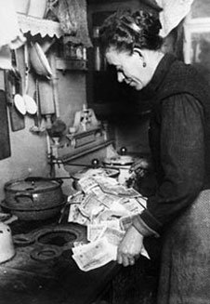
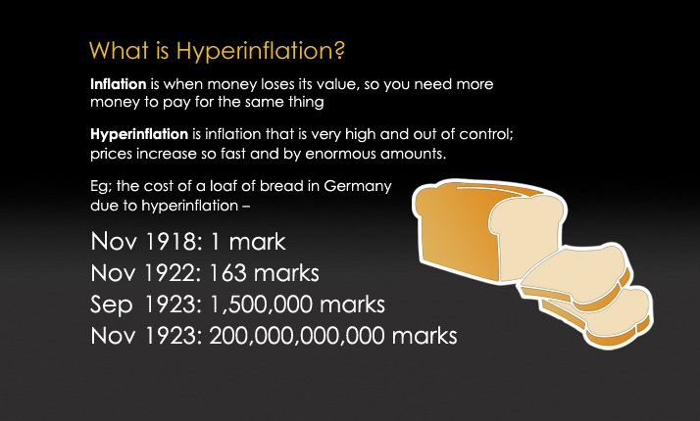
Time Value of Money
A £100 today or a £100 next year; which one would you accept?
In some cases, such as Germany in 1923, we need to change the time horizon from “years” to “days” and “hours”.
We call this as the time value of money, i.e., the difference in value between money today and money in the future; it is also the value difference between two cash flows at two different points in time.
Pictures Adopted from internet

Slide 74
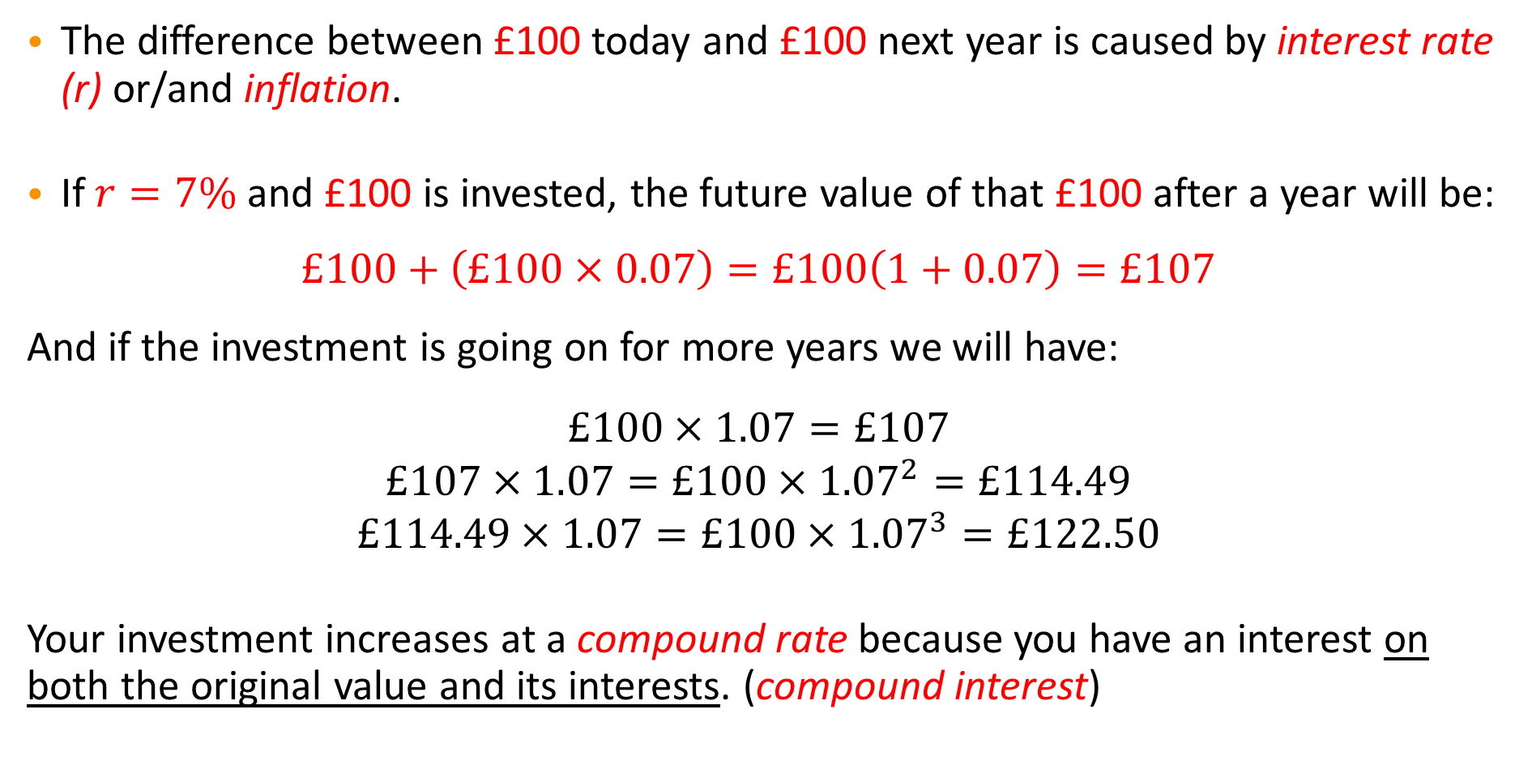
Compound Rate of Interest
The difference between £100 today and £100 next year is caused by interest rate (r) or/and inflation.
If $r=7\%$ and £100 is invested, the future value of that £100 after a year will be:
$$£100+\left(£100×0.07\right)=£100\left(1+0.07\right)=£107$$
And if the investment is going on for more years we will have:
$$£100×1.07=£107$$
$$£107×1.07=£100×{1.07}^{2}=£114.49$$
$$£114.49×1.07=£100×{1.07}^{3}=£122.50$$
Your investment increases at a compound rate because you have an interest on both the original value and its interests. (compound interest)
1st year
2nd year
3rd year

Slide 75
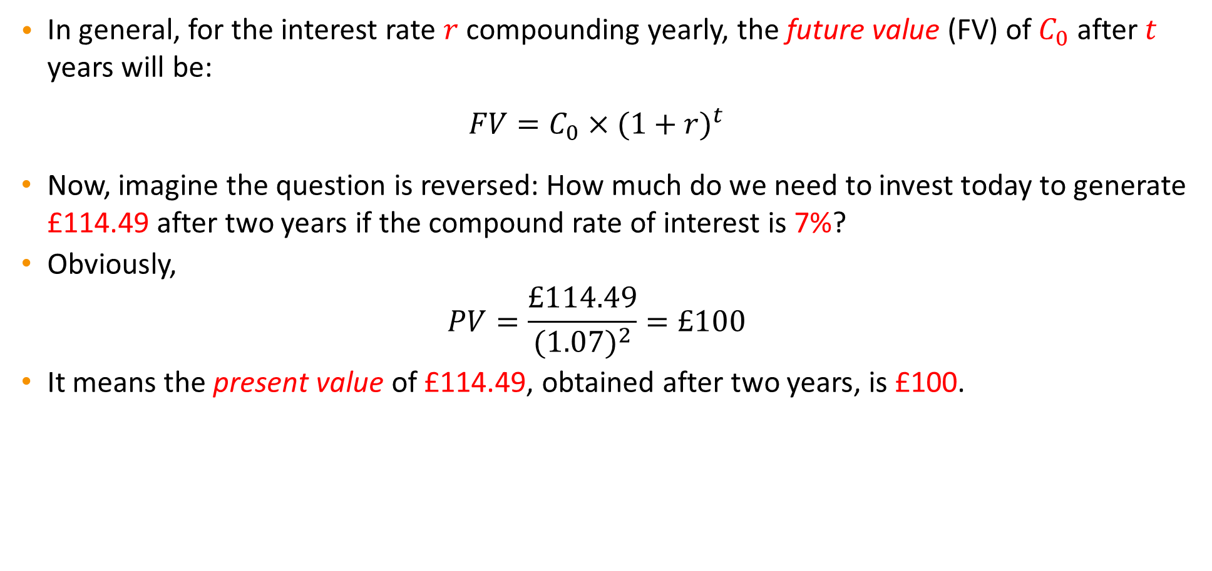
Future Value & Present Value
In general, for the interest rate $r$ compounding yearly, the future value (FV) of $C_{0}$ after $t$ years will be:
$$FV=C_{0}{×(1+r)}^{t}$$
Now, imagine the question is reversed: How much do we need to invest today to generate £114.49 after two years if the compound rate of interest is 7%?
Obviously,
$$PV=\frac{£114.49}{{(1.07)}^{2}}=£100$$
It means the present value of £114.49, obtained after two years, is £100.

Slide 76
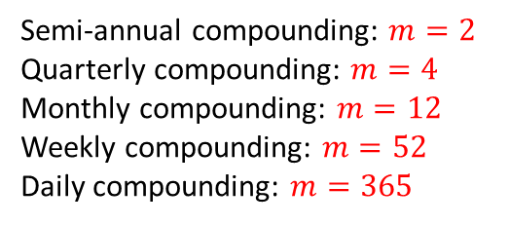
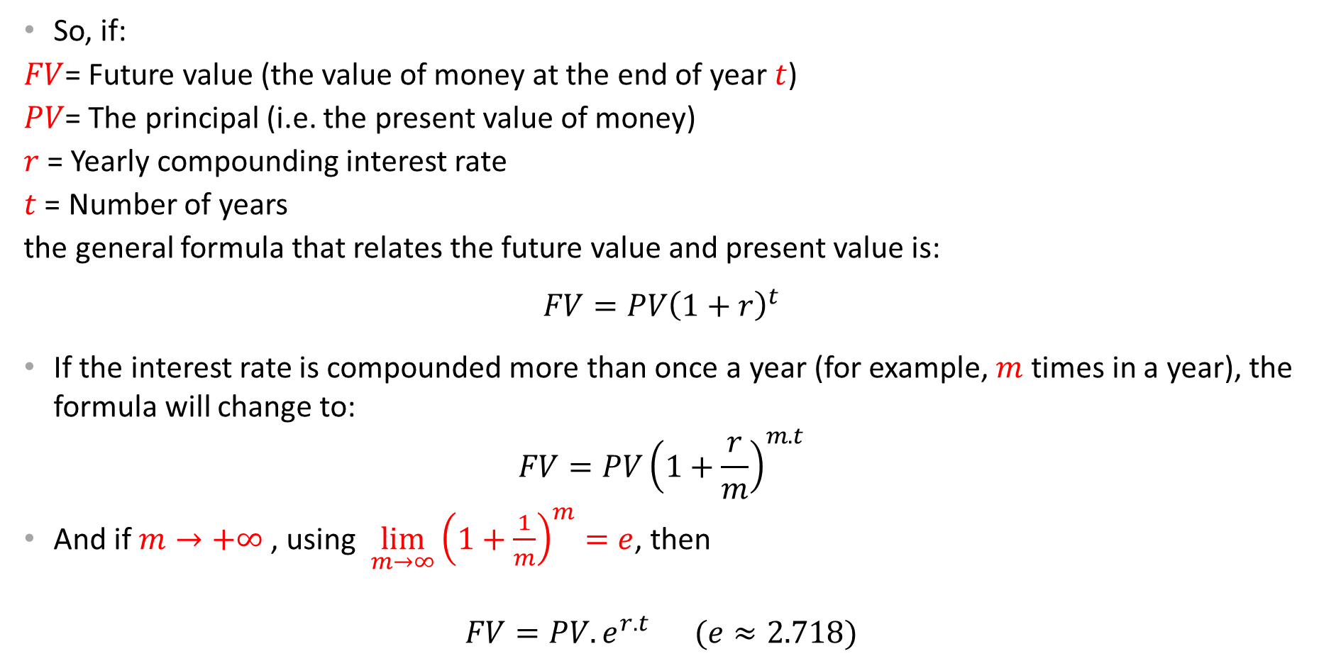
Future Value & Present Value ( Intra-year Compounding)
So, if:
$FV$= Future value (the value of money at the end of year $t$)
$PV$= The principal (i.e. the present value of money)
$r$= Yearly compounding interest rate
$t$ = Number of years
the general formula that relates the future value and present value is:
$$FV=PV{\left(1+r\right)}^{t}$$
If the interest rate is compounded more than once a year (for example, $m$ times in a year), the formula will change to:
$$FV=PV{\left(1+\frac{r}{m}\right)}^{m.t}$$
And if $m→+∞$ , using $\lim_{m→∞}{{\left(1+\frac{1}{m}\right)}^{m}=e}$, then
$$FV=PV.e^{r.t} (e≈2.718)$$
Semi-annual compounding: $m=2$
Quarterly compounding: $m=4$
Monthly compounding: $m=12$
Weekly compounding: $m=52$
Daily compounding: $m=365$

Slide 77
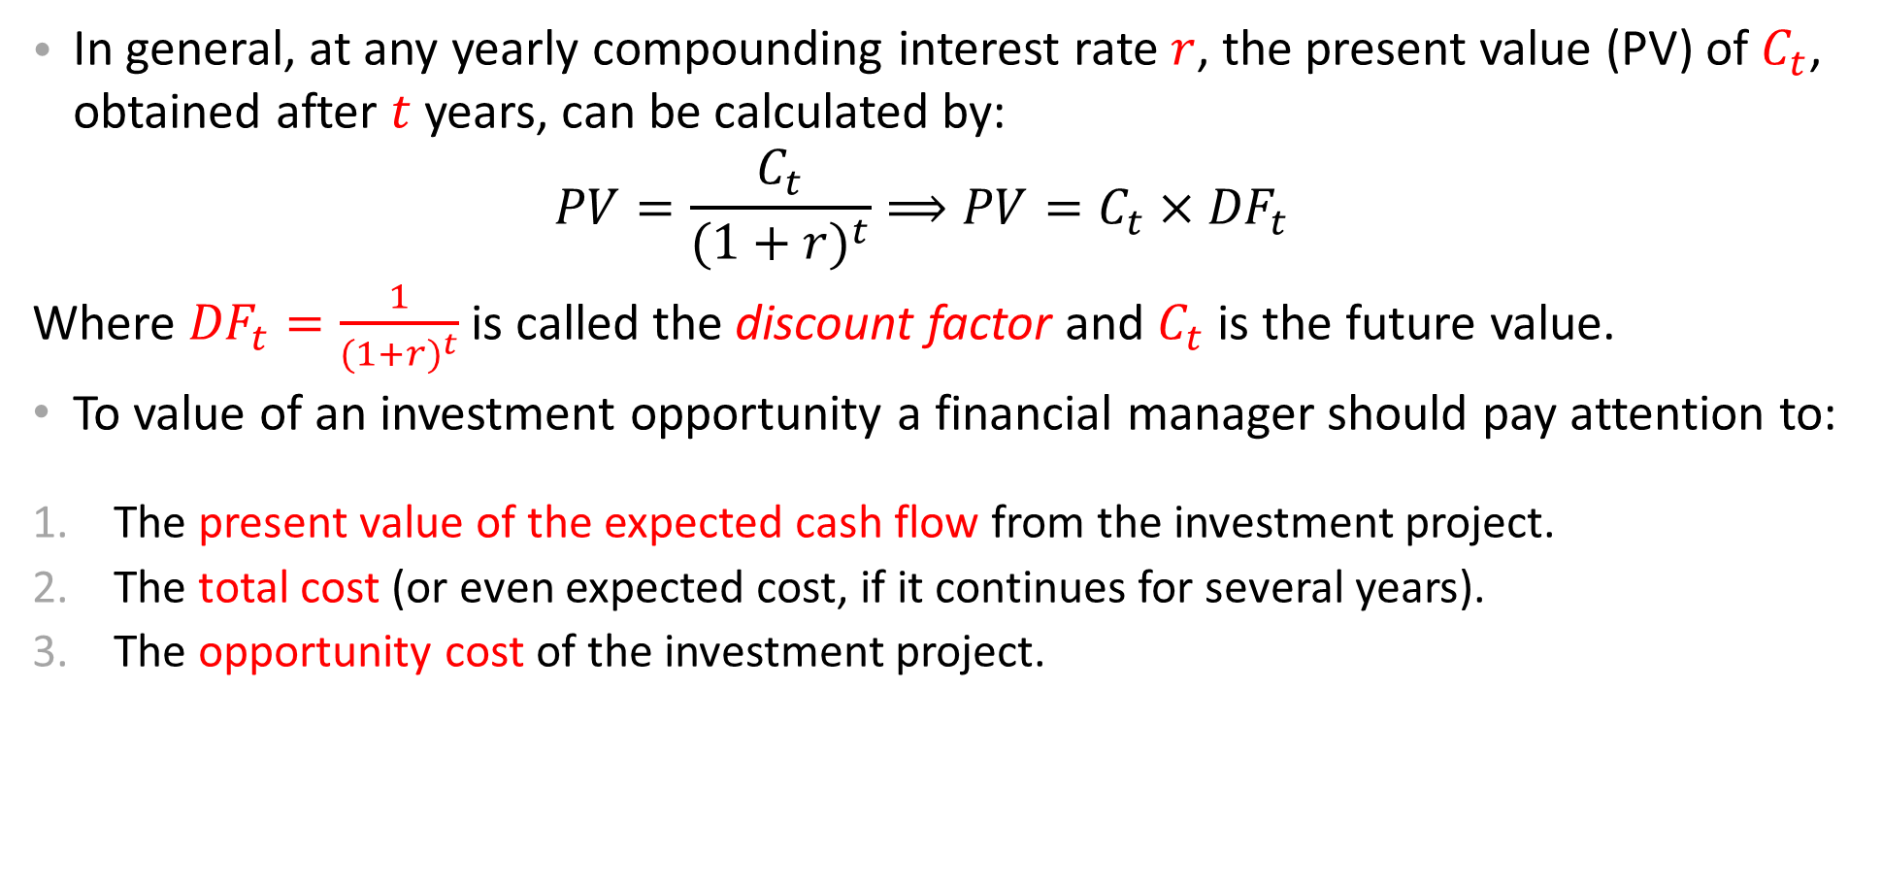
Future Value & Present Value
In general, at any yearly compounding interest rate $r$, the present value (PV) of $C_{t}$, obtained after $t$ years, can be calculated by:
$$PV=\frac{C_{t}}{{(1+r)}^{t}}⟹PV=C_{t}×{DF}_{t}$$
Where ${DF}_{t}=\frac{1}{{(1+r)}^{t}}$ is called the discount factor and $C_{t}$ is the future value.
To value of an investment opportunity a financial manager should pay attention to:
The present value of the expected cash flow from the investment project.
The total cost (or even expected cost, if it continues for several years).
The opportunity cost of the investment project.

Slide 78
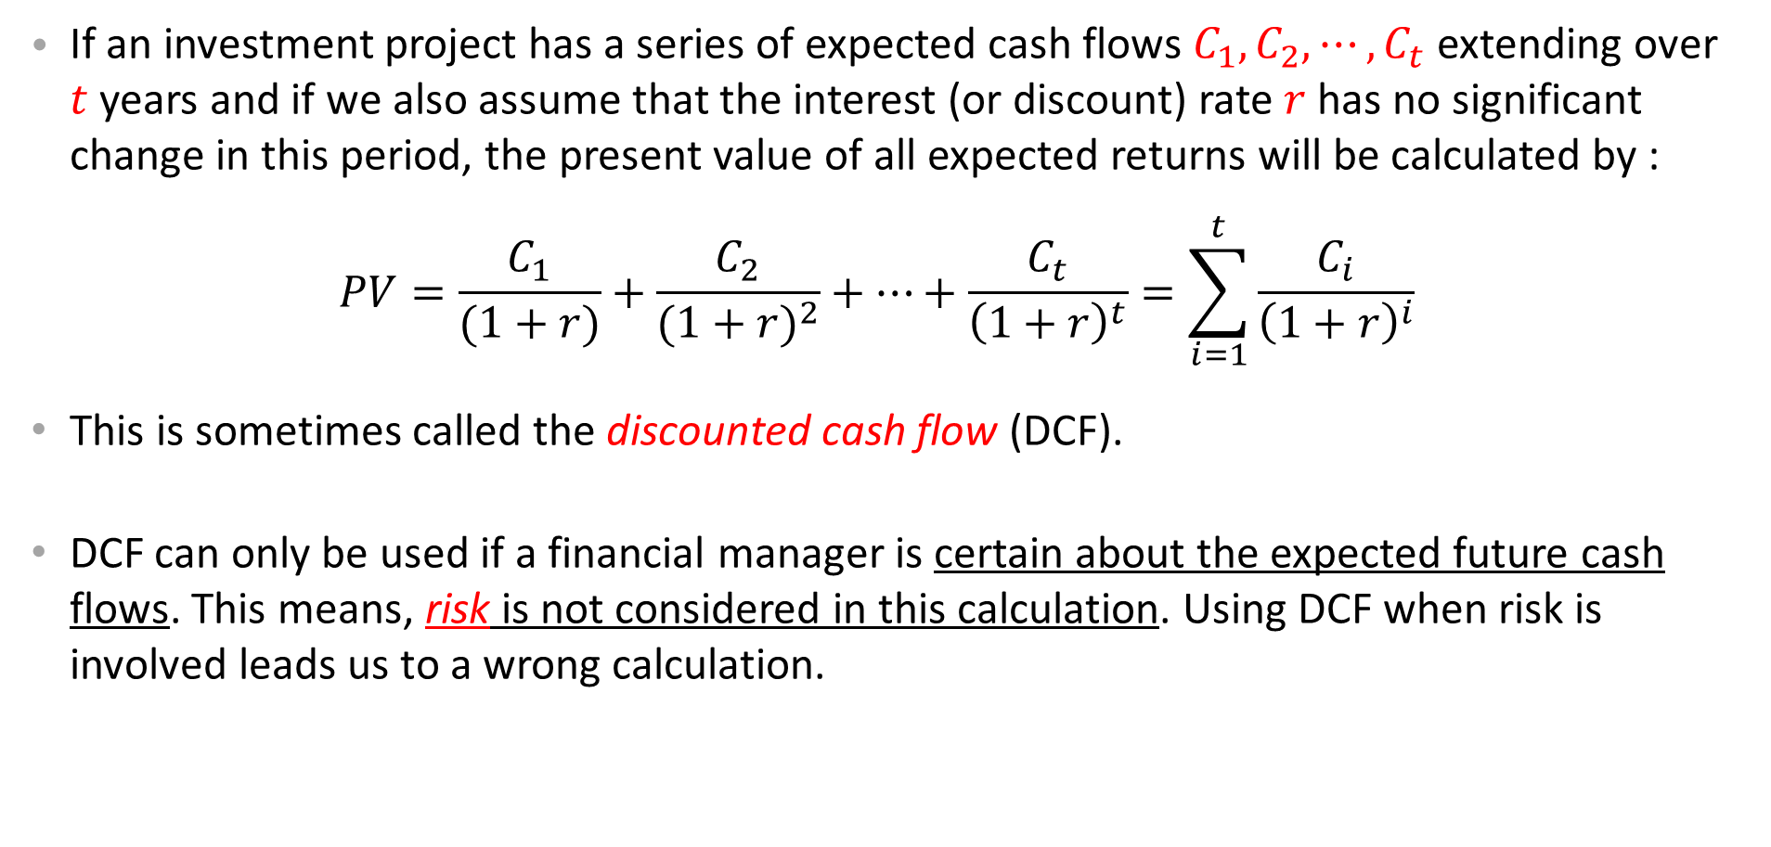
The Present Value of a Multiple Cash Inflows
If an investment project has a series of expected cash flows $C_{1}, C_{2}, ⋯, C_{t}$ extending over $t$ years and if we also assume that the interest (or discount) rate $r$ has no significant change in this period, the present value of all expected returns will be calculated by :
$$PV=\frac{C_{1}}{(1+r)}+\frac{C_{2}}{{(1+r)}^{2}}+⋯+\frac{C_{t}}{{\left(1+r\right)}^{t}}=\sum_{i=1}^{t}{\frac{C_{i}}{{\left(1+r\right)}^{i}}}$$
This is sometimes called the discounted cash flow (DCF).
DCF can only be used if a financial manager is certain about the expected future cash flows. This means, risk is not considered in this calculation. Using DCF when risk is involved leads us to a wrong calculation.

Slide 79
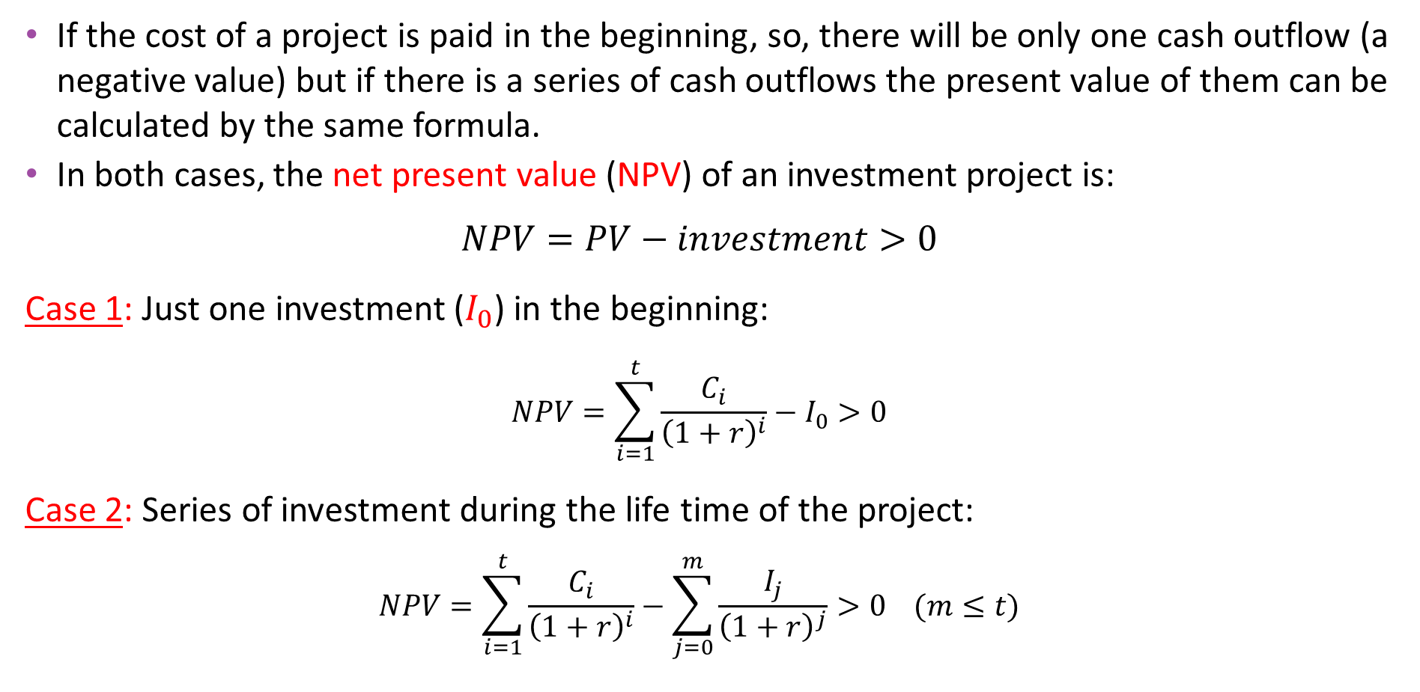
The Net Present Value
If the cost of a project is paid in the beginning, so, there will be only one cash outflow (a negative value) but if there is a series of cash outflows the present value of them can be calculated by the same formula.
In both cases, the net present value (NPV) of an investment project is:
$$NPV=PV−investment>0$$
Case 1: Just one investment ($I_{0}$) in the beginning:
$$NPV=\sum_{i=1}^{t}{\frac{C_{i}}{{\left(1+r\right)}^{i}}}−I_{0}>0$$
Case 2: Series of investment during the life time of the project:
$$NPV=\sum_{i=1}^{t}{\frac{C_{i}}{{\left(1+r\right)}^{i}}}−\sum_{j=0}^{m}{\frac{I_{j}}{{\left(1+r\right)}^{j}}}>0 (m≤t)$$

Slide 80
Test Yourself
1. Shareholders of a corporation may be, among others,
A. individuals.
B. individuals and pension funds.
C. pension funds.
D. individuals, pension funds, and insurance companies.
2. Generally, a corporation is owned by its
A. managers.
B. board of directors and shareholders.
C. shareholders.
D. managers, board of directors, and shareholders.
3. A corporation, potentially, has infinite life because it
A. is a legal entity.
B. has the same ownership and management.
C. has limited liability.
D. is closely regulated.
4. Limited liability is an important feature of
A. sole proprietorships.
B. partnerships.
C. corporations.
D. both partnerships and corporations.
5. As a legal entity, a corporation can perform the following functions except
A. borrow money and lend money.
B. borrow money, lend money, and sue and be sued.
C. vote.
D. borrow money, lend money, sue and be sued, and vote.
6. In the principal-agent framework,
A. shareholders are the principals.
B. managers are the principals.
C. managers are the agents.
D. shareholders are the principals and managers are the agents.
7. Costs associated with the conflicts of interest between the bondholders and the shareholders of a corporation are called
legal costs.
B. agency costs.
C. bankruptcy costs.
D. administrative costs.
8. A corporation may incur agency costs because
A. managers may not attempt to maximize the value of the firm to shareholders.
B. shareholders incur monitoring costs.
C. of the separation of ownership and management.
D. all of the responses are correct.
9. The following groups are some of the claimants to a firm's income stream
A. shareholders and bondholders only.
B. shareholders, bondholders, and employees only.
C. shareholders, bondholders, employees, and management only.
D. shareholders, bondholders, employees, management, and government.
10. The financial goal of a corporation is to
A. maximize profits.
B. maximize sales.
C. maximize the value of the firm for the shareholders.
D. maximize managers' benefits.
11. The firm's purchase of real assets is also referred to as the
capital structure decision.
capital investment decision
C. CFO decision.
D. financing decision.
12. Mr Free has $100 income this year and zero income next year. The market interest rate is 10% per year. If Mr Free consumes $30 this year and invests the rest in the market, what will be his consumption next year?
A. $50
B. $55
C. $77
D. $100

Slide 81
Extra Questions & Answers
Extra Questions with Answers
1- D
2- C
3- A
4- C
5- C
6- D
7- c
8- D
9- D
10- C
11- B
12- C

Slide 82
Extra Questions & Answers
Question 1: Define the following concepts and find at least one example for each:
  Corporations
  Limited Liability
  Real Assets
  Financial Assets
  Securities
  Market Capitalisation of a Company
  Hurdle Rate
  Opportunity Cost of Capital
  Agency Problem
  Time Value of Money
Answer:
a) Slide 59 , b) limitation of shareholders’ losses to the amount of investment, c) Slide 63, d) Slide 63, e) Slide 21 & 64, f) It is the values of the company in terms of its shares, g) Slide 71, h) Slide 71 & 72, i) Slide 60 & 61, j) Slide 73

Slide 83
Extra Questions & Answers
Question 2: Fill the gaps by choosing one of the terms:
“Companies usually buy …(a)... Assets. These include both tangible assets such as …(b)…. and intangible assets such as ...(c)…. . To pay for these assets, they sell ….(d)…. Assets such as …(e).... The decision about which assets to buy is usually termed the …(f)…. or …(g)…. decision. The decision about how to raise the money is usually termed the …(h)... decision.
(Terms: financing, real, bonds, investment, executive aeroplane, financial, capital budgeting, brand names)
Answer:
Real
Executive aeroplane
Brand names
Financial
Bonds
Investment or capital budgeting
Capital budgeting or investment
financing

Slide 84
Extra Questions & Answers
Question 3: You are a shareholder in a corporation. The corporation earns $5 per share before taxes. After taxes, it will distribute the rest of its earnings to you as a dividend. The dividend is your income so you will pay taxes on these earnings. The corporate tax rate is 40% and your tax rate on dividend income is 15%. How much of the earnings remain after all taxes are paid? How much is the total effective tax rate for you?
Answer:
Corporate tax to the government= 0.40 x $5=$2
Remaining income= $5-$2=$3
Tax on the remaining= 0.15 x $3=$0.45
Total tax= $2+$0.45=$2.45
Remaining income for the shareholder=$5-$2.45=$2.55
Total effective tax rate=2.45/5=49%

Slide 85
Extra Questions & Answers
Question 4: You are a shareholder in a corporation that has income before taxes of $4 million. Once the firm has paid taxes, it will distribute the rest of its earnings to its shareholders as a dividend. There are 1 million shares outstanding. Assume the corporate tax rate is 34%, and the personal tax rate on dividend income is 20%. As a shareholder with 100 shares, how much will you receive after all taxes are paid?
Answer:
First, the corporation must pay its taxes. It earned $4 million but must pay 34% × $4 million = $1.36 million in corporate taxes. That leaves $2.64 million to distribute to shareholders. Collectively, shareholders will have to pay 20% × $2.64 million = $528,000 in taxes on the dividends. This leaves $2.64 million - $528,000 = $2,112,000 after all taxes are paid. As the owner of 100 shares, you will have $211.20 after both corporate and personal taxes are paid.

Slide 86
Extra Questions & Answers
Question 5: F&H Corp. continues to invest heavily in a declining industry. Here is a passage from a recent speech by F&H’s CFO.
We at F&H have of course noted the complaints of a few spineless investors and uninformed security analysts about the slow growth of profits and dividends. Unlike those confirm doubters, we have confidence in the long-run demand for mechanical encabulators, despite competing for digital products. We are therefore determined to invest to maintain our share of the overall encabulator market. F&H has a rigorous CAPEX approval process, and we are confident of returns of around 8% on investment. That’s a far better return than F&H earns on its cash holdings. The CFO went on to explain that F&H invested excess cash in short-term U.S. government securities, which are almost entirely risk-free but offered only a 4% rate of return.
Is a forecasted 8% return in the encabulator business necessarily better than a 4% safe return on short-term U.S. government securities? Why or why not?
Is F&H’s opportunity cost of capital 4%? How in principle should the CFO determine the cost of capital?
Answer:
Assuming that the encabulator market is risky, an 8% expected return on the F&H encabulator investments may be inferior to a 4% return on U.S. government securities.
Unless their financial assets are as safe as U.S. government securities, their cost of capital would be higher. The CFO could consider what the expected return is on assets with similar risk.

Slide 87
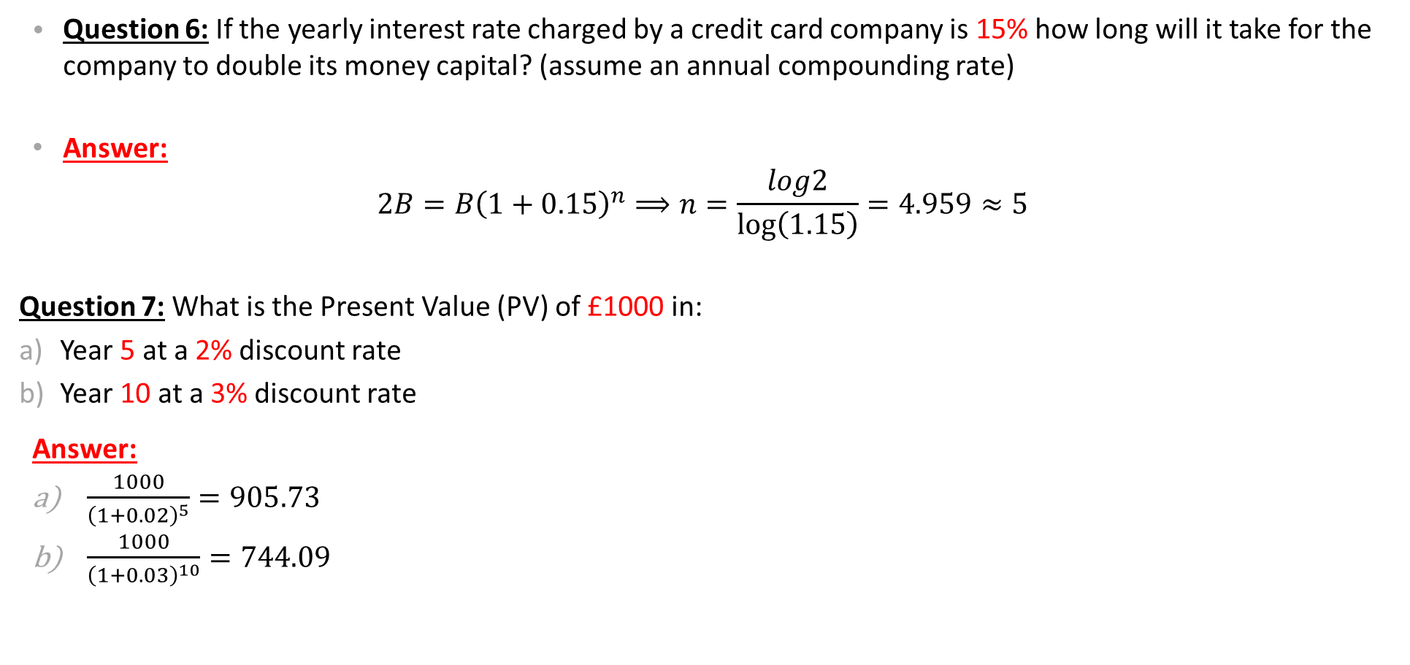
Extra Questions & Answers
Question 6: If the yearly interest rate charged by a credit card company is 15% how long will it take for the company to double its money capital? (assume an annual compounding rate)
Answer:
$$2B=B{\left(1+0.15\right)}^{n}⟹n=\frac{log2}{\log\left(1.15\right)}=4.959≈5$$
Question 7: What is the Present Value (PV) of £1000 in:
Year 5 at a 2% discount rate
Year 10 at a 3% discount rate
Answer:
$\frac{1000}{{\left(1+0.02\right)}^{5}}=905.73$
$\frac{1000}{{\left(1+0.03\right)}^{10}}=744.09$

Slide 88
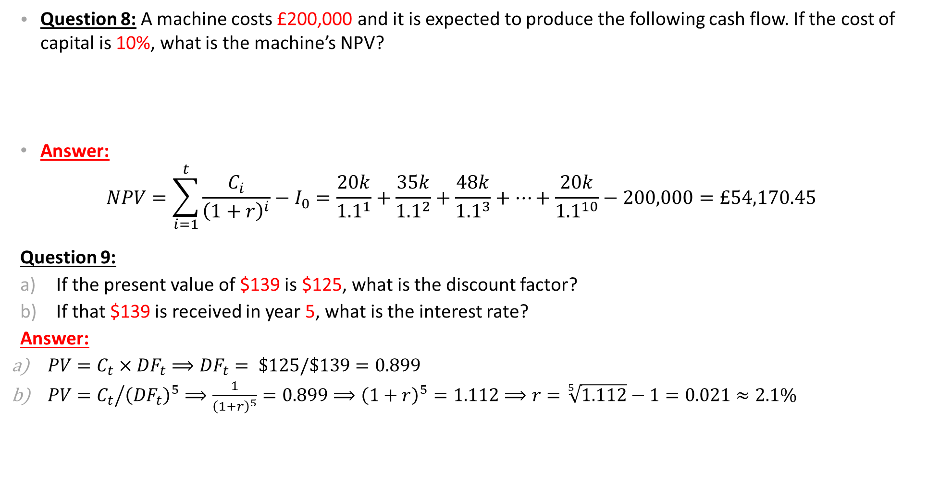
Extra Questions & Answers
Question 8: A machine costs £200,000 and it is expected to produce the following cash flow. If the cost of capital is 10%, what is the machine’s NPV?
Answer:
$$NPV=\sum_{i=1}^{t}{\frac{C_{i}}{{\left(1+r\right)}^{i}}}−I_{0}=\frac{20k}{{1.1}^{1}}+\frac{35k}{{1.1}^{2}}+\frac{48k}{{1.1}^{3}}+…+\frac{20k}{{1.1}^{10}}−200,000=£54,170.45$$
Question 9:
If the present value of $139 is $125, what is the discount factor?
If that $139 is received in year 5, what is the interest rate?
Answer:
$PV=C_{t}×{DF}_{t}⟹{DF}_{t}= \$125/\$139=0.899$
$PV={C_{t}}/{{\left({DF}_{t}\right)}^{5}⟹\frac{1}{{\left(1+r\right)}^{5}}=0.899⟹{\left(1+r\right)}^{5}=1.112}⟹r=\sqrt[5]{1.112}−1=0.021≈2.1\%$
Years | 1 | 2 | 3 | 4 | 5 | 6 | 7 | 8 | 9 | 10
K=£1000 | 20k | 35k | 48k | 50k | 65k | 65k | 42k | 40k | 28k | 20k

Slide 89
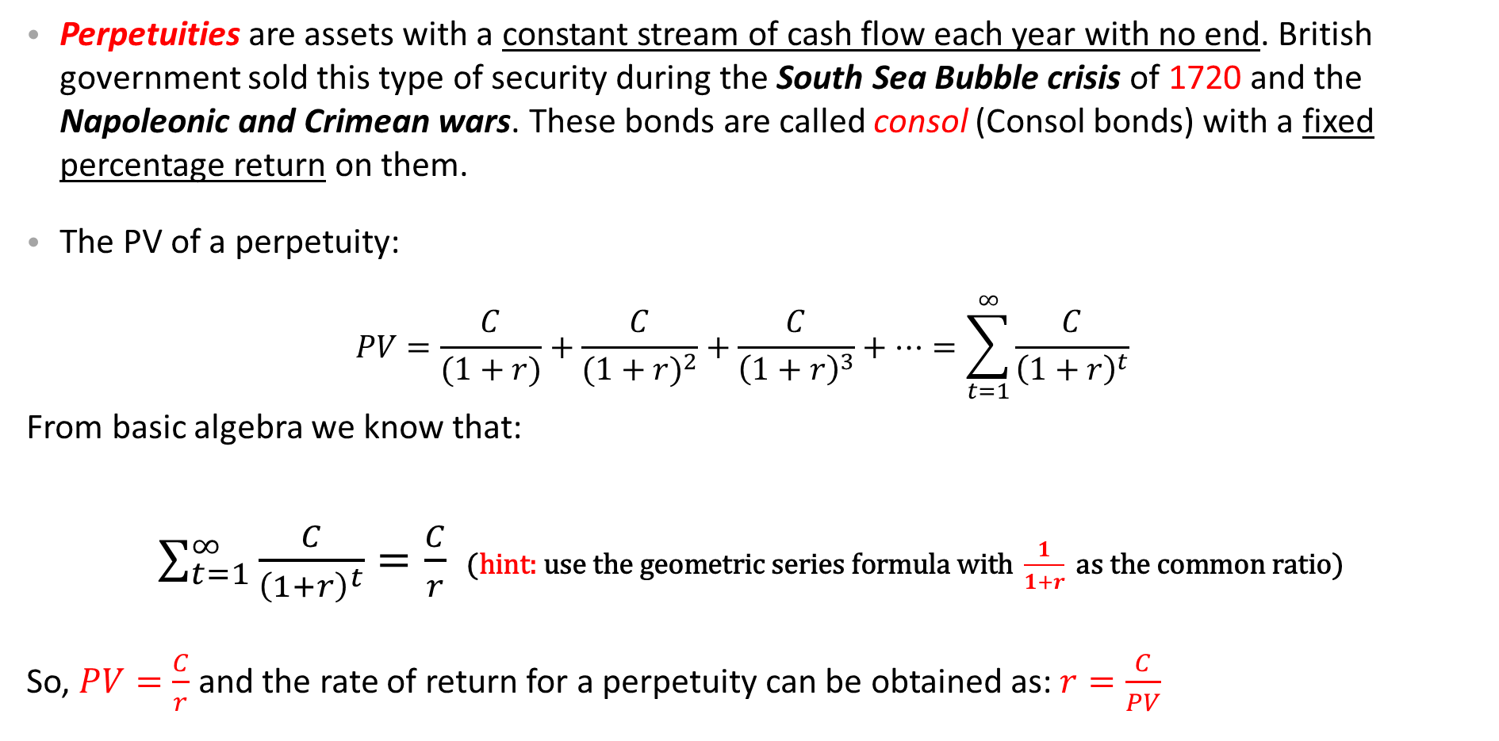
Perpetuity and its PV
Perpetuities are assets with a constant stream of cash flow each year with no end. British government sold this type of security during the South Sea Bubble crisis of 1720 and the Napoleonic and Crimean wars. These bonds are called consol (Consol bonds) with a fixed percentage return on them.
The PV of a perpetuity:
$$PV=\frac{C}{(1+r)}+\frac{C}{{(1+r)}^{2}}+\frac{C}{{\left(1+r\right)}^{3}}+⋯=\sum_{t=1}^{∞}{\frac{C}{{\left(1+r\right)}^{t}}}$$
From basic algebra we know that:
$\sum_{t=1}^{∞}{\frac{C}{{\left(1+r\right)}^{t}}}=\frac{C}{r}$ $\text{(}\text{hint}\text{: }\text{use} \text{the} \text{geometric} \text{series} \text{formula} \text{with} \frac{1}{1+r} \text{as} \text{the} \text{common} \text{ratio}\text{) }$
So, $PV=\frac{C}{r}$ and the rate of return for a perpetuity can be obtained as: $r=\frac{C}{PV}$
Fixed payments
Financial Times 2014:
On Twitter, George Osborne, the chancellor, wrote: “We’ll redeem £218m of 4% Consols, including debts incurred because of South Sea Bubble. Another financial crisis we’re clearing up after …”

Slide 90
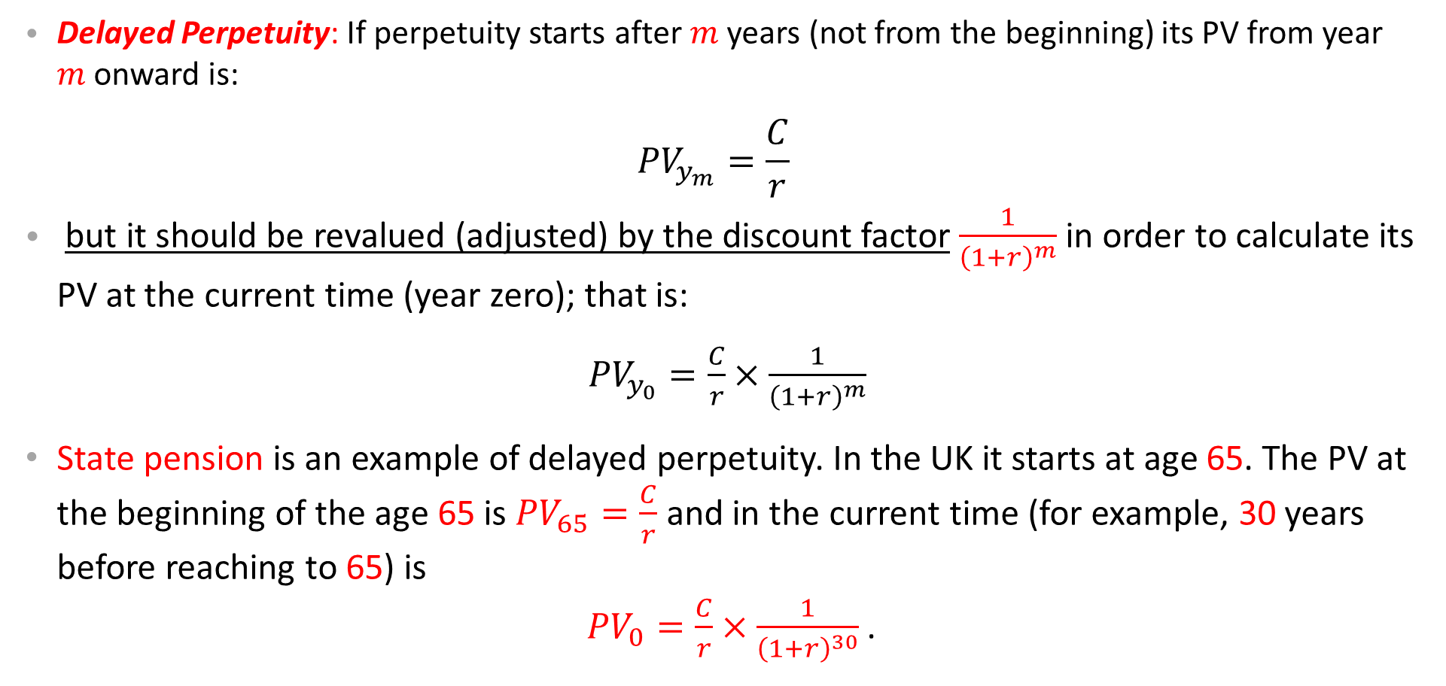
Delayed Perpetuity and its PV
Delayed Perpetuity: If perpetuity starts after $m$ years (not from the beginning) its PV from year $m$onward is:
$${PV}_{y_{m}}=\frac{C}{r}$$
but it should be revalued (adjusted) by the discount factor $\frac{1}{{\left(1+r\right)}^{m}}$ in order to calculate its PV at the current time (year zero); that is:
${PV}_{y_{0}}=\frac{C}{r}×\frac{1}{{\left(1+r\right)}^{m}}$
State pension is an example of delayed perpetuity. In the UK it starts at age 65. The PV at the beginning of the age 65 is ${PV}_{65}=\frac{C}{r}$ and in the current time (for example, 30 years before reaching to 65) is
${PV}_{0}=\frac{C}{r}×\frac{1}{{\left(1+r\right)}^{30}}$ .

Slide 91
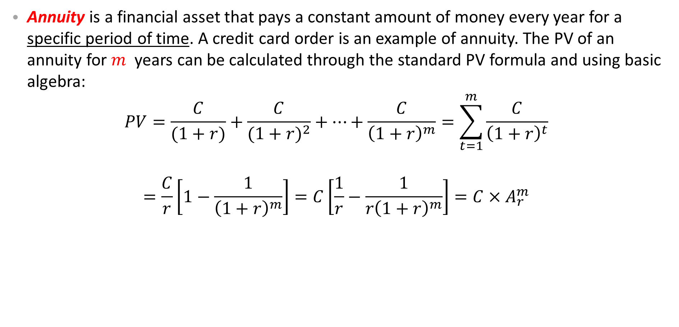
Annuity and its PV
Annuity is a financial asset that pays a constant amount of money every year for a specific period of time. A credit card order is an example of annuity. The PV of an annuity for $m$ years can be calculated through the standard PV formula and using basic algebra:
$$PV=\frac{C}{(1+r)}+\frac{C}{{(1+r)}^{2}}+⋯+\frac{C}{{\left(1+r\right)}^{m}}=\sum_{t=1}^{m}{\frac{C}{{\left(1+r\right)}^{t}}}$$
$$=\frac{C}{r}\left[1−\frac{1}{{\left(1+r\right)}^{m}}\right]=C\left[\frac{1}{r}−\frac{1}{r{\left(1+r\right)}^{m}}\right]=C×A_{r}^{m}$$
Annuity Factor

Slide 92
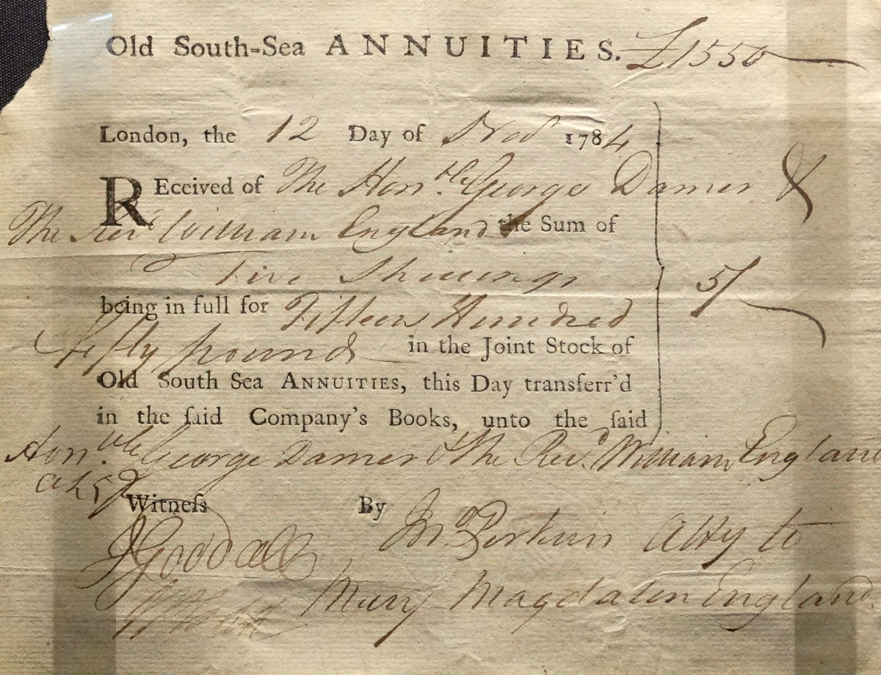
Old South-Sea Annuity (12/Nov/1784)

Slide 93
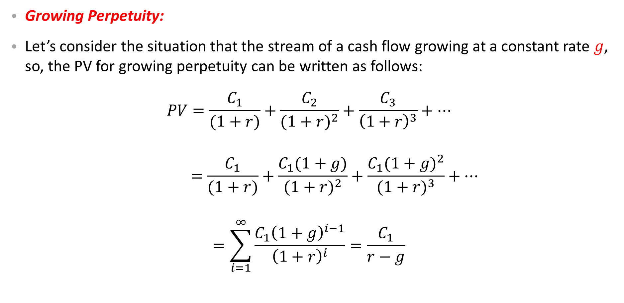
Growing Perpetuity at a Constant Rate
Growing Perpetuity:
Let’s consider the situation that the stream of a cash flow growing at a constant rate $g$, so, the PV for growing perpetuity can be written as follows:
$$PV=\frac{C_{1}}{(1+r)}+\frac{C_{2}}{{(1+r)}^{2}}+\frac{C_{3}}{{\left(1+r\right)}^{3}}+⋯$$
$$=\frac{C_{1}}{(1+r)}+\frac{C_{1}(1+g)}{{(1+r)}^{2}}+\frac{C_{1}{(1+g)}^{2}}{{(1+r)}^{3}}+⋯$$
$$=\sum_{i=1}^{∞}{\frac{C_{1}{\left(1+g\right)}^{i−1}}{{\left(1+r\right)}^{i}}}=\frac{C_{1}}{r−g}$$

Slide 94
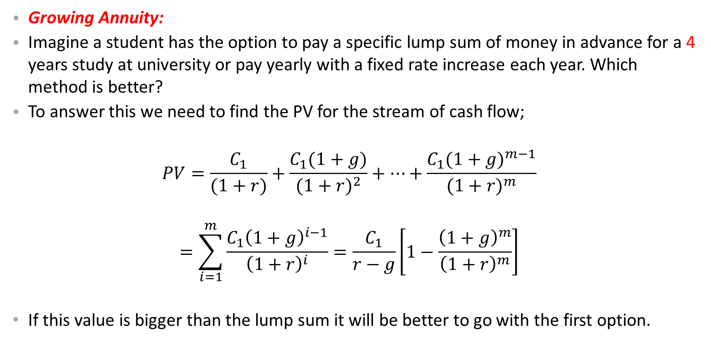
Growing Annuity at a Constant Rate
Growing Annuity:
Imagine a student has the option to pay a specific lump sum of money in advance for a 4 years study at university or pay yearly with a fixed rate increase each year. Which method is better?
To answer this we need to find the PV for the stream of cash flow;
$$PV=\frac{C_{1}}{(1+r)}+\frac{C_{1}(1+g)}{{(1+r)}^{2}}+…+\frac{C_{1}{(1+g)}^{m−1}}{{(1+r)}^{m}}$$
$$=\sum_{i=1}^{m}{\frac{C_{1}{\left(1+g\right)}^{i−1}}{{\left(1+r\right)}^{i}}}=\frac{C_{1}}{r−g}\left[1−\frac{{\left(1+g\right)}^{m}}{{\left(1+r\right)}^{m}}\right]$$
If this value is bigger than the lump sum it will be better to go with the first option.

Slide 95
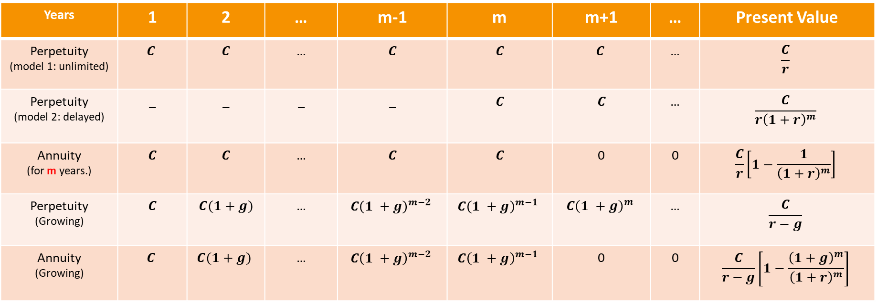
Perpetuity & Annuity (Review)
To see the difference between perpetuities (starting from year 1 or later) and annuity the following table would be informative:
Years | 1 | 2 | … | m-1 | m | m+1 | … | Present Value
Perpetuity (model 1: unlimited) | $$C$$ | $$C$$ | … | $$C$$ | $$C$$ | $$C$$ | … | $$\frac{C}{r}$$
Perpetuity (model 2: delayed) | _ | _ | _ | _ | $$C$$ | $$C$$ | … | $$\frac{C}{r{\left(1+r\right)}^{m}}$$
Annuity (for m years.) | $$C$$ | $$C$$ | … | $$C$$ | $$C$$ | 0 | 0 | $$\frac{C}{r}\left[1−\frac{1}{{\left(1+r\right)}^{m}}\right]$$
Perpetuity (Growing) | $$C$$ | $$C(1+g)$$ | … | $$C{\left(1 +g\right)}^{m−2}$$ | $$C{\left(1 +g\right)}^{m−1}$$ | $$C{\left(1 +g\right)}^{m}$$ | … | $$\frac{C}{r−g}$$
Annuity (Growing) | $$C$$ | $$C(1+g)$$ | … | $$C{\left(1 +g\right)}^{m−2}$$ | $$C{\left(1 +g\right)}^{m−1}$$ | 0 | 0 | $$\frac{C}{r−g}\left[1−\frac{{\left(1+g\right)}^{m}}{{\left(1+r\right)}^{m}}\right]$$

Slide 96

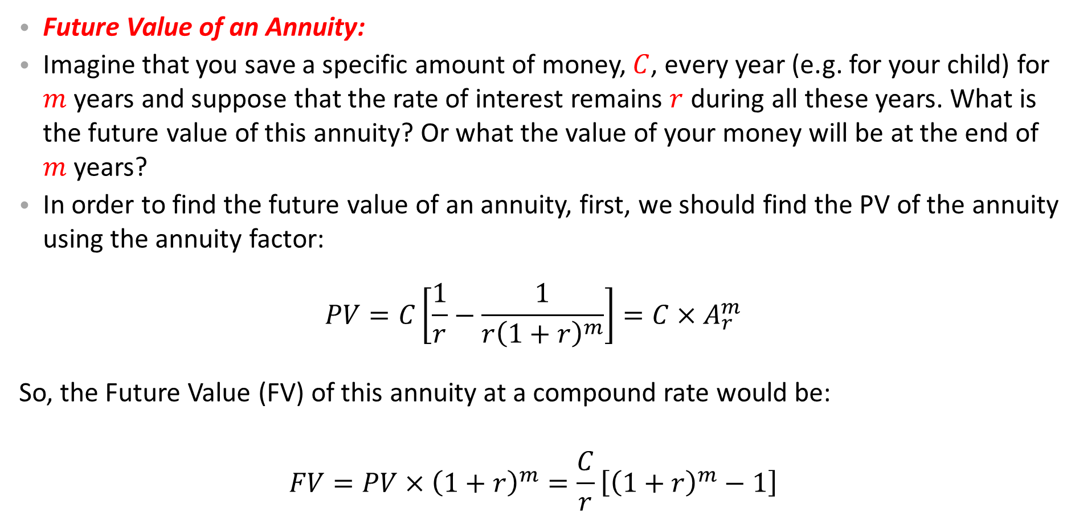
Future Value of an Annuity
Future Value of an Annuity:
Imagine that you save a specific amount of money, $C$, every year (e.g. for your child) for $m$ years and suppose that the rate of interest remains $r$ during all these years. What is the future value of this annuity? Or what the value of your money will be at the end of $m$ years?
In order to find the future value of an annuity, first, we should find the PV of the annuity using the annuity factor:
$$PV=C\left[\frac{1}{r}−\frac{1}{r{\left(1+r\right)}^{m}}\right]=C×A_{r}^{m}$$
So, the Future Value (FV) of this annuity at a compound rate would be:
$$FV=PV×{\left(1+r\right)}^{m}=\frac{C}{r}\left[{\left(1+r\right)}^{m}−1\right]$$
Annuity for $m$ yeras

Slide 97


Some Specific Examples
A Delayed Annuity:(Example 4.18, Hiillier et al 2013, p.111):
Roberto Balotelli will receive a four-year annuity of $€500$per year, beginning on date 6. If the interest rate is 10 per cent, what is the present value of his annuity? How do you do it?
Discount annuity back to year 5
Discount year 5 value of annuity back to year $0$
Adopted from Hillier’s PPT , The McGraw-Hill Companies, 2012

Slide 98

Some Specific Examples
Step 1: Discount annuity to year 5
$$€500\left[\frac{1−\frac{1}{{\left(1.10\right)}^{4}}}{0.10}\right]=500×A_{0.10}^{4}=500×3.1699$$
$=€1584.95$
Step 2: Discount year 5 value back to year $0$
Adopted from Hillier’s PPT , The McGraw-Hill Companies, 2012

Slide 99
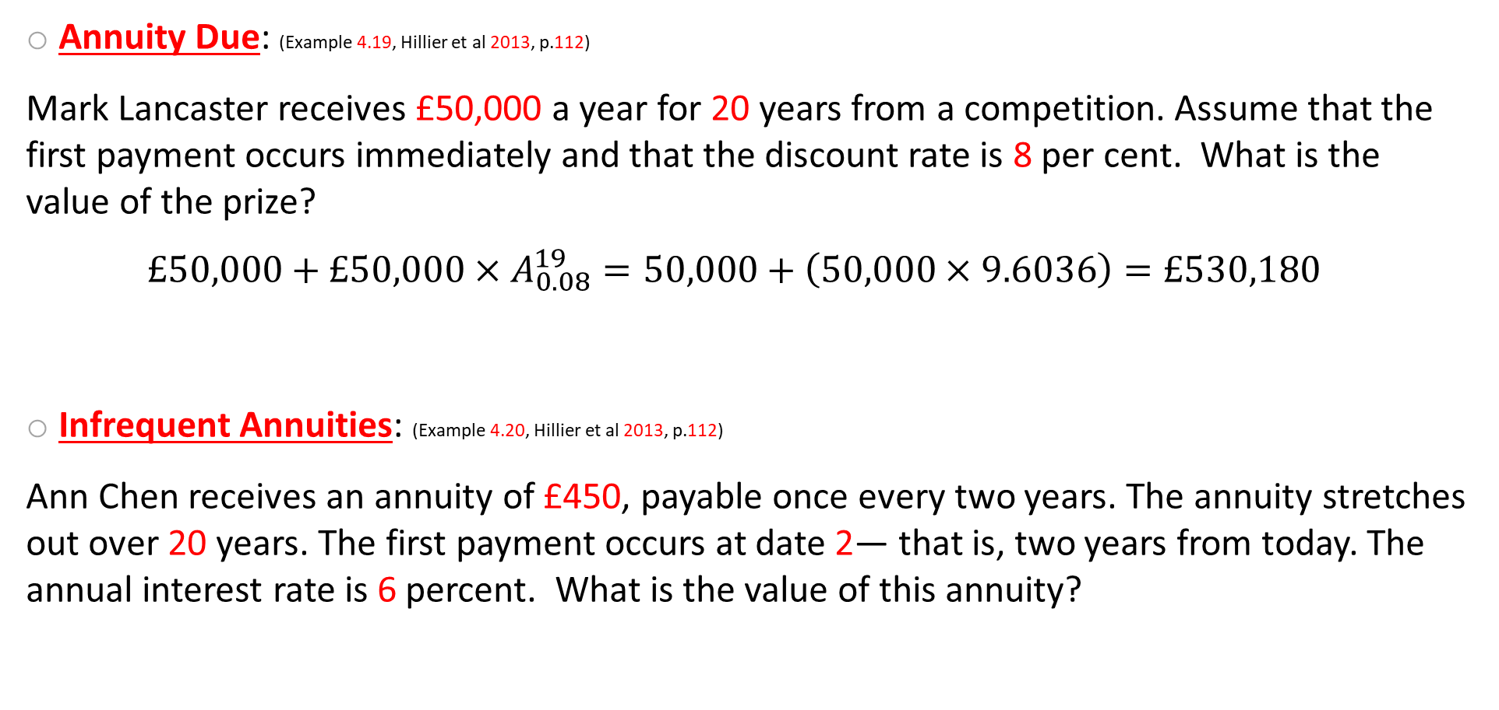
Some Specific Examples
Annuity Due: (Example 4.19, Hillier et al 2013, p.112)
Mark Lancaster receives £50,000 a year for 20 years from a competition. Assume that the first payment occurs immediately and that the discount rate is 8 per cent. What is the value of the prize?
$$£50,000+£50,000×A_{0.08}^{19}=50,000+\left(50,000×9.6036\right)=£530,180$$
Infrequent Annuities: (Example 4.20, Hillier et al 2013, p.112)
Ann Chen receives an annuity of £450, payable once every two years. The annuity stretches out over 20 years. The first payment occurs at date 2— that is, two years from today. The annual interest rate is 6 percent. What is the value of this annuity?
19 years Annuity
Adopted from Hillier’s PPT , The McGraw-Hill Companies, 2012

Slide 100
Some Specific Examples
Determine the interest rate over a two-year period.
(1.06 x 1.06) – 1 = 12.36%
Now calculate the present value of a £450 annuity over 10 periods, with an interest rate of 12.36 per cent per period:
William and Kate are saving for the university education of their newborn daughter, Susan. They estimate that university expenses will be €30,000 per year when their daughter reaches university in 18 years. The annual interest rate over the next few decades will be 14 per cent. How much money must they deposit in the bank each year so that their daughter will be completely supported through four years of university?
Adopted from Hillier’s PPT , The McGraw-Hill Companies, 2012

Slide 101
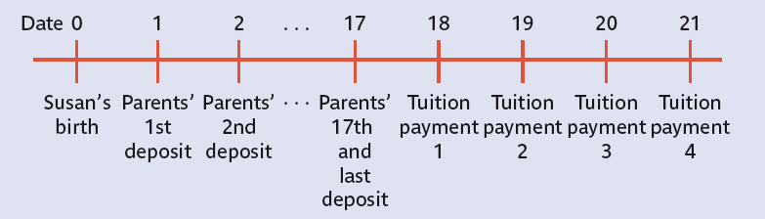
Some Specific Examples
Three Steps:
Calculate the Year 17 Value of the University payments
Calculate the Year 0 value of the university payments
Calculate the cash flow that equates the year 1 – 17 payments to the year 0 value of the university payments
Adopted from Hillier’s PPT , The McGraw-Hill Companies, 2012

Slide 102
Some Specific Examples
1.
2.
3.
Adopted from Hillier’s PPT , The McGraw-Hill Companies, 2012

Slide 103

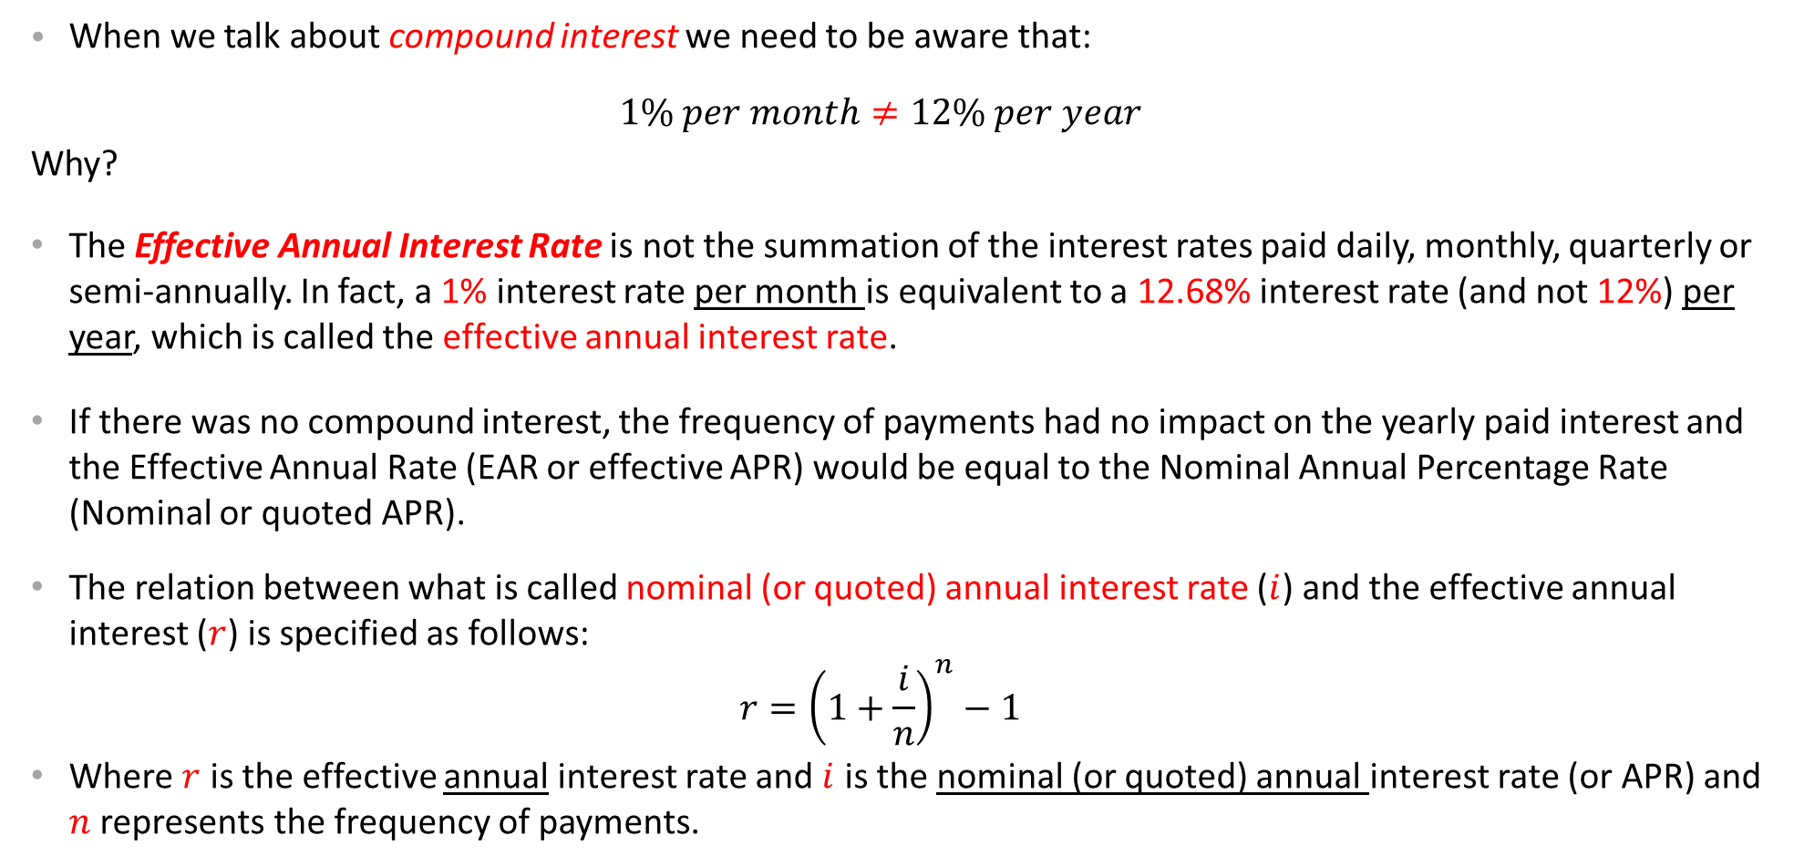
Quoted (Nominal) VS Effective Annual Interest Rate
When we talk about compound interest we need to be aware that:
$$1\% per month≠12\% per year$$
Why?
The Effective Annual Interest Rate is not the summation of the interest rates paid daily, monthly, quarterly or semi-annually. In fact, a 1% interest rate per month is equivalent to a 12.68% interest rate (and not 12%) per year, which is called the effective annual interest rate.
If there was no compound interest, the frequency of payments had no impact on the yearly paid interest and the Effective Annual Rate (EAR or effective APR) would be equal to the Nominal Annual Percentage Rate (Nominal or quoted APR).
The relation between what is called nominal (or quoted) annual interest rate ($i$) and the effective annual interest ($r$) is specified as follows:
$$r={\left(1+\frac{i}{n}\right)}^{n}−1$$
Where $r$ is the effective annual interest rate and $i$ is the nominal (or quoted) annual interest rate (or APR) and $n$ represents the frequency of payments.
Nominal rate
Or $1+r={\left(1+\frac{i}{n}\right)}^{n}$
Effective rate
A

Slide 104
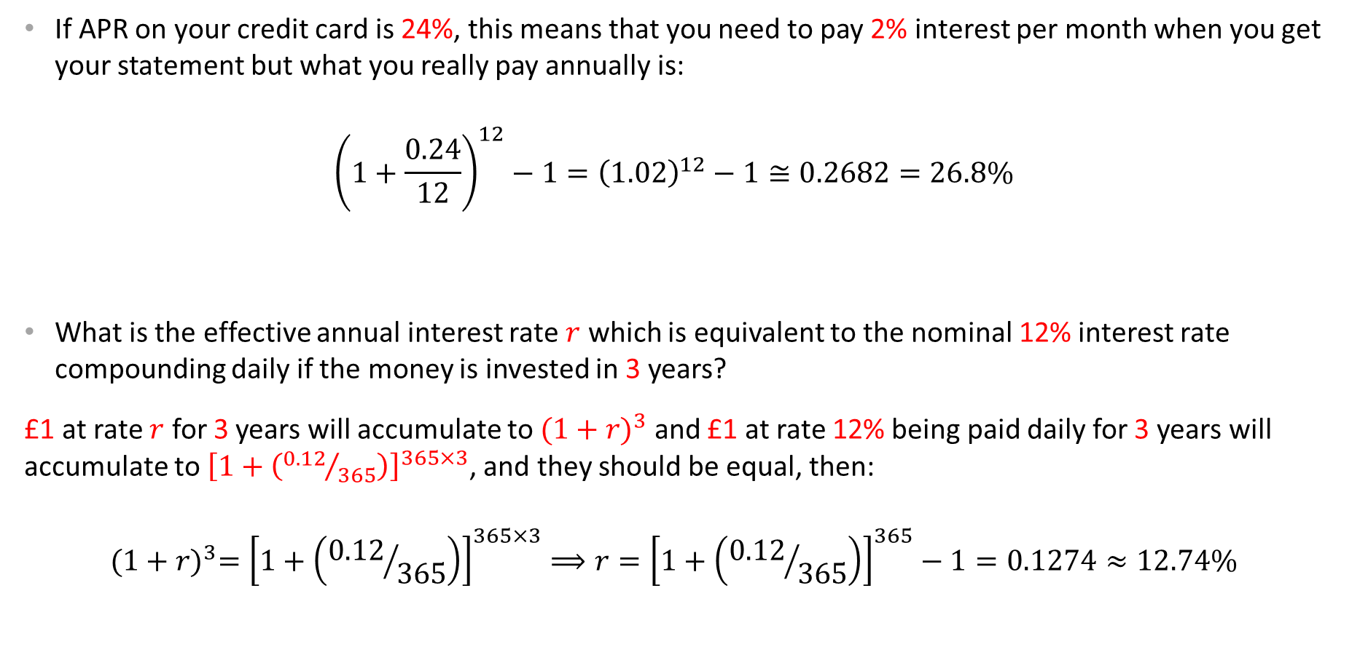
Quoted (Nominal) VS Effective Annual Interest Rate
If APR on your credit card is 24%, this means that you need to pay 2% interest per month when you get your statement but what you really pay annually is:
$${\left(1+\frac{0.24}{12}\right)}^{12}−1={\left(1.02\right)}^{12}−1≅0.2682=26.8\%$$
What is the effective annual interest rate $r$ which is equivalent to the nominal 12% interest rate compounding daily if the money is invested in 3 years?
£1 at rate $r$ for 3 years will accumulate to ${(1+r)}^{3}$ and £1 at rate 12% being paid daily for 3 years will accumulate to ${\left[1+\left({0.12}/{365}\right)\right]}^{365×3}$, and they should be equal, then:
$${(1+r)}^{3}={\left[1+\left({0.12}/{365}\right)\right]}^{365×3}⟹r={\left[1+\left({0.12}/{365}\right)\right]}^{365}−1=0.1274≈12.74\%$$
Effective Annual Interest Rate=Annual Percentage Yield (APE)

Slide 105
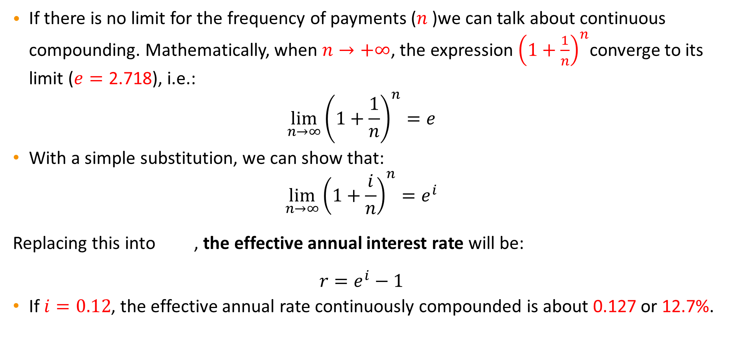
Continuous Compounding
If there is no limit for the frequency of payments ($n$)we can talk about continuous compounding. Mathematically, when $n→+∞$, the expression ${\left(1+\frac{1}{n}\right)}^{n}$converge to its limit ($e=\text{2.718}$), i.e.:
$$\lim_{n→∞}{{\left(1+\frac{1}{n}\right)}^{n}}=e$$
With a simple substitution, we can show that:
$$\lim_{n→∞}{{\left(1+\frac{i}{n}\right)}^{n}=e^{i}}$$
Replacing this into , the effective annual interest rate will be:
$$r=e^{i}−1$$
If $i=0.12$, the effective annual rate continuously compounded is about 0.127 or 12.7%.
A

Slide 106
Quoted (Nominal) VS Effective Annual Interest Rate
The following table shows the difference between nominal and effective annual interest rates based on the frequency of compounding:
Effective Annual Rate Based on Frequency of Compounding
Nominal Rate | Semi-Annual | Quarterly | Monthly | Daily | Continuous
1% | 1.003% | 1.004% | 1.005% | 1.005% | 1.005%
5% | 5.063% | 5.095% | 5.116% | 5.127% | 5.127%
10% | 10.250% | 10.381% | 10.471% | 10.516% | 10.517%
15% | 15.563% | 15.865% | 16.075% | 16.180% | 16.183%
20% | 21.000% | 21.551% | 21.939% | 22.134% | 22.140%
30% | 32.250% | 33.547% | 34.489% | 34.969% | 34.986%
40% | 44.000% | 46.410% | 48.213% | 49.150% | 49.182%
50% | 56.250% | 60.181% | 63.209% | 64.816% | 64.872%
Adopted from http://en.wikipedia.org/wiki/Effective_interest_rate

Slide 107
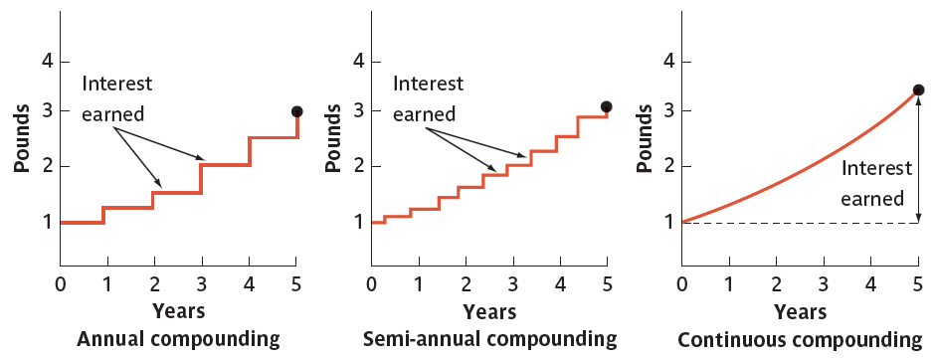
Difference Between Annual, Semi-Annual & Continuous Compounding
Adopted from Hillier’s PPT , The McGraw-Hill Companies, 2012

Slide 108
PV of Bonds
Stocks & Shares: They are both certificates of ownership. Stocks refer to the ownership of any company but shares refer to the ownership of a specific company.
Bonds:
Financial instruments (or debt securities or long-term loans) showing the indebtedness of the bond issuer (borrower) to the bondholder (lender or creditor).
For usual bonds the issuer is obliged to pay interests (coupons) before reaching its maturity date (redemption date), which is the final date of payment of the original debt (principal) and possibly the remaining interests.
Shareholders are investors in a company with an equity of ownership but bondholders are just lenders (or creditors) of a company with no ownership right. But, in case of company bankruptcy, they have priority over shareholders in terms of repayments. Shares can be kept infinitely but bonds should be redeemed at their maturity dates. Consols are the only exception.

Slide 109
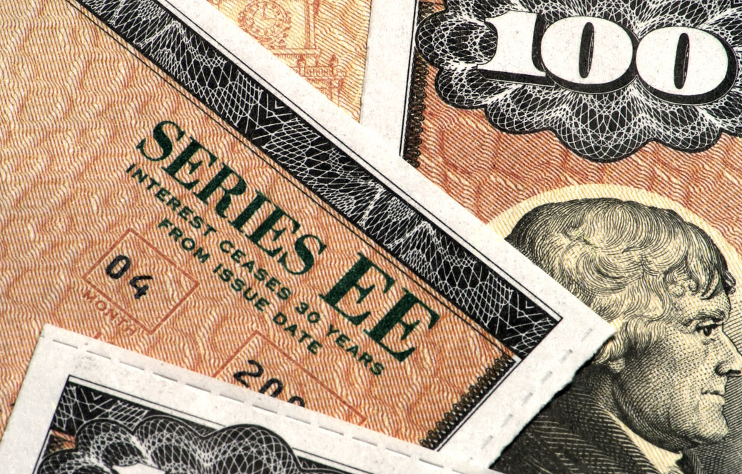
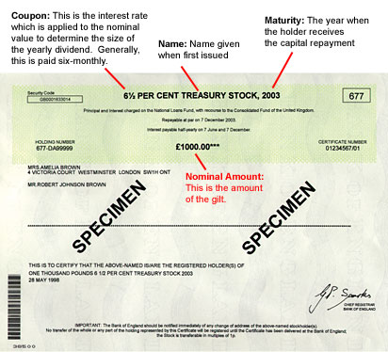
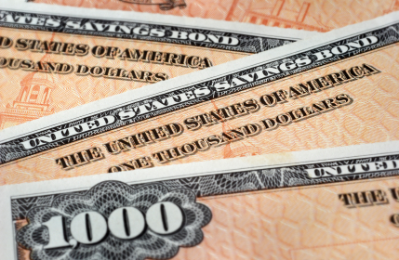
PV of Bonds
Large corporations, credit institutions, governments and international institutions can issue bonds when they need to borrow money for the long term.
Among all, government bonds are the safest securities in the world. UK government bonds are called Gilts as it was a certificate trimmed by gold.
Bonds’ maturities can be categorised as short-term, medium-term and long-term. In the UK, the maturities are defined by Debt Management Office (DMO) as short (0-7 years), medium ( 7-15 years) and long (15+ years), respectively.
Every bond has a face value (par value) and the bond’s coupons are calculated as a percentage of its face value.
Adopted from http://www.dailyfinance.com/2013/02/06/bond-market-crash-fears-interest-rates/
Adopted from http://www.the-diy-income-investor.com/2012_01_01_archive.html
Adopted from http://images.dailytech.com/nimage/21262_large_Treasury_Bonds.jpg

Slide 110

PV of Bonds
There are three types of bonds in general:
The Pure Discount Bond: Simplest bond which promises a single payment in its maturity date. It could be a 1-year discount or 2-year discount or n-year discount bond. Holders of these bonds receive no payment until the maturity date and for that reason, they are called zero-coupon bonds.
The PV of these bonds is the discounted amount of the face value in its maturity date, i.e.:
$$PV=\frac{Face Value}{{\left(1+r\right)}^{t}}$$
Where $r$ might be (but not necessarily) the market interest rate and $t$ is the maturity date of the bond.
The PV of a pure 6-year discount bond with a face value
of £1000 at the interest rate of 10% is:
$$PV=\frac{£1000}{{1.1}^{6}}=£564.47$$
This means the bond keeps 56.4% of its face value after 6 years. So, if it is offered for a price of more than £564.47 it is over-valued but less than that is profitable for the buyer.

Slide 111

PV of Bonds
The Level Coupon Bond: Usual bonds which offer a regular cash payment or coupons (usually yearly or 6-monthly) up to and including their maturity date.
The value of this type of bond is again the PV of the bond, which is calculated through the following formula: (see an example in the next slide)
$$PV=\frac{C}{(1+r)}+\frac{C}{{(1+r)}^{2}}+⋯+\frac{C}{{\left(1+r\right)}^{t}}+\frac{Face Value}{{\left(1+r\right)}^{t}}=\sum_{i=1}^{t}{\frac{C}{{\left(1+r\right)}^{i}}+\frac{Face Value}{{\left(1+r\right)}^{t}}=\frac{C}{r}\left[1−\frac{1}{{\left(1+r\right)}^{t}}\right]+\frac{Face Value}{{\left(1+r\right)}^{t}}}$$
Consol: Special bond which offers a regular coupons forever with no finite maturity date. The PV of these type of bonds can be calculated as:
$$PV=\frac{C}{(1+r)}+\frac{C}{{(1+r)}^{2}}+⋯=\sum_{i=1}^{∞}{\frac{C}{{\left(1+r\right)}^{i}}=\frac{C}{r}}$$
Years | 1 | 2 | ….. | t | t+1 | ….
Pure Discount Bonds | --- | --- | --- | F
Coupon Bonds | C | C | …. | C+F
Consols | C | C | …. | C | C | C

Slide 112

PV of Bonds
Example for the coupon bonds: If you buy a 4% treasury bond in 2014 with a face value of £100 maturing in 2018, it means you are entitled to get $0.04×100=£4$ interest (coupon) each year until 2018, which you receive the final coupon and the face value (nominal value) of your bond, i.e.:
$$\underset{2015}{\underbrace{£4}}, \underset{2016}{\underbrace{£4}},\underset{2017}{\underbrace{£4}},\underset{2018}{\underbrace{£104}}$$
Obviously, this is an annuity for 4 years plus a final payment. So, the PV of this bond can be calculated as:
$$\frac{£4}{r}\left[1−\frac{1}{{\left(1+r\right)}^{4}}\right]+\frac{£100}{{\left(1+r\right)}^{4}}$$
But this PV depends on the opportunity cost of capital which in this case must be the rate of return offered by other similar short-term treasury bonds (The word “similar” here refers to the same level of risk and credit quality; same asset class).

Slide 113


PV of Bonds
Imagine other short-term treasury bonds have a 2.8% return, the PV of our example would be:
Now, let’s look at the question from a different angle. What return do investors receive when they buy a bond and hold it to its maturity if the asked price of the bond is given?
Based on our example, we need to find $r$ in this equation:
$$104.40=\frac{4}{\left(1+r\right)}+\frac{4}{{\left(1+r\right)}^{2}}+\frac{4}{{\left(1+r\right)}^{3}}+\frac{104}{{\left(1+r\right)}^{4}}$$
This rate of return $r$is called yield to maturity (YTM) and based on the previous information, we know that $r=2.8\%$ but if we did not have this information, solving this equation would require the trial and error technique or a computer software.
Note: the price of a bond has an inverse relation with the rate of interest (or yield to maturity rate). Why? Can you explain this through the opportunity cost of having bonds?
$$\frac{4}{0.028}\left[1−\frac{1}{{\left(1+0.028\right)}^{4}}\right]+\frac{100}{{\left(1+0.028\right)}^{4}}≅104.40$$

Slide 114

The Term Structure of Interest Rates (Yield Curve)
To calculate the PV of a cash flow we use a single discount rate $r$ with the assumption that $r$ does not change or the change is ignorable. For bonds, we also use a fixed rate (as yield to maturity rate) for the whole period. But, in long term, the assumption of fixed $r$ cannot be supported.
In reality, yields or interest rates vary with the length of the term (length of maturity). In general, yields increase along with the term (maturity), because lenders demand higher yields for longer-term loans as compensation for the greater risk associated with the longer loan contracts, in comparison to the short-term loan contracts.
The relationship between different yields (or interest rates) and different maturities (terms) for a specific bond (government or corporate bond) is called the term structure of interest rates, which can be plotted as a curve, known as the yield curve. In other words, the term structure of interest rates shows the relationship between short-term and long-term interest rates.

Slide 115
The Term Structure of Interest Rates (Yield Curve)
So, the yield curve plots different yields of a specific bond (or similar bonds, in terms of their quality) against their maturities.
The term structure, or its graphical representation of the yield curve, play an important role in financial economics. It shows the expectations of market participants about the level of risk in the economy.
The shape of the yield curve indicates the priorities of lenders relative to that of borrowers. It explains how lenders (or investors) see the state of the economy and the level of risk in lending/investing. Is it riskier to lend (invest) long-term or short-term? How much are they confident about the state of the economy.

Slide 116

Yield Curve & Its Meaning
If short-term yields are lower than long-term yields, the economy is in a normal situation and long-term investments are not considered high-risk activities, so the slope of the yield curve is positive and the curve is called the normal yield curve.
When the yield curve has a positive slope, lenders are happy to provide long-term loans to the approved borrowers, as they are confident (in general) about the state of the economy and future returns from those borrowers.
http://www.investinganswers.com/financial-dictionary/bonds/term-structure-interest-rates-2936

Slide 117

Yield Curve & Its Meaning
If short-term yields are higher than long-term yields, the economy is in a risky situation and long-term investments are risky activities, so the slope of the yield curve is negative and the curve is called the inverted yield curve.
The British pound yield curve on February 9, 2005. This curve is unusual (inverted) in that long-term rates are lower than short-term ones.
Both adopted from http://en.wikipedia.org/wiki/Yield_curve

Slide 118


Yield Curve & Its Meaning
This inverted yield curve means interest rates have flipped on U.S. Treasury with short-term bonds paying more than long-term bonds. It’s generally regarded as a warning sign for the economy and the markets. A recession, if it comes at all, usually appears many months after a yield curve inversion.
In Aug. 2019
Adopted from https://www.cnbc.com/2019/08/14/the-inverted-yield-curve-explained-and-what-it-means-for-your-money.html

Slide 119

Yield Curve & Its Meaning
Finally, if there is little or no variation between short-term and long-term yield rates the yield curve will be flat. This means that lenders/investors are not sure about the future and the risk of lending/investing is the same either in the short or long term.
The flat yield curve can be usually seen during transitory periods when the economy does not show any sign of expansion (normal curve) or contraction (inverted curve).
When short- and long-term bonds are offering equivalent yields, there is usually little benefit in holding the longer-term instruments - that is, the investor does not gain any excess compensation for the risks associated with holding longer-term securities.
Both adopted from http://www.investopedia.com/terms/f/flatyieldcurve.asp

Slide 120


PV & Different Interest Rates (Spot Rates)
How to calculate the PV of a bond when there are different rates of interest each year (spot rates)?
In this case, we need to find the PV of each year separately, using the associated discount factor:
$${PV}_{1}=\frac{C}{\left(1+r_{1}\right)}$$
$${PV}_{2}=\frac{C}{{\left(1+r_{2}\right)}^{2}}$$
$$⋮$$
$${PV}_{t}=\frac{C+Face value}{{\left(1+r_{t}\right)}^{t}}$$
and then add all the PVs in order to reach to a total PV:
$${PV}^{∗}=\sum_{i=1}^{t}{{PV}_{i}}$$
and then use the total value (${PV}^{∗}$) to find a unique yield to maturity rate:
${PV}^{∗}=\frac{C}{\left(1+y\right)}+\frac{C}{{\left(1+y\right)}^{2}}+⋯+\frac{C+face value}{{\left(1+y\right)}^{t}}→y^{∗}$
Spot rate (or sometimes spot price) is the quoted rate for a currency, commodity or security which is valid for a specific period of time (daily, weekly, monthly or yearly).
This rate is determined based on the interaction between demand and supply for currencies or commodities but for a bond it is determined based on the price of a zero-coupon bond.
1st Year
Remember that $r_{1}, r_{2}, …, r_{t}$ are the spot rates for each represented year. Using these spot rates we can calculate the total PV (total value) of the bond and then the yield to maturity rate. we cannot find the yield to maturity rate until we know the price (value) of the bond.
Spot rates comes first and then yield to maturity rate can be calculated
2nd Year
t-th Year

Slide 121

PV of Bonds & Frequency of Payments
In the previous formula used to calculate the PV (value) of a bond we assumed that the coupons are paid yearly, but if the frequency of payments changes the power of the denominators will change: (here we consider a 5-year maturity)
$$PV=\frac{\frac{C}{2}}{{(1+\frac{r}{2})}^{1}}+\frac{\frac{C}{2}}{{(1+\frac{r}{2})}^{2}}+\frac{\frac{C}{2}}{{(1+\frac{r}{2})}^{3}}+\frac{\frac{C}{2}}{{(1+\frac{r}{2})}^{4}}+⋯+\frac{\frac{C}{2}}{{\left(1+\frac{r}{2}\right)}^{10}}+\frac{Face Value}{{\left(1+\frac{r}{2}\right)}^{10}}$$
$$PV=\frac{\frac{C}{3}}{{(1+\frac{r}{3})}^{1}}+\frac{\frac{C}{3}}{{(1+\frac{r}{3})}^{2}}+\frac{\frac{C}{3}}{{(1+\frac{r}{3})}^{3}}+\frac{\frac{C}{3}}{{(1+\frac{r}{3})}^{4}}+⋯+\frac{\frac{C}{3}}{{\left(1+\frac{r}{3}\right)}^{15}}+\frac{Face Value}{{\left(1+\frac{r}{3}\right)}^{15}}$$
$$PV=\frac{\frac{C}{4}}{{(1+\frac{r}{4})}^{1}}+\frac{\frac{C}{4}}{{(1+\frac{r}{4})}^{2}}+\frac{\frac{C}{4}}{{(1+\frac{r}{4})}^{3}}+\frac{\frac{C}{4}}{{(1+\frac{r}{4})}^{4}}+⋯+\frac{\frac{C}{4}}{{\left(1+\frac{r}{4}\right)}^{20}}+\frac{Face Value}{{\left(1+\frac{r}{4}\right)}^{20}}$$
Where $r$ represents the rate of return for a year. It is not necessarily the market interest rate. We may use yield to maturity rate of similar bonds (same category in terms of return and risk). Which one is bigger?
Every 6 months
Arrows show one full year
Every 4 months
Every 3 months

Slide 122

PV of Bonds & Frequency of Payments
In general if $C$is the face value of a bond and $r$ represents the yearly rate of return and $t$, the number of years and $f$, the frequency of payments in a year ($f≤365$), then the PV of the bond can be calculated as:
$$PV=\frac{\frac{C}{f}}{{\left(1+\frac{r}{f}\right)}^{1}}+\frac{\frac{C}{f}}{{\left(1+\frac{r}{f}\right)}^{2}}+\frac{\frac{C}{f}}{{\left(1+\frac{r}{f}\right)}^{3}}+…+\frac{\frac{C}{f}}{{\left(1+\frac{r}{f}\right)}^{f×t}}+\frac{Face Value}{{\left(1+\frac{r}{f}\right)}^{f×t}}$$
$$PV=\frac{C}{r}\left[1−\frac{1}{{\left(1+\frac{r}{f}\right)}^{f×t}}\right]+\frac{Face Value}{{\left(1+\frac{r}{f}\right)}^{f×t}}$$
And, for a zero-coupon bond:
$$PV=\frac{Face Value}{{\left(1+\frac{r}{f}\right)}^{f×t}}$$
Find a formula for a Consol.
The formula for Consols as a specific form of bond ( i.e. no end for the fixed payment) with a frequency of payment can be found in Question 1

Slide 123
Bond’s Return & Inflation
Returns & Inflation:
Bond coupons are fixed nominal returns each year but the real return depends on the level of inflation. When inflation is high and it seems to remain high, borrowers must offer a better deal to convince the lenders/investors to buy and keep long-term bonds.
The term nominal refers to what we observe in the market such as nominal interest rate, nominal wages, and nominal GDP, but when the variable is adjusted for inflation (removing or eliminating the impact of inflation on the variable) the real element appears, such as real interest rate, real wages, real GDP.
It is important for financial managers to base their calculations on real and not nominal interest rates.

Slide 124

Bond’s Return & Inflation
The economist Irving Fisher believed that investors and in general, all people, to some extent have money illusion; meaning the nominal (face) value of money is mistaken for its purchasing power and in the presence of money illusion, price fluctuations (in the form of inflation or deflation) do many harms.
His theory suggests that the change in the nominal interest rate is proportionate to a change in the expected inflation rate. Mathematically, the relationship between real interest rate $r$ and nominal interest rate $i$ and the expected inflation rate $π^{e}$can be expressed as:
$$r=\frac{\left(1+i\right)}{\left(1+π^{e}\right)}−1$$

Slide 125
Appendix
Some Preliminaries in Algebra
Some Basics in Algebra

Slide 126



Some Basics in Algebra
Sequence: is an encountered set of elements (objects or numbers), usually (in mathematics) with a specific pattern with finite (limited) or infinite (unlimited) elements. A more advanced definition is based on the function definition whose domain is the natural numbers set.
Two important sequences in mathematics are arithmetic and geometric. They are sometimes called arithmetic progression and geometric progression.
https://oeis.org/A000217
https://lacienciaesbella.blogspot.co.uk/2010/10/el-mundo-de-mandelbrot-en-3-d.html
https://www.bossmaths.com/a25b/

Slide 127








Some Basics in Algebra
Arithmatic sequence (progression): is a sequence that each term (apart from the first term) can be obtained from the previous term by adding or subtracting a fixed value, called the “common difference”.
$t_{1},\left(t_{1}+d\right),\left(t_{1}+2d\right),\left(t_{1}+3d\right),…,\left(t_{1}+\left(n−1\right)d\right)$
$$t_{1}$$
$$t_{2}$$
$$t_{3}$$
$$t_{4}$$
$$t_{n}$$
first term
n-th term
e.g.:
15, 12, 9, 6, …. ($t_{1}=15, d=−3)$
-5,-1,+3,+7, … ($t_{1}=−5, d=+4)$
$t_{1}=t_{1}$
$t_{2}=t_{1}+d$
$t_{3}=t_{2}+d=t_{1}+2d$
$t_{4}=t_{3}+d=t_{1}+3d$
$⋮$
$t_{n}=t_{n−1}+d=t_{1}+\left(n−1\right)d$

Slide 128

Some Basics in Algebra
Sum of the terms (entirely or partially) of an arithmetic sequence is called arithmetic series. The series for $n$ term can be shown as $S_{n}$:
$$S_{n}=t_{1}+\left(t_{1}+d\right)+\left(t_{1}+2d\right)+…+\left(t_{1}+\left(n−1\right)d\right)$$
We can write $S_{n}$ in these ways:
$S_{n}=t_{1}+\left(t_{1}+d\right)+\left(t_{1}+2d\right)+…+\left(t_{n}−2d\right)+\left(t_{n}−d\right)+t_{n}$ (1)
Or
$S_{n}=t_{n}+\left(t_{n}−d\right)+\left(t_{n}−2d\right)+…+\left(t_{1}+2d\right)+\left(t_{1}+d\right)+t_{1}$ (2)
Adding (1) and (2), we have:
$$2S_{n}=\left(t_{1}+t_{n}\right)+\left(t_{1}+t_{n}\right)+…+\left(t_{1}+t_{n}\right)+\left(t_{1}+t_{n}\right)=n\left(t_{1}+t_{n}\right)$$
Or
$$S_{n}=\frac{n}{2}\left(t_{1}+t_{n}\right)$$

Slide 129

Some Basics in Algebra
Example: If you borrow £30,000 from a friend agreeing to pay back the principle by £500 per month at the end of each month (apart from the first month), and the interest rate per annum is 15% on all remaining balances, find the sum of all interest payments you pay.
Answer:
$$\text{Total} \text{number} \text{of} \text{payments}\text{=}\frac{£30,000}{£500}=60 months$$
The interest payment is 15% per year or 1.25% per month, calculated based on the remaining balances each month, which are:
Remaining balances after each month: £29,500, £29,000, £28,500, £28,000, …, £500
The interest rate on remaining balances: £368.75, £362.5, 356.25, £350, £343.75, £337.50, …, £6.25. This is an arithmetic progression so, the total interest paid in 5 years (60 months) will be:
$$S_{n}=\text{£}\text{3}\text{68}\text{.}\text{75}\text{+} \text{£}\text{362}\text{.}\text{5}\text{+ £}\text{356}\text{.}\text{25}\text{+ }\text{…}\text{+ £}\text{6}\text{.}\text{25}\text{=}\frac{60}{2}\left(£368.75+£6.25\right)=£11,250$$

Slide 130






Some Basics in Algebra
Geometric sequence (progression): is a sequence of numbers where each term (apart from the first term) can be obtained by multiplying the previous term by a fixed non-zero number, called the common ratio.
$$a, ar, ar^{2},ar^{3},…, ar^{n−1}, …$$
Where $t_{1}=t_{1}$
$t_{2}=t_{1}×r$
$t_{3}=t_{2}×r=t_{1}×r^{2}$
$t_{4}=t_{3}×r=t_{1}×r^{3}$
$⋮$
$t_{n}=t_{n−1}×r=t_{1}×r^{n−1}⟹ t_{n}=t_{1}×r^{n−1}$
We also know that the common ratio $r$ can be obtained by dividing each term by its previous term; that is:
$$\frac{t_{2}}{t_{1}}=\frac{t_{3}}{t_{2}}=…=\frac{t_{n}}{t_{n−1}}=r$$
$$t_{2}$$
$$t_{3}$$
$$t_{n}$$
$$t_{1}$$

Slide 131

Some Basics in Algebra
Sum of the terms (entirely or partially) of a geometric sequence is called geometric series. The series for $n$ term can be shown as $S_{n}$:
$$S_{n}=a+ar+ar^{2}+ar^{3}+…+ar^{n−1}=\sum_{i=0}^{n−1}{ar^{i}} (1)$$
Multiplying $S_{n}$ by the common ratio $r$, we have:
$$S_{n}×r=ar+ar^{2}+ar^{3}+ar^{4}+…+ar^{n} (2)$$
Subtracting (2) from (1), we have:
$$S_{n}−S_{n}×r=a−ar^{n}$$
Or
$$S_{n}\left(1−r\right)=a\left(1−r^{n}\right)\underset{⇒}{r≠1}S_{n}=\frac{a(1−r^{n})}{\left(1−r\right)}$$

Slide 132

Some Basics in Algebra
Note: if $\left|r\right|<1$(i.e. $−1<r<1$) and the number of terms in the series is increasing $\left(n→+∞\right)$ then: $r^{n}→0.$
Under such circumstances the series is said to be convergent (means, not increasing infinitely) to a value, which is:
$$S_{n}\underset{→}{n→+∞}\frac{a}{1−r}$$
Or
$$\lim_{n→∞}{S_{n}=\frac{a}{1−r}}$$

Slide 133
Test Yourself
1. The rate of return is also called the
A. discount rate only.
B. discount rate and hurdle rate only.
C. discount rate, hurdle rate, and the opportunity cost of capital.
D. discount rate and the opportunity cost of capital only.
2. If the one-year discount factor is 0.8333, what is the discount rate (interest rate) per year?
A. 10 per cent
B. 20 per cent
C. 30 per cent
D. 40 per cent
3. You would like to have enough money saved after your retirement such that you and your heirs can receive $100,000 per year in perpetuity. How much would you need to have saved at the time of your retirement in order to achieve this goal? (Assume that the perpetuity payments start one year after the date of your retirement. The annual interest rate is 12.5 per cent.)
A. $800,000
B. $1,000,000
C. $10,000,000
D. $1,125,000
4. After retirement, you expect to live for 25 years. You would like to have $75,000 income each year. How much should you have saved in your retirement account to receive this income, if the annual interest rate is 9 per cent per year? (Assume that the payments start on the day of your retirement.)
A. $736,693.47
B. $802,995.88
C. $2,043,750.21
D. $1,427,831.93
5. If the future value of $1 invested today at an interest rate of r per cent for n years is 9.6463, what is the present value of $1 to be received in n years at r per cent interest rate?
A. $9.6463
B. $1.0000
C. $0.1037
D. $0.4132
6. An investment at 10 per cent compounded continuously has an equivalent annual rate of
A. 10.250 per cent.
B. 10.517 per cent.
C. 10.381 per cent.
D. none of the options.
7. You just inherited a trust that will pay you $100,000 per year in perpetuity. However, the first payment will not occur for exactly five more years. Assuming an 8 per cent annual interest rate, what is the value of this trust?
A. $850,729
B. $918,787
C. $1,000,000
D. $1,250,000
8. An investment at 12 per cent APR compounded monthly is equal to an effective annual rate of
A. 12.68 per cent.
B. 12.36 per cent.
C. 12.00 per cent.
D. 11.87 per cent
9. Ms Colonial has just taken out a $150,000 mortgage at an interest rate of 6 percent per year. If the mortgage calls for equal monthly payments for 20 years, what is the amount of each payment? (Assume monthly compounding or discounting.)
A. $1,254.70
B. $1,625.00
C. $1,263.06
D. $1,074.65
10. The present value of a $100 per year perpetuity at 10 per cent per year interest rate is $1,000. What would be the present value of this perpetuity if the payments were compounded continuously?
A. $1,000.00
B. $1,024.40
C. $950.83
D. $1,049.21

Slide 134
Extra Questions & Answers
Extra Questions with Answers
C
B
A
B
C
B
B
A
D
C

Slide 135


Extra Questions & Answers
Question 1: Imagine a pensioner getting a basic state pension of £129.20 per week from the age of 65.
How much is the PV of this pension at the beginning of the pension year if the annual compounding interest rate is 2% and remains at this level for an unlimited period?
How much is the PV if the person is 25 years old?
Answer:
The start of the pension year can be considered as year 1, therefore:
$${PV}_{65}=\sum_{t=1}^{∞}{\frac{C}{{\left(1+\frac{r}{m}\right)}^{m.t}}}=\sum_{t=1}^{∞}{\frac{129.20}{{\left(1+\frac{0.02}{52}\right)}^{52.t}}=}\frac{129.20}{{\left(1+\frac{0.02}{52}\right)}^{52}−1}=£6396$$
There is $m=40$ years gap before reaching to 65, so:
$${PV}_{0}=\frac{C}{r}×\frac{1}{{\left(1+r\right)}^{m}}=£6396×\frac{1}{{\left(1+0.02\right)}^{40}}≈£2896.74$$
$\frac{C}{r}=6460$ can be used here just as an approximation. The difference is due to the frequency of payments.

Slide 136

Extra Questions & Answers
Question 2: Helen has 60 months amortised loan (a loan that is to be repaid in equal periodic amounts) for her new car. The amount of the loan is £10,000 and the interest rate is 5% fixed for that period. Calculate how much she should pay monthly.
Answer: If the monthly payment is $C$, then:
$10,000=C\left[\sum_{n=1}^{60}{\frac{1}{{\left(1+i\right)}^{n}}}\right]⟹C=\frac{10,000}{\sum_{n=1}^{60}{\frac{1}{{\left(1+0.05\right)}^{n}}}}=\frac{10,000}{18.93}≈£528.3$

Slide 137

Extra Questions & Answers
Question 3: To accumulate £20,000 cash for your marriage at the end of 7 years, you are going to put equal annual end-of-year money as deposits in a savings account. If the interest rate is 5%, how much should be your annual deposit?
Answer: The annual deposit should be:
Based on slide no. 76, we have:
$$FV=PV×{\left(1+r\right)}^{m}=\frac{C}{r}\left[{\left(1+r\right)}^{m}−1\right]$$
Therefore,
$$C=\frac{FV×r}{\left[{\left(1+r\right)}^{m}−1\right]}=\frac{£20,000×0.05}{{1.05}^{7}−1}≈£2457$$

Slide 138

Extra Questions & Answers
Question 4: A sum of money is left invested for 3 years. In the first year, it earns 15% monthly; in the second year 10% quarterly and in the third year 12% daily. What is the effective rate of interest that would accumulate the same amount of interest at the end of three years?
Answer: £1 at rate $r$ for 3 years will accumulate to ${\left(1+r\right)}^{3}$, and £1 at the given rates for 3 years will accumulate to
$${\left(1+\frac{0.15}{12}\right)}^{12}{\left(1+\frac{0.10}{4}\right)}^{4}{\left(1+\frac{0.12}{365}\right)}^{365}=1.444583388$$
Therefore,
$${\left(1+r\right)}^{3}={\left(1+\frac{0.15}{12}\right)}^{12}{\left(1+\frac{0.10}{4}\right)}^{4}{\left(1+\frac{0.12}{365}\right)}^{365}⟹r≈13.04\%$$

Slide 139

Extra Questions & Answers
Question 5: A company is going to make 200 workers redundant and you are on the list. You can choose one of the following redundancy payment schemes. Explain which scheme will you choose if the annual rate of interest is 10% and does not change at all?
£42,000 after 5 years from now.
£3,000 per year from next year for 25 years.
£2,600 per year forever from next year.
£1,000 next year and increasing thereafter by 6% for ever.
£1,500 next year and increasing thereafter by 7% for 20 years.
Answers:
PV after 5 years: $\frac{42000}{{\left(1+0.1\right)}^{5}}=26078.69$
Annuity for 25 years: $\frac{C}{r}\left[1−\frac{1}{{\left(1+r\right)}^{m}}\right]=27231.12$
Question: Why is this not considered a delayed annuity? Shouldn’t 27231.12 be discounted back to year 0 since it starts the following year? This question also applies to questions d) and e).
The question says from next year for 25 years. All the formulae we have in lecture 2 assume that the payment starts from the next year, otherwise the formula would be different. Delayed annuity implies when something will start after some years (at least after 2 years). Perpetuity: $\frac{C}{r}=26000$
Perpetuity with growing returns: $\frac{C}{r−g}=25000$
Annuity with growing returns: $\frac{C}{r−g}\left[1−\frac{{\left(1+g\right)}^{m}}{{\left(1+r\right)}^{m}}\right]=21239$
Considering all options scheme b) is more profitable than others.

Slide 140

Extra Questions & Answers
Question 6: An academic is 35 years old and his salary next year will be £30,000. His salary will increase at a steady rate of 4% per annum until his retirement at age 65.
  If the interest rate is 5%, what is the present value of these future salary payments?
  If he saves 8% of his salary each year (from next year) and invests these savings at an interest rate of 5%, how much will he have saved by age 65?
  How will your calculations for parts a) and b) change if the inflation rate is 0.5% inflation rate? (without changing the nominal flows)
Answers:
  $growing anuuity:PV=\frac{C}{r−g}\left[1−\frac{{\left(1+g\right)}^{m}}{{\left(1+r\right)}^{m}}\right]=\frac{30000}{0.05−0.04}\left[1−\frac{{\left(1+0.04\right)}^{30}}{{\left(1+0.05\right)}^{30}}\right]=£748652.8$
  8% of 30,000=2400; growing at the rate of 4% yearly:
  PV=$\frac{2400}{0.05−0.04}\left[1−\frac{{\left(1+0.04\right)}^{30}}{{\left(1+0.05\right)}^{30}}\right]=59892.2$ now
$$FV=PV{\left(1+r\right)}^{30}=59892.2{(1+0.05)}^{30}=258850.6$$
  $r=\frac{1+i}{1+π}−1=\frac{1.05}{1.005}−1=4.5\%$ so; a) 804076.8 b) PV=64326.1 , FV=240921.8

Slide 141

Extra Questions & Answers
Question 7: You have the option to buy a 5-year US government bond at $1100 now. The face value of the bond is $1000 and it pays $50 interest semi-annually and is sold to yield 8%. Will you buy it?
Answers:
$50 semi-annually means yearly payment is $100=$C.$The formula of the PV of this bond is:
$$PV=\frac{\frac{C}{2}}{{(1+\frac{r}{2})}^{1}}+\frac{\frac{C}{2}}{{(1+\frac{r}{2})}^{2}}+\frac{\frac{C}{2}}{{(1+\frac{r}{2})}^{3}}+\frac{\frac{C}{2}}{{(1+\frac{r}{2})}^{4}}+⋯+\frac{\frac{C}{2}}{{\left(1+\frac{r}{2}\right)}^{10}}+\frac{Face Value}{{\left(1+\frac{r}{2}\right)}^{10}}$$
Therefore,
$$PV=\$50\left(\sum_{i=1}^{10}{\frac{1}{{\left(1+0.04\right)}^{i}}}\right)+\frac{\$1000}{{\left(1+0.04\right)}^{10}}=\$405.55+\$675.60=\$1,081.15$$
The demanded price ($1,100) is more than the present value of the bond ($1,081.15), so, it is better not to buy the bond.

Slide 142
Extra Questions & Answers
Question 8: Severn Trent plc pays dividends that are expected to grow at 4% each year. These will stop in year 5, at which point the company will pay out all its earnings as dividends. Next year’s dividend is £0.67 and its earning per share (EPS) at the time will be £1.01. If the appropriate discount rate on Severn Trent plc shares is 9%, what is its share price today?
Answers:
The retention ratio of Severn Trent plc is (£1.01 - 0.67)/£1.01 = 0.3366. The dividends are given below:
Earnings at year 5 are £0.78381/(1-0.3366) = £1.1816.
To value this company, we discount the dividend stream to the present day and then treat the £1.1816 as perpetuity since the firm will no longer grow. The present value of the dividend stream from years 1 to 4 is £2.295 when discounted at a rate of 9%. We use the perpetuity shortcut to value the remaining cash flows.
V₄ = £1.1816/.09 = £13.1284
V₀ = £13.1284/(1.09⁴) = £9.30
So the share price of Severn Trent is £2.295 + £9.300 = £11.59.
Year | 1 | 2 | 3 | 4 | 5
Dividend | £0.67 | £0.6968 | £0.72467 | £0.75366 | £0.78381
Retention Ratio=(Net Income-Dividend)/Net Income
Year 2: 1(1+0.04)
Year 3: 2(1+0.04)=1(1+0.04)^2
…..

Slide 143
Securitisation
Introduction:
We saw earlier that securities are tradable in all free financial markets, but financial assets such as debt contracts (e.g., loans and mortgages) are not.
Question: Is it possible to make non-tradable to tradable?
Short answer: Yes, the process of this financial practice is called securitisation which turns illiquid assets (non-tradable/transferable) into liquid assets (tradable/transferable).
Securitisation is the process of combining various types of debt contracts (such as mortgages, loans or credit card debt obligations) in the form of securities in order to sell them (with their cash flow returns) to some investors (e.g., pension funds, banks, asset managers, hedge funds) based on their risk preferences, through an entity called Special Purpose Vehicle (SPV).

Slide 144
Securitisation
Special Purpose Vehicle (SPV) also called a Special Purpose Entity (SPE), is a subordinate legal company created by a parent company to execute the securitization by isolating financial risk away from the parent company if it goes bankrupt.
One of the main differences between securitised assets and other tradable assets such as bonds, stock of shares, etc. is that the second types of assets have certain returns for a short or long period, but the securitised assets offer no such certainty.
Securities can have different names based on their underlying assets, but in general, any form of an asset with its cash flow returns can be the subject of securitisation. (see more in National Audit Office, Introduction to Asset-Backed Securities, Nov. 2016)
Asset-Backed Securities (ABS) are the assets whose incomes are backed by underlying assets.

Slide 145
Securitisation
Types of Securitised Assets
Mortgages
Car Loans
Credit Card Debt
Student Loans

Slide 146

How Does Securitisation Work?
Adopted from: National Audit Office, Introduction to Asset-Backed Securities, Nov. 2016Adapted

Slide 147

Securitisation
Reasons behind
securitisation:
1- Obtaining cash in advance by selling assets & their future cash flows
2- Removing assets off the balance sheet (specifically when they are risky)

Slide 148



Equity (Stock) Market
When a corporation enters into an equity (stock) market, stockholders (shareholders) become its new owners and the ownership of each shareholder is defined as the percentage of the total shares he/she retains.
Issuing new shares is an alternative way of borrowing. New shares go to the primary market (where they are created) but the existing shares are being traded in the secondary market executed by brokers (individuals or firms).
One of the important measures for investors to evaluate the equity-side value of a company is the market value of the company’s total shares.
Adopted from Google pictures

Slide 149

The Concept of Market Capitalisation
One of the important measures for investors to evaluate the value of a company (equity-side) is the market value of the company’s total shares. This is called market capitalisation or the market cap of the company.
Market cap of Microsoft:
Price of shares (at the end of 2011)=$26
Number of shares =8.4 billion
So, Market capitalisation which is the total market value of equity (outstanding shares), can be calculated as:
Market Capitalisation in 2011 =$26×8.4=\$218 billion$
Not by going into debt, just by re-investment of cash flow
Price of shares (June 2019)=$132.32 & Number of shares =5.6 billion
Market Capitalisation in 2019 =$132.32×5.6=\$740.99 billion$

Slide 150

Valuation of Common Stocks
The Present Value of Equity:
There are two sources of payoff for the shareowners (if they stay with their shares for a year): a) cash dividends and b) capital gain or loss.
If $P_{0},P_{1}$are the current and expected price (after a year) of a share, respectively, and ${Div}_{1}$is the expected dividend at the end of a year; the expected rate of return $r$at the end of the year is:
$$r=\frac{{Div}_{1}+\left(P_{1}−P_{0}\right)}{P_{0}}$$
So, the current price of share can be calculated as:
$$P_{0}=\frac{{Div}_{1}+P_{1}}{(1+r)}$$
PV of the share price & its dividend

Slide 151

Valuation of Common Stocks
If $P_{2}$ is the price of the share at the end of year 2, we can determine the value of $P_{1}$based on ${Div}_{2}$ and $P_{2}$:
$$P_{1}=\frac{{Div}_{2}+P_{2}}{(1+r)}$$
So, the current price of a share can be calculated as:
$$P_{0}=\frac{{Div}_{1}+P_{1}}{(1+r)}=\frac{{Div}_{1}+\frac{{Div}_{2}+P_{2}}{(1+r)}}{(1+r)}=\frac{{Div}_{1}}{(1+r)}+\frac{{Div}_{2}+P_{2}}{{(1+r)}^{2}}$$
If the share holder keeps the share for $n$ years, we have:
$$P_{0}=\frac{{Div}_{1}}{(1+r)}+\frac{{Div}_{2}}{{(1+r)}^{2}}+⋯+\frac{{Div}_{n}+P_{n}}{{\left(1+r\right)}^{n}}=\sum_{i=1}^{n}{\frac{{Div}_{i}}{{\left(1+r\right)}^{i}}}+\frac{P_{n}}{{\left(1+r\right)}^{n}}$$
If the above share is held infinitely, then:
$P_{0}=\sum_{i=1}^{∞}{\frac{{Div}_{i}}{{\left(1+r\right)}^{i}}}$
So, theoretically:
Value of a firm’s equity to the investor = PV of all the expected future dividends

Slide 152

Valuation of Common Stocks
This formula is called the dividend discount model of stock price or simply DCF.
This formula says that the current price of a stock can be obtained by discounting (finding the PV) the cash flow of dividend at the rate that can be obtained in the capital market on other securities with a similar level of risk.
If dividends grow at a constant rate $g$ each year (like growing perpetuity), the current share price can be calculated by:
$$P_{0}=\frac{{Div}_{1}}{r−g} (if r>g)$$
We can re-write the formula to show $r$ (expected return) as the subject. In this case;
$$r=\frac{{Div}_{1}}{P_{0}}+g$$
Where $\frac{{Div}_{1}}{P_{0}}$ is called dividend yield.

Slide 153

Valuation of Common Stocks
Three Scenarios
Zero Growth
Constant Growth
Differential Growth
The same dividend each year infinitely
(Hint: using perpetuity formula)
Adopted from Hillier’s PPT , The McGraw-Hill Companies, 2012

Slide 154


Valuation of Common Stocks
Example 1: Hampshire Products will pay a dividend of £4 per share a year from now. Financial analysts believe that dividends will rise at 6 per cent per year for the foreseeable future.
What is the dividend per share at the end of each of the first five years?
Answer:
Example 2: Suppose an investor is considering the purchase of a share of the Avila Mining Company. The equity will pay a £3 dividend a year from today. This dividend is expected to grow at 10 per cent per year (g = 10%) for the foreseeable future. The investor thinks that the required return (R) on this equity is 15 per cent, given her assessment of Avila Mining’s risk.
What is the share price of Avila Mining Company?
Answer:
$$£60=\frac{£3}{0.15−0.10}$$

Slide 155
Derivatives
Derivative: A contract between two or more parties that derives its value from the primitive or the underlying asset/assets such as stocks, bonds, currencies, commodities, interest rates, etc.
Note 1: Many derivatives are in the form of a forward contract which is also called a swap.
An agreement to buy or sell an asset at some date in the future at a price agreed today
A forward contract is not an option. Both the buyer and the seller are obligated to perform under the terms of the contract.
Adopted from Hillier’s PPT, The McGraw-Hill Companies, 2012

Slide 156
Derivatives (Example)
A Forward Interest Rate Contract:
You borrow £90.91 for one year at 10%
You lend £90.91 for two years at 12%
The cash flow on your transactions is as follows:
In this example, you construct a forward loan by borrowing short term and lending long.
 | Year 0 | Year 1 | Year 2
Borrow for 1 Year at 10% | +90.91 | -100
Lend for 2 years at 12% | -90.91 |  | +114.04
Net cash flow | 0 | -100 | +114.04
Brealey, Myers, and Allen 13th Edition PPT., 2017
You have a contract to pay this in year 1

Slide 157
Derivatives
Why do companies use derivatives?
Changing or reducing their risk exposures (this is called hedging)
Making a profit through borrowing and lending (this is called speculation)
On April 1, Maan Chemical agreed to sell petrochemicals (in US dollars) to the Dutch government in the future. The delivery dates and prices have been determined. Because oil is a basic ingredient of the production process, Maan Chemical will need to have large quantities of oil on hand. The firm can get the oil in one of two ways:
In January, Simon Agyei-Ampomah, a Ghanaian farmer, anticipates a harvest of 5,000 tones of cocoa at the end of September. He has two alternatives.
Write futures contracts against his anticipated harvest. This is known as a short hedge.
Harvest the cocoa without writing a futures contract
Buy the oil as the firm needs it.
Buy futures contracts. This is known as a long hedge
Adopted from Hillier’s PPT , The McGraw-Hill Companies, 2012

Slide 158
Hedging with Forward Contracts
Business has risk
  Business risk - Variable costs
  Financial risk - Interest rate changes
  Goal – Minimise or Eliminate the risk
HOW?
  Hedging & forward contracts
This slide and the coming slides are borrowed (with minor changes) from “Principles of Corporate Finance” by Brealey, Myers, and Allen, McGraw Hill Education, 2017, Chapter 26

Slide 159
Hedging with Forward / Future Contracts
Example - Kellogg produces cereal. A major component and cost factor is sugar.
Forecasted income & sales volume is set by using a fixed selling price.
Changes in cost can impact these forecasts.
To fix your sugar costs, you would ideally like to purchase all your sugar today, since you like today’s price, and made your forecasts based on it. But you can not.
You can, however, sign a contract to purchase sugar at various points in the future for a price negotiated today.
This contract is called a “Futures Contract.”
This technique of managing your sugar costs is called “Hedging.”

Slide 160
Some Terminologies
Spot Contract - A contract for immediate sale & delivery of an asset.
Forward Contract - A contract between two entities for the delivery of an asset at a negotiated price on a set date in the future.
Futures Contract - A contract similar to a forward contract except there is an intermediary that creates a standardised contract. Thus, the two parties do not have to negotiate the terms of the contract.
The intermediary is the Commodity Clearing Corp (CCC).
  The CCC guarantees all trades & “provides” a secondary market for the speculation of Futures.
Note: The distinction between “futures” and “forward” does not apply to the contract, but to how the contract is traded.

Slide 161
Swaps
Different companies might have fixed or variable cash flows:
Fixed (e.g. sell their products locally & no need to import anything, no need to borrow or when they borrow, the interest rate is fixed for them)
Variable (sell their products to foreign countries, need to import their basic materials, need to borrow) their risk profile might be volatile.
Swaps are financial instruments that allow two companies to change their risk profiles in this way. (Birth of the Swaps 1981)
Different types of Swaps:
Interest rate swaps
Currency swaps
Other swaps (e.g. credit default swaps, CDS)

Slide 162
Swaps
Example (interest rate swap):
If London Interbank Offered Rate (LIBOR) = 3%, what swap can be made and what is the profit?
  Assume $1 million face value loans
    XYZ borrows $1 million at 6% fixed and pays a floating rate of 3.25%
    ABC borrows $1 million at 3.5% floating and pays a fixed rate at 6.50%
Vanilla / Annually Settled | XYZ | ABC
Fixed rate | Borrow at 6% | Pay 7.5%
Floating rate | Pay LIBOR + 0.25 | Borrow LIBOR + 0.50

Slide 163
Swaps
XYZ is better off getting a payment based on 6.5% from ABC and pays at 6% to its bank.
ABC is better off getting a payment based on 7.5% from XYZ and pays at 6.5% to its bank
 | Benefit to XYZ | Net Position
Floating | +3.25 -3.25 | 0
Fixed | +6.50 -6.00 | +.50
Net gain |  | +.50%
 | Benefit to ABC | Net Position
Floating | +3.25 - 3.50 | -.25
Fixed | -6.50 + 7.50 | +1.00
Net gain |  | +.75%
If it swaps with ABC
This is paid by XYZ in case that swap happens
If it swaps with XYZ

Slide 164
Options
In a world, full of unpredicted events people try to reduce risk by making advance contracts which secure some aspects of the risky events. Options can be seen in this context.
An option is a derivative whose value depends on the underlying asset.
There are two main categories for options:
Call Option
Put Option

Slide 165
What is a Financial Option?
Examples Of Different Options:
A company that wishes to limit its future borrowing costs might take out an option to sell long-term bonds (for example, government bonds or its own bonds) at a fixed price in future. This company has a right to sell its bonds (can exercise its right) if the cost of borrowing is not cheap. The company may not exercise its right to sell the bonds if borrowing is more affordable.
An oil refinery company in Japan that wishes to reduce the risk of buying expensive crude oil in the future may take out an option to buy oil from Iran at a fixed price. If, at the time, the cost of oil in the market is cheaper, the company won’t exercise its right to buy at an agreed price.
A meat-packing company that wishes to lower the cost of beef might take out an option to buy live cattle at a fixed price.
A big agricultural production company that expects a weak market for its product might take out an option to sell part of its product at a specific price in future.
The underlying asset in the contract ( to buy or sell) could be a commodity, currency, stock of shares or bonds. Here we talk more about financial options which deal with financial assets (shares/bonds/etc.).

Slide 166
Definitions & Different Types of Options
Definition 1: An option is a contract giving its owner the right (but not the obligation) to buy or sell an asset at a fixed price on (or before) a given date.
Some Terminologies:
The fixed price in the definition is also called the exercise price or strike price.
The given date in the definition is also called maturity date or expiration date, which is the last date on which an option holder has the right to exercise the option.
Definition 2: An option is a contract giving its owner the right (but not the obligation) to buy or sell an asset at its strike (exercise) price on (or before) a specified maturity (expiration) date.
Note that the holder of the contract (agreement) has the right of exercising the option; which means he/she is liable to enforce the contract.
Different Types of Options: Options can be categorised based on the nature of the contract or on the right of the owner for exercising it before or on the maturity date.
Based on the nature of the contract: 1) call option 2) put option
Based on the exercising right before or on the maturity date: 1) European 2) American

Slide 167

Different Types of Options
Call Option: A call option gives its owner the right to buy an asset at an exercise (strike) price before (or on) the maturity date.
Put Option: A put option gives its owner the right to sell an asset at an exercise (strike) price before (or on) the maturity date.
European Call/Put Option: It can be exercised only at its maturity (expiration) date.
American Call/Put Option: It can be exercised on any date up to and including the maturity (expiration) date.
Note: The names American and European have nothing to do with the geographical location where the options are traded.
Long Position V.S. Short Position: Depending on the type of contract, both option buyers and option sellers can have a long position or short position. If you have a right, you have a long position but if you have an obligation, you have a short position (whenever the person who has the right, tries to practice their rights, a short position person is obliged to sell or buy).

Slide 168
More Terminologies
The option buyer (holder)
  Holds the right to exercise the option and has a long position in the contract
The option seller (writer)
  Sells (or writes) the option and has a short position in the contract.
Why? Because the long side has the right to exercise, the short side has an obligation to fulfil the contract if it is exercised.
The buyer pays the writer an option premium because the obligation is costly and the buyer must accept to pay this cost. This upfront payment compensates the seller for the risk of loss if the option holder (buyer) chooses to exercise the option.

Slide 169
Option Premium
To understand the idea of option and option premium consider the following example:
Imagine you are going to buy a house. After searching for a while, you find what you like but the price is £300,000 and you do not have that much yet the process of getting a mortgage of £300,000 from your bank takes another 4 months. You talk to the seller and ask him not to sell it to another person for 4 months until you get the mortgage. You negotiate an option with the owner of the house to sell you the house for £300,000 in 4 months. The owner agrees to wait for 4 months and sell the house to you at the end of the 4th month. He sells this option to you for the price of £5,000.
In this example:
Call Option: Call Contract (American type as you can buy the house anytime before or on the 4th month)
Exercise/Strike price: £300,000
Expiration/maturity time: 4 months
Underlying asset: House
Option premium: £5,000

Slide 170
Option Premium
Two Scenarios:
1. During these 4 months, news comes out that the house and some of the neighbouring houses have been built on a land which was an important place thousand years ago and you may find something really valuable underneath the house or some organisations are happy to pay three times above the current price for their excavations. The value of the house is now £900,000, but the writer of the option (the owner) must sell the house to you for £300,000. It is his obligation as he has a short position in this contract. If you exercise the option and buy the house the total cost would be £305,000 (£300,000 for the house plus £5,000 premium paid for the option). You can then sell it for £900,000. So, your profit would be £900,000-£305,000=£595,000.
2. You may find that the government is going to make an international airport which is close enough to the house and that brings the price of the house down to £200,000. You may decide not to exercise the option and you just lose the £5000 premium paid for the contract to the owner of the house (option writer).

Slide 171
Some More Terminologies
At-the-money: Describes an option whose exercise price is equal to the current stock price.
In-the-money: Describes an option whose value, if immediately exercised, would be positive.
Out-of-the-money: Describes an option whose value, if immediately exercised, would be negative.
Deep in-the-money: Describes an option that is in-the-money and for which the strike price and the stock price are very far apart.
Deep out-of-the-money: Describes an option that is out-of-the-money and for which the strike price and the stock price are very far apart.
Hedge: To reduce risk by holding contracts or securities whose payoffs are negatively correlated with some risk exposure. (or; using options to reduce the risk of losses in a portfolio when the markets go down).
Speculate: When investors use contracts or securities to place a bet on the direction in which they believe the market is likely to move.

Slide 172




Example
Current stock price
Table 20.1
Strike/Exercise price
Ask price of the call option
Out-of-the-money because:
$$Exercise price (\$80)>Current stock price (\$77.03)$$
Adopted from Berk & DeMarzo

Slide 173
Another Example
Problem: You have decided to purchase 25 contracts from September 2016’s put contracts on the DJIA with an exercise price of $180. How much money will this purchase cost you? Is this option in-the-money or out-of-the-money?
Solution:
The asking price is $6.35 per contract.
The total cost is 25 × $6.35 × 100 = $15,875.
Because the strike price ($180) exceeds the
current price ($178.65), the put option is in-the-money.

Slide 174
Example of a Call Option
You plan to add 100 shares of Amazon to your portfolio on the first day of the next month.
The current price of a single share of Amazon is $232 and you are happy with this price. So, for 100 of them, you must invest $23,200 of your money.
It is not good if the price of Amazon shares goes up next month, so, you decide to buy a call option on 100 shares of Amazon with the exercise (strike) price of $232 with a maturity date on the first day of the next month.
If the price of Amazon shares starts to rise in the market and you believe it may rise further, you can exercise the call option at $232 for each share. But if the price of Amazon shares starts to decline, you do not need to exercise your call option (right to buy).

Slide 175





Option Payoffs At Expiration
How do option holders decide to exercise their options?
Call Option: If the stock price $S$, is bigger than the exercise (strike) price $K$ at the expiration (maturity) date the value of call option $C$ is bigger than zero, so the option holder will exercise the option to protect themselves from rising the stock price. So,
$$S−K>0⟺C>0≡the call option will be exercised$$
And if
$S−K<0⟺C=0≡the call option will not be exercised$
Therefore, the call option payoff either pays $⁡(S−K)$or 0 and it can be written as (assuming no other cost) :
$C=max⁡(S−K, 0)$
The graphical representation of the payoff of a call option (Pay off diagram):
Call value at expiration
Payoff ($C$)
Or the value of the call option
$$C=\left\{\begin{matrix}S−K & if S>K \text{(}\text{in}\text{−}\text{the}\text{−}\text{money}\text{)} \\ 0 & if S≤K (\text{Out}\text{−}\text{of}\text{−}\text{the}\text{−}\text{money})\end{matrix} \right.$$
Strike Price ($K$)
Stock Price ($S$)

Slide 176
Example of a Put Option
Call options protect the investor when the price of the underlying asset is rising against the investor’s interest. The Put option, in contrast, protects the investor when the price of the underlying asset is falling.
You are selling 100 shares of Apple on the first day of next month and the current price is $185 per share. With this sale, you can earn $18500 if the price of shares remains at $185, but to guarantee this minimum earning, you buy a put option on these 100 shares at the strike (exercise) price of $185 each, (so, you have a long position as you have the right to sell).
If the price of Apple’s shares (stock price) goes up, you will be happy and do not need to exercise your option, but if the price goes down, you can exercise your right to sell your shares at $185.

Slide 177





Option Payoffs At Expiration
Put Option: The first owner (first holder) of a put option will exercise the option if the stock price $S$ is below the exercise (strike) price $K$. So, when the value of a put option $P$ is greater than zero the put option will be exercised, i.e.:
$$K−S>0⟺P>0≡the put option will be exercised$$
And if
$K−S<0⟺P=0≡the call option will not be exercised$
Therefore, the put option payoff either pays $⁡(K−s)$or 0 and it can be written as (assuming no other cost):
$P=max⁡(K−S, 0)$
The graphical representation of the payoff of a call option:
Put value at expiration
Payoff ($P$)
Or the value of the put option
$$P=\left\{\begin{matrix}K−S & if K>S \text{(}\text{in}\text{−}\text{the}\text{−}\text{money}\text{)} \\ 0 & if K≤S (\text{Out}\text{−}\text{of}\text{−}\text{the}\text{−}\text{money})\end{matrix}\right.$$
Strike Price ($K$)
Stock Price ($S$)

Slide 178


Example
If the stock price S is 15 that means the value of this put option will be 5.
Adopted from Berk & DeMarzo

Slide 179



Another Example
Question: You own a put option on Dell stock with an exercise price of $12.50 that expires today. Plot the value of this option as a function of the stock price.
Solution: Let $S$ be the stock price and $P$ be the value of the put option. The value of the option is
$$P = max⁡(12.5−S,0)$$
$$P=12.5−S (when K>S or S<12.5)$$
$$K=12.5$$
$$P=0 (when K≤S or S≥12.5)$$

Slide 180


Short Position in a Call Option Contract
As it was said before, the seller of the option (first owner/first holder), as an investor who tries to avoid risk in future, has a short position in an option contract as he/she has an obligation if the option buyer (new owner/second holder), who has a long position in the contract, wants to exercise his/her right to buy.
Therefore, the option seller (the investor with a short position) takes the opposite side of the contract to the investor who bought the option. Thus, the seller’s payoff is the negative of the buyer’s payoff.
The pay-off of the call option seller with a short position
The pay-off of the call option holder with a long position

Slide 181




Short Position in a Put Option Contract
Similarly, the pay-off diagram for a put option buyer is symmetrical to the pay-off diagram of the put option seller around the x-axis.
The pay-off for the put option seller
$$P=\max{(20−S, 0)}$$
The pay-off for put option buyer
$$−P=−max⁡(20−S, 0)$$
Adopted from Berk & DeMarzo

Slide 182


Profit For Holding An Option To Expiration
Profit of Holding a Call Option: Although the pay-offs on a call option contract are never negative, the profit from purchasing and keeping it to expiration could be negative.
Example: Look at Slide No. 172. The 09 Aug. 80 call option costs $4.00 and expires in 45 days. If you borrow $4 at 3% interest, the cost of borrowing after 45 days is $\$4×{(1.03)}^{\frac{45}{365}}=\$4.01$ and if $S$ represents the stock price at expiration, the total profit of purchasing the call option will be
$$\max\left(S−80 , 0\right)−4×{1.03}^{\frac{45}{365}}$$
Therefore, if the stock price
exceeds $84.01, the call option
purchasing is profitable.
(look at the red graph)
$84.01
Adopted from Berk & DeMarzo

Slide 183


Profit For Holding An Option To Expiration
Profit of Holding a Put Option: Because a put option is the opposite of a call option, the profit of the put option is just the negative of the profit of a call option.
Suppose
$$S=Stock Price$$
$$K=Strike Price$$
$$P=Purchasing price of put option$$
Then the profit from buying any
put option on July 8, considering
Borrowing at 3% interest will be:
$$\max\left(K−S , 0\right)−P×{(1.03)}^{\frac{45}{365}}$$
Adopted from Berk & DeMarzo

Slide 184


Combination of Options
Some investors have both option positions by holding a portfolio of different options. Buying a call option can be considered an investment. They generally have more extreme returns than stocks. But put options are generally not held as an investment, but rather as insurance to hedge other risks in a portfolio.
There are different combinations of options together or options with stocks. We will consider some of these combinations here:
Straddle: A portfolio including a long-call and a long-put options on the same stock with the same exercise date and the same strike price. This strategy may be used if investors expect the stock to be very volatile and move up or down a large amount but do not necessarily have a view on which direction the stock will move.
Payoff and profit of the straddle strategy are illustrated
By this graph. This strategy makes money when stock
And strike prices are far away from one another.
If $S$ moves in the neighbourhood of $K$, the profit is negative
Adopted from Berk & DeMarzo

Slide 185


Combination of Options
Strangle : A portfolio that has a long position on a call option and a put option on the same stock (or underlying asset such as Hewlett-Packard stock) with the same exercise date but the strike price on the call exceeds the strike price on the put.
Contrary to the Straddle strategy the investor has absolutely no idea about the direction of price movement in the strangle strategy the investor believes the stock has a better chance of moving in a certain direction, but would still like to be protected in the case of a negative move.
If the price of the stock is between 30 and 40, the investor is happy not to exercise any of the options
Adopted from Berk & DeMarzo

Slide 186


Combination of Options
Butterfly Spread: A portfolio that is long two call options with differing strike prices and is short two call options with a strike price equal to the average strike price of the first two calls.
Although a straddle strategy makes money when the stock and strike prices are far apart, a butterfly spread makes money when the stock and strike prices are close.
When the $S$ moves towards $K$ , the payoff increases.
Yellow line: Payoff from a long position in a $20 call
Red line: Payoff from a long position in a $40 call
Blue line: Payoff from a short position in two $30 calls
Black line: Payoff the entire combination (butterfly Spread)
Adopted from Berk & DeMarzo

Slide 187
Put-Call Parity
Other forms of combinations: Combination of some assets (such as shares and bonds) with some options (puts and calls) on the same underlying assets creates more complex option contracts. The idea behind these combinations is to protect the investors from financial loss and also to guarantee a minimum payoff if something goes wrong in the financial market.
This can be considered as an insurance policy on the asset price for the investor.
Example: Imagine you buy a Google share and, simultaneously, you buy the put option on that share (i.e. buying the right to sell Google’s share at a specific price). This strategy of buying a put and buying the underlying share is called a protective put.
If the share price is greater than the exercise (strike) price, the put option is worthless, and the value of the combined position is equal to the value of the equity. If instead, the exercise price is greater than the share price, the decline in the value of the share will be exactly offset by the rise in the value of the put. The share can always be sold at the exercise price, regardless of how far the market price of the share falls.

Slide 188




Put-Call Parity
Payoff to the combination of buying a put and buying the underlying equity
$$Payoff=S$$
$$Payoff=Max (50−S, 0)$$
$$Payoff=Max (50, S)$$
Minimum payoff protected by the put option
If the price of share goes below 50, you exercise the put and if it goes above 50, you keep the share.
Adopted from Hillier et al.

Slide 189




Put-Call Parity
Buying a call option and simultaneously buying a risk-free, zero-coupon bond (with the face value equal to the strike price) gives the same payoff.
Minimum payoff protected by zero coupon bond
$$Payoff=Max (50, S)$$
$$Payoff=Max (S−50, 0)$$
$$Payoff=50$$
The previous slide. In this case, you do not need to buy the share and accept the possible loss.
Adopted from Hillier et al.

Slide 190


Put-Call Parity
If the payoffs of these two strategies are the same, the cost of using them should be the same too. Otherwise, all investors will choose the lower-cost strategy. Therefore, we have:
$$Cost of the first strategy=Cost of the second strategy$$
i.e.
$$Price of underlying equity+Price of put=Price of call+Present value of a bond with the value of the exercise price$$
If $S=$ $Price of underlying equity$ (Stock price)
$P=$ Price of put
$C=$ Price of call
$PV\left(K\right)=$ Present value of exercise price, then:
$$S+P=C+PV\left(K\right)$$
Or
$$S=C−P+PV(K)$$
This is one of the most fundamental and theoretical equation in the option markets, which is called put-call parity.
If there is no gap between the price of the call option and the price of the put option (with the same underlying asset), it means there is no arbitrage opportunity and the price of the equity will be equal to the PV of the exercise price, i.e.
$$C−P=0 ⟺S=PV(K)$$
Note: Minus sign behind the put price means that the put is sold, not bought.

Slide 191

Synthetic Share & Replicating Payoff
The put-call relationship in the form of $S=C−P+PV(K)$ has another meaning. It means an investor can replicate the purchase of a share of equity by buying a call, selling a put, and buying a zero-coupon bond (or any other safe assets). It gives the same payoff of buying a share. This is called a synthetic share.
The Holy Grail: This is the most important use of options to eliminate the risk of real investments.
Through buying and selling options an investor can imitate the payoff of another investment without laying out the capital to actually buy or sell the asset unless the risk is eliminated.
Payoff
Payoff
You have borrowed to buy the stock and if the stock price is less than X, you will have a negative payoff
Stock
x
Stock
-x
Buying a call option with the exercise price X
This is the replication of the payoff of the stock
If S>X, then the call option is valuable & can be exercised
If S=X, then the zero-coupon (low-risk) bond with the face value of X protects our interest
If S<X, then by selling the put option, the negative pay-off is transferred to the buyer of it
-x
x
The pay-off of buying a put option from a seller with the exercise price X

Slide 192

Synthetic Share & Replicating Payoff
To test your understanding of the put-call parity we bring some examples:
Question 1: Suppose Nokia shares are selling for £10.95. A three-month call option with a £10.95 strike price goes for £0.35. The risk-free rate is 0.5% per month. What is the value of a 3-month put option with a £10.95 strike price?
Answer: Using the put-call parity equation we have
$P=−S+C+PV\left(K\right)⟹P=−£10.95+£0.35+\frac{£10.95}{{1.005}^{3}}=£0.1873$
Question 2: Suppose shares of Kassam plc are selling for £110. A call option on Kassam with one year to maturity and a £110 strike price sells for £15. A put with the same terms sells for £5. What is the risk-free rate?
Answer: We have
$PV\left(K\right)=S−C+P⟹PV\left(K\right)=£110−£15+£5=£100$
Because the PV of £110 strike price is £100, the implied risk-free is 10%.

Slide 193



Synthetic Call Option
In this example, we are going to sell a call option to a client. The payoff can be replicated through buying a put + buying a share with the price equal to the strike price of a put option and selling a risk-free zero-coupon bond with the same face value of the strike price. i.e.
$$C=P+S−PV(K)$$
If we sell the call for $2.632 the payoff is zero, but anything above that makes a profit.

Slide 194


Put-Call Parity With Dividend
If the stock pays a dividend, put-call parity becomes $C=P+S−PV\left(K\right)−PV(Div)$

Slide 195

Put-Call Parity With Dividend
Question: You are considering investing in Ford, which currently trades at $13.10 per share. A one-year call option with a strike price of $13 costs $0.87, while a put option with the same strike price and expiration costs $0.98. If the risk-free rate is 0.10%, what is Ford’s expected dividend?
Answer: According to the put-call parity with dividend we have:
$$C=P+S−PV\left(K\right)−PV(Div)$$
Therefore,
$$PV\left(Div\right)=P−C+S−PV\left(K\right)=0.98−0.87+13.10−\frac{13.00}{1.001}=0.22$$

Slide 196

Valuing Options (Lower & Upper Limits)
So far, we determined the value of options on their expiration date (European options). Now we would like to know what is the value of options before their expiration date (American options).
Consider an American call that is in the money prior to its expiration, that is if you exercise it now it has a positive value. For example, if the share price is $S=£60$ and its exercise price $K=£50$, then the price of this call option in the market cannot be less than £10. Why?
Because if you buy the option at a lower price, e.g. £8, you can exercise it immediately (i.e. paying £50 more to buy the underlying asset, therefore, totally paying £58) and sell it also immediately in the market at £60, which in this case you can get £2 arbitrage profit. There is no risk and no cost in this profit and it cannot happen in normal well-functioning financial markets. (everyone can do that and the price will go up)
The difference $S−K$, is the intrinsic value of a call option which shows the lower limit. The upper limit is also the price of the underlying asset $S$ itself. That is, an option to buy equity cannot have a greater value than the equity itself. Similarly, the intrinsic value of a put option is $K−S$.

Slide 197


Valuing Options (Lower & Upper Limits)
The price of a call option must be between two boundaries (limits) in the shaded area.
Factors Determining Call Option Values
Exercise Price
$$K↑ ⟹C↓$$
Exercise Price
𝐾↑ ⟹𝐶↓
Expiration Date
$C_{Long}≥C_{Short}$
Expiration Date
𝐶_𝐿𝑜𝑛𝑔≥𝐶_𝑆ℎ𝑜𝑟𝑡
Share Price
$$S↑ ⟹C↑$$
Share Price
𝑆↑ ⟹𝐶↑
Underlying Asset Volatility
$$Var\left(S_{1}\right)>Var \left(S_{2}\right)⟹C_{1}>C_{2}$$
Underlying Asset Volatility
𝑉𝑎𝑟(𝑆_1 )>𝑉𝑎𝑟 (𝑆_2 )⟹𝐶_1>𝐶_2
The Interest Rate
$$i↑ ⟹C↑$$
The Interest Rate
𝑖↑ ⟹𝐶↑
Intrinsic value
The ability to delay payment (before expiration) is more valuable when interest rate is high
Adopted from Hillier et al.

Slide 198

Valuing Options (Lower & Upper Limits)

Slide 199


Test Yourself
1. Firms regularly use the following to reduce risk:
A. currency options.
B. interest-rate options.
C. commodity options.
D. currency options, interest-rate options, and commodity options.
2. Suppose an investor sells (writes) a put option. What will happen if the stock price on the exercise date exceeds the exercise price?
A. The seller will need to deliver stock to the owner of the option.
B. The seller will be obliged to buy stock from the owner of the option.
C. The owner will not exercise the option.
D. The option will extend for nine more months.
3. Figure 1 depicts the
A. position diagram for the buyer of a call option.
B. profit diagram for the buyer of a call option.
C. position diagram for the buyer of a put option.
D. profit diagram for the buyer of a put option.
4. Figure 2 depicts the
A. position diagram for the buyer of a call option.
B. profit diagram for the buyer of a call option.
C. position diagram for the buyer of a put option.
D. profit diagram for the buyer of a put option.
5. Suppose an investor buys one share of stock and a put option on the stock. What will be the value of her investment on the final exercise date if the stock price is below the exercise price? (Ignore transaction costs.)
A. The value of two shares of stock
B. The value of one share of stock plus the exercise price
C. The exercise price
D. The value of one share of stock minus the exercise price
6. Put-call parity can be used to show
A. how valuable in-the-money put options can get.
B. how valuable in-the-money call options can get.
C. the precise relationship between put and call option prices, given equal exercise prices and equal expiration dates.
D. that the value of a call option is always twice that of a put, given equal exercise prices and equal expiration dates.
7. If the stock makes a dividend payment before the expiration date, then the put-call parity relation is
A. Value of call = value of put + share price - present value (PV) of dividend - PV of exercise price.
B. Value of call = value of put - share price + PV of dividend - PV of exercise price.
C. Value of call = value of put + share price + PV of dividend + PV of exercise price.
D. Value of call = value of put + share price + PV of dividend - PV of exercise price.
8. Suppose the underlying stock pays a dividend before the expiration of options on that stock. This will
A. increase the value of a call option and increase the value of a put option.
B. decrease the value of a call option and decrease the value of a put option.
C. increase the value of a call option and decrease the value of a put option.
D. increase the value of a put option and decrease the value of a call option.
9. Which of the following features increase(s) the value of a call option?
A. A high interest rate
B. A long time to maturity
C. A higher volatility of the underlying stock price
D. A high interest rate, a long time to maturity, and a higher volatility of the underlying stock price
5. The value of any option (both call and put options) is positively related to the
A. time to expiration and risk-free rate.
B. volatility of the underlying stock price and time to expiration.
C. volatility of the underlying stock price and risk-free rate.
D. risk-free rate.

Slide 200
Extra Questions & Answers
Extra Questions with Answers
Answers of the previous tests:
1.D
2.C
3. B
4. D
5. C
6. C
7. A
8. D
9. D
10. B

Slide 201

Extra Questions & Answers
Question 1: Assume you have a 2-month call option which allows you to sell 500 shares of XYZ company at a £20 strike price per share. Imagine there are always some buyers at any market price. What is your decision (to exercise or not) and possible gain/loss in each of the following scenarios?
The market price is £42 and you believe it does not go further up very soon.
The market price is £19 but the chance of going up to £38 is about 10%.
Answer:
You are better off to sell the option to a potential buyer as it gives you $\left(£42−£20\right)×500=£11,000$ profit when it is compared to a situation that you are in a contract and the buyer is not going to practice it until the maturity of the option contract.
The expected gain, in this case, is $\left[90\%×\left(19−20\right)+10\%×\left(38−20\right)\right]×500=£450$. So, it is better to have a contract with an option buyer and make sure he/she will exercise it at its expiration date as you can get $£20×500=$£10,000.

Slide 202
Extra Questions & Answers
Question 2: Explain the difference between a long position in a put and a short position in a call.
Answer: When a party has a long position in a put, it has the right to sell the underlying asset at the strike price; when it has a short position in a call, it has the obligation to sell the underlying asset at the strike price if exercised. These are clearly different positions.
Question 3: Which of the following positions benefit if the stock price increases?
Long position in a call
Short position in a call
Long position in a put
Short position in a put
Answer: Long call and short put.
Remember this:

Slide 203

Extra Questions & Answers
Question 4: The share price of a company is £8.895. A call option with an exercise price of £9 sells for £0.35 and a put option with the same exercise price sells for £0.65. Does this make sense? Explain.
Answer: It makes sense because the call option is out of the money ($S−K<0$) and the put option is in the money ($K−S>0$).
Question 5: T-bills currently yield 2.1% and a company’s share price is £0.97.
What is the value of a call option with a £0.97 exercise price? What is the intrinsic value?
What is the value of a call option with a £0.70 exercise price? What is the intrinsic value?
What is the value of a call option with a £1.10 exercise price? What is the intrinsic value?
Answer:
The value of the call is the share price minus the present value of the exercise price, so: $C=£0.97–[£0.97/1.021]=£0.02$ . The intrinsic value is the amount by which the share price exceeds the exercise price of the call, so the intrinsic value is £0.
The value of the call is the share price minus the present value of the exercise price, so: $C=£.97–[£0.7/1.021]=£0.284$. The intrinsic value is the amount by which the share price exceeds the exercise price of the call, so the intrinsic value is £0.27.
The value of the call option is £0 since there is no possibility that the call will finish in the money. The intrinsic value is also negative.

Slide 204

Extra Questions & Answers
Question 6: In Oct. 2011, a 15-month call on the stock of Amazon.com, with an exercise price of $230, sold for $46.97. The stock price was $230. The risk-free interest rate was 3% yearly. How much would you be willing to pay for a put on Amazon stock with the same maturity and exercise price? Assume that the Amazon options are European options without paying any dividend)
Answer: From put-call parity:
$$C+\left[\frac{K}{{\left(1+r\right)}^{t}}\right]=P+S⟹P= –S+C+\left[\frac{K}{{\left(1+r\right)}^{t}}\right]$$
$P= –\$230+46.97+\left[\frac{\$230}{{1.03}^{\frac{12+3}{12}}}\right]$
$=\$38.62$

Slide 205

Extra Questions & Answers
Question 7: The common stock of a company is selling at £90. A 26-week call option written on the company’s stock is selling for £8. The call’s exercise price is £100. The risk-free interest rate is 10% per year.
Suppose that puts on company stock are not traded, but you want to buy one. How would you do it?
Suppose that puts are traded. What should a 26-week put with an exercise price of £100 sell for?
Answer:
Use the put-call parity relationship for European options:
Value of call + present value of exercise price = value of put + share price
Solve for the value of the put, i.e. Value of put = value of call + PV(EX) – share price
Thus, to replicate the payoffs for the put, you would buy a 26-week call with an exercise price of $100, invest the present value of the exercise price in 26-week risk-free security, and sell the stock short.
$Put=£8+\left(\frac{£100}{{1.1}^{0.5}}\right)–£90⟹Put=£13.35$

Slide 206

Extra Questions & Answers
Question 8: You happen to be checking the newspaper and notice an arbitrage opportunity. The current stock price of Intrawest is $20 per share and the one-year risk-free interest rate is 8%. A one year put on Intrawest with a strike price of $18 sells for $3.33, while the identical call sells for $7. Explain what you must do to exploit this arbitrage opportunity.
Answer: The arbitrage opportunity exists because:
$$C>P+S+\frac{K}{(1+r)}$$
So the call is overpriced compared to the portfolio of a put, the stock, and risk-free borrowing. As a result, the strategy would be to sell the call option, buy the put, buy the stock, and borrow $16.67 (the present value of $18). The net amount left after doing this is $0.34, with no cash flows when the options expire i.e.: $0.34=C−P−S+PV(K)$

Slide 207
Option Pricing

Slide 208
The Binomial Option Pricing Model
Before buying or selling an option, we need to know the theoretical price of that and then check it with the real price of the option in the market.
In this lecture, we explain the most used techniques for calculating the price of an option. These techniques are all derived from the Black & Scholes formula.
These techniques are:
Binomial Option Pricing Model
Black-Scholes Formula
Risk-Neutral Probabilities
Option Pricing Methods:
Binomial Option Pricing Model: A technique for pricing options based on the assumption that the stock’s return can undertake only two values in each period. We can use a binomial tree to demonstrate that.
Binomial Tree: A timeline with two branches at every date representing the possible events that could happen at those times.

Slide 209


A Two-State Single-Period Model
One way to value the option is by constructing a replicating portfolio.
Replicating Portfolio: A portfolio consisting of a stock and a risk-free bond that has the same value and payoffs in one period as an option written on the same stock.
The Law of One Price implies that the current value of the call and the replicating portfolio must be equal.
Assume:
A European call option expires in one period with an exercise price of K=£50.
The stock price today is equal to S=£50 and the stock pays no dividends.
In one period, the stock price will either rise by £10 or fall by £10.
The one-period risk-free rate is 6%.
The payoffs can be summarised in a
binomial tree.
$$C=max⁡(S−K, 0)$$
Stock price
bond price

Slide 210


A Two-State Single-Period Model
How does replicating strategy work? The replicating portfolio strategy is created by buying a certain number of shares of the underlying asset and borrowing money to buy zero-coupon bonds. The amount borrowed is equal to the present value of the option’s strike price. This portfolio is called a replicating portfolio because if you borrowed money and purchased a specific number of coupon bonds, your payoff will exactly match the payoff from the call option
Let $∆$ be the number of shares of stock we need to buy and let $B$ be the initial investment in riskless bonds.
To create a call option using stock and bond, the value of the portfolio consisting of the stock and bond must match the value of the option in every possible state.
In the upstate, the value of the portfolio must be £10, and In the downstate, the value of the portfolio must be £0, i.e.
$60Δ+1.06B=10$
$$40Δ+1.06B=0$$
Note: One way to look at this strategy is that we buy $∆=0.5$ shares and finance this through borrowing $B=18.8679$ at the risk-free rate of 6%.
A portfolio that is long 0.5 shares of stock and short approximately £18.87 worth of bonds will have a value in one period that exactly matches the value of the call.
60 × 0.5 – 1.06 × 18.87 = 10
40 × 0.5 – 1.06 × 18.87 = 0
A negative sign shows the amount borrowed for investing in the bond
$∆=0.5$ and $B=−18.8679$

Slide 211





Replicating An Option in the Binomial Model
What is the value of this portfolio? What should be the price of the call option?
The value of the portfolio today is the value of $∆=$0.5 shares at the current share price (£50), less the amount borrowed, i.e.:
By the Law of One Price,
price of the call option today = current market value of the replicating portfolio.
No need for knowing Probability:
$$\text{£}\text{50}Δ+\text{B}=\text{£}\text{50}(\text{0}\text{.}\text{5})−\text{£}\text{18}\text{.}\text{87}=\text{£}\text{6}\text{.}\text{13}$$
The red line shows
Note that by using the Law of One Price, we can solve for the price of the option without knowing the probabilities of the states in the binomial tree.
Slope of the replicating portfolio: $∆=0.5$
intercept of the replicating portfolio:
$FV\left(B\right)=1.06\left(−18.87\right)=−20$

Slide 212



The Binomial Pricing (General Formula)
Assume:
  $S$ is the current stock price, and $S$ will either go up to $S_{u}$ or go down to $S_{d}$ next period.
  The risk-free interest rate is $r_{f}$.
  $C_{u}$ is the value of the call option if the stock goes up, and $C_{d}$ is the value of the call option if the stock goes down.
Given the above assumptions, the binomial tree would look like the following:
The payoffs of the replicating portfolios could be written as follows:
$$S_{u}Δ+\left(1+r_{f}\right)B=C_{u}$$
and
$$S_{d}Δ+(1+r_{f})B=C_{d}$$

Slide 213




The Binomial Pricing (General Formula)
Solving the two replicating portfolio equations for the two unknowns $Δ$ and B yields the general formula for the replicating formula in the binomial model.
  Replicating Portfolio in the Binomial Model
The value of the option is
  Option Price in the Binomial Model
Note: $Δ$ which is the number of shares in the replicating portfolio is also called a hedge ratio as it reduces (hedge) risk from the price movement of the underlying asset. Since delta hedging attempts to neutralize or reduce the extent of the move in an option's price relative to the asset's price, it requires a constant rebalancing of the hedge.
Question: Assume CLW stock has a current price of £24. The one-year risk-free rate is 5%. At the end of one year, CLW will either be trading at £21 or £31.
CLW Inc. does not pay dividends. What is the price of a European put option that expires in one year and that has a strike price of £24?
$$Δ= \frac{C_{u}−C_{d}}{S_{u}−S_{d}} \text{and} B= \frac{C_{d}−S_{d}Δ}{1+r_{f}}$$
Note that $∆<1$ in our example, which means the change in the call price is always less than the change in the stock price.
$$C=SΔ+B$$

Slide 214





Example
Solution: If the stock price rises to $£31$, the put option will be worthless (max of $£24−£31 , £0$)
If the stock price falls to $£21$, the put option will be worth $£3$ (max of $£24−£21 , £0$):
Put value:
If the put’s price was different, for example, $£1.90$, there would be an arbitrage opportunity; as we could earn profit by buying the replicating portfolio for $£1.66$and selling the put for $£1.90$. As there is no risk involved in such action the profit would be $£1.90−£1.66=£0.24$per option.
$$Δ= \frac{C_{u}−C_{d}}{S_{u}−S_{d}}=\frac{£0−£3}{£31−£21}=−0.3$$
£31
Max (£24-£31 , £0) = 0
$$B= \frac{C_{d}−S_{d}Δ}{1+r_{f}}=\frac{£3−£21(−0.3)}{1.05}=£8.86$$
Stock £24
£21
Max (£24-£21 , £0) = 3
$P=max⁡(K−S, 0)$
$$C=SΔ+B=£24\left(−0.3\right)+£8.86=£1.66$$

Slide 215









A Multiperiod Model
Now consider a two-period binomial tree for the stock price:
To calculate the value of an option in a multiperiod binomial
tree, start at the end of the tree and work backwards.
  At time 2, the option expires, so its value is equal to its
  intrinsic value.
  In this case, the call will worth $£10, (i.e. £60−£50)$if the stock
  price goes up to $£60$and will worth $£0,(i.e.£40−£50<0)$otherwise.
$$S_{uu}$$
$$S_{u}$$
$$S$$
Assume K=50
$$S_{ud}=S_{du}$$
$$S_{d}$$
$$S_{dd}$$
Upper Branch
Period 1 to Period 2

Slide 216



A Multiperiod Model
Now, let’s determine the value of the option in each possible state at time 1.
  If the stock price has gone up to £50 at time 1,
  the binomial tree will look like this:
  The value of the option will be £6.13 (just as in
  the single period example.)
$\text{£50}Δ+\text{B}=\text{£50}(\text{0.5})−\text{£18.87}=\text{£6.13}$
  If the stock price has gone down to £30 at time 1,
  the binomial tree will look like this:
  The value of the option will be £0 because
  it is £0 in either state.
The Main Branch
Period 0 to Period 1
Slide No. 209
Lower Branch
Period 1 to Period 2

Slide 217



A Multiperiod Model
The final step is to determine the value of the option in each possible state at time 0.
Solving for $∆$ and B:
Thus, the initial option value is
$$Δ=\frac{C_{u}−C_{d}}{S_{u}−S_{d}} =\frac{6\text{.}\text{13 }− 0}{5\text{0 }− 30}=0\text{.}\text{3065 }$$
$$\text{and}$$
$$B=\frac{C_{d}−S_{d}Δ}{1+r_{f}}=\frac{0−\text{3}0(0.3065)}{1.06}=−8\text{.}\text{67}$$
The initial value of the call at time 0
$$C=SΔ+B=40(0.3065)−8.67= \text{£}3.59$$

Slide 218




All In One Go
Up branch:
$∆=\frac{C_{u}−C_{d}}{S_{u}−S_{d}}=\frac{10−0}{60−40}=0.5$
$$B=\frac{C_{d}−S_{d}Δ}{1+r_{f}}=\frac{0−40(0.5)}{1.06}=−18.87$$
$$C=S∆+B=50\left(0.5\right)−18.87=6.13$$
Down branch:
$$∆=\frac{C_{u}−C_{d}}{S_{u}−S_{d}}=\frac{0−0}{40−20}=0$$
$$B=\frac{C_{d}−S_{d}Δ}{1+r_{f}}=\frac{0−20(0)}{1.06}=0$$
$$C=S∆+B=30\left(0\right)−0=0$$
Call ($C_{u }, C_{d}$)
Max(60-50, 0)=10
Max(40-50, 0)=0
Max(20-50, 0)=0
Value at year zero:
$$∆=\frac{C_{u}−C_{d}}{S_{u}−S_{d}}=\frac{6.13−0}{50−30}=0.3065$$
$$B=\frac{C_{d}−S_{d}Δ}{1+r_{f}}=\frac{0−30(0.3065)}{1.06}=−8.67$$
$$C=S∆+B=40\left(0.3065\right)−8.67=3.59$$

Slide 219



Example

Slide 220







A Risk-Neutral Pricing (Two-State Model)
Risk-Neutral Pricing Model: Assume a world consisting of only risk-neutral investors and consider the original two-state example. The stock price today is equal to £50. In one period it will either go up by £10 or go down by £10. The one-period risk-free rate of interest is 6%.
The value of the stock today must equal the present value of the expected price next period discounted at the risk-free rate.
The call option had an exercise price of £50, so it will be worth either £10 or nothing at expiration. The present value of the expected pay-outs is as follows:
$$ρ$$
60
$$C_{u}=Max\left(60−50, 0\right)=£10$$
Assume also that $ρ$ is the probability that the stock price will increase, then $(1–ρ)$is the probability that it will go down.
50
$$1−ρ$$
40
$$C_{d}=Max\left(40−50, 0\right)=£0$$
$$50=\frac{60ρ+40(1−ρ)}{1.06}⇒ρ=0.65$$
This is precisely the value calculated using the Binomial Option Pricing Model where it was not assumed that investors were risk neutral. (slides No. 209 & 214)
$$\frac{\text{£}\text{10}(\text{0}\text{.}\text{65})+\text{£}\text{0}(\text{1}−\text{ 0}\text{.}\text{65})}{1.06} =£6\text{.}\text{13}$$

Slide 221



A Risk-Neutral Two-State Model
$ρ$and $\left(1−ρ\right)$ represent how the actual probability would have to be adjusted to keep the stock price the same in a risk-neutral world. They are called by different names:
Risk-neutral probabilities, State-contingent prices, State prices, Martingale prices
Implications of the Risk-Neutral World :
Assume from the previous example that the current price of £50 has a true probability of 75% of increasing to £60 and a true probability of 25% of decreasing to £40.
This stock’s true expected return is therefore
Given the risk-free interest rate of 6%, this stock has a 4% risk premium.
But as calculated earlier, the risk-neutral probability that the stock will
increase is 65%, which is less than the true probability.
Thus, the expected return of the stock in the risk-neutral world is
underestimated at 6%.
      $${\left(60×0.65 + 40×0.35\right)}/{50}− 1 = 6\%$$
$$\frac{\text{60 }×\text{ 0.75 }+\text{ 40 }×\text{ 0.25}}{50} −\text{ 1 }= 1\text{0\%}$$

Slide 222






Risk-Neutral Probabilities and Option Pricing
Consider again the general binomial stock
price tree.
Compute the risk-neutral probability that makes the stock’s expected return equal to the risk-free interest rate:
Solving for the risk-neutral probability $r$ yields:
As it was said before, the value of the option can be calculated by computing its expected payoff using the risk-neutral probabilities and discounting the expected payoff at the risk-free interest rate. i.e. $C=\frac{ρ.C_{u}+\left(1−ρ\right).C_{d}}{1+r_{f}}$
The value of the stock today must equal to the present value of the expected price next period discounted at the risk-free rate
$$S=\frac{ρS_{u}+(\text{1}−ρ)S_{d}}{1+r_{f}}$$
$$\frac{ρS_{u}+(\text{1}−ρ)S_{d}}{S}−\text{1}= r_{f}$$
Or $\frac{S\left[ρu+\left(1−ρ\right)d\right]}{S}−1=r_{f}⟹ρu+\left(1−ρ\right)d=1+r_{f}$
$$ρ= \frac{(\text{1}+r_{f})S−S_{d}}{S_{u}−S_{d}}=\frac{S\left[\left(\text{1}+r_{f}\right)−d\right]}{S\left(u−d\right)}=\frac{\left(\text{1}+r_{f}\right)−d}{u−d}$$

Slide 223



Example
Slide No. 217

Slide 224

Test Yourself
1. Which of the following statements is FALSE?
A. A replicating portfolio is a portfolio of other securities that has exactly the same value in one period as the option.
B. By using the Law of One Price, we are able to solve for the price of the option as long as we know the probabilities of the states in the binomial tree.
C. The binomial tree contains all the information we currently know: the value of the stock, bond, and call options in each state in one period, as well as the price of the stock and bond today.
D. The idea that you can replicate the option payoff by dynamically trading in a portfolio of the underlying stock and a risk-free bond was one of the most important contributions of the original Black-Scholes paper. Today, this kind of replication strategy is called a dynamic trading strategy.
2. Which of the following statements is FALSE?
A. The techniques of the binomial option pricing model are specific to European call and put options.
B. We can summarize the payoffs for the Binomial Option Pricing Model in a binomial tree—a timeline with two branches at every date that represent the possible events that could happen at those times.
C. We define the state in which the stock price goes up as the up state and the state in which the stock price goes down as the downstate.
D. When using the Binomial Option Pricing Model, by the Law of One Price, the price of the option today must equal the current market value of the replicating portfolio.
3. Consider the following equation: $Δ=\frac{C_{u}−C_{d}}{S_{u}−S_{d}}$.
In this equation, the term $∆$, represents:
A. the change in the stock price from the low state to the high state.
B. the sensitivity of the option's value to changes in the stock price.
C. the position in bonds for the replicating portfolio.
D. the change in the stock price from the high state to the low state.
The current price of KD Industries stock is $20. In the next year the stock price will either go up by 20% or go down by 20%. KD pays no dividends. The one year risk-free rate is 5% and will remain constant.
4. Using the binomial pricing model, the calculated price of a one-year call option on KD stock with a strike price of $20 is closest to:
A. $2.40
B. $2.00
C. $2.15
D. $1.45
5. Using the binomial pricing model, the calculated price of a one-year put option on KD stock with a strike price of $20 is closest to:
A. $2.00
B. $2.15
C. $2.40
D. $1.45
Taggart Transcontinental's stock has a volatility of 25% and a current stock price of $40 per share. Taggart pays no dividends. The risk-free interest rate is 4%.
6. The Black-Scholes value of a one-year, at-the-money call option on Taggart stock is closest to:
A. $1.45
B. $3.15
C. $4.75
D. $9.50
7. The term [N(d2) × PV(K)] in the Black-Scholes model represents the
A. call option delta.
B. Put option delta.
C. Bank Loan.
D. present value of a bank loan.
8. Consider the following equation:
In this equation, the term σ represents:
A. the number of days to expiration.
B. the number of years to expiration.
C. the expected return on the stock.
D. the annual volatility of the stock.
9. Which of the following statements is FALSE?
A. In both the Binomial and Black-Scholes Pricing Models, we need to know the risk-neutral probability of each possible future stock price to calculate the option price.
B. In the real world, investors are risk-averse. Thus, the expected return of a typical stock includes a positive risk premium to compensate investors for risk.
C. Because no assumption on the risk preferences of investors is necessary to calculate the option price using either the Binomial Model or the Black-Scholes formula, the models must work for any set of preferences, including risk-neutral investors.
D. If all market participants were risk neutral, then all financial assets (including options) would have the same cost of capital - the risk free rate of interest.
The current price of KD Industries stock is $20. In the next year the stock price will either go up by 20% or go down by 20%. KD pays no dividends. The one year risk-free rate is 5% and will remain constant.
10. The risk neutral probability of an up state for KD Industries is closest to:
A. 37.5%
B. 60.0%
C. 40.0%
D. 62.5%

Slide 225


Some Explanations For the Previous Questions
Question 4:
Question 5:
Question 6:
Question 10:
1-B
2-A
3-B
4-A
5-D
6-C
7-C
8-D
9-A
10-D

Slide 226

Extra Questions & Answers
Question 1: The current price of Kinston Corporation stock is $10. In each of the next two years, this stock price can either go up by $3.00 or go down by $2.00. Kinston stock pays no dividends. The one year risk-free interest rate is 5% and will remain constant. Using the binomial pricing model, calculate the price of a two-year call option on Kinston stock with a strike price of $9.
Answer: This problem requires a two-period binomial tree. The solution will start by solving the value of the call option for the up and down branches as of year 1 and then solve for the final value of the option at year 0.
Up branch:
Down branch:
Value at year zero:
$$C=SD+B=\$10(0.704)+(−4.497143)=\$2.54$$

Slide 227

Extra Questions & Answers
Question 2: Using the binomial pricing model, calculate the price of a two-year put option on Kinston stock (in question 1) with a strike price of $9.
Answer: This problem requires a two-period binomial tree. The solution will start by solving the value of the put option for the up and down branches as of year 1 and then solve for the final value of the option at year 0.
Up branch:
Down branch:
Value at year zero:
$$C=SD+B=\$10\left(−0.298\right)+3.874=\$0.89$$

Slide 228

Extra Questions & Answers
Question 3: Ineffable corporations stock price is currently £100. At the end of 3 months it will be either £110 or £90.91. The risk-free interest rate is 2% per annum. What is the value of a 3-month European call option with a strike price of £100? Calculate your answer using:
Replication
The risk-neutral method
Answer:
First we need to calculate option’s hedge ratio: $∆=\frac{10−0}{110−90.91}=0.5238.$
To replicate the call, we need to buy $∆$ shares and finance this by borrowing at $r_{f}$. If the amount we need to borrow is $X$, then we need to have $X\left(1+\frac{0.02}{4}\right)=10⟹X=£47.38$. Hence the price of the call option is: $0.5238×100−£47.38=£5$. (this is a shortcut solution but you can go through the formula)
Solve for $ρ$and $\left(1−ρ\right)$ :
$ρ×£110+\left(1−ρ\right)×£90.91=£100×\left(1+\frac{0.02}{4}\right)$ $⟹ ρ=0.503 and \left(1−ρ\right)=0.497$
So we have:
$$Call price=\frac{(0.503×10)+(0.497×0)}{1+\frac{0.02}{4}}=£5$$

Slide 229
Extra Questions & Answers
Question 4: State whether the following statements are true or false. In each case, provide a brief explanation.
In a risk averse world, the binomial model states that, other things being equal, the greater the probability of an up movement in the stock price, the lower the value of a European put option.
By observing the prices of call and put options on a stock, one can recover an estimate of the expected stock return.
In a binomial world, if a stock is more likely to go up in price than to go down, an increase in volatility would increase the price of a call option and reduce the price of a put option.
Answer:
False. You can replicate the pay-off of the put option using a replication portfolio that is independent of the probabilities of the up or down movement. Hence, by the arbitrage argument, the probability of the up or down movement is irrelevant for the option pricing as long as the price of the stock is given and fixed.
False. By observing the put and call prices, one can recover the stock price using the put-call parity. However that does not give you an estimate of the stock return.
False. Due to put call parity, if stock price and risk-free rate stays constant, an increase in call price will necessarily lead to increase in put price.

Slide 230

Extra Questions & Answers
Question 5: In August 1998 the Bank of Thailand was reported as offering to foreign investors in troubled banks the opportunity to resell their shares back to the central bank within a period of five years for the original purchase price. “This is to guarantee that at least they will not lose any of the money they plan to invest," said the Deputy Governor. (The Wall Street Journal Europe, August 6, 1998, p.20) Suppose that(a) the standard deviation of Thai bank shares was about 50 percent a year, (b) the interest rate on the Thai baht was 15%, and (c) the banks were not expected to pay a dividend in this five-year period. How much was this option worth? Assume an investment of 100 million baht.
Answer:
The date for the underlying asset, the interest rate and the option is as follows: $σ=0.5$ , $r=0.15,$ $t=5,$
$S/K=1$.
Ratio of PV of strike price to stock price ($K{\left(1+r\right)}^{−5}/S$) is 49.72%. Also $σ\sqrt{T}=0.5\sqrt{5}=1.118$. By the Black-Scholes formula, the call price as percentage of the stock price is 62.05%. (Note that the interest rate you put in the Black-Scholes in the continuously compounding interest rate. So you should plug $ln⁡(1+15\%)$in the formula to take this into account). By put-call parity, the put price with the same strike is 11.77% of the stock price.

Slide 231

Extra Questions & Answers
Question 6: The price of the stock of NewWorld Chemicals Company is $80. The standard deviation of NewWorld's stock returns is 50%. The 1-year interest rate is 6%.
What should be the price of a call on one share of NewWorld with a maturity of 1-year and strike price of $85? Use the Black-Scholes formula.
What should be the price of a put on one share of NewWorld with the same maturity and strike price?
Answer:
From Black-Scholes, we have: $C\left(S,K,T\right)=S.N\left(d_{1}\right)−K.r^{−T}. N(d_{2})$
Where $d_{1}=\frac{Ln\left(S/{Kr^{−T}}\right)}{σ\sqrt{T}}+\frac{1}{2}$ $σ\sqrt{T}$ and $d_{2}=d_{1}−σ\sqrt{T}$. In this case, S = $80, K = $85, $σ$= 0:5, r = 1.06, T = 1. Plugging these values in the above equation, you will find that the value of the call option is approximately $15.71.
Using put-call parity, you have: $P=C−S+\frac{K}{{\left(1+r\right)}^{T}}$ , So the value of a put is
$$P= \$15.71−\$80+\$85/1.06≈\$15:91$$

Slide 232

Extra Questions & Answers
Question 7: Suppose a stock price can go up by 15% or down by 13% over the next year. You own a one-year put on a stock. The interest rate is 10%, and the current stock price is $60.
What exercise price leaves you indifferent between holding the put or exercising it now?
How does this break-even exercise price change if the interest rate is increased?
Answer:
Let $p$ equal the probability of a rise in the stock price. Then, if investors are risk neutral:
$$(p×0.15)+(1 – p)×(–0.13)=0.10⟹p=0.821$$
The possible stock prices next period are:
$$\$60  1.15=\$69.00$$
$$\$60  0.87=\$52.20$$
The value of the put if exercised immediately equals the value of the put if it is held to the next period. So, letting $X$ equal the break-even exercise price, we find:
$$X –\$60=[(0.821)(\$0)+(1–0.821)(X–\$52.20)]/1.10⟹X=\$61.51$$
If the interest rate is increased, the value of the put option will decrease.

