Slide 1


Topics in International Business & Finance
(Warwick Summer School 2023)
Week 3
Globalisation &
Principle of International Trade,
International Competition & Corporation,
Economic & Political Risks
Lecturer:
Farzad Javidanrad

Slide 2
International Business
Learning Objectives:
Identify the types of companies active in international business.
Explain globalisation and how it affects markets and production.
Detail the forces that drive globalisation.
Outline the debate about globalisation’s impact on jobs and wages.
Globalisation & Capitalism
Some parts of this lecture is taken from the book “International Business: The Challenges of Globalization”, Ninth Edition, Global Edition, by John Wild and Kenneth Wild, 2019 Pearson Education Ltd

Slide 3
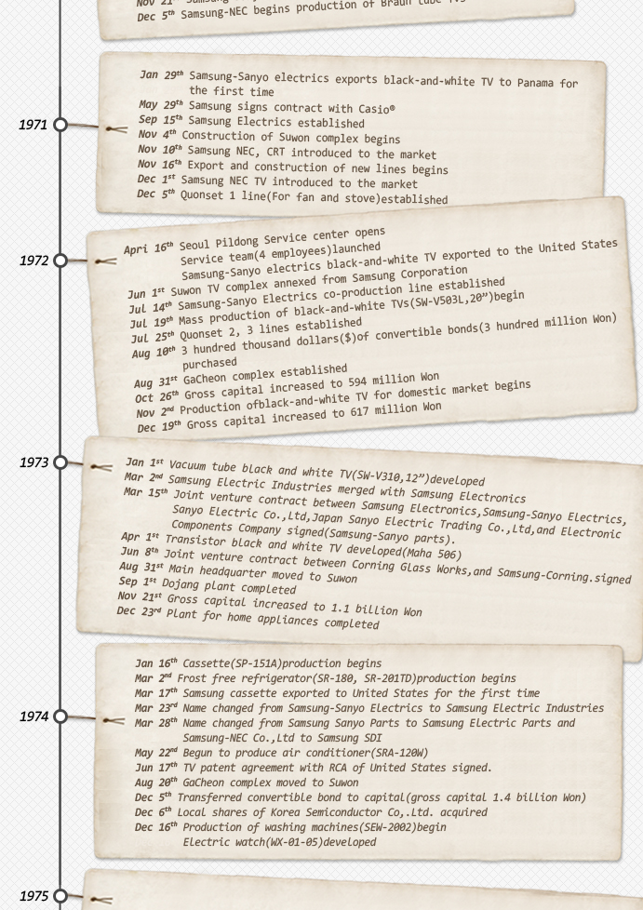
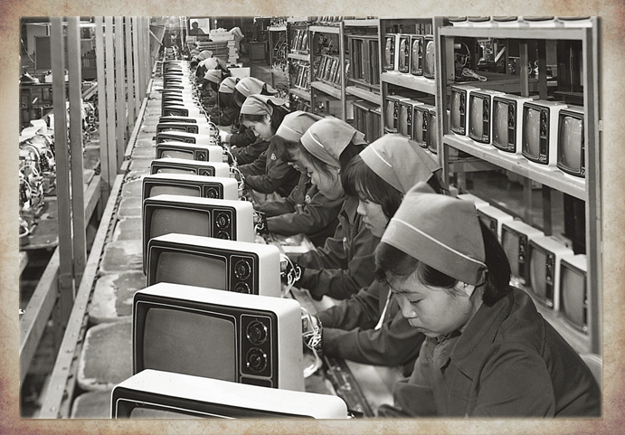
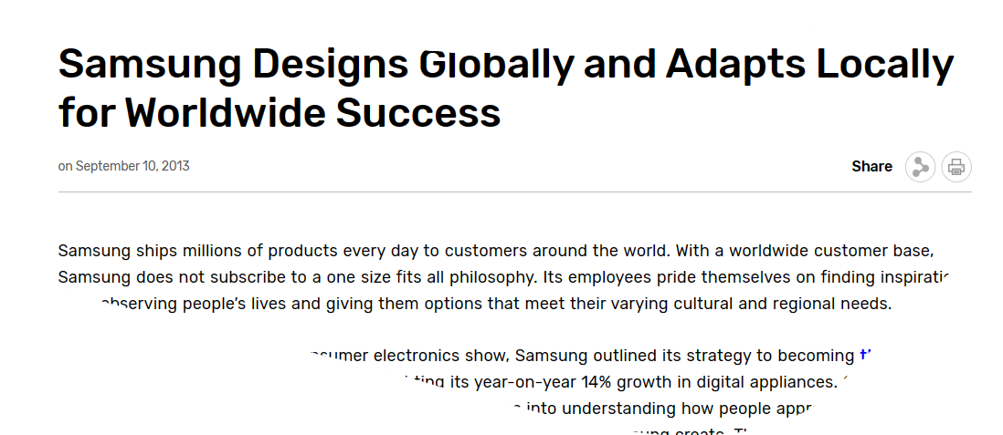

SAMSUNG Group: A Multinational Corporation
One way to understand globalisation is to understand the concept of multinational corporations.
Let’s start with SAMSUNG: it was founded by Lee Byung-Chul in 1938 as a trading company.
Until the 1970s, the group diversified into areas including
food processing, textiles, insurance, securities, and retail.
By the 1990s, the company entered the electronics industry among
Other industries such as construction, finance, etc.
By the end of the 2000s, the company had established its headquarters
in many countries. Its market cap is around $366 trillion in 2023 (July).

Slide 4
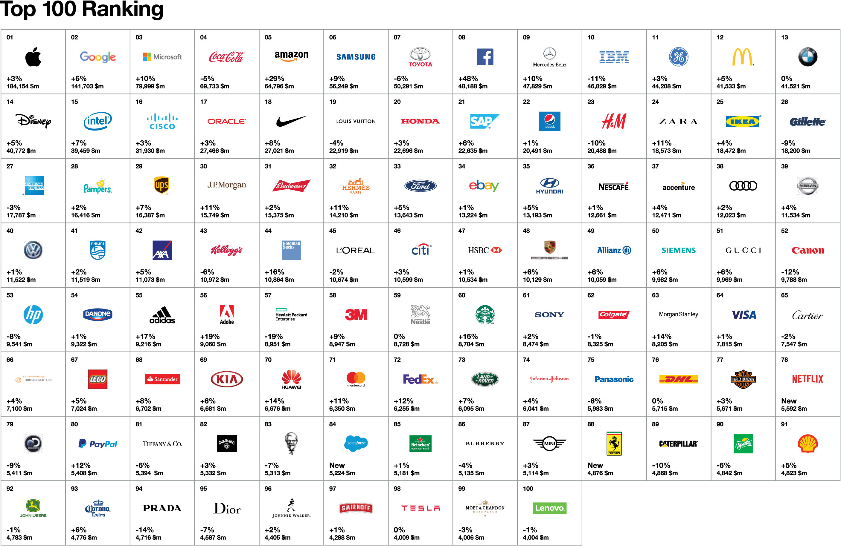
International Business
How many companies like Samsung are in the international business?
International Business: Refers to the commercial transaction that crosses the borders of two or more nations. Key players are:
Large companies from the wealthiest nations (Amazon, Apple, Intel, …)
Firms from emerging markets (Huawei, Aramco, …)
Small and medium-sized companies (Splunk Inc, SAP AG)
Multinational corporations (MNCs) (Coca-Cola, TOTAL, Samsung) Some MNCs have more employees than small nations have citizens (e.g., Walmart has 2.2 million employees globally).
Born global firm (BP, Shell) adopts a global perspective and engages in international business from or near its inception.

Slide 5
From International Business to Globalisation
The transformation from international business to globalisation:
Difference: While international business refers to the commercial transaction that crosses the borders of two or more nations, globalisation refers to a multifaceted and ongoing process of deepening interconnection and integration on a global scale.
The concept of globalisation encompasses the increasing flow of goods, services, capital, technology, ideas, and cultural influences across national boundaries, impacting economies, societies, institutions and individuals worldwide.
Globalisation also increases and intensifies the job and investment opportunities for people and businesses, and at the same time, demands new rules and governance to facilitate the diverse interconnection between different agents.

Slide 6
From International Business to Globalisation
The transformation from international business to globalisation can be understood as a progression in the scale, scope, and interconnectedness of economic activities and interactions between countries. While both concepts involve cross-border economic activities, they differ in their depth and impact on a global scale. Here's how this transformation occurred:
Early International Business: In the earlier stages of modern history, international business involved simple trade relationships between nations, typically centred around the exchange of goods and services. Merchants and traders engaged in cross-border transactions to access resources not available domestically or to sell their products in foreign markets. This kind of international trade was relatively limited in scope and scale.
Industrial Revolution and Technological Advancements: The Industrial Revolution, starting in the late 18th century, brought significant advancements in technology, transportation, and communication. Steamships, railways, and telegraphs facilitated faster and more efficient movement of goods, capital, and information across borders. This enabled businesses to expand their reach and operations beyond their home countries, establishing larger international networks.

Slide 7
From International Business to Globalisation
Rise of Multinational Corporations: By the late 19th and early 20th centuries, industrialisation and the growth of global transportation systems led to the emergence of multinational corporations (MNCs). These large enterprises had production, distribution, and marketing operations in multiple countries, allowing them to take advantage of resources, labour, and markets worldwide. This marked a significant shift from traditional international business, as MNCs became increasingly integrated into the global economy.
Trade Liberalisation and Economic Blocs: After World War II, there was a growing recognition of the benefits of international economic cooperation. Countries began to lower trade barriers and enter into agreements to facilitate trade and investment. Regional economic blocs like the European Union and NAFTA (North American Free Trade Agreement) were established to foster economic integration among member nations. These developments further promoted economic interdependence and globalisation.

Slide 8
From International Business to Globalisation
Advancements in Information Technology and Communication: The latter part of the 20th century saw a rapid advancement in information technology and the widespread adoption of the internet. This revolutionised communication, making it easier and cheaper for businesses to connect and collaborate across borders. The digital age contributed to the acceleration of global transactions, information flow, and the rise of e-commerce.
Global Supply Chains and Outsourcing: Globalisation facilitated the development of complicated global supply chains. Companies began to source components and services from various countries to optimise efficiency and reduce costs. This process of outsourcing and offshoring allowed businesses to access specialised skills and resources from different parts of the world.
Cultural Globalisation: As globalisation expanded, cultural exchange and interconnectedness also intensified. The spread of media, entertainment, and communication technologies allowed for the dissemination of cultural products and ideas on a global scale. This cultural interconnectedness complemented and reinforced economic globalisation.

Slide 9
Globalisation (1 of 4)
After all these introductions, what is Globalisation (or Globalization)?
Globalisation: Trend toward greater economic, cultural, political, and technological interdependence among international institutions and economies.
Globalisation is characterised by denationalisation (national boundaries becoming less relevant)
Globalisation is different from internationalisation (entities cooperating across national boundaries but globalisation is beyond cooperation. It is more about interdependence)
Globalisation
Market Globalisation: the convergence in buyer preferences in markets around the world
Production Globalisation: the dispersal of production activities to locations that help a company achieve its cost-minimisation or profit-maximisation objectives for a good or service. This includes the sourcing of key production inputs (such as raw materials or products for assembly) as well as the international outsourcing of services.

Slide 10
Globalisation of Markets
Globalization of Markets:
Benefits of Globalisation of Markets
Reduces marketing costs: By standardising certain marketing activities (McDonald’s, HP advertisements)
Creates new market opportunities (more foreign demand, selling palm oil worldwide)
Levels uneven income streams (products can be sold permanently instead of seasonally, watermelon or banana in the middle of winter/ selling heating system in summer)
Considers the local buyers’ needs (Making sure that the products are based on the taste of the local buyers, veggie Big-Mac or Maharaja Mac in India)
Considers global sustainability (Increase in transparency, due to the extensive use of social media by people, push firms to think about the sustainability of their products. If the production of a company causes harm to the environment, there will be a global awareness about that that might change the policy of the firm, using decomposable materials instead of plastic)

Slide 11
Globalisation of Markets
Globalization of Production:
Benefits of Globalisation of Production
Access to lower-cost workers (Lower-cost labour, Boing pieces)
Access to technical expertise (Getting knowledge from those who know how things are going to be done, Cocoa beans production in South America, Boing pieces)
Access to production inputs (lower cost of materials, petrochemical products in the Middle East)

Slide 12
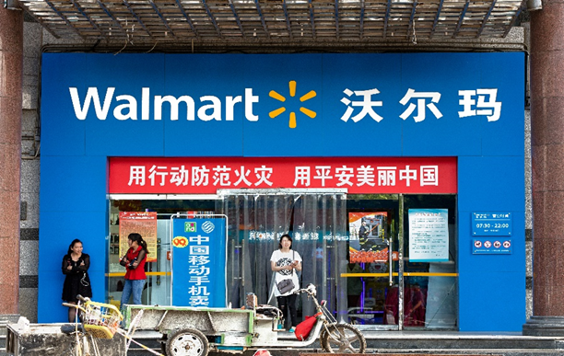
International Trade
Fact: The expansion of international trade is an inseparable part of globalisation.
Benefits of International Trade:
Greater choice of goods and services
Important engine for job creation in many countries (The U.S. Department of Commerce (www.commerce.gov) calculates that for every $1 billion increase in exports, 22,800 jobs are created in the US)
In 1991, Walmart first became an international company.
Ambitious global expansion:
Walmart has around 5,300 stores in the United States and
more than 6,200 stores in 27 other countries.
Nearly $486 billion in sales globally.
Walmart is one of the world’s largest companies.
Walmart sources inexpensive merchandise from low-cost production
locations such as China.
Helping boost international trade.

Slide 13
For and Against Globalisation
For Globalisation
Increases wealth and efficiency in all nations
Generates labour & capital market flexibility in developed nations
Advances the economies & technology of developing nations
Allows poor countries to profit from their differing circumstances and skills
It creates some institutions in developing economies that promote same values/same rules
It creates tax income for the governments in poor countries

Slide 14
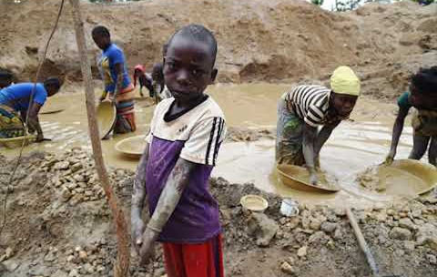
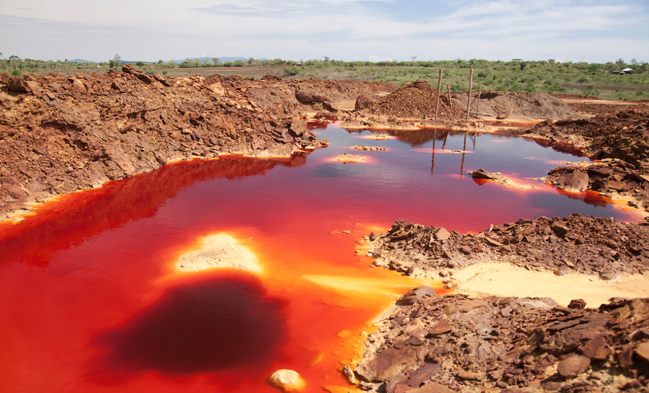
For and Against Globalisation
Against Globalisation
Eliminates jobs in developed nations
Lowers wages in developed nations
Exploits workers in developing nations
Creates a wage gap between white-collar and blue-collar occupations in developed nations
Homogenises our world and destroys our rich diversity of cultures
Empowers supranational institutions at the expense of national governments
It increases the environmental damage/pollution in countries without strong protection laws or strong monitoring institutions
Child labour ‘is helping to power our mobile phones’
South Africa has failed to protect locals from gold mine pollution

Slide 15
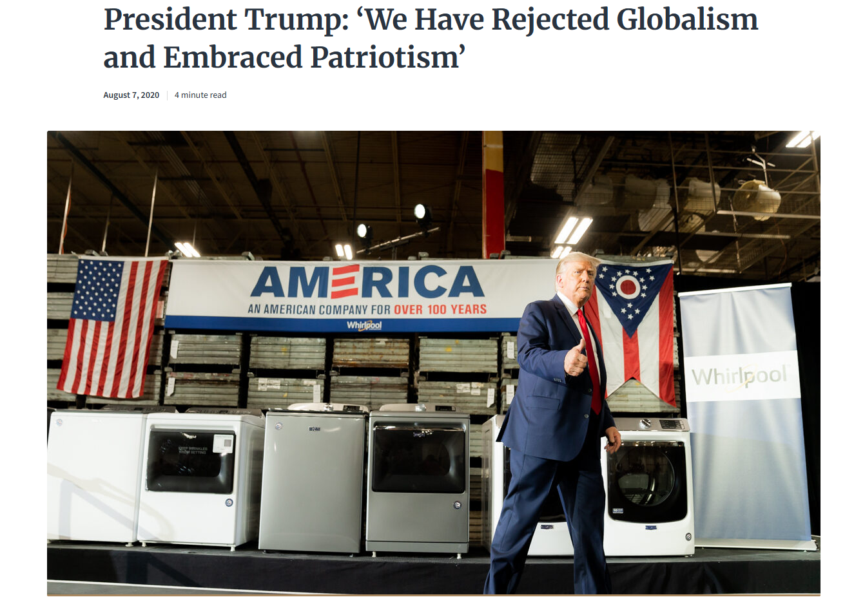
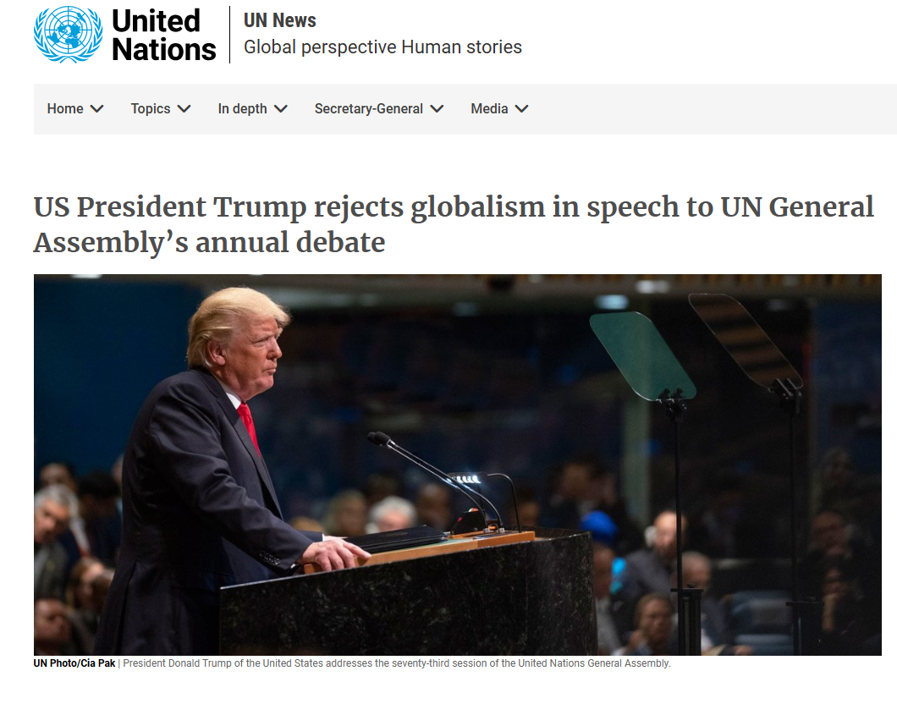
International Trade & Globalisation: The Essence of Capitalism
Is It Possible To Stop The Process Of Globalisation? (Deglobalisation)
Answer this question for the anti-globalist politicians!!
The short answer is NO. The process of globalisation is an integral part of capitalism.
To chase profit and survive in a constantly increasing competition:
1- All big companies should expand their markets beyond their national territories.
2- They should continuously change their strategy in order to reduce their costs and increase their income. Investing in other countries is part of this strategy.
3- They must invest massively in new technologies (in some cases without getting any help from governments or national banks), but sometimes they can benefit in terms of tax and subsidies when they move to other countries.
https://trumpwhitehouse.archives.gov/articles/president-trump-we-have-rejected-globalism-and-embraced-patriotism/

Slide 16
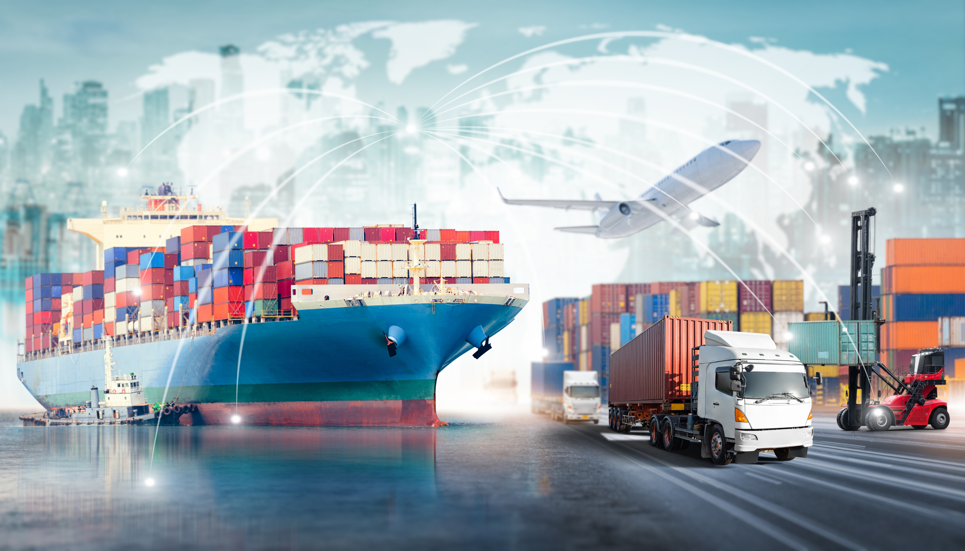
Some Theories on International Trade

Slide 17
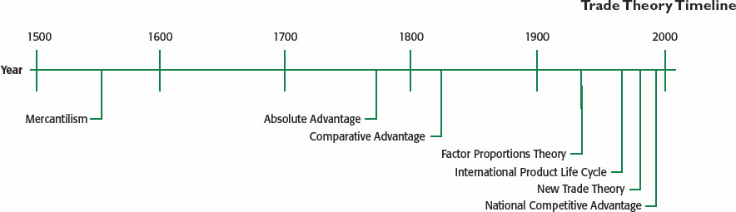
Timeline of Trade Theories
Trade between different groups of people has existed for many thousands of years. But it was not until the 15th century that scholars tried to conceive this concept in the form of a theory.
The following figure shows a timeline of when the main theories of international trade were proposed.

Slide 18
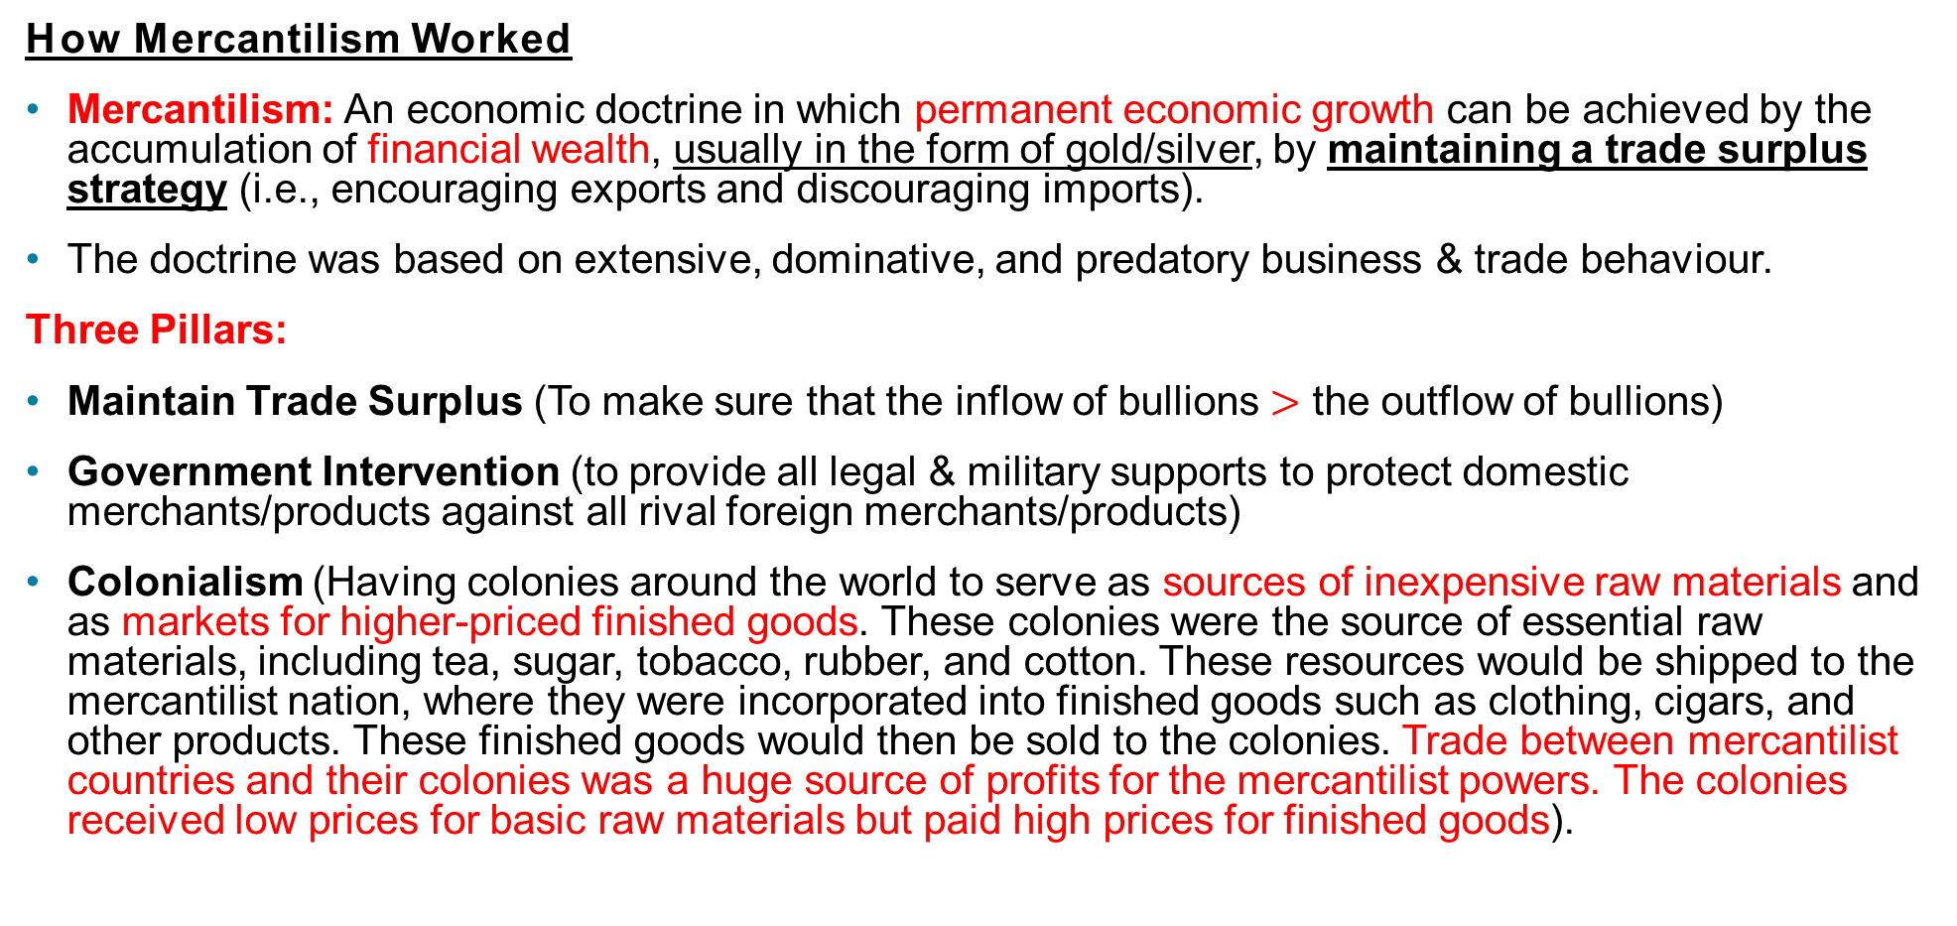
Mercantilism As An Extreme Trade Theory
How Mercantilism Worked
Mercantilism: An economic doctrine in which permanent economic growth can be achieved by the accumulation of financial wealth, usually in the form of gold/silver, by maintaining a trade surplus strategy (i.e., encouraging exports and discouraging imports).
The doctrine was based on extensive, dominative, and predatory business & trade behaviour.
Three Pillars:
Maintain Trade Surplus (To make sure that the inflow of bullions $>$ the outflow of bullions)
Government Intervention (to provide all legal & military supports to protect domestic merchants/products against all rival foreign merchants/products)
Colonialism (Having colonies around the world to serve as sources of inexpensive raw materials and as markets for higher-priced finished goods. These colonies were the source of essential raw materials, including tea, sugar, tobacco, rubber, and cotton. These resources would be shipped to the mercantilist nation, where they were incorporated into finished goods such as clothing, cigars, and other products. These finished goods would then be sold to the colonies. Trade between mercantilist countries and their colonies was a huge source of profits for the mercantilist powers. The colonies received low prices for basic raw materials but paid high prices for finished goods).

Slide 19
Mercantilism As An Extreme Trade Theory
Flaws of Mercantilism
World trade is a zero-sum game. A nation benefits from trade only at the expense of other nations. According to LaHaye (2008), “During the mercantilist period, military conflict between nation-states was both more frequent and more extensive than at any other time in history”.
Restricts international trade. If all nations do that there will be no trade. This is an intrinsic flaw.
Limits colonies’ market potential. Lack of effective demand from the colonies as they are not paid fairly for their resources.
Accumulation of precious metals was wrongly conceptualized as the accumulation of wealth.
(+)BT More gold & silver more inflation cheaper to import (-)BT Losing gold & silver

Slide 20
Theories of Absolute and Comparative Advantage
Adam Smith helped to instigate the concept of absolute advantage and then Ricardo explained how countries can benefit from trading even if one of them has an absolute advantage in producing everything with countries that have a comparative advantage:
Absolute advantage: When an entity (business or country) can produce a good/goods more efficiently using one unit of resources (here: labour)
Comparative advantage: When an entity (business or country) is less efficient in the production of all goods, but it is less inefficient in the production of one good.

Slide 21
Theories of Absolute and Comparative Advantage
Smith’s argument: Countries should specialise in the goods they can produce most efficiently and trade for those goods they can't produce as well. If England can produce more good quality textiles per labour and Spain can produce more good quality wine per labour, so, both countries will be benefited from the trade of goods that they have an absolute advantage in their production.
Ricardo’s argument: Even without having an absolute advantage in the production of any good, free trade would be beneficial to both nations with or without absolute advantage.
According to both absolute and comparative advantage theories, there is no need to start a war to get a surplus in trade. All countries can be benefited if they choose trade instead of war.

Slide 22
Theories of Absolute and Comparative Advantage
Assumptions and Limitations: These theories are based on some assumptions that may not be applicable in the real world.
All entities/countries are driven only by the maximisation of production and hence, consumption. There are many other goals/industrial policies followed by the public sector (government) in supporting some specific productions/sectors either to boost economic activities or the maintain the economic, financial, and technological security of the economy.
The theories assume there are only two countries with two goods, but in reality, we have many countries that produce many goods partially and globally.
Other costs in trade, such as transport, insurance, etc. are not considered in these theories.
The theories are based on labour as the only source of production which is not transferable between nations. Technology and capital and even labour are transferable, and the advantages of countries are changing over time.
These theories assume that “specialisation in the production of one particular good does not result in gains in efficiency”, but we need fewer resources by specialising in the field of production.

Slide 23
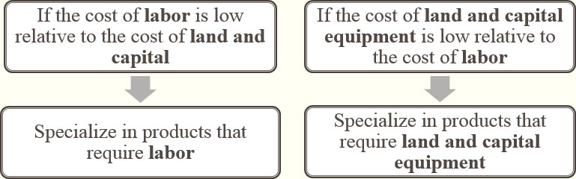
Factor Proportions Theory of Trade
Factor Proportions Theory: resulted from the research of two economists, Eli Heckscher and Bertil Ohlin, and is therefore sometimes called the Heckscher–Ohlin theory.
According to this theory, countries produce and export goods that require resources (factors) that are abundant and import goods that require resources in short supply.
While in this theory the focus is on the factors of production in comparative advantage theory the emphasis is on productivity using resources.
taken from the book “International Business: The Challenges of Globalization”, Ninth Edition, Global Edition, by John Wild and Kenneth Wild, 2019 Pearson Education Ltd

Slide 24
Factor Proportions Theory of Trade
The Leontief Paradox
The Apparent Paradox
Leontief found evidence opposite of that predicted by the factor proportions theory.
U.S. exports are more labour-intensive than U.S. imports, while the US is the most capital-abundant country.
Leontief’s findings are supported by more recent research.
What might account for the paradox?
Factor proportions theory assumes a nation’s production factors to be homogeneous (particularly labour).
Factor proportions theory seems to be supported when expenditures on labour are considered.
Note: Here we are not going to talk about other theories. Those who are interested can see Chapter 5 of the book “International Business: The Challenges of Globalization”, Ninth Edition, Global Edition, by John Wild and Kenneth Wild, 2019 Pearson Education Ltd.

Slide 25
Valuing Foreign Projects

Slide 26
International Trade for Corporations
Big corporations do not just target the national markets. In order to survive in intense competition, they should permanently grow, constantly reduce risk and continuously search for new markets to get benefited from these new markets, either through selling goods and services or through finding cheaper labour, cheaper or subsidised capital, cheaper access to raw materials, etc. So, simply, they need to produce and invest in foreign countries.
Integrated capital markets with free capital movement through different currencies are the necessary parts of this goal. Globalisation facilitates this integration and free capital movement.
Questions: Now, two questions:
What methods can be applied to value foreign currency cash flows?
How investment projects should be evaluated (in terms of domestic/foreign currency, tax system, inflation and interest rate) and what currencies should be used when inputs and outputs are valued at different currencies?
Before answering these questions, we need to know how to deal with the risk of exchange rate fluctuations.

Slide 27
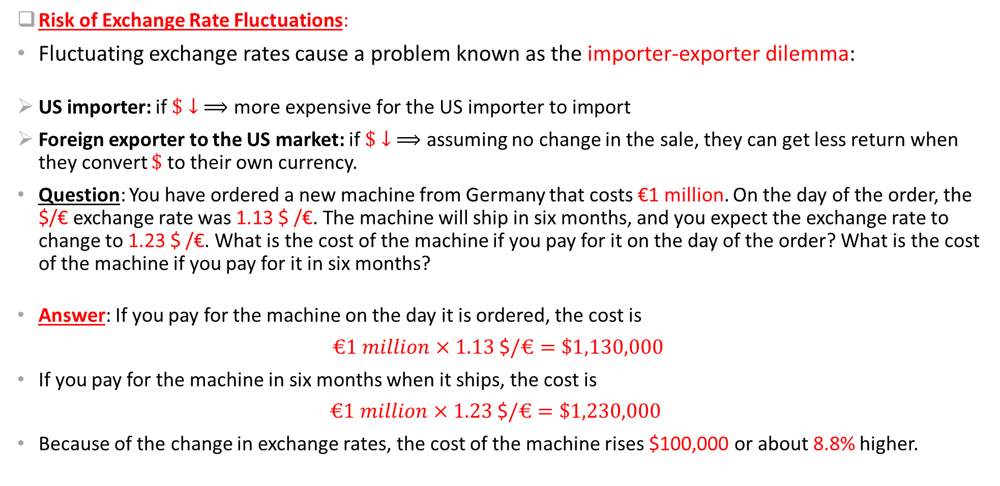
Exchange Rate Risk
Risk of Exchange Rate Fluctuations:
Fluctuating exchange rates cause a problem known as the importer-exporter dilemma:
US importer: if $\$↓ ⟹\text{more} \text{expensive} \text{for} \text{the} \text{US} \text{importer} \text{to} \text{import}$
Foreign exporter to the US market: if $\$↓ ⟹$ assuming no change in the sale, they can get less return when they convert $\$$ to their own currency.
Question: You have ordered a new machine from Germany that costs €1 million. On the day of the order, the $/€ exchange rate was 1.13 $ /€. The machine will ship in six months, and you expect the exchange rate to change to 1.23 $ /€. What is the cost of the machine if you pay for it on the day of the order? What is the cost of the machine if you pay for it in six months?
Answer: If you pay for the machine on the day it is ordered, the cost is
$$€1 million×1.13 \text{\$}/€=\$1,130,000$$
If you pay for the machine in six months when it ships, the cost is
$$€1 million×1.23 \text{\$}/€=\$1,230,000$$
Because of the change in exchange rates, the cost of the machine rises $100,000 or about 8.8% higher.

Slide 28
Hedging with Forward Contracts
First way to reduce risk: One way to reduce the risk of exchange rate fluctuations is to have an exchange rate forward contract:
What is a forward contract?
Forward Contract: An agreement to trade an asset on some future date, at a price that is locked in today.
Futures contracts (contrary to long-term contracts) are traded anonymously on an exchange at a publicly observed market price and are generally very liquid. Both the buyer and the seller can get out of the contract at any time by selling it to a third party at the current market price. These contracts are designed to reduce risk.
Forward Exchange Rate:
A currency forward contract is a contract that sets the exchange rate in advance. By entering into a currency forward contract, a firm can lock in an exchange rate in advance and reduce or eliminate its exposure to fluctuations in a currency’s value. The exchange rate set in the contract is referred to as the forward exchange rate.
A currency forward contract specifies:
An exchange rate
An amount of currency to exchange
A delivery date on which the exchange will take place

Slide 29
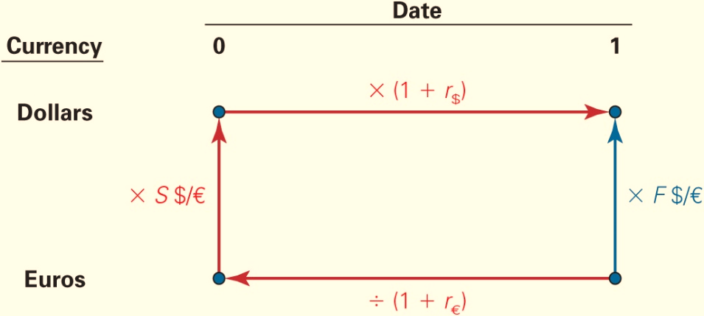
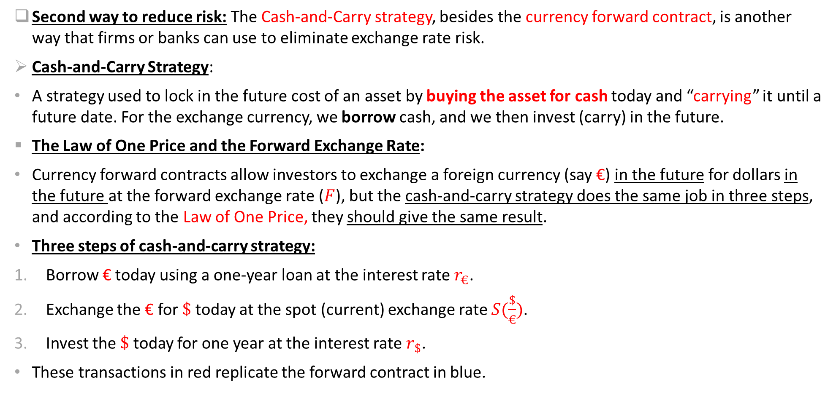


Cash-and-Carry and the Pricing of Currency Forwards
Second way to reduce risk: The Cash-and-Carry strategy, besides the currency forward contract, is another way that firms or banks can use to eliminate exchange rate risk.
Cash-and-Carry Strategy:
A strategy used to lock in the future cost of an asset by buying the asset for cash today and “carrying” it until a future date. For the exchange currency, we borrow cash, and we then invest (carry) in the future.
The Law of One Price and the Forward Exchange Rate:
Currency forward contracts allow investors to exchange a foreign currency (say €) in the future for dollars in the future at the forward exchange rate ($F$), but the cash-and-carry strategy does the same job in three steps, and according to the Law of One Price, they should give the same result.
Three steps of cash-and-carry strategy:
Borrow € today using a one-year loan at the interest rate $r_{€}$.
Exchange the € for $\$$ today at the spot (current) exchange rate $S(\frac{\$}{€})$.
Invest the $\$$ today for one year at the interest rate $r_{\$}$.
These transactions in red replicate the forward contract in blue.
Invest the $\$$
Change it into $\$$
Borrow in €
In the forward contract, every part of the transaction happens in future, apart from the price which is fixed in advance

Slide 30
Valuing Foreign Projects
Let’s return to the topic of evaluation of investment projects in foreign countries:
We learned how to hedge our business against the risk of exchange rate fluctuations. Now, it is time to think about the complexities of investment in foreign countries with different currencies.
We can think of investment in either the production sector or the financial sector. The rules are the same. For simplicity, we go through a scenario in which you have a one-year investment in the foreign financial sector.
For example, we buy a financial asset in a foreign financial market. We introduce a basic benchmark model in the next slide. The assumptions:
There is free capital movement.
All financial assets with the same return and same risk are perfect substitutes and for that reason, we have no preference between them.

Slide 31
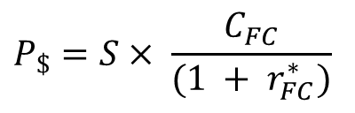
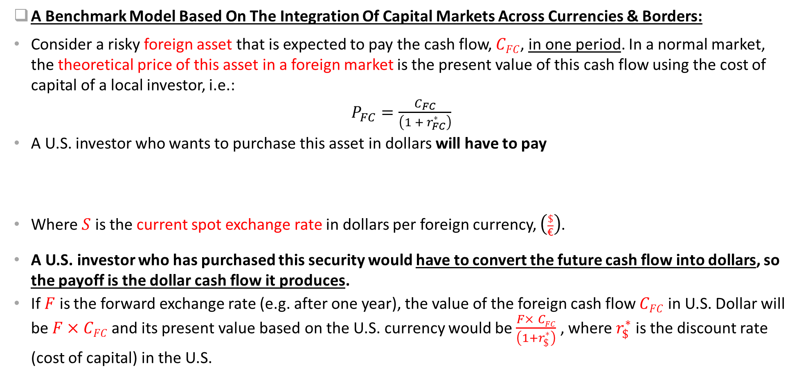

Valuing Foreign Projects
A Benchmark Model Based On The Integration Of Capital Markets Across Currencies & Borders:
Consider a risky foreign asset that is expected to pay the cash flow, $CFC$, in one period. In a normal market, the theoretical price of this asset in a foreign market is the present value of this cash flow using the cost of capital of a local investor, i.e.:
$P_{FC}=\frac{C_{FC}}{\left(1 +{ r}_{FC}^{∗}\right)}$
A U.S. investor who wants to purchase this asset in dollars will have to pay
Where $S$ is the current spot exchange rate in dollars per foreign currency, $\left(\frac{\$}{\text{€}}\right)$.
A U.S. investor who has purchased this security would have to convert the future cash flow into dollars, so the payoff is the dollar cash flow it produces.
If $F$ is the forward exchange rate (e.g. after one year), the value of the foreign cash flow $CFC$ in U.S. Dollar will be $F×$ $CFC$ and its present value based on the U.S. currency would be $\frac{F× CFC}{\left(1+r_{\$}^{∗}\right)}$ , where $r_{\$}^{∗}$ is the discount rate (cost of capital) in the U.S.
Price of the security in foreign currency
$FC$ = foreign currency e.g. Euro (€)
Price of the security in domestic currency
$$P_{\$}=S× \frac{C_{FC}}{(\text{1 }+ r_{FC}^{∗})}$$

Slide 32

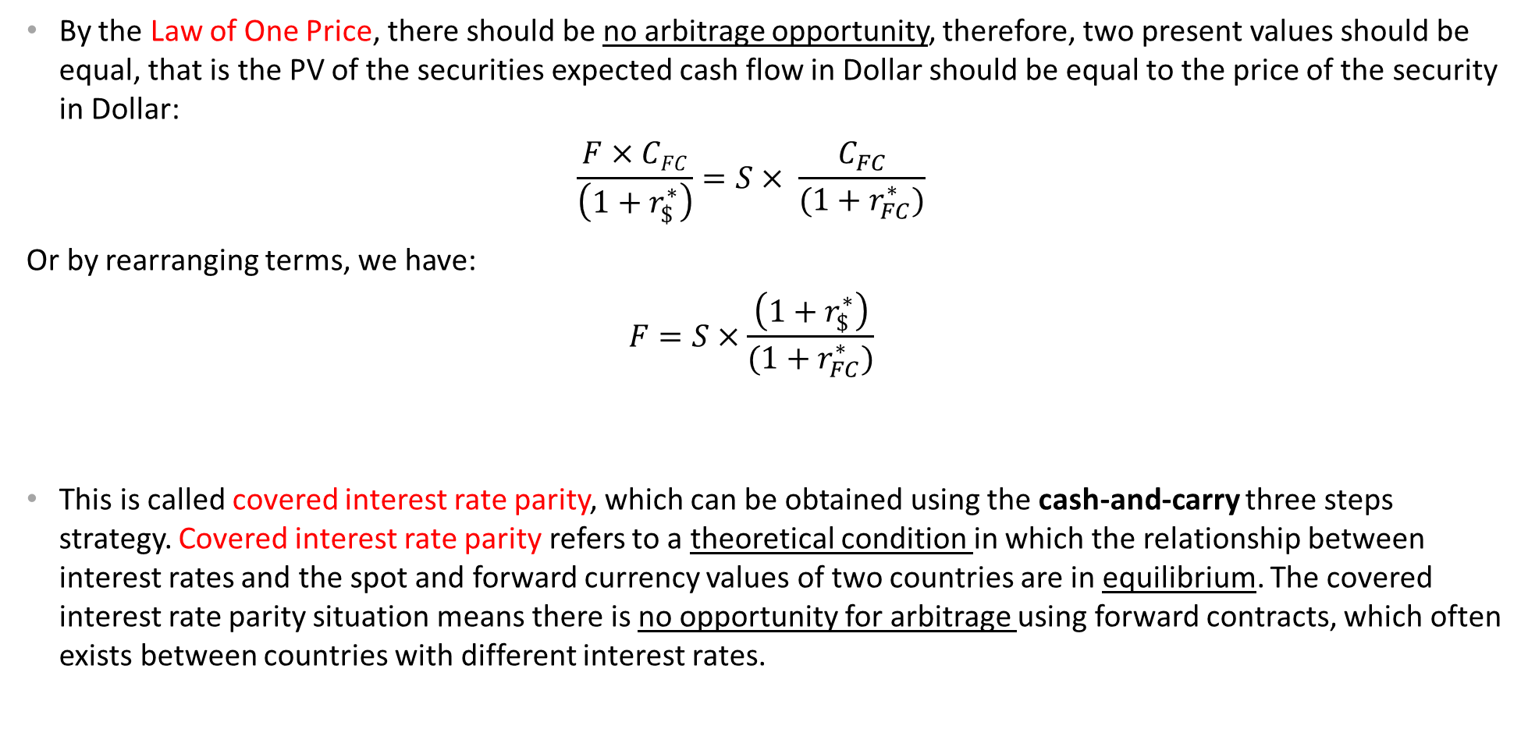


Valuing Foreign Projects & Covered Interest Rate Parity
By the Law of One Price, there should be no arbitrage opportunity, therefore, two present values should be equal, that is the PV of the securities expected cash flow in Dollar should be equal to the price of the security in Dollar:
$$\frac{F×CFC}{\left(1+r_{\$}^{∗}\right)}=S× \frac{C_{FC}}{(\text{1}+r_{FC}^{∗})}$$
Or by rearranging terms, we have:
$$F=S×\frac{\left(1+r_{\$}^{∗}\right)}{(\text{1}+r_{FC}^{∗})}$$
This is called covered interest rate parity, which can be obtained using the cash-and-carry three steps strategy. Covered interest rate parity refers to a theoretical condition in which the relationship between interest rates and the spot and forward currency values of two countries are in equilibrium. The covered interest rate parity situation means there is no opportunity for arbitrage using forward contracts, which often exists between countries with different interest rates.
$$P_{\$}$$
$$\frac{\$ in one year}{FC in one year}$$
$$\frac{\$ today}{FC today}$$

Slide 33
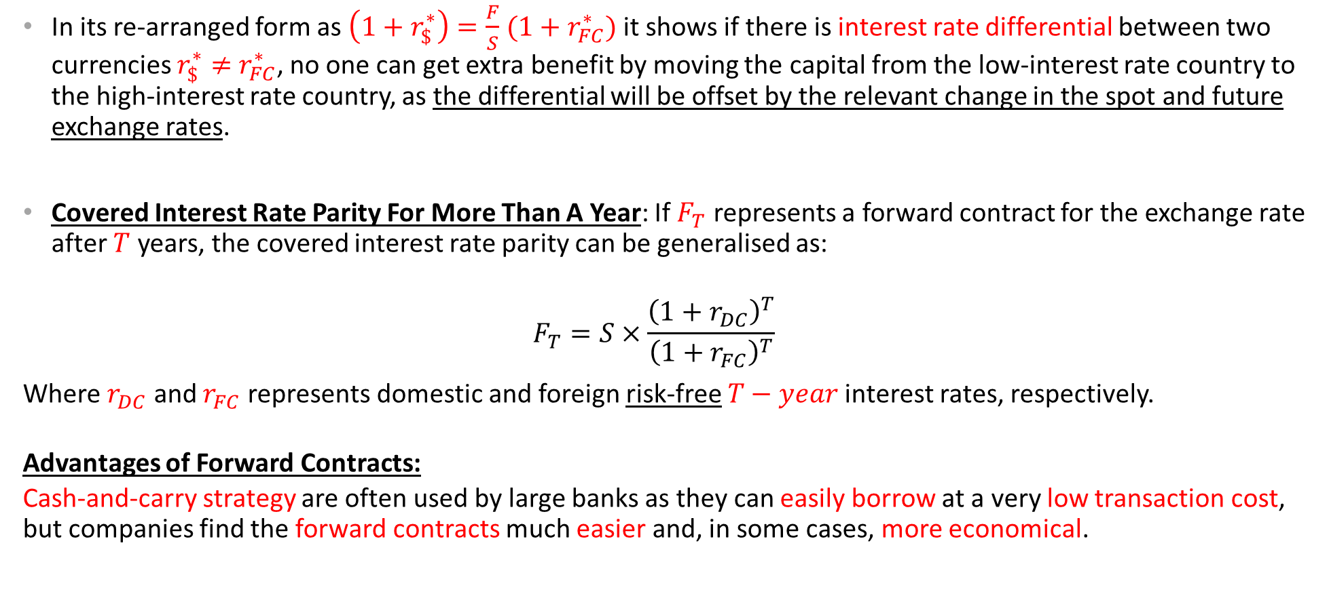
Covered Interest Rate Parity For More Than A Year
In its re-arranged form as $\left(1+r_{\$}^{∗}\right)=\frac{F}{S}$ $(\text{1}+r_{FC}^{∗})$ it shows if there is interest rate differential between two currencies $r_{\$}^{∗}≠$ $r_{FC}^{∗}$, no one can get extra benefit by moving the capital from the low-interest rate country to the high-interest rate country, as the differential will be offset by the relevant change in the spot and future exchange rates.
Covered Interest Rate Parity For More Than A Year: If $F_{T}$ represents a forward contract for the exchange rate after $T$ years, the covered interest rate parity can be generalised as:
$$F_{T}=S×\frac{{\left(1+r_{DC}\right)}^{T}}{{\left(1+r_{FC}\right)}^{T}}$$
Where $r_{DC}$ and $r_{FC}$ represents domestic and foreign risk-free $T−year$interest rates, respectively.
Advantages of Forward Contracts:
Cash-and-carry strategy are often used by large banks as they can easily borrow at a very low transaction cost, but companies find the forward contracts much easier and, in some cases, more economical.

Slide 34
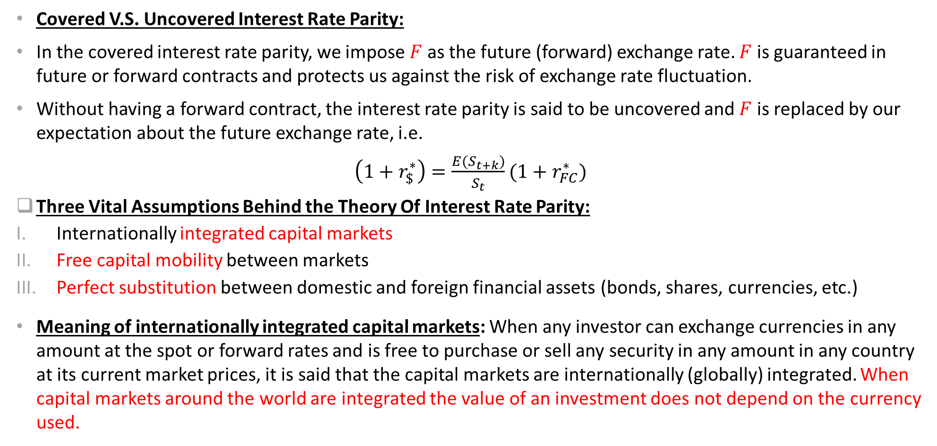
Uncovered Interest Rate Parity
Covered V.S. Uncovered Interest Rate Parity:
In the covered interest rate parity, we impose $F$ as the future (forward) exchange rate. $F$ is guaranteed in future or forward contracts and protects us against the risk of exchange rate fluctuation.
Without having a forward contract, the interest rate parity is said to be uncovered and $F$ is replaced by our expectation about the future exchange rate, i.e.
$\left(1+r_{\$}^{∗}\right)=\frac{E(S_{t+k})}{S_{t}}$ $(\text{1}+r_{FC}^{∗})$
Three Vital Assumptions Behind the Theory Of Interest Rate Parity:
Internationally integrated capital markets
Free capital mobility between markets
Perfect substitution between domestic and foreign financial assets (bonds, shares, currencies, etc.)
Meaning of internationally integrated capital markets: When any investor can exchange currencies in any amount at the spot or forward rates and is free to purchase or sell any security in any amount in any country at its current market prices, it is said that the capital markets are internationally (globally) integrated. When capital markets around the world are integrated the value of an investment does not depend on the currency used.
Expected exchange rate $k−$period ahead of current time

Slide 35
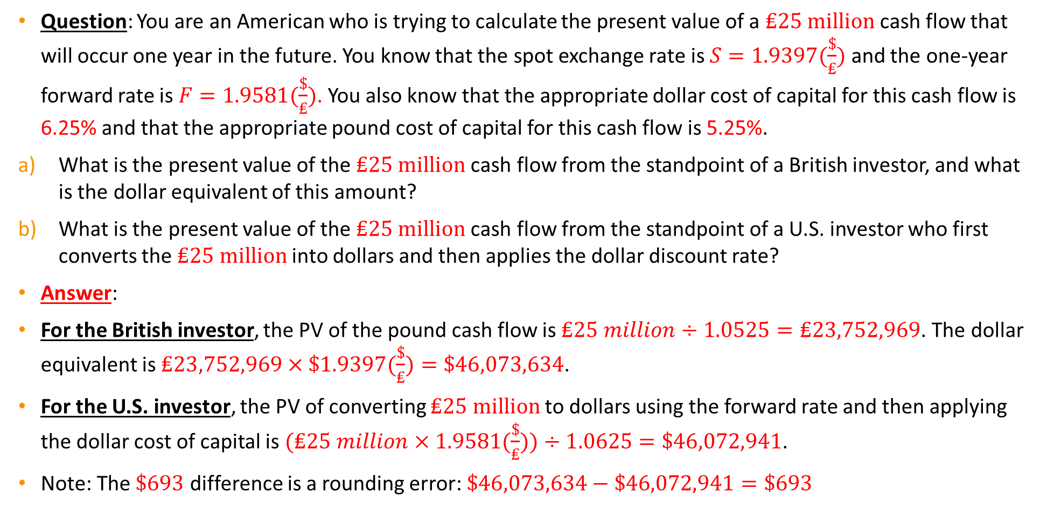
Example
Question: You are an American who is trying to calculate the present value of a $₤25 million$cash flow that will occur one year in the future. You know that the spot exchange rate is $S=1.9397(\frac{\$}{₤})$ and the one-year forward rate is $F=1.9581(\frac{\$}{₤})$. You also know that the appropriate dollar cost of capital for this cash flow is 6.25% and that the appropriate pound cost of capital for this cash flow is 5.25%.
What is the present value of the $₤25 million$cash flow from the standpoint of a British investor, and what is the dollar equivalent of this amount?
What is the present value of the $₤25 million$cash flow from the standpoint of a U.S. investor who first converts the $₤25 million$into dollars and then applies the dollar discount rate?
Answer:
For the British investor, the PV of the pound cash flow is $₤25 million÷1.0525=₤23,752,969$. The dollar equivalent is $₤23,752,969×\$1.9397(\frac{\$}{₤})=\$46,073,634$.
For the U.S. investor, the PV of converting $₤25 million$to dollars using the forward rate and then applying the dollar cost of capital is $(₤25 million×1.9581(\frac{\$}{₤}))÷1.0625=\$46,072,941$.
Note: The $\$693$ difference is a rounding error: $\$46,073,634−\$46,072,941=\$693$

Slide 36
PV of Cash Flow in Foreign Currency vs
Domestic Currency

Slide 37
Valuation of Foreign Currency Cash Flows & WACC Valuation
Valuation of Foreign Currency Cash Flows: In an internationally integrated capital market, two equivalent methods are available for calculating the NPV of a foreign project.
Calculate the NPV in the foreign country and convert it to the local currency at the spot rate.
Convert the cash flows of the foreign project into the local currency and then calculate the NPV of these cash flows.
We talk about the second method here. To do that, we need to know the rate of return at which the converted cash flow (into our domestic currency) must be discounted.
We need to answer the question about the rate of return again, but in a different context:
Question: What rate of return must be used to calculate the PV of an investment project when the cash flow is in another currency?
A quick answer: It depends on the capital structure of the company.

Slide 38
Capital Structure & WACC Valuation
Large corporations are typically the ones exploring investment opportunities abroad. They allocate capital across a range of assets, each with its own risk and return profile. Two key scenarios can be considered:
The corporation operates without any debt, which means the source of funds is from shareholders.
The corporation finances its projects using a mix of equity (from shareholders) and debt (from bondholders or lenders).
The cost of capital in the above scenarios is different; therefore, the PV of the investment project is different.
The terminology that helps us to understand this difference is WACC.
What is WACC? It is the abbreviation for the weighted average cost of capital. To understand WACC better, let’s talk about the cost of capital for a company with and without debt.

Slide 39
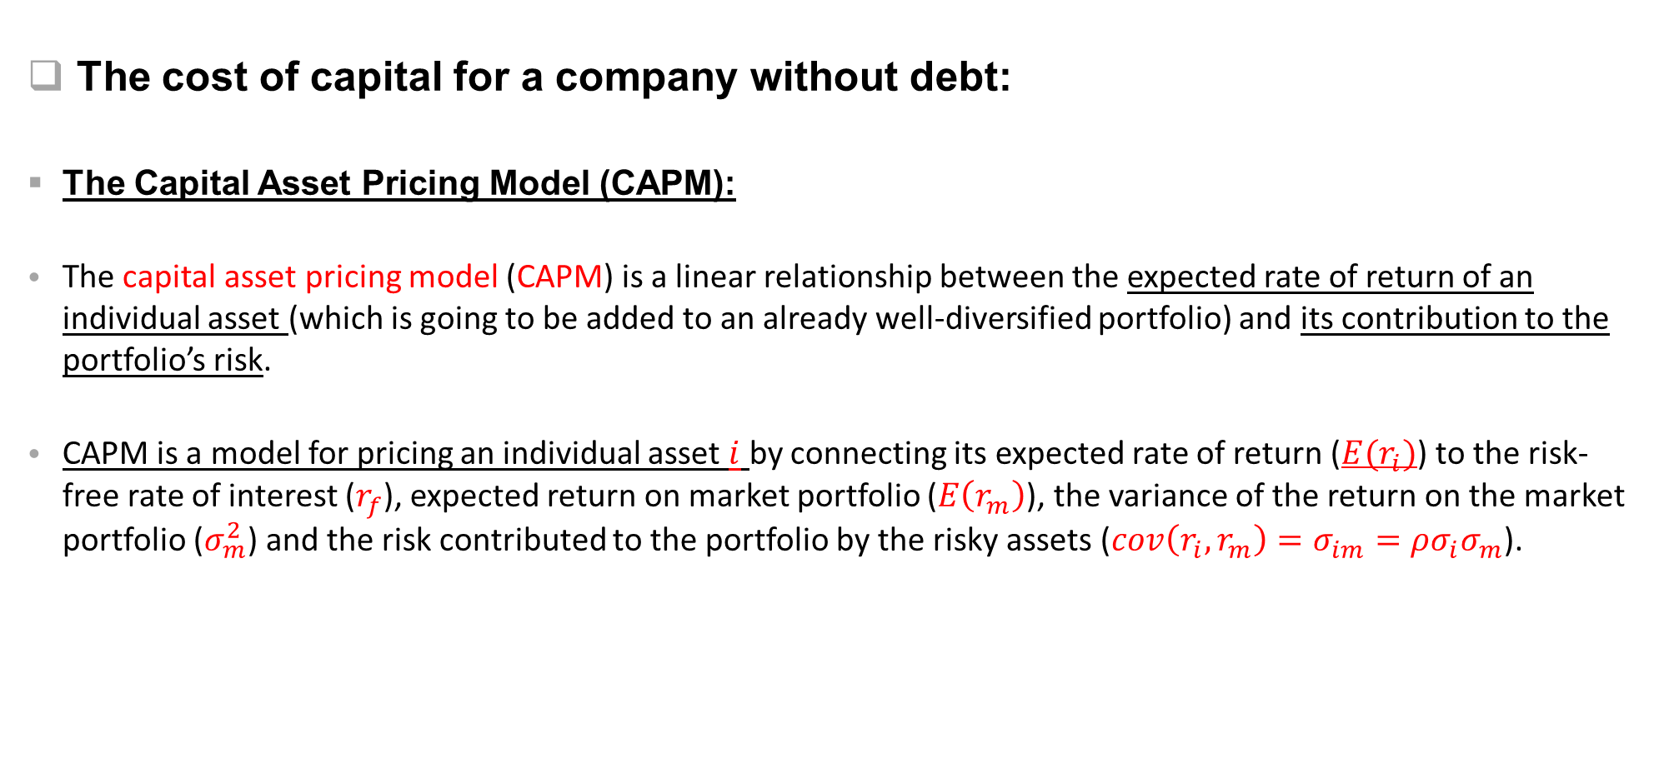
The Capital Asset Pricing Model (CAPM)
The cost of capital for a company without debt:
The Capital Asset Pricing Model (CAPM):
The capital asset pricing model (CAPM) is a linear relationship between the expected rate of return of an individual asset (which is going to be added to an already well-diversified portfolio) and its contribution to the portfolio’s risk.
CAPM is a model for pricing an individual asset $i$ by connecting its expected rate of return ($E(r_{i})$) to the risk-free rate of interest ($r_{f}$), expected return on market portfolio ($E\left(r_{m}\right)$), the variance of the return on the market portfolio ($σ_{m}^{2}$) and the risk contributed to the portfolio by the risky assets ($cov\left(r_{i},r_{m}\right)=σ_{im}=ρσ_{i}σ_{m}$).

Slide 40

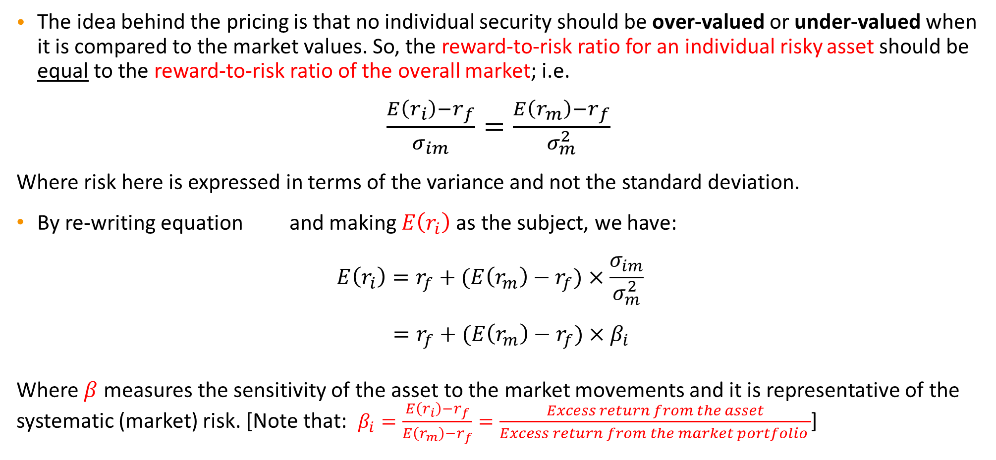


The Capital Asset Pricing Model (CAPM)
The idea behind the pricing is that no individual security should be over-valued or under-valued when it is compared to the market values. So, the reward-to-risk ratio for an individual risky asset should be equal to the reward-to-risk ratio of the overall market; i.e.
$\frac{E\left(r_{i}\right)−r_{f}}{σ_{im}}=\frac{E\left(r_{m}\right)−r_{f}}{σ_{m}^{2}}$
Where risk here is expressed in terms of the variance and not the standard deviation.
By re-writing equation and making $E\left(r_{i}\right)$ as the subject, we have:
$$E\left(r_{i}\right)=r_{f}+(E\left(r_{m}\right)−r_{f})×\frac{σ_{im}}{σ_{m}^{2}}$$
$=r_{f}+(E\left(r_{m}\right)−r_{f})×β_{i}$
Where $β$ measures the sensitivity of the asset to the market movements and it is representative of the systematic (market) risk. [Note that: $β_{i}=\frac{E\left(r_{i}\right)−r_{f}}{E\left(r_{m}\right)−r_{f}}=\frac{Excess return from the asset}{Excess return from the market portfolio }$]
Q
Q
$$σ_{}{}_{}$$
$$σ_{i}σ_{m}ρ$$
Risk premium for security $i$
Which is also equal to $E\left(r_{i}\right)−r_{f}$

Slide 41
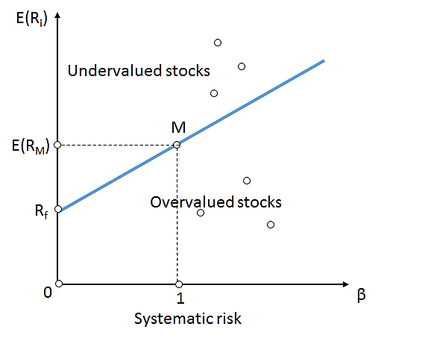




Security Market Line (SML)
The re-written form of the equation is called Security Market Line (SML), which shows the relation between the expected return of an asset and its systematic risk $β_{i}$. The SML is the graphical depiction of the capital asset pricing model (CAPM). The SML states that an individual asset’s excess return ($E\left(r_{i}\right)−r_{f}$) should be equal to the market excess return ($E\left(r_{m}\right)−r_{f}$) times the systematic risk $β_{i} \text{. }\text{I}$t is a useful tool in determining whether an individual asset offers a rationally expected return for the risk contributed to the whole portfolio.
The SML shows the expected return for each security positively related to its beta. According to the CAPM, the market portfolio (point $M$) is efficient, so all stocks and portfolios should lie on the SML. If, at any given $β$, they don’t lie on the SML, they are either over-valued or under-valued.
Q
market portfolio
Securities with 𝜷>𝟏 amplify the overall movements of the market. They lie on the SML but after point $M$. Their expected returns are bigger than the expected return on the market.
Securities with 0<𝜷<𝟏 they move in the same direction as the market but slower than the market. They lie on the SML but before point $M$. Their expected returns are lesser than the expected return on the market.
Finally securities with 𝜷=𝟏 or close to that represent the market portfolio $M$. Their expected returns is similar to the expected return on the market.
SML: $E\left(r_{i}\right)=r_{f}+\left(E\left(r_{m}\right)−r_{f}\right).β_{i}$
$$β_{M}=1$$
0.5
2
Adopted from http://en.wikipedia.org/wiki/File:SML-chart.png

Slide 42

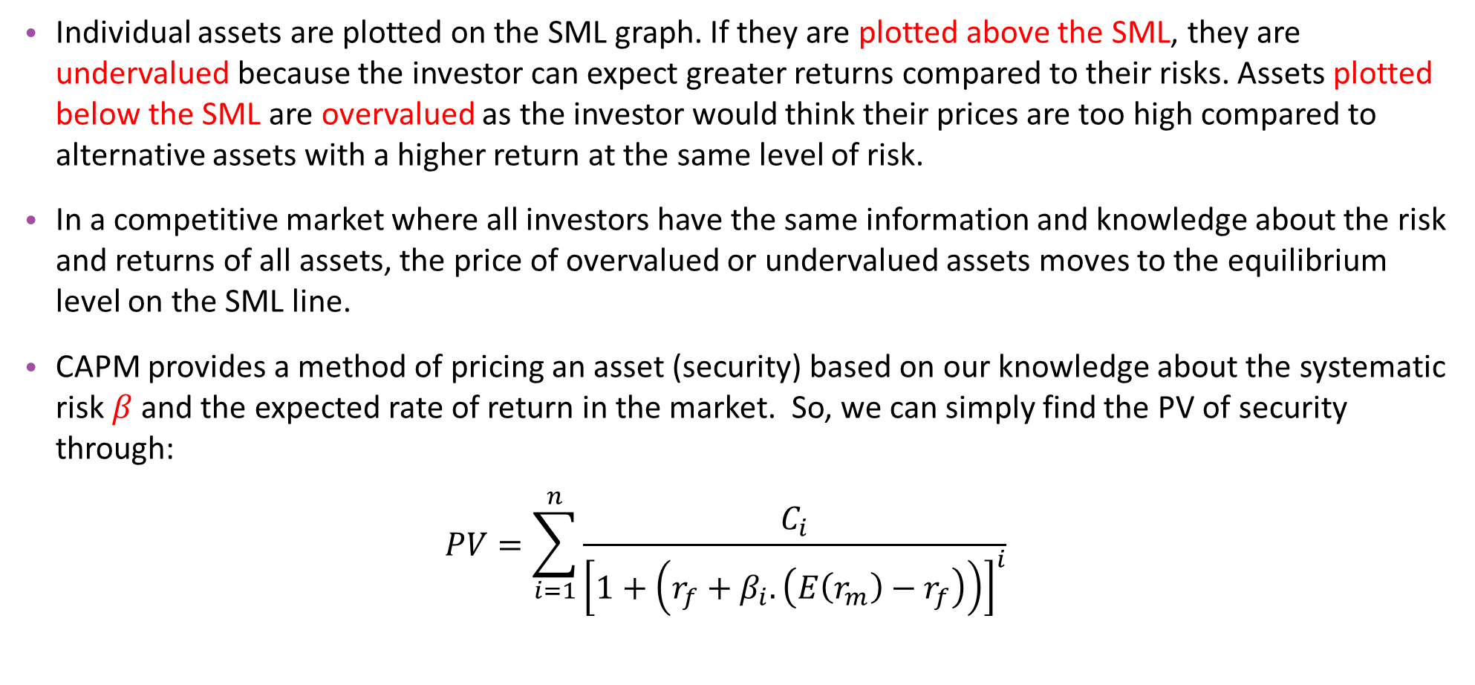
Security Market Line (SML)
Individual assets are plotted on the SML graph. If they are plotted above the SML, they are undervalued because the investor can expect greater returns compared to their risks. Assets plotted below the SML are overvalued as the investor would think their prices are too high compared to alternative assets with a higher return at the same level of risk.
In a competitive market where all investors have the same information and knowledge about the risk and returns of all assets, the price of overvalued or undervalued assets moves to the equilibrium level on the SML line.
CAPM provides a method of pricing an asset (security) based on our knowledge about the systematic risk $β$ and the expected rate of return in the market. So, we can simply find the PV of security through:
$$PV=\sum_{i=1}^{n}{\frac{C_{i}}{{\left[1+\left(r_{f}+β_{i}.\left(E\left(r_{m}\right)−r_{f}\right)\right)\right]}^{i}}}$$
$$E\left(r_{i}\right)$$

Slide 43

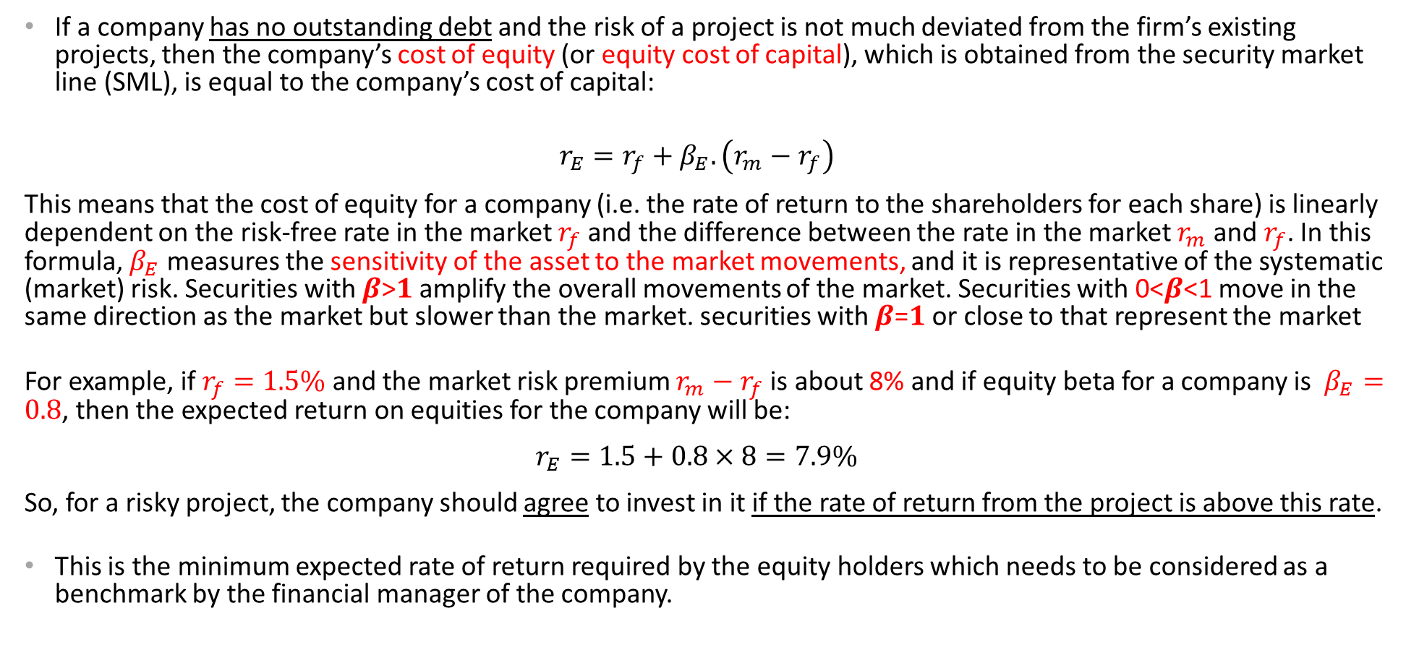
Company Cost of Capital (With No Debt)
If a company has no outstanding debt and the risk of a project is not much deviated from the firm’s existing projects, then the company’s cost of equity (or equity cost of capital), which is obtained from the security market line (SML), is equal to the company’s cost of capital:
$$r_{E}=r_{f}+β_{E}.\left(r_{m}−r_{f}\right)$$
This means that the cost of equity for a company (i.e. the rate of return to the shareholders for each share) is linearly dependent on the risk-free rate in the market $r_{f}$ and the difference between the rate in the market $r_{m}$ and $r_{f}$. In this formula, $β_{E}$ measures the sensitivity of the asset to the market movements, and it is representative of the systematic (market) risk. Securities with 𝜷>𝟏 amplify the overall movements of the market. Securities with 0<𝜷<1 move in the same direction as the market but slower than the market. securities with 𝜷=𝟏 or close to that represent the market
For example, if $r_{f}=1.5\%$ and the market risk premium $r_{m}−r_{f}$ is about 8% and if equity beta for a company is $β_{E}=0.8$, then the expected return on equities for the company will be:
$$r_{E}=1.5+0.8×8=7.9\%$$
So, for a risky project, the company should agree to invest in it if the rate of return from the project is above this rate.
This is the minimum expected rate of return required by the equity holders which needs to be considered as a benchmark by the financial manager of the company.
$$E\left(r_{i}\right)$$

Slide 44
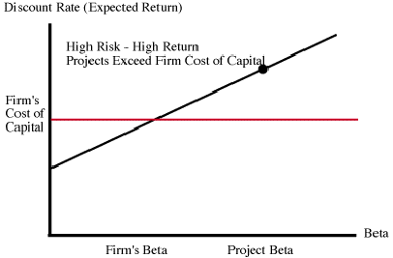


Company Cost of Capital (With No Debt)
Graphically, this means any risky projects that lie above the 7.9% horizontal line (company cost of capital) can be accepted.
$$r_{E}=r_{f}+β_{E}.\left(r_{m}−r_{f}\right)$$
Security Market Line (SML) shows the required return on projects
Company cost of capital with no debt
7.9%
$$r_{f}$$
0.8
Adopted and amended from http://viking.som.yale.edu/will/finman540/classnotes/class7.html
Once Again: When there is no debt the company’s cost of capital is measured by the company’s cost of equity. In this example, 7.9% is the return on equity (cost of equity) but at the same time (as a fixed value) it is the company’s cost of capital.

Slide 45

Company Cost of Capital (With Debt)
The cost of capital for a company with Equity & debt:
But this rate is not very realistic because the assumption of having no outstanding debt (specifically for large corporations) is far from reality.
A portfolio of all the company’s securities includes debt as well as equity.
According to the balance sheet of any company, the company’s market value $V$ (= asset value of the company in the market) is the summation of the company’s debt $D$ and the company’s equity $E$, i.e.
$$V=D+E$$
The company cost of capital, in this case, is not the cost of debt or the cost of equity alone, but it is a weighted average cost of capital (average rate of returns demanded by investors) that the company acquired through debt or equity. We return to this point a bit later.

Slide 46

Company Cost of Capital (With Debt)
If $r_{D}$ represents the rate of paying debt ( to lenders or bondholders) then
$$Company cost of capital= \frac{D}{V}.r_{D}+\frac{E}{V}.r_{E}=\frac{D}{D+E}.r_{D}+\frac{E}{D+E}.r_{E}=r_{WACC}$$
In some books, the company cost of capital is also called asset cost of capital or overall cost of capital.
For example, for a company with a balance sheet composed of 40% debt and 60% equity, if $r_{D}$ and $r_{E}$ are 8% and 12% respectively, then the company cost of capital will be:
$$Company cost of capital(WACC)=8×0.4+12×0.6=10.4\%$$
The real interest paid to the lenders can be obtained after deducting tax. So, after-tax cost of debt will be $\left(1−τ\right).r_{D}$ and eventually the weighted average cost of capital (WACC) can be calculated by:
$$After−tax WACC= r_{WACC}={(1−τ)r}_{D} . \frac{D}{V}+r_{E} . \frac{E}{V}$$
Now, it will be easy to calculate the PV of the investment project by applying WACC as a discount rate:
$$PV=\sum_{i=1}^{N}{\frac{C_{i}}{{\left(1+r_{WACC}\right)}^{i}}}$$
Expected return on all assets of a company
Tax rate

Slide 47
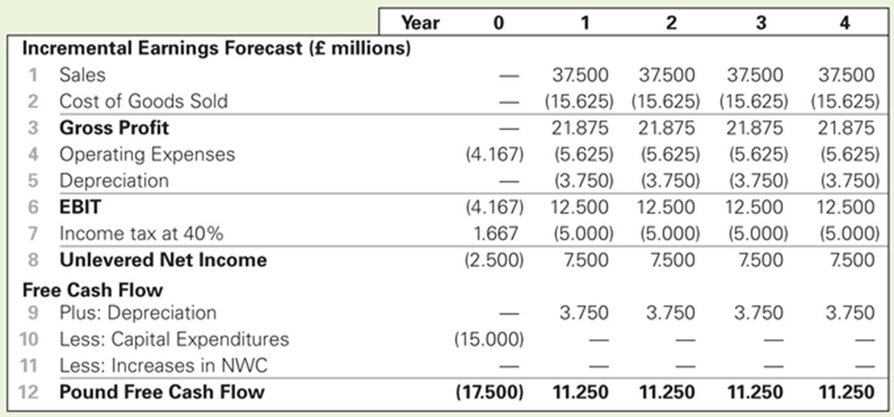
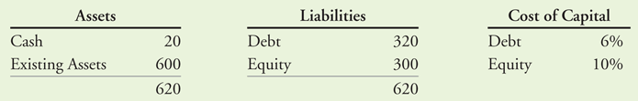

Example
Question: Ityesi Inc. wants to apply the WACC technique to value a project in the United Kingdom. The project will be completely self-contained in the United Kingdom, such that all revenues are generated, and all costs are incurred there. The technology used in the new products will be obsolete after four years. Annual sales are expected to be £37.5 million per year. Manufacturing costs and operating expenses are expected to total £15.625 million and £5.625 million per year, respectively. Developing the product will require an upfront investment of £15 million in capital equipment that will be obsolete in four years and an initial marketing expense of £4.167 million. Ityesi pays a corporate tax rate of 40% no matter in which country it manufactures its products. Assume the current spot exchange rate, $S$, is $1.60\left(\frac{\$}{£}\right)$, also assume the risk-free rate on dollars, $r_{\$}$, is 4% and the risk-free interest rate on pounds, $r_{£}$, is 7%. Using the tables below, find the value of Ityesi’s foreign project with WACC.
Ityesi’s Current Market Value Balance Sheet ($ millions) and Cost of Capital Without the U.K. Project

Slide 48
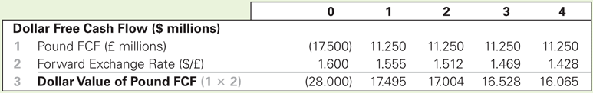

Example
Answer: Using the covered interest rate parity condition we can calculate forward exchange rates:
Free Cash Flow Conversion:
Using these forward exchange rates, the expected free cash flows in dollars can be calculated by multiplying the expected cash flows in pounds by the forward exchange rate:
$$F_{1} = S × \frac{(1 + r_{\$})}{(1 + r_{£})} = (\$1.60/£)\frac{(1.04)}{(1.07)} =\text{ \$}1.5551\text{/£} \\ F_{2} = S × \frac{(1 + r_{\$})^{2}}{(1 + r_{£})^{2}} = (\$1.60/£)\frac{(1.04)^{2}}{(1.07)^{2}} =\text{ \$}1.5115\text{/£} \\ F_{3} = S × \frac{(1 + r_{\$})^{3}}{(1 + r_{£})^{3}} = (\$1.60/£)\frac{(1.04)^{3}}{(1.07)^{3}} =\text{ \$}1.4692\text{/£} \\ F_{4} = S × \frac{(1 + r_{\$})^{4}}{(1 + r_{£})^{4}} = (\$1.60/£)\frac{(1.04)^{4}}{(1.07)^{4}} =\text{ \$}1.4280\text{/£}$$

Slide 49
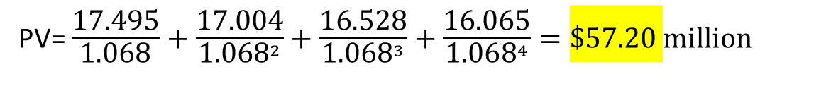
Example
The Value of Ityesi’s Foreign Project with the Domestic WACC (Domestic Cost of Capital):
With the cash flows of the U.K. project now expressed in dollars, the foreign project can be valued as if it were a domestic U.S. project.
Ityesi’s WACC is calculated as follows:
Note: Ityesi’s net debt is $320 million in debt minus the $20 million in cash for net debt of $300 million.
The present value of the future free cash flows is:
Given the upfront cost of launching the product line in dollars is only $28 million, the net present value is $29.20 million: $57.20 – $28 = $29.20
$r_{wacc}=\frac{E}{E + D}.r_{E}+\frac{D}{E + D}.r_{D}(\text{1}−τ_{C})$ $=(\text{0.5})(\text{10.0\%})+(\text{0.5})(\text{6.0\%})(\text{1}−\text{40\%})=\text{6.8\%}$
PV= $\frac{\text{17.495}}{\text{1.068}}+\frac{\text{17.004}}{\text{1.06}{\text{8}}^{2}}+\frac{\text{16.528}}{\text{1.06}{\text{8}}^{3}}+\frac{\text{16.065}}{\text{1.06}{\text{8}}^{4}}=\text{\$57.20 }\text{million}$

Slide 50
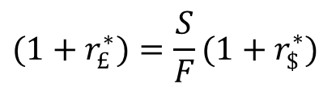

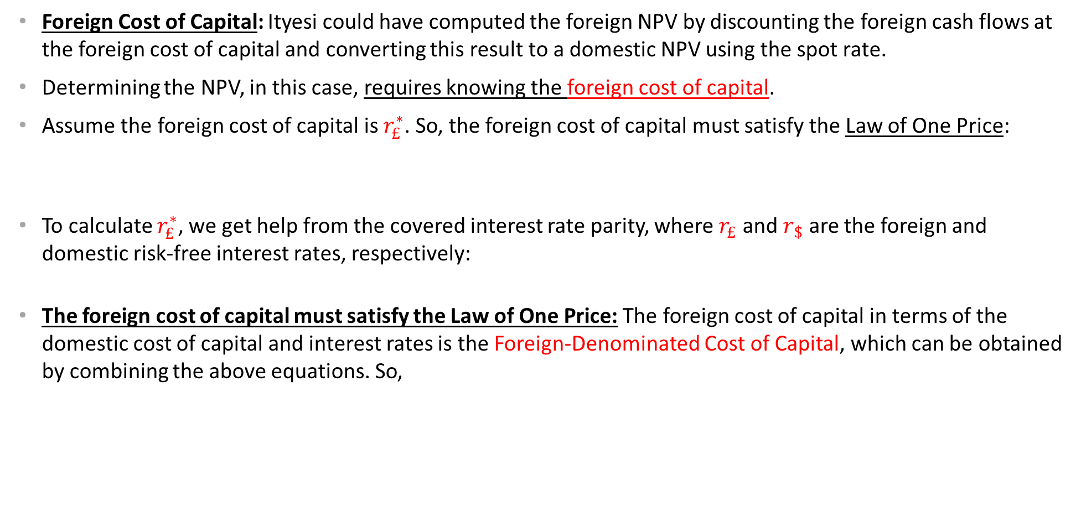

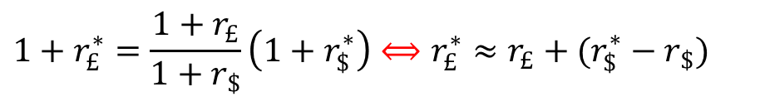

Using The Law of One Price As a Robustness Check
Foreign Cost of Capital: Ityesi could have computed the foreign NPV by discounting the foreign cash flows at the foreign cost of capital and converting this result to a domestic NPV using the spot rate.
Determining the NPV, in this case, requires knowing the foreign cost of capital.
Assume the foreign cost of capital is $r_{£}^{∗}$. So, the foreign cost of capital must satisfy the Law of One Price:
To calculate $r_{£}^{∗}$, we get help from the covered interest rate parity, where $r_{£}$ and $r_{\$}$ are the foreign and domestic risk-free interest rates, respectively:
The foreign cost of capital must satisfy the Law of One Price: The foreign cost of capital in terms of the domestic cost of capital and interest rates is the Foreign-Denominated Cost of Capital, which can be obtained by combining the above equations. So,
$$(1+r_{£}^{∗})=\frac{S}{F}(1+r_{\$}^{∗})$$
$$\frac{S}{F} = \frac{1 + r_{£}}{1 + r_{\$}}$$
$${1+r}_{£}^{∗}=\frac{1+r_{£}}{1+r_{\$}}\left(1+r_{\$}^{∗}\right)⟺r_{£}^{∗}≈r_{£}+(r_{\$}^{∗}−r_{\$})$$
So, we can estimate the foreign cost of capital $r_{£}^{∗}$, using domestic cost of capital $r_{\$}^{∗}$ and risk-free interest rates $r_{£}$ and $r_{\$}$.
Hint: $Ln(1+X)≈X$ when $X≈0$

Slide 51
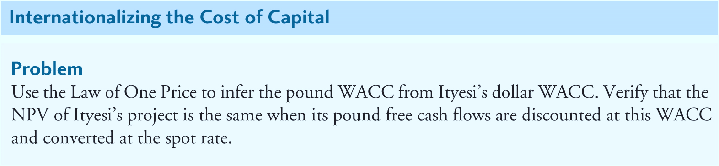
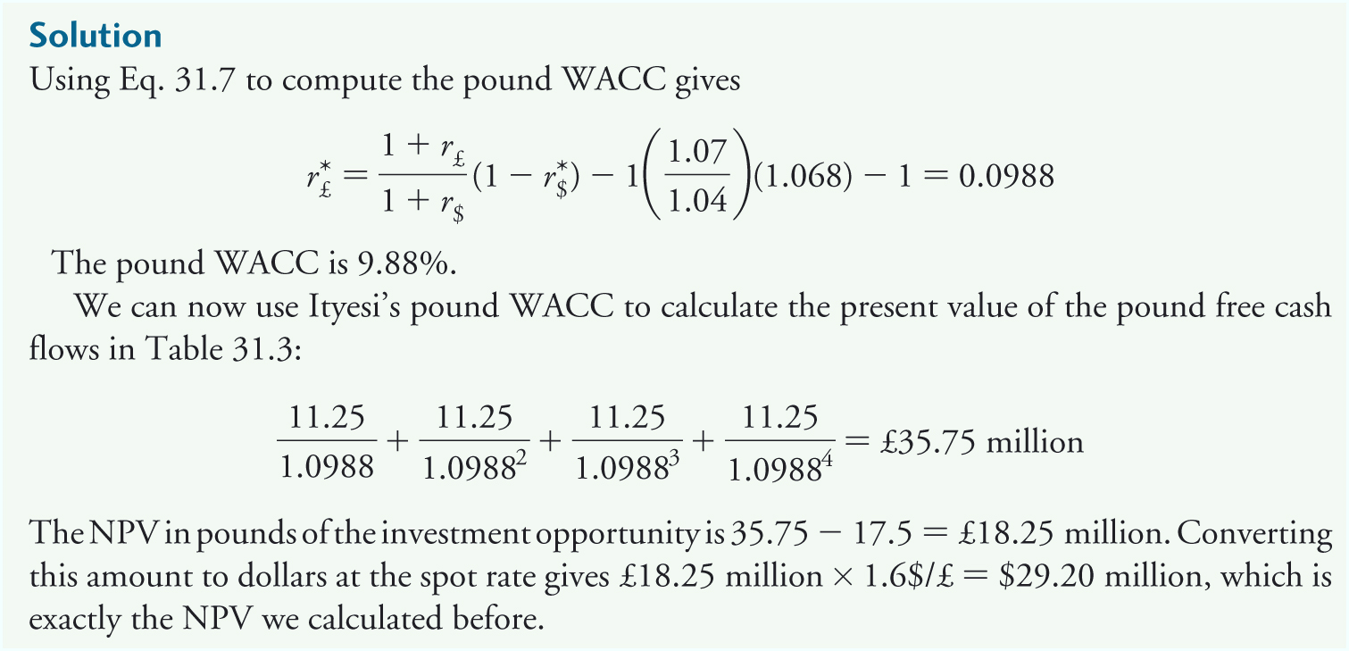
Example

Slide 52
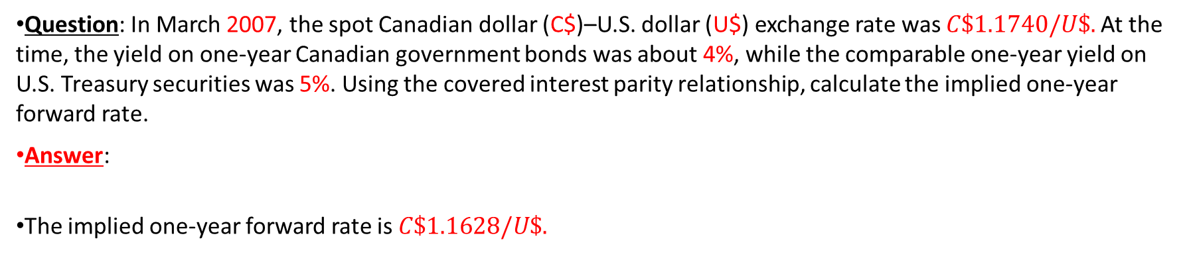
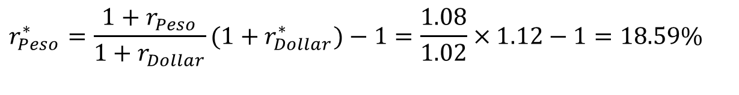
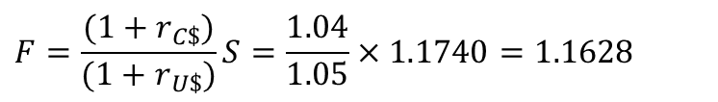
Example
Question: Sky Motors, based in Austin, TX, is considering opening a manufacturing plant in Mexico. Sky’s weighted average cost of capital in the United States is 12%. The current risk-free rate is 2% in the United States and 8% in Mexico. What is the firm’s peso WACC?
Answer: Using Foreign-Denominated Cost of Capital formula:
$$r_{Peso}^{∗}=\frac{1+r_{Peso}}{1+r_{Dollar}}(1+r_{Dollar}^{∗})−1=\frac{1.08}{1.02}×1.12−1=18.59\%$$
Question: In March 2007, the spot Canadian dollar (C$)–U.S. dollar (U$) exchange rate was $C\$1.1740/U\$.$At the time, the yield on one-year Canadian government bonds was about 4%, while the comparable one-year yield on U.S. Treasury securities was 5%. Using the covered interest parity relationship, calculate the implied one-year forward rate.
Answer:
The implied one-year forward rate is $C\$1.1628/U\$.$
$$F=\frac{(1+r_{C\$})}{(1+r_{U\$})}S=\frac{1.04}{1.05}×1.1740=1.1628$$

Slide 53
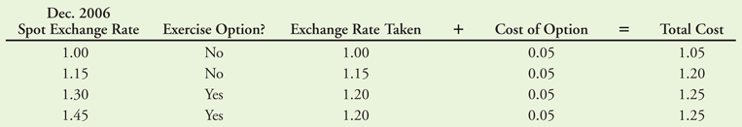
Hedging with Options
Third way to reduce risk: Another way to manage risk in the exchange rate market is to use currency options.
Assume that in December 2005, the one-year forward exchange rate was $1.20 per euro. A firm that will need euros in one year can buy a call option on the euro, giving it the right to buy euros at a maximum price. Suppose a one-year European call option on the euro with a strike price of $1.20 per euro trades for $0.05 per euro.
The following table shows the outcome of hedging with a call option:
If the spot exchange rate is less than the $1.20 per euro, which is the strike price of the option, then the firm will not exercise the option and will convert dollars to euros at the spot exchange rate.
If the spot exchange rate is more than $1.20 per euro, the firm will exercise the option and convert dollars to euros at the rate of $1.20 per euro. Adding in the initial cost of the option gives the total dollar cost per euro paid by the firm.

Slide 54
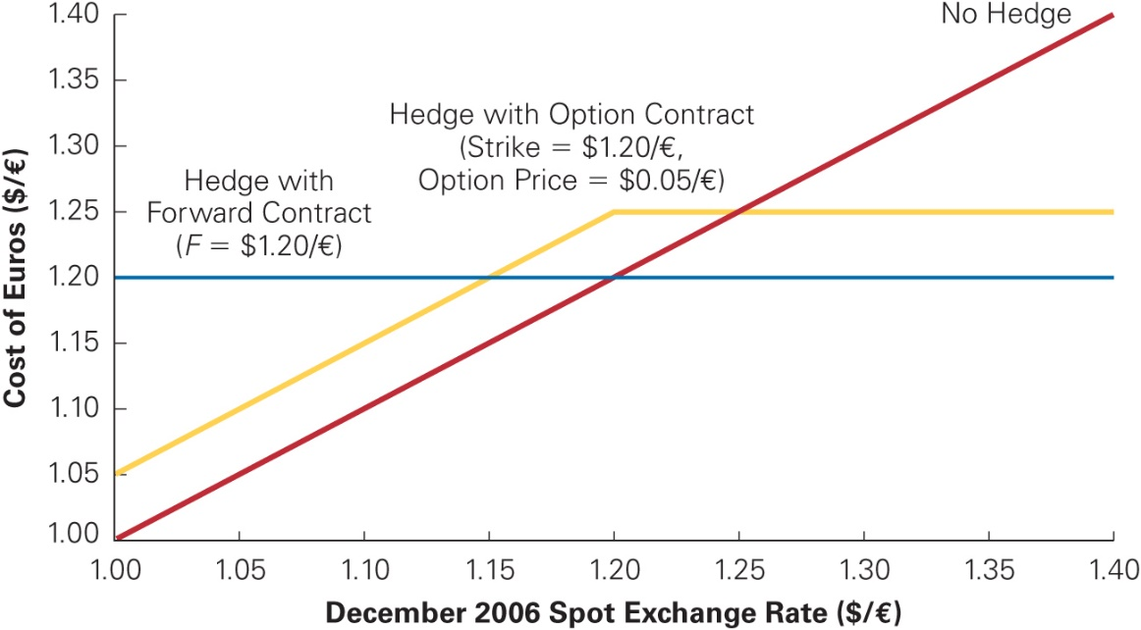
Hedging with Options
If the firm does not hedge at all, its cost for euros is simply the spot exchange rate.
If the firm hedges with a forward contract, it locks in the cost of euros at the forward exchange rate, and the firm’s cost is fixed.
If the firm hedges with options, it puts a cap on its potential cost, but it will benefit if the euro depreciates in value.
The forward hedge locks in an exchange rate and thus eliminates all risk. Not hedging leaves the firm fully exposed. Hedging with an option allows the firm to benefit if the exchange rate falls and protects the firm from a very large increase.

Slide 55





Currency Option Pricing
Options V.S. Forward Contracts:
A firm may use options instead of a forward contract:
The firm can benefit if the exchange rate moves in its favour and not be stuck paying an above-market rate.
The transaction they are hedging might not take place, as options give rights not obligations we face in forward contracts.
Currency Option Pricing:
If the current spot exchange rate is $S$ dollars per euro and the dollar and euro interest rates are $r_{\$}$and $r_{€}$, respectively, then the price of a European call option on the euro that expires in $T$ years with a strike price of $K\left(\frac{\$}{€}\right)$ is:
Price of a Call Option on a Currency:
Where:
In these formulae we have used the fact that: $S^{x}=\frac{S}{{\left(\text{1 }+ r_{€}\right)}^{T}}$ and $\frac{S^{x}}{PV(K)}=\frac{F_{T}}{K}$
$$S^{x}$$
$$PV(K)$$
$$C = \frac{S}{(\text{1 }+ r_{€})^{T}}N(d_{1}) − \frac{K}{(\text{1 }+ r_{\$})^{T}}N(d_{2})$$
$$d_{1} = \frac{\ln{(}F_{T} / K)}{σ\sqrt{T}} + \frac{σ\sqrt{T}}{2} \text{and} d_{2} = d_{1} − σ\sqrt{T}$$

Slide 56


Example
previous equations

Slide 57
Internationally Segmented Capital Markets
What happens if Capital Markets are not integrated internationally?
Capital markets that are not internationally integrated are called Segmented Capital Markets.
Reasons For Segmentation of The Capital Markets & Its Implications:
Important macroeconomic reasons for segmented capital markets include capital controls and foreign exchange controls that create barriers to international capital flows and thus segment national markets.
Political, legal, social, and cultural characteristics that differ across countries may require compensation in the form of a country risk premium.
As a result of these barriers, firms may face differential access to markets if there is any kind of asymmetry concerning information about them.
For example, Ityesi may be well known in the U.S. but not be equally well known in the UK, thus increasing their WACC in the UK. Ityesi would then view the foreign project as less valuable if it raises capital in the United Kingdom rather than in the United States.

Slide 58

Example
Implication of Internationally Segmented Capital Market:
Firms may be able to benefit from a segmented international financial market if one country or currency has a higher rate of return than another country or currency, when the two rates are compared in the same currency.

Slide 59


Example

Slide 60

Test Yourself
Which of the following statements regarding international projects is FALSE?
A. Interest rates and costs of capital will likely be different in the foreign country as a result of the macroeconomic environment.
B. The project will most likely generate foreign currency cash flows, although the firm cares about the foreign currency value of the project.
C. Under internationally integrated capital markets, the value of an investment does not depend on the currency we use in the analysis.
D. The firm will probably face a different tax rate in the foreign country and will be subject to both foreign and domestic tax codes
Consider the following equation:
The term $r_{\$}^{∗}$ in this equation is:
A. the appropriate cost of capital from the standpoint of a U.S. investor.
B. the risk-free rate for a foreign investor.
C. the risk-free rate for a U.S. investor.
D. the appropriate cost of capital from the standpoint of a foreign investor.
The dollar cost of debt for John Galt Industries is 8.0%. The firm faces a tax rate of 40% on all income, no matter where it is earned. Galt needs to know its Yen cost of debt. The risk-free interest rates on dollars and yen are r$ = 6% and r¥ = 2%, respectively. Galt is willing to assume that capital markets are internationally integrated and that its free cash flows are uncorrelated to the yen-dollar spot rate. Galt's after-tax cost of debt in yen is closest to:
A. 0.9%
B. 2.0%
C. 3.9%
D. 4.8%
You are a U.S. investor who is trying to calculate the present value of £5 million cash inflow that will occur one year in the future. The spot exchange rate is S = $1.8839/£ and the forward rate is F1 = $1.8862/£. The appropriate dollar discount rate for this cash flow is 5.32% and the appropriate £ discount rate is 5.24%. The present value of the £5 million cash inflow computed by first discounting the £s and then converting into dollars is closest to:
A. $8,961,420
B. $8,943,695
C. $8,954,615
D. $8,950,495
The spot GBP/USD exchange rate is 0.5025/USD, and the one-year forward rate is GBP 0.5048/USD. If the annual interest rate on dollar CDs is 6 percent, what would you expect the annual interest to be on GBP CDs?
A. 5.52 percent
B. 6.49 percent
C. 3.55 percent
D. 8.25 percent
The spot exchange rate for British pounds is 0.5025 (GBP/USD). The one-year risk-free rates in the United States and Britain are 3 percent and 2.75 percent, respectively. What is the forward exchange rate in GBP/USD?
A. 0.6170
B. 0.5037
C. 0.5013
D. 0.6050
Suppose that the G Company knows that in one month it must pay £7 million for goods that its U.S. subsidiary will receive in Britain. The current exchange rate is $1.99/£. The risk that the corporate treasurer faces is that
A. the $US/pound exchange rate falls in a month's time (i.e., the pound weakens).
B. the $US/pound exchange rate rises in a month's time (i.e., the pound strengthens).
C. the $US/pound exchange rate does not change from its current position.
D. the pound exchange rate falls in a month's time (i.e., the pound strengthens).
An Australian firm is evaluating a proposal to build a new plant in the United States. The expected cash flows in $US (in millions) are as follows: Year 0, -100; Year 1, 40; Year 2, 50; Year 3, 65. The discount rate in $A is 10 percent, while the discount rate in $US is 12 percent and the spot rate is $US0.85/$A. Calculate the NPV in $A.
A. +25.69
B. -21.84
C. +13.10
D. +21.84

Slide 61

Some Explanations For the Previous Questions
Question 7:
After tax WACC= $r(1−τ)$= 8%(1 - 40%) = 4.8%
Question 8:
1-B
2-C
3-B
4-A
5-B
6-A
7-A
8-D

Slide 62
Extra Questions & Answers
Extra Questions with Answers

Slide 63
Extra Questions & Answers
Question 1: Suppose the exchange rate for Norwegian Krone is quoted as 12.54 NKr/£ in the spot market and 13 NKr/£ in the 90-day forward market.
Is the British pound selling at a premium or a discount relative to the Krone?
Does the financial market expect the Krone to weaken relative to the pound? Explain.
What do you suspect is true about relative economic conditions in the UK and Norway?
Answer:
The pound is selling at a premium because it is more expensive in the forward market than in the spot market (NKr 13 versus NKr 12.54).
The kroner is expected to depreciate relative to the pound because it will take more kroner to buy one pound in the future than it does today.
Inflation in Norway is higher than in the United Kingdom, as are nominal interest rates.

Slide 64

Extra Questions & Answers

Slide 65

Extra Questions & Answers
Question 2: Take a look at the table in slide no. 57 and answer the following questions.
If you have €100, how many British pounds can you get?
Which is worth more, a New Zealand dollar or a Singapore dollar?
Which would you rather have, 100 Swiss francs (SFr) or 100 Norwegian kroner (NKR)? Why?
What is the 3-month forward rate for the US dollar per euro? Is the dollar selling at a premium or a discount? Explain.
What is the cross-rate in terms of Iranian Rial per Thai baht?
Suppose the cross-rate is 279 Rial=1 Thai baht. Is there any arbitrage opportunity here? If there is, how to take advantage of the mispricing.
Answer:
€100(€0.8196/£1) = £81.96
New Zealand dollar
Use the €, $£$ or $\$$ as the base currency: (SFr100)(£0.6821/SFr) = £68.21, (NKr100)(£0.10843/NKr)= £10.84
F90 = $1.3215 (per €). The dollar is selling at a discount because it is less expensive in the forward market than in the spot market ($1.3215 versus $1.3208).
The cross rate in Rial/Baht terms is: (Rial19823/£1)(£0.02006/Baht1) = Rial397.67/Baht (Note: £1=49.8484 Baht)
The Rial is quoted as too high relative to the baht. Take out a loan for 100 baht and buy £2.006. Use the £2.006 to purchase a rial at the cross-rate, which will give you: £2.006(Rial19823/£) = Rial39,766.57. Now use the Rial to buy back baht and repay the loan. The cost to repay the loan will be: Rial39,766.57(1/(Rial397.67/bt)= 99.998 Baht, your arbitrage profit is 0.00151 Baht per baht used.

Slide 66

Extra Questions & Answers
Question 3: The spot rate of foreign exchange between the US and the UK is $1.6117 \$/£.$If the interest rate in the US is 13% and it is 8% in the UK, what would you expect the one-year forward rate to be if no immediate arbitrage opportunities existed?
Answer: Using the interest-rate parity theorem:
$$(1+r_{\$})/(1+r_{£})=F/S$$
We can find the forward rate as:
$$F=[(1+r_{\$})/(1+r_{£})] S$$
$F=(1.13/1.08)×\$1.6117/£=\$1.686/£$
Question 4: Using the interest rate parity for one-period shows that the forward rate for T-period can be approximately written as $F_{T}=S×{\left[1+\left(r_{FC}−r_{DC}\right)\right]}^{T}$.
Answer: We have $F=S×\frac{\left(1+r_{DC}\right)}{\left(\text{1}+r_{FC}\right)}⟹F=S×\left[1+\left(r_{FC}−r_{DC}\right)\right]$
So, in general, if we have T periods instead of just one, the interest rate parity approximation can be written as
$$F=S×{\left[1+\left(r_{FC}−r_{DC}\right)\right]}^{T}$$
hillier848

Slide 67

Extra Questions & Answers
Question 5: Imagine you are a resident of the EU. Using the table in slide no. 57 and the equation we obtained in Question 4, what must the annual risk-free rate in the UK be if the current annual risk-free rate in Eurozone is 3.8%?
Answer: We can write the formula as :
$$r_{£}=\frac{F−S}{S}+r_{€}⟹r_{£}\text{= }\text{(£0.8251 – £0.8196)/£0.8196 + }\text{0}\text{.038 = 4.47\%}$$
Question 6: If financial markets are perfectly competitive and the Eurodollar rate is above the offered in the US loan market, you would immediately want to borrow money in the US and invest it in Eurodollars. True or false? Explain. (Eurodollar is the amount of dollar kept in the EU’s financial system)
Answer: False. If the financial markets are perfectly competitive, the difference between the Eurodollar rate and the U.S. rate will be due to differences in risk and government regulation. Therefore, speculating in those markets will not be beneficial.

Slide 68

Extra Questions & Answers
Question 7: An Dutch firm has an investment opportunity in the UK. The project costs £12 million and is expected to produce cash flows of £2.7 million, £3.5 million and £3.3 million in years 1 to 3, respectively. The current spot exchange rate is $€1.12/£$ and the current risk-free rate in the Eurozone is 2.12%, compared to that in the UK of 2.13%. The appropriate discount rate for the project is estimated to be 13% which is the Eurozone cost of capital for the company. In addition, the subsidiary can be sold at the end of 3 years for an estimated £7.4 million. What is the NPV of the project?
Answer: First, we need to forecast the expected future rate for each of the next three years. From the exact form of interest rate parity, the expected exchange rate is: $E(S)=[(1+r_{€})/(1+r_{£})]T×S$
$$E(S1) = (1.0212 / 1.0213)1 €1.12/£ = €1.1199/£$$
$$E(S2) = (1.0212 / 1.0213)2 €1.12/£ = €1.1198/£$$
$$E(S3) = (1.0212 / 1.0213)3 €1.12/£ = €1.1197/£$$
Now we can use these expected future rates to find the euro cash flows. The euro cash flow each year will be:
$Year 0 cash flow = –£12,000,000(€1.12/£)= –€13,440,000$
$Year 1 cash flow = £2,700,000(€1.1199/£)= €3,023,704$
$Year 2 cash flow = £3,500,000(€1.1198/£)= €3,919,232$
$Year 3 cash flow = (£3,300,000 + £7,400,000)(€1.1197/£)= €11,980,480$
And the NPV of the project will be:
$$NPV = –€13,440,000+ €3,023,704/1.13 + €3,919,232/1.132 + €11,980,480/1.133= €608,251.7$$

Slide 69
International Competition & Risks
Learning Objectives:
Explain the reasons that governments intervene in trade
Explain the instruments government have/use to promote or restrict trade
Outline the various sources of political risk
Explain how companies can manage political risk
Some parts of this lecture is taken from the book “International Business: The Challenges of Globalization”, Ninth Edition, Global Edition, by John Wild and Kenneth Wild, 2019 Pearson Education Ltd

Slide 70
Governments, International Competition & Risks
Why do governments intervene to regulate their national trade?
Political Motives
Protect jobs
Preserve national security (Military equipment, Prevent importing Genetically modified corps)
Respond to unfair trade
Gain influence (in the region or on a bigger scale for political reasons, e.g., getting UN member votes in the time of crisis)
Economic Motives
Protect infant industries (industrial policy)
Pursue strategic trade policy (positive trade balance or consolidating the economic power of some industries against severe global competition, e.g., shipbuilding in South Korea)
Cultural Motives
Achieve cultural objectives
Protection of national identity
“French law bans foreign-language words from all business & gov. Communications” + 35% of the music played on Canadian radio must be from Canadian artists)

Slide 71

International Competition & Risks
US, EU & Canada Used Multi-Fiber Arrangement (MFA) between 1974 and 2004 to regulate the imports of cheaper textile and clothing from China and India (due to economy of scale in production and lower wages in these countriess) to safeguard their manufacturing businesses.
Multifiber Arrangement (https://www.wto.org/english/tratop_e/texti_e/texintro_e.htm)
Governments use different instruments to promote or restrict trade for their national interests:

Slide 72
Instruments of Trade Promotion
1. Trade Promotion
Subsidies (Financial assistance: Cash payment, Low-interest loan, price supports, etc.)
Export Financing (all above financial assistance + loan guarantee by the government)
Foreign Trade Zones (FTZ) (a designated geographic region through which merchandise is allowed to pass with lower customs duties (taxes) and/or fewer customs procedures)
Special Government Agencies (to promote the growth of the export of mostly small and medium-sized companies, e.g., Japan External Trade Organization (JETRO: www.jetro.go.jp)

Slide 73
Instruments of Trade Restrictions
Trade Restrictions
Tariffs
Quotas: Restriction on the amount (measured in units or weight) of a good that can enter or leave a country during a certain period.
Embargoes: Complete ban on trade (imports and exports) in one or more products with a particular country.
Local Content Requirements: Laws stipulating that producers in the domestic market must supply a specified amount of a good or service.
Administrative Delays: Regulatory controls or bureaucratic rules designed to impair the flow of imports into a country. (food products, cosmetic products, pharmaceutical products, ….)
Currency Controls: Restrictions on the convertibility of a currency into other currencies.
Export tariff: It is levied by the government of a country that is exporting a product.
Transit Tariff: It is levied by the government of a country that a product is passing through on its way to its destination.
Import Tariff: It is levied by the government of a country that is importing a product.

Slide 74

Instruments of Trade Restrictions
Tariff-Quotas: A hybrid form of trade restriction is called a tariff-quota—a lower tariff rate for a certain quantity of imports and a higher rate for quantities that exceed the quota.
Tariff-Quotas : How a Tariff-Quota Works
Source: World Trade Organization Website (www.wto.org).

Slide 75

Global Trading System
“The act represented a major shift in U.S. trade policy from one of free trade to one of protectionism”.
“A treaty designed to promote free trade by reducing both tariff and non-tariff barriers to international trade”. Formed in 1947 by 23 nations. In the early years, tariffs were reduced from 40% to 5%. Agreement on services, intellectual property & agricultural subsidies.
Replaced the GATT and its agreements for the same goals and also help to negotiate for further opening of markets, and to settle trade disputes among its members + retaliation for following dumping policy.

Slide 76
Global Trading System (GATT)
General Agreement on Tariffs and Trade (G A T T)
The General Agreement on Tariffs and Trade (G A T T): A treaty designed to promote free trade by reducing tariff and non-tariff barriers to international trade. Its origin goes back to the Bretton Woods conference in 1944 towards the end of World War II.
Between 1947 and 1988: Highly successful
Reduced average tariffs from 40 per cent to 5 per cent
Multiplied the volume of international trade by a factor of 20
By the middle to the late 1980s: Challenges
Non-tariff barriers (rising nationalism globally led to a nearly 50% increase in non-tariffs)
Services not covered by the original G A T T (e.g., international calls, tourism, banking operations, business consultants)

Slide 77
Global Trading System (GATT)
Round of Negotiations: Completed Rounds of G A T T
Source: Based on About the WTO, World Trade Organization website (www.wto.org).
Year | Site | Number of Countries Involved | Topics Covered
1947 | Geneva, Switzerland | 23 | Tariffs
1949 | Annecy, France | 13 | Tariffs
1951 | Torquay, England | 38 | Tariffs
1956 | Geneva | 26 | Tariffs
1960-1961 | Geneva (Dillon Round) | 26 | Tariffs
1964-1967 | Geneva (Kennedy Round) | 62 | Tariffs, antidumping measures
1973-1979 | Geneva (Tokyo Round) | 102 | Tariffs, nontariff measures, “framework agreements”
1986-1994 | Geneva (Uruguay Round) | 123 | Tariffs, non-tariff measures, rules, services, intellectual property, dispute settlement, investment measures, agriculture, textiles and clothing, natural resources, creation of the World Trade Organization

Slide 78
Global Trading System (GATT)
Uruguay Round of Negotiations (1986-1994):
Largest trade negotiation in history.
Begun in 1986 in Punta del Este in Uruguay
7 years to complete
Agreements:
Agreement on services (all services necessary to promote trade between countries)
Agreement on intellectual property (to help standardise all rules around intellectual properties around the world)
Agreement on agricultural subsidies (forces countries to convert all non-tariff barriers to tariffs—a process called “tariffication” e.g., ISO, CE= complies with the EU rules & regulations)
Creation of the W T O (the greatest achievement of the Uruguay Round)
Notes:
The Uruguay Round of GATT negotiations, begun in 1986 in Punta del Este, Uruguay (hence its name), was the largest trade negotiation in history. It was the eighth round of GATT talks within a span of 40 years and took more than 7 years to complete.
The negotiations modified the original GATT treaty in several important ways:
Agreement on Services: Because of the ever-increasing importance of services to the total volume of world trade, nations wanted to include GATT provisions for trade in services.
Agreement on Intellectual Property: The Uruguay Round created the Agreement on Trade-Related Aspects of Intellectual Property (TRIPS) to help standardize intellectual property rules around the world.
Agreement on Agricultural Subsidies: The Uruguay Round addressed the main issues of agricultural tariffs and nontariff barriers in its Agreement on Agriculture. The agreement forces countries to convert all nontariff barriers to tariffs—a process called “tariffication.”
Perhaps the greatest achievement of the Uruguay Round was the creation of the World Trade Organization (WTO).

Slide 79
Global Trading System (WTO)
World Trade Organisation (W T O)
The World Trade Organisation (W T O): the international organisation that regulates trade among nations. It came into existence on 1st January 1995 with the membership of 128 countries. Now, 164 members and 21 observers.
Main goals of the W T O (www.wto.org)
Help the free flow of trade
Help negotiate the further opening of markets
Settle trade disputes among its members
Monitoring & surveillance of the trade between members to make sure the implementation of agreed policies
The principle of nondiscrimination (called normal trade relations)
Notes:
The Uruguay Round of GATT negotiations, begun in 1986 in Punta del Este, Uruguay (hence its name), was the largest trade negotiation in history. It was the eighth round of GATT talks within a span of 40 years and took more than 7 years to complete.
The negotiations modified the original GATT treaty in several important ways:
Agreement on Services: Because of the ever-increasing importance of services to the total volume of world trade, nations wanted to include GATT provisions for trade in services.
Agreement on Intellectual Property: The Uruguay Round created the Agreement on Trade-Related Aspects of Intellectual Property (TRIPS) to help standardize intellectual property rules around the world.
Agreement on Agricultural Subsidies: The Uruguay Round addressed the main issues of agricultural tariffs and nontariff barriers in its Agreement on Agriculture. The agreement forces countries to convert all nontariff barriers to tariffs—a process called “tariffication.”
Perhaps the greatest achievement of the Uruguay Round was the creation of the World Trade Organization (WTO).

Slide 80

Three main reasons for the replacement of GATT with WTO:
Global Trading System (WTO)
1970s
GATT dealt with only tariff barriers but by the 1970s non-tariff barriers has also started increasing.
1980s
GATT dealt with trade in goods. But by the 1980s developed countries started having comparative advantages in trade in services.
By the 1980s, developing countries started pursuing export-oriented growth. For e.g.- Singapore, South Korea etc.
1980s

Slide 81
Global Trading System (WTO)
Dispute Settlement in the WTO (in terms of the time of action (1 year) and fairness)
Dumping and the WTO (Allows member countries to retaliate against dumping by imposing an anti-dumping duty which is an additional tariff placed on an imported product that a nation believes is being dumped on its market).
Subsidies and the WTO (A countervailing duty is an additional tariff placed on an imported product that a nation believes is receiving an unfair subsidy).
Doha Round of Negotiations (started in 2001 but very slow moving + without any significant achievement on agricultural trade issues, tariffs)
WTO and the Environment (no separate agreement for environmental issues)
Note: Dumping occurs when a company exports a product at a price that is either lower than the price normally charged in its domestic market, or lower than the cost of production. Because dumping is an act by a company, not a country, the WTO cannot punish the country on which dumping is based.
Notes:
The Uruguay Round of GATT negotiations, begun in 1986 in Punta del Este, Uruguay (hence its name), was the largest trade negotiation in history. It was the eighth round of GATT talks within a span of 40 years and took more than 7 years to complete.
The negotiations modified the original GATT treaty in several important ways:
Agreement on Services: Because of the ever-increasing importance of services to the total volume of world trade, nations wanted to include GATT provisions for trade in services.
Agreement on Intellectual Property: The Uruguay Round created the Agreement on Trade-Related Aspects of Intellectual Property (TRIPS) to help standardize intellectual property rules around the world.
Agreement on Agricultural Subsidies: The Uruguay Round addressed the main issues of agricultural tariffs and nontariff barriers in its Agreement on Agriculture. The agreement forces countries to convert all nontariff barriers to tariffs—a process called “tariffication.”
Perhaps the greatest achievement of the Uruguay Round was the creation of the World Trade Organization (WTO).

Slide 82
Bottomline For Business
Despite the theoretical benefits of trade, nations do not simply throw open their doors to free trade and force all their domestic businesses to sink or swim. This part has discussed the reasons why national governments continue to protect all or some of their industries and how they go about it.
The global trading system through the World Trade Organization tries to strike a balance between national desires for protection and international desires for free trade and also serves to settle trade disputes between countries.
Notes:
The Uruguay Round of GATT negotiations, begun in 1986 in Punta del Este, Uruguay (hence its name), was the largest trade negotiation in history. It was the eighth round of GATT talks within a span of 40 years and took more than 7 years to complete.
The negotiations modified the original GATT treaty in several important ways:
Agreement on Services: Because of the ever-increasing importance of services to the total volume of world trade, nations wanted to include GATT provisions for trade in services.
Agreement on Intellectual Property: The Uruguay Round created the Agreement on Trade-Related Aspects of Intellectual Property (TRIPS) to help standardize intellectual property rules around the world.
Agreement on Agricultural Subsidies: The Uruguay Round addressed the main issues of agricultural tariffs and nontariff barriers in its Agreement on Agriculture. The agreement forces countries to convert all nontariff barriers to tariffs—a process called “tariffication.”
Perhaps the greatest achievement of the Uruguay Round was the creation of the World Trade Organization (WTO).

Slide 83
Economic & Political Risk
In economics, we classify economic systems based on their GDP or GNP growth and their economic development.
Gross Domestic Product (GDP) is one of the vastly accepted measures that estimate the total value of activities in an economy for a specific period of time.
GDP today is the main and the most important measure to judge the success of an economy in terms of accumulation of wealth. This means how much monetary value an economic system can produce.
GDP or GNP?
Gross National Product (GNP) is another measure that includes the nation’s net income from using their labour or capital out of the country.
Notes:
The Uruguay Round of GATT negotiations, begun in 1986 in Punta del Este, Uruguay (hence its name), was the largest trade negotiation in history. It was the eighth round of GATT talks within a span of 40 years and took more than 7 years to complete.
The negotiations modified the original GATT treaty in several important ways:
Agreement on Services: Because of the ever-increasing importance of services to the total volume of world trade, nations wanted to include GATT provisions for trade in services.
Agreement on Intellectual Property: The Uruguay Round created the Agreement on Trade-Related Aspects of Intellectual Property (TRIPS) to help standardize intellectual property rules around the world.
Agreement on Agricultural Subsidies: The Uruguay Round addressed the main issues of agricultural tariffs and nontariff barriers in its Agreement on Agriculture. The agreement forces countries to convert all nontariff barriers to tariffs—a process called “tariffication.”
Perhaps the greatest achievement of the Uruguay Round was the creation of the World Trade Organization (WTO).

Slide 84
Economic & Political Risk
While GDP measures the total income which is domestically earned, GNI=GNP estimates the total net income which is internationally earned including those citizens who work abroad.
In the calculation of GNI=GNP, if a UK citizen works abroad or invests abroad, the income he/she receives (for the work/the investment) must be added to GDP but for the foreigners who work/invest in the UK, their incomes should be deducted from GDP. So;
$$GNI=GNP=GDP+Factor Payments from Abroad−Factor Payments to Abroad$$
Notes:
The Uruguay Round of GATT negotiations, begun in 1986 in Punta del Este, Uruguay (hence its name), was the largest trade negotiation in history. It was the eighth round of GATT talks within a span of 40 years and took more than 7 years to complete.
The negotiations modified the original GATT treaty in several important ways:
Agreement on Services: Because of the ever-increasing importance of services to the total volume of world trade, nations wanted to include GATT provisions for trade in services.
Agreement on Intellectual Property: The Uruguay Round created the Agreement on Trade-Related Aspects of Intellectual Property (TRIPS) to help standardize intellectual property rules around the world.
Agreement on Agricultural Subsidies: The Uruguay Round addressed the main issues of agricultural tariffs and nontariff barriers in its Agreement on Agriculture. The agreement forces countries to convert all nontariff barriers to tariffs—a process called “tariffication.”
Perhaps the greatest achievement of the Uruguay Round was the creation of the World Trade Organization (WTO).

Slide 85

Gross Domestic Product (GDP)
Notes:
The Uruguay Round of GATT negotiations, begun in 1986 in Punta del Este, Uruguay (hence its name), was the largest trade negotiation in history. It was the eighth round of GATT talks within a span of 40 years and took more than 7 years to complete.
The negotiations modified the original GATT treaty in several important ways:
Agreement on Services: Because of the ever-increasing importance of services to the total volume of world trade, nations wanted to include GATT provisions for trade in services.
Agreement on Intellectual Property: The Uruguay Round created the Agreement on Trade-Related Aspects of Intellectual Property (TRIPS) to help standardize intellectual property rules around the world.
Agreement on Agricultural Subsidies: The Uruguay Round addressed the main issues of agricultural tariffs and nontariff barriers in its Agreement on Agriculture. The agreement forces countries to convert all nontariff barriers to tariffs—a process called “tariffication.”
Perhaps the greatest achievement of the Uruguay Round was the creation of the World Trade Organization (WTO).

Slide 86

Gross Domestic Product (GDP)
Notes:
The Uruguay Round of GATT negotiations, begun in 1986 in Punta del Este, Uruguay (hence its name), was the largest trade negotiation in history. It was the eighth round of GATT talks within a span of 40 years and took more than 7 years to complete.
The negotiations modified the original GATT treaty in several important ways:
Agreement on Services: Because of the ever-increasing importance of services to the total volume of world trade, nations wanted to include GATT provisions for trade in services.
Agreement on Intellectual Property: The Uruguay Round created the Agreement on Trade-Related Aspects of Intellectual Property (TRIPS) to help standardize intellectual property rules around the world.
Agreement on Agricultural Subsidies: The Uruguay Round addressed the main issues of agricultural tariffs and nontariff barriers in its Agreement on Agriculture. The agreement forces countries to convert all nontariff barriers to tariffs—a process called “tariffication.”
Perhaps the greatest achievement of the Uruguay Round was the creation of the World Trade Organization (WTO).

Slide 87
Gross Domestic Product (GDP)
If GDP growth in a country is high and it grows continuously at a high level, the country is called economically successful as the higher GDP means more values are created domestically & more money comes into the economic system through international trade which provides more investment, employment, production and more economic score for the country.
GDP per Capita:
GDP per capita shows the value of the total output/income or expenditure per person (domestic population) in a specific period (usually a year).
GNP per capita shows the share of all generated income per domestic population in a specific period.
Notes:
The Uruguay Round of GATT negotiations, begun in 1986 in Punta del Este, Uruguay (hence its name), was the largest trade negotiation in history. It was the eighth round of GATT talks within a span of 40 years and took more than 7 years to complete.
The negotiations modified the original GATT treaty in several important ways:
Agreement on Services: Because of the ever-increasing importance of services to the total volume of world trade, nations wanted to include GATT provisions for trade in services.
Agreement on Intellectual Property: The Uruguay Round created the Agreement on Trade-Related Aspects of Intellectual Property (TRIPS) to help standardize intellectual property rules around the world.
Agreement on Agricultural Subsidies: The Uruguay Round addressed the main issues of agricultural tariffs and nontariff barriers in its Agreement on Agriculture. The agreement forces countries to convert all nontariff barriers to tariffs—a process called “tariffication.”
Perhaps the greatest achievement of the Uruguay Round was the creation of the World Trade Organization (WTO).

Slide 88
Gross Domestic Product (GDP)
What does GDP measure?
GDP measures both the economy’s total income (earned by domestically- located factors of production such as labour, land and capital) and the economy’s total expenditure (on domestically-produced final goods and services).
How is that possible?
In every transaction, the buyer’s expenditure becomes the seller’s income.
Thus, the sum of all expenditure equals the sum of all income.
Adopted from Mankiw’s PPT

Slide 89
GDP & Its Limitations
GDP has its own limitations. In his 1934 report, Kuznets “cautioned against equating GDP growth with economic or social well-being”.(Costanza et al, 2009)
It does not include the production of items which are not supplied in the market for sale, such as volunteer work, household services, work of prisoners, some defence productions etc. It also does not include the income resulting in the black market or illegal activities.
It does not work as the measure of economic well-being as it does not show how the profit of the monetary transaction in the market is distributed between different factors of production.
It does not consider the environmental damage and the depletion & degradation of the natural resources in the process of production. Countries with a high level of GDP provide more waste and create more pollution for the environment.
It does not reflect the quality of life. Higher GDP is not equal to more happiness.
It does not show any social, political or environmental improvement.
It does not show the purchasing power of the unit of the domestic currency compared to other currencies.
Notes:
The Uruguay Round of GATT negotiations, begun in 1986 in Punta del Este, Uruguay (hence its name), was the largest trade negotiation in history. It was the eighth round of GATT talks within a span of 40 years and took more than 7 years to complete.
The negotiations modified the original GATT treaty in several important ways:
Agreement on Services: Because of the ever-increasing importance of services to the total volume of world trade, nations wanted to include GATT provisions for trade in services.
Agreement on Intellectual Property: The Uruguay Round created the Agreement on Trade-Related Aspects of Intellectual Property (TRIPS) to help standardize intellectual property rules around the world.
Agreement on Agricultural Subsidies: The Uruguay Round addressed the main issues of agricultural tariffs and nontariff barriers in its Agreement on Agriculture. The agreement forces countries to convert all nontariff barriers to tariffs—a process called “tariffication.”
Perhaps the greatest achievement of the Uruguay Round was the creation of the World Trade Organization (WTO).

Slide 90


SPI Index As An Alternative To GDP
If GDP is replaced by another index such as the “Social Progress Index”, some other countries get the highest ranks; including Finland, Canada, Denmark, Australia etc.
The Social Progress Index (SPI) is an index to measure the society’s well-being based on social & environmental progress rather than just economic progress.
https://www2.deloitte.com/content/dam/Deloitte/ec/Documents/deloitte-analytics/Estudios/2018-Social-Progress-Index-brief.pdf
Figure: The SPI V.S. GDP per Capita

Slide 91
Purchasing Power Parity
One of the limitations of GDP or GNP is that the measure does not show the purchasing power of each unit of the currency in a country.
Purchasing Power: Value of goods and services that can be purchased with one unit of a country’s currency.
Purchasing Power Parity: Relative ability of two countries’ currencies to buy the same “basket” of goods in those two countries.
To understand the PPP theory, we need to have an idea about the nominal exchange rate and real exchange rate.

Slide 92



Nominal & Real Exchange Rates
Nominal exchange rate ($e$):
International flows of capital, goods and services are all types of transactions between different countries, but these transactions occur at a price. In this part, we focus on the price of such transactions.
Real exchange rate ($ε$): This is the rate that shows the relative price of goods in two countries.
$e$ = nominal exchange rate, the relative price of domestic currency in terms of foreign currency (e.g., Yen per Euro or Pound)
$$ε$$
= real exchange rate, the relative price of domestic goods in terms of foreign goods (e.g., price of a Mars bar in Tokyo per price of a Mars bar in Frankfurt)

Slide 93


Understanding the units of ε
$$Real exchange rate=Nominal exchange rate×\frac{Domestic price}{Foriegn price}$$
Or $ε=e×\frac{P}{P^{∗}}$
Price of a burger in the UK= $£6.00$
Price of a burger in France= $€6.66$ (Similar burger in terms of the size and quality)
Nominal exchange rate= $1.11 €/£$(for ever pound you get 1.11 Euro)
So, we have:
$$ε=1.11\left(\frac{€}{£}\right) ×\frac{6 \left(£\right)}{6.66 \left(€\right)}=1$$
Now, if the price of the burger in France changes to $€7.00$, then the real exchange rate would be:
$$ε=1.11×\frac{6}{7}≈0.95$$
This means that the good is cheaper in the UK, i.e. if a French comes to the UK and buy a burger, at the UK’s price, he/she can buy 95% of the similar burger in his own country.
Notes:
Students often have trouble understanding the units of the real exchange rate.
It’s worth explaining each line carefully, and making sure students understand it before displaying the next line.
Note: The examples here and in the text are in terms of one good, a Mars bar. But P and P* are the overall price levels of the domestic & foreign countries. Thus, they each measure the price of a basket of goods.
When you get to the bottom line, emphasize that the real exchange rate measures the amount of purchasing power in Japan that must be sacrificed for each unit of purchasing power in Europe.

Slide 94


Purchasing Power Parity
Question: Is it cheaper to buy a hp printer from the US? What about a Toyota car from Japan?
Definition 1: PPP is a doctrine that states that goods must sell at the same (currency-adjusted) price in all countries.
Definition 2: PPP asserts that the nominal exchange rate adjusts to equalize the cost of a basket of goods across countries.
Reasoning: No arbitrage and the law of one price in the free markets.
PPP says: $e×P=P^{∗}$
Cost of a basket of foreign goods, in foreign currency.
Cost of a basket of domestic goods, in foreign currency.
Cost of a basket of domestic goods, in domestic currency.
PPP implies that the nominal exchange rate between two countries equals the ratio of the countries’ price levels. i.e.: $e=\frac{P^{∗}}{P}$

Slide 95
Purchasing Power Parity
US and Switzerland:
GDP per capita at PPP is lower in Switzerland because of that nation’s higher cost of living. It simply costs more to buy the same basket of goods in Switzerland than it does in the United States.
In the case of the Czech Republic the cost of living is lower than in the United States, and the Czech Republic’s GDP per capita rises from $10,600 to $18,600 when PPP is considered.
Country | GDP per capita | GDP per capita (adjusted for PPP)
US | $39,700 | $39,700
Switzerland | $47,900 | $34,700
Czech Republic | $10,600 | $18,600

Slide 96
Human Development Index
So far, we see that adjusting figures on national production for purchasing power provides numerical measures for comparing different nations/economies. But we also see that they do not capture development’s qualitative aspects.
Also, the PPP concept does a fairly good job of revealing different levels of economic development but is a poor indicator of a people’s total well-being.
The United Nations’ human development index (HDI)—the measure of the extent to which a government equitably provides its people with long and healthy life, an education, and a decent standard of living.

Slide 97
Human Development Index
HDI Rank | Country | HDI Value | GNI per Capita Rank | Life Expectancy at Birth (Years)
Very High Human Development | Blank | Blank | Blank | Blank
1 | Norway | 0.949 | 6 | 81.7
2 | Switzerland | 0.939 | 9 | 83.1
4 | Germany | 0.926 | 17 | 81.1
10 | Canada | 0.920 | 22 | 82.2
10 | United States | 0.920 | 11 | 79.2
16 | United Kingdom | 0.909 | 26 | 80.8
21 | France | 0.897 | 25 | 82.4
27 | Spain | 0.884 | 34 | 82.8
45 | Argentina | 0.827 | 57 | 76.5
This table also illustrates the disparity that can be present between a nation’s wealth and the HDI.

Slide 98
Human Development Index
HDI Rank | Country | HDI Value | GNI per Capita Rank | Life Expectancy at Birth (Years)
High Human Development | Blank | Blank | Blank | Blank
49 | Russia | 0.804 | 50 | 70.3
77 | Mexico | 0.762 | 68 | 77.0
90 | China | 0.738 | 83 | 76.0
Medium Human Development | Blank | Blank | Blank | Blank
111 | Egypt | 0.691 | 104 | 71.3
119 | South Africa | 0.666 | 89 | 57.7
139 | Bangladesh | 0.579 | 147 | 72.0
Low Human Development | Blank | Blank | Blank | Blank
152 | Nigeria | 0.527 | 129 | 53.1
188 | Central African Rep. | 0.352 | 192 | 51.5

Slide 99
Economic & Political Risks
Risk factor is important when an investors plan to invest in another country.
We focused on the economic risk (in week 1) and how we can use different strategies to reduce risk (e.g. Using Options or forward contracts).
Now we would like to focus on the political risks:
Property seizure: confiscation (without compensation), expropriation (with compensation), or nationalisation (Egypt, Iran, Cuba)→
Confiscation: Cuban government faces nearly 6,000 company claims valued at $20 billion.
Expropriation: Buenos Aires Waterworks and Aerolineas Argentinas.
Nationalisation: Venezuela’s late President Hugo Chavez nationalised the telephone, electricity and oil industries.
Policy changes (Banning coal industry in England, Brexit)→ Some companies such as Panasonic, Sony, Nissan, Airbus and many banks changed their headquarters from London to Paris after Brexit

Slide 100
Managing Political Risks
Local content requirements (40% FDI & 60% Domestic ownership)→ in Many developing nations you cannot have dominant ownership of companies if the investing company is foreign.
How to manage Political risks?
The three main methods of managing political risk are adaptation, information gathering, and political influence.
Adoption: It means incorporating risk into business strategies, often with the help of local officials. Companies can incorporate risk in four ways:
First, partnerships help companies leverage expansion plans. They can be informal arrangements or include joint ventures, strategic alliances, and cross-holdings of company stock.
Second, localisation entails modifying operations, the product mix, or some other business element—even the company name—to suit local tastes and culture.
Third, development assistance allows an international business to assist the host country or region in improving the quality of life for locals.
Fourth, insurance against political risk can be essential to companies entering risky business environments.

Slide 101
Managing Political Risks
Information Gathering: International firms attempt to gather the information that will help them predict and manage political risk. (using special agencies specialised in providing such information such as international banks, domestic government agencies )
Political Influence: Lobbying is the policy of hiring people to represent a company’s views on political matters. Lobbyists meet with a local public official to influence their position on issues relevant to the company. Bribes often represent attempts to gain political influence.

