Slide 1
Common Law Contracts, Arbitration and Advocacy
Oral Advocacy
Dr Velimir Zivkovic

Slide 2
Components of Advocacy
Written Argument – the factum
  Court gets it in advance
  Clerks digest it and do further research
  Court can refer to it when they reserve to consider their decision

Slide 3
Components of Advocacy
Oral Argument
  Answer questions
  Focus in on what is important
  Support the open court principle

Slide 4
How to Prepare
Create a Roadmap for the Court
Identify your arguments under each issue
  Strongest argument first
Digest the cases

Slide 5
How to Prepare
Be organized – index cards, binder
Draft a conclusion – are you first or second counsel?
Do not write or memorize a speech

Slide 6
Preparation requires practice
Alone and with an audience
Time yourself
Write down the questions your partner is getting and work on better answers
Experiment with order and wording to streamline your argument

Slide 7
Delivering your Submissions (Formalities)
  Dress appropriately
  Procedures for starting (rising up etc)
  Introduction
  How to address the court? Arbitrators?
  How to address the opposing counsel

Slide 8
Delivering your Submissions (Substance)
  Help the court follow along in your factum
  Tell the court what you want them to find
  Think about point first speaking
  Refer to the case by the name of the parties and the court and date if necessary
  Avoid lengthy quotes but use the exact language in the case

Slide 9
Delivering Submissions (Style)
  Go slowly
  Vary your cadence, volume, sentence length
  Maintain eye contact
  Avoid distracting movements

Slide 10
VIDEO TIME!
https://www.youtube.com/watch?v=m2njW04XSjo&list=PLnsrw4KMG77uUyba6tcasIANHqY1TnmRW&index=16

Slide 11
Why advocacy?
is an opportunity for the attorney to add aspects of humanity to the decision-making process
is an opportunity to add voice, gesture, tone, expression, etc. to substantive analysis
is an opportunity to help the court “see” your client, appreciate the gravity of a situation or understand the real-life implications of a particular decision

Slide 12
Why else advocacy?
is an opportunity for the attorney to summarize and highlight particular facts and issues, to help the court better understand the party’s position
is an opportunity to help the judge clarify the facts, law, and policies, especially in close cases

Slide 13
Answering Questions
Tough questions don’t mean you have lost
Not every question is a trap
Not every question needs a lengthy answer
Be wary of hypotheticals
Ask for clarification if you need to
Don’t ask if you’ve answered the question

Slide 14
Answering Questions
Be wary of hypotheticals
Ask for clarification if you need to
Don’t ask if you’ve answered the question

Slide 15
Problematic Questions
Question takes you out of order
Question is for your co-counsel
Question is stupid

Slide 16
VIDEO TIME AGAIN!
https://www.youtube.com/watch?v=VSS7FFsspBQ&list=PLnsrw4KMG77uUyba6tcasIANHqY1TnmRW&index=17

Slide 17
Common disasters and how to deal with them
Error in your factum
Not knowing the answer (don’t lie!)
Running out of time

Slide 18
VIDEO TIME AGAIN AND AGAIN!
https://www.youtube.com/watch?v=LhDC8apIbuk

Slide 19
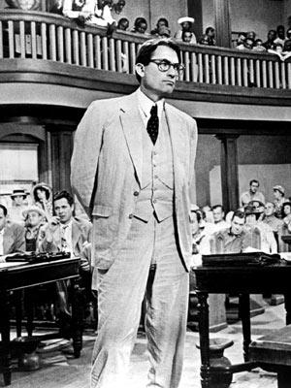
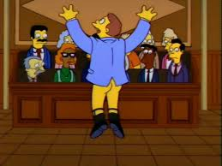
Finding your authentic style

Slide 20
Confidence
What message do you send when you speak softly? “I’m sorry, I’m nervous.”
How about when you mumble? “I’m sorry, I’m not very sure about what I’m saying.”
How about when you slouch in your seat or walk tentatively from one side of the courtroom to the other? “I’m sorry, I probably don’t belong here.”

Slide 21
How to Demonstrate Confidence
1. Demonstrate your mastery of the facts of the case
2. Know what you want to accomplish
3. Why you want to accomplish it
4. How you intend to accomplish it
5. In short, be prepared

Slide 22
Integrity
Latin – integritas – wholeness or soundness, complete in itself.
Lawyer’s integrity – unsullied, unbroken, and undivided moral principle, e.g., quality of the whole and honest lawyer.

Slide 23
How do I show integrity in the courtroom?
Do not overstate your case.
Do not promise evidence you cannot deliver.
Do not make arguments you cannot support.
In other words, follow ethical and procedural rules.

Slide 24
Respect
Treat everyone in the courtroom with respect.
Yes, even your opponent – you don’t have to like your opponent, but you must show respect.

Slide 25
Respect II
Do not use bullying tactics to intimidate your opponent.
Do not attempt to distract the judge during your opponent’s presentation.
Do not try to disrupt opposing counsel’s argument or use facial expressions, grimaces, or gestures to argue your case during opposing counsel’s argument.

Slide 26
Accepting loss
Above all else, be a good loser
  Remember, you can lose a few battles and still prevail.
  Don’t display your frustration or worse, take the loss out on others.
  Let it go and move ahead.

