Slide 1
Getting Your Ideas Heard
Negotiation as problem solving
Persuasion and influencing skills are critical
How to resolve conflict

Slide 2

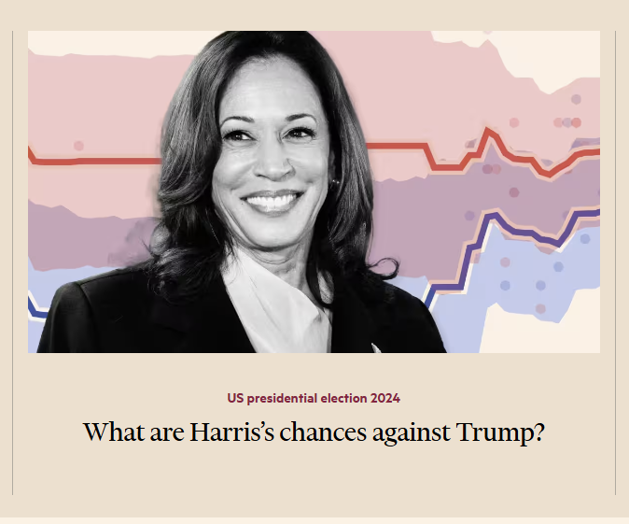
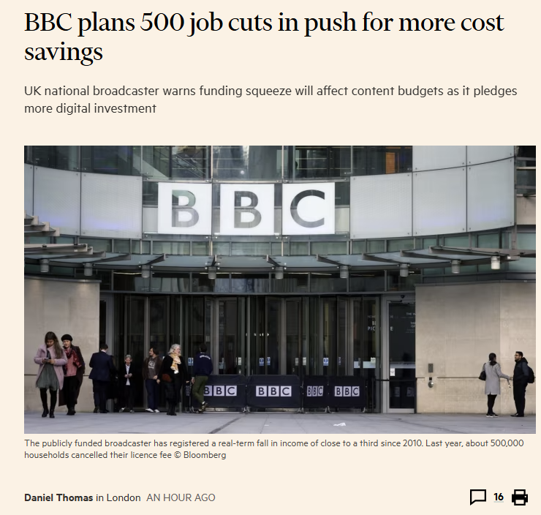

Almost Everything we do, we do Together
Financial Times (ft.com)
Notes:
Even walking down the street together is importantly different from walking separately
E.g., How do the others feel if one person wanders off? Walks too fast? Etc, etc
2

Slide 3

https://youtu.be/h2WLI9AqDvM
https://www.youtube.com/watch?v=h2WLI9AqDvM
Activity Question:
What does Mike do to reach a deal?

Slide 4
What is inside your negotiating partner’s mind?
Judgments of Authenticity – involves interpretations about the other’s intentions, which are likely to be influenced by emotional expressions - improve with experience
Creative problem solving – improves with practice – shared experiences
Understanding interests – key in integrative negotiations and gaining agreement
Leads to Trust

Slide 5
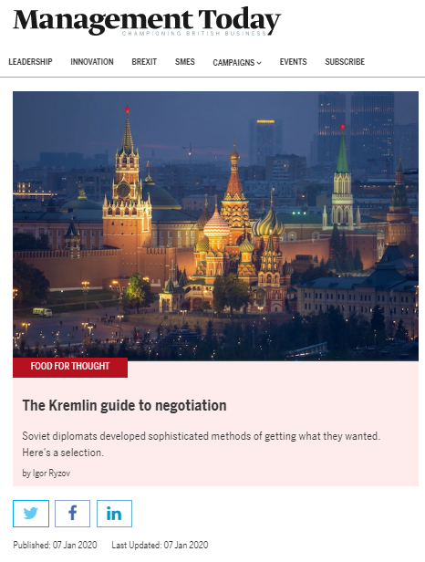
Cultural Contexts
https://www.managementtoday.co.uk/kremlin-guide-negotiation/food-for-thought/article/1670017

Slide 6
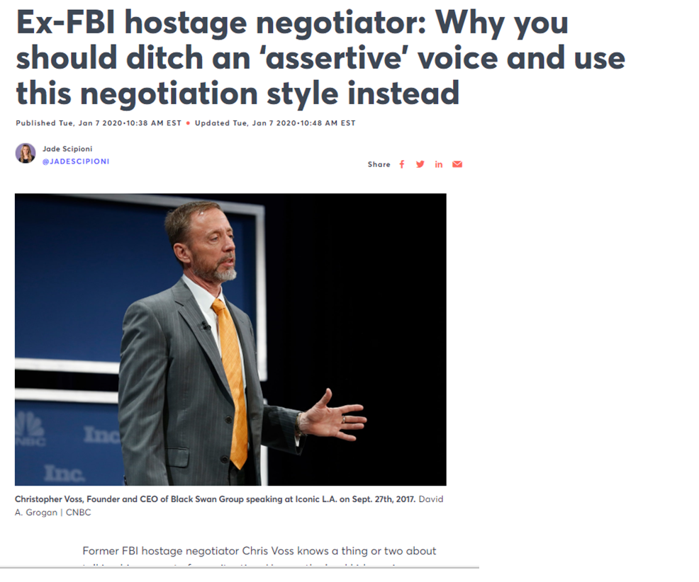
Extreme Contexts
Can we build a model of the process of negotiation in an extreme situation e.g., a hostage situation?
https://www.cnbc.com/2020/01/07/ex-fbi-negotiator-chris-voss-how-to-negotiate.html

Slide 7

Value creation and Integrative Negotiation
Old farm exercise
Notes:
Negotiation is about understanding your own and the ‘others’ bases of power
Context is almost everything: even a 1to1 negotiation is a special type of group decision making
The world does not stay the same – your actions change the actions of others – seek rules but have the wisdom to know when to break them.
Maximise both your own and the other parties outcomes
It is often not apparent what value can be created until two parties work at figuring it out.
Value creation is in the service of value claiming—if you can create it, then you can claim some it.
Searching for issues that you and your counterparts' value differently can increase the value of the negotiation.
Set your reservation price at the level of the “deal” or the package rather than at the issue level.

Slide 8
Instructions
There are two negotiators.
Find a partner and decide who will be the seller and the buyer.
You will then be given confidential information and take a few minutes to consider your position and outline a negotiation strategy. Questions to ask yourself are :
What is your own position and interest?
How can you discern the position and interests of the other party?
What information do you need?
Are you able to walk away from the negotiations, in other words, do you have a viable alternative to a negotiated agreement?
Before you start to negotiate consider who should open the negotiations and why?
You will be given some additional information during the exercise…so do not reach a deal before then
When the negotiations are complete, explore with each other how you think the negotiations went: your own performance as well as that of the opposite number. What might you do differently?

Slide 9
Additional information
A press release by the local newspaper states that the area may become a ‘Business Park’.
Re-negotiate

Slide 10
Negotiation Approaches
Distributive
Resources appear limited and fixed, so parties want to maximize their respective shares:
WIN-LOSE
Competitive
The problem for the parties is how to find out what each values (the resource)
Integrative
Resources not fixed.
Both parties can achieve their goals:
WIN-WIN
Cooperative
Negotiator’s Dilemma
10
Notes:
10
Buying a car or a house
Job Negotiations
Peace settlements
Sharing a pie - what is the total value of the pieIntegrative
A definition
Two or more bargainers jointly decide on a determinate value over two or more issues.
Goals are not necessarily mutually exclusive.
This can make the negotiations more collaborative than those involving the settlement of festering disputes.
Often called “win-win”
Distributive Negotiation often comes after integrative value creation.

Slide 11
Developing a BATNA
Best Alternative To A Negotiated Agreement
Produce a list of alternatives
Evaluate these alternatives: practical, plausible, reasonable and available
Which seems – tentatively – the best
…but! Do you have a real option?

Slide 12
First Offers: Should you make the first offer?
Naïve negotiators think not
Why? Making the first offer anchors the negotiation at a number of your choosing, influencing every subsequent stage – disclaimer: you need to have done your preparation and understood what the interests of the other side are.
Universality: Holds across cultures
The offer is a form of communication - provides information about the value you place on the resource
→The first offer does not mean you it is the first thing you do! Only make an offer when you know the other side, what might be a ‘realistic’ price and the pressures on the other side.
Gunia, B.C., Swaab, R.I., Sivanathan, N. and Galinsky, A.D., 2013. The remarkable robustness of the first-offer effect: Across culture, power, and issues. Personality and Social Psychology Bulletin, 39(12), pp.1547-1558. https://www.researchgate.net/profile/Brian_Gunia/publication/255959274_The_Remarkable_Robustness_of_the_First-Offer_Effect_Across_Culture_Power_and_Issues/links/543997780cf24a6ddb95db0f.pdf
Notes:
On average those who make the first offer get more than those who receive the first offer
Making the first offer influences how much value that negotiator may claim but does not influence how much value they create
Making the first offer and getting more influences both parties in a post-settlement settlement conference to give the negotiator who made the first offer more.
Making the first offer results in getting more even when the negotiator has less power than his/her counterpart
These effects hold across cultures.

Slide 13
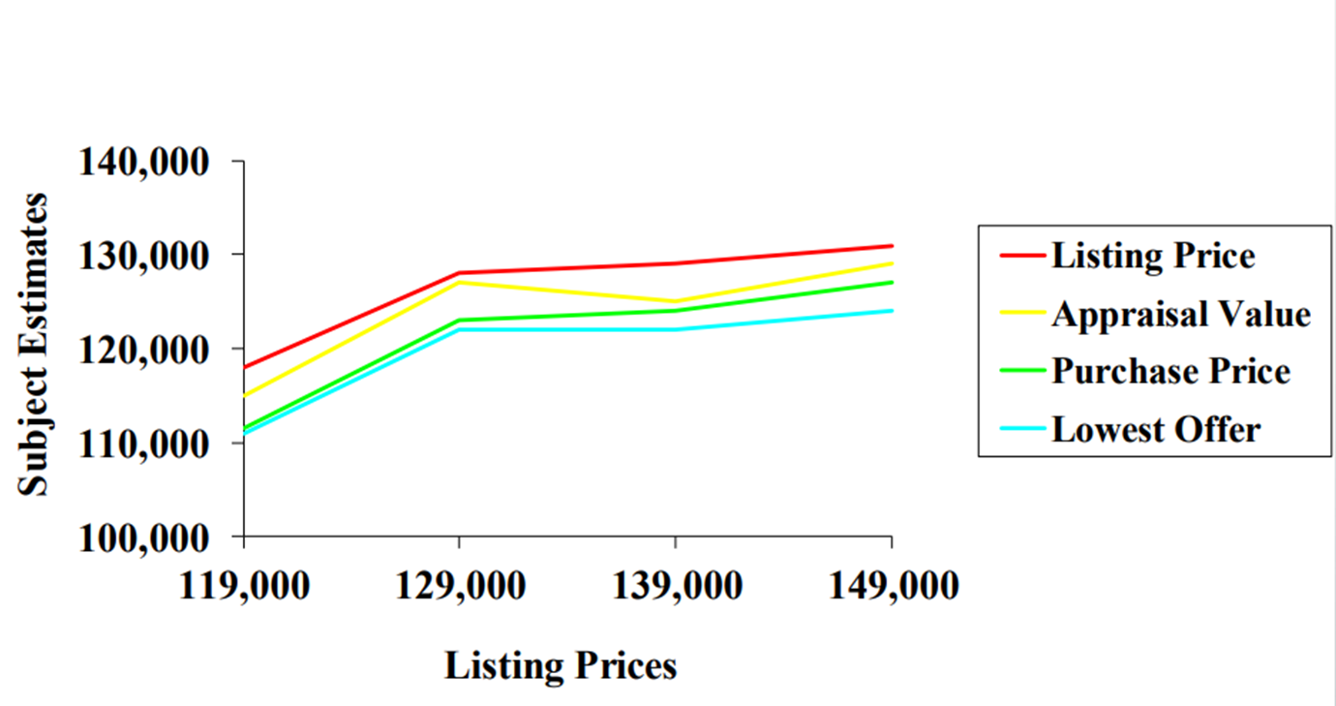
First Offers: Should you make the first offer?
The first offer has the Power of the Anchor – negotiation varies around the anchor
House Prices
Gunia, B.C., Swaab, R.I., Sivanathan, N. and Galinsky, A.D., 2013. The remarkable robustness of the first-offer effect: Across culture, power, and issues. Personality and Social Psychology Bulletin, 39(12), pp.1547-1558. https://www.researchgate.net/profile/Brian_Gunia/publication/255959274_The_Remarkable_Robustness_of_the_First-Offer_Effect_Across_Culture_Power_and_Issues/links/543997780cf24a6ddb95db0f.pdf
Northcraft, G.B. and Neale, M.A., 1987. Experts, amateurs, and real estate: An anchoring-and-adjustment perspective on property pricing decisions. Organizational behavior and human decision processes, 39(1), pp.84-97.
Notes:
On average those who make the first offer get more than those who receive the first offer
Making the first offer influences how much value that negotiator may claim but does not influence how much value they create
Making the first offer and getting more influences both parties in a post-settlement settlement conference to give the negotiator who made the first offer more.
Making the first offer results in getting more even when the negotiator has less power than his/her counterpart
These effects hold across cultures.

Slide 14
Should you accept the first offer?
Generally, no …there is a game at play!
Your counterpart will expect to negotiate, so is either lower or higher (depending on if they are buyer or seller) than they expect to achieve.
May conclude they underestimated value if offer is accepted
A bit of playacting reluctance can make your counterpart more comfortable and even improve your reputation
→ everyone leaves feeling they have achieved the best deal

Slide 15
Were there any ethical or other issues?
Negotiation is a social situation where lying is acceptable….unless you are caught lying!

Slide 16
Conflict Resolution Styles and the Dual-Concern Theory

Slide 17
One to One : Dealing with difficult conversations…the basis of negotiation - how to avoid conflict and create resolution
Negotiation event
Remind yourself of what you are here for
Discuss around options –Provide assistance to their problems (defined by them)…requires adaptation within the discussion …how do you avoid ‘giving’ things away or setting unwanted precedents
Be cool: Behaviourally professional – tone/ respect/ concern + don’t get drawn into diversions or destabilising (stone-walling, sarcasm, accusing, silence, anger)
Stop and Think – how to avoid cognitive bias
Know when to walk away or terminate (professionally) the negotiation
Notes:
https://www.americanexpress.com/en-us/business/trends-and-insights/articles/top-ten-tips-for-handling-the-difficult-conversation/
1. Be clear about the issue or conflict.
If you are unclear on why the discussion needs to happen, you won’t be able to articulate it clearly to the other person. Moreover, they might misinterpret your intentions.
2. Know what your desired end result is.
Think about how the conversation will fix the situation. What do you need the person to agree to? What support will you provide? What do you both need to agree on to help the situation?
3. Check your mindset.
Ensure you approach the conversation with a positive attitude. The more calm and comfortable you are, the better you will handle any conflict. Additionally, check for hidden purposes behind initiating the discussion. Will the conversation fix anything or just make you feel better?
4. Choose an appropriate setting.
Your office might not be the best place to stage a conversation. Instead, consider holding the meeting in a neutral place such as a meeting room, or a friendly location like the local coffee shop. Use your judgement to determine what’s appropriate for the conversation and your company culture.
5. Stick to the facts and evidence.
State only the facts and provide real evidence of the problematic behaviour. Additionally, ensure you objectively outline the impact of their behaviour on their work and the workplace.
6. Be okay to sit in silence.
There will be silent moments in the conversation. Don’t rush to fill the silence with words. The other party may just want to think before they speak, so allow them their moment.
7. Deal appropriately with thwarting tactics.
Thwarting tactics include stonewalling, sarcasm, and accusing. Address the tactic openly and sincerely. And disarm it by labelling the observed behaviour.
8. Preserve the relationship.
Your goal is to make the person aware of the problem and fix it, not destroy your working relationship. Therefore, don’t shame or embarrass them. Don’t go into the conversation with a my-way-or-the-highway attitude either. Moreover, listen to their side of the story, so they feel they are getting a fair “trial”.
9. Have the right tone of voice.
You’re having a discussion, not an inquisition, so ensure that comes across. Moreover, ensure your language is simple, clear, direct, and neutral.
10. Plan what you might say, without scripting it.
Before the conversation, jot down notes and key points of what you want to say. Don’t draft a script though, as the meeting is unlikely to go according to your plan.
11. Give something back.
Offering up options helps the other person see a positive side to the conversation. For example, if you’re laying someone off, write them a recommendation. Or if you need to take someone off a project, give them a fair alternative.
12. Keep it professional.
Remember that your conversation is a business discussion. Be honest but respectful. Avoid inappropriate language and focus on the person’s behaviour or performance. Also, decide if it would be more appropriate to have a third person present.
Having difficult conversations is never easy. However, with skills and practice, work life and its inevitable conflicts can become more productive and comfortable for everyone involved.
17

Slide 18
Dual-Concern Theory where Yes means Win:Win
The most effective negotiation strategy and the best outcomes will occur when the negotiators have a dual-concern:
Care not only about their own outcomes but also the outcomes of the other party.
Dual-Concern Theory
Peter J. Carnevale
In: Encyclopedia of Management Theory
Edited by: Eric H. Kessler
DOI: http://dx.doi.org/10.4135/9781452276090.n74
Shell, G.R., 2001. Bargaining styles and negotiation: The Thomas-Kilmann conflict mode instrument in negotiation training. Negotiation Journal, 17(2), pp.155-174.

Slide 19
Thomas-Kilmann Dual Concern Negotiating Style
DISTRIBUTIVE
INTEGRATIVE
Assertive
Competing
Collaborating
Compromise
Assertiveness
Avoiding
Accommodating
Unassertive
Uncooperative
Cooperative
Cooperativeness
Notes:
Contend (also called contending, competing, forcing, dominating, win-lose). In this conflict style, individuals strive to get what they want, with little or no concern for the other party in the conflict. They are contentious and engage in competitive behaviors and tactics trying to force the solution that they want by dominating the interaction with the other party.
Avoid (also called withdrawing, inaction, avoiding, or lose-leave). In this conflict style, individuals seek to withdraw from or avoid the conflict by not dealing with the other person. They do so even though this may mean that they themselves will not benefit from the dispute. Neither they nor the other party receives a good outcome.
Compromise (also called compromising or sharing). In this conflict style, individuals make concessions and give in on some things in exchange for concessions or compromises from the other party in the dispute. Although the individuals’ outcomes are not as high as they could be in either contending or collaborating styles, the parties are striving to achieve some form of mutually acceptable agreement.
Accommodate (also called accommodating, appeasing, obliging, smoothing, yielding, or yield-lose). In this conflict style, individuals yield or give in to the other party’s interest and desires. They oblige the other party and appease them by giving them what they want, even though they themselves get very little or nothing in return.
Collaborate (also called collaborating, confronting, integrating, problem solving, or synergistic). In this conflict style, individuals work collaboratively with the other party in the dispute to create solutions which enable both parties to get more. The goal is that both parties can win. This conflict style can be thought of as the golden rule of conflict management since it is consistent with the idea that you should treat others as you would like to be treated.
19

Slide 20
Negotiating Styles are not mutually exclusive
… An experienced negotiator can adapt their negotiating style according to the context.

Slide 21
The power of questions or respectful inquiry

Slide 22
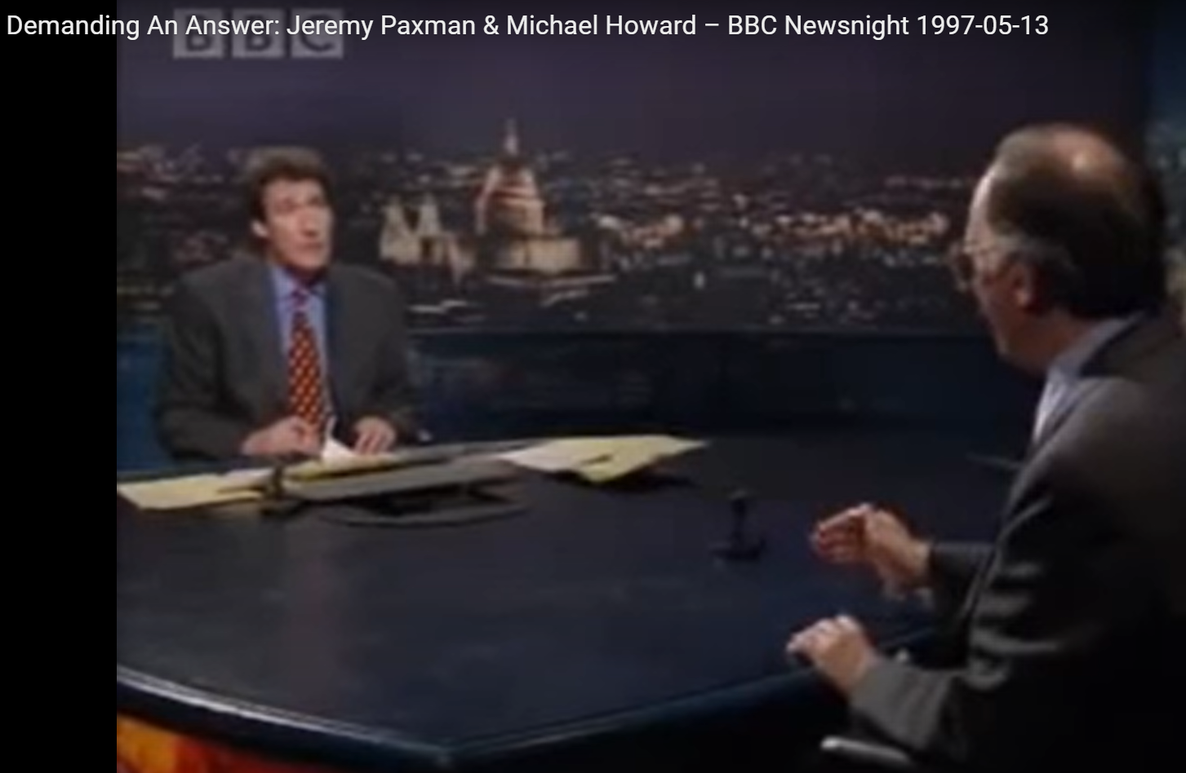
https://youtu.be/pyqnu6ywhR4

Slide 23
The power of questions
Unless people are trained/told to do otherwise, they will automatically respond to questions by believing in their legitimacy (Gilbert, 1991, “How mental systems believe.”)
There is a social cost to not attempting to answer your questions (Flynn & Lake, 2008, “. If you need help, just ask: Underestimating compliance with direct requests for help”)
Notes:
Flynn, F.J. and Lake, V.K., 2008. If you need help, just ask: Underestimating compliance with direct requests for help. Journal of personality and social psychology, 95(1), p.128.

Slide 24
Questioning Strategies and Power
Type of Question | Power and effect
‘WH’ questions: who, where, what , why, how | Allows a wide range of responses
Yes/ No question [polar or digital questions] | To restrict and channel the listener to the questioner’s advantage e.g., there are many others waiting to buy, you don’t want to regret not buying it?
Either/ Or question | The restrict options to suit the questioner e.g., you can have more pay or more holidays but not both
Referential questions | ‘Socratic’ – designed to teach e.g., have you thought about the position of the other party
Confirmation questions | Seeking confirmation or agreement e.g.,, do you think this will work? e.g., do we have a deal?
Rhetorical questions | For effect –no answering move is allowed e.g., So what will be the barriers…they will be…

Slide 25
Respectful inquiry
Respectful inquiry as the multidimensional construct of asking questions in an open way and subsequently listening attentively, which, in their interplay, signal the degree to which a person invites an addressee to (continue to) share his/her thoughts on a subject during a conversational episode.
Van Quaquebeke, N. and Felps, W., 2018. Respectful inquiry: A motivational account of leading through asking questions and listening. Academy of Management Review, 43(1), pp.5-27.

Slide 26
Respectful inquiry
Allow the person to talk – do not assume
Active listening
Knowing the Discourse community
Respectful inquiry as the multidimensional construct of asking questions in an open way and subsequently listening attentively, which, in their interplay, signal the degree to which a person invites an addressee to (continue to) share his/her thoughts on a subject during a conversational episode.
Purposeful questions – not designed
to evade or distract or abuse of power...
…used to explor
Defining and Resolving the Problem…
…JOINTLY
Closed – yes/no
Limited openness – giving a choice/ directing discussion
Open – seeking information

Slide 27
Negotiation as Story Telling
When you persuade yourself

Slide 28
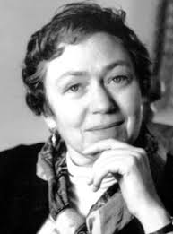
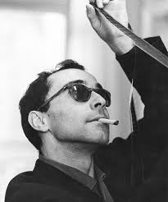
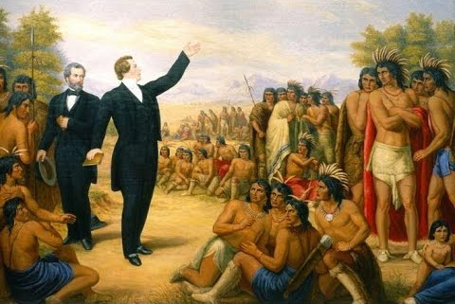

"The human species
thinks in metaphors and learns through stories."
Mary Catherine Bateson
"Sometimes reality is too complex.
Stories give it form."
Jean Luc Godard
"Those who tell the stories
rule the world."
Hopi American Indian proverb
Jean-Jacques Rousseau
Kondiaronk
(Huron ‘chief’)

Slide 29
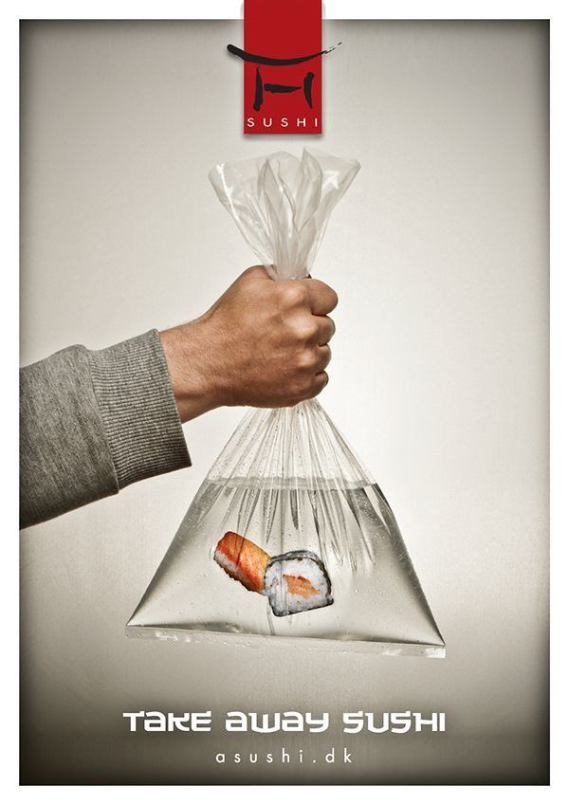



Slide 30



Slide 31
Three Little Pigs and the Big Bad Wolf
https://www.youtube.com/watch?v=vDGrfhJH1P4&pp=ygUbdGhyZWUgbGl0dGxlIHBpZ3MgYXJyZXN0ZWQg

Slide 32
Writing Poetry

Slide 33
Step1:
Think of something important to you & Write down a set of keywords

Slide 34
Step 2
Write some short prose using the keywords

Slide 35
Step 3:
Look at your prose and see if you can use fewer words

Slide 36
You are a CEO
Create a 1-minute speech of a vision for your organisation
Work in groups of 3
Individually Take 5 minutes to prepare
Present to your group – get feedback

Slide 37
Story telling requires a listener

Slide 38
Attentive Listening
Attentive listening behaviour includes:
Eye contact
Facial expressions (expressions consistent with the emotional tone of the speaker)
Head movements that convey understanding (e.g., nodding)
Occasional verbal reassurances that encourage the speaker to continue (e.g., saying “uh huh” or “sure”), and
Expressing emotion (e.g., wincing or exclaiming)
Notes:
1 A study by Pasupathi and Rich (2005) suggests, however, it is not important for the listener to agree with the speaker. Instead, it is the signal of alertness and responsiveness that is crucial for the conversation, since these perceived listening cues indicate to the speaker whether what they have to say is valuable and worth remembering (Bavelas et al., 2000; Pasupathi & Hoyt, 2010).
Blow back effect: ask a question and then gaze off, check their phone, interrupt the response, or otherwise demonstrate that they were not listening to the follower. Such a configuration can confuse, hurt, or offend = DISRESPECTFUL

Slide 39
Barriers to Attentive Listening
Time pressure
Physical distance
Cognitive load
Cognitive load refers to the total amount of mental effort needed to solve a certain problem
Informational asymmetry
Need to explore…ask questions
History of the relationship

Slide 40
Persuasive arguments
Or what is it we should be saying to become persuasive:
Lessons from Europe and China

Slide 41
Classical European Rhetorical terms
Term | Definition | Application/ Skills
Logos | Rational & Logical | Story telling –setting out the facts and showing we have proved a truth
Pathos | Emotion; an appeal to the emotions, passions, and affects on the listner | Our own frame of mind & expressing feelings in the language used
Ethos | Ethics, law and what is perceived as ‘right’ in the situation | Expertise Reputation (Trust worthiness, Honesty)
https://www.oxfordhandbooks.com/view/10.1093/oxfordhb/9780199731596.001.0001/oxfordhb-9780199731596-miscMatter-9#oxfordhb-9780199731596-miscMatter-9-item1-282

Slide 42
Classical Chinese Rhetorical terms
Ming bian xue (名辩学) equivalent to Western study of rhetoric
Term | Definition | Application
Yan (言) | speech, talks and the use of language | Logical
Ci (辞) | modes of speech, types of discourse, eloquence, style | Art of persuasion
Jian（谏） | giving advice, persuasion | Persuasion through expertise
Shui/shuo（说) | persuasion/ explanation, idea, thought | Changing mental models
Ming（名) | naming, symbol using, rationality, epistemology (probability, relativism and classification) | Symbols in social contexts
Bian（辩) | distinction change, justice-eloquence, arguments, persuasion, debate, disputation discussion | Truth and Justice
Rhetorical devices include: metaphorical, anecdotal, analogical, paradoxical, chain reasoning, classification, and inference.

Slide 43
Learning from Chinese and Greek Philosophers
Speech was highly valued and encouraged. Argumentation and debates were common among philosophers and disputers (bian shi 辩士 and bing jia 名家).
Confucius taught his disciples to practice xin yan (信言, trustworthy speech). It was qiao yan 巧言, clever and manipulative speech that he disliked…we should be able to identify such speech and ignore it.
Dislike of glib speakers or speakers with “flowery and empty words” (Lu X. 31)
Aristotle and Plato’s distaste for the Greek sophists [A plausible but misleading or fallacious argument.]
Rhetorical devices:
metaphorical, anecdotal, analogical/emotional, paradoxical, classification, inference.

Slide 44
Your skill set
Actively curious & Inquisitive demeanour
Accept uncertainty and understanding different perspectives inherent in human interaction
Efforts to stop and rewind misunderstandings
Reflecting back
Attention to comprehending highly charged emotions
Self-disclosure about one’s own thoughts and feeling in ordinary language to model good mentalizing
https://www.psychiatrictimes.com/special-reports/mentalization-based-treatment-common-sense-approach-borderline-personality-disorder

Slide 45
Takeaways

