Slide 1
Strategic Management
Warwick Summer School
16th July 2024 Denise Kendry

Slide 2
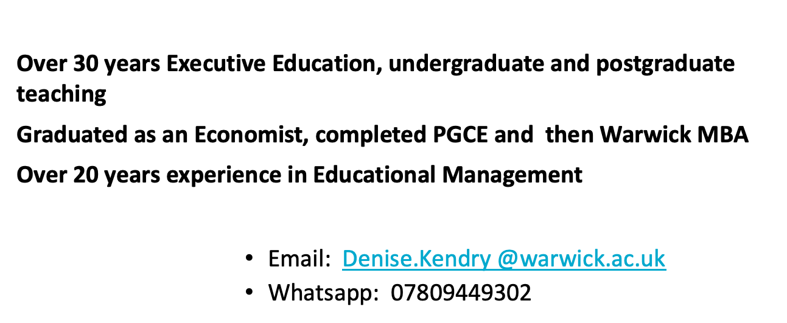

My profile

Slide 3
Setting Expectations -a reminder
Active participation and discussion is great for building professional skills
Sharing our experiences and observations will accelerate the learning process
Focus on developing skills not simply describing concepts and framework

Slide 4
Plan for next two days
Session 2: The External Environment I: Macro-environmental trends and how they impact business
Session 3: The External Environment II: Competition and gaining a competitive advantage

Slide 5
Session 2 Part 1
The External Environment
Macro environmental trends and how they impact business

Slide 6
What are the objectives of this morning 's session
The External Environment, I
Macro-environmental trends and how they impact business
To analyze the impact of external factors on organizations
To consider how organizations might respond
To discuss macro shocks
To examine sources of information to support the above

Slide 7
The strategic context
Strategy is concerned with the setting of long-term goals and establishing the means to achieve those goals
Organizations need to understand where they are before they move forward
Analyzing and understanding the environment is part of the strategic process
How the organization is affected by the environment ( environmental scanning and analysis)
Identifying a strategic response to these by the organization

Slide 8
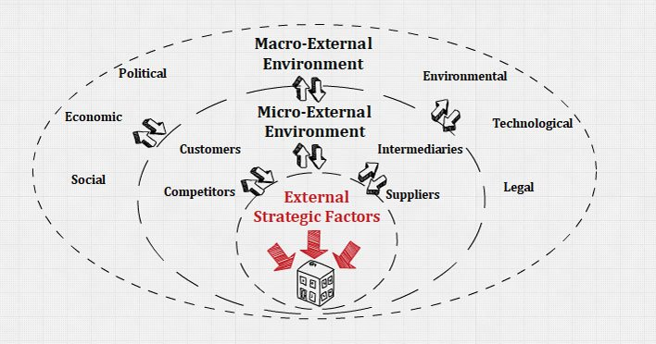
Levels of the external environment

Slide 9
How does the external environment affect business? Your ideas
In small groups draw up a list of external factors that you think are impacting or are going to impact organizations over the next 5-10 years?
Are any of these specific to your country?

Slide 10
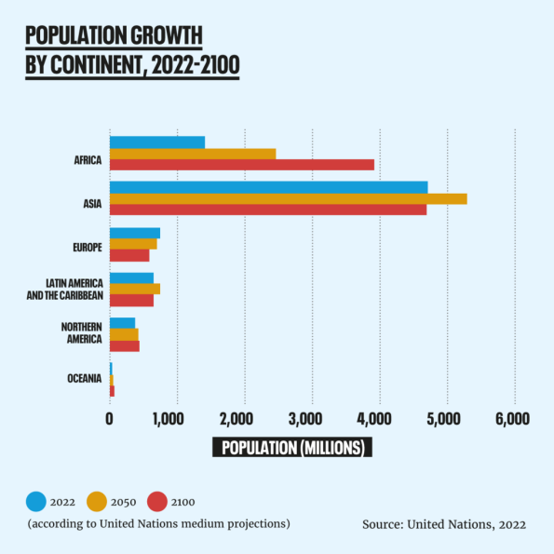
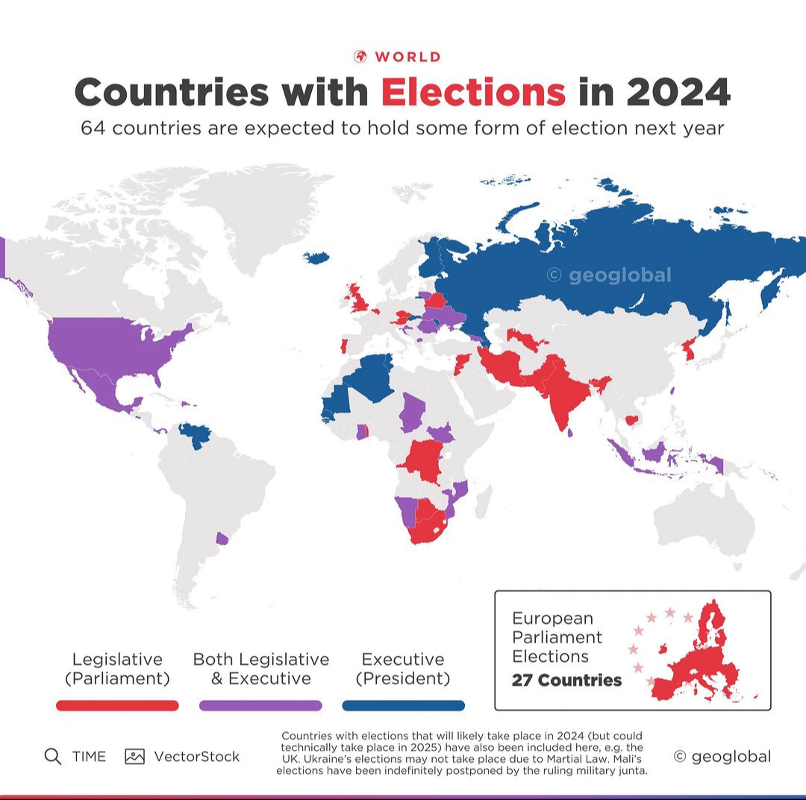
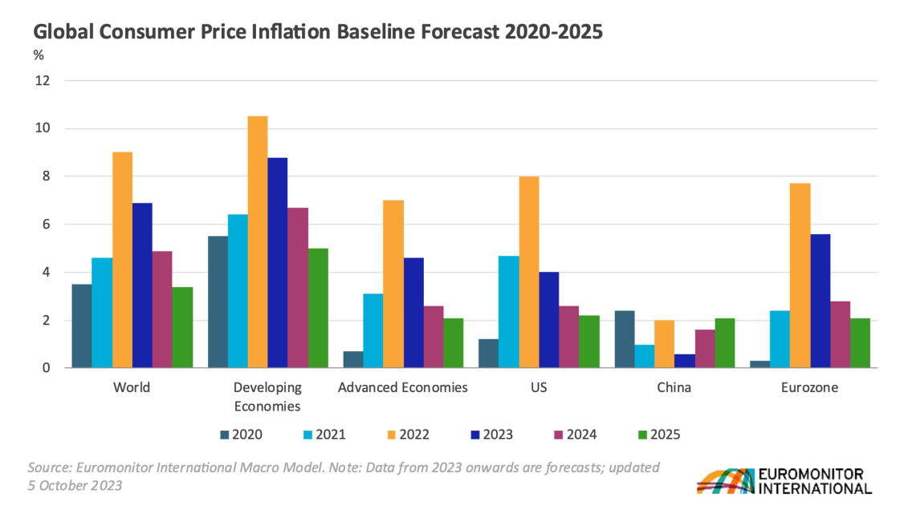
Som current examples

Slide 11
Challenges facing organizations in 2024
These can be general e.g. economic situation, changes in government policy, geopolitical tensions
Or specific to a particular industry e.g. EU raises differential tariffs on Chinese Electric cars such as SAIC, BYD and Geely(BBC News 04/07 /2024)

Slide 12
What the experts say-Standage (2024) tends to watch in 2024
Political landscape/ America's choice
Europe /Middle East
Multipolar disorder
Second Cold War
New energy geography
AI

Slide 13
PWC Megatrends 2024
Climate change
Technological disruption
Demographic shifts
Fracturing world
Social instability

Slide 14
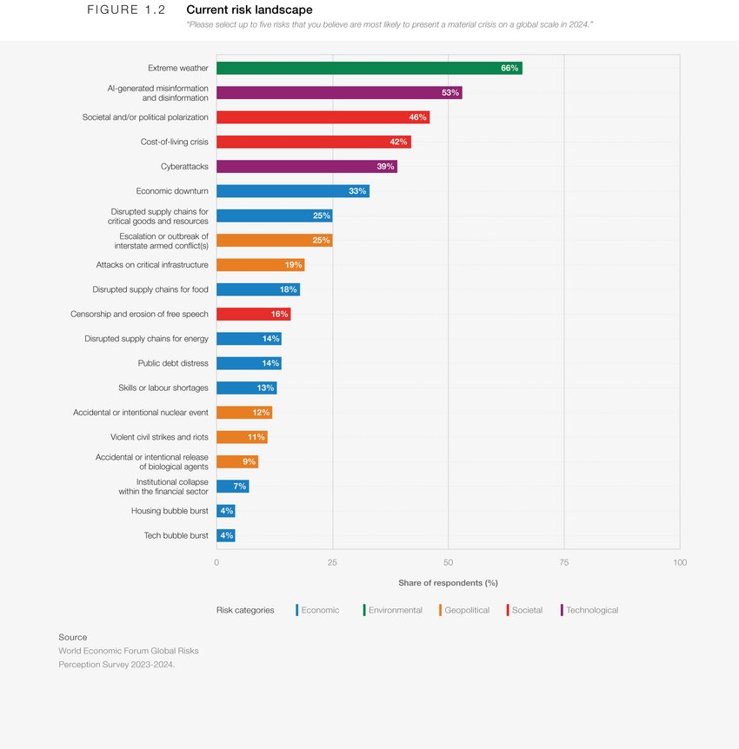

Slide 15
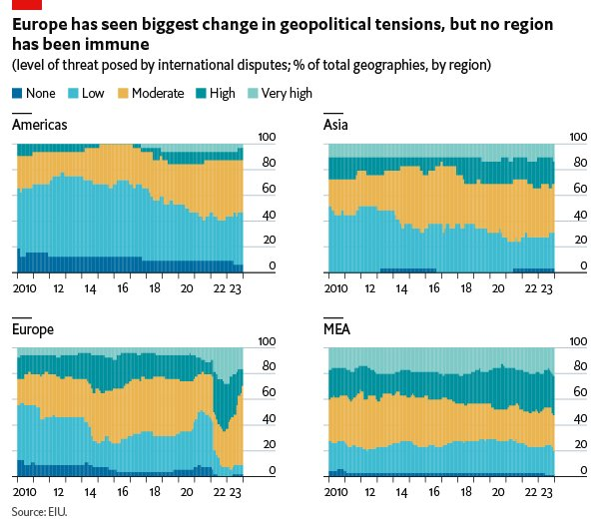

Slide 16
ESTEMPLE
Potential Macro Shock | Data | Example Source
Economic | GDP, employment, interest rates | WEF, OECD
Social | Demographics, culture & values | Sources of Demographic Data on the Web | Round Tables (ala.org)
Technological | Current and future products, internet penetration | Consulting company Trends Reports, Gartner, Forrester
Ecological | Sustainability, CO2
Media | Channels, openness
Political | Stability, policy
Legal | Employment law, health and safety
Ethical | Standards, transparency | ISO ISO - ISO 26000 — Social responsibility

Slide 17
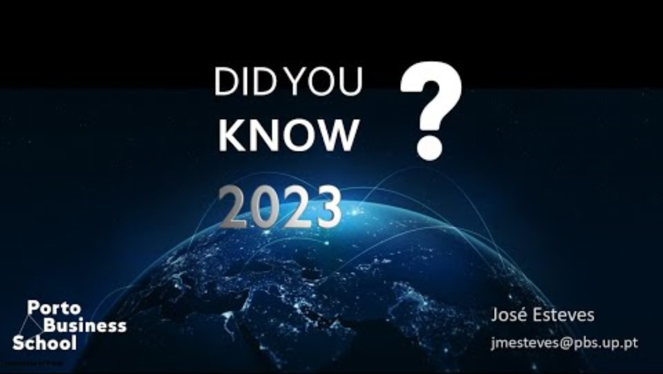
Technology

Slide 18
The Changing Environment
What are the key learning points you take from this video?
Would you do anything differently as a result of the video ?

Slide 19
ESTEMPLE - The Airline sector a worked example
Economic
Social
Technological
Ecological
Media
Political
Legal
Ethical

Slide 20
ESTEMPLE –The Airline sector
Economic – price of oil, economic situation
Social – Demographics, changing travel habits
Technological – May impact supply chain, user interface , how people buy
Ecological – Carbon footprint and emissions
Media – Using channels to maintain brand awareness and trust
Political – state involvement, geopolitical tensions, trade wars
Legal – Regulatory and legal requirements
Ethical -

Slide 21
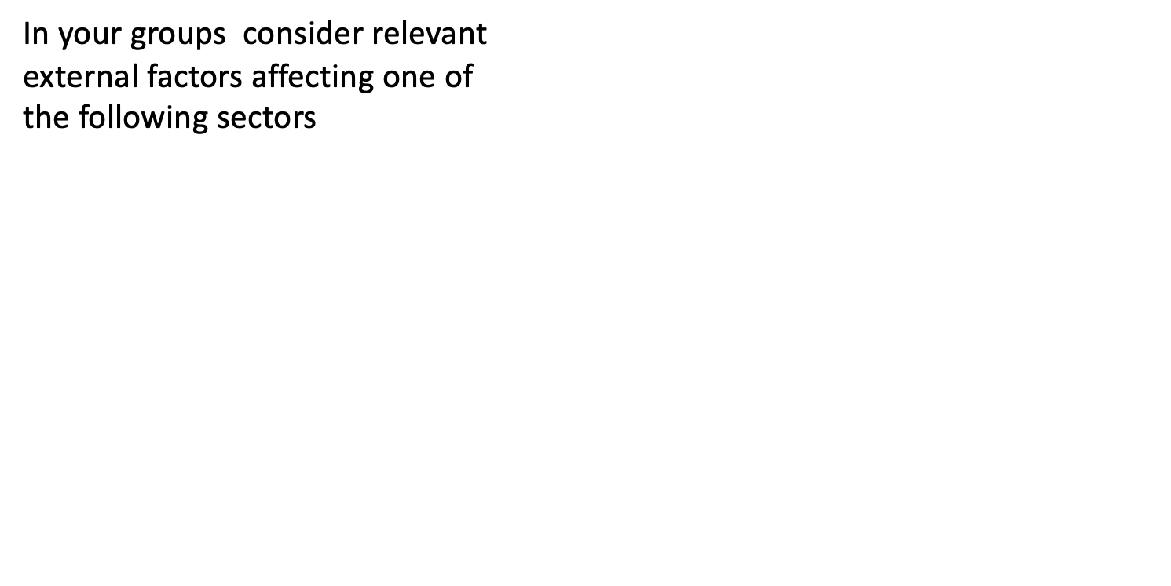
Now your turn!
The automotive /electric vehicle sector​ -use online resources
Pharmaceuticals​
Financial Services​
Online retailing/ retailing
Another of your choice
Discuss examples of environmental challenges and how some companies in these sectors have responded to these

Slide 22
The global auto industry
Examine the data pack on the car industry online and identify the key environmental factors that affect
a) the global car industry
b) the EV sector
What are your findings?

Slide 23
How organizations can respond
By analyzing the external environment (known as environmental scanning ) organizations can determine the potential impact on the company ( forecasting and diagnosis ) to then determine their response.
Opportunities and threats
Scenarios

Slide 24
RECENT MACRO SHOCKS
COVID 19
Brexit
Icelandic volcanic eruption
Question : How did companies respond to these shocks and how these affected them in the long term?
Winners or losers?

Slide 25
Dimensions of environmental turbulence
Dynamism
Complexity
Unpredictability

Slide 26
Examples | Examples
Examples | Examples
Complex and Stable
Stable
Simple and Stable
Universities
Chemicals
Insurance
Soft Drinks
Container manufacturers
Environmental Change
Complex and Unstable
Simple and Unstable
Fashion
Toys
Oil Telecoms
Aerospace
Health care
Unstable
Simple
Complex
Environmental Complexity

Slide 27
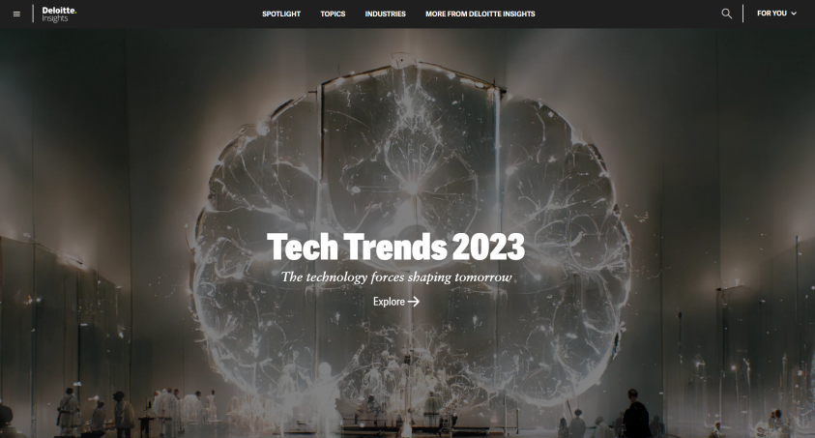
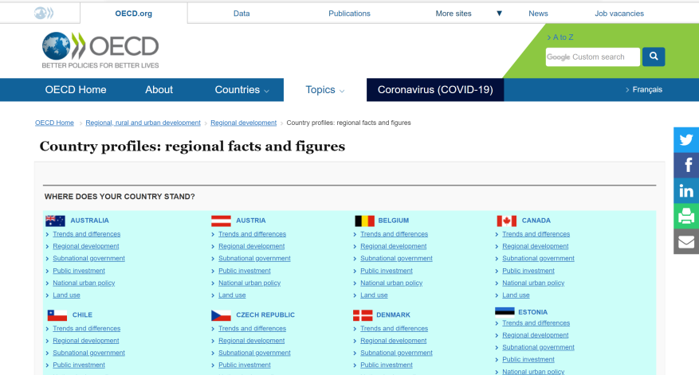
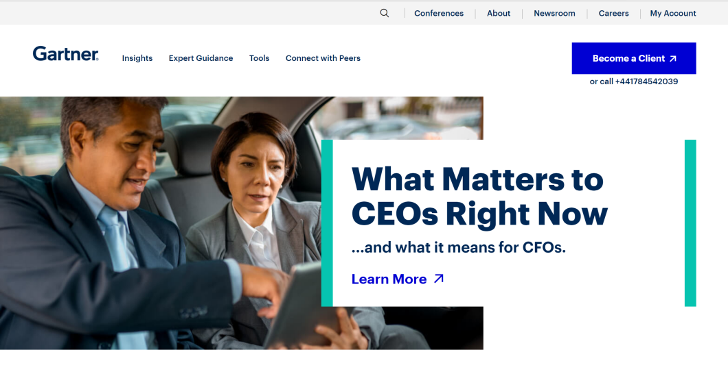
Some useful sources
Sources you need to know about…

Slide 28
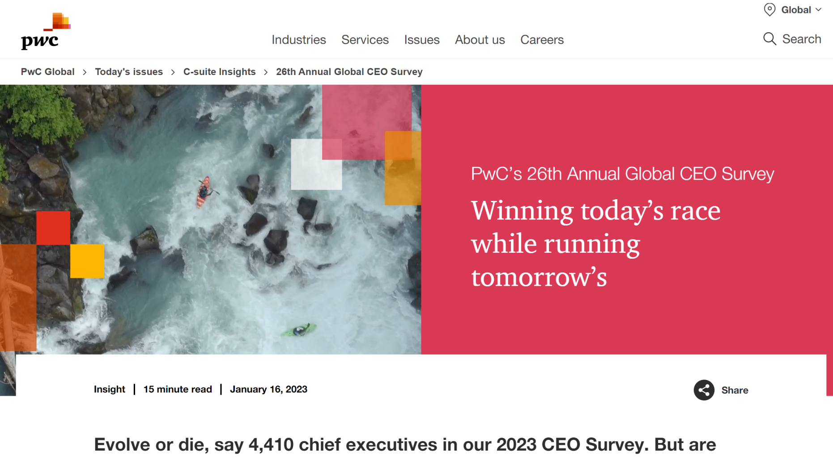
Surveys

Slide 29
To summarise we have covered how to
To analyze the impact of external factors on organizations
To consider how organizations might respond
To discuss macro shocks
To examine sources of information to support the above

Slide 30
What are the objectives of this afternoon's session?
To identify the stakeholders in an organization and their expectations?
To analyze their power and influence

Slide 31
Shareholder v Stakeholder Theory
The business of business is business ( Friedman 1970)
On one side of the current debate are those who argue that, to borrow Milton Friedman's phrase, "the business of business is business." This belief, most established in Anglo-Saxon economies, implies that social issues are peripheral to the challenges of corporate management. The sole legitimate purpose of business is to create shareholder vaue.

Slide 32
Who are an organization's stakeholders?
“Any group or individuals who can affect or be affected by the achievement of the organization’s objectives” (Freeman 1984,46)

Slide 33
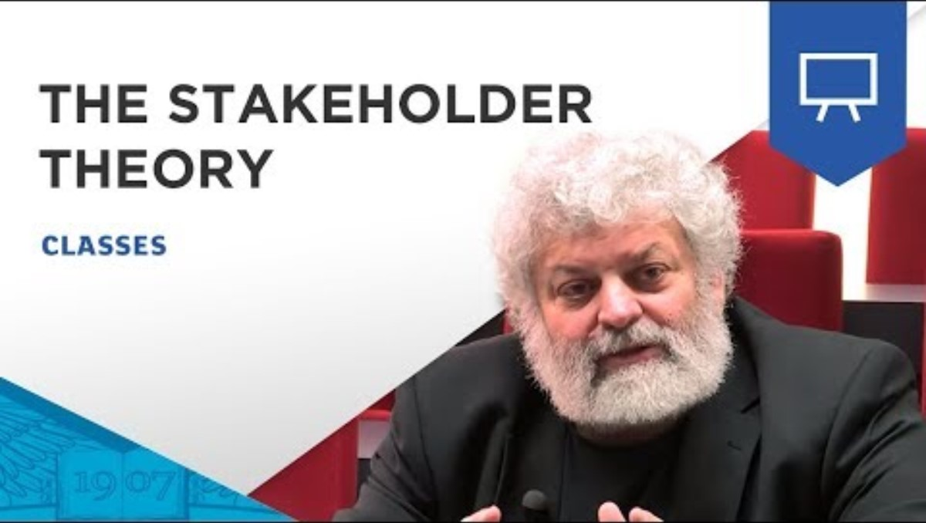
Who are an organization's stakeholders?

Slide 34
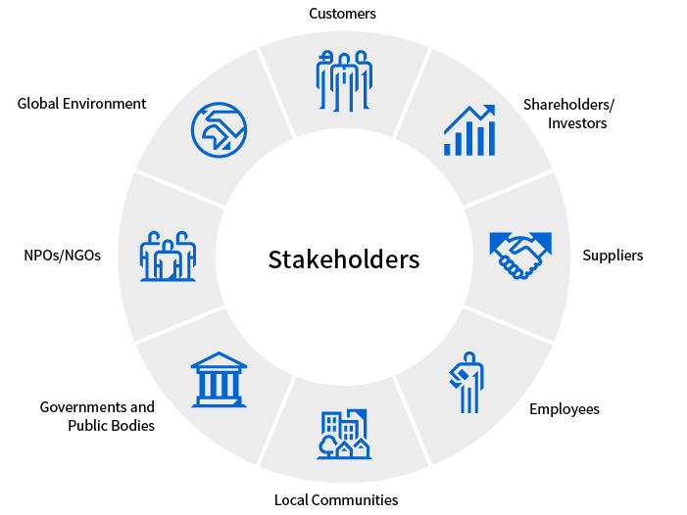
STAKEHOLDERS
Ref: Stakeholders | Sustainability | Toshiba (global.toshiba) Accessed 13th June 2022

Slide 35
Stakeholder expectations
•Goods at right time, price and quality
•Dividends, increased share price
•Reasonable wages, good working conditions, job security
•Salary, perks
•Payment on time, regular orders
•Fair trading practices
•Loans and interest repaid on time
•Employment, wealth -Noise, pollution-lack of
Taxation, employment

Slide 36
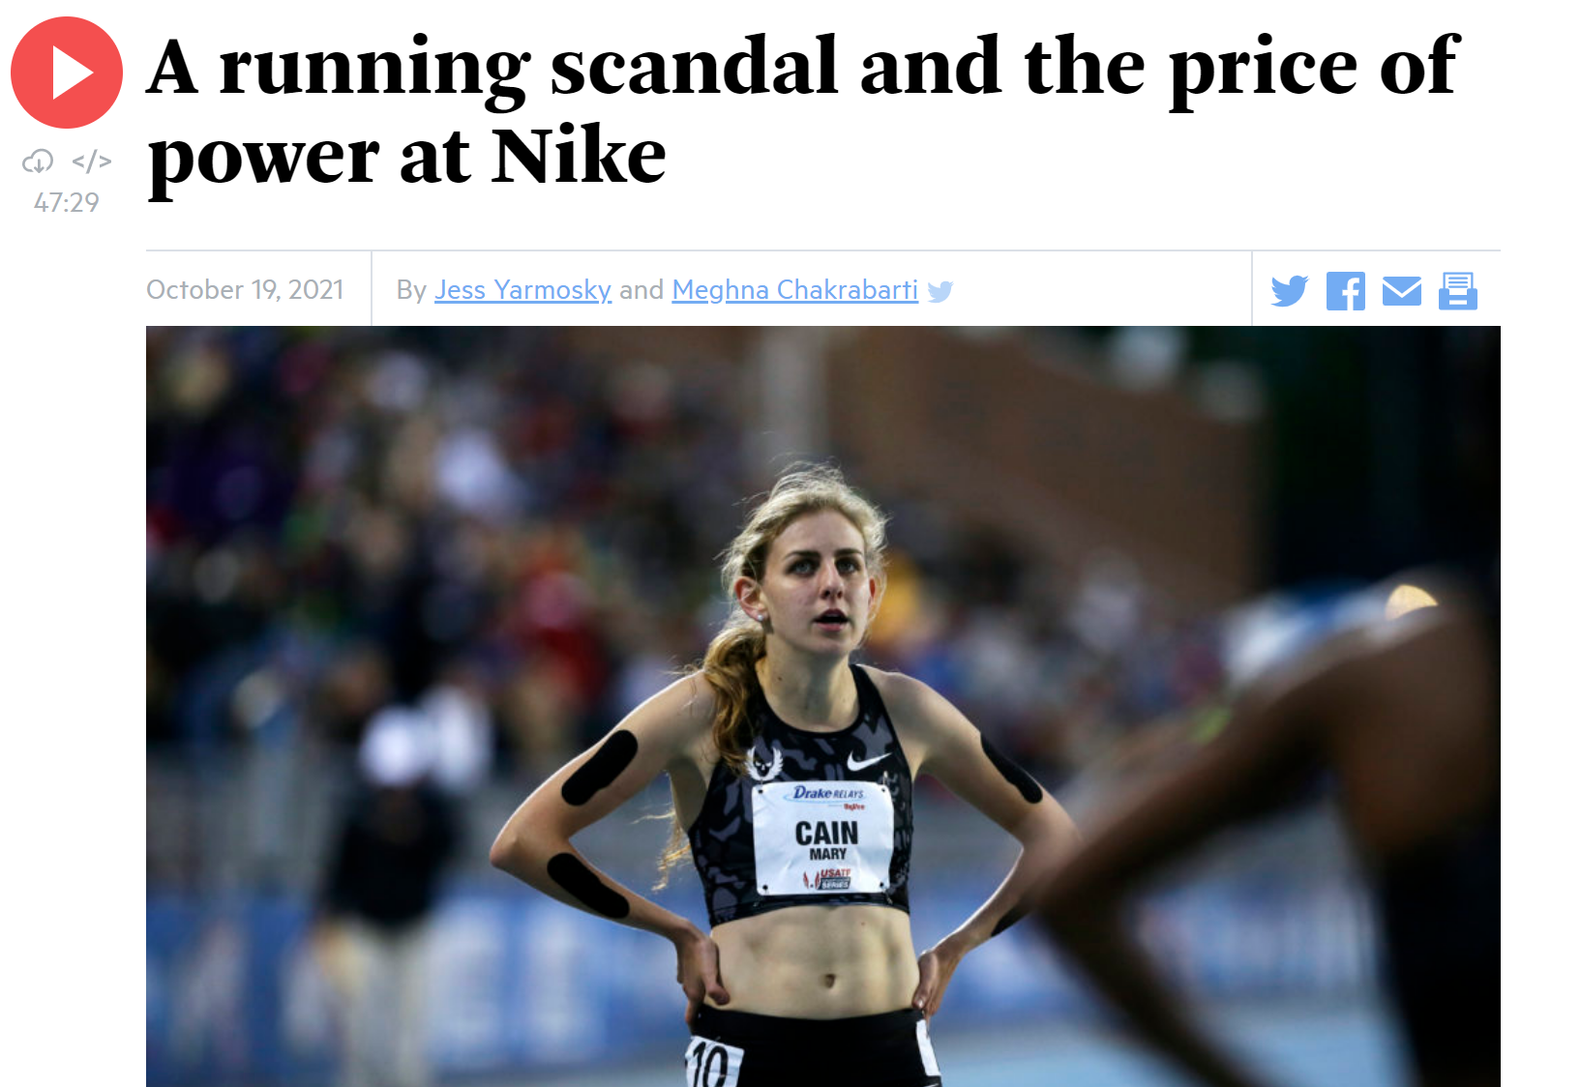
Sometimes not what we expect
Ref: A running scandal and the price of power at Nike | On Point (wbur.org) Accessed Date: 8th July 2022

Slide 37
Stakeholders
In groups discuss who are the University of Warwick's stakeholders ?
Are they all equally important?

Slide 38
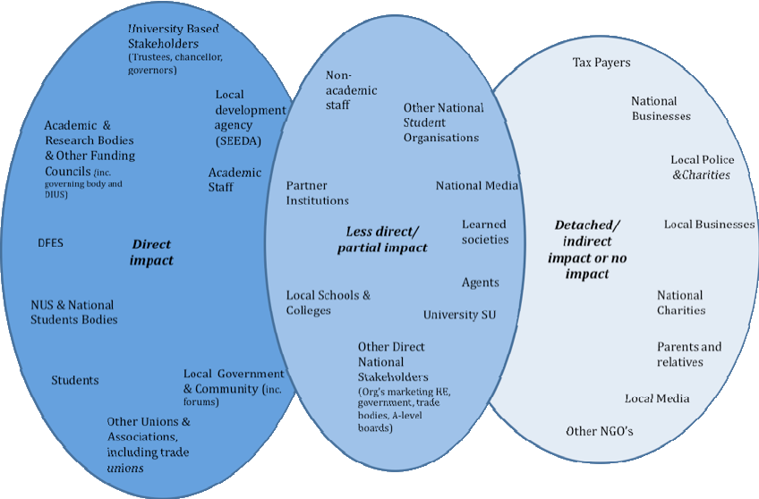
University Stakeholders

Slide 39
Sources of Power
Hierarchy
Control of strategic resources
Possession of knowledge and skills
Influence ( informal power)

Slide 40
Stakeholder mapping
Stakeholder Mapping is an important part of Strategy Formulation. It consists of making judgements on three issues:
How likely each stakeholder group is to impress its expectations on the firm.
Whether they have the means to do so - power of the stakeholder group.
The likely impact that stakeholder expectations will have on future strategies

Slide 41
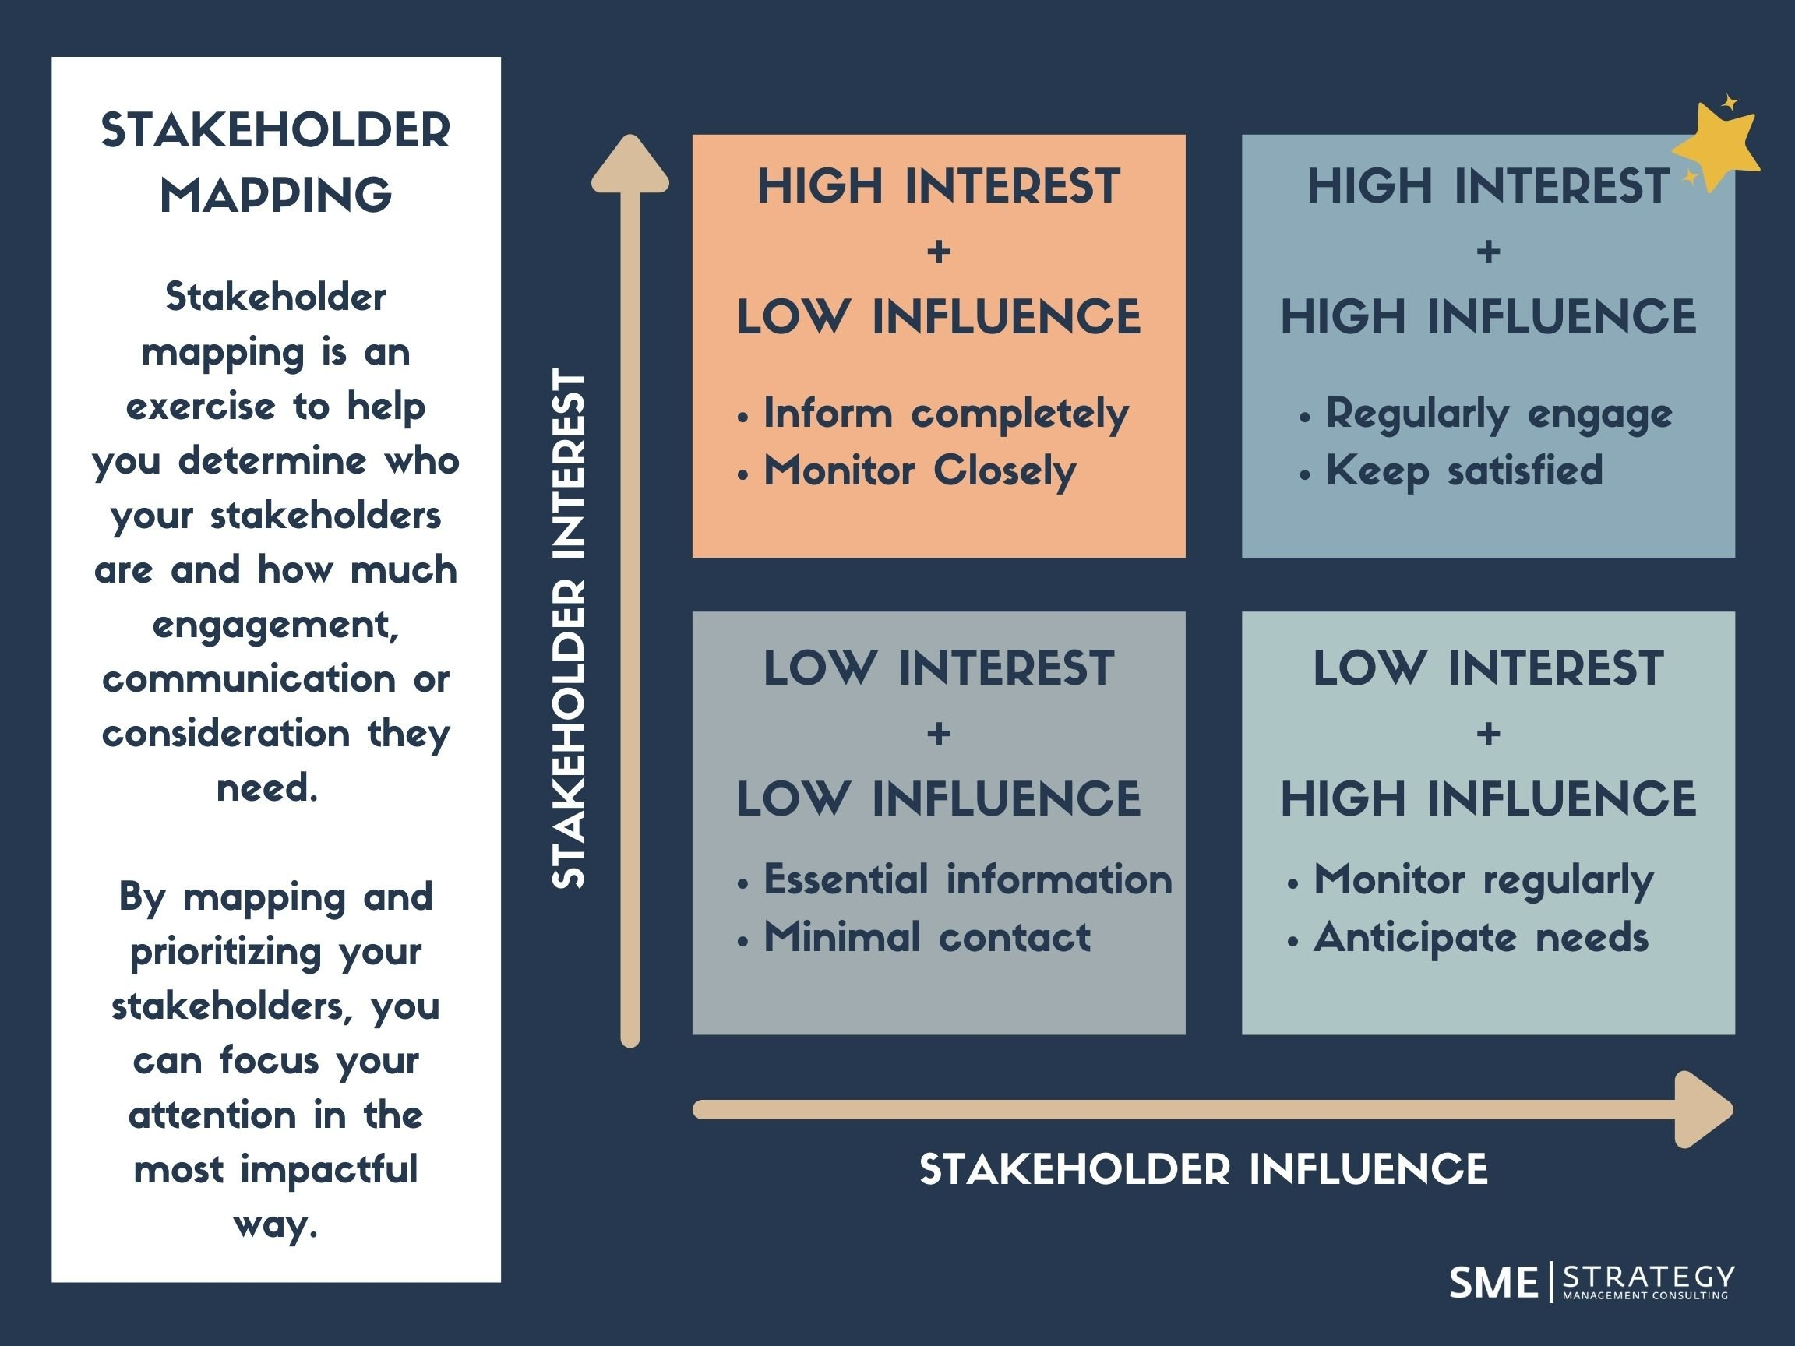
Stakeholder Mapping
Ref: 5 Steps to Stakeholder Engagement in Your Strategic Plan (smestrategy.net) Accessed Date: 13th June 2022

Slide 42

Pharmaceutical Example
Interest
Influence

Slide 43
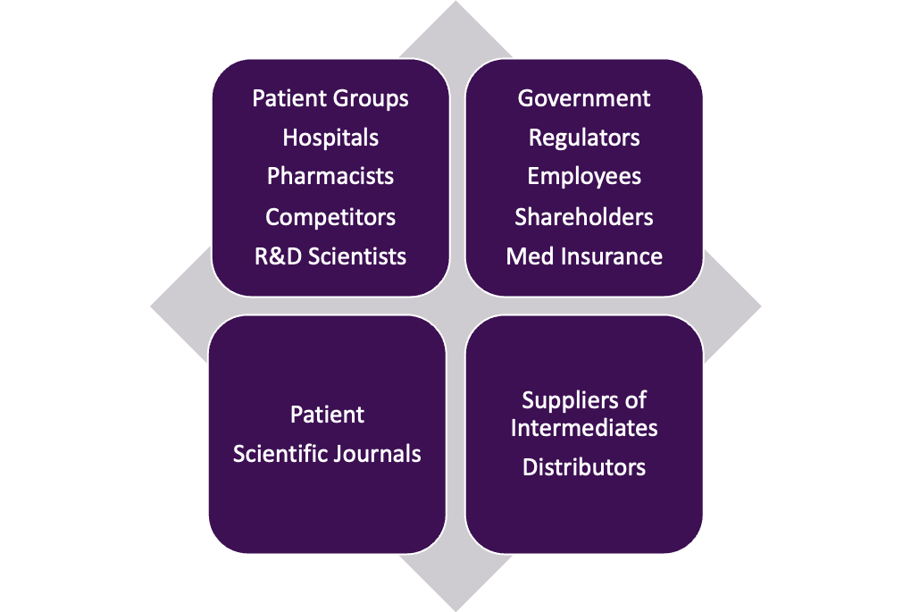
Pharmaceutical example
Interest
Influence

Slide 44
Stakeholder Mapping for a University
In groups identify the power/ interest of different stakeholders at a University

Slide 45
Some other examples to consider
A family owned small business
A football club
A state owned company

Slide 46
What we learned this today
Considered the impact of external factors on organizations
Macro shocks
Defined ESTEMPLE and ongoing external global challenges
Considered data sources both academic and practitioner
Begun to see the external complexity that most organisations deal with
Stakeholders and their power and influence

