Slide 1

Strategic Management
Innovation & Growth
Dr Patrick Reid
29th July 2024

Slide 2
What we have learned so far:
Discussed Strategy from an External and Internal Perspective
Explored corporate strategy and used different frameworks such as ESTEMPLE, Porters Five Forces, VRIO, Growth Matrix, Ansoff Matrix
Impact of Leadership
Considered Challenges, CSR and ESG
Now we will look at Innovation !

Slide 3
Agenda - Innovation
1
Innovation and Why it is Important
2
Closed and Open Innovation
3
Innovation Funnel & Value Chain
4
Group Exercise
5
Recap

Slide 4
Definitions
Creativity, is the generation of ideas.
Innovation, is the implementation of a new or significantly improved product (good or service), or process, a new marketing method, or a new organisational method in business practices, workplace organisation or external relations (OECD, 2005).

Slide 5

Why is this topic important ?
IBM CEO Report 2010
Surveyed 1500 executives
The effects of rising complexity call for CEOs and their teams to lead with bold creativity, connect with customers in imaginative ways and design their operations for speed and flexibility to position their organisations for success in the 21st Century

Slide 6

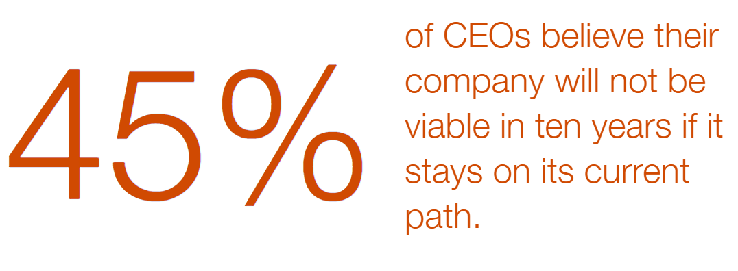
PWC CEO Survey 2024

Slide 7
Exploration versus Exploitation
Exploration
  Searching for new business opportunities
  Being adaptive to the demands of the future
  Developing completely new competencies
  Flexibility
  Radical innovation
Exploitation
  Cashing in on established strategic positions
  Managing the demands of today’s business environment
  Building on and refining existing competencies
  Efficiency
  Incremental innovation

Slide 8
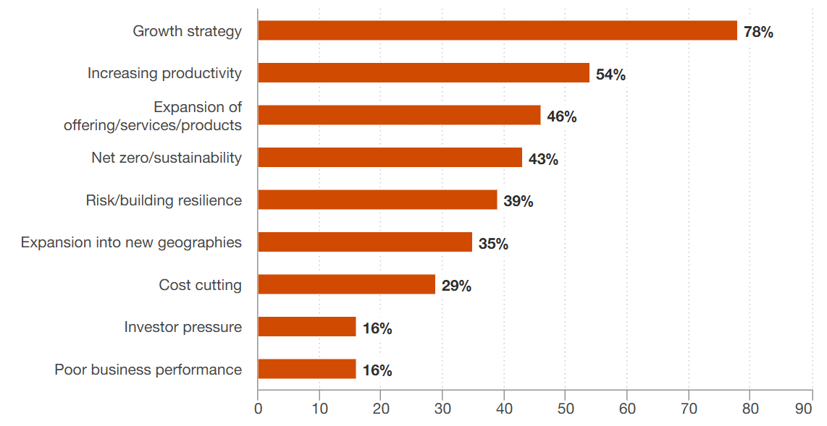
Where do they see their focus…

Slide 9
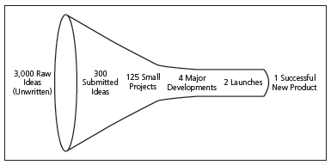
The Innovation Funnel

Slide 10
Closed Versus Open Innovation
Closed Innovation:
This occurs when only internal resources are used. So in technology there are often internal Research and Development teams.
Open Innovation:
Innovation can be sought from external sources. These might include suppliers, customers, partners.

Slide 11
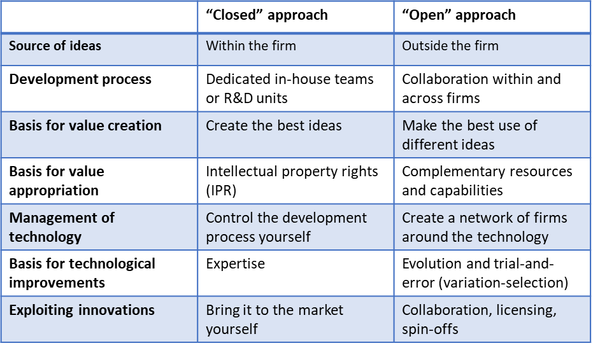
Closed and Open Innovation

Slide 12
Co-opetition
Co-opetition occurs when competitors can collaborate together.
Some famous examples might include ?

Slide 13
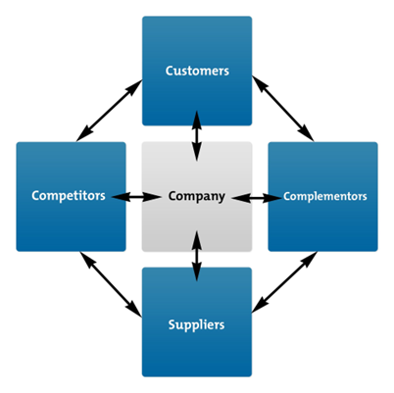
Open Innovation and Value Nets
Collaboration takes many forms
Organisations want to fully exploit opportunities

Slide 14
Consider Tesla
Suppliers – co develop battery technology, car parts, internet and GPS providers
Competitors – work on common parts such as tyres, sell powertrain and technology to others. Leverage Giga Factories.
Customers – community to support new users, product development, influencers
Complementors – service providers, distribution, show rooms

Slide 15
Class Exercise
How many examples of Open Innovation have you experienced ?

Slide 16

Common Examples of Open Innovation
Competitions:
Lego Ideas website: https://ideas.lego.com/
Walkers Crisps Flavour Competition
Bespoke Communities:
Dell Computers
Mozilla Browser
Wikipedia

Slide 17
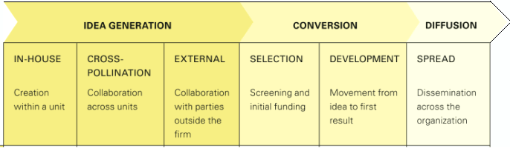
Innovation Value Chain

Slide 18
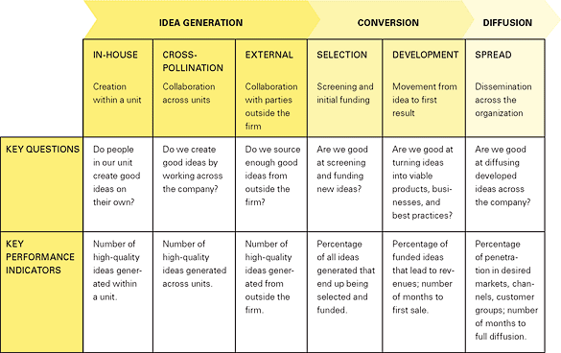

Slide 19
Innovation Work Well…
When:
An organisation has skills in all three areas:
Idea Generation
Conversion
Diffusion
You have to have processes to move an idea into a full scale up

Slide 20
Group Exercise
Identify a company you want to analyse
Develop an Innovation Value Chain Analysis
Maximum 4 slides
Make one Recommendation to improve

Slide 21

An Example of Channel Innovation

Slide 22
What we have learned today
Defined Creativity and Innovation, as well as the drivers
Looked at Open and Closed Innovation
Reviewed the Innovation Value Chain

Slide 23
Any Questions ?

Slide 24
Further Readings
Cheong T, Song SH, Hu C (2016) Strategic alliance with competitors in the electric vehicle market: tesla motor’s case. Math Prob Eng 2016
Cummings, Stephen, and Duncan Angwin. The Strategy Pathfinder : Core Concepts and Live Cases, John Wiley & Sons, Incorporated, 2017. ProQuest Ebook Central http://ebookcentral.proquest.com/lib/warw/detail.action?docID=5050346
Hansen MT, Birkinshaw J. The innovation value chain. Harv Bus Rev. 2007 Jun;85(6):121-30, 142. PMID: 17580654.
The Value Net Model - Strategy Skills Training From MindTools.com https://www.mindtools.com/abqnjon/the-value-net-model Accessed Date: 5th July 2024

