Slide 1

Strategic Management
Sustainability
Corporate Social Responsibility (CSR) & Environmental, Social and Corporate Governance (ESG)
Dr Patrick Reid
22nd July 2025

Slide 2
What we learned yesterday:
Culture, both corporate and international
ANSOFF Matrix
Market Entry
M&A and impact of culture

Slide 3
Sustainability
1
Corporate Social Responsibility
2
Greenwashing
3
Triple Bottom Line
4
Environment
5
Recap

Slide 4
Exercise in Pairs
Take 10 minutes to consider the following:
What does CSR mean to you ?
Can you identify one organisation you believe has good CSR ?

Slide 5
Definition
A responsibility among firms to meet the needs of their stakeholders and a responsibility among stakeholders to hold firms to account for their actions.

Slide 6
The CSR Pyramid
Philanthrophic
Responsibilities
Be a Good Corporate
Citizen
Archie Carroll outlined 4 responsibilities of a firm, outlined in the pyramid.
Ethical Responsibilities, Be Ethical
Legal Responsibilities, Obey the law
Economic Responsibilities, Be Profitable

Slide 7
Class Question
Is CSR a corporate responsibility ?
What about stakeholders ?

Slide 8
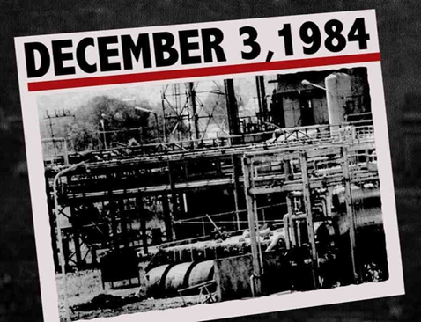
Disasters Force Action
Bhopal, biggest industrial accident to occur so far…
>3700 died, 500 000 people exposed with long term health issues
In settlement, agreed to pay $470 million to the Indian government to be distributed, less than 2500 USD per family.

Slide 9
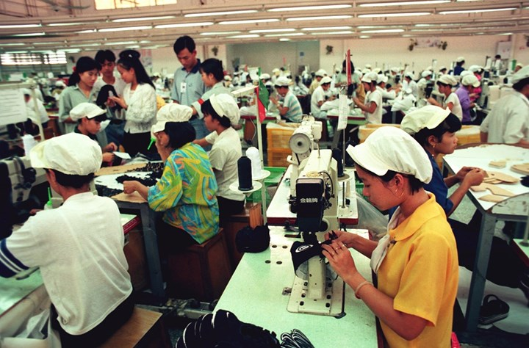
Nike
1996 Life Magazine ran an article on child labour, where a 12 year old was working in a factory for Nike
Company initially blamed sub contractors
Then had to take more direct action

Slide 10
The Iron Law of Social Responsibility
In the long run, those who do not use power in ways society considers responsible will lose it.
With power comes responsibility. Corporate power must always be checked by social responsibility in order for it to be maintained. History shows abuse of power often leads to regulation and control. For example, Enron and WorldCom scandals led to the introduction of the Sarbanes-Oxley Act 2002.

Slide 11
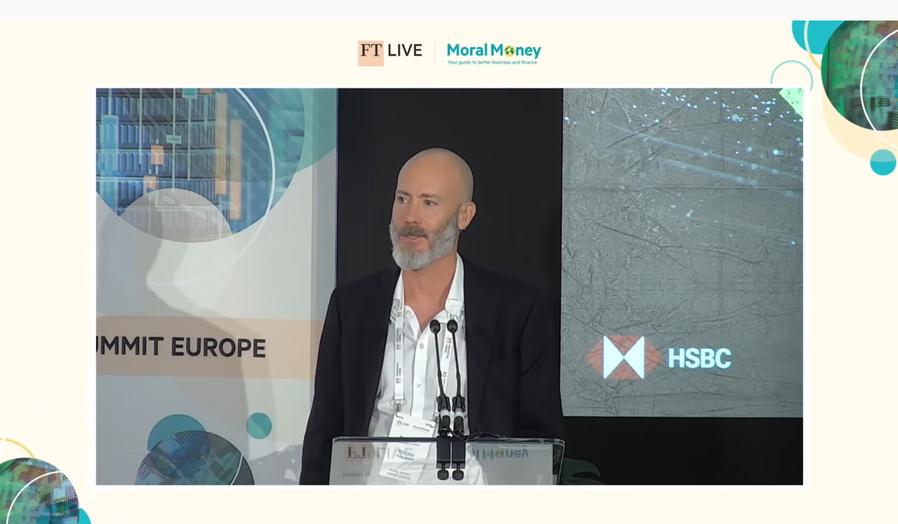
HSBC, Does Climate Change Matter

Slide 12
Climate Change Debate: Class Question
What is your view ?
Would you do business with HSBC ?

Slide 13
What do you do everyday ?
What you purchase
What you choose to put in the bin or recycle

Slide 14
Sustainability Defined
“In the broadest sense, sustainability refers to the ability to maintain or support a process continuously over time. In business and policy contexts, sustainability seeks to prevent the depletion of natural or physical resources, so that they will remain available for the long term.”

Slide 15
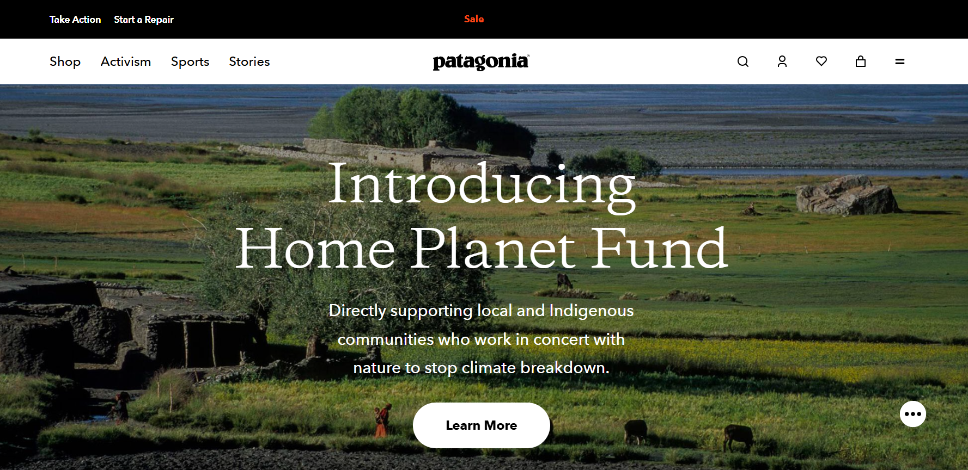
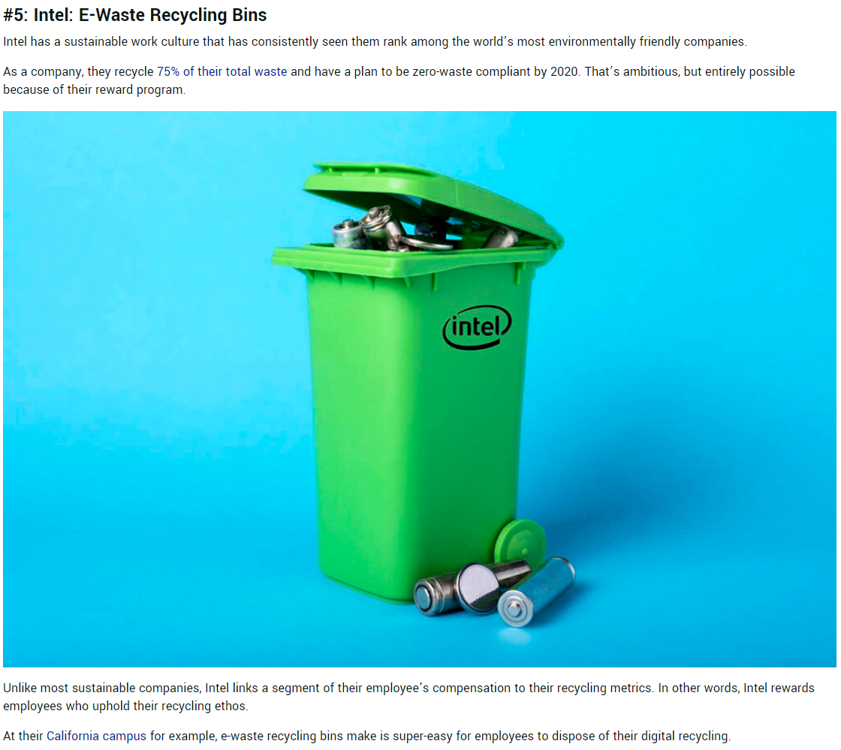

Sustainability

Slide 16
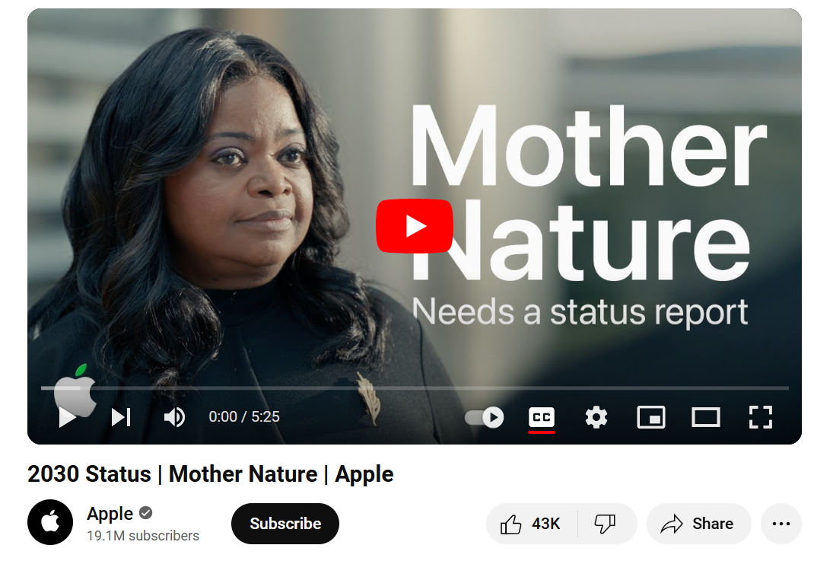
Apple Mother Nature – Sustainability or Greenwashing ?

Slide 17
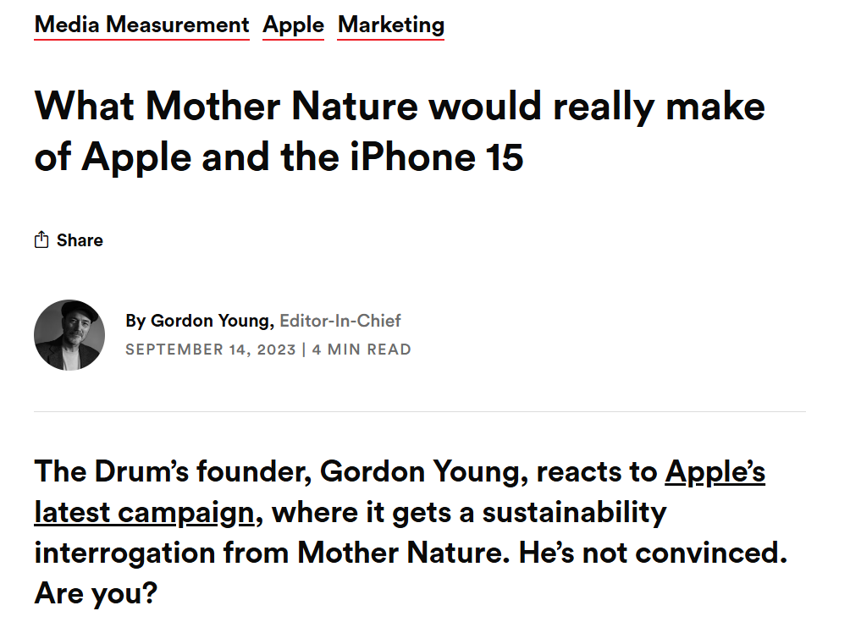
The Reality…

Slide 18
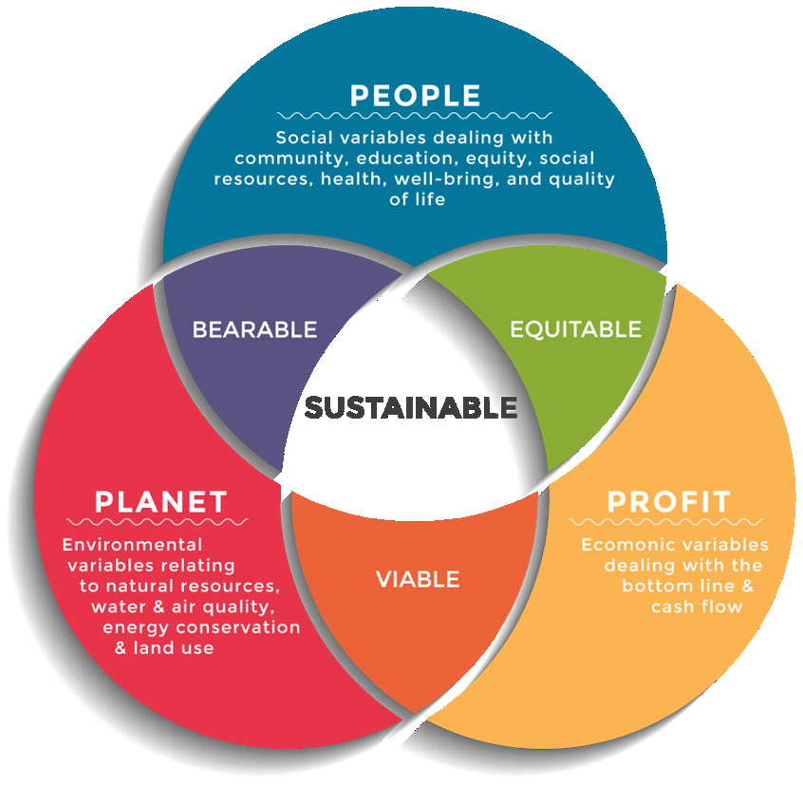
Triple Bottom Line

Slide 19
Exercise in Pairs
Take 10 minutes to consider the following:
Select an organisation you both are familiar with.
Assess the organisation against the Triple Bottom Line (3Ps) ?

Slide 20
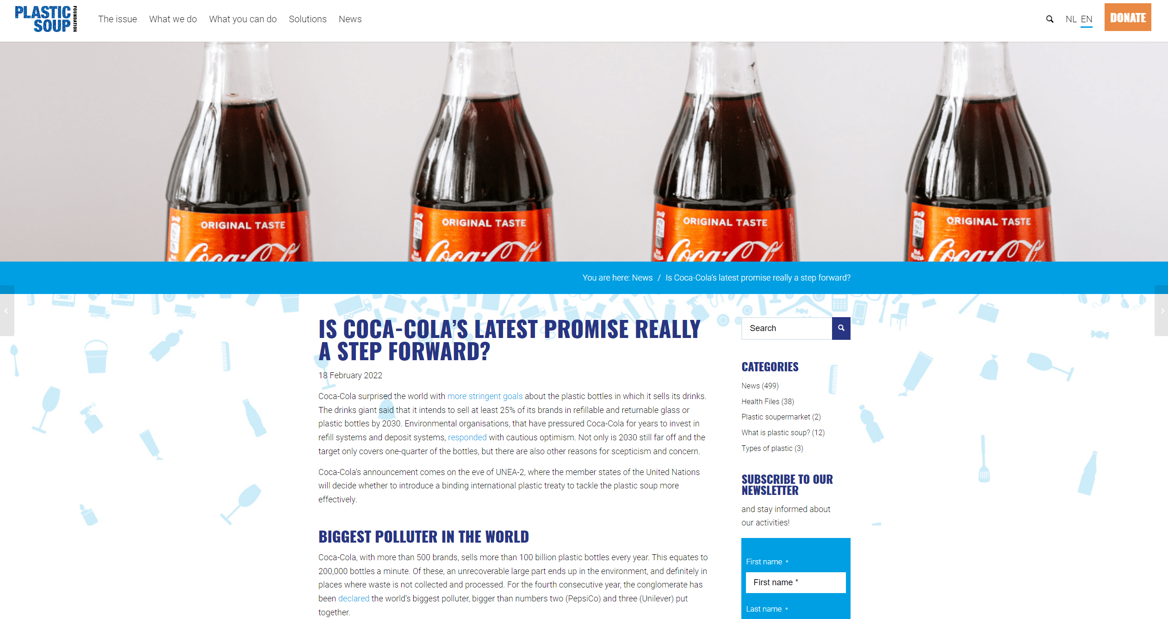
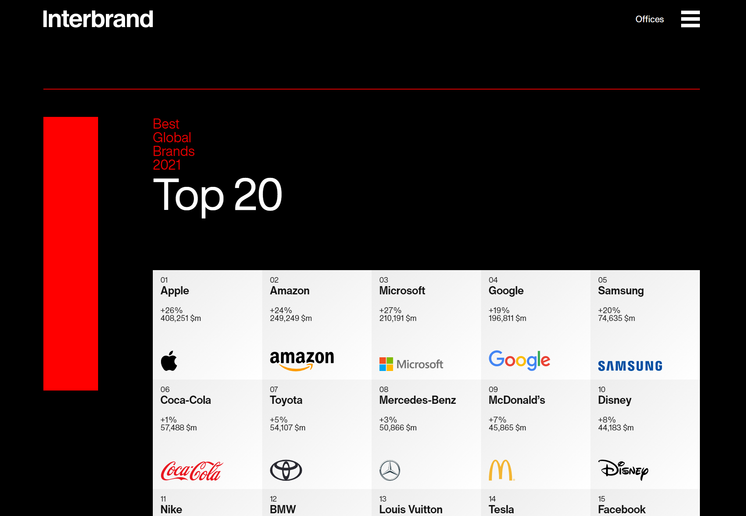
What is your View ?

Slide 21







An Evolving Situation
“Within the next 5 years all investors will measure a company's impact on society, government, and the environment to determine its worth”
- Larry Fink, BlackRock CEO
UN SDGs are driving a global commitment to sustainability
COVID-19 has spurred economic upheaval and The Great Reset
Inequality is driving activism
Climate change is driving corporate strategy

Slide 22
Exercise in Pairs
Take 10 minutes to consider the following:
When did you become aware of CSR and ESG ?
What has raised that awareness in recent year ?

Slide 23
Environmental, Social and Governance (ESG)
ESG Risks
Climate Change
Environmental Impacts
Health and Safety
Communities
Board Quality
Shareholder Rights
ESG addresses many topics and stakeholders.
ESG represents the company’s efforts to systematically assess, manage, and monitor risks of material potential impact to the strategic and financial decisions of the company.
The term ESG is often used as a synonym for sustainability, CSR, public relations, social investment, or environmental compliance. While some of these elements may factor into an ESG program, at the center of ESG is the management of risk and the preservation of shareholder value.

Slide 24
What is ESG ?
Corporate Governance
Workforce & Human Capital
Value Chain (Suppliers and Customers)
Social
Climate Change
Resource Management
Environmental Impact
Society and Communities
Carbon Emissions
2-Degree Alignment
Fossil Fuel Reserves
Renewable Energy
Water Management
Raw Materials
Air Quality
Ecological impacts
Critical Incidents (accidents)
Waste Management
Inclusion and Diversity
Workplace Health and Safety
Gender Pay Gap
Product Health and Safety
Data Privacy
Data Security
Supply Chain Labor
Predatory Sales / Pricing
Community Relations
Economic Impacts
Human Rights
Corruption
Political Activities
Energy Sources
Energy Efficiency
Plastics
Board Quality
Independence
Skills and Qualifications
Diversity
Refreshment
Board Leadership
Management Incentives
Pay-for-Performance Alignment
Ownership Requirements
Metrics and Goals
Severance / CIC Payouts
Claw-back Provisions
Shareholder Rights
Board Accountability to Shareholders
Shareholders’ ability to act
Voting Rights
Environmental
Corporate governance issues apply universally across all industries.
Good governance of corporate, environmental, and social issues creates sustainable companies
Material environmental and social issues vary significantly by industry and may even be company-specific, depending on the level of materiality of each factor.

Slide 25
Why this matters ?
Investors thinking long term
Transparency leads to fewer disasters
People realising the long term impacts of bad behaviour

Slide 26
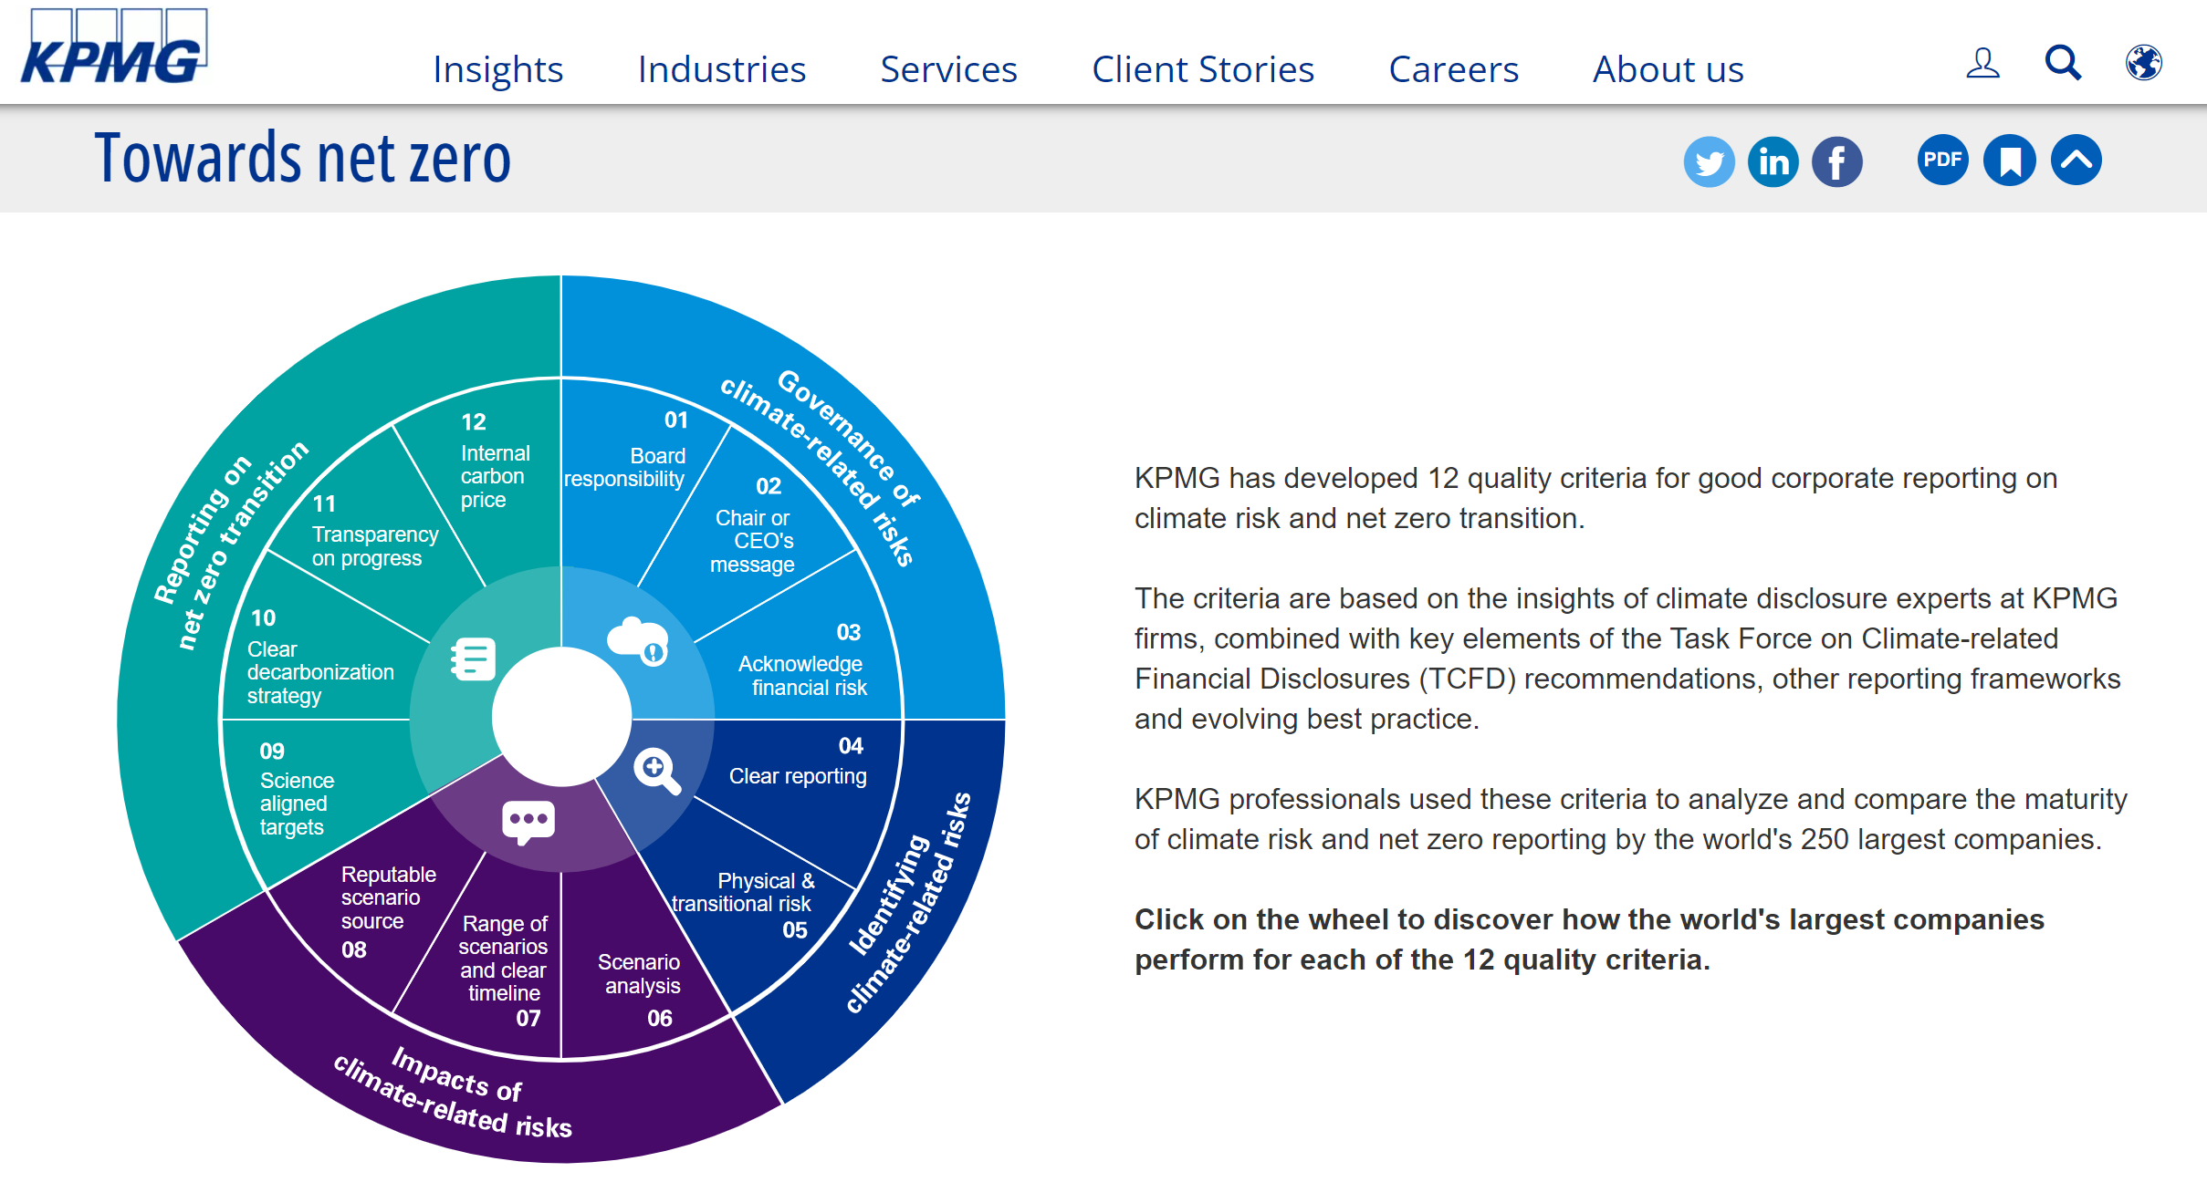
Towards Net Zero…

Slide 27
Exercise some ground rules
Not assessed in this Session
Opportunity to practice
Be confident !
Observe others, what they did well, what they could do better
Be prepared to ask questions of others

Slide 28
Exercise in Groups
Select an organisation of your choice
Consider the CSR activities of the organisation (and in to its supply chain).
Offer a 5 minute presentation, maximum 5 slides.
Can you make any Recommendation based on your insight ?

Slide 29
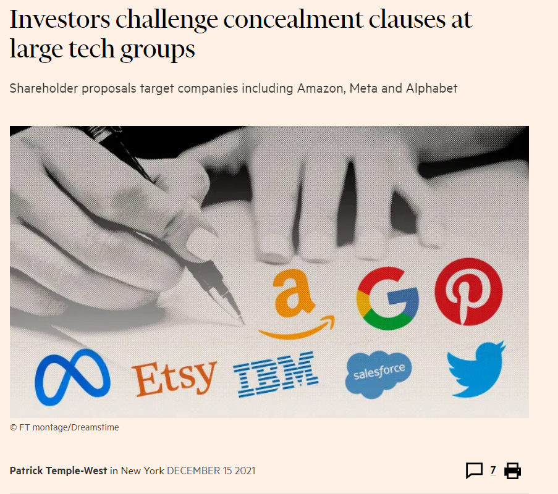
Activist Shareholders

Slide 30
What we have learned today
Defined CSR / ESG
Defined the CSR Pyramid and the Iron Law of
Considered corporate GreenWashing
Considered the challenges of measuring CSR / ESG effectively

Slide 31
Any Questions ?

Slide 32
Further Readings
Carroll, A. B. (1991). The pyramid of corporate social responsibility: toward the moral management of organizational stakeholders. Business Horizons, 34(4), 39–48.
Chandler, David. (2017). Strategic corporate social responsibility: Sustainable value creation (4th ed.). Thousand Oaks, CA: SAGE
Cummings, Stephen, and Duncan Angwin. The Strategy Pathfinder : Core Concepts and Live Cases, John Wiley & Sons, Incorporated, 2017. ProQuest Ebook Central http://ebookcentral.proquest.com/lib/warw/detail.action?docID=5050346
Davis, K. (1973). The Case for and against Business Assumption of Social Responsibilities. The Academy of Management Journal, 16(2), 312-322. Retrieved from http://www.jstor.org/stable/255331
Davis, K., & Blomstrom, R. L. (1971). Business, society, and environment: Social power and social response (2d ed.). New York: McGraw-Hill.
Slaper, T.F., Hall, T. J. (2011) The Triple Bottom Line: What is it and How Does it Work http://www.ibrc.indiana.edu/ibr/2011/spring/pdfs/article2.pdf Accessed 7th July 2024

