Slide 1
THANK YOU FOR JOINING THE WARWICK SUMMER SCHOOL PRE-DEPARTURE BRIEFING
WE WILL START THIS SESSION SHORTLY
PLEASE NOTE WE WILL BE RECORDING THIS PRESENTATION

Slide 2
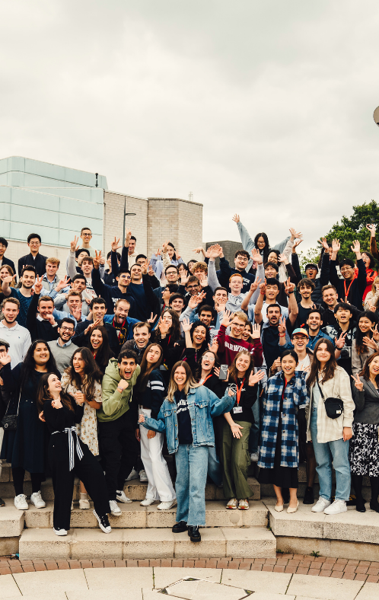
Warwick Summer School
12 July – 1 August 2026
Pre-Departure Briefing, June 2026

Slide 3
What will we cover today?
Logistical arrangements pre- arrival
Support available throughout the programme
WSS Academic Programme
WSS Guest Lecture Series
WSS Social and cultural programme
WSS Optional trips

Slide 4
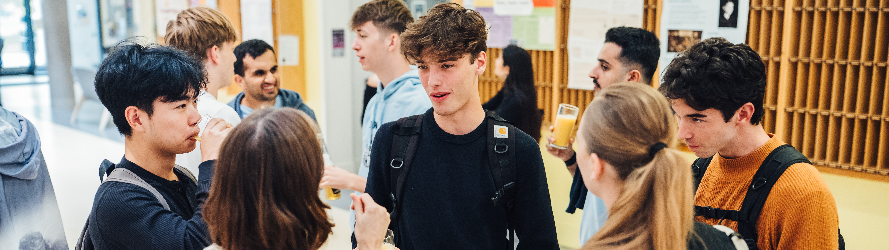
ARRIVAL, LOGISTICS AND SUPPORT

Slide 5
Before you arrive….Be prepared!
Have you completed…
    Enrolment form (emergency contact details, dietary and access requirements etc)?
    Travel form?
    Image consent form?
Have you…
    Set up your Warwick IT account, including photo upload for ID card?
    Read the handbook and all information in advance?​
    Checked your master timetable? Course timetables sent out one week in advance​
    Arranged and paid for travel/medical insurance?​
Have you checked…
    ​Whether you need a Visa or ETA for entering the UK and secured the appropriate travel documentation?
    Your passport is valid for the duration of your stay?

Slide 6
What to Pack
        Clothes for all weathers- including warmer layers, waterproofs and lighter summer clothes​
        Sportswear and trainers if needed​
        Swimwear and towel for the pool if needed​
        Smarter clothes for the evening events​
        Sun Protection
        Umbrella/raincoat
        Laptop/tablet​ for academic work
        UK plug adaptor​
        Mobile phone and a SIM card/package that will work in the UK as soon as you arrive​
        Bilingual dictionary​
        Bank card that works in the UK​
        Money (don’t bring too much, we can’t keep it for you and the campus is cashless)
        Medication – prescribed and basics e.g. paracetamol
        Toiletries
        Small bag for trips​
        Copies of important documents

Slide 7


Travelling to the UK
      Programme dates: Sunday 12 July – Saturday 1 August 2026
      There are direct rail and coach links from Heathrow to Coventry and taxis from Coventry bus/rail station are available and reasonably priced
      Detailed instructions for travelling to campus will be provided in advance​
EDI
GLA
NCL
MAN
BHX
LTN
STN
LHR
LCY
LGW

Slide 8
Passport Control
STUDENTS WITH AN ETA :
Your ETA will be linked to the passport you applied with. You only need to show your passport when you travel to the UK.​
Make sure you also have access to the email decision from UVKI with your 16-digit ETA reference number just in case.​
STUDENTS WHO APPLIED FOR A VISA IN ADVANCE (USUALLY VISA NATIONALS):
Have your visa activated by UK Border Force, if you applied in advance OR​
To have your passport endorsed with an Ink Stamp if you are a Non-Visa National, applying on arrival OR​
Use your biometric passport to enter via an e-Gate if you are an eligible Non-Visa National.​
If visiting the Immigration Desk, please check the entry stamp to make sure they have endorsed the right vignette and that they have stamped the right date of entry.
STUDENTS APPLYING FOR LEAVE ON ARRIVAL TO THE UK (NON-VISA NATIONALS ONLY): ​
Must carry application evidence in their carry on luggage​
Must visit the Immigration Desk, on arrival at the UK Border​
Must state the purpose of the visit, e.g. short period of study under 6 months, attending a viva, etc.​
Must provide any documentary evidence requested by the Border Force official

Slide 9
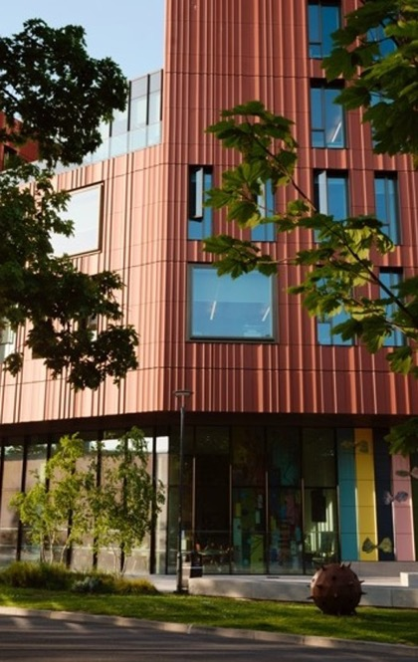
Registration Day
Registration from 1pm in the FAB Building
Check in to your room from 3pm
Complete your registration:
  We will need to check your UK entry permission (e.g. ETA or visa)
  ID card and instructions for accessing WiFi ​
If you are arriving outside of these times, please let us know as soon as possible (via travel form)​
Welcome BBQ in the evening

Slide 10
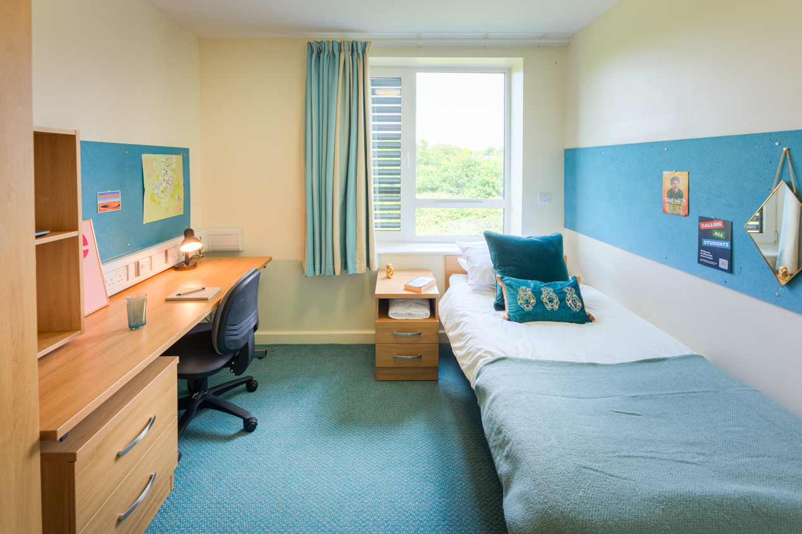
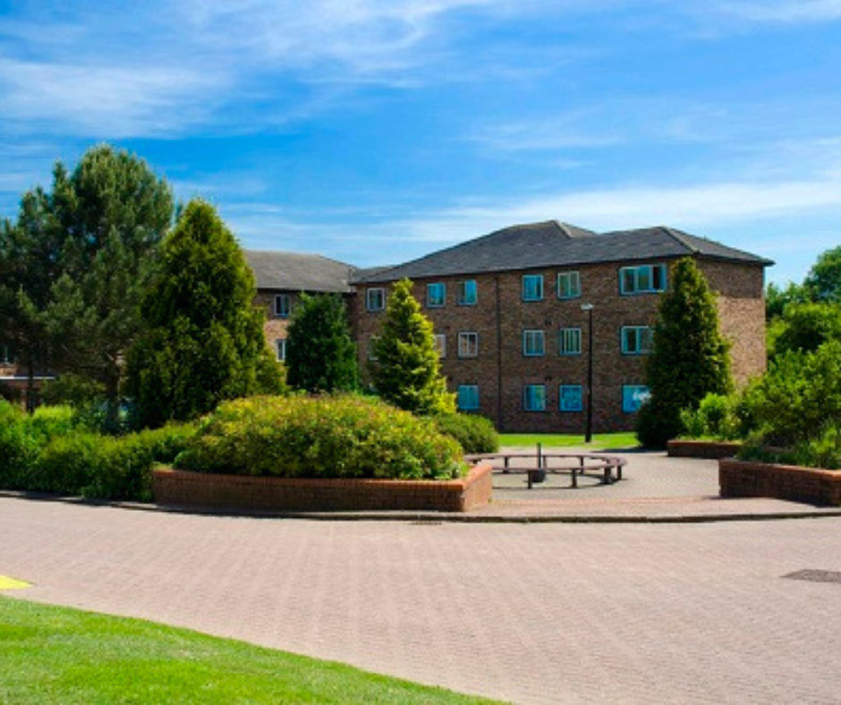
Accommodation
Arthur Vick or Sherbourne Residences
Bedding and towels included​
Half board - make sure you budget for lunches/drinks/snacks​
Kitchens with cooking facilities but no pots, pans, cutlery included
Rooms and kitchens cleaned weekly (can opt out of room clean)
Laundry services available- details in handbook​
Access to gym and swim facilities at Warwick Sport

Slide 11
Support on Campus
Community Safety team (security and first aid)​
Summer School Programme Team​
Conferences Reception​
Residence Hubs​
Wellbeing Support, Disability Support, Chaplaincy (multi-faith)

Slide 12
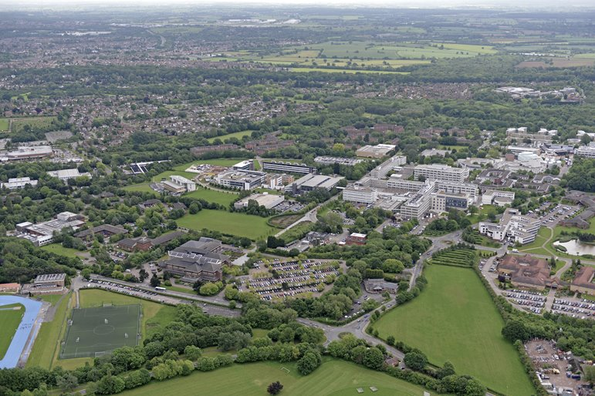
Warwick Campus
Warwick is a ‘Campus-University’
Sports Facilities, Library, Grocery store, Pharmacy, Post Office, ATM machine, Restaurants, all available on campus
Laundry services available – information in the handbook – not advised if have any skin allergies
Library access included – ID card
Gym and swim included

Slide 13

ACADEMIC PROGRAMME AND GUEST SPEAKERS

Slide 14
Warwick Summer School 2026 – Course Options
International Business and Finance
Global Finance, Money and Banking
Strategic Management
Communications and Marketing
Global Connection: Institutions, Mobilities and Cultures
Artificial Intelligence: A Practical Introduction
Data Science and Machine Learning: The Fundamentals

Slide 15
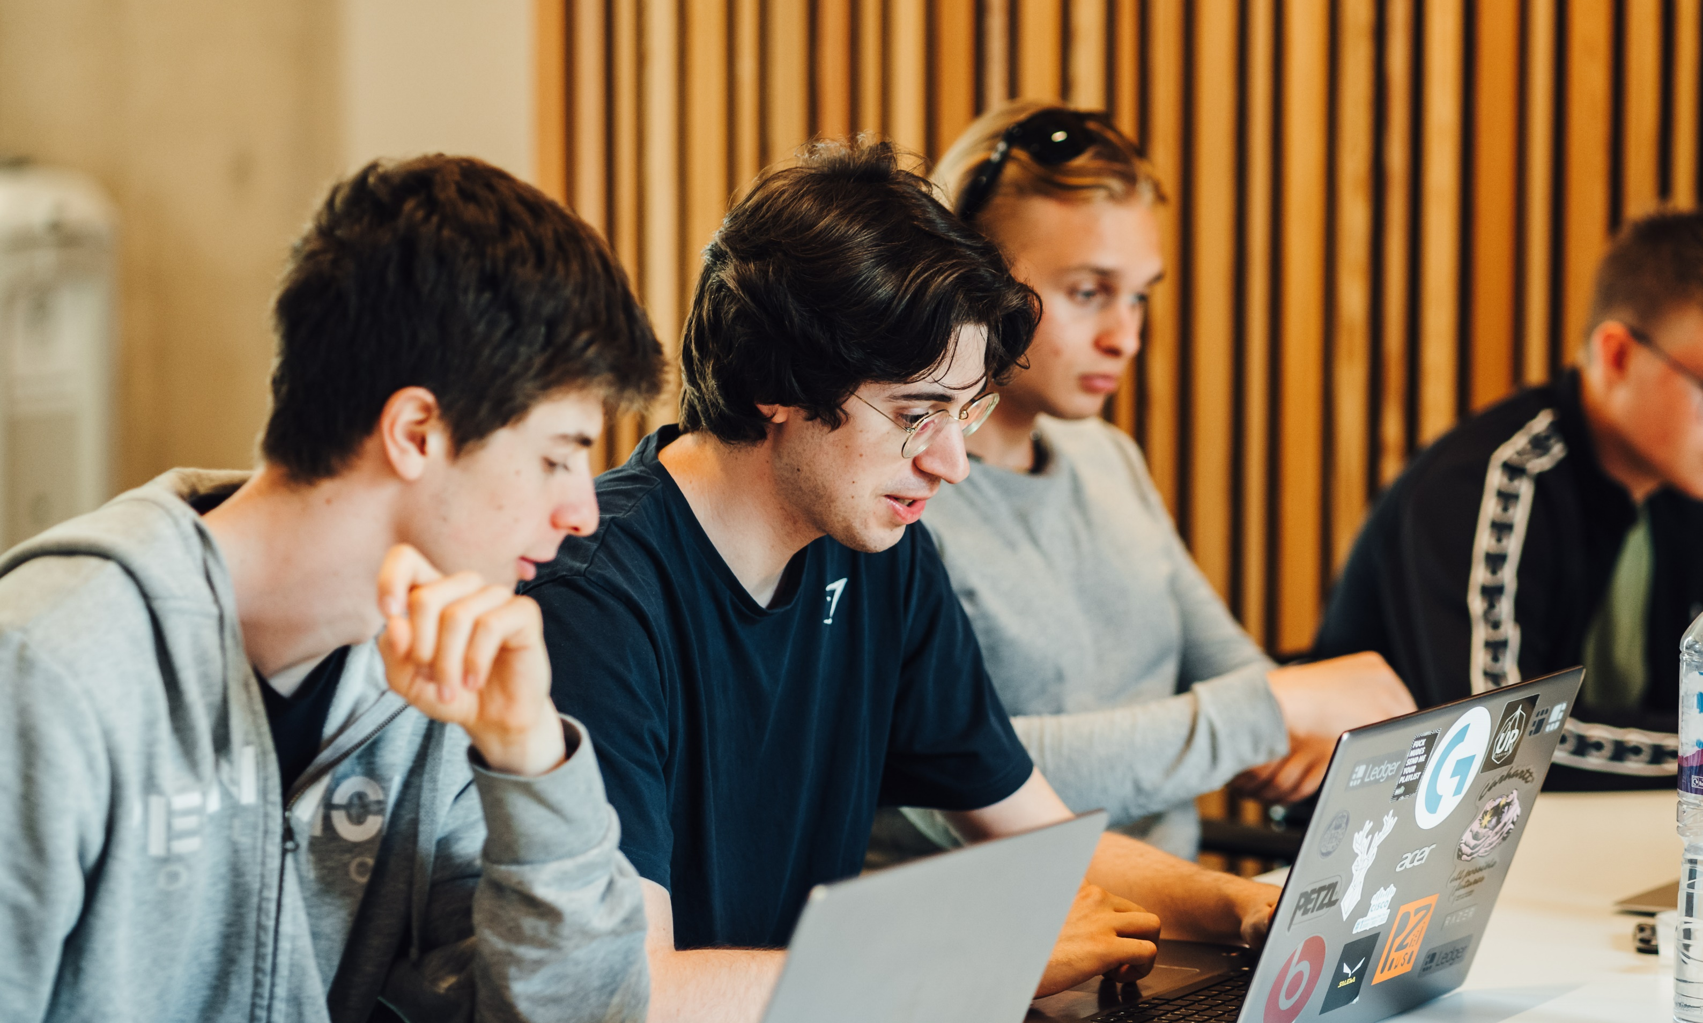
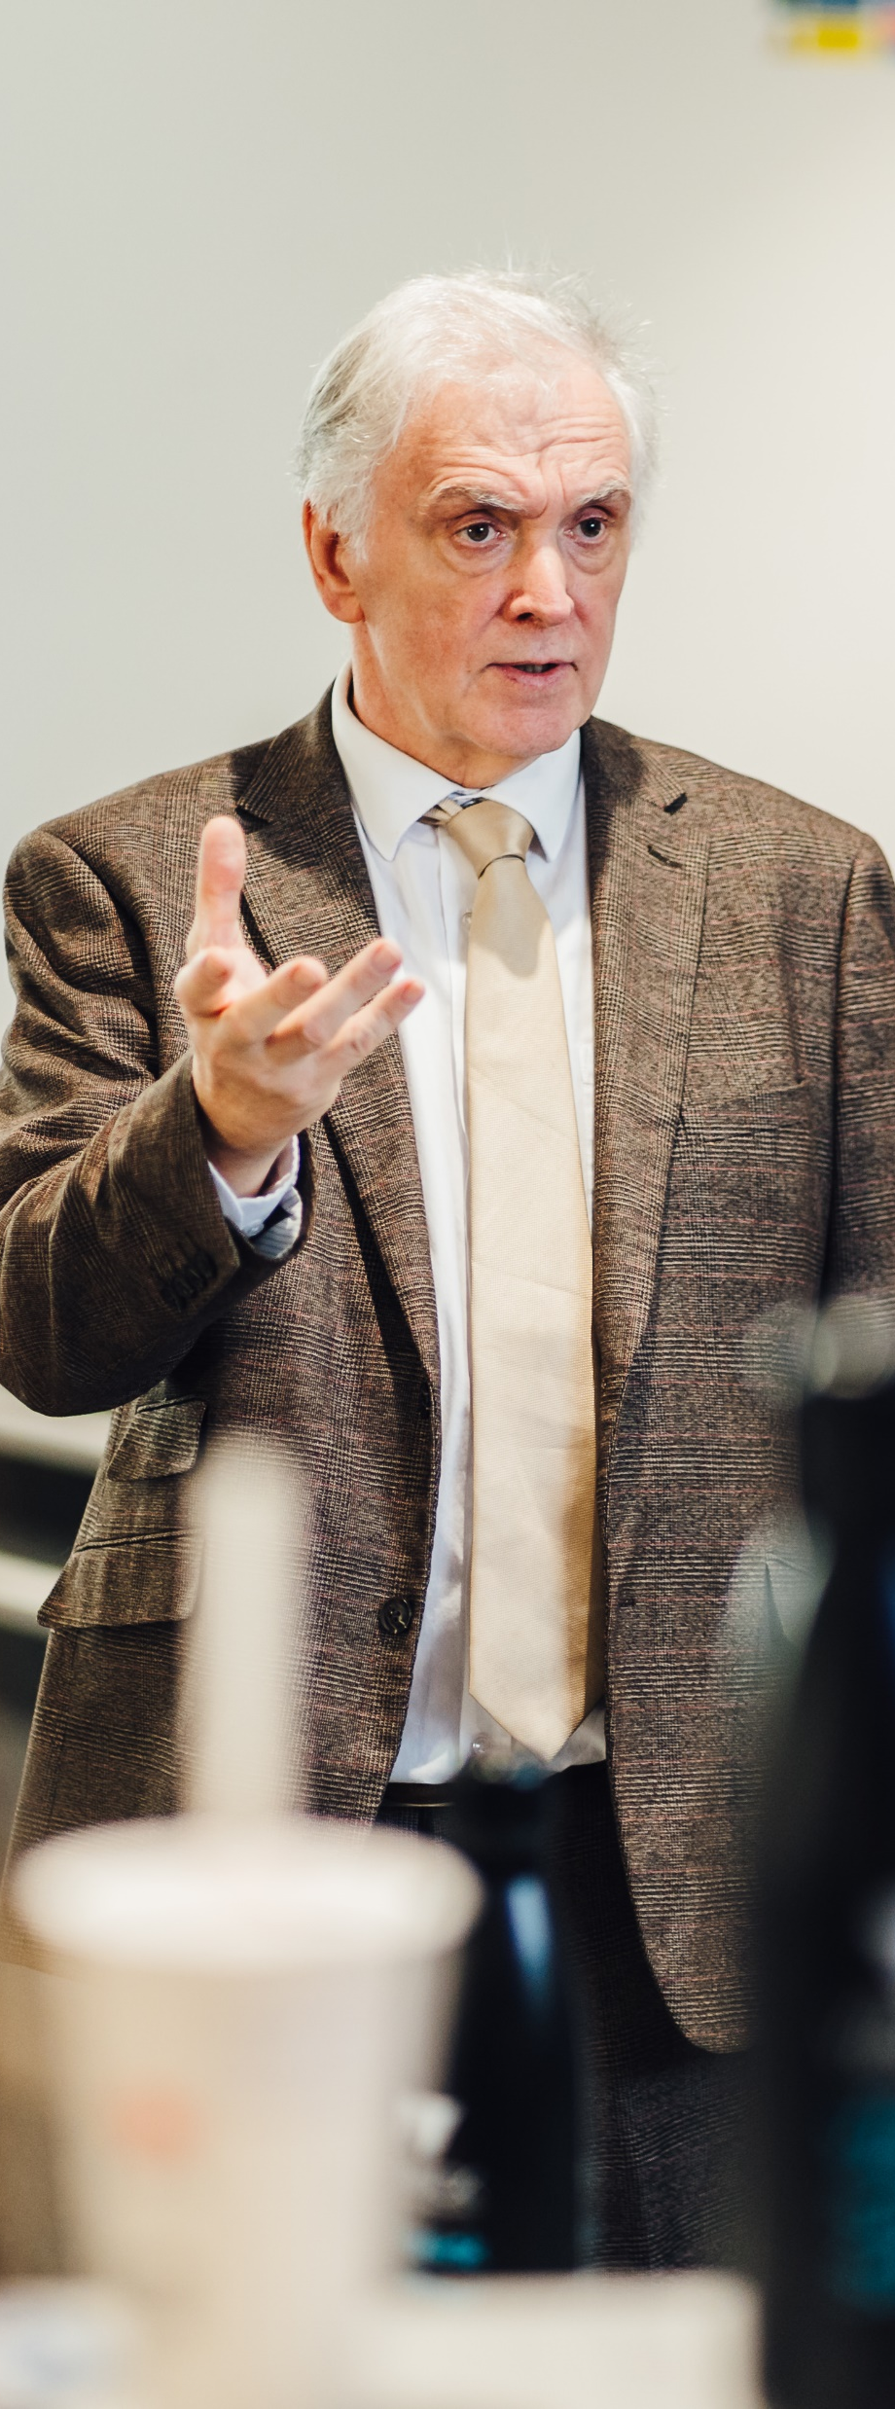

Academic Programme
Introductory lecture on first Monday​
Teaching- average of 4 hours per day
Study group sessions twice a week
Online resources (only accessible during programme)​
Revision sessions – Final Thursday (if your course has an exam)
Assessments on last day​
Transcript sent approximately 4 weeks later​
Attendance certificates – must attend 75%

Slide 16
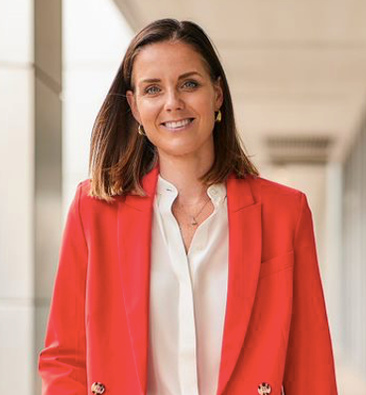


Guest Lecture Series
Alison Hatcher - Wealth and Digital Leader and a member of Council at the University of Warwick
Advocate Bience Gawanas – Chancellor, University of Warwick
Kare Adenegan – Team GB Paralympian medallist and University of Warwick alumni

Slide 17

SOCIAL AND CULTURAL PROGRAMME

Slide 18
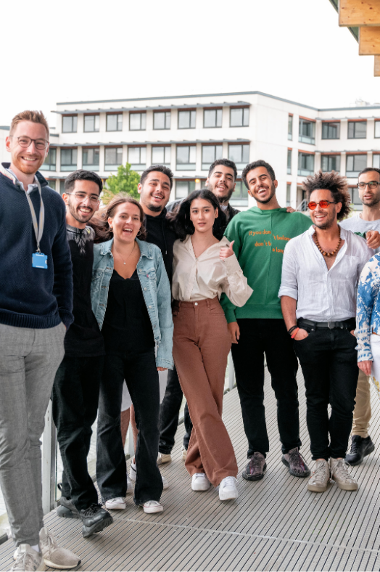
Social Programme
The Summer School tuition fee includes the following social elements:
Meet and Greet BBQ
Three-course Welcome Dinner
Pub Quiz Night
Curry, Karaoke and Disco night
Global Cafe
Farewell Reception
Sports activities – football, basketball and table tennis

Slide 19
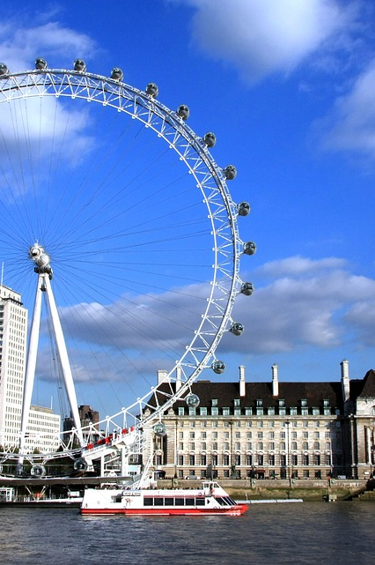
Explore the UK
There are optional trips to:
Cotswolds and Bath - 18 July
London- 22 July
Oxford - 25 July
You must pay in advance and book online for these trips

Slide 20
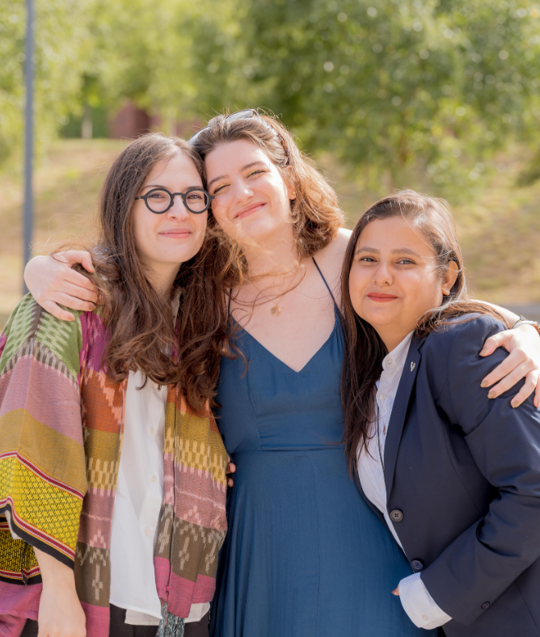
Questions?

Slide 21
EXPLORING BRITISH CULTURE COURSE

Slide 22
Registration Day
Registration 2pm on Saturday 4 July at Radcliffe Conference Centre​
Meet your Student Ambassador
Check in to your room (Radcliffe for the first night)
Complete your registration:
  We will need to check your UK entry permission (e.g. ETA or visa)
  ID card and instructions for accessing WiFi ​
If you are arriving outside of these times, please let us know as soon as possible (via travel form)​
Welcome Meal that evening in Radcliffe

Slide 23
Exploring British Culture
Saturday- Registration, meet your ambassador and welcome meal​​
Sunday- Day trip to Stratford Upon Avon with walking tour and Shakespeare’s Birthplace​​
Monday- Overview of Exploring British Culture week and cultural significance of trips. Launch of Enterprise Project.
Tuesday- British History lecture and seminar. Enterprise Project Skills and Preparation.​​
Wednesday- Day trip to Oxford with walking tour including visit to Christchurch College​
Thursday- Politics Lecture and Seminar, Enterprise Project Presentations and alumni guest speaker with pizza lunch​​
Friday- Overnight trip to London watching Changing of the Guards ceremony at Buckingham Palace, guided tour of St Pauls Cathedral and West End Theatre trip​ ​
Saturday- Houses of Parliament Tour, Thames River Cruise, Visit to Tower of London before return to campus​​
Sunday- Welcome BBQ for Warwick Summer School. ​
No need to re-register for the Warwick Summer School programme, but you will get a welcome pack. ​
​

