Slide 1
THANK YOU FOR JOINING THE WARWICK SUMMER SCHOOL PRE-DEPARTURE BRIEFING
WE WILL START THIS SESSION SHORTLY
PLEASE NOTE WE WILL BE RECORDING THIS PRESENTATION

Slide 2
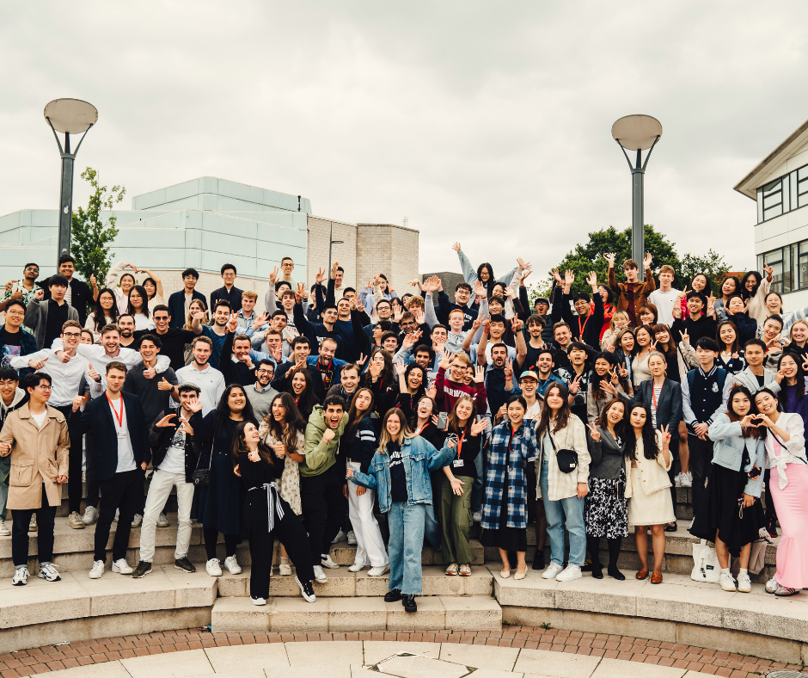
Warwick summer school
13 July – 2 August 2025
Pre-Departure Briefing, June 2025
Notes:
Session is being recorded and will be shared with all students attending the programme. By remaining on the call you are consenting to being recorded. You are welcome to keep your cameras off and use chat function instead to ask any questions. Please keep your microphones minutes to minimise background noise.
Introduction of who is delivering the presentation.

Slide 3



What will we cover today?
Logistical arrangements pre- arrival
What happens over the first two days
Support available throughout the programme
Social and cultural programme
Optional trips
Academic programme
Guest lecture series

Slide 4
ARRIVAL, FIRST TWO DAYS AND SUPPORT

Slide 5
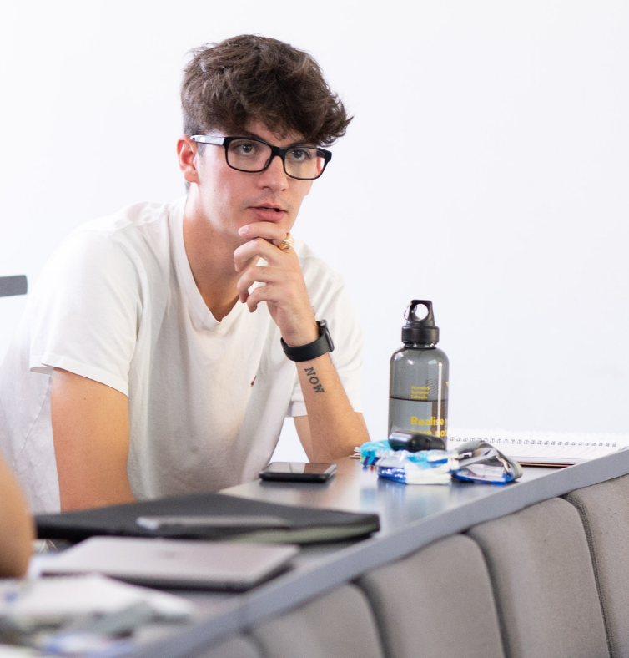
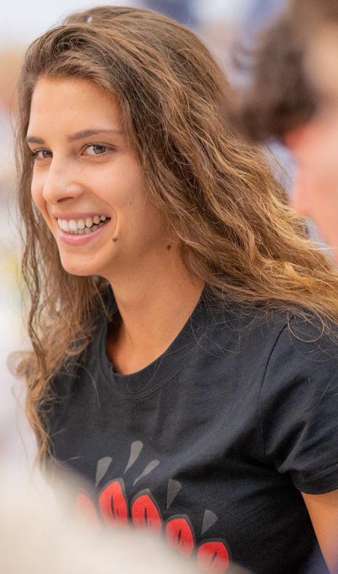
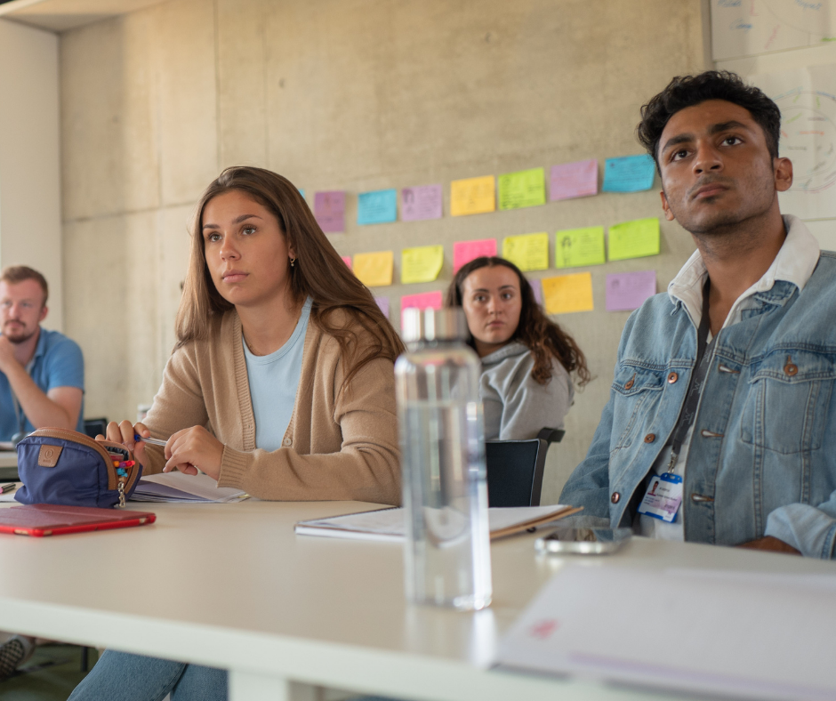
Who will be at the Warwick Summer School?
Around 125 students across 9 different courses
Students travelling from over 23 different countries
Dedicated Programme Team supporting academic and practical aspects
Experienced teaching team delivering academic content and learning experience
Notes:
Programme Team:
The Summer School experience is backed by a dedicated Programme Team. This team will be there to assist you not only with academic matters like attendance monitoring or timetables, but also with practical needs—whether it's navigating the campus, booking optional trips, or ensuring your overall experience is smooth and enjoyable.
Teaching Team:
Your academic journey during the Summer School will be guided by a highly experienced teaching team. They bring both subject expertise and teaching excellence to ensure that your learning experience is engaging, informative, and good quality.

Slide 6



Warwick Summer School 2024 – Course Options
International Business and Finance
Money and Banking
Strategic Management
Communications and Marketing
Common Law Contracts, Arbitration and Advocacy
Global Connection: Institutions, Mobilities and Cultures
International Relations, Security and Development
Artificial Intelligence: A Practical Introduction
Data Science and Machine Learning: The Fundamentals
Notes:
We offer a range of courses across Economics, Science, Business and Social Sciences.

Slide 7
Before you arrive….Be prepared!
Have you completed…
Image consent form?
Enrolment form (emergency contact details, dietary and access requirements etc)?
Travel form?
Have you…
Set up your Warwick IT account, including photo upload for ID card?
Read the handbook and all information in advance?​
Checked your master timetable? Course timetables sent out one week in advance​
Arranged and paid for travel/medical insurance?​
Paid your course balance?
Have you checked…
​Any visa requirements for entering the UK and secured the appropriate visa?
Your passport is valid for the duration of your stay?
Notes:
Before you travel, it’s important to make sure everything is in place for a smooth and stress-free start to your Summer School experience.
Let’s begin with the key forms—have you completed the image consent form, enrolment form, and travel form? These give us the essential information we need, like emergency contacts, dietary and access requirements, and your arrival details.
Next, please ensure you’ve set up your Warwick IT account and uploaded your photo—this is needed for your student ID card and to access your timetable and course materials.
Take some time to read through the student handbook and all the pre-arrival information. It covers what to expect and helps you feel more prepared before you arrive.
Also, don’t forget to check your master timetable. Your course-specific timetable will be sent to you about a week before the programme begins, so keep an eye out for that.
A couple of practical things to double-check: have you arranged and paid for your travel and medical insurance? And is your course balance fully paid?
Lastly, if you're travelling from outside the UK, make sure you’ve looked into visa requirements and have secured the appropriate visa. And of course, double-check that your passport is valid for the full duration of your stay.
Going through this checklist now will save you time and stress later—and make sure you’re fully ready to enjoy everything the programme has to offer.

Slide 8
What to Pack
Clothes for all weathers- including warmer layers, waterproofs and lighter summer clothes​
Sportswear and trainers if needed​
Swimwear and towel for the pool if needed​
Smarter clothes for the evening events​
Sun Protection
Umbrella/raincoat
Laptop/tablet​ for academic work
UK plug adaptor​
Mobile phone and a SIM card/package that will work in the UK as soon as you arrive​
Bilingual dictionary​
Bank card that works in the UK​
Money (don’t bring too much, we can’t keep it for you and the campus is cashless)
Medication – prescribed and basics e.g. paracetamol
Toiletries
Small bag for trips​
Copies of important documents
Notes:
To help you feel prepared for your time here we have created a list of things to pack for your time at Summer School.
The UK weather can be quite changeable, so it’s best to bring clothing for all types of weather—this includes layers for cooler days, a waterproof jacket or umbrella, and some lighter summer clothes for when the sun comes out.
If you’re planning to join in on any sports or fitness activities, remember to pack sportswear and trainers. And for those of you interested in swimming, bring swimwear and a towel.
There will also be a few evening events, so it’s worth packing a couple of smarter outfits.
Don’t forget sun protection like sunscreen and sunglasses for the warmer days, and again, an umbrella or raincoat is a must for those inevitable rainy spells.
On the academic side, make sure to bring your laptop or tablet for your coursework, along with a UK plug adaptor to keep your devices charged.
You’ll also need your mobile phone, and it’s really helpful to have a SIM card or phone plan that works in the UK as soon as you arrive.
A bilingual dictionary can be useful for non-native English speakers, and don’t forget a bank card that works in the UK. You may also want to bring some cash, but please avoid carrying too much—we can’t store it for you, and most places on campus are cashless.
If you take prescribed medication, pack enough for the duration of your stay, and include a few basic medicines like paracetamol. Bring your toiletries, a small bag for day trips, and most importantly—copies of your key documents like your passport, visa, and insurance info, just in case.

Slide 9


Travelling to the UK
Summer School dates: Sunday 13 July – Saturday 2 August 2025​
The closest airport to the University is Birmingham International (BHX) – lots of airlines fly to Birmingham (you may have to take a non-direct flight via Europe)​
There are rail and coach links from all major airports to Coventry (taxis from Birmingham airport to the University are also reasonably priced)​
If arriving by car to campus – follow our instructions in the handbook
EDI
GLA
NCL
MAN
BHX
LTN
STN
LHR
LCY
LGW

Slide 10
Passport Control
STUDENTS WHO APPLIED FOR A VISA IN ADVANCE (USUALLY VISA NATIONALS):
Have your visa activated by UK Border Force, if you applied in advance OR​
To have your passport endorsed with an Ink Stamp if you are a Non-Visa National, applying on arrival OR​
Use your biometric passport to enter via an e-Gate if you are an eligible Non-Visa National.​
If visiting the Immigration Desk, please check the entry stamp to make sure they have endorsed the right vignette and that they have stamped the right date of entry.
STUDENTS APPLYING FOR LEAVE ON ARRIVAL TO THE UK (NON-VISA NATIONALS ONLY): ​
Must carry application evidence in their carry on luggage​
Must visit the Immigration Desk, on arrival at the UK Border​
Must state the purpose of the visit, e.g. short period of study under 6 months, attending a viva, etc.​
Must provide any documentary evidence requested by the Border Force official
STUDENTS WITH AN ETA :
Your ETA will be linked to the passport you applied with. You only need to show your passport when you travel to the UK.​
Make sure you also have access to the email decision from UVKI with your 16-digit ETA reference number just in case.​

Slide 11
Registration
First Days
Registration 2pm – 5pm in the ​Faculty of Arts Building (Central Campus)
We will need to check the VISA permission – everyone should bring their passport even if a British Passport Holder​
ID card and instructions for accessing WiFi
Accommodation check in from 3pm for those who have booked
Sunday evening- welcome BBQ, 6pm
Monday - welcome talk, introductory lecture, campus tour, optional sports activities​
Welcome dinner
Notes:
Our Registration event will take place between 2pm and 5pm in the Faculty of Arts Building on Central Campus.
During registration, we’ll need to check your visa permission, so please make sure to bring your passport with you, even if you hold a British passport—we need to see it for all students.
You’ll also receive your Warwick ID card, which gives you access to campus facilities, and we’ll give you instructions on how to access wifi. You will have already set up your IT account and you will need this information to connect to WiFI.
If you’ve booked University accommodation, you’ll be able to check in from 3pm onwards—there is somewhere to drop your bags with us from 11am if you arrive early and want to explore campus.
We have a number of welcome activities for the first couple of days to help you get to meet some of your peers and get settled into campus.
On Sunday evening, we’ll kick things off with a Welcome BBQ at 6pm on the Piazza. It’s a relaxed, informal event where you eat, drink and get to know your fellow students, and start making new friends before the programme begins.
Then on Monday, we have a full day of welcome activities. The day starts with a Welcome Talk, where you’ll hear from the Programme Team and get an overview of what to expect during your time with us. After that, you’ll attend an introductory lecture, giving you a first taste of the academic experience here at Warwick.
You’ll also go on a campus tour, so you can get familiar with where everything is. In the afternoon, there’ll be some optional sports activities if you want to get moving and meet others in a fun, active way.
In the evening, we’ll come together again for a Welcome Dinner where you will be welcomed to campus by a member of the UEB and our Head of Department.

Slide 12
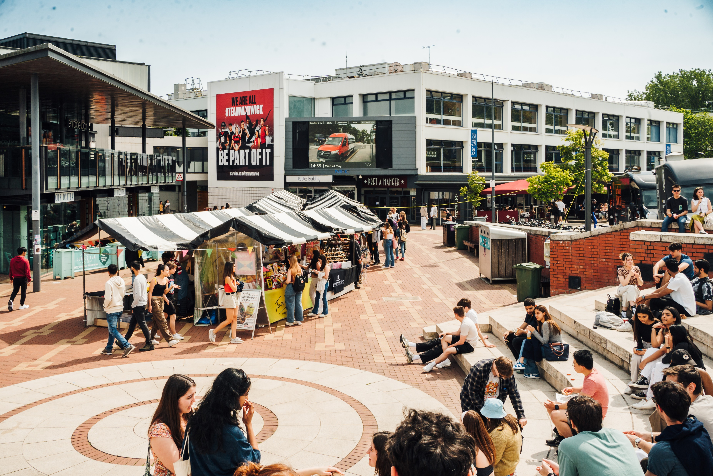
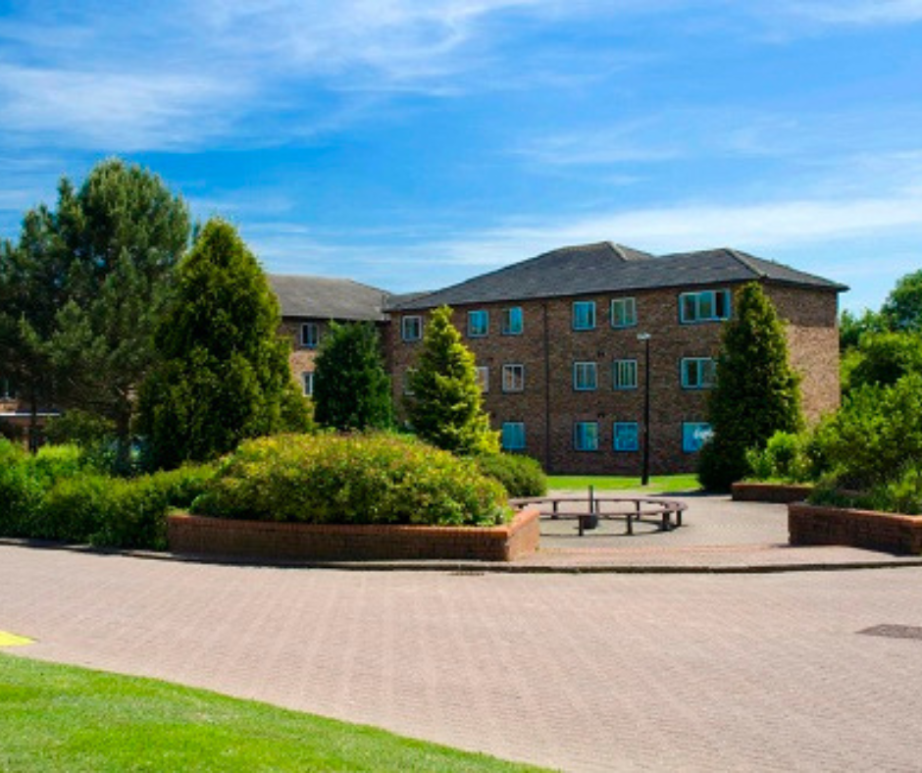
Accommodation (payable separately)
Room only | Bed and breakfast | Dinner, Bed and Breakfast
Rootes, Jack Martin and Arthur Vick
Kitchens with cooking facilities but no pots, pans, cutlery included
Bedding and towels included​
Rooms and kitchens cleaned weekly (can opt out of room clean)
Laundry services available- details in handbook​
Gym and Swim access to Sports Centre included in accommodation price
Must book ASAP
Notes:
There are a few different meal plan options to choose from—Room Only, Bed and Breakfast, or Dinner, Bed and Breakfast, depending on what suits your needs best.
Our student accommodation will be in Rootes, Jack Martin, and Arthur Vick, all of which are located conveniently on campus. Each hall has shared kitchens with cooking facilities, but please note that pots, pans, and cutlery are not provided, so you’ll need to bring or buy your own if you plan to cook.
Bedding and towels are included, so there’s no need to pack those, and both rooms and kitchens are cleaned weekly—although you can choose to opt out of the room cleaning if you prefer more privacy.
Laundry facilities are available, and you’ll find full details about how to use them in your student handbook.
As part of your accommodation, you’ll also get access to the gym and swimming pool at the Sports Centre, which is a great bonus if you want to stay active while you're here.
And finally, just a reminder: accommodation must be booked as soon as possible, as spaces fill up quickly!

Slide 13
Support on Campus
Community Safety team (security and first aid)​
Summer School Programme Team​
Conferences Reception​
Residence Hubs​
Wellbeing Support, Disability Support, Chaplaincy (multi-faith)
Notes:
During your time here, you’ll have access to a range of support services to keep you safe and supported. The Community Safety team is available for security and first aid. The Summer School Programme Team will be on hand to help with any questions about your course or experience.
For general assistance or accommodation enquiries, the Conferences Reception and Residence Hubs are great points of contact. If you need extra support, we have services for wellbeing, disability, and a multi-faith chaplaincy to ensure everyone feels welcome and cared for.

Slide 14
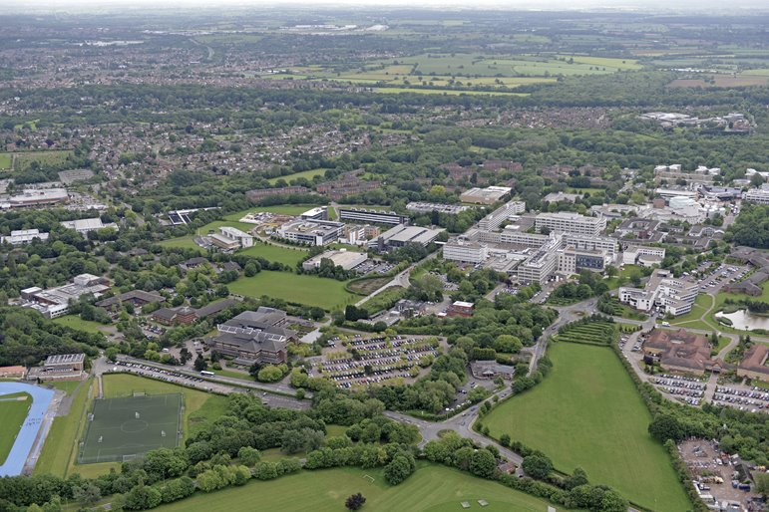
Warwick Campus
Warwick is a ‘Campus-University’
Sports Facilities, Library, Grocery store, Pharmacy, Post Office, ATM machine, Restaurants, all available on campus
Laundry services available – information in the handbook – not advised if have any skin allergies
Library access included – ID card
Gym and swim included
Notes:
Warwick is a true campus university, which means most of what you need is right here on site. You’ll find excellent sports facilities, a well-equipped library, and convenient everyday essentials like a grocery store, pharmacy, post office, and ATM machine—all on central campus or a short walk awat.
There are also plenty of restaurants and cafes on campus, so getting a coffee or getting something to eat on campus is very easy.
If you’re staying in university accommodation, laundry services are available, with full details in your handbook. The laundry machines have already got washing powder included so you don’t need to worry about that aspect.
As part of your student experience, your library access is included, and you’ll be able to use it with your ID card. Plus, your accommodation price covers gym and swimming pool access at the Sports Centre, so you will be able to take advantage of the lovely facilities while you are here.

Slide 15
ACADEMIC PROGRAMME AND GUEST SPEAKERS

Slide 16
Academic Programme
Introductory lecture on first Monday​
Teaching- average of 4 hours per day​
Revision sessions – Final Thursday (if your course has an exam)
Study group sessions twice a week
Online resources (only accessible during programme)​
Exam on last day (alternative assessments for some courses)​
Transcript sent approximately 4 weeks later​
Attendance certificates – must attend 75%
Lectures
Study Sessions
Online Resources
Assessment
Notes:
Your academic journey starts with an introductory lecture on the first Monday, designed to give you a clear overview of the course and what to expect.
You can expect around four hours of teaching per day, including lectures, discussions, and practical sessions.
If your course includes an exam, there will be revision sessions on the final Thursday to help you prepare.
We also organize study group sessions twice a week, providing a great opportunity to get one to one guidance from the academic team to support your learning.
Throughout the programme, you’ll have access to online resources, but please note these are available only during the course dates.
Your exam will take place on the last day, although some courses offer alternative forms of assessment.
After the programme finishes, your transcript will be sent to you about four weeks later, summarizing your performance.
To receive an attendance certificate, you must attend at least 75% of the sessions. We will be monitoring your attendance at teaching sessions.

Slide 17
Guest Speakers
The 2025 Warwick Summer School Guest Lectures:
Sustainability Panel Discussion
Warwick’s Chancellor Bience Gawanas
Kare Adenegan, Team GB Paralympian
Notes:
For the 2025 programme, we’re adding a Sustainability Panel Discussion. You’ll hear from experts who will talk about important environmental issues we all face today. This session will get you thinking, offer new ideas, and give you the chance to join the conversation by asking questions and sharing your thoughts.
We’re also honoured to welcome Warwick’s Chancellor, Advocate Bience Gawanas, who will share her insights and experiences. As a distinguished lawyer, diplomat, and advocate for social justice, her talk promises to be inspiring and thought-provoking.
Additionally, we have Kare Adenegan, a remarkable Team GB Paralympian, joining us. Kare’s story of determination and excellence in sport is sure to motivate and encourage all participants.
These guest lectures offer a fantastic opportunity to engage with leading voices and expand your perspectives during your time here at Warwick.

Slide 18
SOCIAL AND CULTURAL PROGRAMME

Slide 19
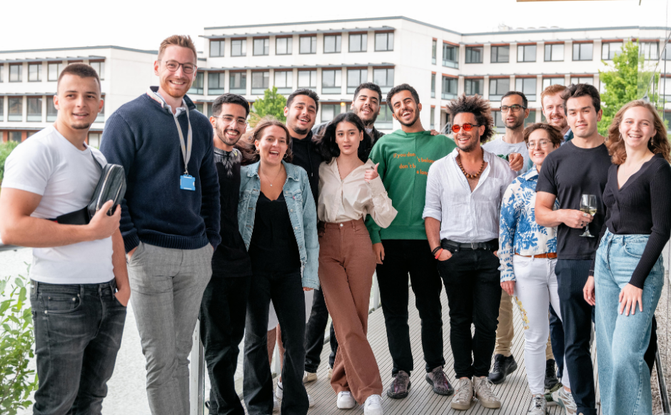
Social Programme
The Summer School tuition fee includes the following social elements:
Meet and Greet BBQ
Three-course Welcome Dinner
Summer School Fair Games
Pub Quiz Night
Curry, Karaoke and Disco night
Farewell Reception
Sports activities – badminton and football
Notes:
Your Summer School tuition fee includes a range of fun social activities designed to help you relax and make new friends. You’ll kick off with a Meet and Greet BBQ, enjoy a three-course Welcome Dinner, and have fun with games at the Summer School Fair.
There’s also a Pub Quiz Night, which is always competitive, with prizes for the winning team. You’ll love the evening of curry, karaoke, and disco, a firm favourite with students for years. To wrap things up, we hold a Farewell Reception to say goodbye and wish you the best of luck!
If you enjoy sports, you can join in the badminton and football sessions—a great way to stay active and have fun outside of class.

Slide 20
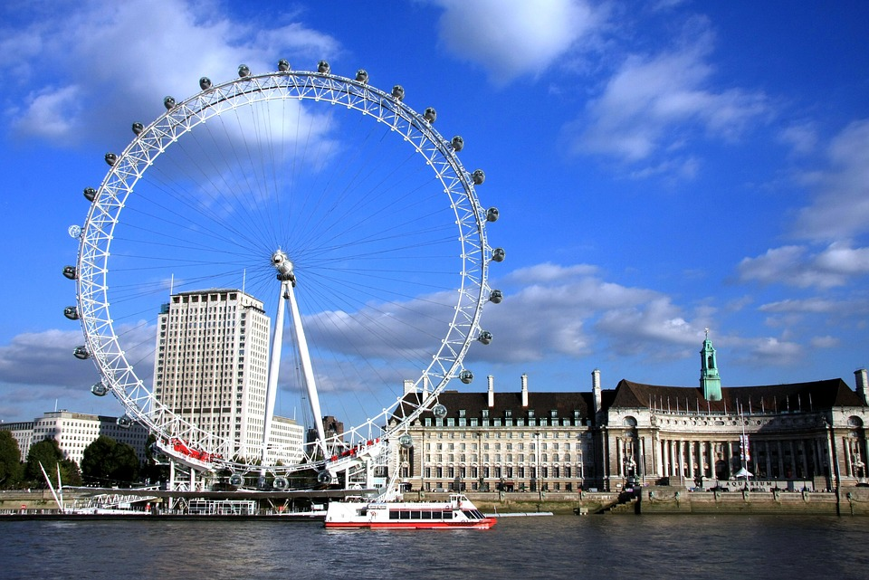
Social Programme
There are optional trips to:
Oxford- 19th July
London- 23rd July
Cotswolds/Bath- 26th July
You must pay in advance and book online for these trips and activity
Notes:
We’re offering optional day trips to some amazing places during the Summer School. You can visit Oxford on the 19th of July, explore London on the 23rd, or discover the beautiful Cotswolds and Bath on the 26th. These trips are a great chance to see more of the UK, experience its history and culture, and spend time with your fellow students outside of the classroom.

Slide 21
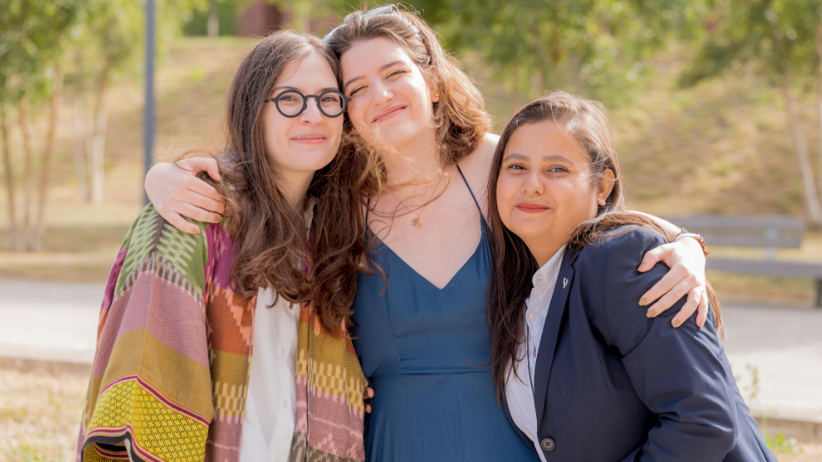
Questions?

Slide 22
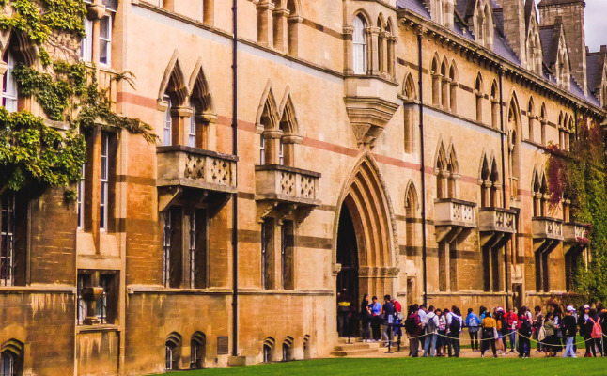
Exploring British Culture
Arrival on Saturday 5 July- registration at Senate House
Staying in Arthur Vick/Jack Martin on Half Board basis
Student ambassador support this programme, living alongside you for a week and joining you on trips and social activities- Elizabeth, final year Liberal Arts student
Includes an overnight stay in London and day trips to Oxford and Stratford-upon-Avon
Will be sending separate pre-arrival communications out in next couple of weeks
5 July-12 July

