Slide 1



Slide 2

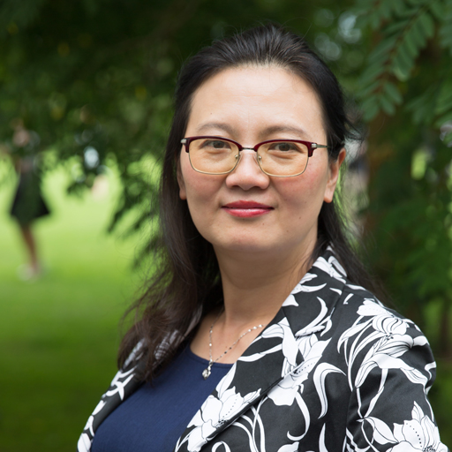
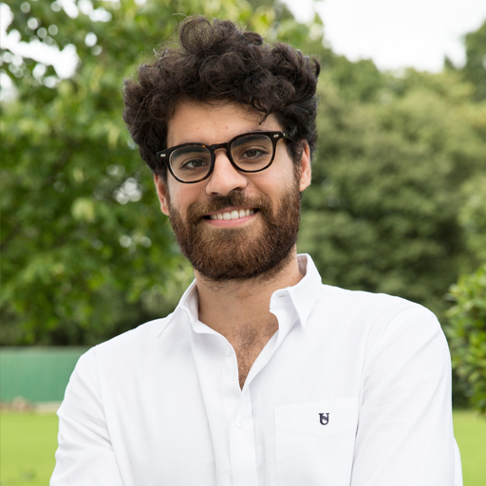
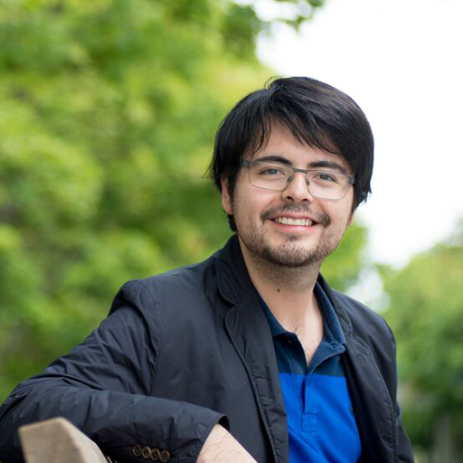
What our students are saying…
“Beautiful scenery around campus. A wonderful programme and excellent teachers and speakers have impressed me so much.”
Yan Jiang, China
“I learned to work with people from different cultures and ways of thinking. It opened my mind.”
Manfredi Randazzo, Italy
“It was an amazing opportunity to learn more and expand what I know.”
Carlos Lavalle, Mexico

Slide 3

Why spend your
summer with us?
3 week programme
Quality teaching
Exciting range of courses
High profile guest speakers
Live on a beautiful campus
Fun and engaging social and cultural programme
Range of accommodation options
Lots of local places of interest and
London just a short train journey away
Community atmosphere
Internationally diverse – over 50 different countries!

Slide 4
WARWICK SUMMER SCHOOL 2023 Courses:
BUSINESS and Economics
Behavioural Economics
Comms and Marketing
Environmental Economics
Game Theory and Competitive Strategy
International
Business and Finance
Money and Banking
Strategic Management
social sciences
Transnational Governance, International Law and Global Capitalism
Common Law Contracts, Arbitration and Advocacy
Leadership, Communication
and Innovation
Politics and International Relations
SCIENCES
Computational Modelling
Data Science: Foundations of Data Analytics
Artificial Intelligence: A Practical Introduction

Slide 5

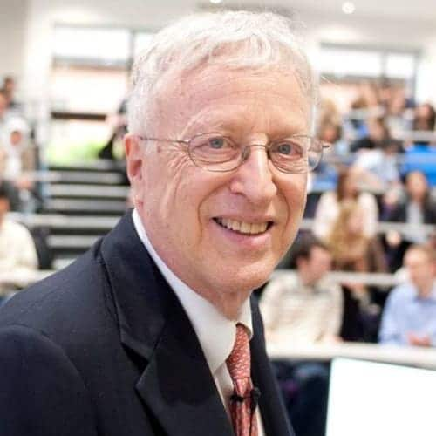
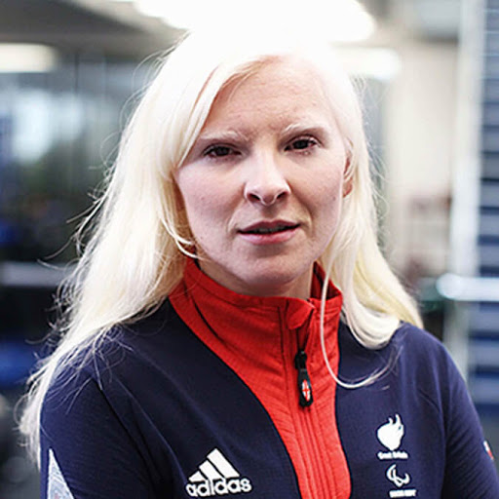

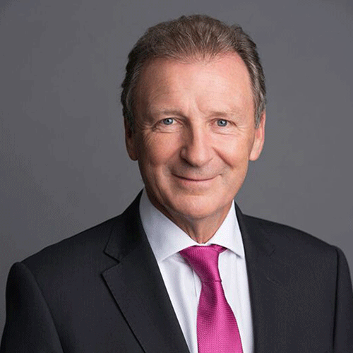
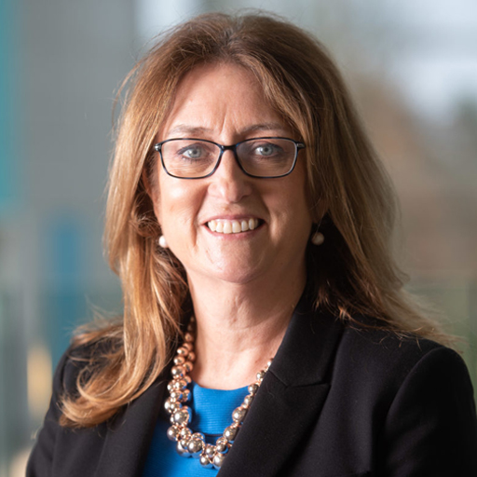
GUEST SPEAKERS
Previous guest speakers have included:
Nobel Prize Winning Economist, Professor George Akerlof
Gold medal winning Alpine Skier, Kelly Gallagher, MBE
Award Winning Entrepreneur, Priya Lakhani, OBE
Former Cabinet Secretary, Lord Gus O’Donnell
Former Home Secretary, Jacqui Smith
*2023 guest speakers will be announced in the coming months

Slide 6

SOCIAL PROGRAMME
The Summer School includes:
Meet and Greet BBQ
Three Course Welcome Dinner
Curry, Karaoke and Disco night
Pizza and Film Night
Farewell Afternoon Tea Reception
Sports activities
Optional trips include:
London, Oxford and Cotswolds/Bath

Slide 7
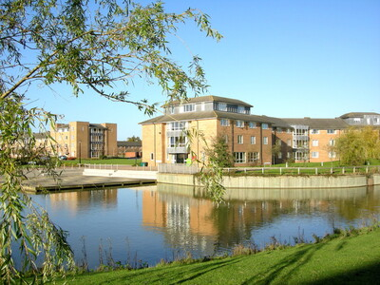
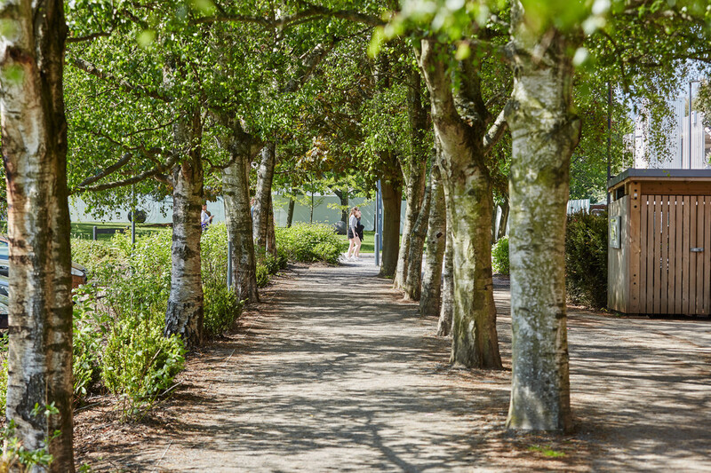
CAMPUS AND ACCOMMODATION
Campus
Large world-class campus with outstanding teaching and learning spaces, a 24-hour library, Arts centre and cinema, brand new sports and wellness hub, restaurants and cafes and many green spaces including lakes, woodland and open fields.
Close to Coventry, Birmingham, London, Stratford-upon-Avon, Warwick Castle and Leamington Spa
Accommodation options
Room only | Bed and breakfast | Dinner, Bed and Breakfast
Halls include options with en-suite bathrooms and shared bathrooms. Prices to suit all budgets.
Gym and Swim access included in accommodation price.

Slide 8


GET IN TOUCH:
wssadmissions@warwick.ac.uk
www.warwick.ac.uk/summerschool
Westwood Campus
University of Warwick
Gibbet Hill Road
Coventry
CV4 7AL UK

Slide 9
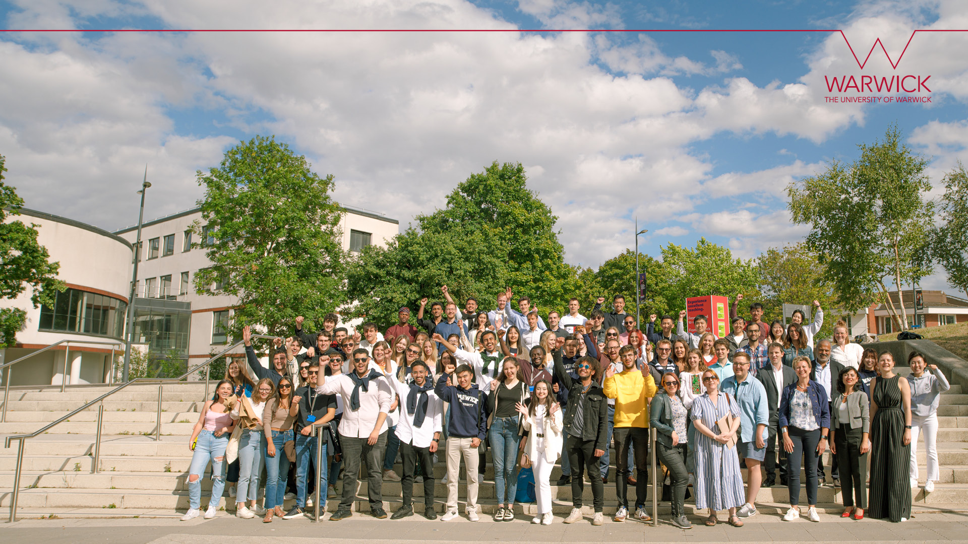



FOLLOW US:
@warwicksummer
facebook.com/warwicksummerschools
instagram.com/warwicksumemrschools

