Slide 1

Warwick Summer School 2026
The Summer to Inspire Your Future
12 July – 1 August 2026

Slide 2
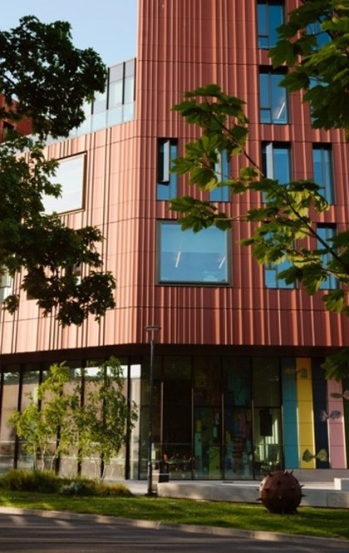

Why Warwick?
The University of Warwick is a leading UK Russell Group University, widely recognised as a leader in research and education.
8th in the UK
GUARDIAN University RANKINGS 2025
22ND in EUROPE
QS WORLD RANKINGS 2025
69th in the world
QS World Rankings 2025

Slide 3
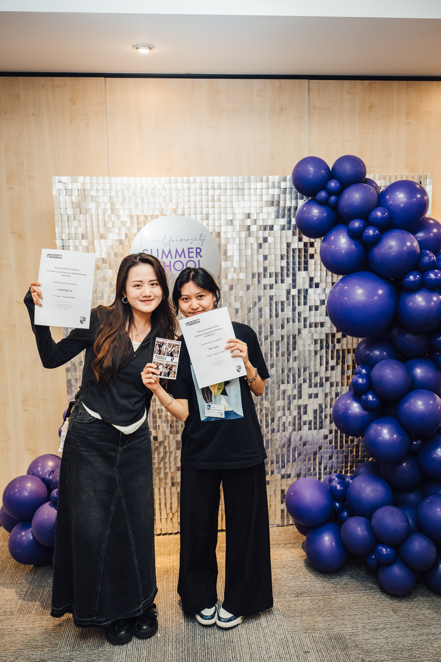
Why Spend Summer With Us?
Quality teaching across a range of courses, taught at different levels
Guest speakers from across the public and private sectors
Live on our beautiful campus in the Heart of England, accommodation and catering options to suit different budgets
Fun and engaging social and cultural programme
Lots of local places of interest - London just a short train journey away!
Community atmosphere and internationally diverse
Optional additional week focused on Exploring British Culture or Preparatory English

Slide 4
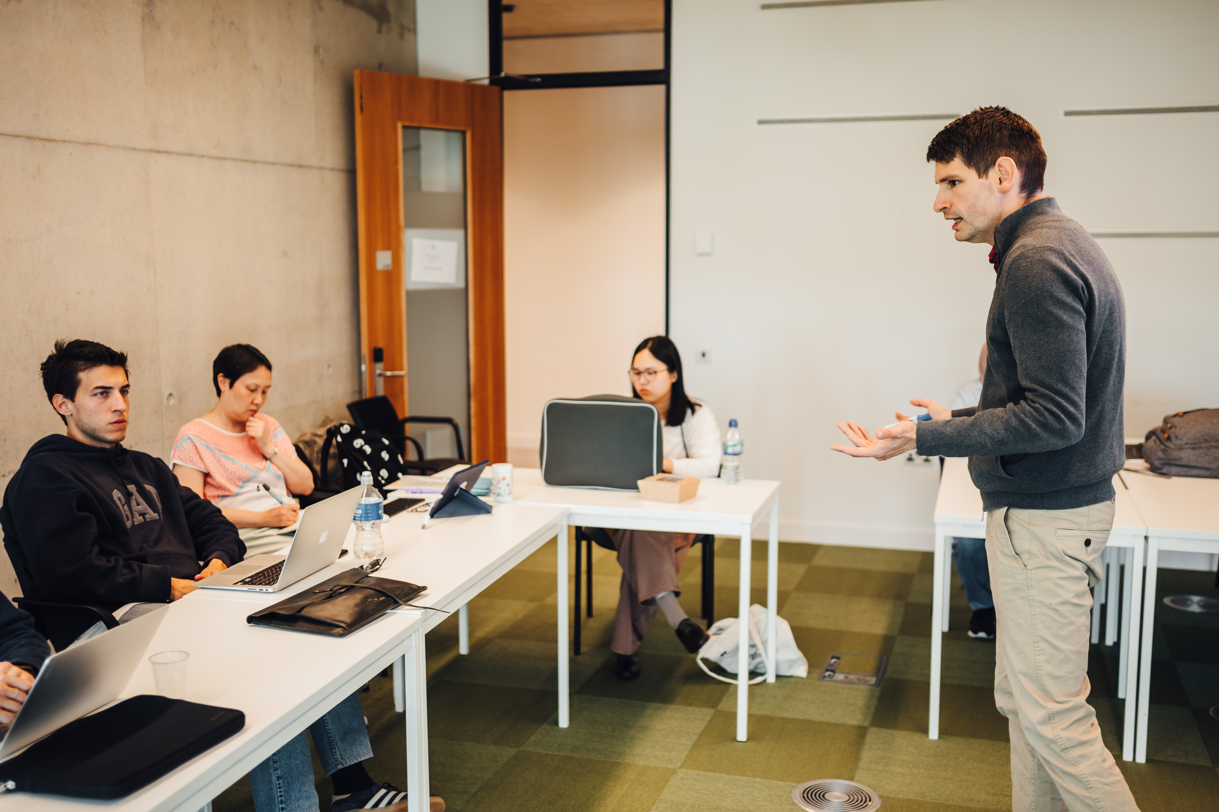
Warwick Summer School 2026 – Course Options
Behavioural and Experimental Economics
International Business and Finance
Money and Banking
Strategic Management
Communications and Marketing
Common Law Contracts, Arbitration and Advocacy
International Relations, Security and Development
Global Connections: Institutions, Mobilities and Cultures
Artificial Intelligence: A Practical Introduction
Data Science and Machine Learning: The Fundamentals
Engineering
Pre-PHD

Slide 5
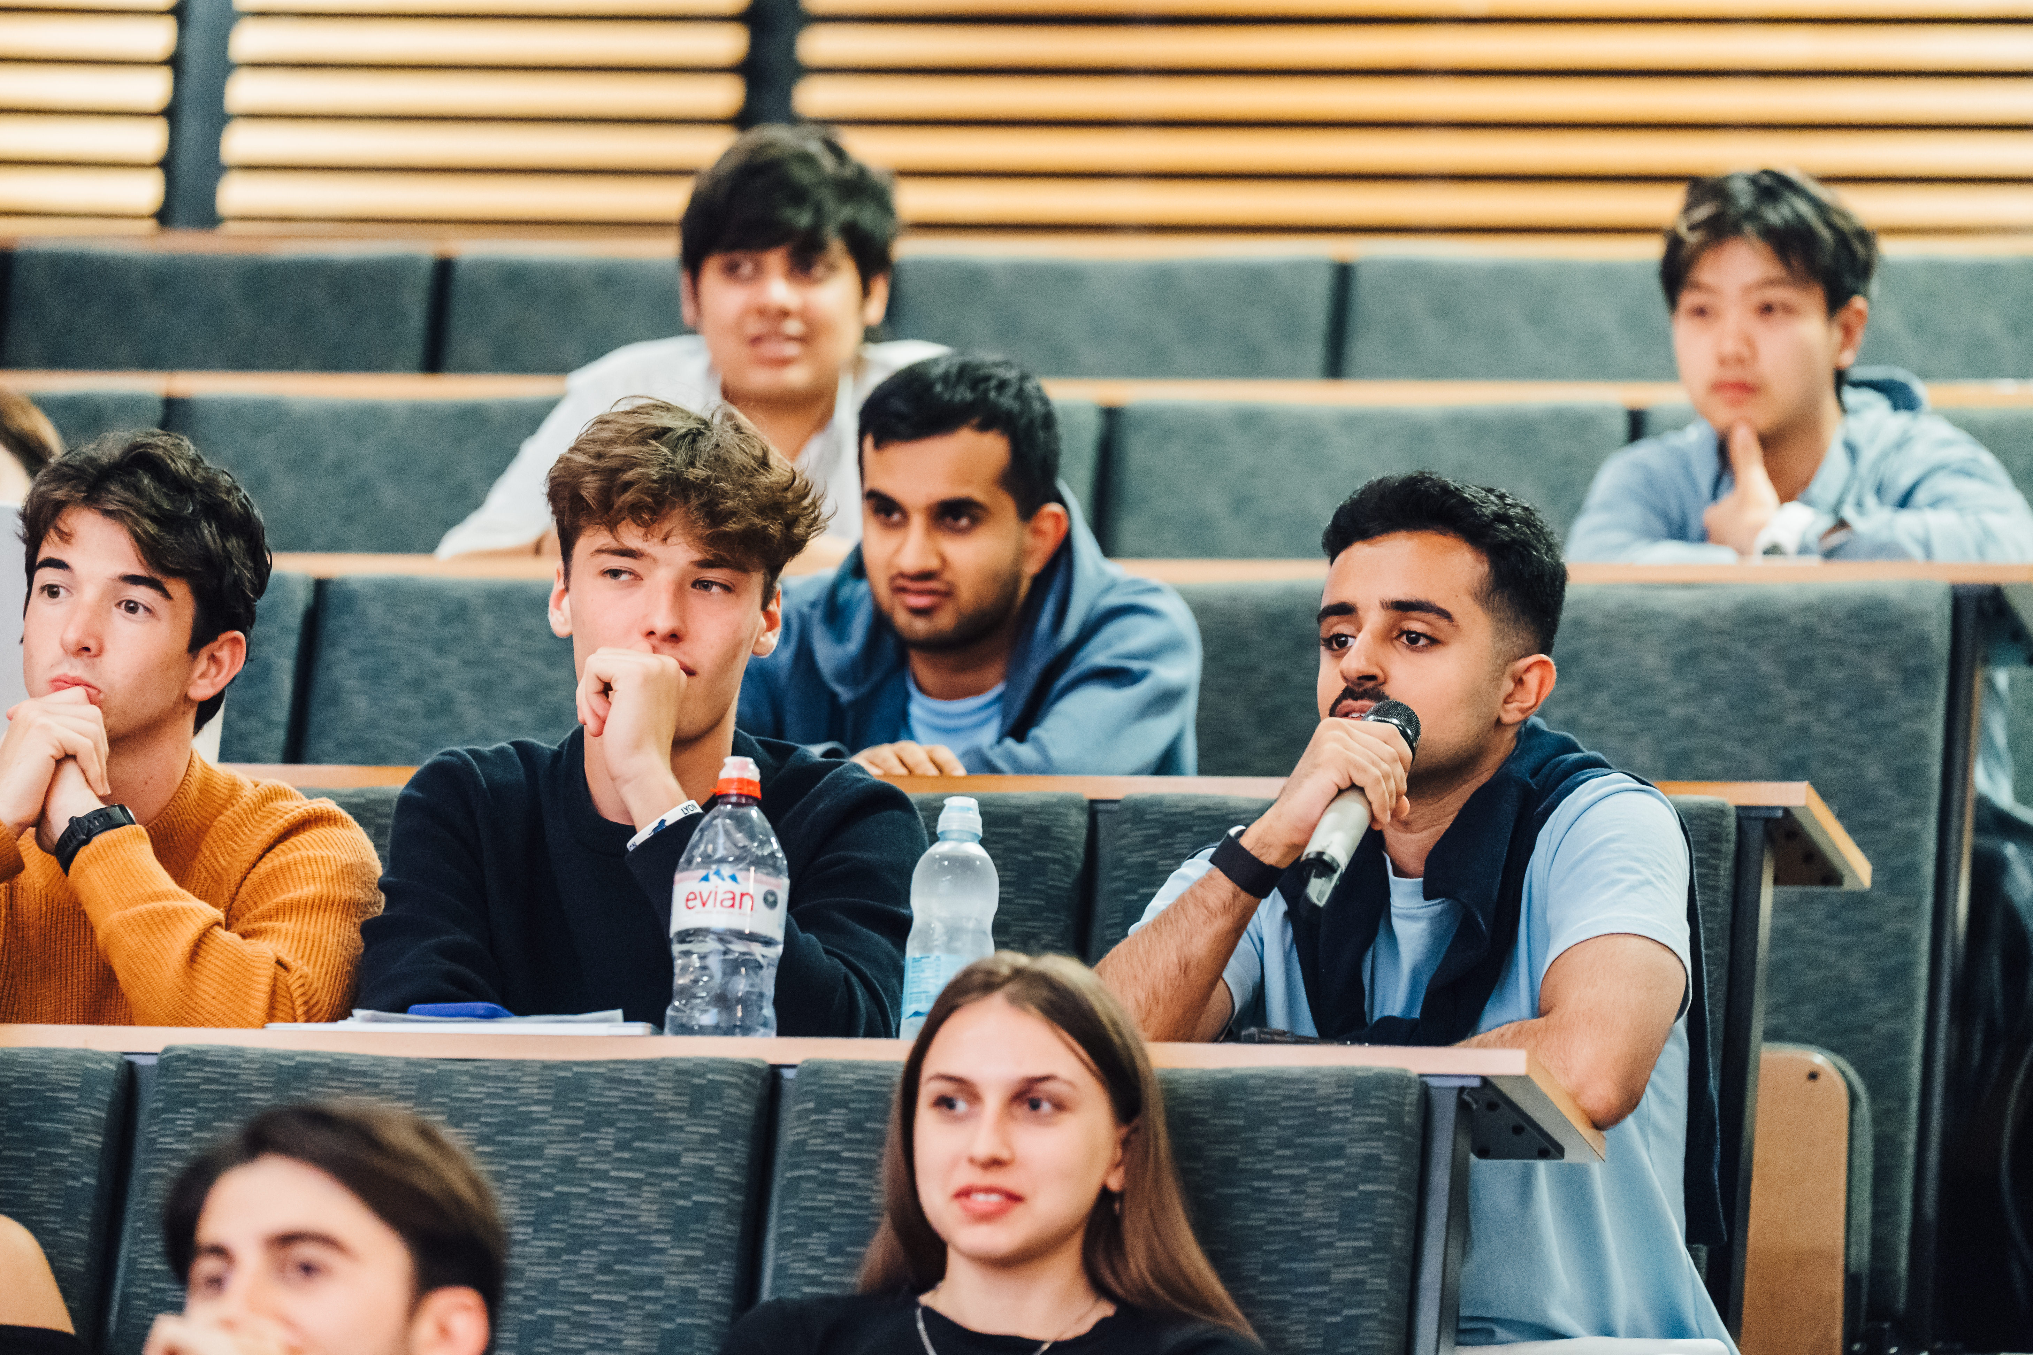
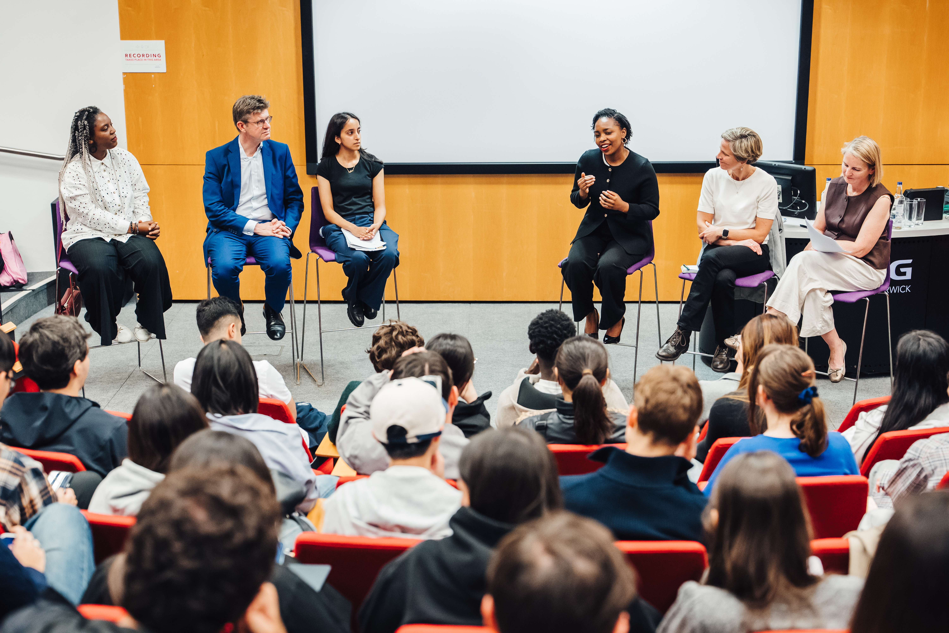
Teaching and Assessment
60 hours of teaching including lectures, seminars/workshops, revision, study groups and guest lectures
Dedicated team of teachers, bespoke syllabi
Optional assessment for all students
Certificate of attendance
Transcript of results for assessments (mid-September)
Modules are equivalent to 7.5 ECTS and 3 US credits – many students use the course to transfer credit to their home institution
Experienced programme team and teaching support
Excellent teaching facilities across the Warwick campus

Slide 6

Guest Speakers
Previous guest speakers have included:
Nobel Prize Winning Economist, Professor George Akerlof
BBC Broadcaster and Journalist, Satnam Rana-Grindley
Award Winning Entrepreneur, Priya Lakhani, OBE
Former Cabinet Secretary, Lord Gus O’Donnell
Former Home Secretary (and current Minister for Skills), Jacqui Smith MP
Former-CEO and Founder of UK's National Cyber Security Centre, Professor Ciaran Martin
Team GB Paralympian, Kare Adenegan
Our 2026 guest speakers will be announced in early 2026

Slide 7
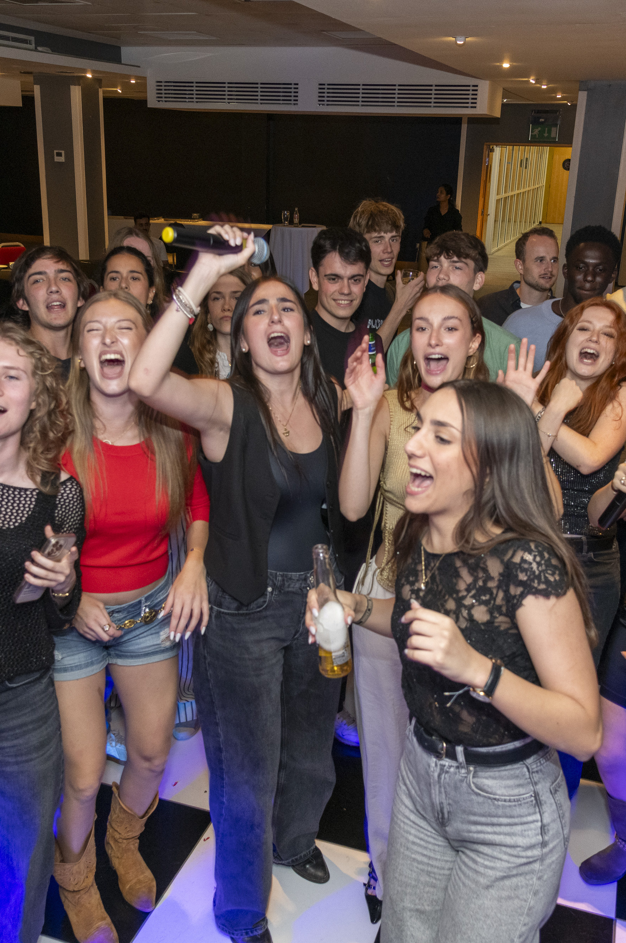
Social Programme
The Summer School tuition fee includes the following social elements:
Meet and Greet BBQ
Three-course Welcome Dinner
Pub Quiz Night
Curry, Karaoke and Disco night
Summer School Fun Day
Farewell Reception
Sports activities – badminton and football
Optional trips in 2025 included London, Oxford, Cotswolds/Bath
(additional fee)

Slide 8
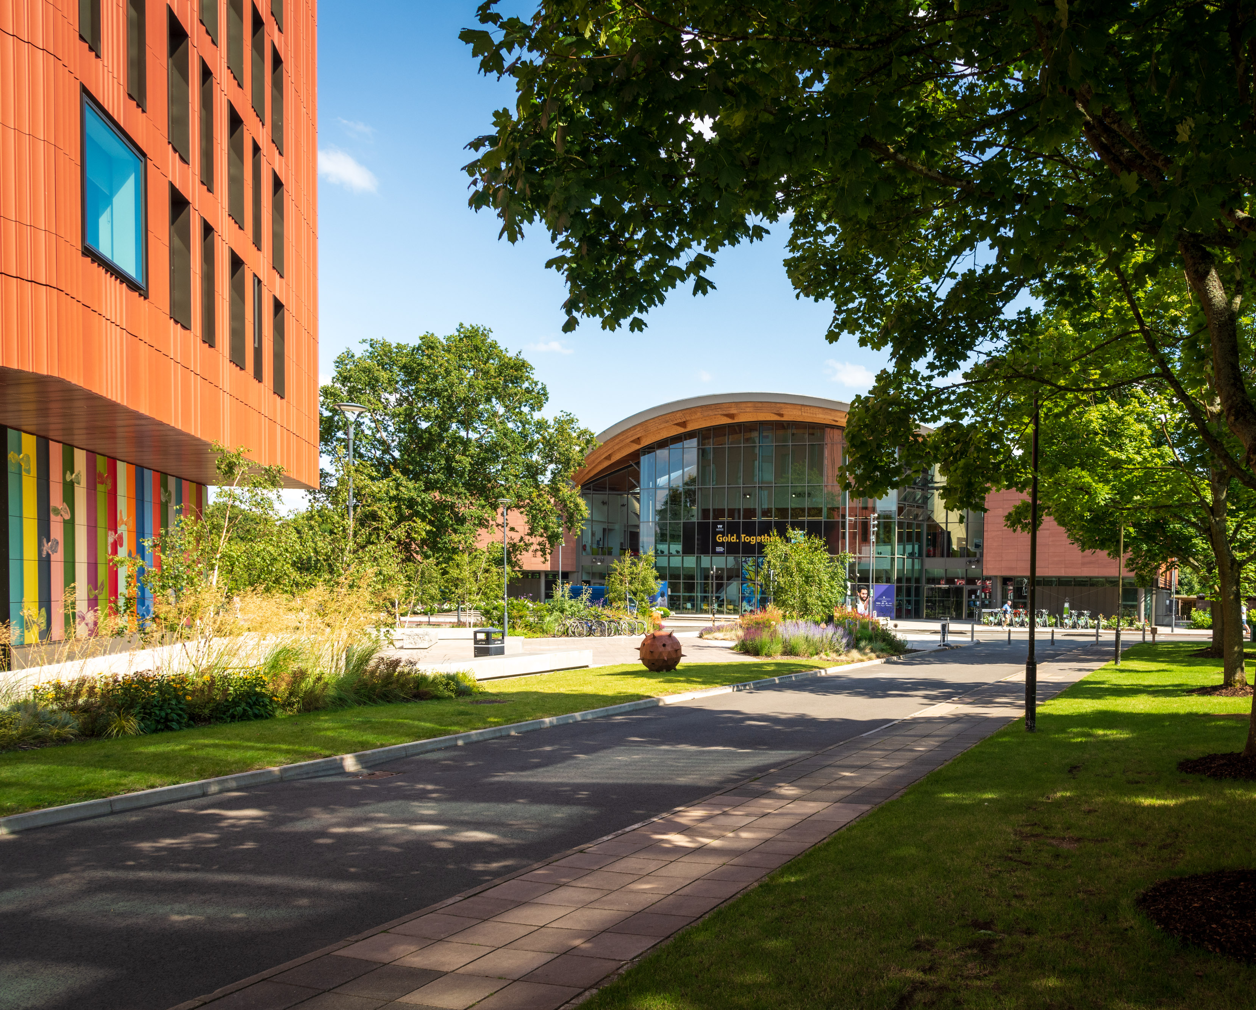
Campus and Accommodation
Campus
World-class campus with outstanding teaching and learning spaces, a 24-hour library, Arts centre and cinema, sports and wellness hub, restaurants and cafes, and many green spaces including lakes, woodland and open fields
Close to major cities and small tourist towns
Accommodation options (payable separately)
Room only | Bed and breakfast | Dinner, Bed and Breakfast
Halls include options with en-suite bathrooms and shared bathrooms. Prices to suit all budgets
Halls are on campus and walking distance to all facilities (can also hire bikes)
Gym and Swim access to Sports Centre included in accommodation price

Slide 9
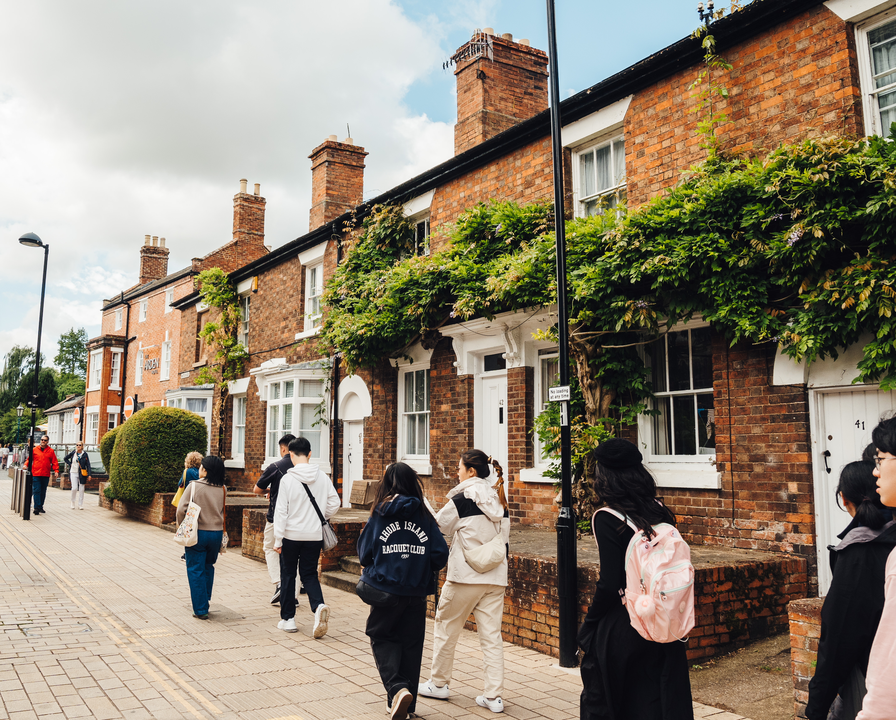
Exploring British Culture
An additional week giving the opportunity to live on campus, study and explore the UK ahead of the main Warwick Summer School
16 hours of teaching and Business Enterprise project work
Key themes include Shakespeare, British history, and politics in the UK, all supported by excellent teaching from Warwick staff and with a relevant field trip for each theme
Includes an overnight stay in London and day trips to Oxford and Stratford-upon-Avon
Student ambassadors support this programme, living alongside you for a week and joining you on trips and social activities
Offered on a half board basis – accommodation and catering included in the fee (£2310)
Limited places available
Students joining this week will receive a 25% discount on the main Summer School tuition fee

Slide 10

Preparatory English - Online
Short online course designed to boost English and academic confidence before the Summer School
Develops speaking, listening, reading and writing through real academic tasks and discussions
Small interactive classes with live teaching and group work
Helps students build vocabulary and communication skills for university-style study
Runs one week before the Summer School (6–10 July 2026)
5-day online course (morning or afternoon sessions)
2026 Fee: £750

Slide 11
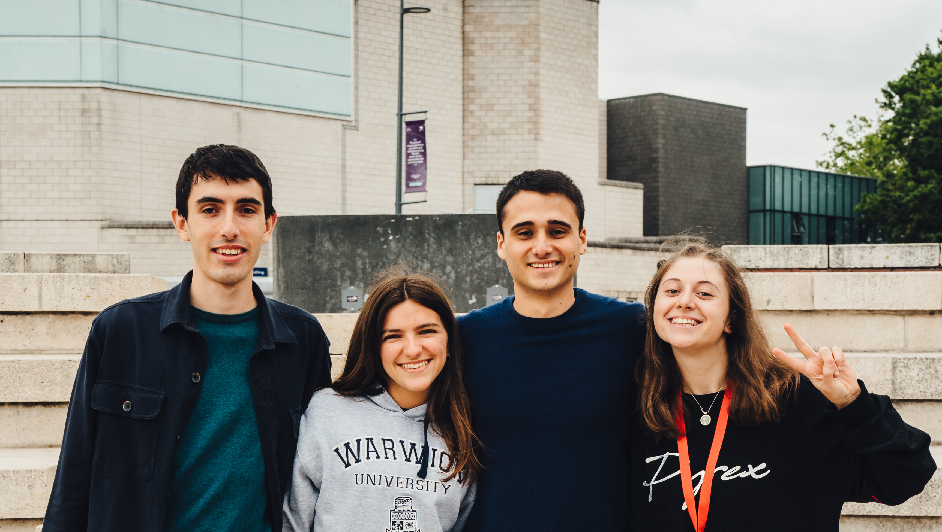
What our students say
Maria
Country: Portugal
WSS course studied: Money and Banking
"Warwick proved to be a milestone in my life. From an academic perspective, it developed a critic spirit that has enhance my learning approach.
It offers you the chance to create lifetime memories, but it’s ultimately up to you to seize this opportunity and make it truly transformative."

Slide 12
2026 Fees and Admissions
Application will close 29 May 2026
Applications made online, via our website
Short application form to gather personal details and education history
Courses are taught at different levels, some courses will have prerequisites
No English tests required – we assess your English based on your correspondence with us
We aim to make a decision and respond to your application within 3-5 working days
If a visa is required, we will issue a visa invitation letter after the deposit payment (A £1,000 deposit (or full payment) will be required to secure your place on the Warwick Summer School - this deposit is included in the overall tuition fees).
 | Student Rate* | Standard Rate
Tuition Fee | £2600 | £3500
Loyalty Discount** | £2210 | £2975
Exploring British Culture Week (Reduced Warwick Summer School tuition fees by 25%) | £2310 | £2310
Preparatory English | £750 | £750
Application Fee (non-refundable) | £50 | £50
3-week Accommodation | £901-£1747 | £907-£1747
*for any students in full-time education at any University or College worldwide.
**for Warwick Alumni, Warwick Students, Offer Holders, Summer School Alumni and Students at our partner institutions.
Group booking discounts are available for institutions with 10+ students interested in joining the Warwick Summer School

Slide 13

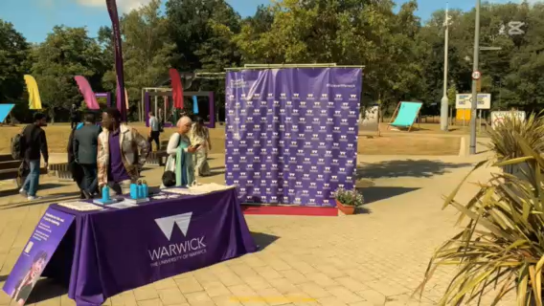
Notes:
Video created by Sara from UCSC who attended the 2025 summer school.

Slide 14
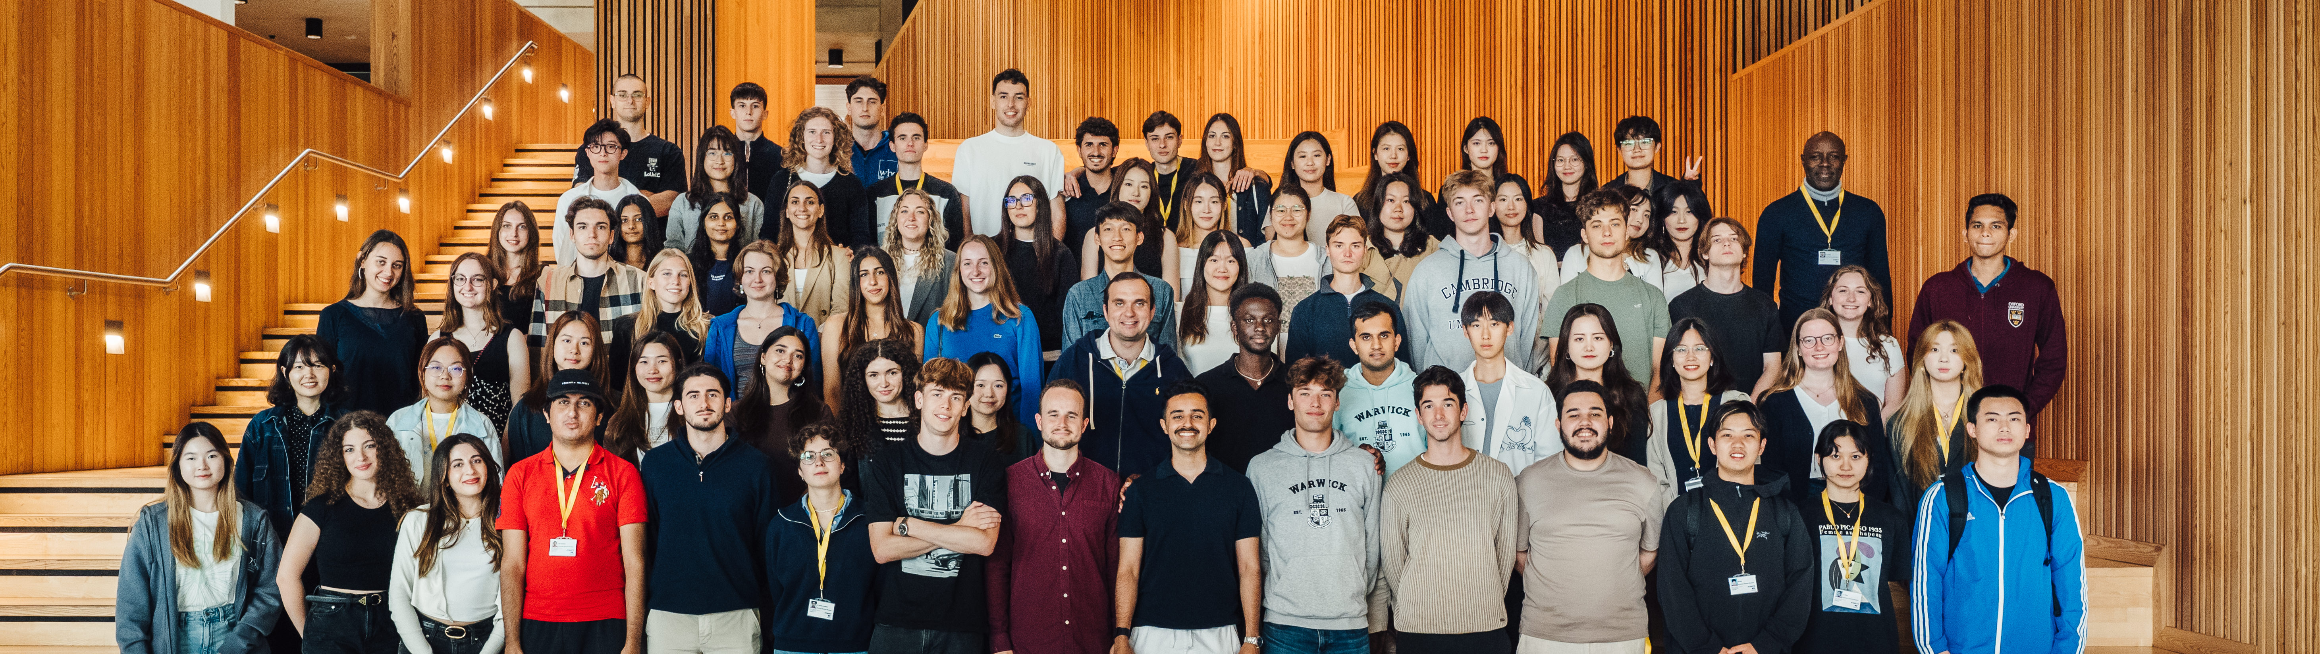
Thank you for listening
Questions?

