Slide 1
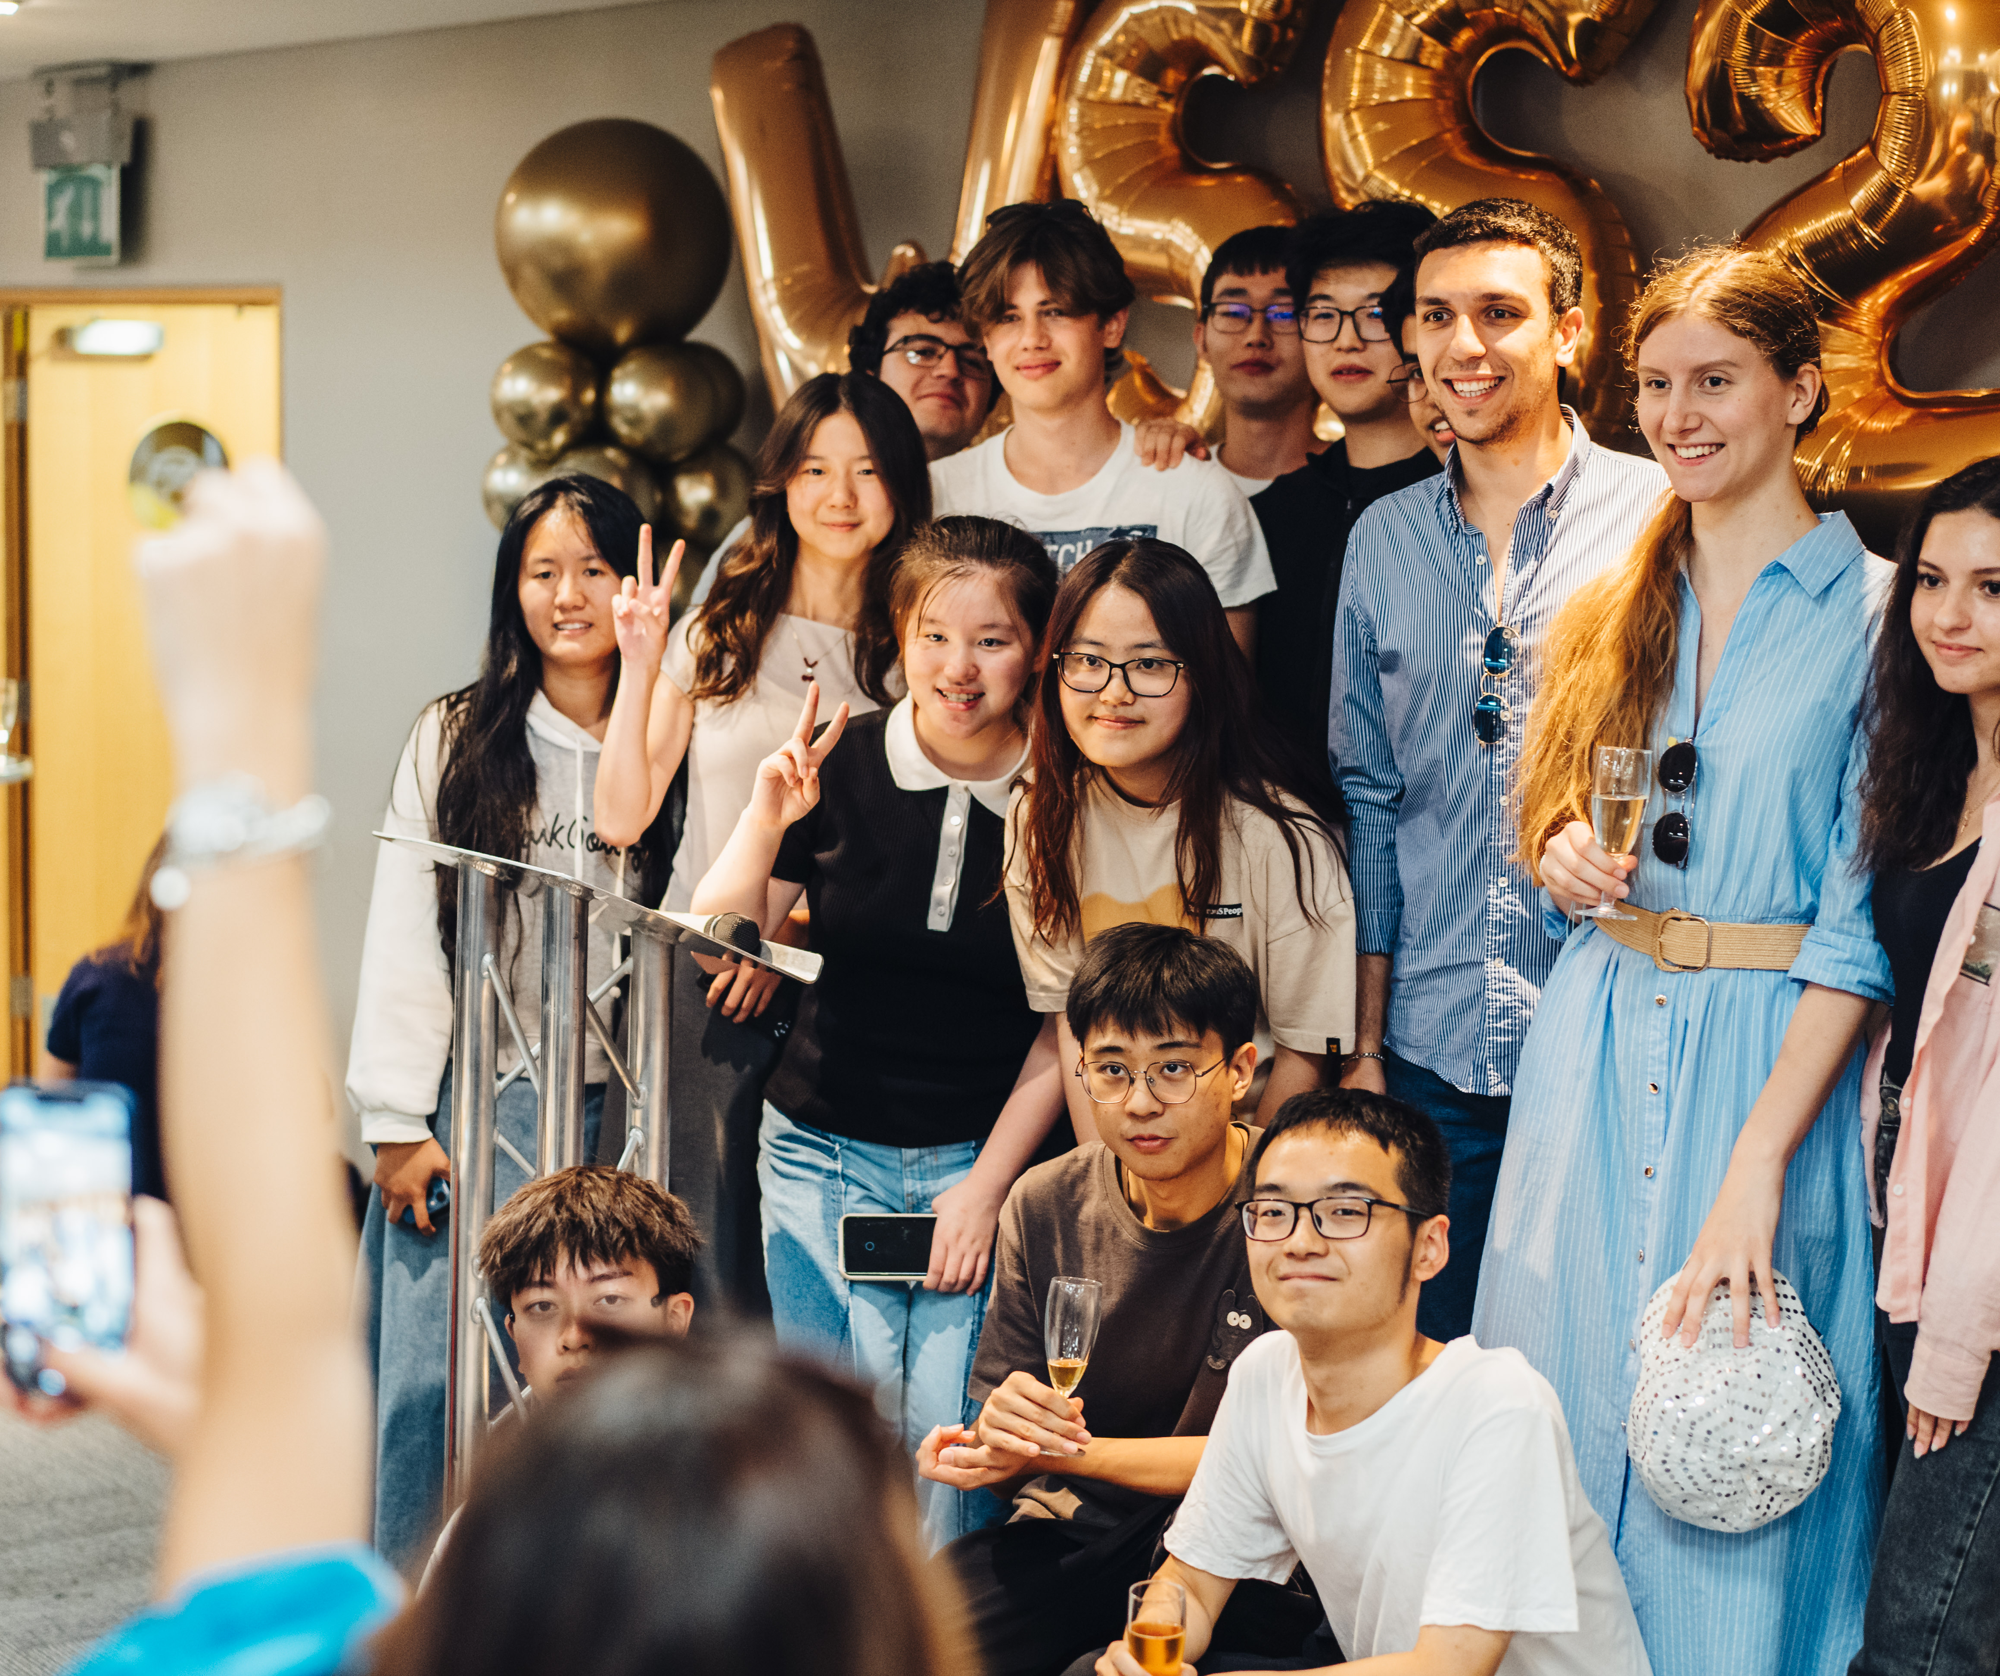
Warwick summer school
The Summer to Inspire Your Future
13 July – 2 August 2025
October 2024

Slide 2
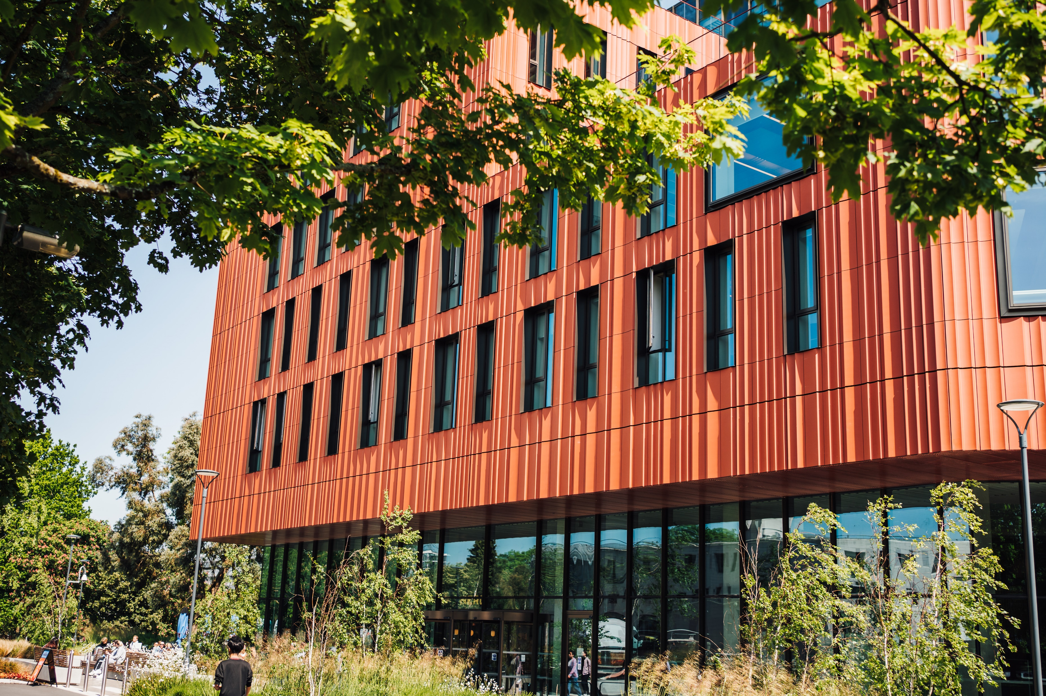

Why Warwick?
The University of Warwick is a leading UK Russell Group University, widely recognised as a leader in research and education.
8th in the UK GUARDIAN University RANKINGS 2025
22ND in EUROPE QS WORLD RANKINGS 2025
69th in the world QS World Rankings 2025
99% of our students would recommend the Warwick Summer School!

Slide 3
Why Spend Summer With Us?
3-week academic programme
Quality teaching across a range of courses, taught at different levels
Guest speakers from across the public and private sectors
Live on our beautiful campus in the Heart of England, accommodation and catering options to suit different budgets
Fun and engaging social and cultural programme
Lots of local places of interest - London just a short train journey away!
Community atmosphere and internationally diverse
Optional additional week focused on Exploring British Culture

Slide 4



Warwick Summer School 2025 – Course Options
Behavioural and Experimental Economics
International Business and Finance
Money and Banking
Strategic Management
Communications and Marketing
Common Law Contracts, Arbitration and Advocacy
International Relations, Security and Development
Global Connections: Institutions, Mobilities and Cultures
Artificial Intelligence: A Practical Introduction
Data Science and Machine Learning: The Fundamentals
Design Thinking

Slide 5



Teaching and Assessment
60 hours of teaching including lectures, seminars/workshops, revision, study groups and guest lectures
Dedicated team of teachers, bespoke syllabi
Optional assessment for all students
Certificate of attendance
Transcript of results for assessments (mid-September)
Modules are equivalent to 7.5 ECTS and 3 US credits – many students use the course to transfer credit to their home institution
Experienced programme team and teaching support
Excellent teaching facilities across the Warwick campus

Slide 6



Guest Speakers
Previous guest speakers have included:
Nobel Prize Winning Economist, Professor George Akerlof
BBC Broadcaster and Journalist, Satnam Rana-Grindley
Award Winning Entrepreneur, Priya Lakhani, OBE
Former Cabinet Secretary, Lord Gus O’Donnell
Former Home Secretary (and current Minister for Skills), Jacqui Smith MP
Former-CEO and Founder of UK's National Cyber Security Centre, Professor Ciaran Martin
Our 2025 guest speakers will be announced in early 2025

Slide 7

Social Programme
The Summer School tuition fee includes the following social elements:
Meet and Greet BBQ
Three-course Welcome Dinner
Pub Quiz Night
Curry, Karaoke and Disco night
Summer School Fun Day
Farewell Reception
Sports activities – badminton and football
Optional trips in 2024 included London, Oxford, Cotswolds/Bath (additional fee)

Slide 8
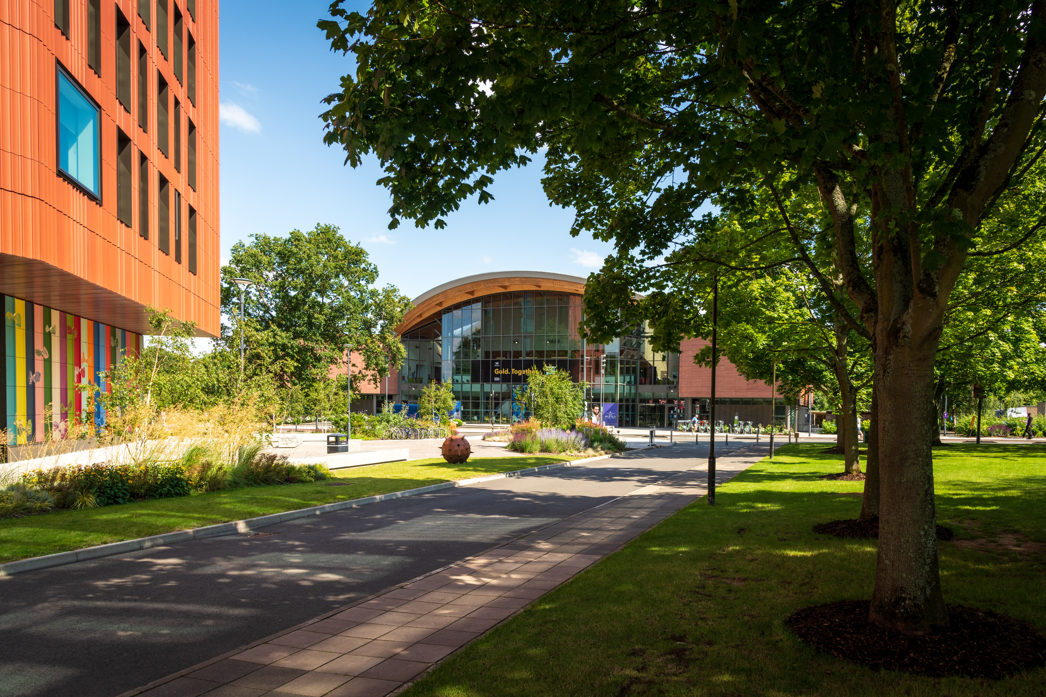
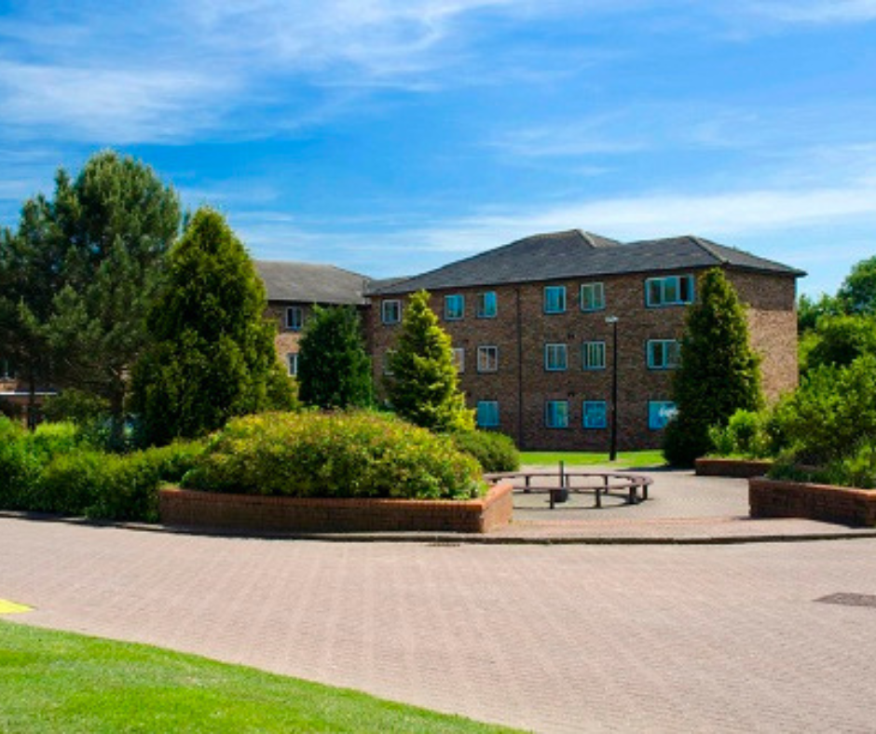
Campus and Accommodation
Campus
World-class campus with outstanding teaching and learning spaces, a 24-hour library, Arts centre and cinema, sports and wellness hub, restaurants and cafes, and many green spaces including lakes, woodland and open fields
Close to major cities and small tourist towns
Accommodation options (payable separately)
Room only | Bed and breakfast | Dinner, Bed and Breakfast
Halls include options with en-suite bathrooms and shared bathrooms. Prices to suit all budgets
Halls are on campus and walking distance to all facilities (can also hire bikes)
Gym and Swim access to Sports Centre included in accommodation price

Slide 9
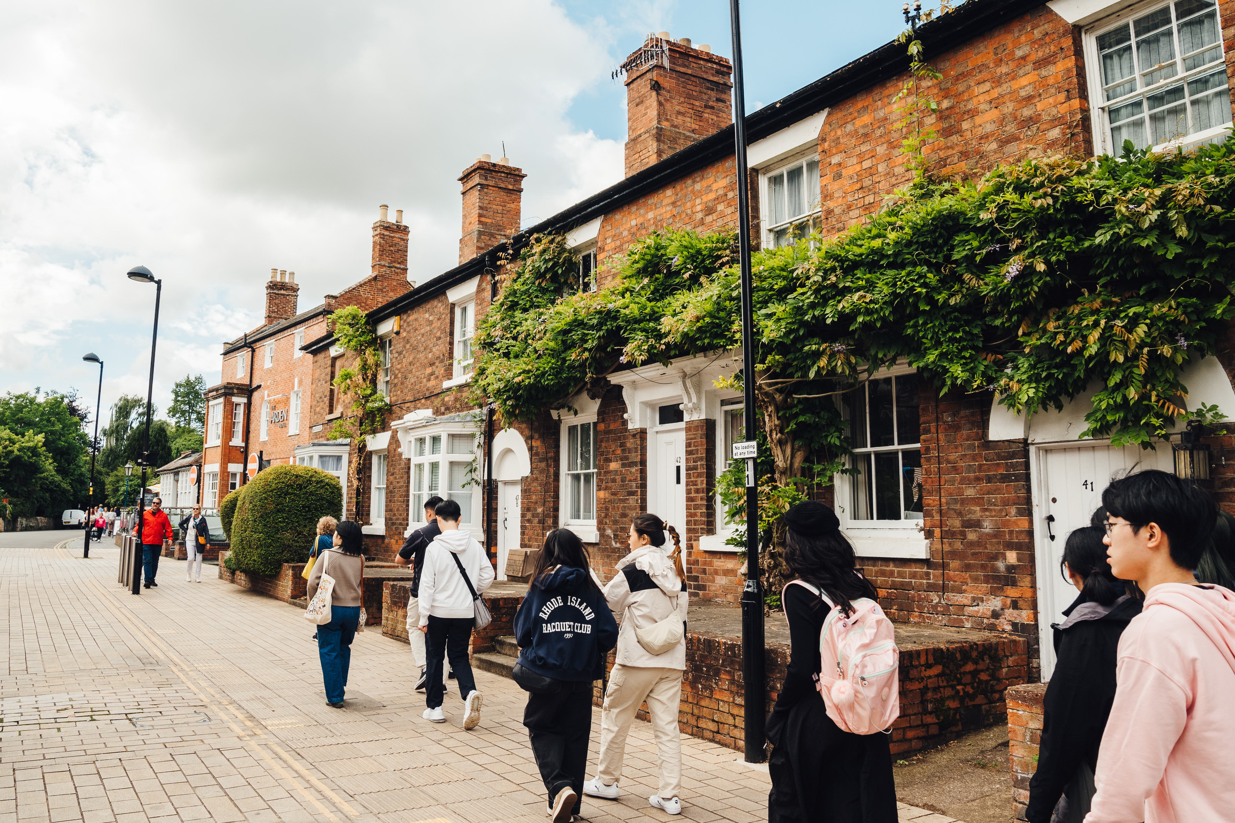
Exploring British Culture
An additional week giving the opportunity to live on campus, study and explore the UK ahead of the main Warwick Summer School
16 hours of teaching and Business Enterprise project work
Key themes include Shakespeare, British history, and politics in the UK, all supported by excellent teaching from Warwick staff and with a relevant field trip for each theme
Includes an overnight stay in London and day trips to Oxford and Stratford-upon-Avon
Student ambassadors support this programme, living alongside you for a week and joining you on trips and social activities
Offered on a half board basis – accommodation and catering included in the fee (£2185)
Limited places available
Students joining this week will receive a 25% discount on the main Summer School tuition fee

Slide 10



What Our Students Say
Yan Jiang, China
“Beautiful scenery around campus. A wonderful programme and excellent teachers and speakers have impressed me so much.”
Manfredi Randazzo, Italy
“I learned to work with people from different cultures and ways of thinking. It opened my mind.”
Carlos Lavalle, Mexico
“It was an amazing opportunity to learn more and expand what I know.”

Slide 11

We wholeheartedly endorse the Warwick Summer School based on the positive experiences shared by our students over the past two years. The programme offers a diverse range of courses that allow students to draw inspiration from distinguished academics in a stimulating learning environment. Consistently, our students commend the expertise and support of the Warwick faculty, alongside the valuable social and cultural interactions with peers from around the world. They return equipped with enhanced academic capabilities, personal development, and enduring connections. We strongly recommend the Warwick Summer School and the supplementary Exploring British Culture Week to those seeking a profoundly transformative summer experience for their students.
Connie Chan, Executive Officer Internationalisation, City University Hong Kong

Slide 12
Fees and Admissions
Applications made online, via our website
Short application form to gather personal details and education history
£50 application fee
Courses are taught at different levels, some courses will have pre-requisites
No English tests required – we assess your English based on your correspondence with us
We aim to make a decision and respond to your application within 3-5 working days
Programme fee - £2460 (student rate), £3300 (standard rate)
£1000 deposit required to secure place, remaining fee due by 13 June 2025
Discounts available for students from partner institutions and group bookings
If a visa is required, we will issue a visa invitation letter after deposit payment
Applications will close 31 May 2025

Slide 13
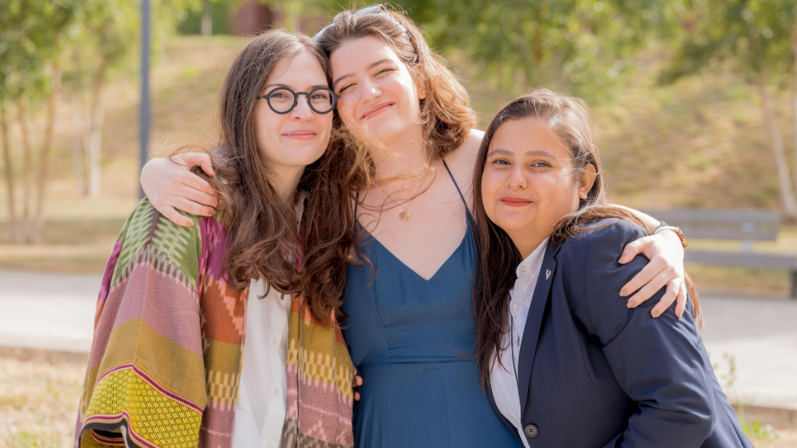
Questions?

