Slide 1

From Classroom to Classroom:
Turning Undergraduate Coursework into A-Level Learning Tools
Sam Trouton
Assistant Professor
Department of Chemistry

Slide 2
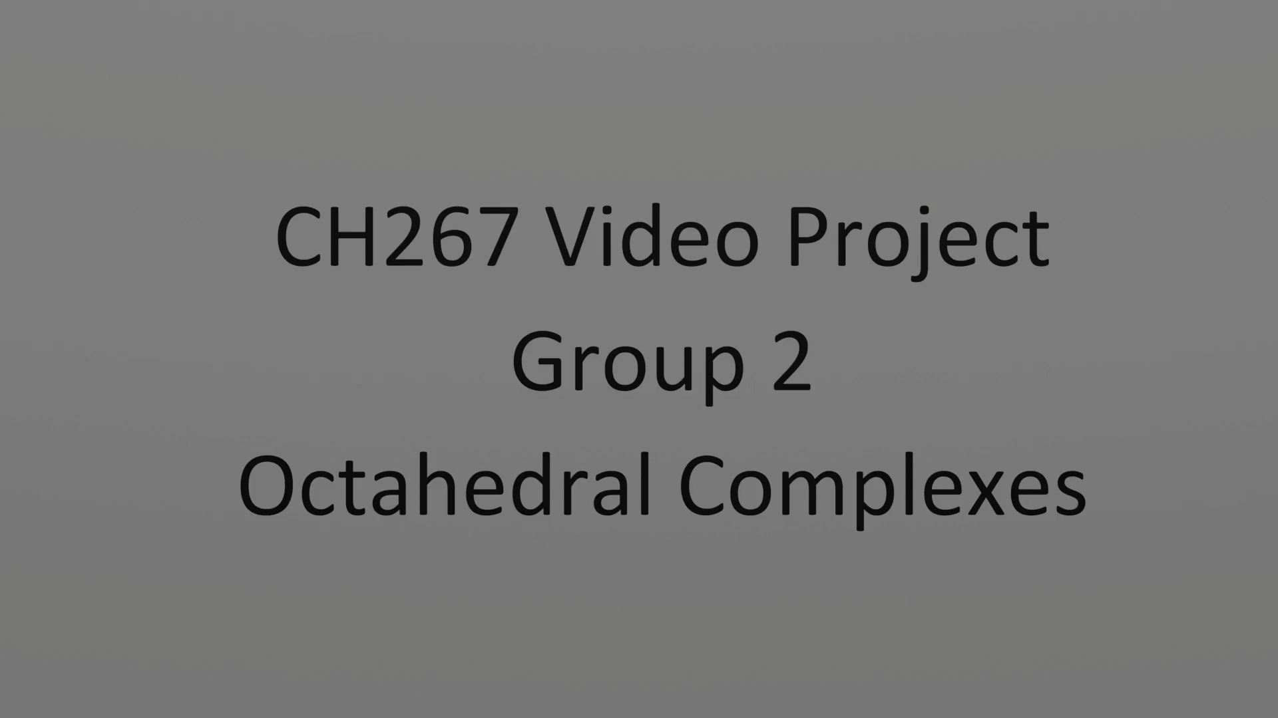

Slide 3


CH277: Inorganic Materials from Complexes to Solids
Video Project Assessment
Task
Produce a
5-minute educational video
Topic
Nobel Prize-winning inorganic chemistry
Audience
A-level Chemistry students

Slide 4

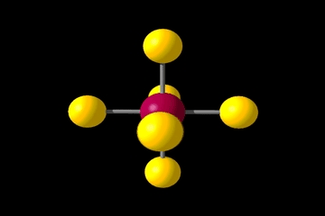
Why Educational Videos
for A-level Students?
A-level is the natural ‘goldilocks’ zone
Advantages
of videos and animation in SciComm

Slide 5
Why Educational Videos
for A-level Students?
A-level is the natural ‘goldilocks’ zone
Advantages
of videos and animation in SciComm
Transferable skills development

Slide 6








Students’ Timeline
Intro Lecture
Resources Available
Initial Planning and Research
Write Script & Storyboard
Record video and/or Animate
Voice Over & Edit
Submit Work & Peer Assess
Feedback & Grades
To Do:
⊠ Watch Examples
⊠ Select a Nobel Prize
⊠ Establish Team Dynamic
⊠ Agree on Timeline
Early Term 1
Throughout Term 1
Mid-End Term 1
End of Term 1
End T1 / Early T2
End T1 / Early T2
Early-mid T2
Mid Term 2

Slide 7
Students’ Timeline
Intro Lecture
Resources Available
Initial Planning and Research
Write Script & Storyboard
Record video and/or Animate
Voice Over & Edit
Submit Work & Peer Assess
Feedback & Grades
To Do:
⊠ Watch Examples
⊠ Select a Nobel Prize
⊠ Establish Team Dynamic
⊠ Agree on Timeline
Early Term 1
Throughout Term 1
Mid-End Term 1
End of Term 1
End T1 / Early T2
End T1 / Early T2
Early-mid T2
Mid Term 2

Slide 8
Students’ Timeline
Intro Lecture
Resources Available
Initial Planning and Research
Write Script & Storyboard
Record video and/or Animate
Voice Over & Edit
Submit Work & Peer Assess
Feedback & Grades
To Do:
⊠ Watch Examples
⊠ Select a Nobel Prize
⊠ Establish Team Dynamic
⊠ Agree on Timeline
Early Term 1
Throughout Term 1
Mid-End Term 1
End of Term 1
End T1 / Early T2
End T1 / Early T2
Early-mid T2
Mid Term 2

Slide 9
Students’ Timeline
Intro Lecture
Resources Available
Initial Planning and Research
Write Script & Storyboard
Record video and/or Animate
Voice Over & Edit
Submit Work & Peer Assess
Feedback & Grades
To Do:
⊠ Watch Examples
⊠ Select a Nobel Prize
⊠ Establish Team Dynamic
⊠ Agree on Timeline
Early Term 1
Throughout Term 1
Mid-End Term 1
End of Term 1
End T1 / Early T2
End T1 / Early T2
Early-mid T2
Mid Term 2

Slide 10

Guidance, Support, and Resources
Getting Started and Software Options
Example Videos (Past & Professional)
Video Production Techniques

Slide 11
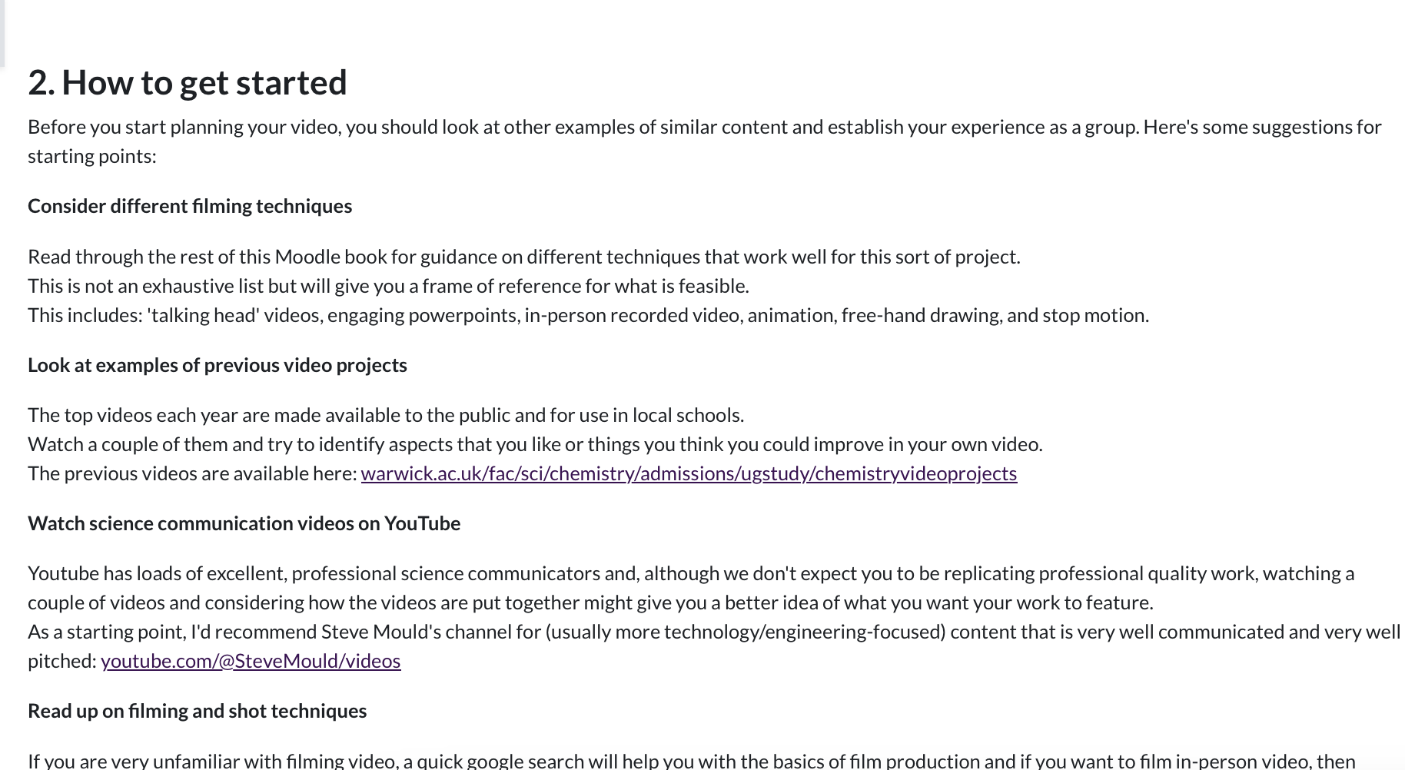
Getting Started and Software Options
Software
  Microsoft Photos
  Apple iMovie
  DaVinci Resolve
  Powerpoint
  Animaker
  Anything Else…

Slide 12

Guidance, Support, and Resources
Getting Started and Software Options
Example Videos (Past & Professional)
Video Production Techniques

Slide 13
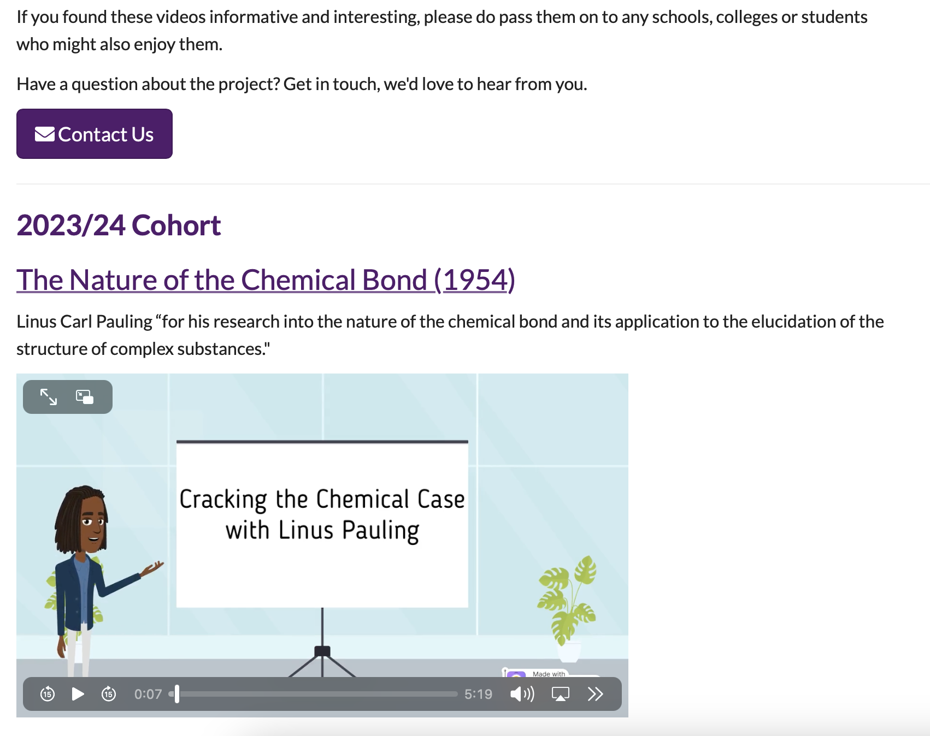
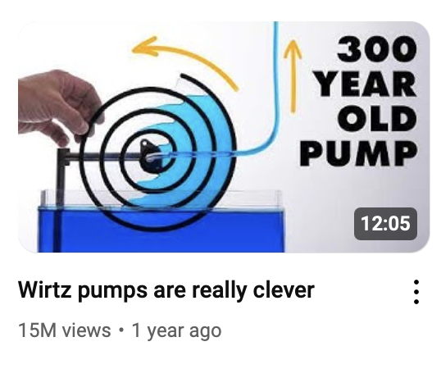
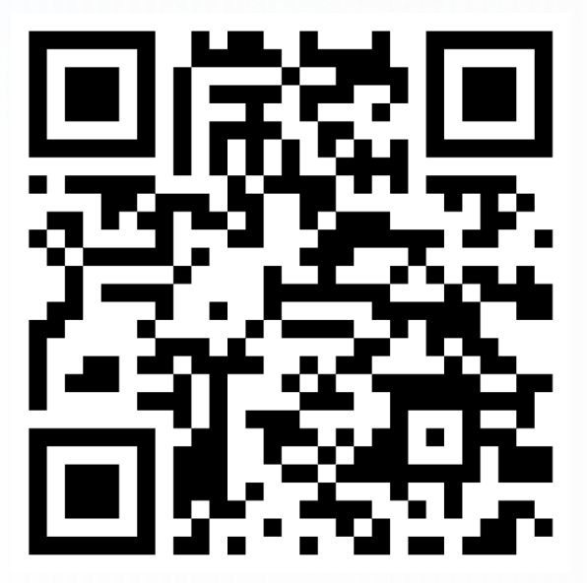

Example Videos (Past & Professional)
warwick.ac.uk/fac/sci/chemistry/admissions/
ugstudy/chemistryvideoprojects

Slide 14
Guidance, Support, and Resources
Getting Started and Software Options
Example Videos (Past & Professional)
Video Production Techniques

Slide 15
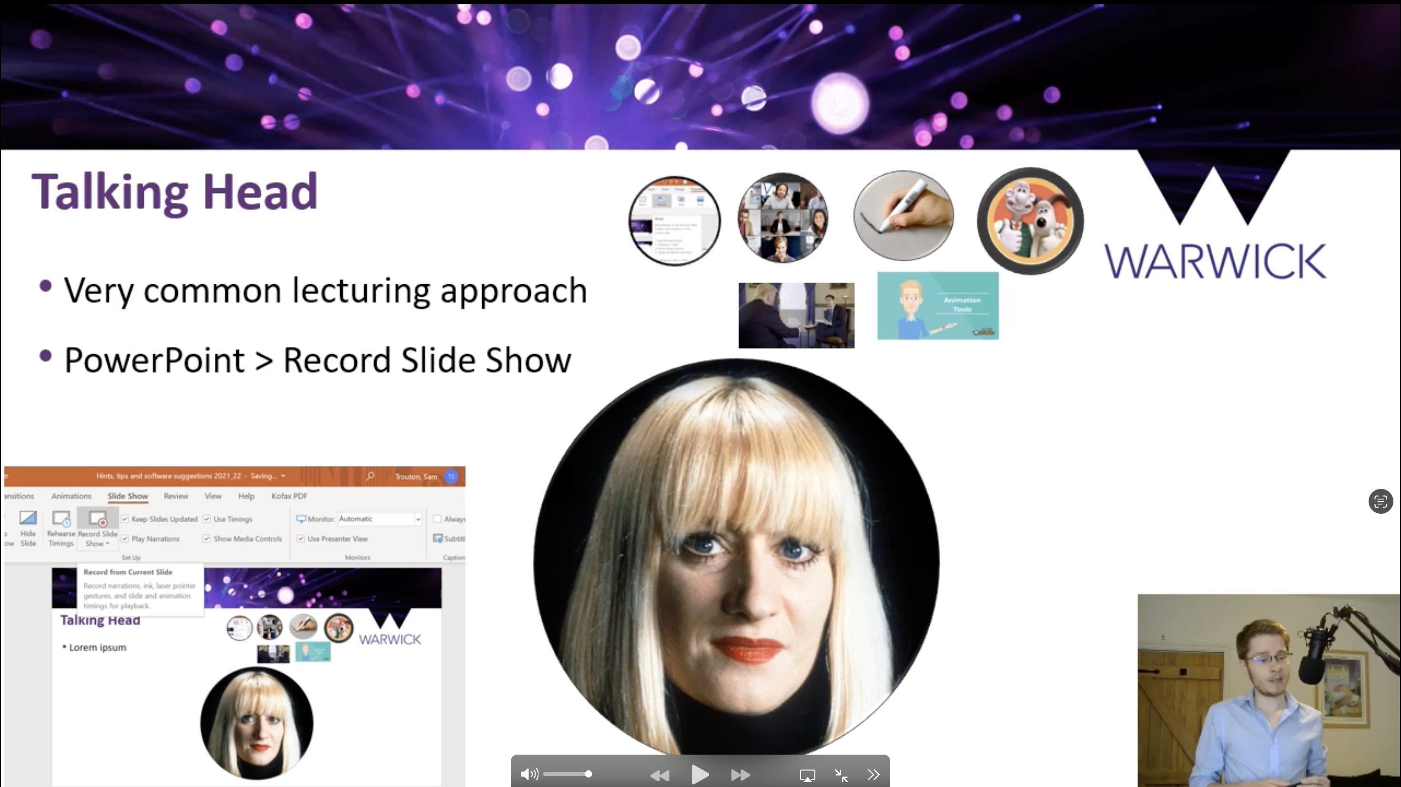
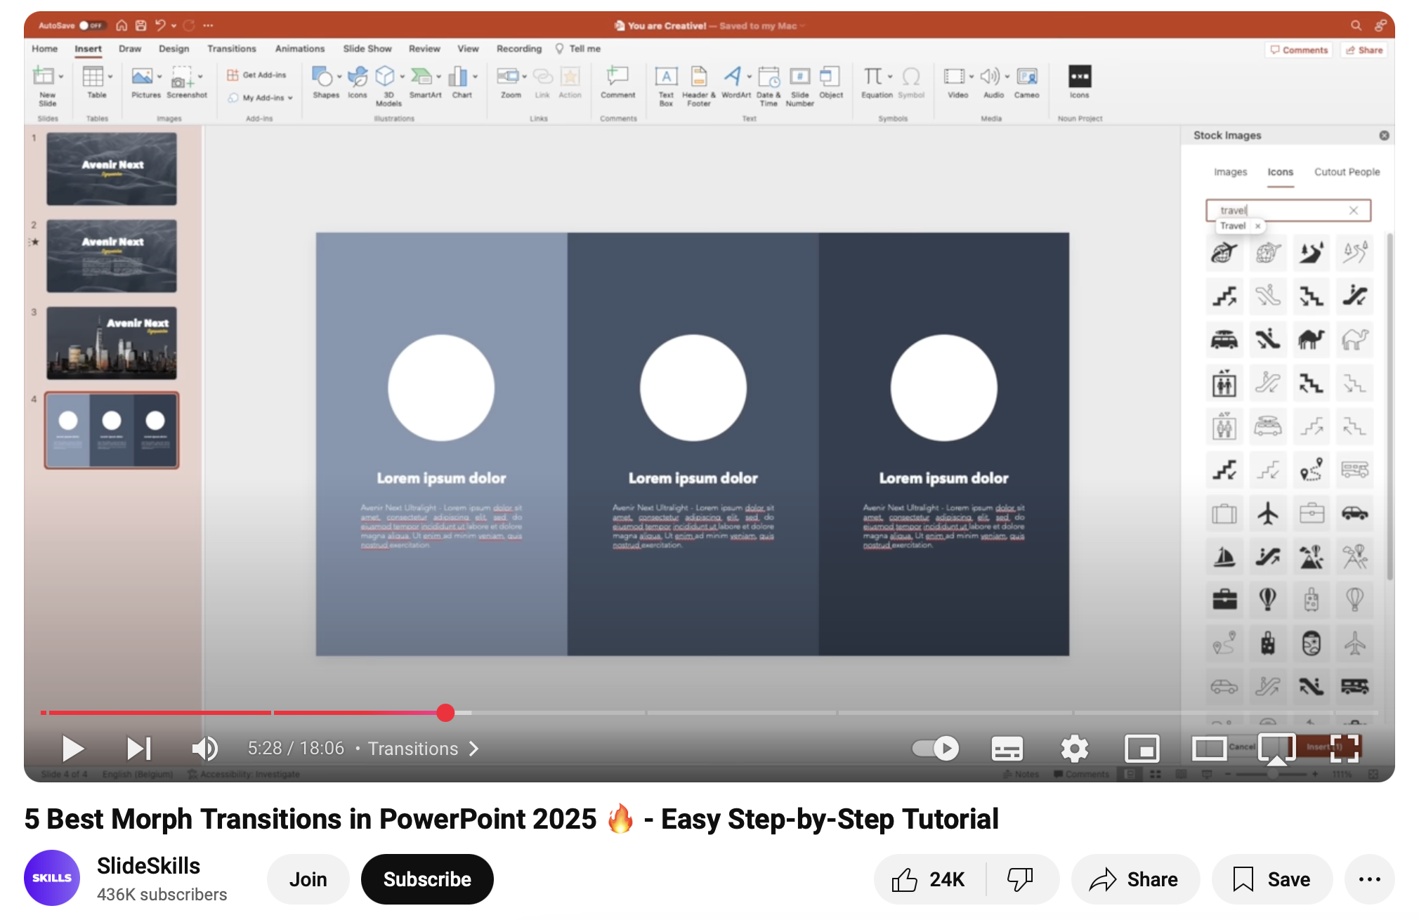
Video Production Techniques
PowerPoint Style

Slide 16


Video Production Techniques
Alternative Animation

Slide 17
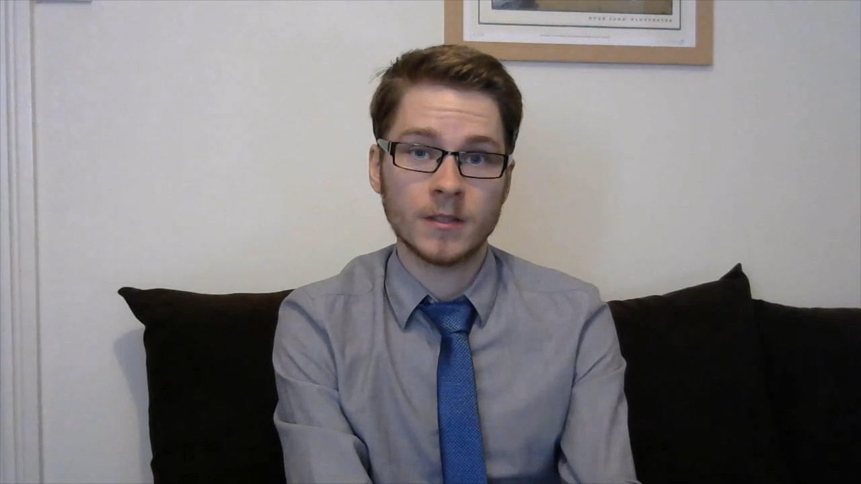
Video Production Techniques
Recorded Video

Slide 18
Guidance, Support, and Resources
Getting Started and Software Options
Example Videos (Past & Professional)
Video Production Techniques

Slide 19
Marking and Feedback
Assessment Rubric
Chemistry Content
Structure & communication
Video production quality
Peer Assessment
Via PeerWork
Grade + feedback for peers and yourself
Outstanding | 100%
Excellent | 85%
Good | 65%
Reasonable | 55%
Poor | 40%
Inadequate | 20%
Zero | 0%
Marking Experience
Need for film production knowledge
More fun than reports!

Slide 20
Challenges and Lessons Learned
“We don’t know where to start!”
“A group member is not engaging”
“Peer assessment isn’t fair”
Importance of resources.
Blend of providing key info…
…and how to independently discover info.
Clear systems in place, outlined in the initial briefing.
Lack of engagement is not always ‘slacking’.
Multiple iterations (without a clear answer)
Be transparent
Moderation and ‘sense check’

Slide 21
Reflections and Impact
Benefits for UGs
Assessment &
Gen AI
Use in Schools
Authentic Assessment
Transferable Skills
Rarely assessed skills (e.g. creativity)
Scope for Positive integration of AI…
… with ‘AI-proof’ elements
”Students should feel they have missed out if they don’t complete it”
Available on the Warwick Chemistry site
Sent to local schools
Used in ‘independent study’ tasks

Slide 22
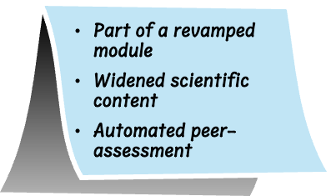
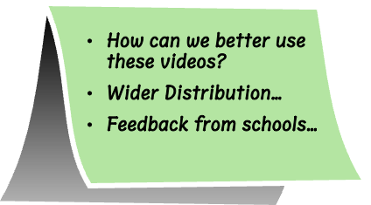
Recent and Future Developments
Current Developments
Future Possibilities

Slide 23
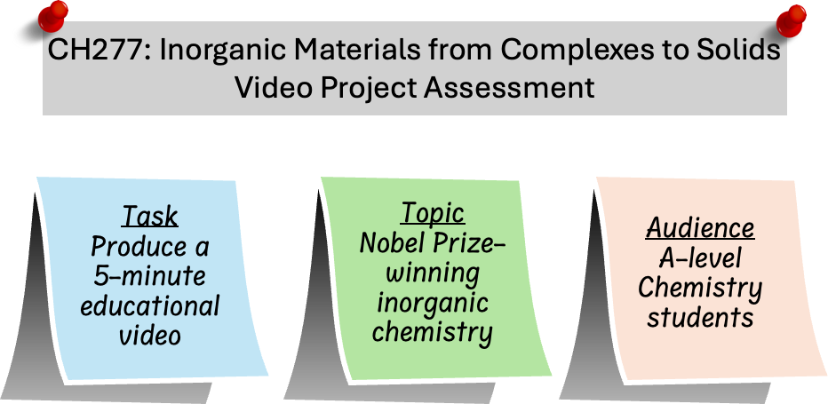
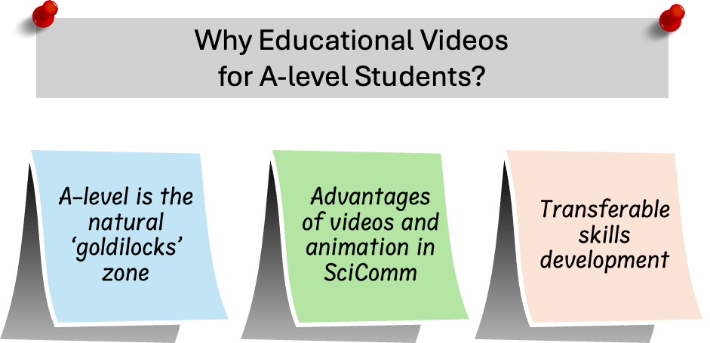
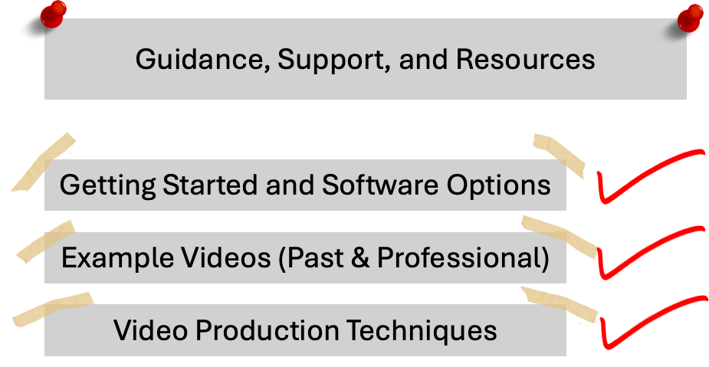
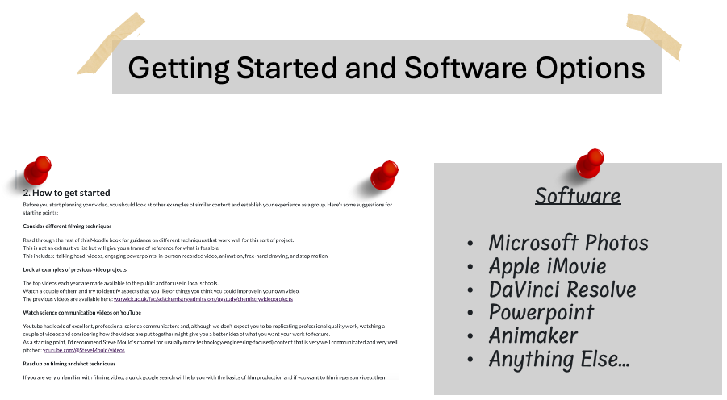
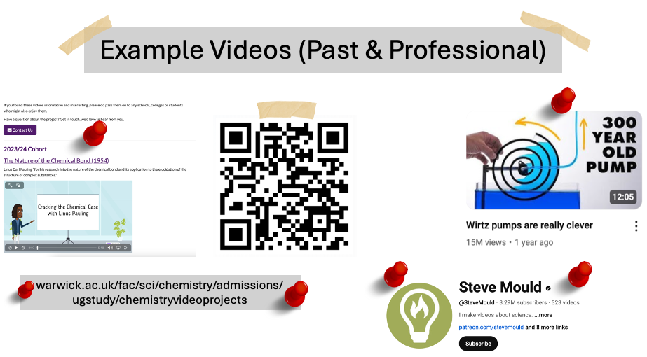
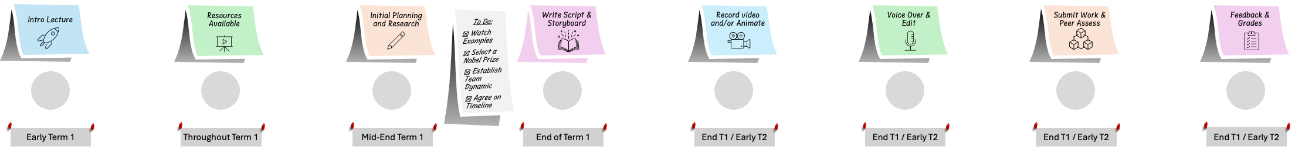
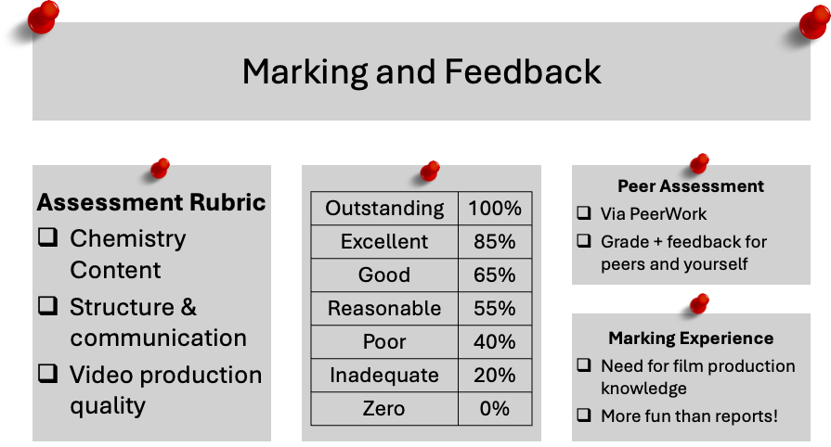
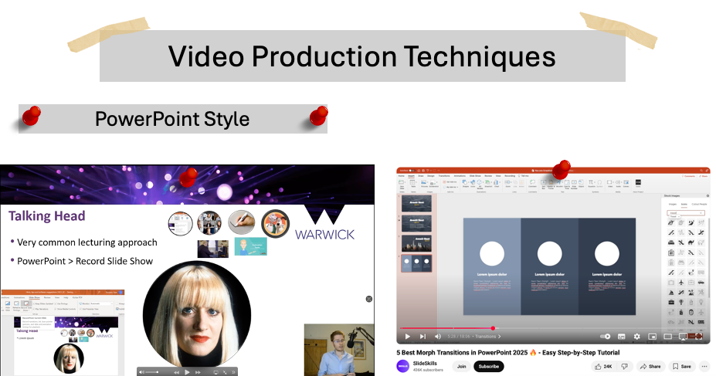
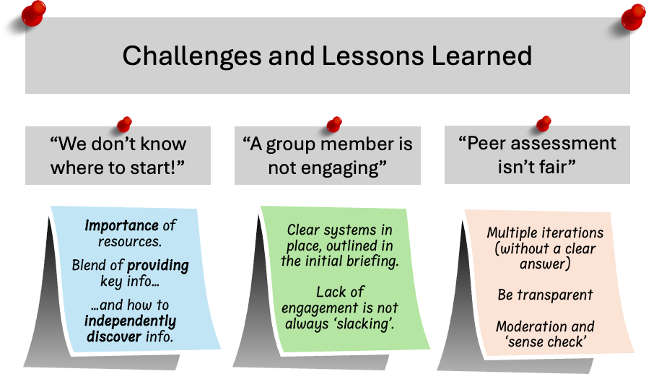
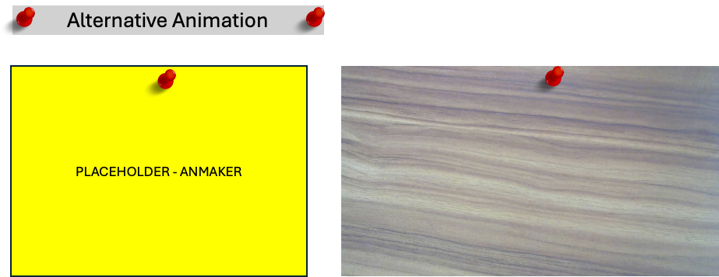
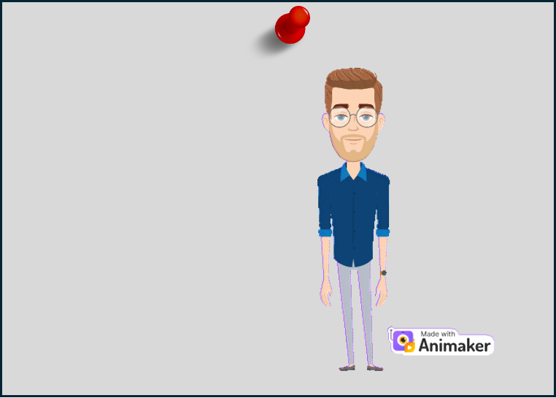
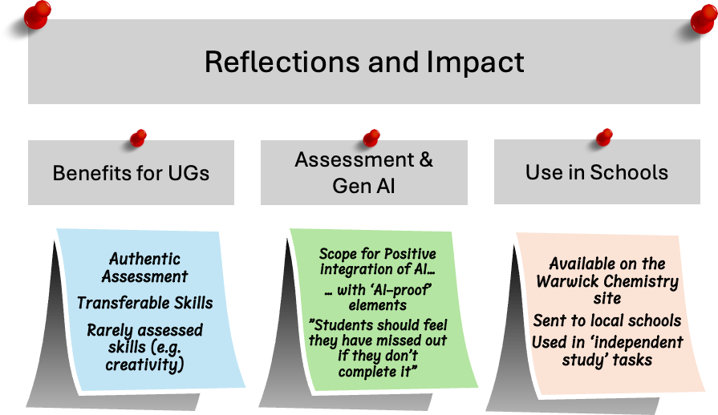
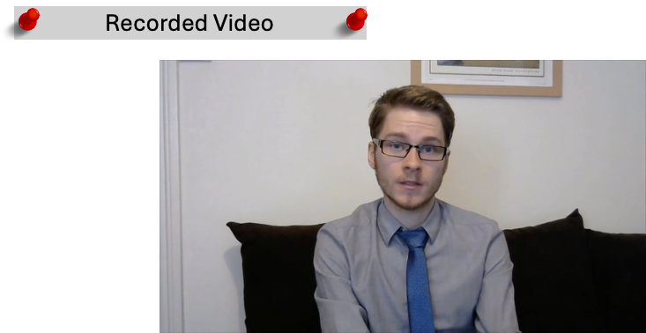
Recent and Future Developments
Current Developments
Future Possibilities

