Slide 1

The Role of
Experts-by-Experience in Research
Katie Crompton

Slide 2

What does evidence tell us about when and how researchers can best draw on lived experience expertise to inform and shape their work?

Slide 3

Experts-by-Experience
Lived experience evidence
vs
Lived experience expertise

Slide 4
Experts-by-Experience
‘patient co-researchers’
‘peer collaborators’
‘survivors’
‘lived experience consultants’
‘lived experience researchers’
‘public and patient involvement’

Slide 5

Method: Scoping Review
Search terms
Search generated 500 articles.
400 were excluded
100 for full-text review.
41 articles included in final review.

Slide 6

Type of Lived Experience
15 healthcare related issues (5 mental health)
4 climate change (eg flood, farming)
3 dementia
3 poverty
Remainder: racial discrimination, substance or alcohol abuse, youth or education, or were general or non-specific.

Slide 7
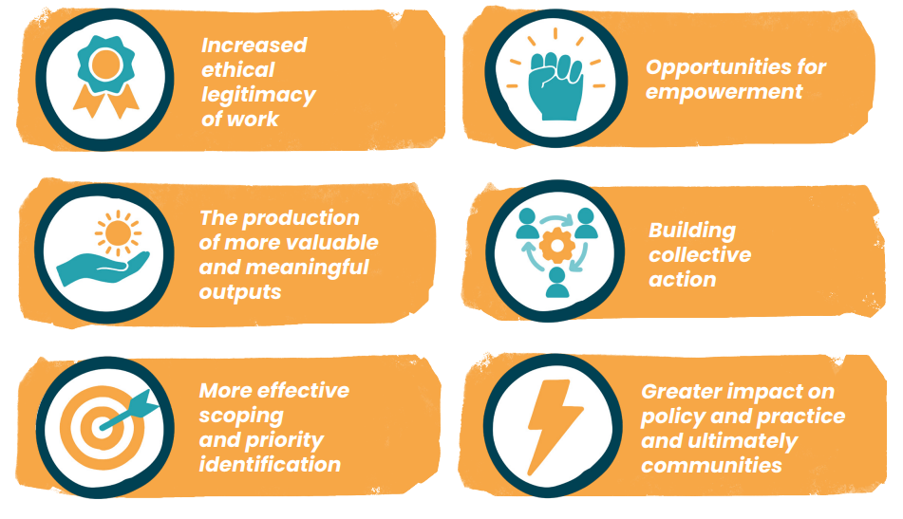


Findings:
Value

Slide 8

Increased ethical legitimacy of work
Moral right

Slide 9

Example: Autistic adults with alcohol /substance abuse set priorities for research in the area.
More effective scoping and priority identification

Slide 10

The production of more valuable and meaningful outputs

Slide 11

‘It made me feel that my story was important. We were involved in choosing the topics that were important to us and were able to share our stories with the other members of the committee. It was an empowering experience knowing that I was not alone.’
Opportunities for empowerment

Slide 12

Building collective action

Slide 13

Greater impact on policy and practice and ultimately communities

Slide 14

Key factors influencing decision making
Funding constraints
Time limitations
Staff capacity and training
Avoiding tokenism

Slide 15

Approaches to involvement
Participatory Action Research

Slide 16
Approaches to involvement
LEAP

Slide 17

Challenges
Time and resource constraints
Tokenism and power imbalances
Emotional and psychological burden
Lack of experience, training and support

Slide 18
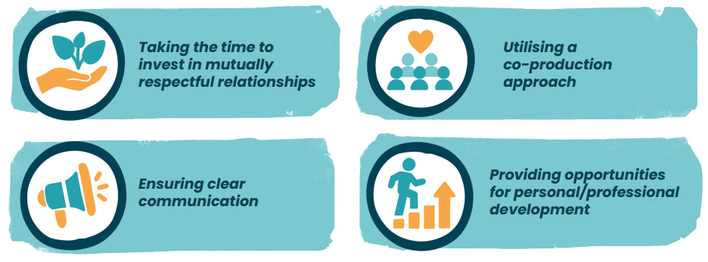
Key Principles

Slide 19

Taking the time to invest in mutually respectful relationships

Slide 20

Ensuring clear communication

Slide 21

Utilising a
co-production approach

Slide 22

INVOLVE (2015)
Public Involvement in Research: Values and Principles Framework
Respect
Support
Transparency
Responsiveness
Fairness of opportunity
Accountability
Providing opportunities for personal/professional development

Slide 23
Summary

Slide 24

katie.crompton@warwick.ac.uk

