Slide 1
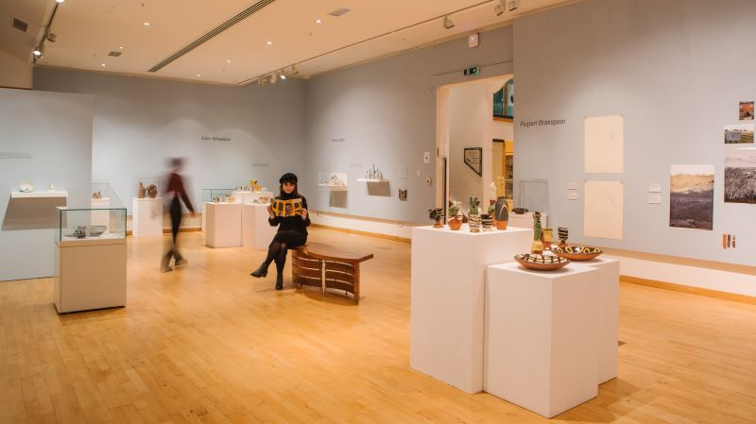
Avenues for engagement through museums
Lily Crowther & Giovanni Vinti
Leamington Spa Art Gallery & Museum

Slide 2
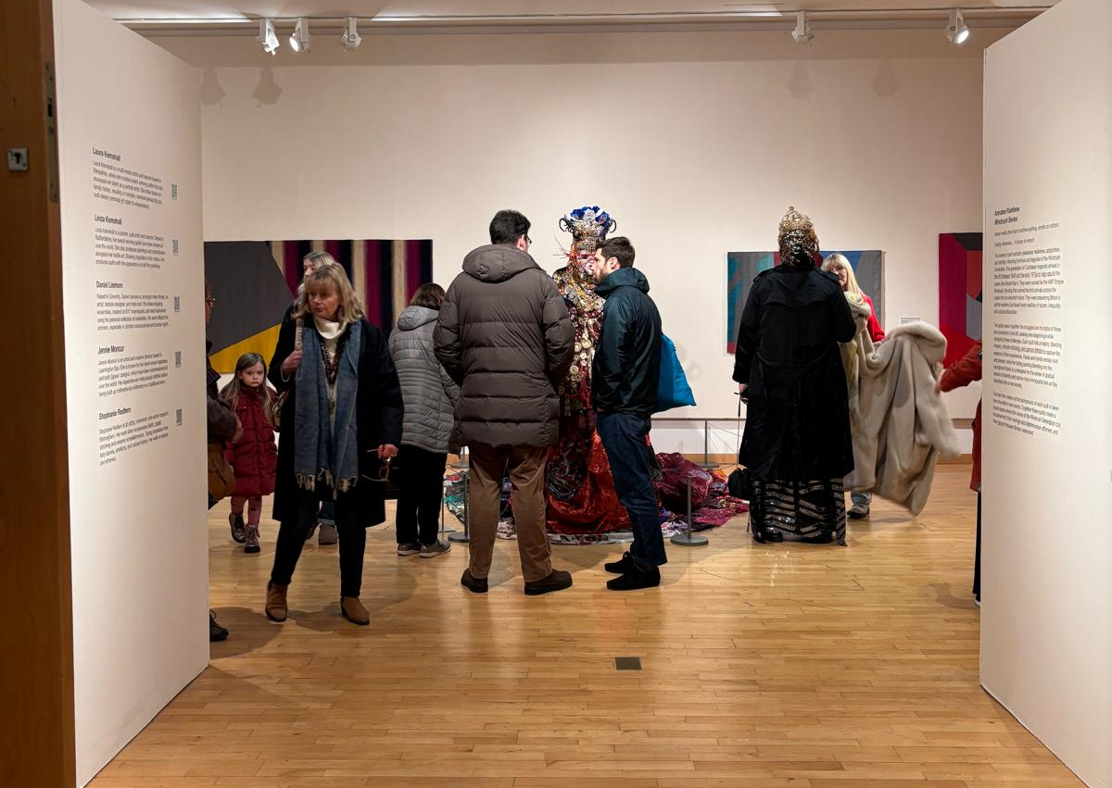
Four key avenues for public engagement:
In-person events
Displays
Print and publications
Collections

Slide 3
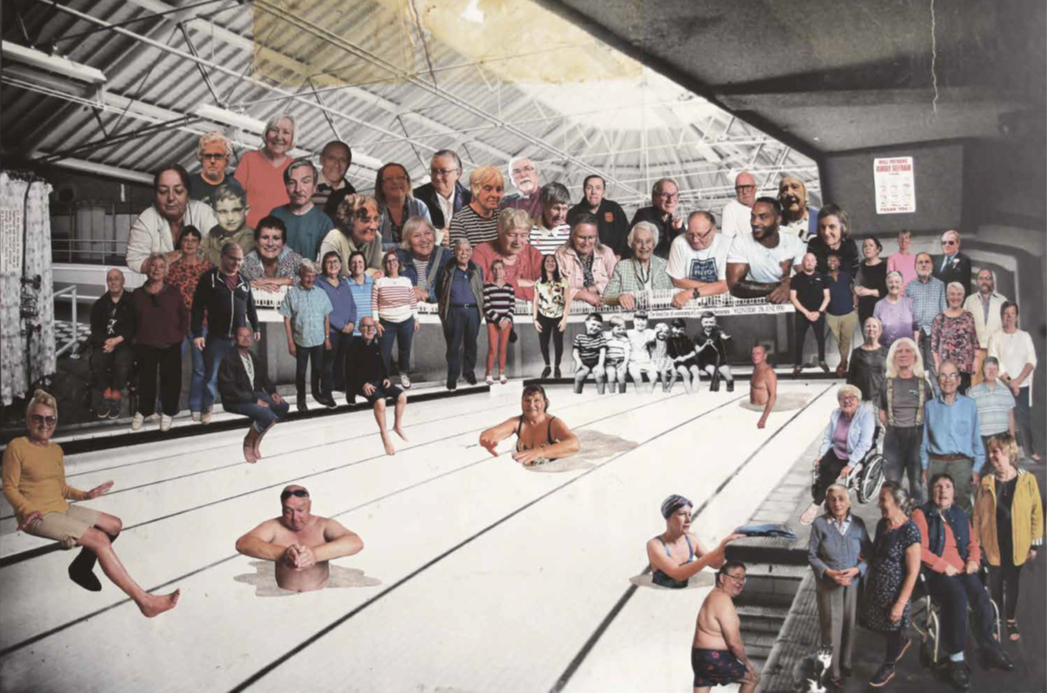
In-person events:
  Public talks
  Drop-in sessions
  Workshops
  Study days

Slide 4
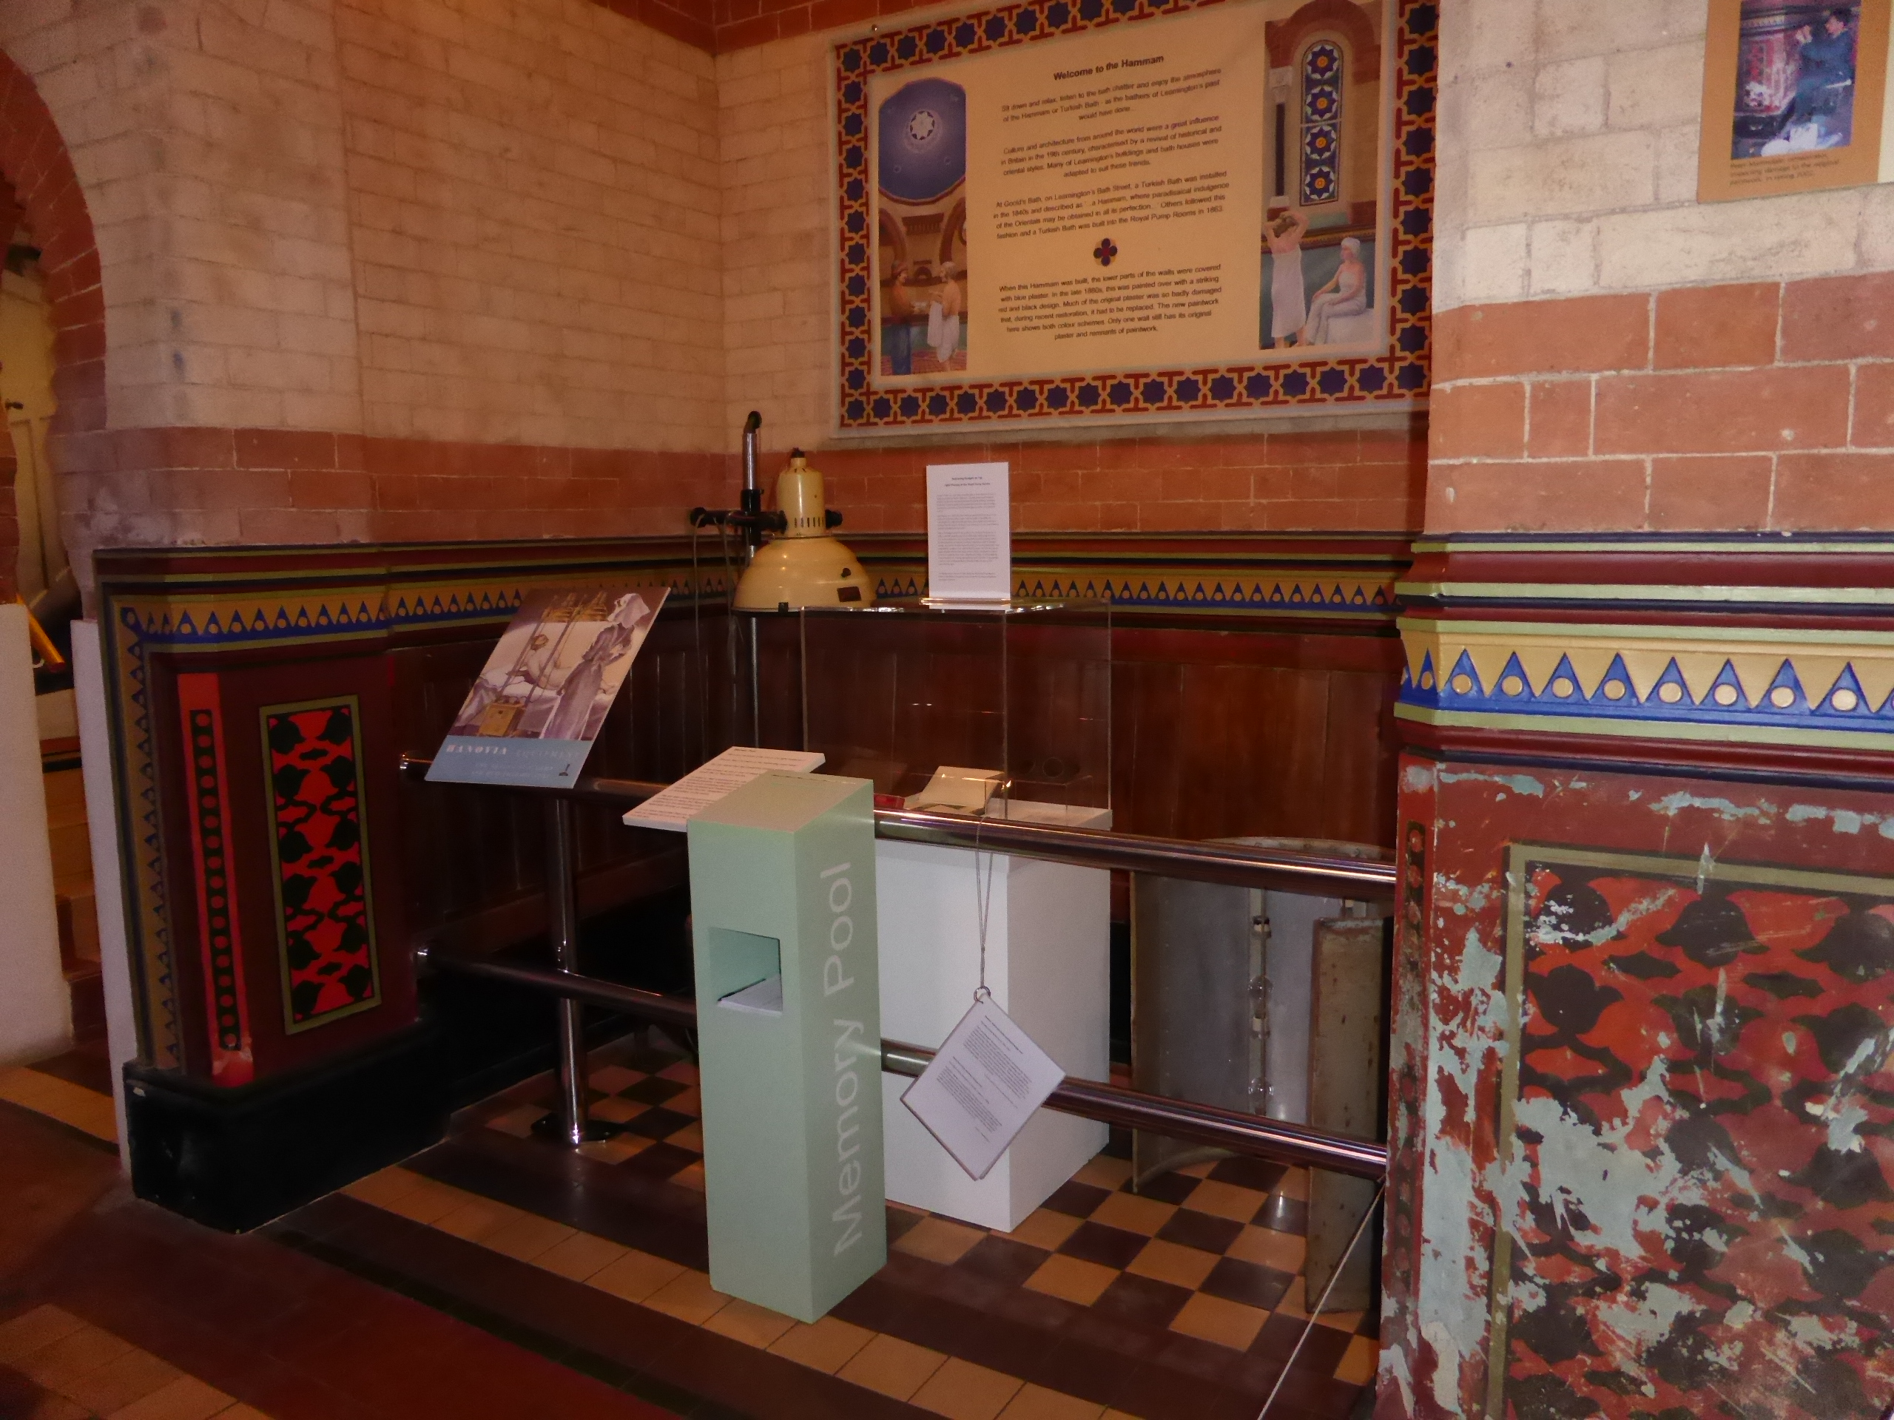
Displays:
  Major exhibitions
  Small-scale displays
  Community pop-ups and interventions

Slide 5
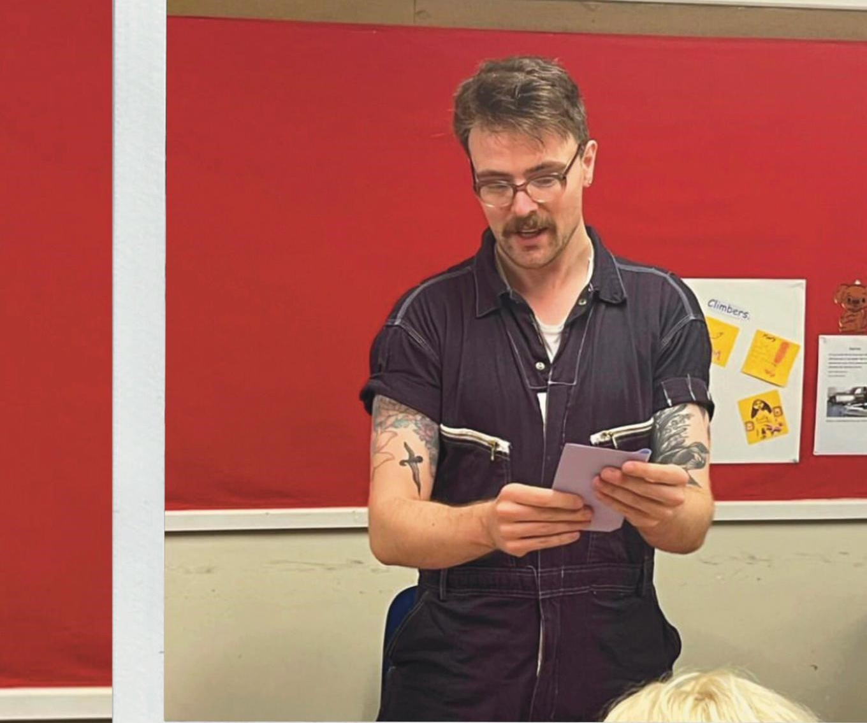
Print and publications:
  Trails
  School resources
  Zines

Slide 6
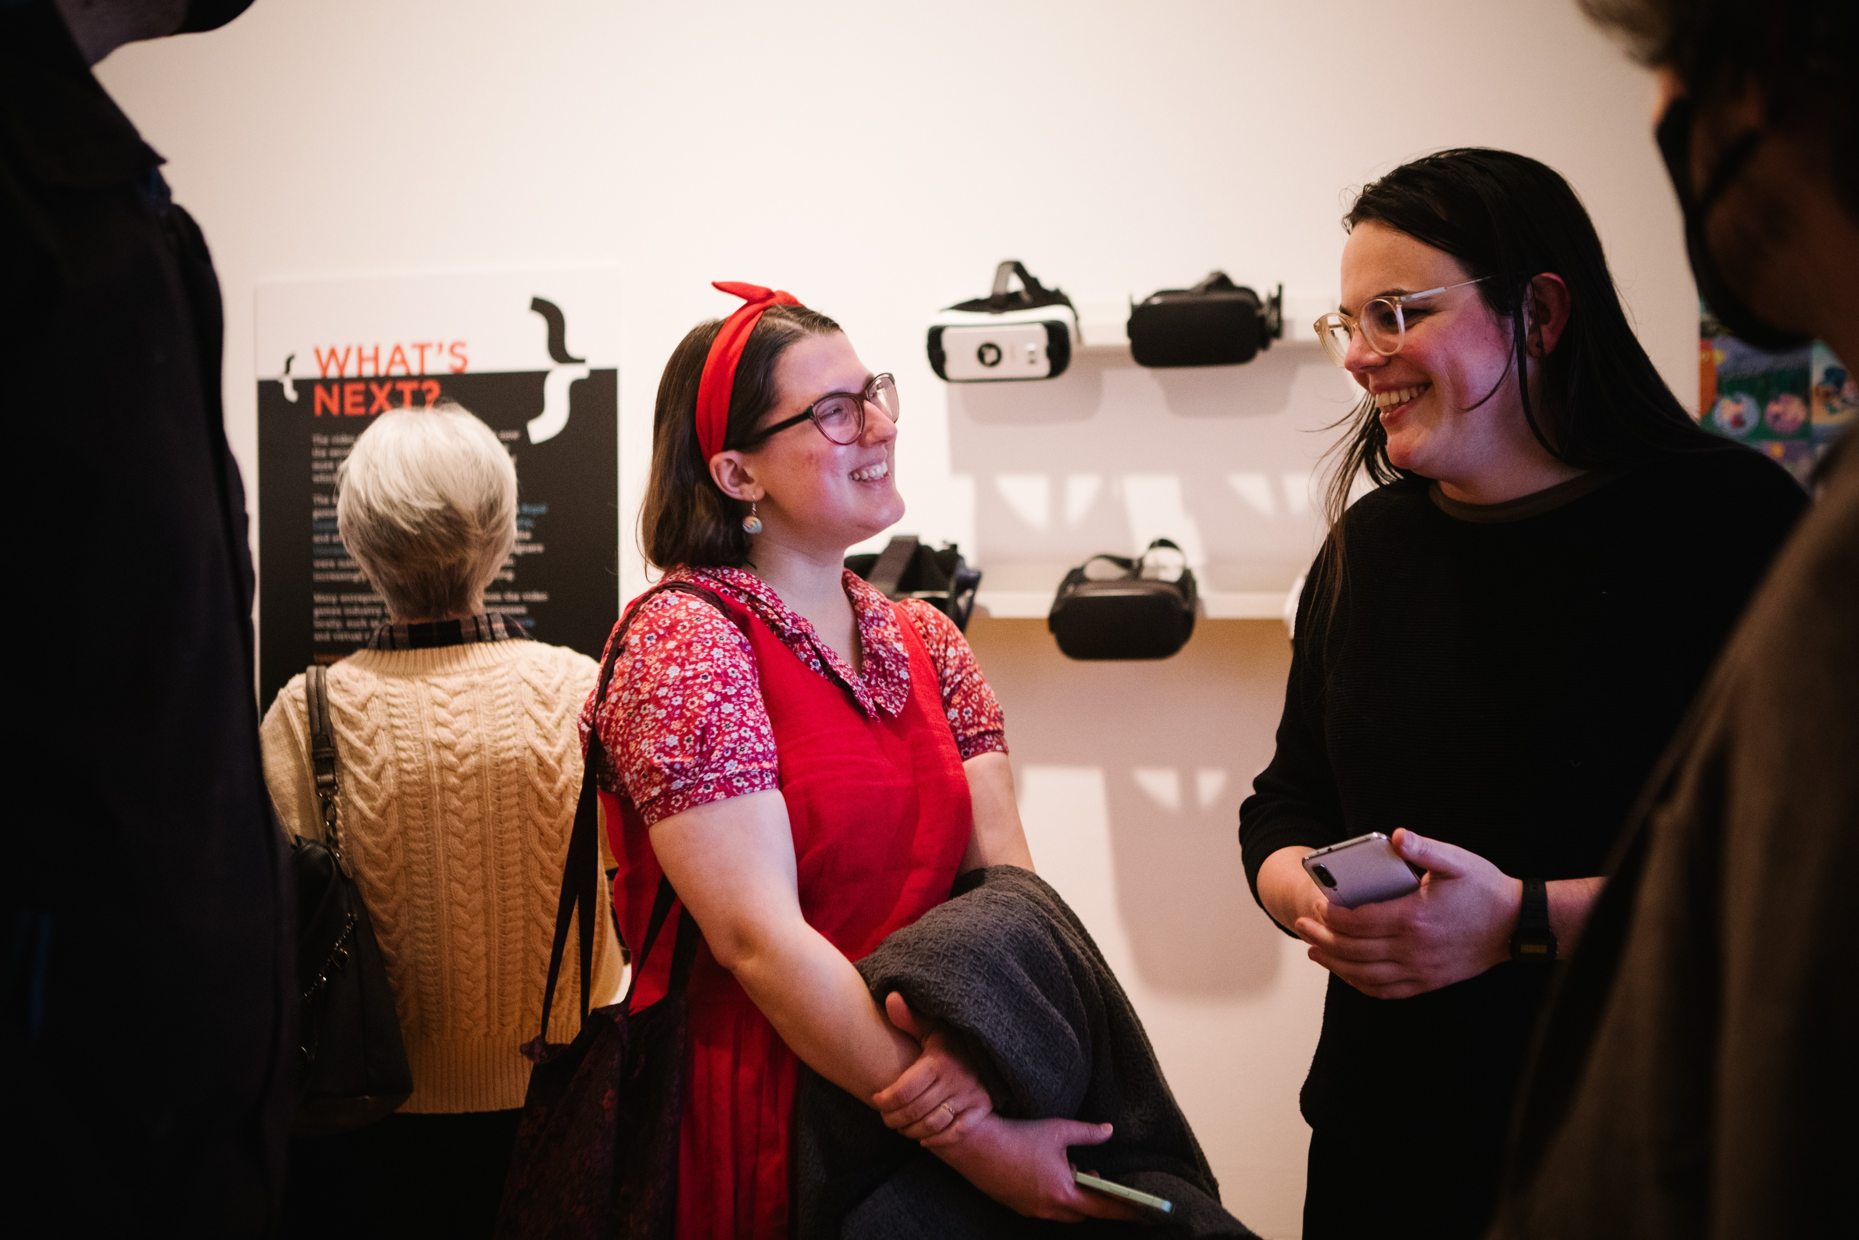
Collections:
  Historical objects
  Contemporary collecting
  Oral histories

