Slide 1
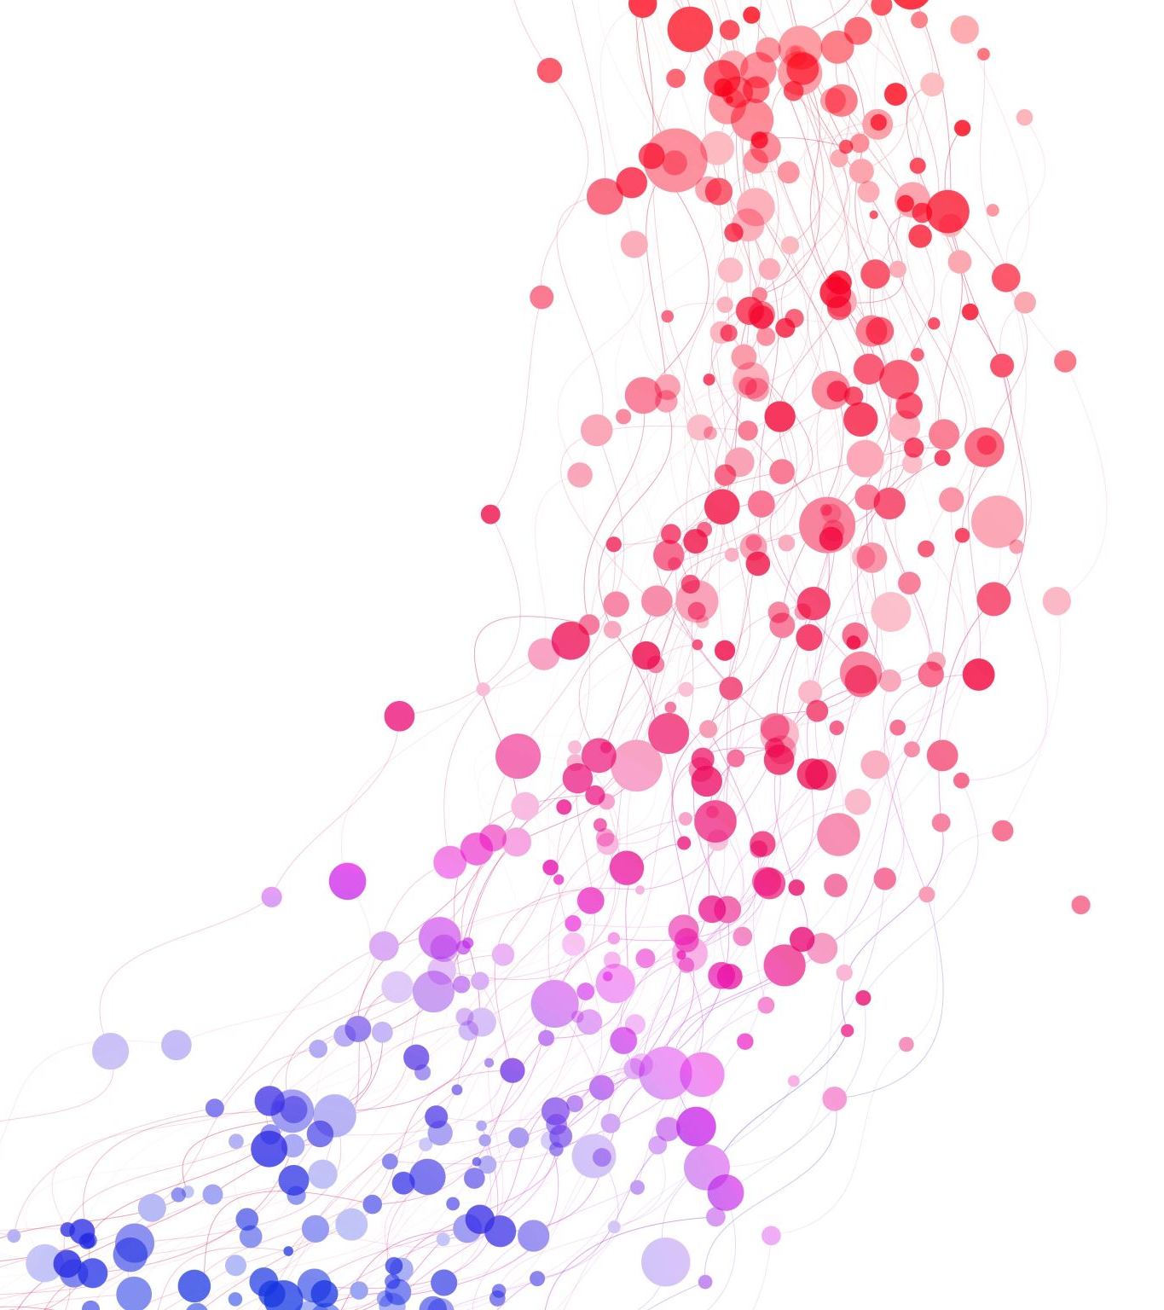
How to Evaluate Public Engagement
A whistle-stop tour for assessing the success of public engagement
Dr Ellie King
Visitor Experience and Evaluation Consultant

Slide 2
Today’s Session
Thinking about outcomes for your PE activities
Different Evaluation Methods and Data Collection Approaches
Selecting Questions
Drawing Conclusions and Identifying Success

Slide 3
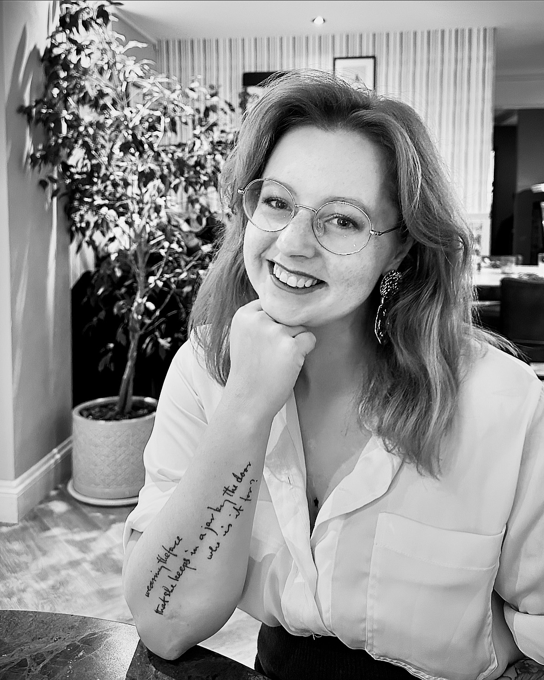
About Me and About You
PhD in visitor experience and evaluation at University of Warwick and Oxford University Museum of Natural History
Freelance consultant and Evaluation Officer for WIE
Turn to the person next to you and tell them:
Your name and job role
What Public Engagement activities you want to evaluate

Slide 4
So, what do you actually want to get out of doing public engagement?
Thinking about your activity/event/programme you are running, what impact do you want to have had on attendees by the end of it?
Have a think about…
What you would like your audiences to know
What you would like your audiences to feel
What you would like your audiences to do
Evaluation is all about painting a picture of your activity from the audience perspective, and gathering data to understand what they knew, felt, and did by the end

Slide 5
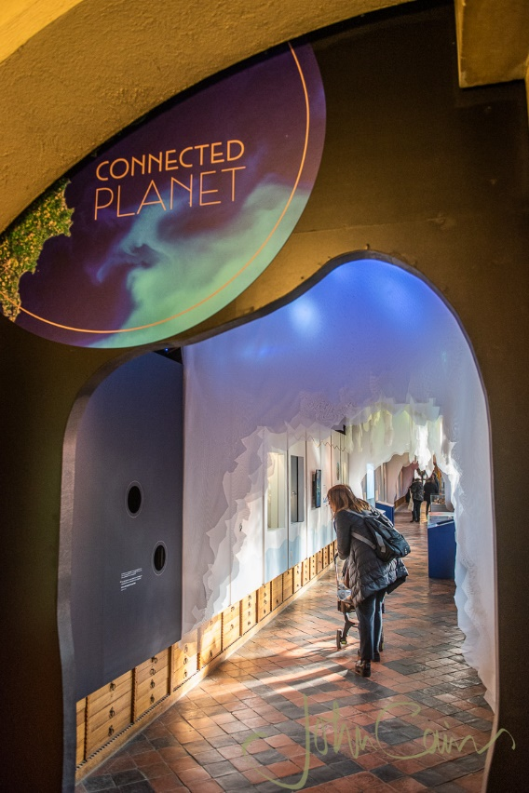
An Example: Connected Planet
We wanted visitors to know… about the interconnected relationship between life and Earth
We wanted visitors to feel… admiration and pride in Earth, a sense of enjoyment, and enrichment
We wanted visitors to… learn more about topics, reflect on their role on Earth, including environmental behaviours

Slide 6
Why do we do Evaluation?
To justify the value of the museum and its activities
To gather information for long-term planning
To support the formulation of new exhibitions and programmes
To assess the effectiveness of current exhibitions and programmes
To construct theories to better understand how people see museums
Munley 1986

Slide 7
Evaluation Methods
Surveys
Guided
Interviews
Structured
Semi-structured
Unstructured
Focus Groups
Snapshots
Polls
Stickers
Smiley faces
Observations
In-person
Tracking and heat maps
All the Other Stuff
Social media
Carpet wear
Bin-use
Glass cleaning
Freebies
Discussion Questions
Audience groups
Potential audiences
Self-reporting
Mix of open and closed questions
Open questions tailored to an activity and/or respondent
One or two specific questions
Experience of spaces
Attendance tracking
Notes:
Activity: pairs, come up with a pro and a con for each type of method

Slide 8
Which Evaluation Methods will you Choose?
Which evaluation methods best suit your activities and projects?
What methods could you combine?
Is there a way to integrate an evaluation method or question into activities to increase engagement?
Will it be conducted online or in person?
Will it be conducted during the event or after?
Who will be conducting it?
What are your ideal sample sizes?

Slide 9
An Example: Connected Planet
A short evaluation survey
A series of short follow-up interviews with visitors

Slide 10

Tell the person next to you!

Slide 11
Types of Evaluation Questions
Open Questions
Closed Questions
Questions about the audience
Questions about their feelings and experiences
Questions about describing the activity
Questions about what they got out of it

Slide 12
Bad Evaluation Questions
How often do you attend events like this?
All the time
Often
Sometimes
Not very often
How would you rate your visit to the museum today?
Brilliant
Fantastic
Epic
Inspiring
Okay
Can we ask your age?
Why was today’s event so brilliant?
Will you remember this event in 5 years’ time?
How much did you learn during today’s event?

Slide 13
Ten Great Evaluation Questions
Audience demographics – don’t be nosey!!!
  Who are you attending with today?
  In a normal year, how often do you visit museums?
  What motivated you to attend today?
Emotions: How do you feel about today’s activity?
Word-pairs: How would you rate today’s activities on the following scales?
If you were to tell somebody about today, what would you say?
What about today’s activities influenced the answers you gave above?
What didn’t you like? What went badly? What could we improve on?
I feel I have learned something today
I feel more confident in myself, my skills, and my knowledge
I feel this has been a good use of my time
I want to return to other events at the University of Warwick

Slide 14
An Example: Connected Planet
Visitor Demographics
  Gender
  Age group
  Visit Group
  Visit Frequency
  Motivations
How did you feel after visiting today’s exhibition?
Word Pairs: covering qualities about content, interpretation, navigation, intellectual engagement, and experience
Outcome statements
For some – which particular features of the exhibition influenced your ratings above?
For some – a short 5-10 minute interview exploring key features, experiences, and how these relate to the visitor’s existing beliefs and values

Slide 15
Data Analysis
Quantitative Data
Frequency counts
Mean calculations
% of ‘agree’ and ‘strongly disagree’
Cross-tabulations and correlational analysis
Qualitative Data
Coding comments into similar items and themes
Quotes to support quantitative data

Slide 16
Drawing Conclusions from your Data
What are you trying to find out? How well you have delivered your event based on your desired impact: What you wanted audiences to know, feel, and do
What evidence does your data give that suggests you have been successful? How could you convince someone who wasn’t there?
Try to look beyond the binary of success, and instead paint a picture of how it was successful – what is the ‘shape’ of your audience experience?

Slide 17
Drawing Conclusions from your Data
Try and look at how questions perform against each other – what is the highest scoring? Which words appear most often?
What specifically about your activity has led to these outcomes?
What improvements need to be made? What lessons can be learned?

Slide 18
An Example: Connected Planet
Visitors showed a good level of understanding of interconnectedness from a variety of different topics
They felt positive emotional engagement and a strong sense of enjoyment and that visiting the exhibition is a good use of time
There was a strong desire for visitors to learn more about exhibition topics, with some reflection on the human impact on the environment
These outcomes were driven by a sense that the exhibition provided a clear presentation of relevant topics, which was enriching, enticing, and semi-immersive

Slide 19
An Example: Connected Planet
Data | Insight
The mean score for the Understanding outcome was 4.11, and the mean score for Learning was 4.16. In comments, the most frequent comment was around the variety of topics included which demonstrated interconnectedness between life and Earth | Visitors showed a good level of understanding of interconnectedness from a variety of different topics
The most selected emotions were Admiration, Pride and Joy. The mean score for Enjoyment was 4.37 and the score for Good Use of Time was 4.34. | They felt positive emotional engagement and a strong sense of enjoyment and that visiting the exhibition is a good use of time
The mean score for Learn More was 3.90 and in comments, participants regularly mentioned how the exhibition topics made them reflect on life and Earth | There was a strong desire for visitors to learn more about exhibition topics, with some reflection on the human impact on the environment
The top rated word-pairs were Clear (5.98), Relevant (5.97), Accessible (5.85), Enriching (5.59) and Impactful (5.45). There were additional comments about the exhibit presenting relevant and familiar comments, using semi-immersive design | These outcomes were driven by a sense that the exhibition provided a clear presentation of relevant topics, which was enriching, enticing, and semi-immersive

Slide 20
An Example: Connected Planet
The specific elements of the exhibition which encouraged these outcomes were:
  A breadth of topics covered in the exhibition, including earthworms, fungi, and volcanic eruptions
  Researcher quotes
  The design which presented content in a semi-immersive environment of water, land, and air
  The engaging talking head videos from researchers
  The relevant nature of the topics presented, such as soil systems, weather, pollen, and grasslands

Slide 21

Any questions?
And happy evaluating!
Ellie.king.4@warwick.ac.uk

