Slide 1

Engagement and Wellbeing
Wellbeing Services
Dr Linda Sherwin

Slide 2

What is Wellbeing?
‘a positive state of body and mind. … It includes physical, material, social, emotional ('happiness')’ (Waddell & Burton, 2006)
How Are You Doing?
Notes:
Wellbeing encompasses the environmental factors that affect us, and the experiences we have throughout our lives.
How do we see or feel about ourselves? What is our sense of purpose?

Slide 3
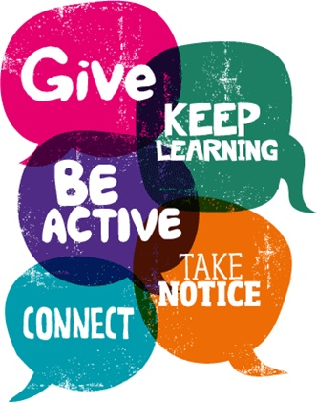
Wellbeing and Engagement
The five ways to wellbeing are evidence based ideas to improve your wellbeing.
They are simple suggestions to keep in mind when identifying how we can look after ourselves.
The 5 Ways of Wellbeing
Notes:
So why is engaging with others good for our wellbeing?
To explain this, I wanted to refer to the 5 ways of wellbeing. utilised by the NHS, mental health services and educational institutions.
Evidence suggests that a small improvement in wellbeing can help to decrease some mental health problems and also help people to flourish. In 2008, the Foresight Mental Capital and Wellbeing Project produced their final report which found these 5 steps can support people in managing their wellbeing.
All 5 ways to wellbeing can support your mental and physical health, Public Engagement in turn takes in 3 of these -
Keep Learning - Learning new skills – outside of your studies – can help improve your mental wellbeing by:
boosting self-confidence and raising self esteem
helping you to build a sense of purpose
helping you to connect with others
To Connect - Being connected with others is a fundamental human need. Working with others and feeling valued by them contributes to functioning well and is also important for your mental health.
Connecting with others gives you opportunities to make friends and feel good. Isolating yourself from others can have a detrimental impact on your wellbeing.
Give - Research shows that people with an interest in helping others are more likely to rate themselves as happy. Giving your time and expertise then to demonstrate your work is an opportunity to support others and increase your self esteem and sense of worth.

Slide 4


Pressures
Stress is a natural reaction to excessive pressures and demands placed on us.
We experience stress when the demands upon us outweigh our resources.
Resources
Demands
Notes:
Of course, giving anything to others requires time and commitment, perhaps it isn’t something you enjoy, but even if it is it does inevitably create a demand on our own resources. And this leads to stress -
Stress is a natural response to demands placed on us that overwhelm our capacity to manage those demands. Stress is not always a bad thing, much of the time it is what drives us. But if it’s not recognised and managed, it can impact your wellbeing, your relationships and concentration. There may be organisational factors, or factors related to your particular subject area, or indeed personal factors that impact on your mental health and wellbeing.
It therefore needs to be managed.

Slide 5
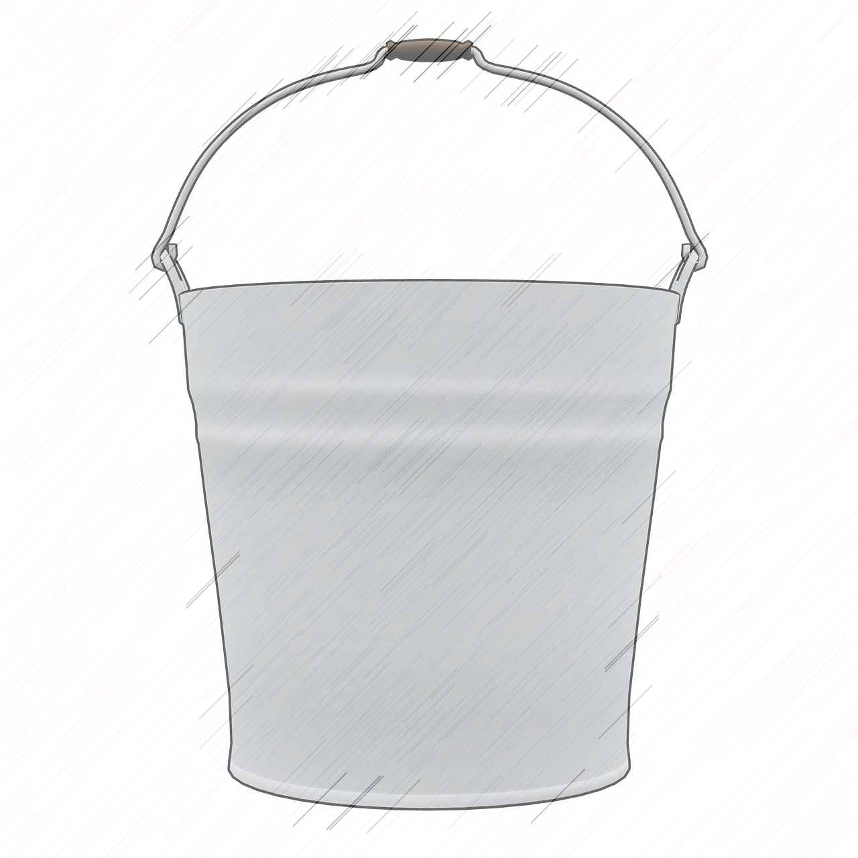
Demands
Overflowing/overwhelmed
The Stress Bucket
Becoming stressed
Unhelpful coping mechanisms
Reflect
What is filling your stress bucket?
What are your outlets?
Managing well
Relaxed
Outlets
Notes:
It can be helpful to use the analogy of the stress bucket when thinking about stress. Basically, we all carry around a bucket of stress. Ideally we don’t want it to be too full, so if something unexpected does happen we still have the capacity to carry it.
When our bucket gets too full, it’s at risk of getting too heavy or overflowing. And that’s when we find ourselves feeling strained or heading for burn out.
One of the most important ways of managing stress is to have some outlets for the stress in our bucket. These are activities which allow to relax and refresh and which are essential for keeping us feeling good and functioning well.
These will vary from person to person, but some common outlets for stress are taking exercise, socialising, spending time in nature and being creative. When feeling stressed, it can be easy to stop doing these activities – perhaps to focus exclusively on work demands. However, these outlets are essential for productivity.
Sometimes, we can turn to less positive outlets for stress. For example, comfort eating, smoking, using alcohol and other drugs. These can provide short-term stress relief, but on the long-term they can make us feel more stressed and end up filling up our bucket…
Existing workplace pressures for people working in Higher Education such as high and intense workloads, long working hours, lack of support, work-life conflict and unrealistic time pressures, are already known sources of stress; during the pandemic, additional stresses such as fear of infection, forced isolation from family and friends, and inadequate resources in health care facilities, have also now compounded the pressures.
Think about what is filling up your stress bucket at the moment. What are your outlets?

Slide 6

Notes:
mindfulness meditation with 3 minutes breathing space by Prof. Mark Williams, Oxford Mindfulness Centre

