Slide 1
Engagement & Promotion
Amy Stickels and Nicholas Jackson

Slide 2
Introduction
Academic Promotions at Warwick involve 4 areas of activity of which one is Impact, Outreach and Engagement.
This means that the engagement activities that you partake in can be useful to you as much as they are valuable to those you engage with.

Slide 3
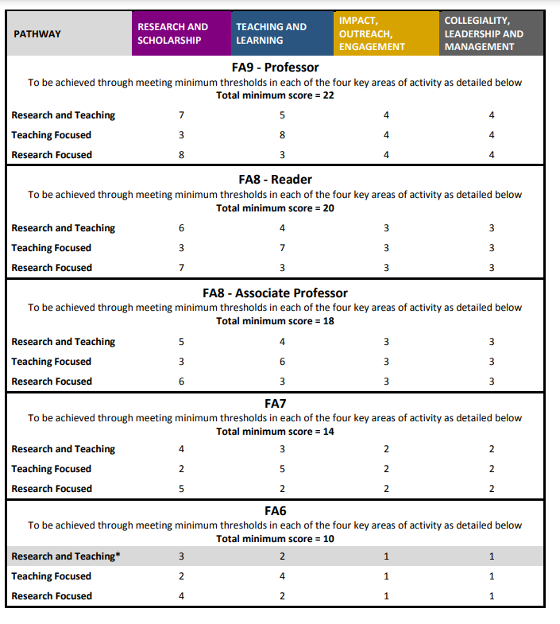
Engagement is integral part of promotions for all contract types and for all levels of promotion:

Slide 4
Band | Description | Suggestions
1 (min for Fellow FA6) | Build a reputation for academic contribution | Presenting research to others. Completing engagement training. Contributing to festivals Membership of professional bodies
2 (min for Associate Prof FA7) | Recognised externally for work in a specialist field | Public engagement activities to promote department on campus and off-campus Invited speaker Organising public engagement events. Participation in inclusion work/ WP Talks in schools School governor Speaker at student society Outreach with 3rd parties

Slide 5
Band | Description | Explanation/ suggestions
3 (min for associate prof/ reader – FA8) | Develop a reputation and recognition with key stakeholders for the broader value of specialist activity | More sustained/ developed Develop relationships with external organisations Integrating public engagement into modules Leadership in inclusion/ WP/ community projects Engage with policy making bodies Publications aimed at Sixth Form students Manage small grants Broadcast interviews Work with educational charities Speak at conferences aimed at widening access to HE Work with schools and business – consult
4 – (min for Professorial – FA9) | Develop a regional/ national recognition for work demonstrating value of broad based academic activity | Beyond Warwick: Record of collaboration with industry – generating income Being part of national networks Leadership in community projects/ national festivals National inclusion/ student recruitment activities

Slide 6
Band | Description | Explanation/ suggestions
5 | An established regional/ national reputation for work demonstrating value which might include significant contribution to impact for the major development of one or more fields of knowledge. | “track record” of collaboration “sustained” and “developed” over a number of years. Leadership on inclusion at university level. Extensive public engagement over number of years. Representative on a regional body
6 | Developing an international reputation for engagement which demonstrates broader external value of academic activity. | “Creates change” “success“ “recognised” “demonstrable, beneficial impact” Leading public understanding of a subject at international/ national level. Significant innovative examples in public engagement with national or international recognition National/ international recognition of success in knowledge exchange

Slide 7
Mapping your Engagement
What is the activity/ activities?
How often do you do it?
How sustained is the activity?
Who benefits from the activity? How do you know?
What is outcome of the activity? (This can be academic - the contribution that research and teaching makes within and across disciplines- and/or beyond academia)

Slide 8
Reminder:
Cannot double count evidence – use it wisely.

Slide 9

Any questions?

